Slide 1
Recent progress on investigations into plasma-lithium surface interactions in LTX-β (ISLA-7 Encore)
Shota Abe^{1,2}, Anurag Maan¹, Evan T. Ostrowski², Promise O. Adebayo-Ige³, Kaifu Gan³, Euichan Jung¹,
Jhovanna Garcia^{1,4}, Brady Moore^{1,5}, Sophie M. Redd^{1,6}, Zihan Lin², Dennis P. Boyle¹, Predrag Krstic⁷,
Rajesh Maingi¹, Brian Wirth³, Bruce E. Koel², and Dick Majeski¹
¹Princeton Plasma Physics Laboratory, USA ²Department of Chemical and Biological Engineering, Princeton University, USA
³University of Tennessee, Knoxville, USA ⁴San Diego State University, USA ⁵University of Illinois, Urbana-Champaign, USA
⁶University of Colorado Boulder, USA ⁷TheoretiK, USA
NSTX-U / Magnetic Fusion Science Meeting (B318 / Zoom)
PPPL, NJ, USA, June 26, 2023

Slide 2
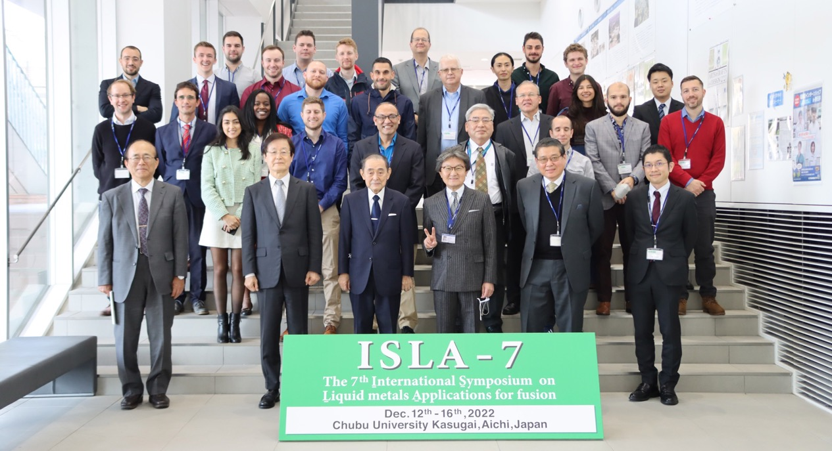

Slide 3
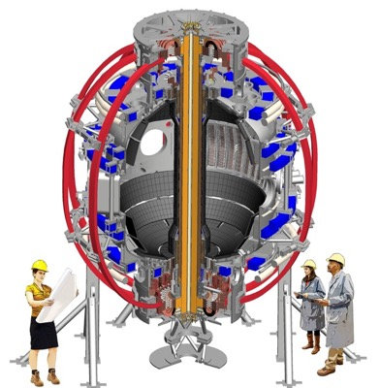
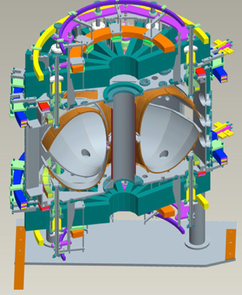
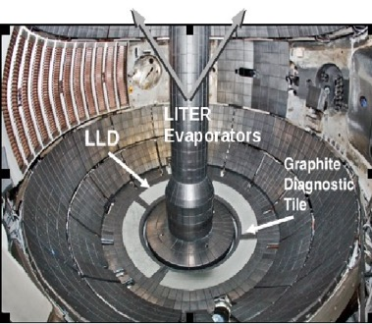
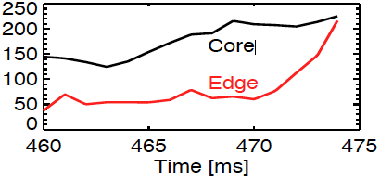
Lithium as plasma-facing material (PFM)
NSTX-U
PPPL
Benefits of Lithium walls
LTX-β
PPPL
High H retention ~0.4-0.8
Low recycling
Light mass (Li = 7 amu)
Liquid state (> 455 K) = No cracks
Low H recycling enables
1.6 m
Flat temperature profile
Experiment
Low energy loss
Fewer instabilities
T_{e}
Flat
Properties of Li as PFC needs to be studied
Boyle, PRL 2017
Jaworski, Nucl. Fusion 2013

Slide 4
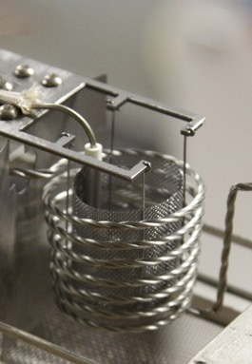
Lithium as plasma-facing material (PFM)
Li Evaporator in LTX-β
Maximum Parameters |  | LTX | LTX-β
Major Radius | R | 40 cm
Minor Radiues | a | 26 cm
Toroidal Field | B_{T} | 0.18 T | 0.3 T
Ohmic Flux Swing | ΔΦ | 75 mV∙s | 120 mV∙s
Plasma Current | I_{p} | 85 kA | 135 kA
Flattop Duration | t_{flat} | ~15 ms | ~35 ms
Electron Temperature | T | ~250 eV | ~400 eV
Ion Temperature | T_{i} | ~100 eV | ~200 eV
Plasma Pressure | p | ~0.5 Pa | ~1.5 kPa
Energy Confinement | τ_{E} | ~2 ms | ~5 ms
Neutral Beam Current | I_{nbi} | - | ~35 A
Neutral Beam Energy | E_{nbi} | - | 13-20 keV
Neutral Beam Duration | t_{nbi} | - | 5-10 ms
Wall Temperature | T_{wall} | Up to 500 K (liquid)
LTX-β
PPPL
1.6 m
100% Li coated plasma-facing surface
Fresh vs. Old Li
Investigating plasmas for
Liquid vs. Solid Li
Boyle, PRL 2017
Anurag Maan, Dennis P. Boyle, Dick Majeski (PPPL)

Slide 5
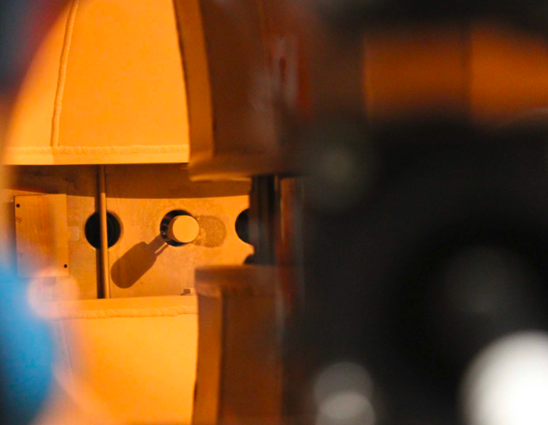
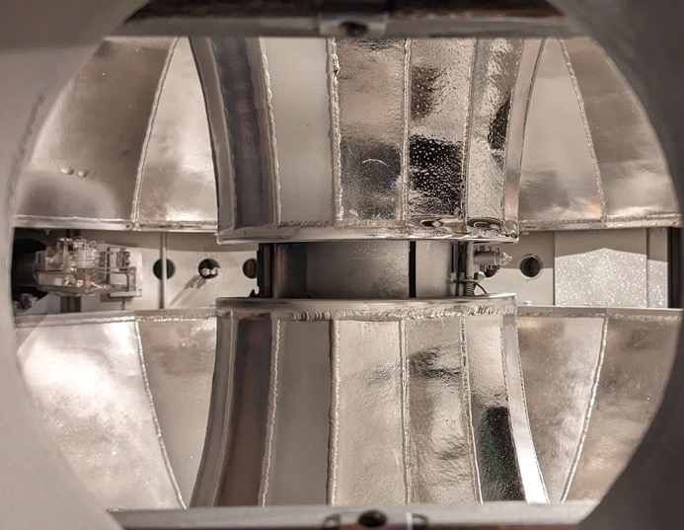
Hot shell operation in 2023
2023
Liquid
Solid
Maan, IEEE 2020
Anurag Maan, Dennis P. Boyle, Dick Majeski (PPPL)

Slide 6
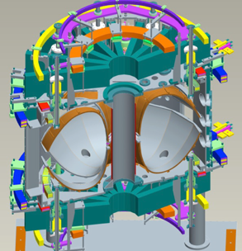
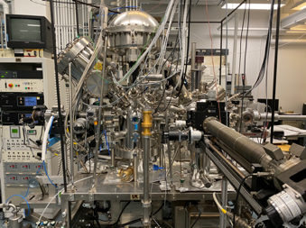
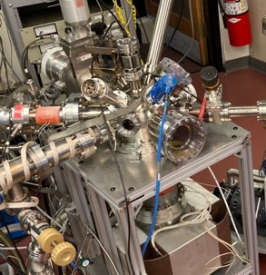
LTX-β
Bruce E. Koel lab
Plasma performance affected by wall conditions
Li evaporation
H retention using TPD
HR-XPS analysis for detailed chemical state
Controlled experiment under ultra-high vacuum (10⁻¹⁰ Torr)
Surface Science and Technology Laboratory
Post-mortem surface analysis
Sample preparations
Li target
IAC&PRISM
XPS analysis
SIMS analysis
Sputtering
Retention
Emissivity
Li deposition
Impurity
SAM imaging
Li target
Sample Exposure Probe (SEP)
Vacuum suitcase for sample transfer
Predrag Krstic
(TheoretiK)
Molecular-Dynamics calculations
Sputtering and Retention

Slide 7
★
★
★
★
★
★
★
IAC&PRISM

Slide 8
LTX-β
Bruce E. Koel lab
Plasma performance affected by wall conditions
Li evaporation
H retention using TPD
HR-XPS analysis for detailed chemical state
Controlled experiment under ultra-high vacuum (10⁻¹⁰ Torr)
Surface Science and Technology Laboratory
Post-mortem surface analysis
Sample preparations
Li target
IAC&PRISM
XPS analysis
SIMS analysis
Sputtering
Retention
Emissivity
Li deposition
Impurity
SAM imaging
Li target
Sample Exposure Probe (SEP)
Vacuum suitcase for sample transfer
Predrag Krstic
(TheoretiK)
Molecular-Dynamics calculations
Sputtering and Retention

Slide 9
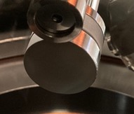
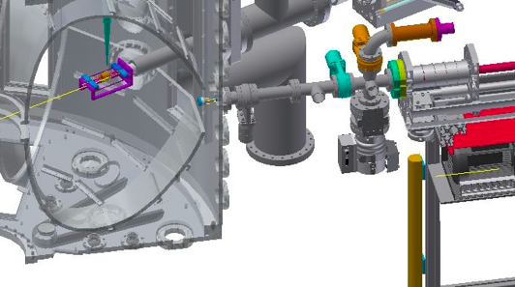
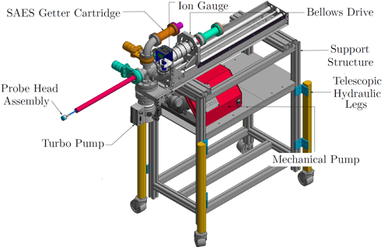
Sample Exposure Probe (SEP) enables in-vacuo sample transfer
SS Sample Head
[Ongoing]
Sara Sawford (SULI 2023)
Powder sample manipulator
Sample Exposure Probe (SEP)
Maan RSI 2020
Gate Valve
1” Diameter
Sample Head
LTX-β
Maan, PhD thesis 2019
Turbo Pump
Transfers sample at P₀ ~ 10⁻⁹ Torr
Heating capability up to 900 K
[New!] Temperature Programmed Desorption (TPD) for surface composition and H retention analysis
Evan T. Ostrowski (Princeton U.) and Anurag Maan (PPPL)

Slide 10
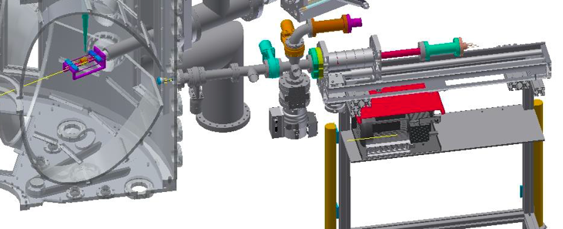
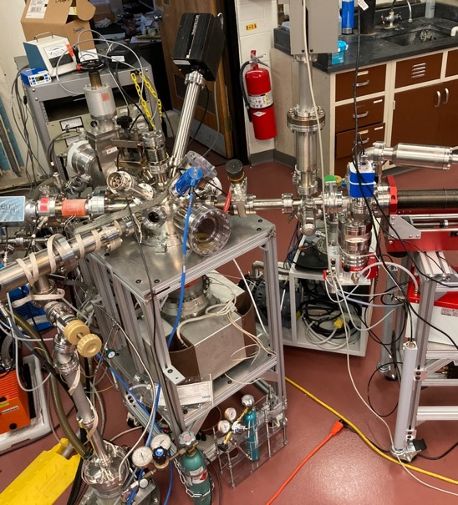
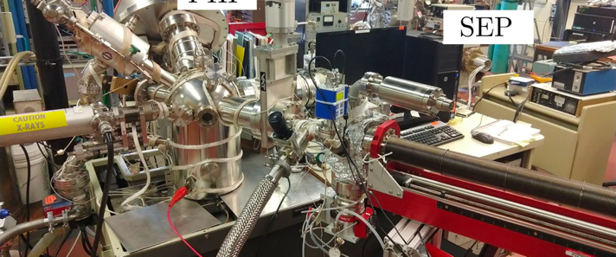
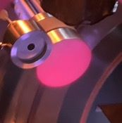
Sample Exposure Probe facilities to investigate experimental Li studies
[New!] Sample Exposure Station
w/ electron cyclotron resonance (ECR) plasma source
LTX-β
Sample Exposure Probe (SEP)
Maan RSI 2020
SEP
Li target
Maan, PhD thesis 2019
XPS analysis chamber
SEP
SEP
Surface Science and Technology Laboratory
Surface Science and Technology Laboratory

Slide 11
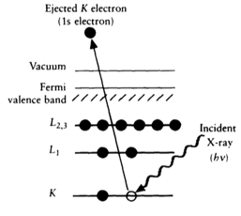
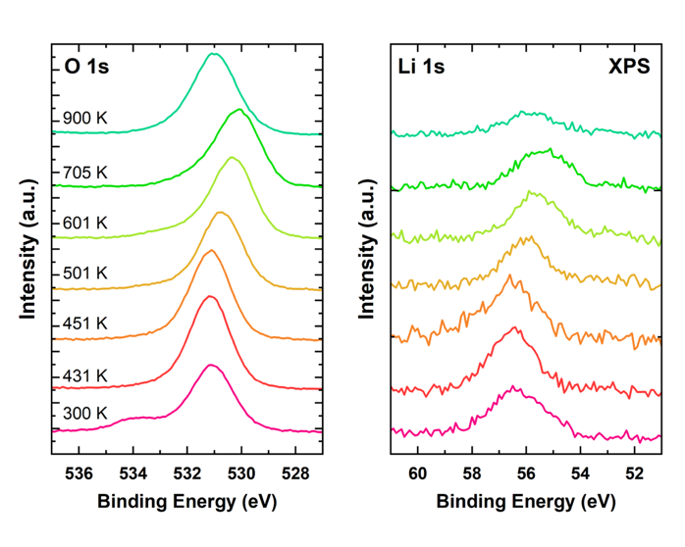
X-ray Photon Spectroscopy (XPS) revealed surface composition of the LTX-β Li surface
! Old data !
LiOH
Li₂O
Measured
Determined
Known
Kolasinski “Surface Science” 2012
XPS analysis chamber
SEP
Temperature changes surface composition
Surface Science and Technology Laboratory
Evan T. Ostrowski (Princeton U.)

Slide 12
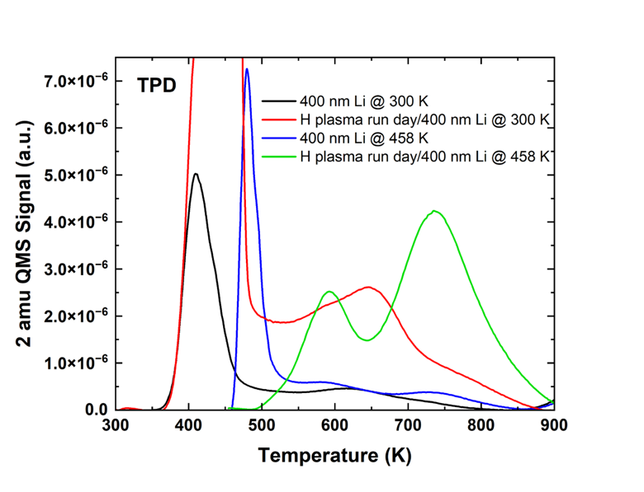
Temperature Programmed Desorption (TPD) for H retention analysis
! Old data !
QMS
Desorbed H₂
458 K
LTX-β
H plasma
SEP
300 K
Heated
Li target
Measured retained H by heating up Li sample after exposures
Surface temperature during exposure affects H retention behavior
Evan T. Ostrowski (Princeton U.)

Slide 13
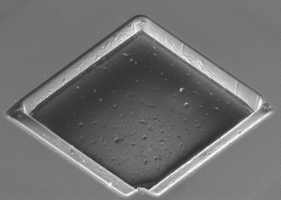
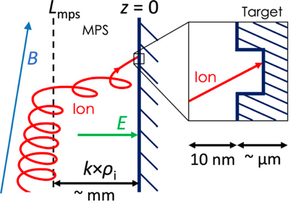
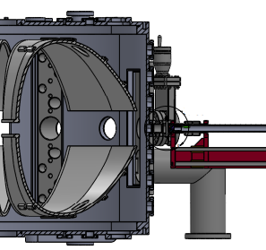
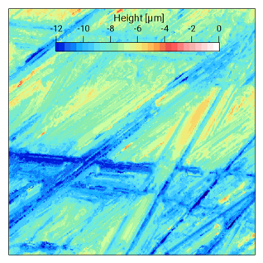
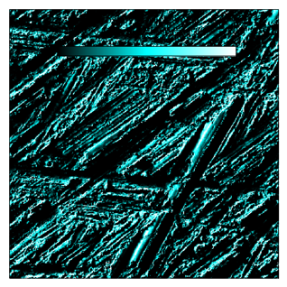
Investigations on Incident Ion Angle, Sheath and Roughness Effects for better PMI understanding
Ion Angle Probe (IAP)
Incident Ion
Angle
Microtrench
Sample
30 μm
Langmuir
Prove
Heater
Expected Deposition Pattern
MPR
Monte-Carlo
Equation-of-motion
Microtrench Method
Incident Ion Angle
Li deposition Rate
Net Li Sputtering Rate
IAP
MPR Calculation
Sputtering Yield on Rough-surface
Shadowed Area
Confocal Microscopy
on SS LTX Wall
MPR Calculation
S. Abe, PoP,NF,NME,PS 2021-2022
Jhovanna Garcia and Euichan Jung (PPPL)

Slide 14
LTX-β
Bruce E. Koel lab
Plasma performance affected by wall conditions
Li evaporation
H retention using TPD
HR-XPS analysis for detailed chemical state
Controlled experiment under ultra-high vacuum (10⁻¹⁰ Torr)
Surface Science and Technology Laboratory
Post-mortem surface analysis
Sample preparations
Li target
IAC&PRISM
XPS analysis
SIMS analysis
Sputtering
Retention
Emissivity
Li deposition
Impurity
SAM imaging
Li target
Sample Exposure Probe (SEP)
Vacuum suitcase for sample transfer
Predrag Krstic
(TheoretiK)
Molecular-Dynamics calculations
Sputtering and Retention

Slide 15
Sample exposure probe facilities to boost the speed of experimental Li studies
[New!] Sample Exposure Station
w/ electron cyclotron resonance (ECR) plasma source
Sample Exposure Probe (SEP)
Maan RSI 2020
SEP
Li target
Maan, PhD thesis 2019
XPS analysis chamber
SEP
SEP
Surface Science and Technology Laboratory

Slide 16
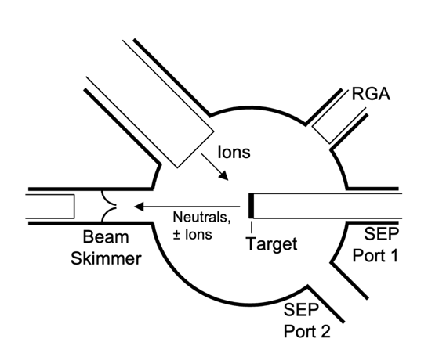
New chamber for plasma exposures, surface analysis, and Li target preparation
Ion exposures
SEP compatibility to introduce LTX-β sample
In-vacuo Li deposition (100 nm/min)
Sputtering yield measurements
Secondary ion mass spectrometry (SIMS)
Thermal programmed desorption (TPD)
IR window for emissivity measurements
Sample Exposure Station (SES)
ECR
Plasma
D₂, H₂, He, Ar, Ne
20-2000 eV
Hiden
IDP
SEP
± Ions
Energy
analyzer
[Ongoing]
Amanda Roman (SULI 2023)
Base pressure: 10⁻⁹ Torr
Shota Abe and Euichan Jung (PPPL)

Slide 17
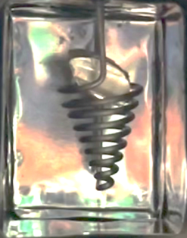
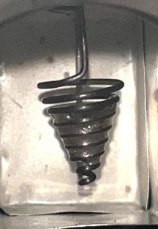
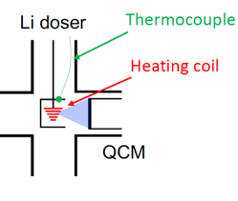
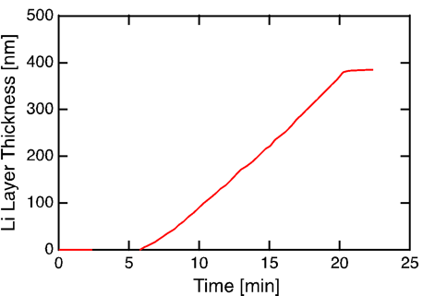
In-vacuo thick Li film deposition for plasma exposure studies
Before
After
Sample Exposure Station (SES)
ECR
Plasma
D₂, H₂, He, Ar, Ne
20-2000 eV
Thermocouple
Hiden
IDP
Heating Coil
± Ions
Energy
analyzer
Li deposition at 2.5” distance
SEP
Base pressure: 10⁻⁹ Torr
Only 5 min duration between
deposition and experiment
Experiments on pure liquid Li
Euichan Jung, Amanda Roman, Brady Moore (PPPL)

Slide 18
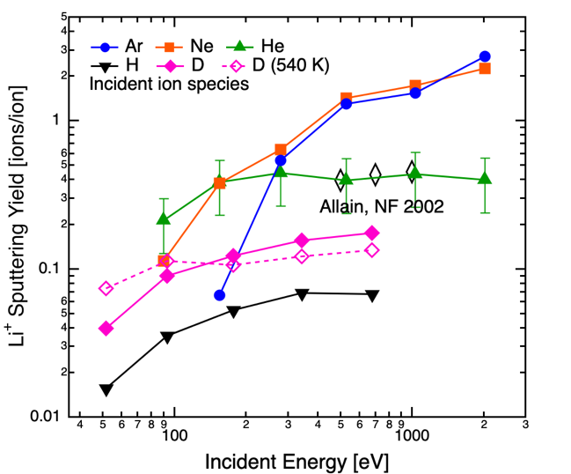
Experimental Measurement of Li⁺ Sputtering Yields
Allain, NF 2002
Ionic state of sputtered Li is ~60%
, which will be back to the surface by sheath.
D bombardment ejects more (~2x) Li⁺ than H
Hot surface (460 K) changes Li⁺ ejection behavior
H and D will sputter Li⁺ even for E < 100 eV
He can cause large sputtering even for E < 100 eV
For E > 200 eV, yields for Ar / Ne ion bombardment are 10x higher than H and D ion bombardments
⁷Li⁺
Target (300 or 460 K)
* QMS intensity normalized by the ion current at the target (measured/calibrated by Faraday cup)
* D₃⁺ and H₃⁺ are dominant species
(E_{D} = E_{D2+}/3, I_{D} = I_{D2+}×3)
Li(60%)-C(2%)-O(38%)-H on SS
At.% measured by XPS
Maan, IEEE 2020
Shota Abe (PPPL)

Slide 19
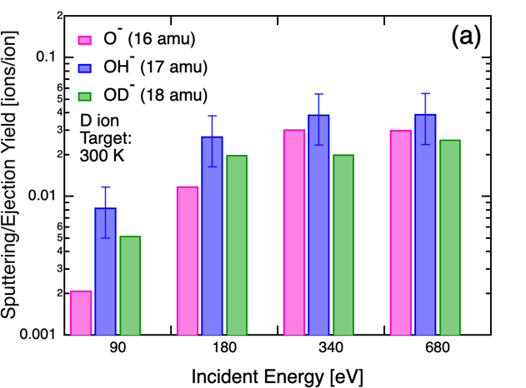
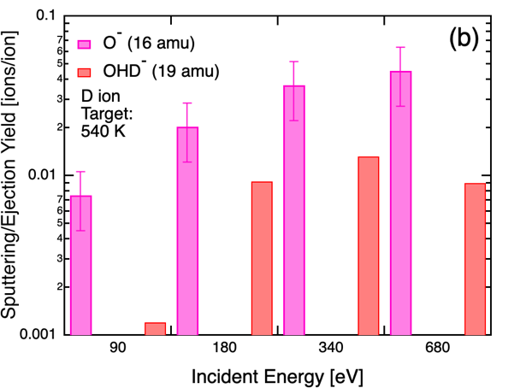
O ions ejected as negative ions
Drawn to the plasma by sheath
OH⁻ ejection due to sputtering
O ejection with attached D (OD⁻)
No OH⁻ nor OD⁻ ejections observed
Water ion OHD⁻ ejection
Shota Abe (PPPL)

Slide 20
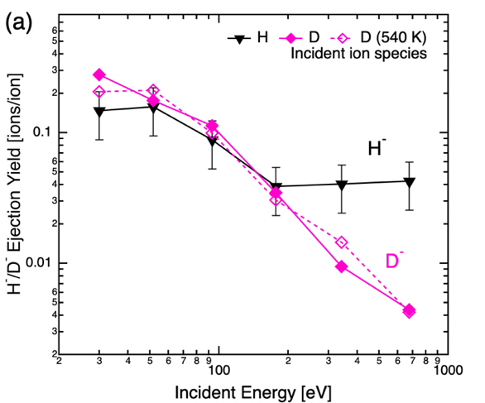
H⁻ ion ejection was observed
Drawn to the plasma by sheath
[Ongoing]
Andrea Hernandez (SULI 2023)
Secondary ion emission from
Li, B, W, C etc.
> 0.1 [H⁻/H] at low incident energy
Shota Abe (PPPL)

Slide 21
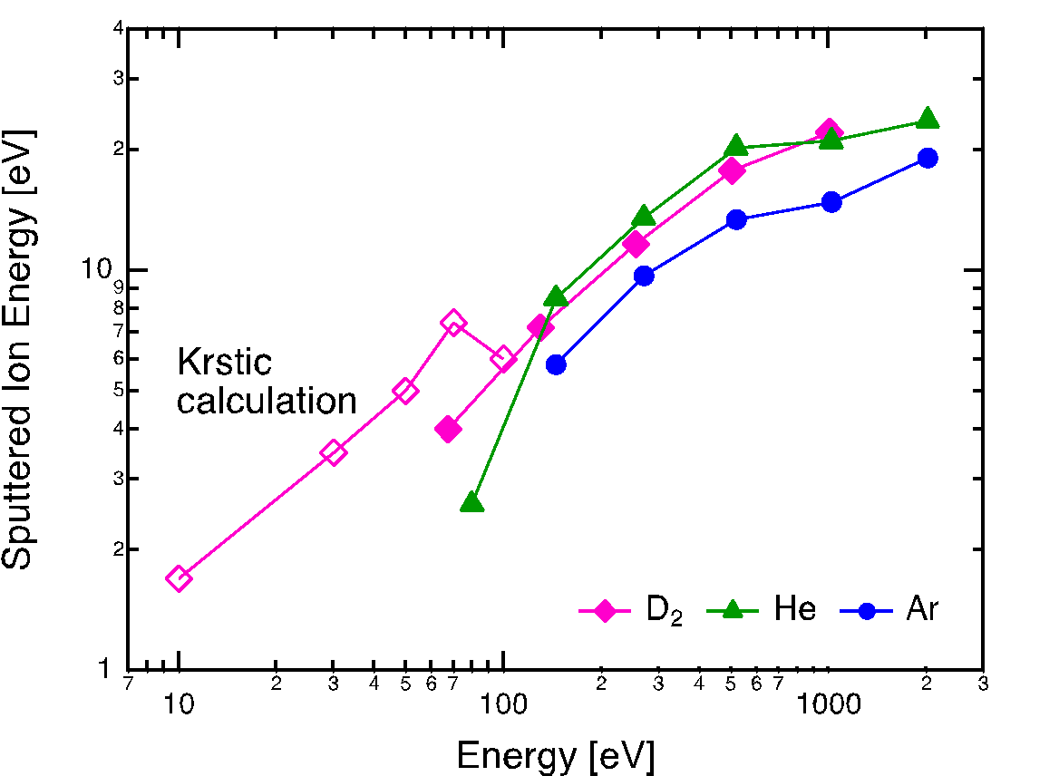
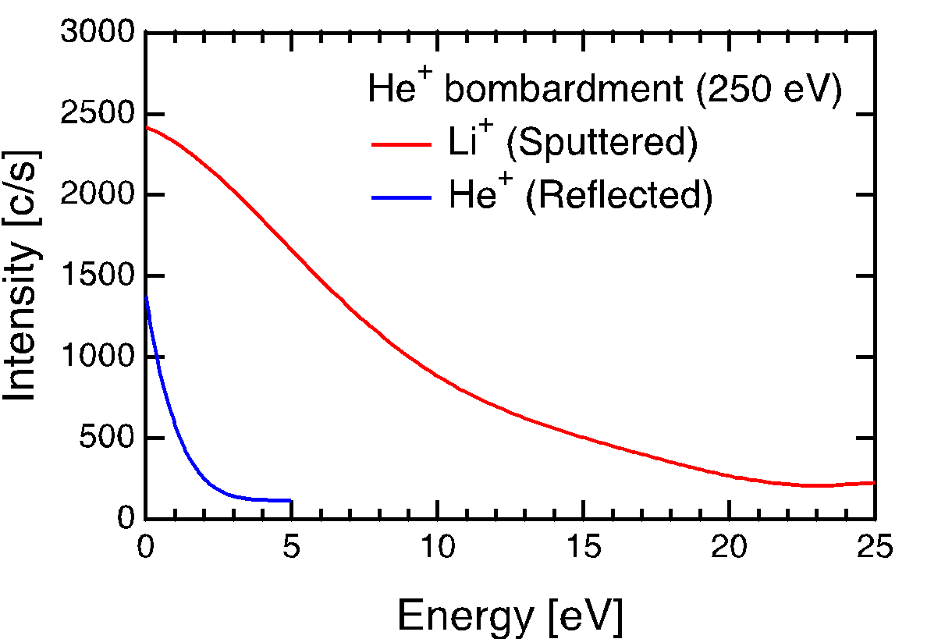
Retarding Field Energy Analysis of Ejected Ions
⁷Li⁺
<E>
unpublished
MD
40%
Incident ion species
<E>
Reflected ion E << Sputtered ion E
Sputtered Li⁺ ions: 1-20 eV
Sputtered positive Li ions will be trapped in the sheath (~100 eV)
Shota Abe (PPPL)

Slide 22
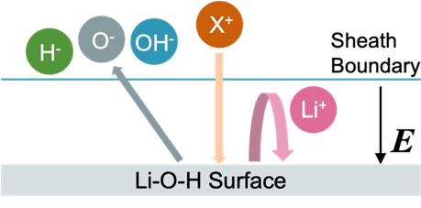
Retarding Field Energy Analysis of Ejected Ions
⁷Li⁺
<E>
unpublished
MD
Incident ion species
Ion bombardments work for surface cleaning
Sputtered Li⁺ ions: 1-20 eV
Abe et al., Journal of Fusion Engineering, ISLA-7 special issue (2023), Under review
Sputtered positive Li ions will be trapped in the sheath (~100 eV)
Shota Abe (PPPL)

Slide 23
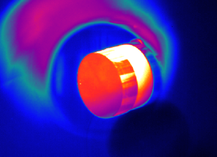
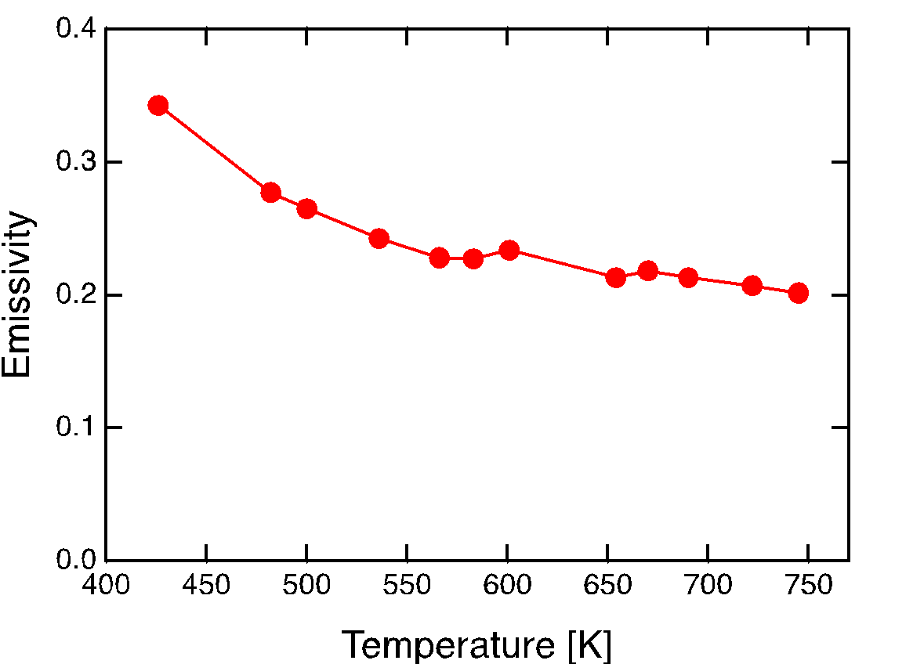
Emissivity determination for accurate wall temperature measurements
Measured
Emissivity
Ideal black body
Oxidized Li
Emissivity can be different for different materials and chemical states
IR temperature measurement relies on the emissivity value
Emissivity for Li₂O was determined
Pure Li including liquid state and different compositions (C/N/D) are being investigated
Promise O. Adebayo-Ige, Kaifu Gan, Brian Wirth (University of Tennessee, Knoxville)

Slide 24
LTX-β
Bruce E. Koel lab
Plasma performance affected by wall conditions
Li evaporation
H retention using TPD
HR-XPS analysis for detailed chemical state
Controlled experiment under ultra-high vacuum (10⁻¹⁰ Torr)
Surface Science and Technology Laboratory
Post-mortem surface analysis
Sample preparations
Li target
IAC&PRISM
XPS analysis
SIMS analysis
Sputtering
Retention
Emissivity
Li deposition
Impurity
SAM imaging
Li target
Sample Exposure Probe (SEP)
Vacuum suitcase for sample transfer
Predrag Krstic
(TheoretiK)
Molecular-Dynamics calculations
Sputtering and Retention

Slide 25
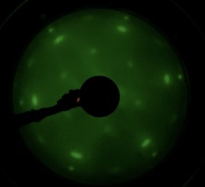
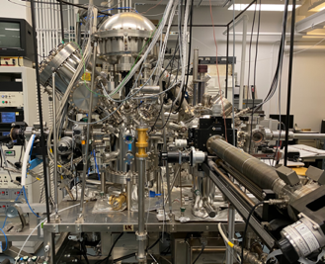
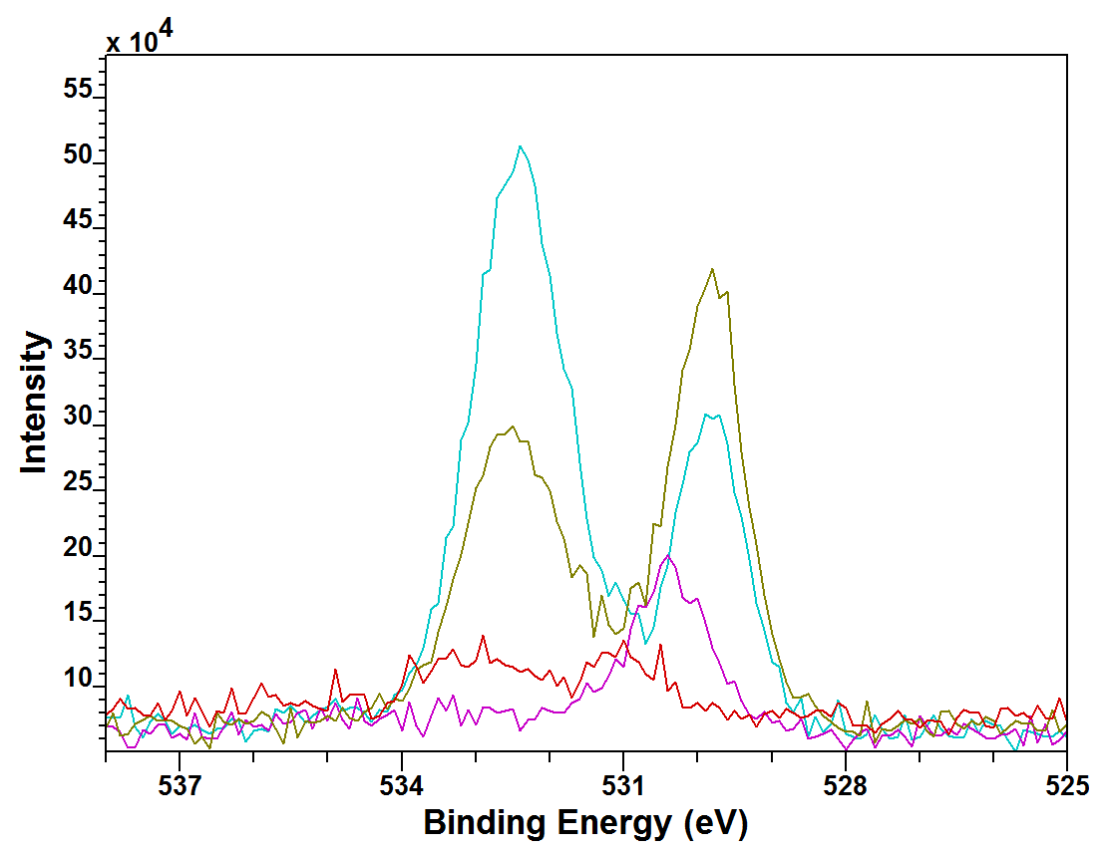
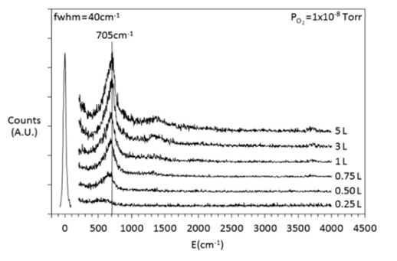
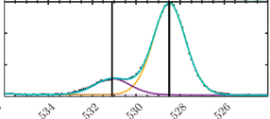
Detailed understanding of chemical states and evolutions of lithium surface
HR Electron Energy Loss Spectroscopy (HREELS)
LEED
e⁻
Absorbed XY Molecule
Li/Ni(111)
Dosed @ 300 K
LEED @ 300 K
E = 63 eV
e⁻
E_{i}
X
E_{s}
Y
Li
Li
HR-XPS
ΔE = E_{i} - E_{s}
Li₂O suggested
O 1s
LiOH
3 nm Li
Li₂O
Artificially oxidized Li target on graphite
44-hr resting in vacuum
No O₂
H₂⁺ ion exposure 10¹⁵ H/cm²
Low-res
Maan 2020
Wulfsberg 2016
Evan T. Ostrowski and Zihan Lin (Princeton U.)

Slide 26
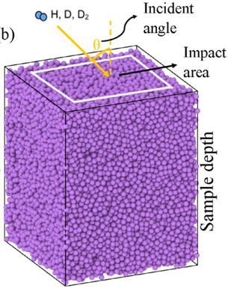
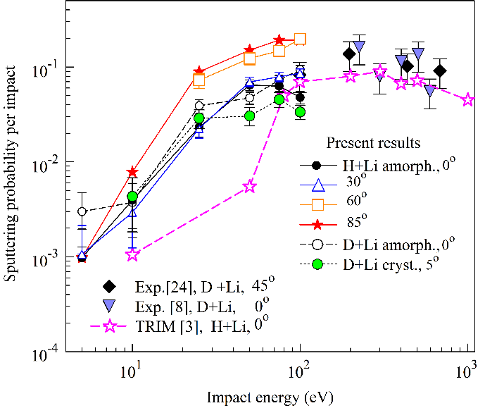
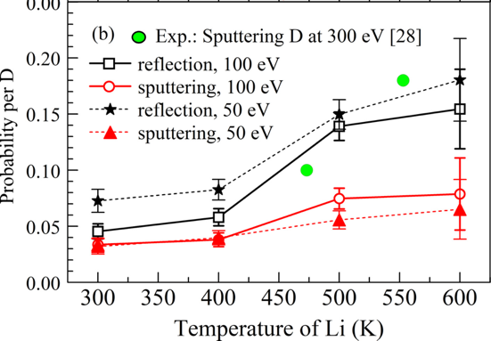
Molecular-Dynamics Calculation Revealed Several PMI parameters
Sputtering and Reflection (= 1 - Retention) Yields
Ion energy: 0.03-100 eV
Projectile species: H, D, and T
Target: Li, LiH, Li₂O, and LiOH
Target Temperature: 300 – 600 K
MD Results
Previous exp.
Crystal
Liquid (Amorphous)
Sputtering Yield
Sputtering Yield
Lab. experiments are on going to catch up the speed of calculations
Krstic, JNM 2022
Krstic, JNM 2022
Predrag Krstic (TheoretiK)

Slide 27
Thank you!
LTX-β
Dr. Anurag Maan, Dr. Dennis P. Boyle, Dr. Dick Majeski (PPPL)
Sample exposure probe (SEP)
Evan T. Ostrowski, Prof. Bruce E. Koel (Princeton U.)
Dr. Shota Abe, Dr. Anurag Maan (PPPL)
Micro-trench ion incident angle measurement
Jhovanna Garcia, Euichan Jung, Dr. Shota Abe (PPPL)
Prof. Bruce E. Koel (Princeton U.)
Ion sputtering Experiment
Dr. Shota Abe (PPPL), Prof. Bruce E. Koel (Princeton U.)
HR-XPS
Evan T. Ostrowski, Zihan Lin, Prof. Bruce E. Koel (PU)
Emissivity measurement
Promise O. Adebayo-Ige, Kaifu Gan, Brian Wirth (UTK)
Rajesh Maingi (PPPL)
Molecular-dynamics calculations
Dr. Predrag Krstic (TheoretiK)
sabe@pppl.gov
Acknowledgements: Koel (PU) group, LTX-β (PPPL) group, and SULI program (PPPL)
This work is supported by U.S. DOE under DE-SC0019308, DE-AC02-09CH11466, DE-AC52-07NA27344, and DE-SC0008309

