Slide 1
Machine Learning Application in KSTAR
Disruption Prediction and Autonomous Tokamak Plasma Control
Jinsu Kim and Prof. Yong-Su Na
asdwlstn@snu.ac.kr, ysna@snu.ac.kr
Department of Nuclear Engineering, Seoul National University, Seoul, Korea
2023.08.08

Slide 2
Contents
Introduction
ML application for fusion research
Conclusion
Machine Learning and Deep Learning
Reinforcement Learning
Explainable AI: How to explain model capabilities in ML
Topic 1. Disruption prediction and analysis through multi-modal deep learning in KSTAR
Topic 2. Tokamak plasma operation control based on multi-objective reinforcement learning in KSTAR

Slide 3
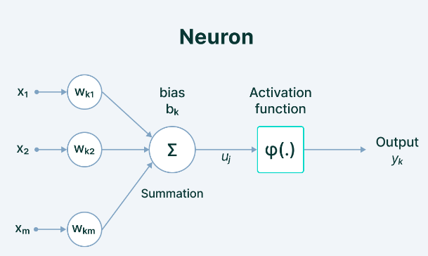
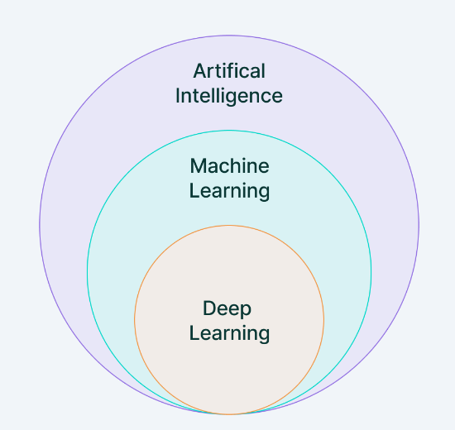
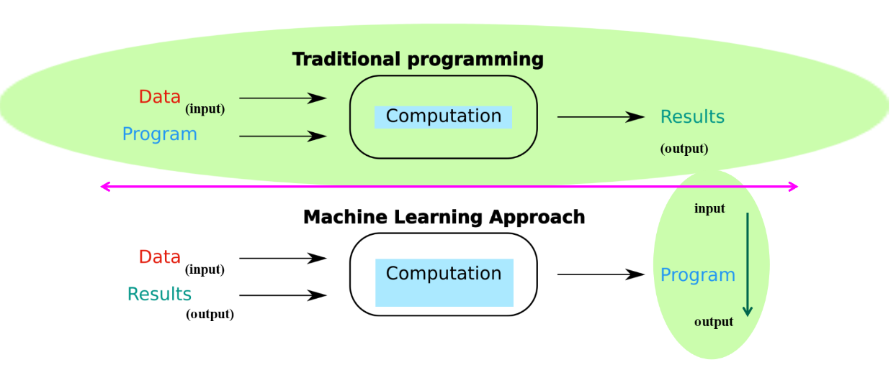
Introduction : Machine Learning and Deep Learning
Basic of ML and DL
Machine Learning : Detecting patterns in data → Learning data representation
Goal: to learn a mapping from input data distribution to output data distribution → to Learn probability distribution $p(y|x,D)$
Deep Learning : A subset of machine learning algorithm which use Artificial Neural Network as a function approximator
Easy to model the nonlinear and complex relation between input and output
Low inductive bias: better generalization in large dataset
Universal approximation theorem : NN can represent a wide variety of functions when given appropriate weights.
Notes:
Main process 제외

Slide 4
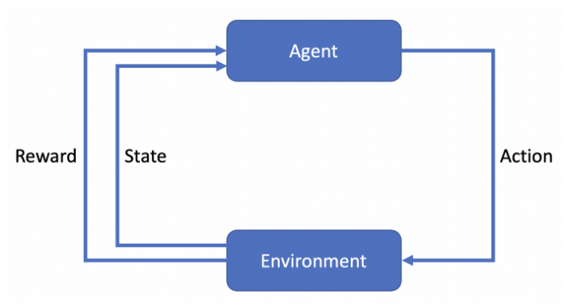
Introduction : Reinforcement Learning
Basic of reinforcement learning
How AI should take actions in an environment in order to satisfy the objectives
Basic components
Agent: Object that takes decisions based on the rewards
Environment: Physical world in which the agent interacts
Reward: Feedback from the environment
Action: Decision of agents that transits the states
State: Current situation of the agent
Bellman equation
$$V_{π}\left(s_{t}\right)=E_{π}[R\left(s_{t+1}\right)+γQ\left(s_{t+1}, a_{t+1}\right)]$$
Learning process for the case of policy gradient method
Exploration
Objective: To find the optimal policy which achieves the maximum reward
Reward function:
How to optimize:
Policy evaluation
Policy improvement

Slide 5
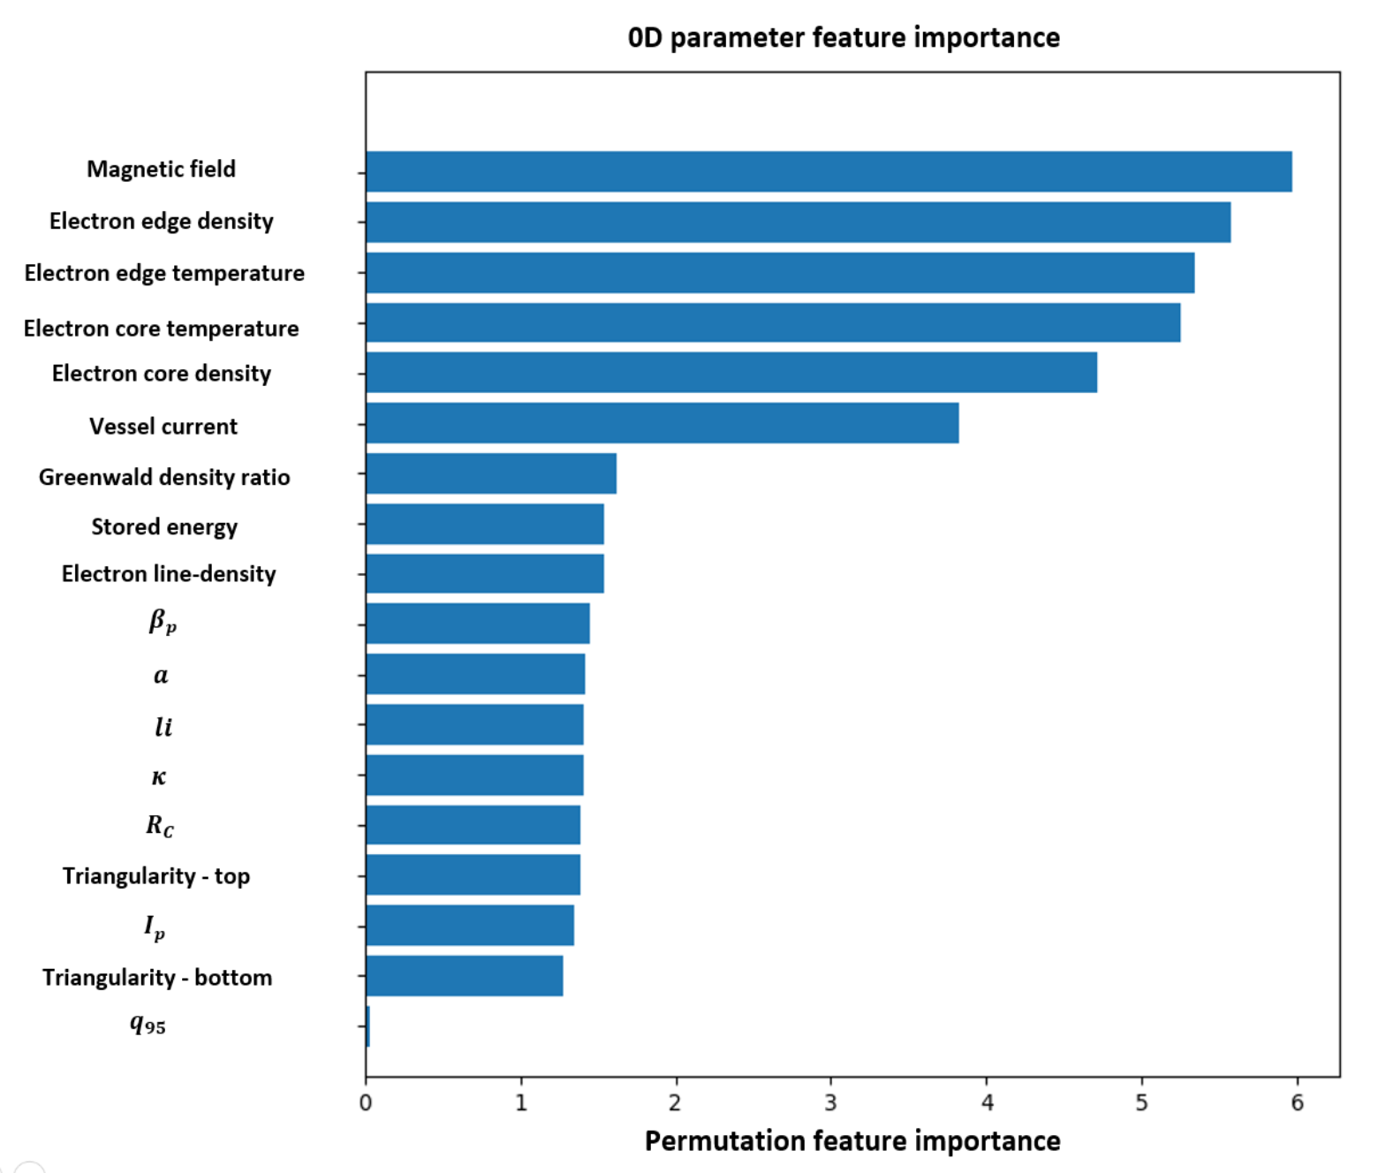
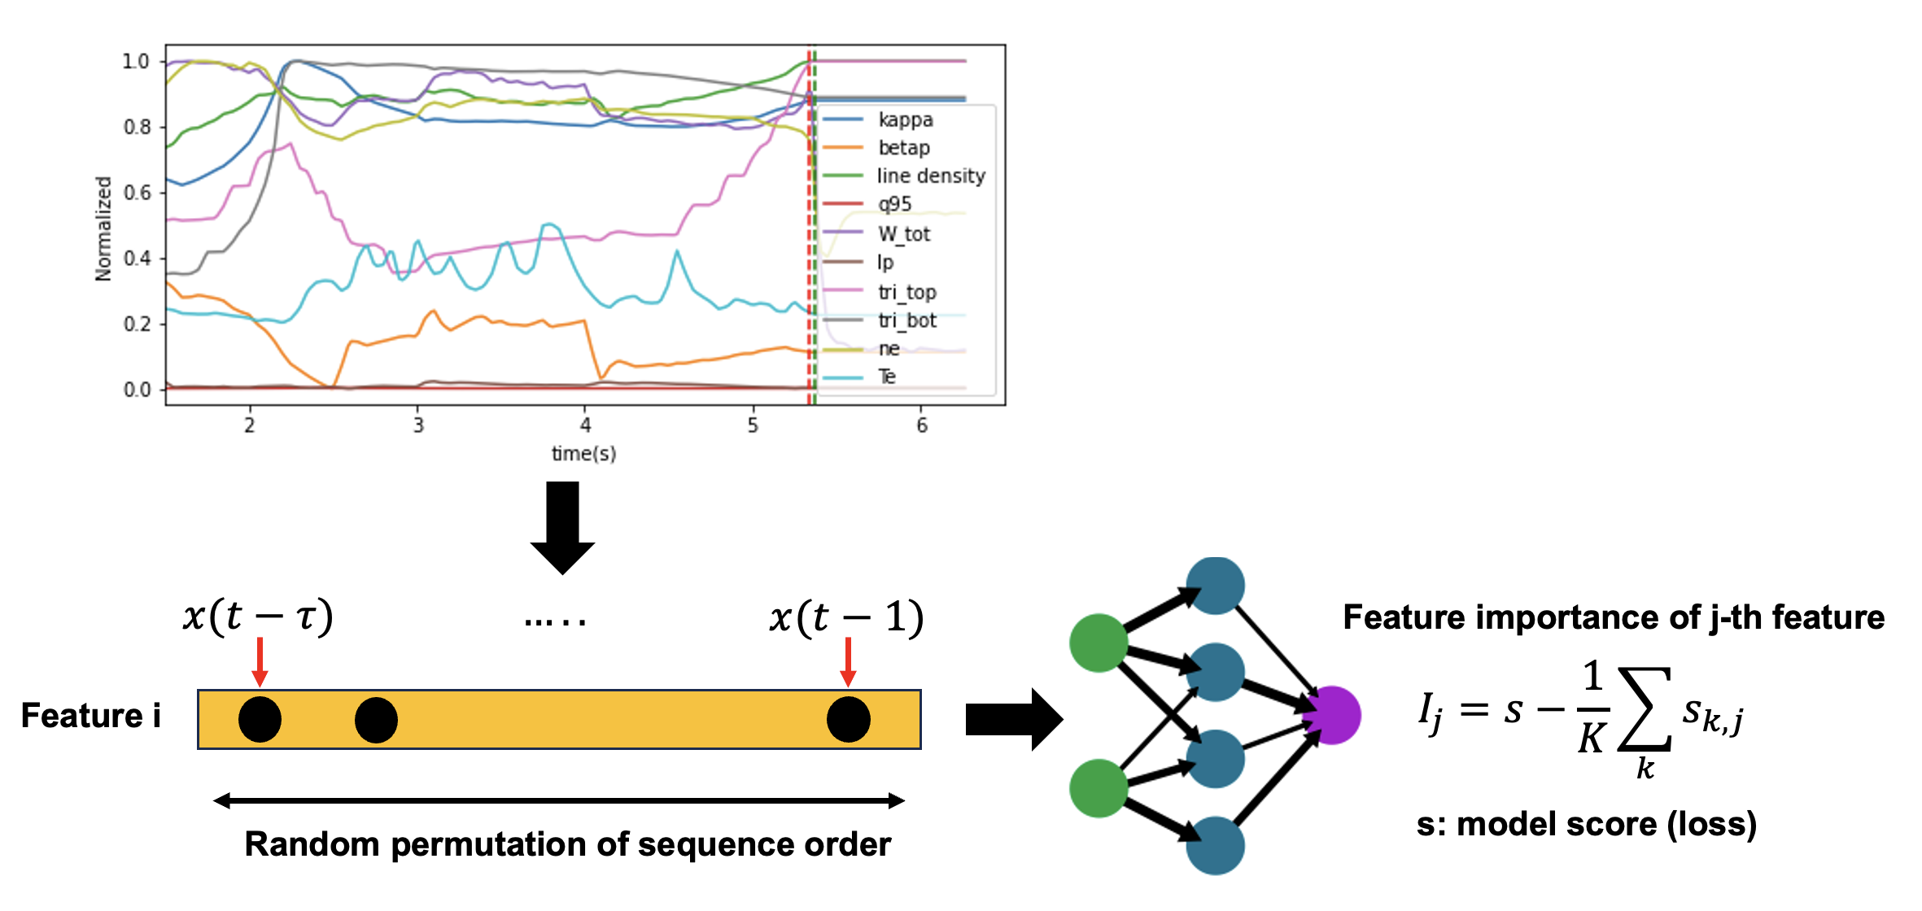
Introduction: Explainable AI (1)
How to explain model capabilities in ML / DL
Method1. Visualization of latent variables from neural networks (t-SNE)
t-Distributed Stochastic Neighbor Embedding (t-SNE): A non-parametric dimensionality reduction method using t-distributed variant and Stochastic Neighbor Embedding for clustering the data distribution.
High dimensional latent variables from neural network can be visualized in low-dimensional space using t-SNE technique.
Method2. Permutation feature importance
Model agnostic method: defined to be the decrease in a model score when a single feature value is randomly shuffled.
Permutation of sequential order of input features → model score drops = dependence of the features
Data clusters indicate the similar data distribution
Permutation feature importance
Notes:
t-Distributed Stochastic Neighbor Embedding (t-SNE) is a non-parametric dimensionality reduction technique in which high-dimensional data (n features) is mapped into low-dimensional data (typically 2 or 3 features) while preserving relationship among the data points of original high-dimensional data.
https://scikit-learn.org/stable/modules/permutation_importance.html#id2
The permutation feature importance is defined to be the decrease in a model score when a single feature value is randomly shuffled
This procedure breaks the relationship between the feature and the target, thus the drop in the model score is indicative of how much the model depends on the feature

Slide 6
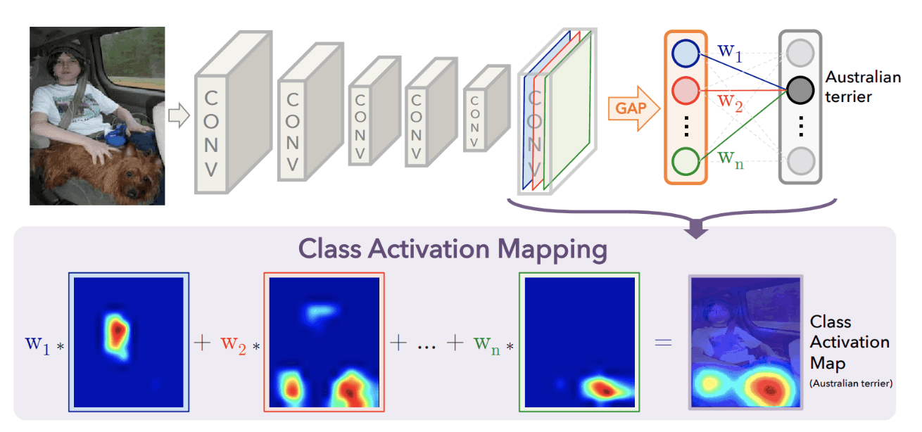
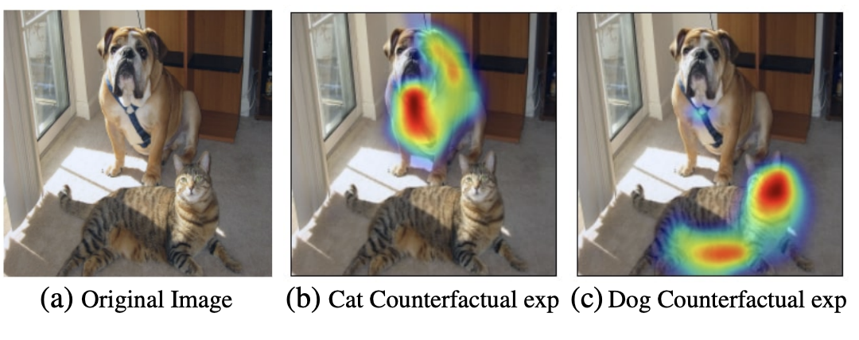
Introduction: Explainable AI (2)
How to explain model capabilities in ML / DL: specific case (computer vision)
Method3. Gradient-Weight Class Activation Mapping (GradCAM)
GradCAM: a useful technique for visualizing where a convolutional neural network model is looking.
Using the gradients related to the CNN layers, it visualizes the map highlighting the important regions in the image for computing the output.
If local regions containing the important features show the large gradient of weights, it indicates that networks have enough capabilities to localize the category in image and to capture fine-grained details.
$$M_{c}\left(x,y\right)=\sum_{k}{w_{k}f_{k}(x,y)}$$
Ramprasaath R. Selvaraju et al., IJCV 2019
$$a_{k}^{c}=\frac{1}{Z}\sum_{i}{\sum_{j}{\frac{∂y^{c}}{∂A_{ij}^{k}}} }$$
$$M_{grad}^{c}\left(x,y\right)=RELU(\sum_{k}{a_{k}^{c}A^{k})}$$
Figure 1 from Learning Deep Features for Discriminative Localization

Slide 7
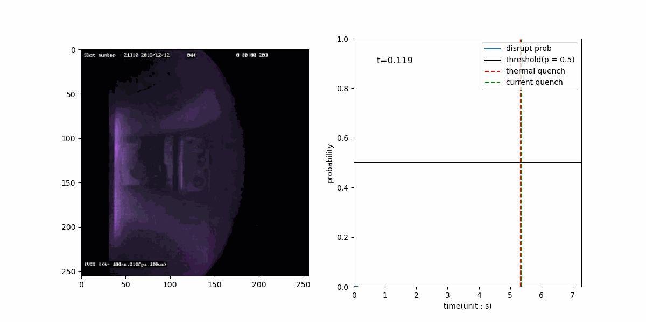
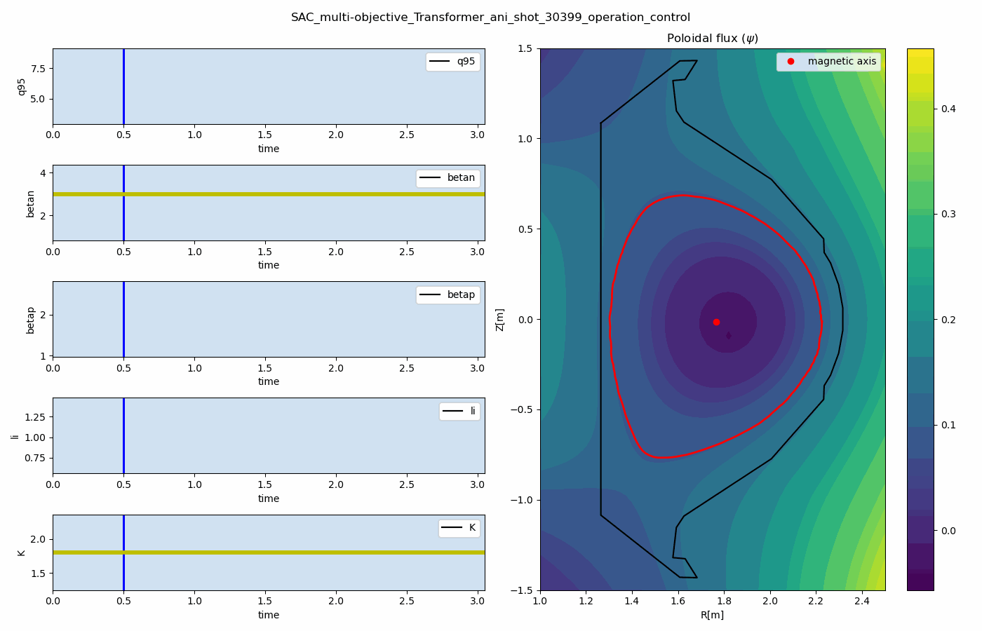
ML application for fusion research
Examples for ML application in KSTAR
Disruption prediction based on multimodal learning
Virtuak KSTAR tokamak control using MORL

Slide 8
Topic 1. Disruption prediction and analysis through
multi-modal deep learning in KSTAR

Slide 9
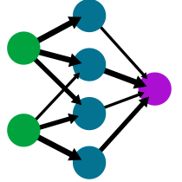
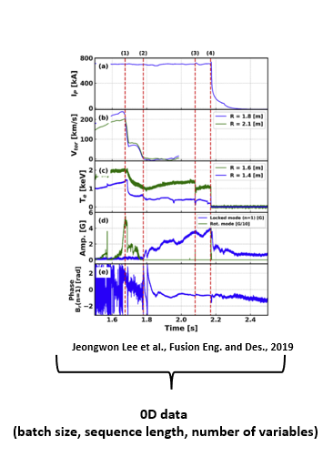
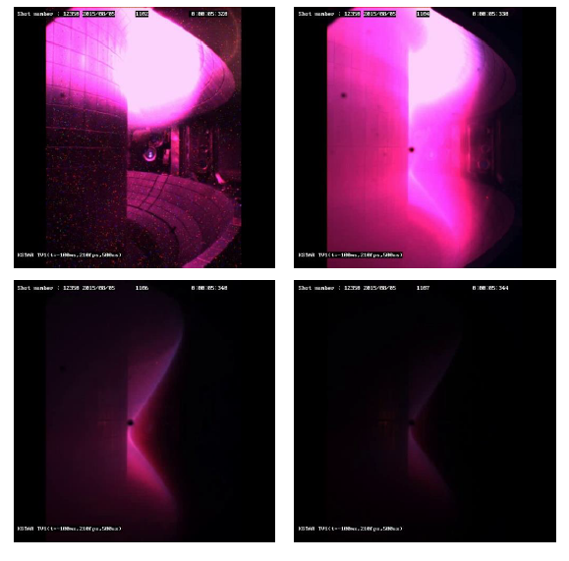
ML application – disruption prediction
Purpose of this research
Disruption prediction using on multi-modal data through deep learning
Concept: Neural Network based disruption predictor + Multi-modal data (IVIS video data + Diagnostic data)
Multi-modal learning: Use Multiple forms of input data (e.g. Video, Text, Audio) → improve model capabilities by combining information from multiple modalities [Summaira Jabeen et al., 2023].
3 issues related to this work
Imbalanced data distribution induced by data sampling method → Focal Loss, LDAM Loss, Boosting method
Overfitting induced by different data modalities → Gradient Blending
Black-box : Hard to analyze the model capabilities → GradCAM, Attention Rollout, Permutation feature importance
Neural Network
(Disruption prediction model)
Plasma state information
(IVIS video data + Diagnostic data)

Slide 10
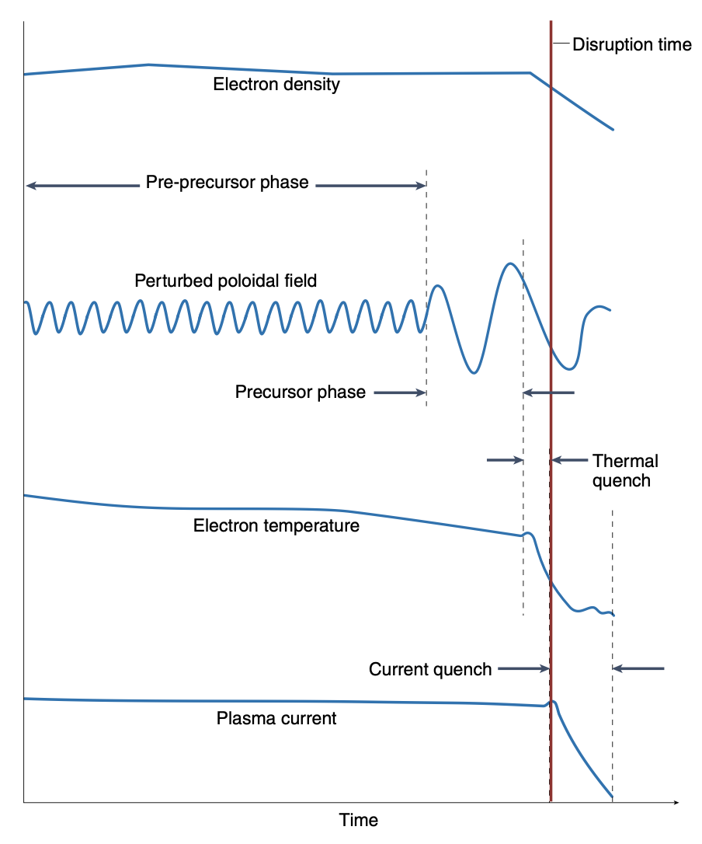
ML application – disruption prediction
Definition and general process
Definition
Global and sudden losses of plasma with large amount of energy loss.
4 phases: Pre-precursor phase → Precursor phase → Fast phase → Current phase
Process of disruption
The evolution of an unstable current profile → growth of a tearing mode
A sudden relaxation of the equilibrium: current profile flatten + loss of confinement + collapse of $T_{plasma}$→ Thermal quench (TQ)
The total current decays → Current quench (CQ)
$E_{φ}$ ↑ associated with $Z_{plasma}$ ↑: generates runaway electrons → Large current
Loss of plasma energy + current decay
Fig 1, J.Vega et al, 2022, Nature Physics

Slide 11
ML application – disruption prediction
Importance of disruption prediction
Severeness of the disruption in tokamak device
Disruptions→ erosion / melting / structural damage in Tokamak device
Predicting disruption well in advance is important to mitigate and to avoid disruptions.
Limitation of the conventional approach
Conventional approaches by MHD theory and simulation have remained limitations.
→ Disruption = highly non-linear dynamics with complex interaction of different physical processes.
Data-driven approaches (ML/DL) can be alternative for disruption predictor.
Deep Learning: FRNN (https://github.com/PPPLDeepLearning/plasma-python)
Various attempts based on data-driven approach
Kates et al (2019): Fusion recurrent neural networks in JET and D3D
Croonen et al (2020): SVM, RF, GBT → Ensemble learning
Ferreiral et al (2020): CNN models with Plasma tomography (image)
Notes:
중요도에 대한 기술 줄이자 / ML DL 언급 줄이자

Slide 12
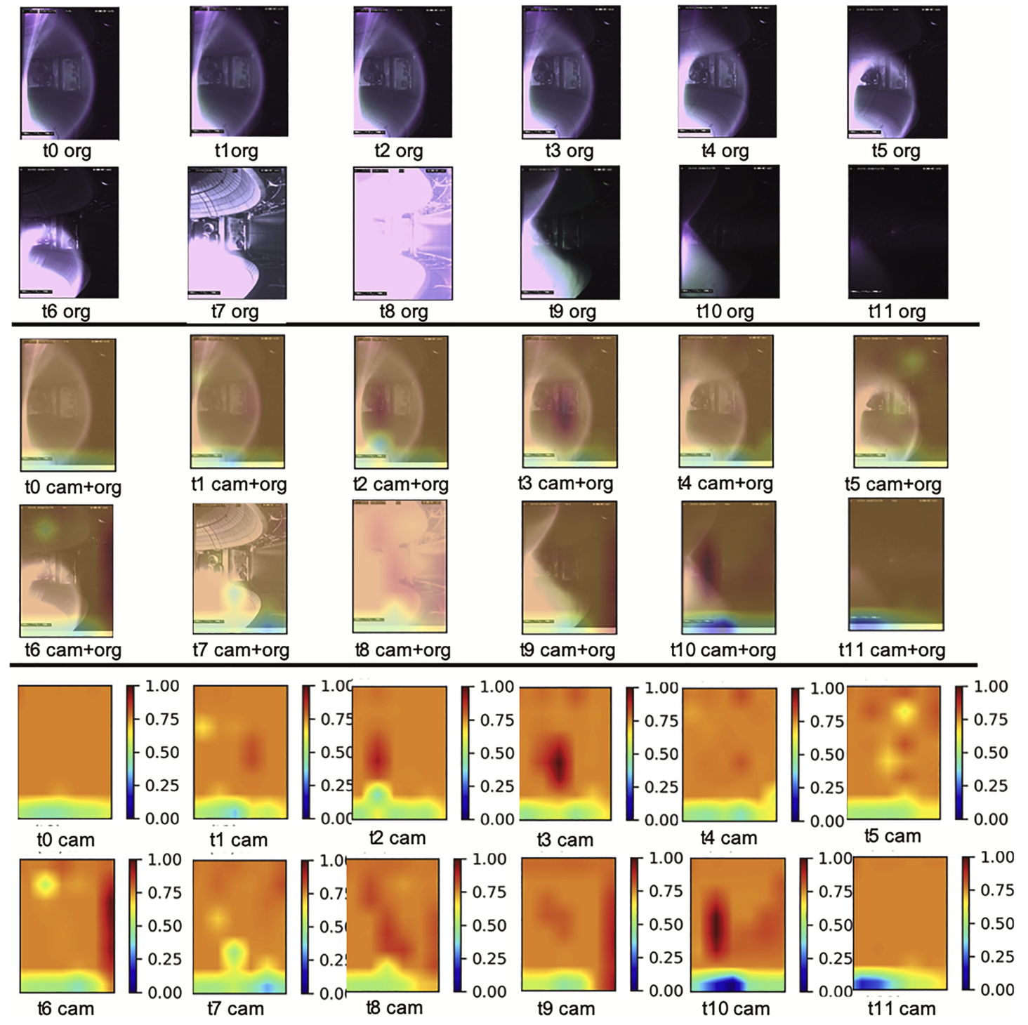
ML application – disruption prediction
Why use video data?
KSTAR IVIS data : In-vessel Visible Inspection System (Kwon et al, FED, 2021)
Video data contain spatial-temporal information including time-varying position and shape of plasma.
Vertical Displacement Event may be captured from video directly.
In the computer vision area, there are many implemented codes which show high performance with several tasks (e.g. Video Action Recognition, Video Prediction)
Kwon et al used video data to classify the disruptive event and showed the neural network recognized disruption image using relative change in brightness from the plasma area.
Disruption prediction using video data
Figure 5 from Kwon et al, 2021
Notes:
IVIS : In-vessel visible inspection system

Slide 13
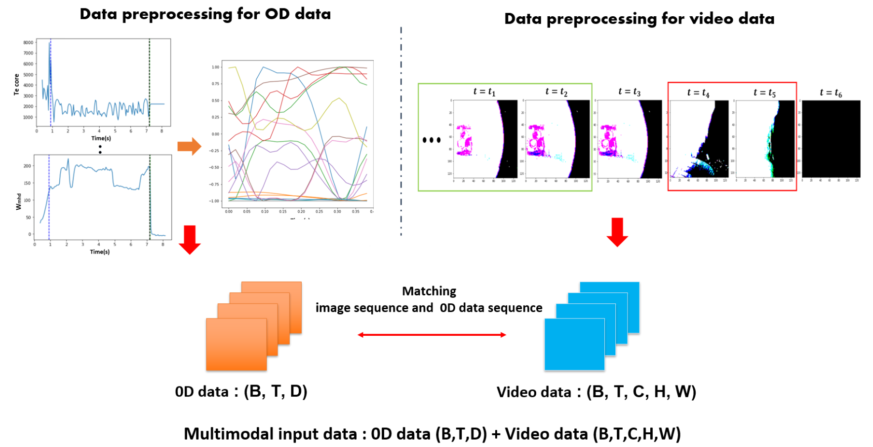
ML application – disruption prediction
Why use multimodal learning?
Effect of multimodal deep learning
Multimodal Deep Learning: Multiple data with different modalities + Deep Learning
Data fusion combining the feature extracted from different data modalities improves data representation and model capabilities.
Diagnostic data + Thomson data + EFIT data
(Multi-variable time-series data)
IVIS Image sequential (video) data
(Time-varying shape and position of plasma)
Encoders for each data modality
(Feature extraction)
Data fusion
(Concatenation)
Notes:
IVIS : In-vessel visible inspection system

Slide 14
ML application – disruption prediction
Methodology
Dataset setup
Model setup
Learning Algorithm
KSTAR IVIS Video data : Image sequence data / 210 fps and 480 X 640 resolution (4.76ms)
KSTAR 0D data : Time-series data / 20kHz sampling rate (4x4.76ms)
Multimodal data : Video data + 0D data (4x4.76ms)
Model for video data: SlowFast / R2Plus1D / ViViT
Model for 0D data: Transformer / CNN-LSTM / MLSTM-FCN
Model for multimodal data (Video + 0D) : Tensor Fusion Network / Simple concatenated network
Objective / Loss function : Cross Entropy Loss, Focal Loss, LDAM Loss
Learning algorithm for imbalance data distribution : Re-Sampling, Re-Weighting, Deferred Re-Weighting
Learning algorithm for multimodal data : Gradient Blending

Slide 15
ML application – disruption prediction
Experimental results: comparison for data modality
IVIS data only vs Multi-modal data
0D data only vs Multi-modal data
Multi-modal model has shown the enhancement over 19.04ms compared with IVIS model in terms of all metrics.
Overall improvement observed from multi-modal model for all prediction times.
# of disruption dataset decrease due to different temporal length
Improved!
All improved!

Slide 16
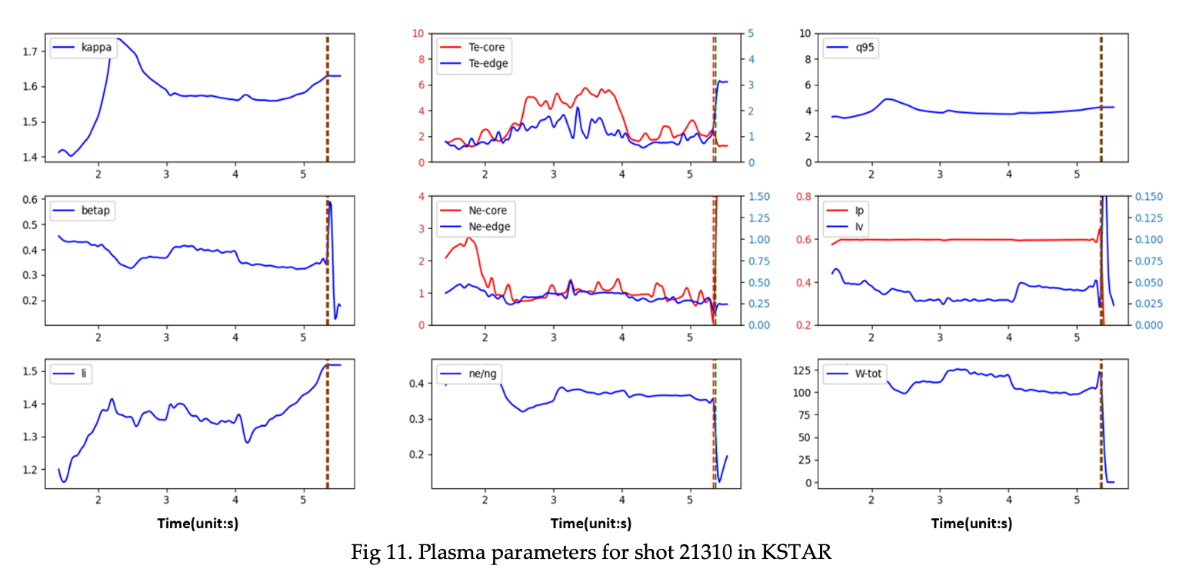
ML application – disruption prediction
Continuous disruption prediction using shot 21310 in KSTAR
Thermal quench (TQ) at t = 5.342 s, current quench (CQ) at t = 5.368 s.
$li$and $β_{p}$ dropped at t = 2.5 s and t = 4.2 s.
This abrupt change results from $P_{EC}$, which is applied from t = 2.5 s to t = 4.2 s.

Slide 17
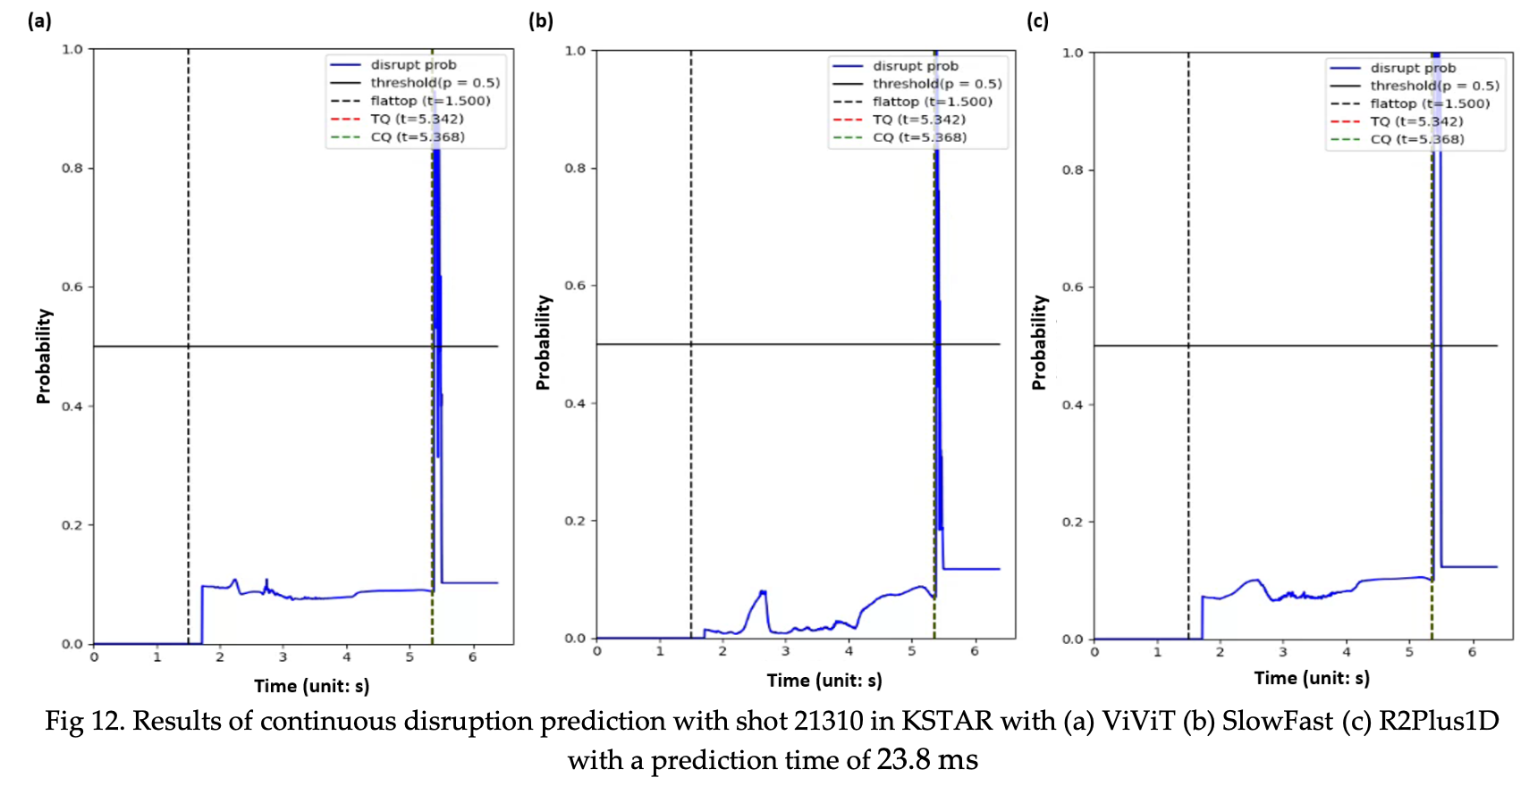
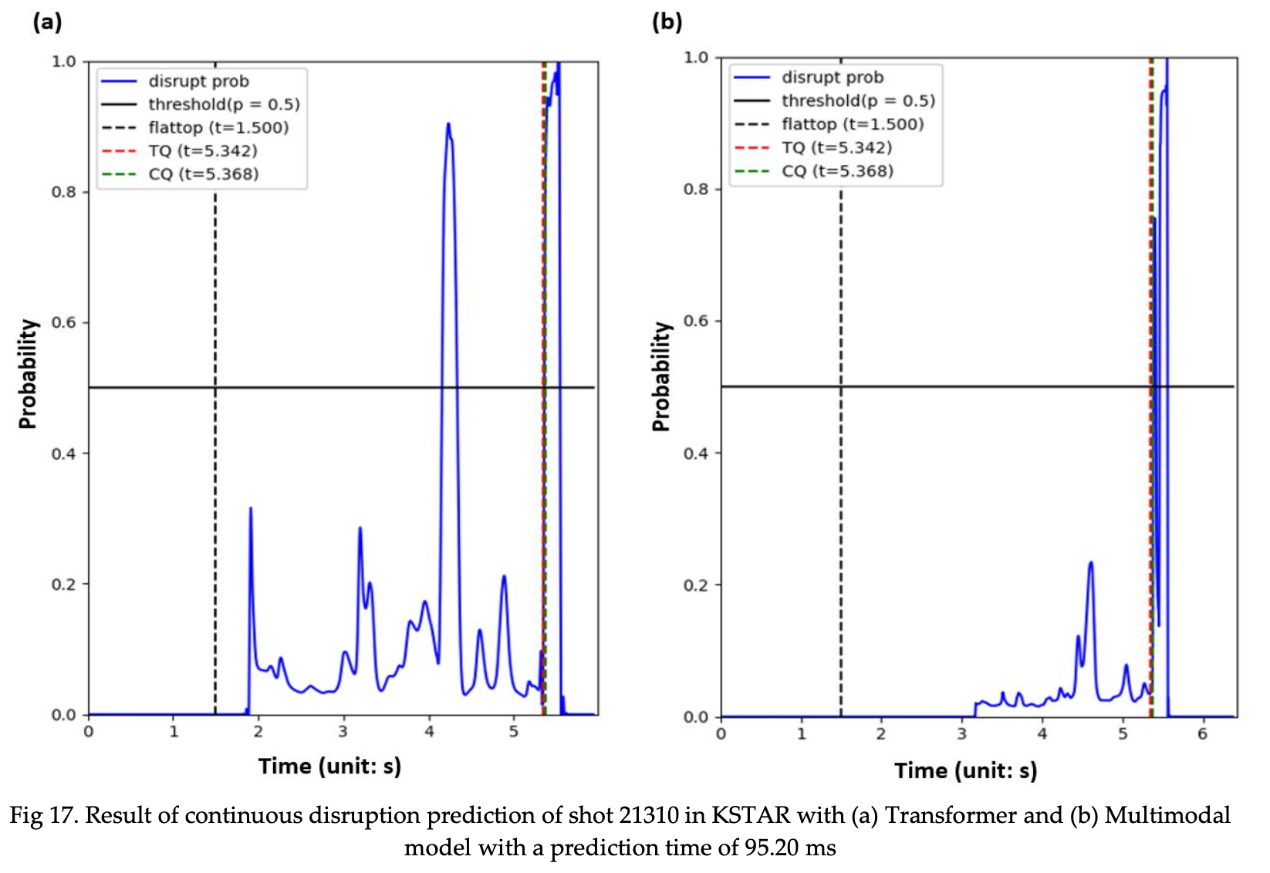
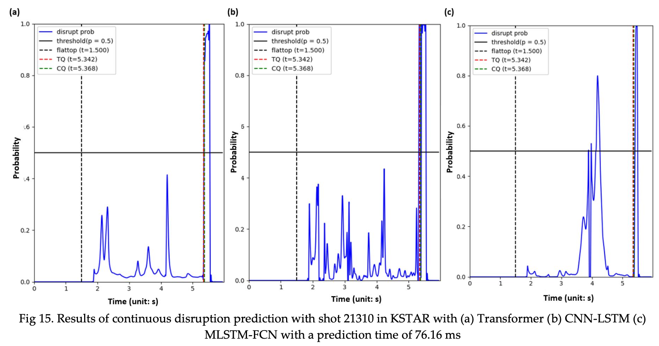
ML application – disruption prediction
More than 90ms, Multimodal model can predict the disruptions without false alarms or missing alarms.
False alarm occurs at t = 4.2s

Slide 18
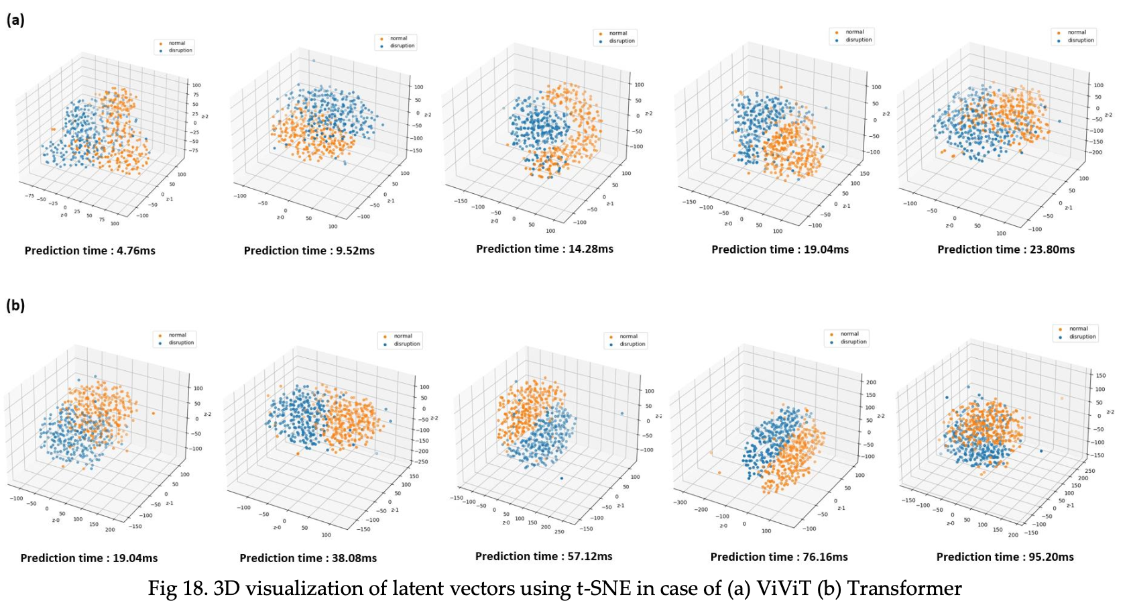
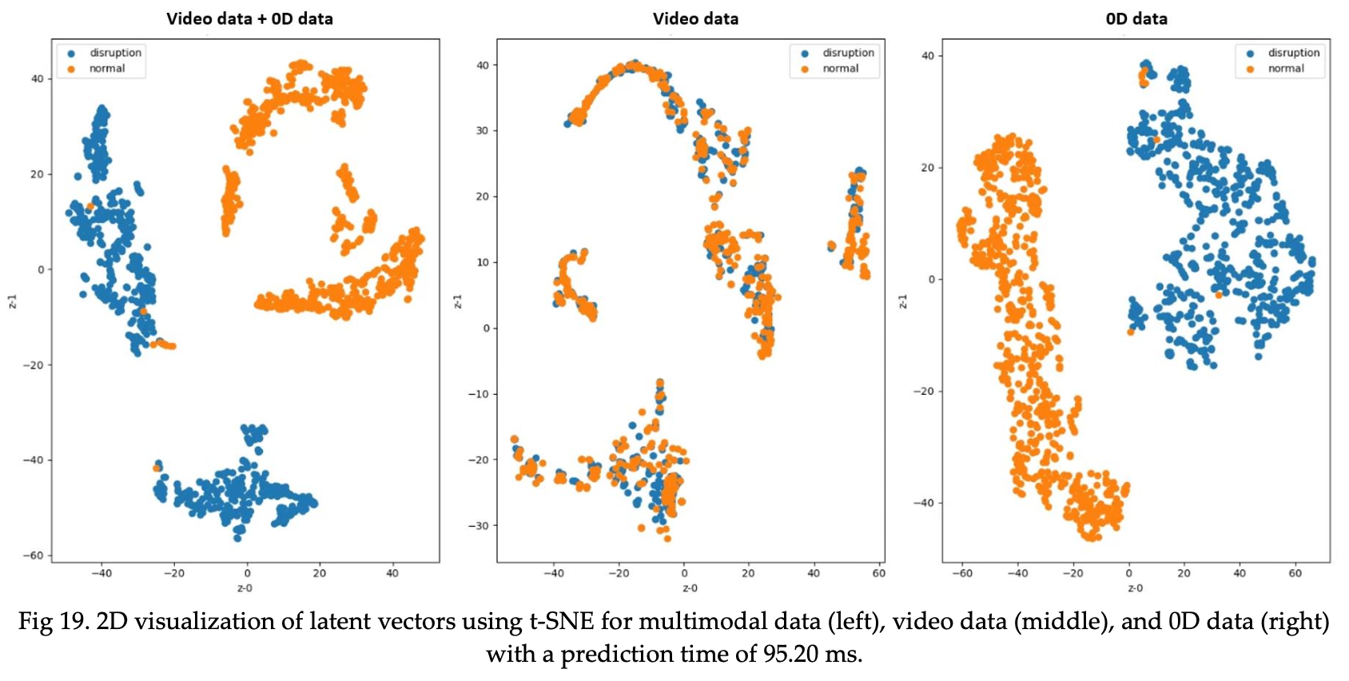
ML application – disruption prediction
Analysis: t-SNE for visualizing the hidden vectors from trained models
If models predict disruption as well, the hidden vectors depicted in low dimensional space are also well separated
✰ distance between data points indicates the similarity of the data.
Over the appropriate prediction time, overlapped regions are observed, meaning the limit of model capabilities.
Disruptive data discrimination enhanced by using multi-modal data
Overlapped regions observed as models can not predict disruptions as well

Slide 19
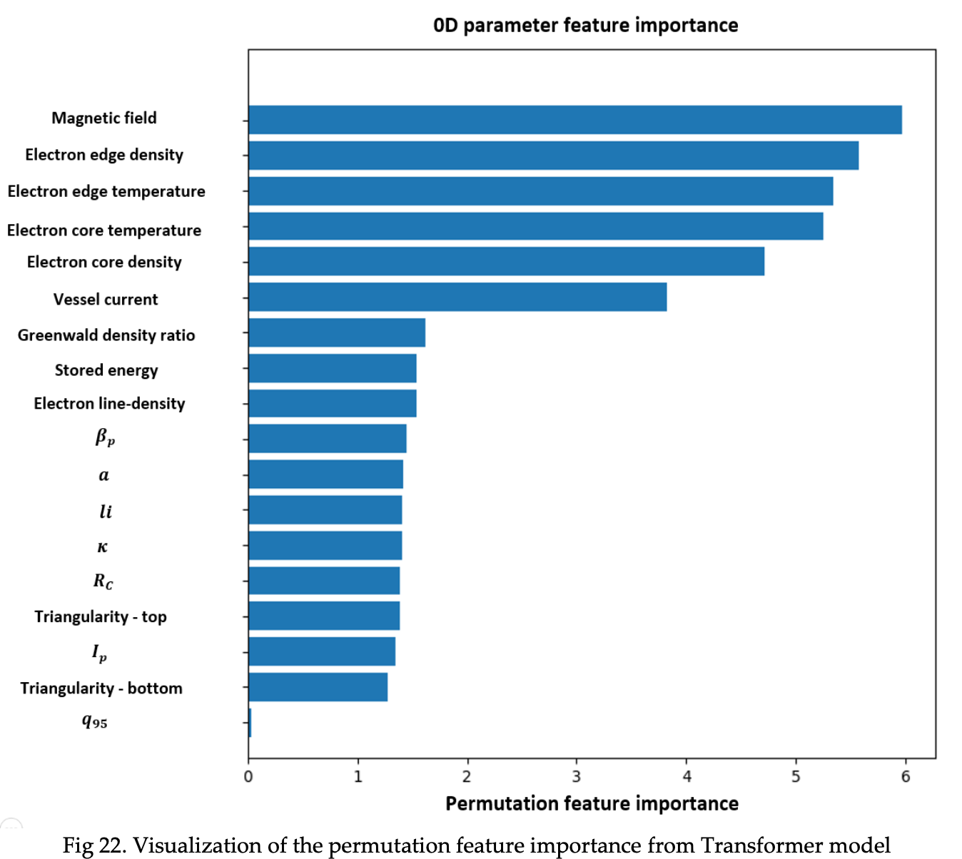
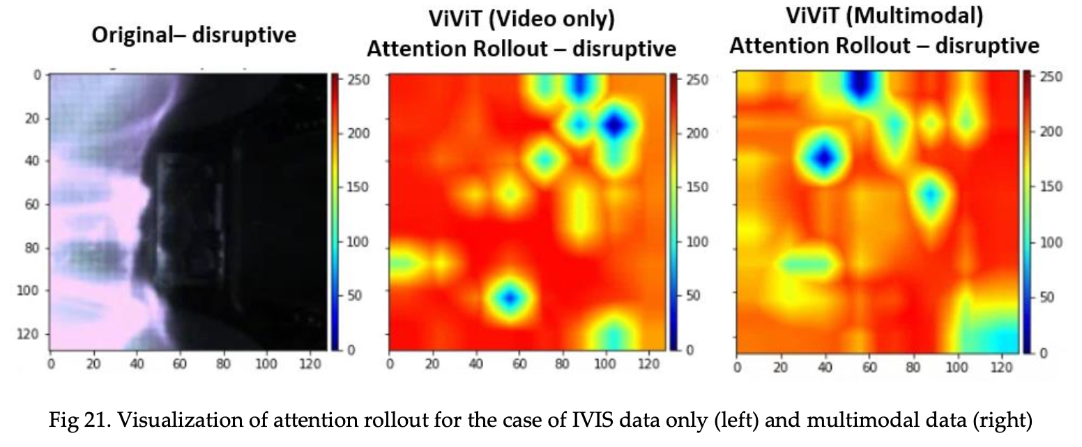
ML application – disruption prediction
Analysis: GradCAM and Permutation feature importance
Multimodal learning can improve the recognition of models since they capture fine-grain details as well by using multimodal data.
Information about electron profiles from both edge and core is critical for predicting disruptions.

Slide 20
Topic 2. Tokamak plasma operation control based on multi-objective reinforcement learning in KSTAR

Slide 21
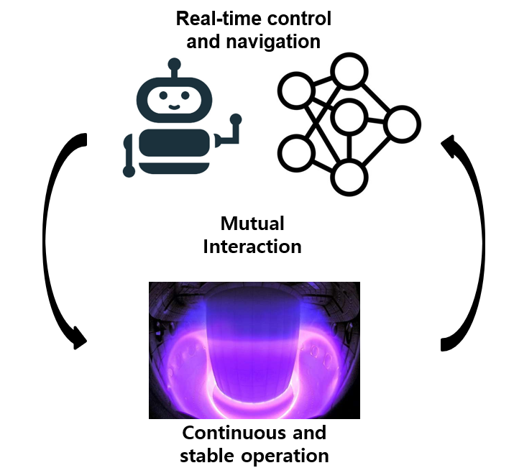
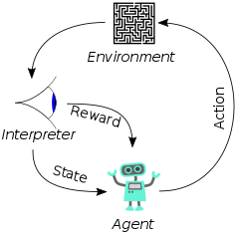
ML application – tokamak plasma operation control
Purpose of this research
Tokamak plasma autonomous operation based on reinforcement learning
Concept: Control by Reinforcement Learning + Virtual KSTAR environment
Under the virtual KSTAR environment, we can find out the near-optimal way to approach the ideal operation scenario
How to implement the virtual KSTAR environment
How to control the virtual KSTAR environment
Neural network: A computing system for approximating the mapping function based on forward-backward algorithm
Reinforcement learning: One of the machine learning concept for dynamic decision making
Neural Network
(Function approximator, Simulator)
Reinforcement Learning
(Decision maker / Feedback controller)

Slide 22
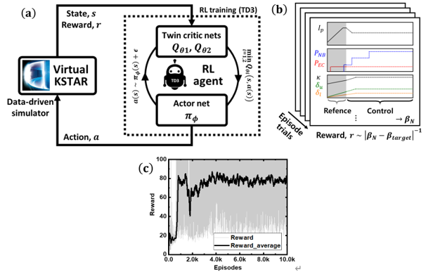
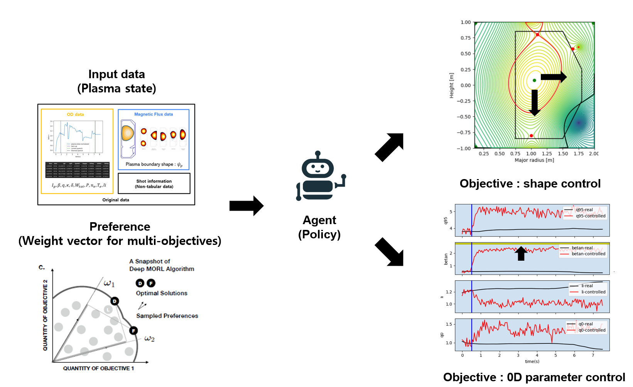
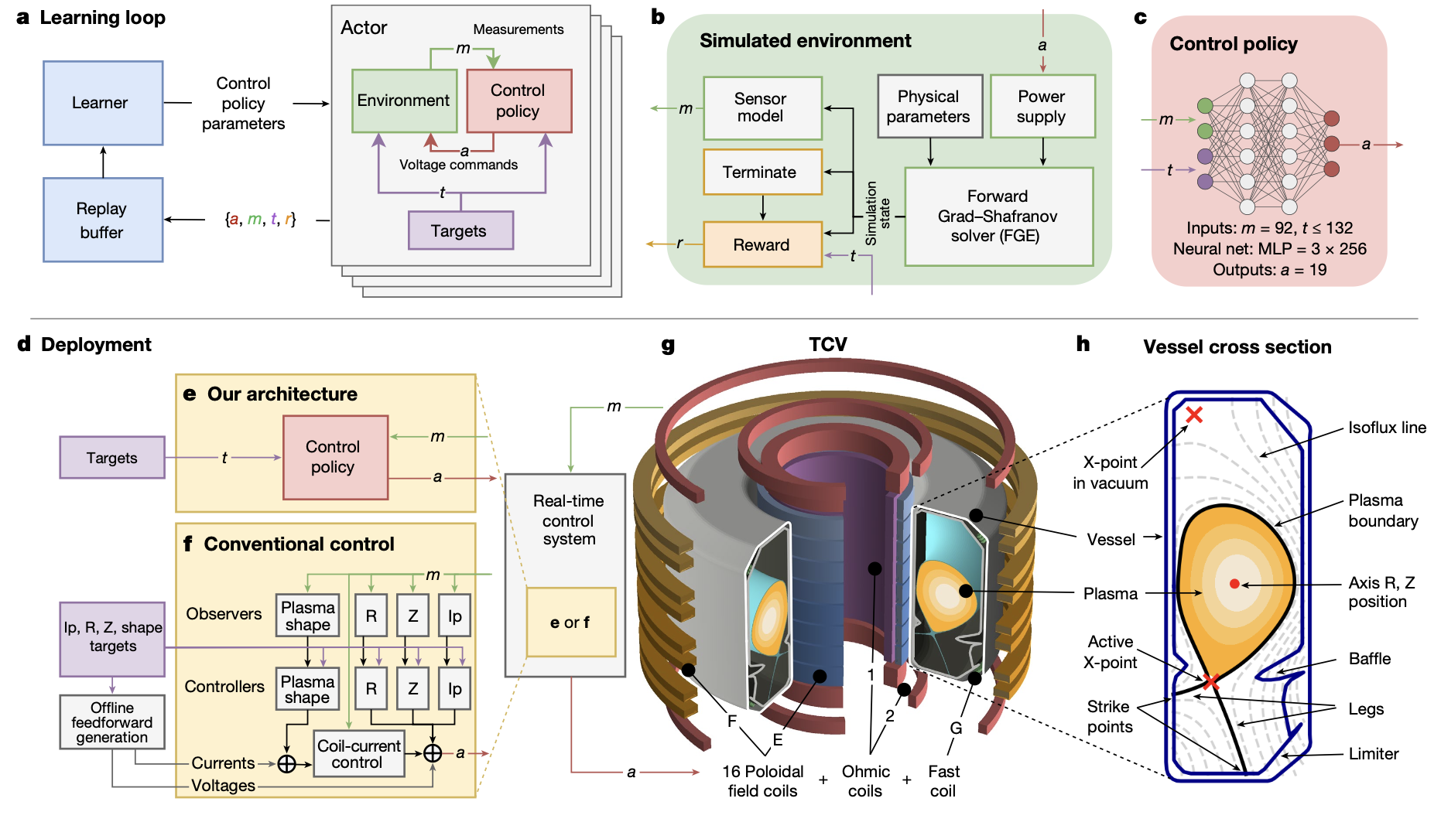
ML application – tokamak plasma operation control
The overall framework for our research: MORL
0D parameter control
Multi-objective reinforcement learning
Jaemin Seo et al 2021 Nucl. Fusion 61 106010
Shape control
Google Deepmind, Nature 2022

Slide 23
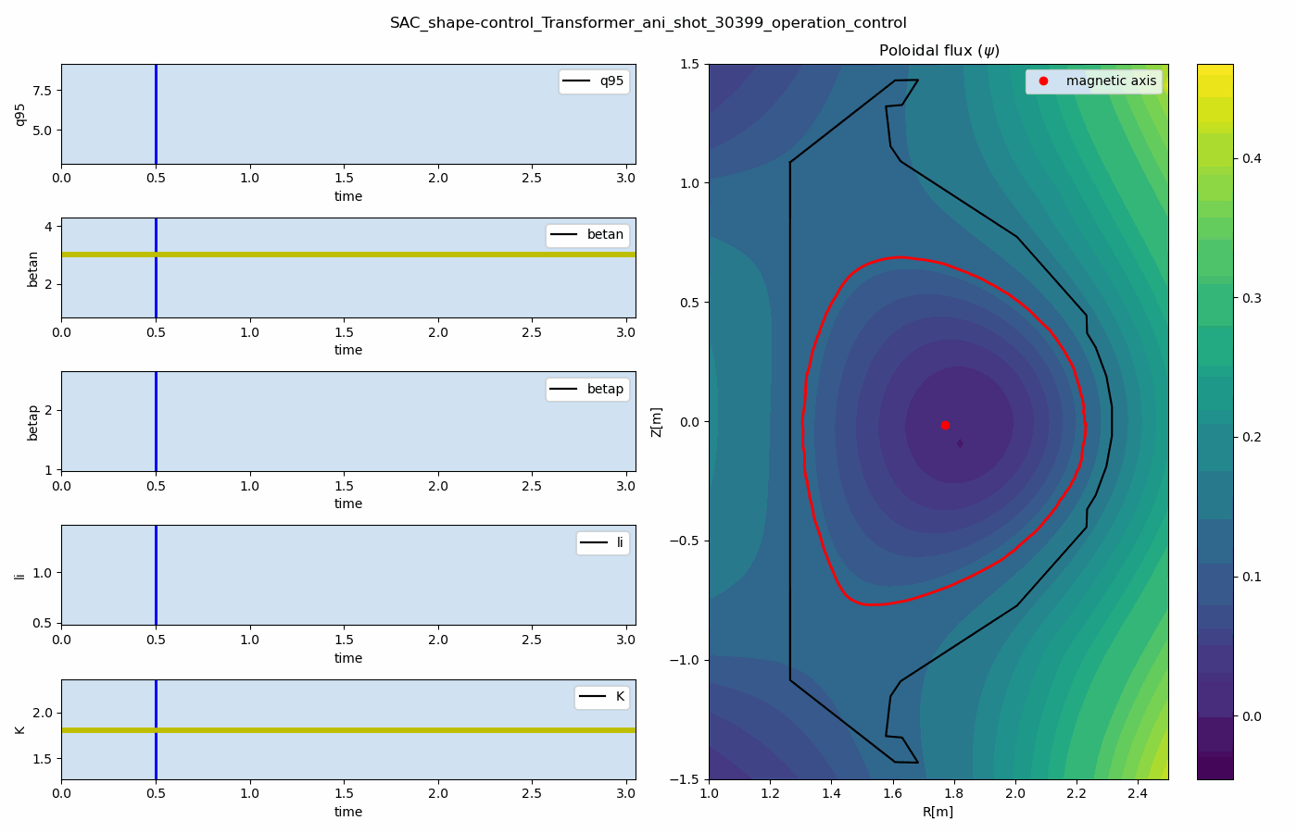
ML application – tokamak plasma operation control
The overall framework for our research: NN-based module for visualizing plasma
PINN-based Grad-Shafranov equation solver
ResNet-based Plasma contour regressor
23

Slide 24
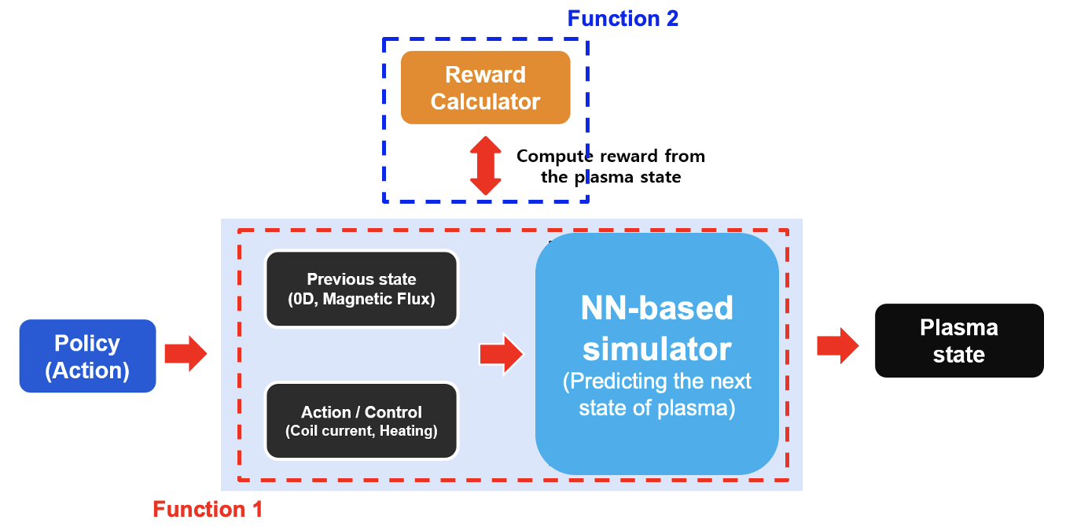
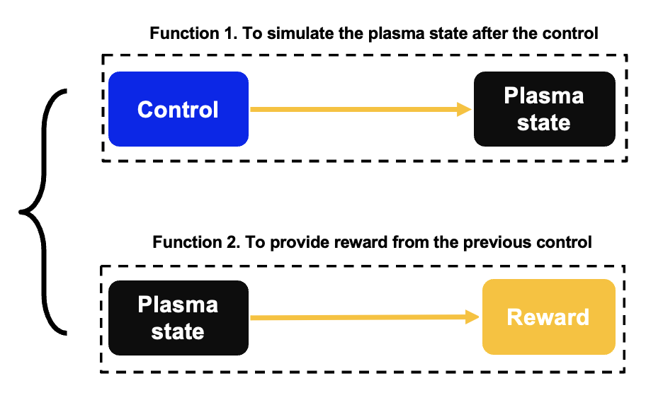
ML application – tokamak plasma operation control
Development of the environment for virtual tokamak operation
Virtual KSTAR environment for RL: Integration of NN-based simulator and reward calculator
Virtual Environment
Integration: Neural networks for predicting plasma state parameters + magnetic flux + contour (shape)
Action: control parameters including NBI, EC heating, plasma current, toroidal magnetic field, and PF coil currents
State: $β_{n}, q_{95}, li, β_{p}, κ, δ, R_{geo}, a_{minor}$

Slide 25
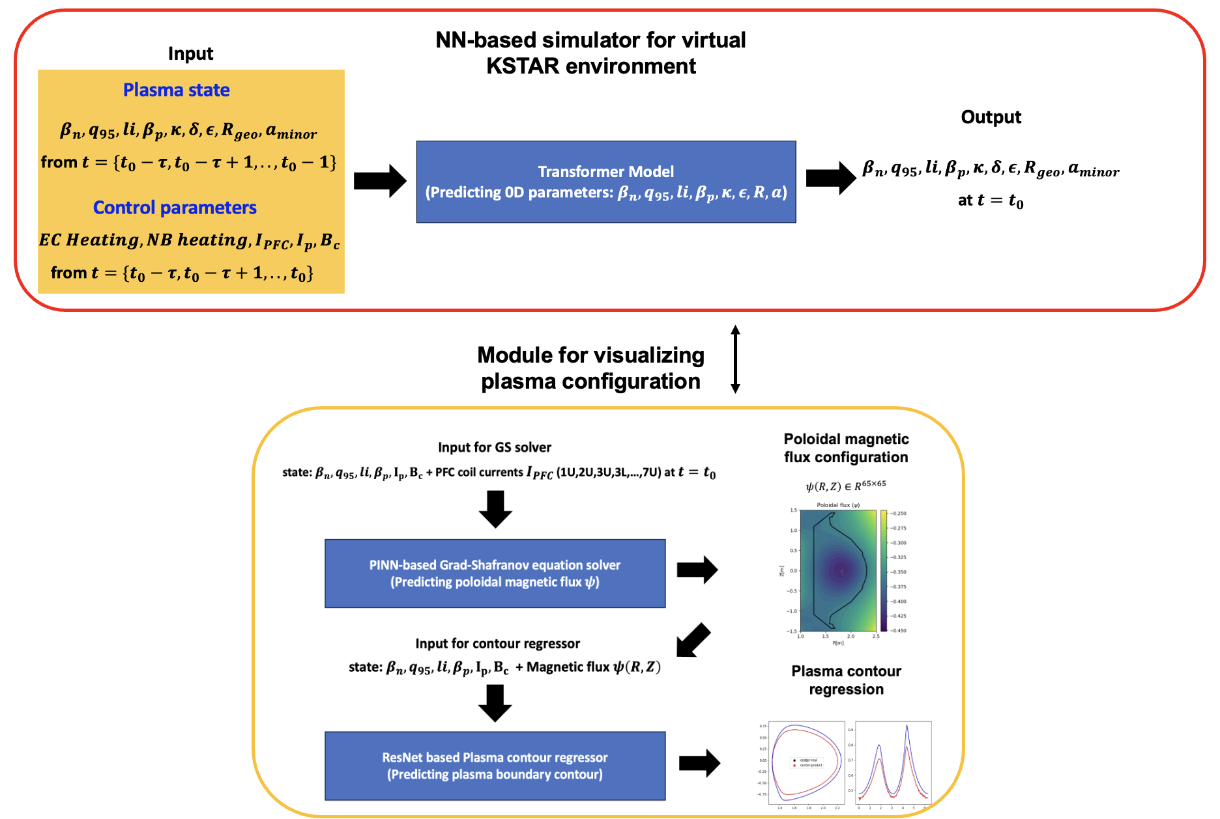
ML application – tokamak plasma operation control
Function 1. Simulation of the plasma state
Overall architecture of Neural network-based simulator + visualization module for virtual KSTAR environment
Overall plasma state information
(Plasma parameters + Magnetic flux configuration)
Time interval: 50ms / Input sequence length: 10 points (500ms) / # of KSTAR experiment: 1840

Slide 26
ML application – tokamak plasma operation control
Function 2. reward engineering based on the plasma state
Reward engineering for 0D parameter control
Reward: key component for agent to provide the feedback for learning the optimal policy
Increase when the agent approach to the target values, decrease when the agent provides wrong actions
The reward must be affected by the current plasma state and the target values.
Tanh function : the range of the output value is bounded + slope increase near the original point (target value = actual value) → Stability of the learning
Reward function for $target_{i}$ at state $s_{t}$ :
$$R{\left(s_{t}\right)}_{i}=tanh⁡(\frac{1}{target value×0.001+\sqrt{{\left(target value−actual value\right)}^{2}}})$$
Ignore NaN
Consider target value scale
Linear scalarization for multi-target control
$$Total Reward=\sum{w_{i}R{\left(s_{t}\right)}_{i}}$$
Single-objective reinforcement learning still valid under the linear scalarization
$w_{i}$: weight value for target i

Slide 27
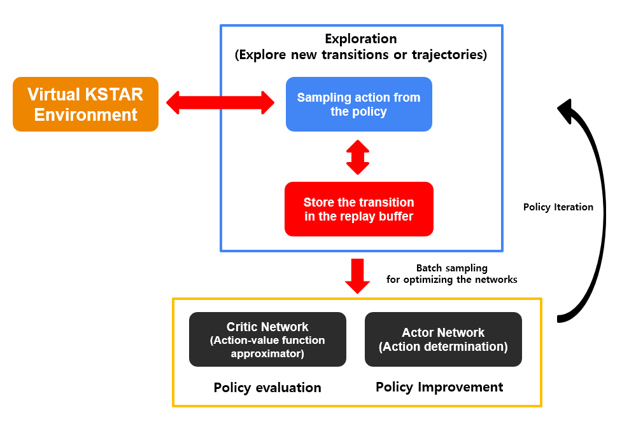
ML application – tokamak plasma operation control
Combining RL framework with virtual KSTAR environment
Integration with RL based controller and virtual KSTAR environment
It is necessary to construct the mutual interaction between virtual KSTAR environment and the agent
For each time, RL controller interacts with virtual KSTAR environment to learn the optimal control policy.
Soft Actor-Critic Algorithm
Action-Value function + Entropy term
Optimal policy: Maximization of the reward + Maximization of the entropy term

Slide 28
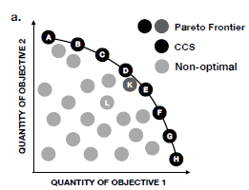
ML application – tokamak plasma operation control
Generalized Policy Improvement Linear Support : MORL
Limits of linear scalarization in multi-objective control
Using linear scalarization method to convert multi-objective problems as single objective problems (Scalarization : $V_{w}^{π}\left(s\right)=f\left(V^{ π}\left(s\right), \vec{w}\right)=\vec{w} ̇ {\vec{V}}^{π}(s)$ → If Pareto-optimal situations, we can not find the optimal policy satisfying multi-objectives.
If the objectives have Pareto-optimal relation, we should find a feasible set of all Pareto-optimal solutions (Pareto-front)
Sample-Efficient MORL algorithm: GPI-LS
We should select weight vectors from infinite subset of the weight vector space: reduction of the search space is needed
Corner weights: the weights contained in the vertices of polyhedron $P=\left\{x∈R^{d+1} \right|V^{+}x≤0, \sum_{i}{w_{i}=1}\}$ $where x=(w_{1},w_{2},…, v_{w})$
It is possible to reduce the search space as the finite set of Corner weights for finding the Pareto-front.
Linear scalarization to find the optimal policy corresponding to the given weight vector
SORL can only find a part of Pareto-front set
Given the set of policies, find the new weight vector that guarantee to achieve the maximum possible improvement via GPI-LS algorithm
Weight vectors should be updated for each policy to get a set of Pareto-front
A set of Pareto-optimal solutions

Slide 29
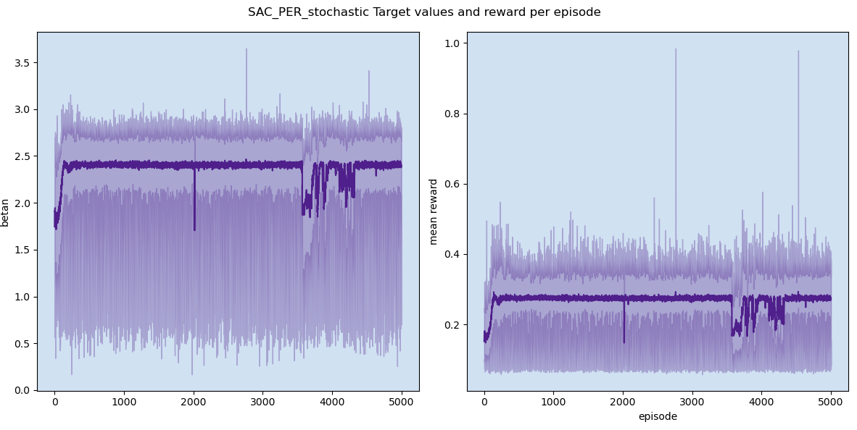
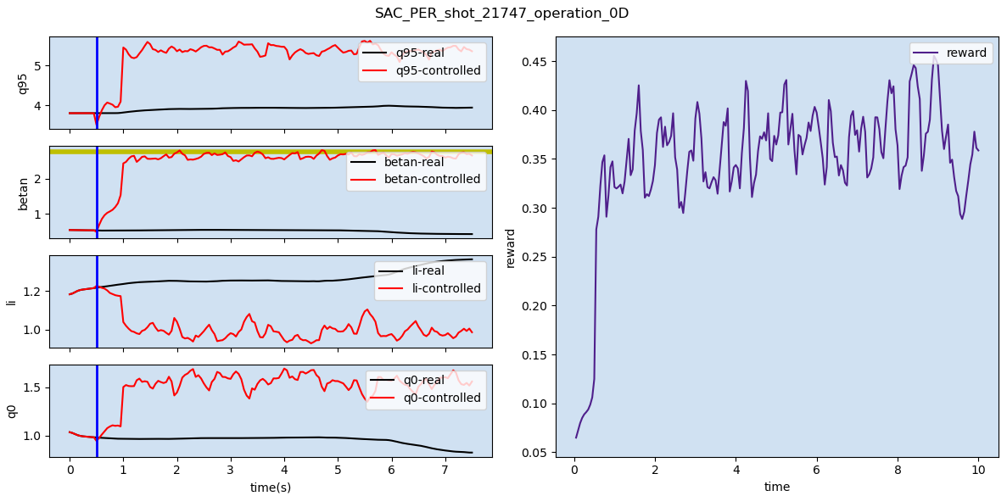
ML application – tokamak plasma operation control
Parameters control in virtual KSTAR environment
Single objective Reinforcement Learning: SAC
Target parameter: beta-n, 2.75
Total episodes for training: 5000 episodes * different initial data used for each episode
Memory buffer: Prioritized experience replay
Stochastic environment: Gaussian noise added due to the stochasticity of real tokamak environment

Slide 30
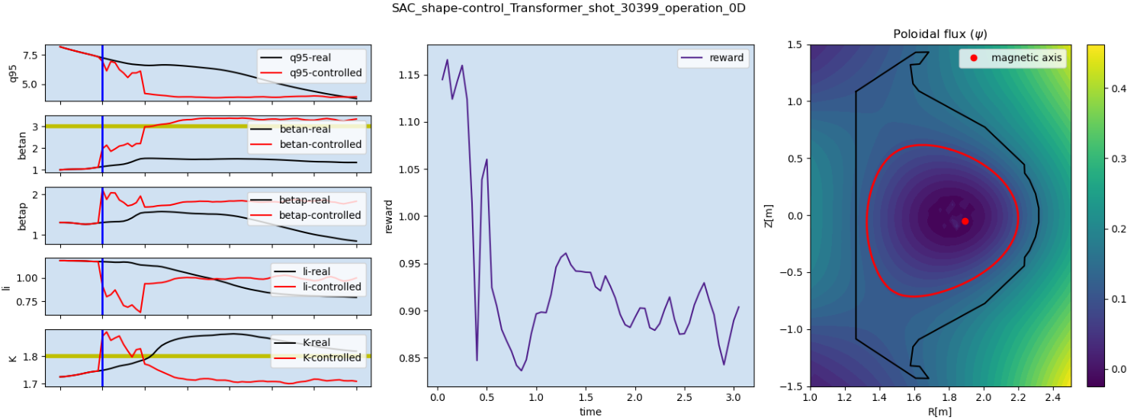
ML application – tokamak plasma operation control
Without GPI-LS: Linear scalarization using fixed weight vector (shot 30399)
Transformer based virtual KSTAR environment operation control
Target: $β_{n}=3.0$, $κ=1.8$ → $β_{n}≥3.0$, $κ=1.7$ (final)

Slide 31
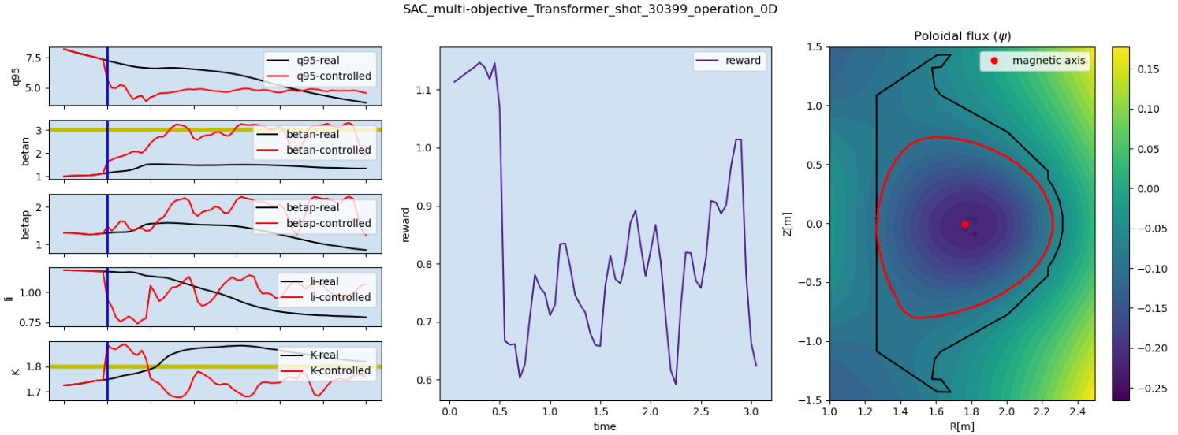
ML application – tokamak plasma operation control
With GPI-LS : Linear scalarization using weight vectors by GPI-LS (shot 30399)
Transformer based virtual KSTAR environment operation control
Trade-off between $β_{n}$ and $κ$
Target: $β_{n}=3.0$, $κ=1.8$ → $β_{n}\sim 3.0$, $κ\sim 1.8$ (final)

Slide 32
ML application – tokamak plasma operation control
Control performance comparison: SORL vs MORL(GPI-LS)
SORL with target: $β_{n}=3.0$, $κ=1.8$
MORL(GLI-LS) with target: $β_{n}=3.0$, $κ=1.8$
F$inal: β_{n}≥3.0$, $κ=1.7$
F$inal β_{n}\sim 3.0$, $κ\sim 1.8$

Slide 33
Conclusion
Data-driven approach based on ML techniques can show interesting results and it will provide impetus for enhancing the fusion plasma research.
We can interpret the ML based models with several ways including the methods mentioned in this presentation.
→ Helpful for finding / understanding the dynamics with a data-scientific view in fusion plasma
Novel algorithms including Physics-encoded neural networks, or Neural ODE, which aim for combining dynamics of systems with the model architectures.
→ Interesting research topics if we apply these algorithms in fusion plasma research

Slide 34
Thank You

Slide 35
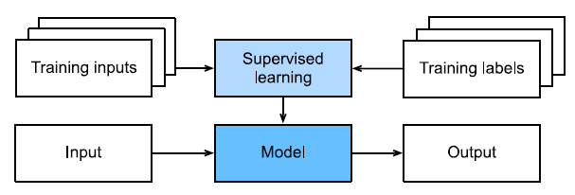
Appendix : Machine Learning and Deep Learning
Machine Learning and Deep Learning
Dataset : A set of data point collected from given prior data distribution
Model : A set of mapping functions which generate the mapping from input data to output data or probability distribution.
Objective function : A set of targets as formal measures of how good the models are. Training or Learning is equal to optimization process of objective function. (We also call it as ‘Loss function’)
Algorithm : A set of methods for optimizing a well-defined objective function given from the task
Stochastic Gradient Descent (SGD)
Momentum method
Adagrad
Adam
Training process per batch data
Simple process for supervised learning

Slide 36
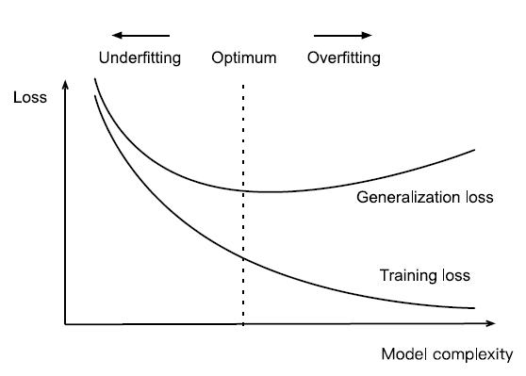
Appendix : Basic concept
Issues on Deep Learning
The goal of machine learning : to learn general patterns / data distribution with given data
If we increase model complexity or use few data compared to the model complexity, generalization error increases
Generalization : Fundamental issue of machine learning about how to discover general patterns from given data
Overfitting : the phenomenon of fitting closer to the training data than to the underlying distribution (prior distribution)
Underfitting : the phenomenon of limiting the reduction of training error due to the low complexity of model or small size of data
Complexity: low
Sample bias: low
Complexity: High
Sample bias: High
Fig 3.6.1. from Dive into Deep Learning, Aston Zhang et al

Slide 37
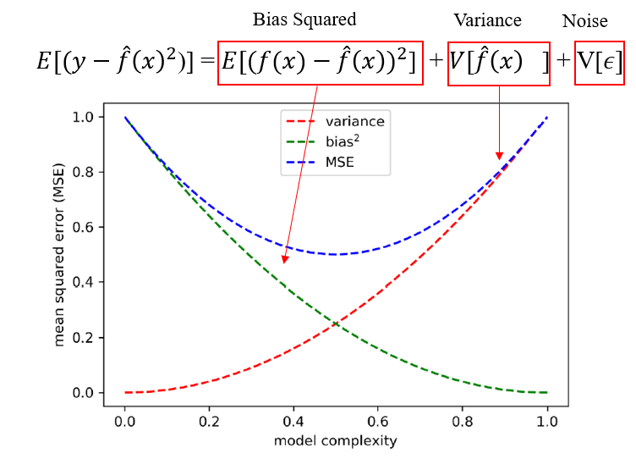
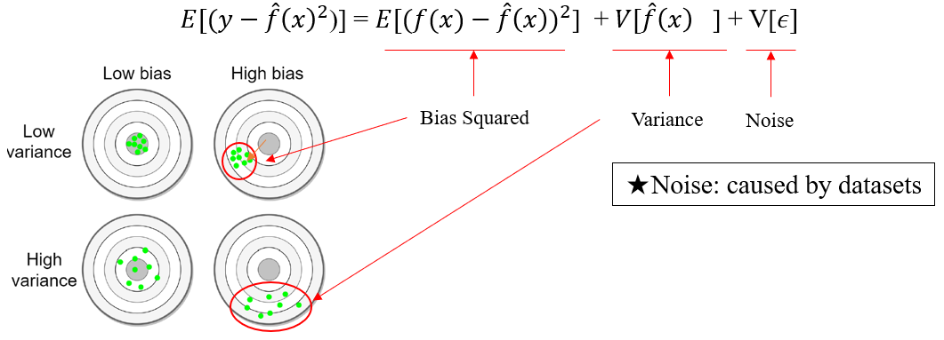
Appendix : Basic concept
Issues on Deep Learning
A good statistical model minimizes the loss by finding the optimal balance between bias and variance
Factors for underfitting
(1) High bias and low variance (2) Not enough features of training dataset (3) The model is too simple (4) Noise on data
Factors for overfitting
(1) High variance and low bias (2) The model is too complex (3) Not enough size of training dataset

Slide 38
Appendix – disruption prediction
Data collection and labeling process
We collected 3 types of data from KSTAR: (1) IVIS data (2) 0D data (3) Multimodal data (IVIS + 0D data)
Data preprocessing: Converting the temporal sequential data with a constant time interval
Data configuration: Training dataset(64%) + Validation dataset (16%) + Test dataset (20%)
Labeling process
IVIS data: 4.76ms
0D data: 4 x 4.76ms
Multimodal data: modifying variable $τ$ x 4.76ms
We relied on frame numbers and the corresponding time recorded in the IVIS image to match disruption time.
We utilized the $I_{p}$ minimum fault time, referring to the point when the plasma current drops below 200kA.

Slide 39
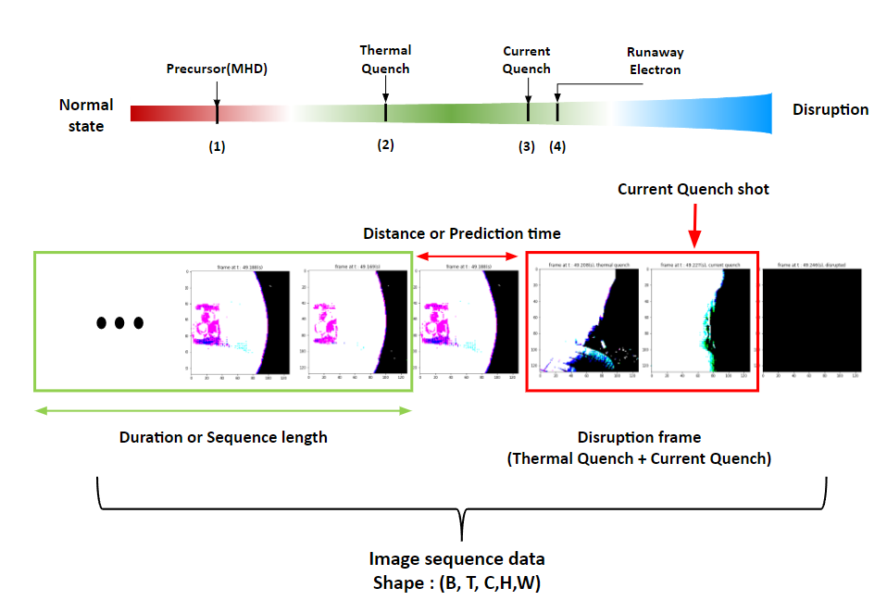
Appendix – disruption prediction
Dataset configuration: IVIS video data
The dataset contains 358 experiments as a video with 210 fps collected from KSTAR IVIS
21 frames as sequence length, image size of 256 x 256, cropped as 128 x 128
Data augmentation technique (e.g. rotation, flipping, shift, Gaussian noise) applied to avoid overfitting

Slide 40
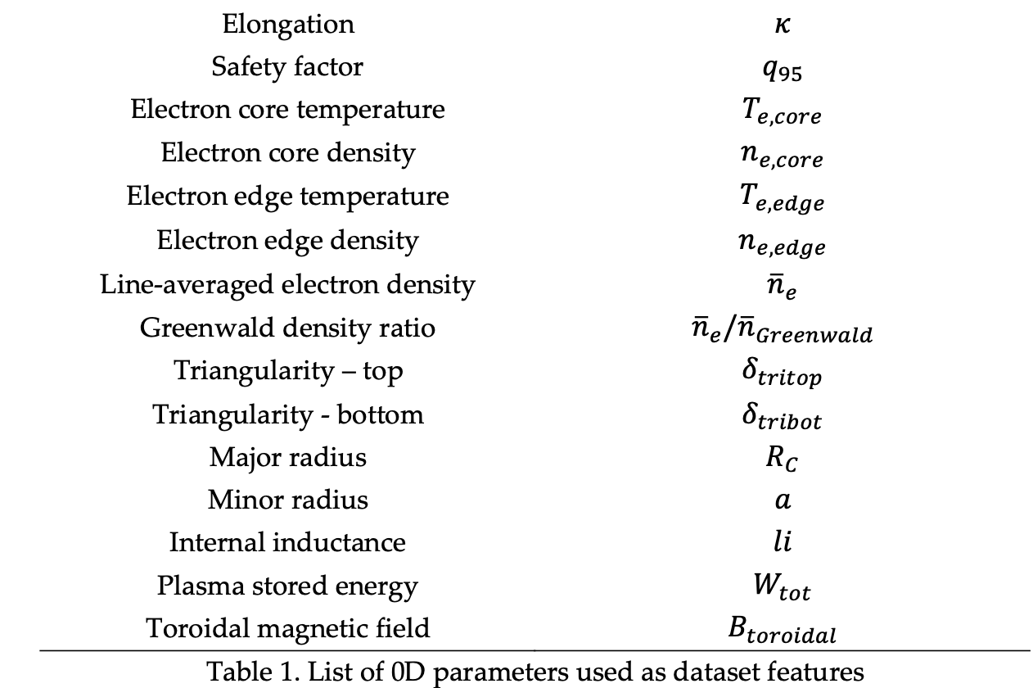
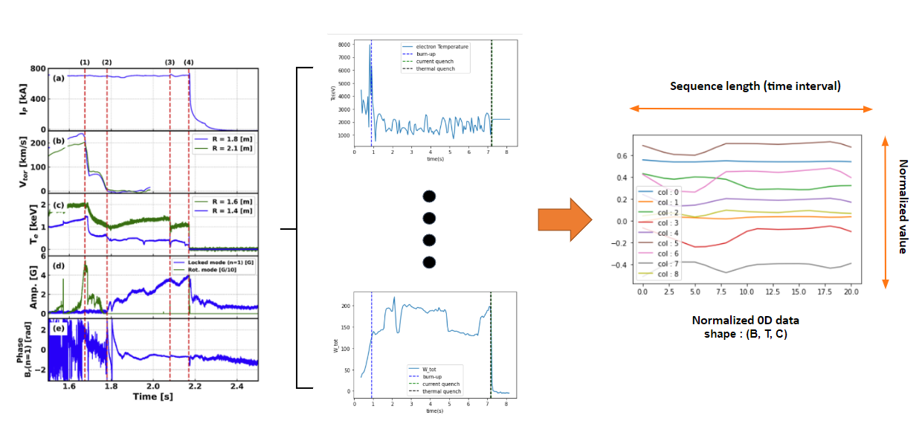
Appendix – disruption prediction
Dataset configuration: Plasma 0D parameters
Different sampling rates from experimental data: 20kHz, 50kHz
Linear interpolation with constant time interval (=19.04ms, 4 times of video fps)
Scaling : Robust scaler was used for ignoring anomality
Data point: 21-points for each input feature

Slide 41
Appendix – disruption prediction
Learning algorithms for imbalance data distribution
Method for learning imbalanced datasets : Boosting vs Alternative objective functions
Boosting : Meta learning technique designed to improve classification performance
Alternative objective functions
Re-Sampling : Over-sampling the minority classes or Under-sampling the frequent classes
Re-Weighting : Assigning weights for different classes or different samples to compensate the importance
Deferred Re-Weighting : 2-stage method (1-stage : training without re-weighting , 2-stage : training with re-weighting)
Focal Loss : reshape the cross entropy with modulating factor ${\left(1−p\right)}^{γ}$ to compensate the importance for hard samples
LDAM Loss : reshape the cross entropy for maximizing class margin according to label-distribution
$$Focal Loss=−\sum{{\left(1−p_{i}\right)}^{γ}logp_{i}}$$
$$LDAM Loss=−\sum{log\frac{{exp⁡(z}_{y}−∆_{y}) }{{exp⁡(z}_{y}−∆_{y})+ \sum_{y≠j}{\exp\left(z_{y}\right)}} where ∆_{j}}=\frac{C}{n_{j}^{0.25}}$$

Slide 42
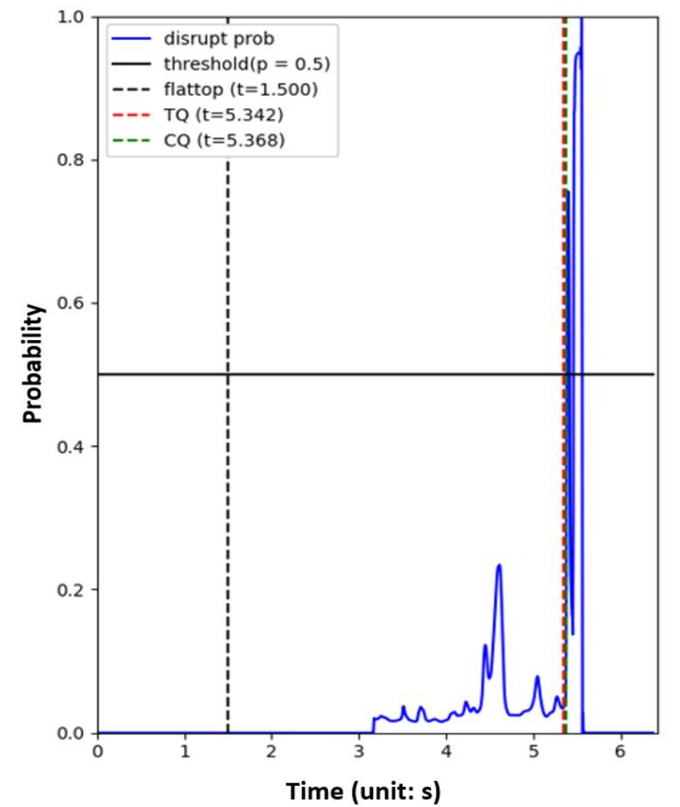
Appendix – disruption prediction
Overall framework of this research
Learning disruption prediction = Binary classification based on plasma state prior to the disruption
Objective of binary classification : to maximize likelihood of output y with given input x → Cross entropy loss is used generally.
Maximization of likelihood = Minimization of loss functions (CE, Focal Loss, LDAM Loss..)

Slide 43
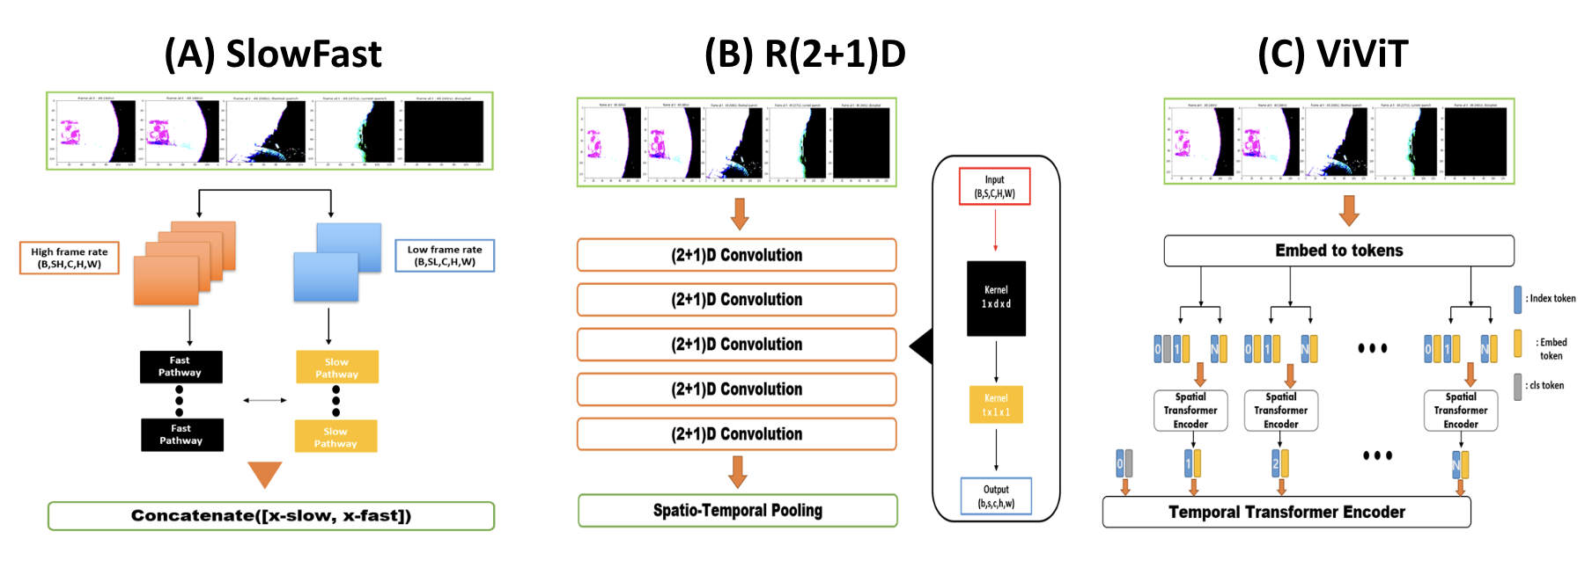
Appendix : Model setup
Development of plasma disruption prediction model using Deep Learning
Vision model for KSTAR IVIS video data
Convolutional Neural Network (CNN) - based model : SlowFast, R(2+1)D
Transformer – based model : Video Vision Transformer (ViViT) → Efficient for small dataset with effective regularization
Different objective functions : Cross Entropy Loss, Focal Loss, LDAM Loss
Different learning algorithms : Re-Sampling, Re-Weighting, Deferred Re-Weighting

Slide 44
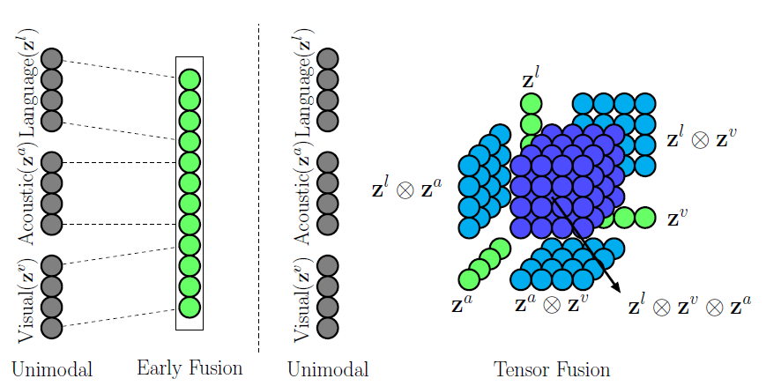
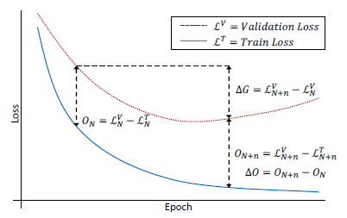
Appendix : Learning algorithms
Learning algorithms for multi-modal data
Muti-modal networks are often prone to overfitting due to increased capacity : Multi-modalities often cause negative effect
Different modalities overfit and generalize at different rates : training multi-modal data can cause sub-optimal problems
Gradient-Blending : Training multi-head model (training single-modal model + multi-modal model) with additional optimization process of overfitting-to-generalization-ratio for blending weights
Tensor Fusion Networks : improved architecture to learn intra-modality (uni-modal interaction) and inter-modality (interaction between different modality) dynamics
Tensor Fusion Networks for Multimodal Sentiment Analysis, Amir Zadeh et al, 2017
What Makes Training Multi-modal Classification Networks Hard?, Weiyao Wang et al, 2020,

Slide 45
Appendix : Evaluation of the disruption predictors
Metrics for evaluation
It is important to predict disruptive phase to alert prior to the disruption event without false /missing alarms.
So, We should monitor both precision and recall score for training and evaluation.
Precision: the ratio of true positives over the predicted positives
Recall: the ratio of true positives over the real disruption
Macro-F1: Mean of the F1 scores for each class → Main metric for this research
Confusion Matrix: Error matrix reporting the number of True-Positive(TP), False-Positive(FP), True-Negative(TN), False-Negative(FN)
Area Under the ROC Curve (AUC): A performance measurement for classifications at various threshold settings
Confusion Matrix
ROC curve
AUC

Slide 46
Appendix
Experimental setup
Cross Entropy Loss : Baseline for comparison
Focal Loss : r = 2, Re-Weighting with inverse class frequency
LDAM Loss : Rescaling class-dependent margin loss with 0.5, Re-weighting with inverse class frequency
Training Epochs : 128 for all experiments
Learning algorithms for use
Data Properties
Re-Sampling : Over-sampling the disruptive data
Re-Weighting : Assigning inverse class frequency to weight loss functions
Deferred Re-Weighting : 4-stages Re-Weighting (update $β$ and weight $w_{j}=\frac{1−β}{1−β^{n_{j}}}$ with respect to epochs)
Image size : 256
Crop size : 128
Sequence length : 21 frames for video data, 21 points for 0D data, 84 frames / 21 points for multi-modal data
Augmentation : Flip, Shift, Brightness, Contrast, Blur for video data

Slide 47
Appendix: Environment for RL
Function 1. Simulation of the plasma state
Overall architecture of Neural network-based simulator for virtual KSTAR environment
Overall plasma state information
(0D parameters + Shape + Magnetic flux configuration)
Time interval: 50ms / Input sequence length: 10 points (500ms) / # of KSTAR experiment: 1840

Slide 48
Appendix : Pareto optimal and Pareto front
Pareto optimal (Pareto efficiency)
Definition of Pareto optimal
Pareto optimal (Pareto-efficient): A situation where no action or allocation is available that makes one individual better off without making another worse off.
Pareto improvement: A new situation where some agents will gain, and no agents will lose.
Pareto-dominated: A situation when there exists a possible Pareto improvement.

Slide 49
Appendix : Pareto optimal and Pareto front
Pareto front: Pareto frontier or Pareto curve
Definition of Pareto front
Set of all Pareto efficient solutions : $P\left(Y\right)=\left\{y^{′}∈Y \right| \left\{y^{′′}∈Y :y^{′′}>y^{′}, y^{′}≠y^{′′}\right\}=φ\}$
$$f :X →R^{m}$$
$Y=\left\{y∈R^{m}\right|y=f\left(x\right), x∈X\}$ : feasible set of criterion vectors in $R^{m}$

Slide 50
Appendix : Pareto optimal and Pareto front
Algorithms for computing the Pareto frontier
The Scalarization algorithm (Method of weighted sums)
The E constraints method

Slide 51
Review : 3 issues of the previous research
Issue 1. Is the KSTAR environment non-stationary?
Stationary: the statistics or attributes are not changeable over time.
Data distribution shift causes non-stationarity: the statistics of the variables change over time
Non-stationarity makes the prediction of the 0D parameters difficult because there is no consideration for data distribution shift in the training process.
How to check stationarity in time series data (global): Augmented Dickey-Fuller test (ADF)
(e.g.) p-value : 0.387 for q95 in shot 30399 / 0.059 for betan in shot 30399 => Non-stationary
Transformer model for handling non-stationarity is already investigated by Yong Liu et al, NeurLPS 2022..!
Transformer architecture, 2017
Figure 1 from Yong Liu et al, NeurIPS 2022

Slide 52
Review : 3 issues of the previous research
Issue 2. Is the KSTAR environment stochastic?
Stochasticity: the property of being a random process
Stationary process = stochastic process in which unconditional joint probability distribution does not change over time.
Non-stationarity $≠$ Stochasticity
Since there are not enough measurements or variables which represent the KSTAR plasma state, the virtual KSTAR environment acts as a partially observable system: POMDP (Partially Observable Markov Decision Process)
Latent variables which affect the next state of the plasma: noise/stochasticity
Virtual KSTAR environment = Stochastic environment
How to learn optimal policy in a stochastic environment?
Recurrent Neural Network based policy network can handle the stochasticity of the environment by taking sequential states as an input
Stochasticity causes a totally different result of the tokamak operation
RNN model architecture
Notes:
Memory based model

Slide 53
Review : 3 issues of the previous research
Issue 3. Can the RL agent reflect the realistic control of the actuator in KSTAR?
The actions (= control values, NBI, EC, Ip, Bc, ..) are bound by physical constraints in a real KSTAR environment, since the change rate of the actuator control is limited.
Conditioning for Action Policy Smoothness (CAPS): Adding the KL divergence terms related to the temporal smoothness and spatial smoothness can regularize the action policy to be smooth control.
No need to modify the reward or training algorithms
Out of range
Action change rapidly
The valid change rate of the actuator control
$$a_{t}$$
$$a_{t+1}\sim π(a_{t+1}|s_{t},a_{t})$$
Out of range
Action space is change over time
Notes:
https://stackoverflow.com/questions/55088497/limit-on-action-change-in-reinforcement-learning

