Slide 1
DECAF analysis of an MHD mode locking forecaster with real-time application
J.D. Riquezes¹, S.A. Sabbagh¹, Y.S. Park¹, K. Erickson³, M.D. Boyer³, J.W. Berkery³, G. Bustos¹ ,M. Tobin¹, V. Zamkovska¹, J. Butt¹, J.W. Lee², J.G. Bak², J. Kim², J. Ko², S.W. Yoon²
¹Department of Applied Physics, Columbia University, New York, NY
²Korea Institute of Fusion Energy, Daejeon, Republic of Korea
³Princeton Plasma Physics Laboratory, Princeton, NJ
NSTX-U / Magnetic Fusion Science Meeting
Monday, Jan. 22 2024
Princeton, NJ

Slide 2
Successfully forecasting the locking of rotating MHD modes can be used to engage disruption avoidance and/or mitigation
Motivation
The stress on or heating of device components caused by high performance plasma disruptions could render reactor scale tokamaks, like ITER, inoperable and in need of costly repair. Forecasting, avoiding, suppressing, and/or mitigating disruptions are then a crucial part of tokamak research and development.
Born-rotating MHD modes can slow down to the wall reference frame and drastically increase heat transport away from the core frequently leading to a plasma disruption
Outline
Introduction to the Disruption Event Characterization and Forecasting (DECAF) code
Physics of the torque balance model used to develop a mode locking forecaster
Diagram of the real-time forecasting algorithm
Performance of the forecaster in predicting a mode locking and subsequent disruption
Triggering avoidance and mitigation strategies
Summary and next steps

Slide 3
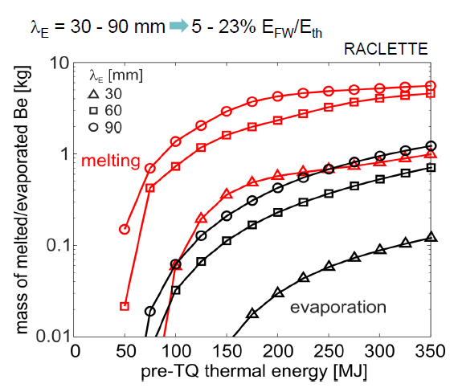
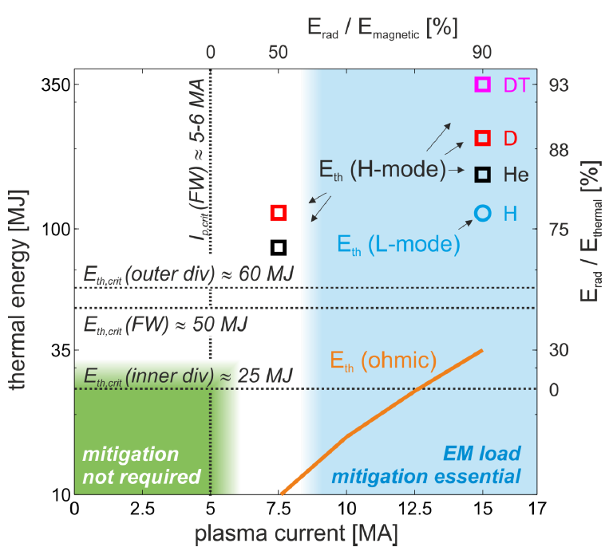
Plasma disruptions pose serious problems to reactor scale tokamak operation
When the operation of a tokamak plasma is disrupted due to growing instabilities it can lead to considerable current and thermal.
For larger scale tokamaks, these loads are capable of damaging plasma facing components and key diagnostics leading to costly repairs and decreasing the machine lifetime.
For reactor scale tokamaks, like ITER, disruptions pose an even greater risk. Only one or two category III major disruptions (long current decay time and maximum halo currents of 8.2 MA for downward VDEs) are allowed to happen [1]. For disruptions rates of 1% more than 95% of disruptions will need to be mitigated [8]
Even ohmic, full current disruptions can cause melting damage
[2] Lehnen, et. al. (2014).
[1] Lehnen, et. al. (2015).
Notes:
Get DOE report 2015 that makes reactor needs in disruption prediction / control. Show numbers and establish a goal.

Slide 4
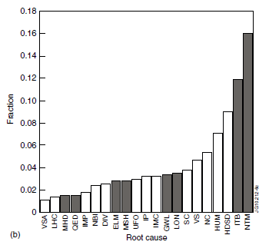
Rotating tearing modes are a frequent precursor to disruptions
In ideal conditions, tokamaks form 2D flux surfaces, each of a specific safety factor q. At rational q surfaces, finite resistivity allows for the reconnection of magnetic surfaces and the formation of island chains. Islands significantly increase transport and reduce performance.
First observed in TFTR [4], neoclassical tearing modes (NTM) are modes of island chains that are driven by helical holes in bootstrap current and flattening of pressure profiles [5]
In a survey of the 2000-2010 JET database the presence of an NTM was identified as the predominant root cause of a disruption [3]
Typically, it is the locking of NTMs to the wall reference frame that precedes the plasma disruptions [6]
Root cause of disruptions that had a stored energy of W > 1 MJ or caused a force of F > 1 MN. NTMs account for 16% of disruptions!
[3] De Vries, et. al. (2011).

Slide 5
Multi-criteria Mode Forecasting Model
Notes:
-Jumped without the NTM intro. Discontinuous.
- Want to have set up the intro to the mode so then I can jump into proposed work and models.
-Went too fast through it as well
-Too much info into 8-10. Expand.

Slide 6
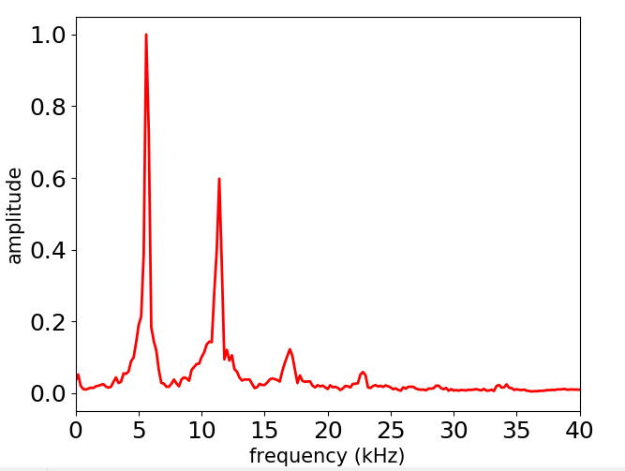
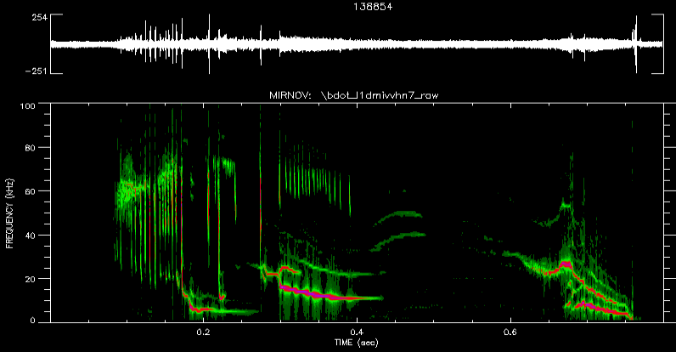
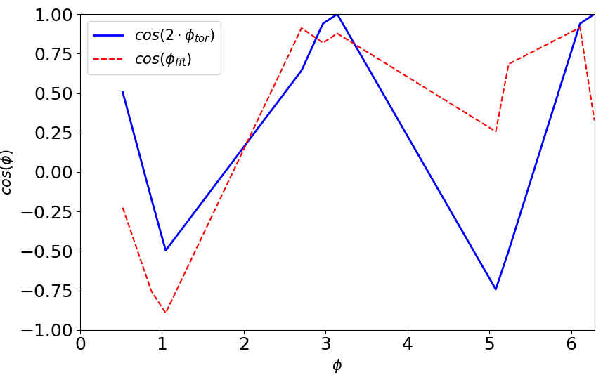
Spectral decomposition of probe signals used to identify the mode number and rotation frequency
Consecutive short time FFTs give the phase and amplitude of a signal in frequency and time
The phase shifts at every frequency and time point for the channel array should match with the expected toroidal angle dependence of the predominant n mode.
NSTX shot 138854
time = 0.72 s
NSTX shot 138854
Channel at φ = 302.8°
(rad)

Slide 7
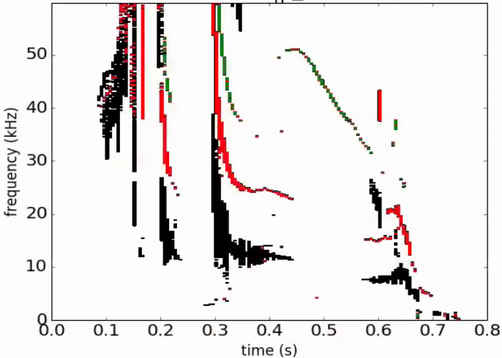
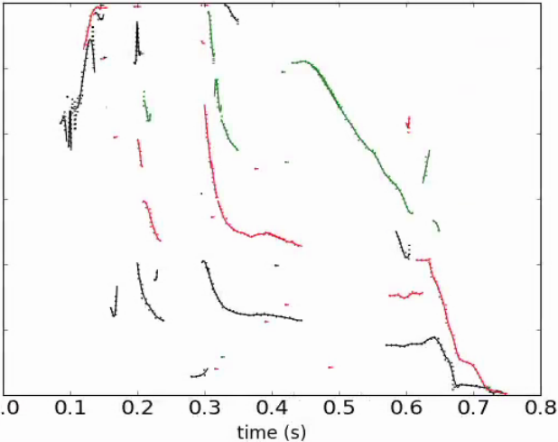
Simplified generated spectrogram for further analysis of rotating MHD modes
Selected peak amplitude frequency from mode bandwidth
Performed low pass filter smoothing on frequency curves
Spectogram
Rotating MHD Events
shot 130198

Slide 8
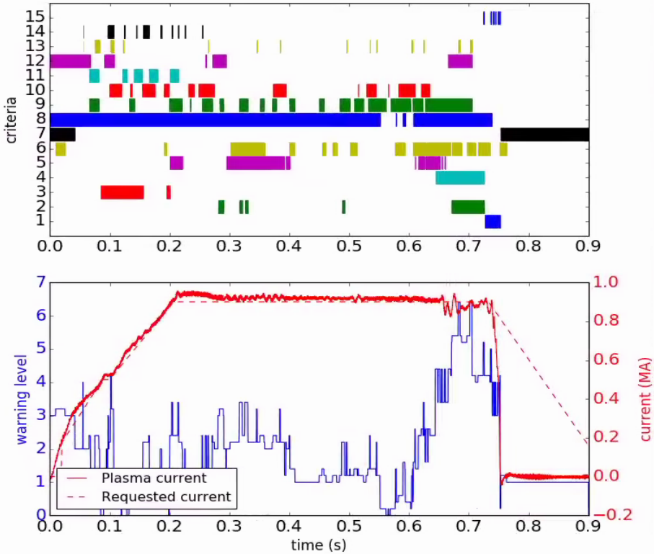
Severity of mode determined from preliminary criteria based on rotating MHD analysis and relevant plasma signals
Criteria | Description
15 | Locked n=1 strong
14 | Outer core rotation
13 | Mid core rotation
12 | Low core rotation
11 | Dec. outer rotation
10 | Dec. mid rotation
9 | Dec. core rotation
8 | Low li
7 | β_{N}/li range
6 | Decreasing β_{N}
5 | Strong mode
4 | Bifurcation
3 | High-freq
2 | Low-freq
1 | Lock freq
NSTX shot 130198
Low frequency magnetic probes
Rotation Profiles
$β_{N}$ and internal inductance
Mode amplitude
Past bifurcation
Magnitude of frequency
Criteria cover magnetic and kinetic properties of the plasma relevant to rotating MHD mode evolution
Summed criteria with the appropriate weights to generate disruption warning level
Feasibility of this approach in real-time is dependent on the availability of the required signals for each condition in real-time
SAFE
Δt
Notes:
- Don’t give impression that this is flawed. No need to show all latest results. Can show results for one device and discuss the possible and path to expanding to other devices and diag. sets (limitiations). Will show maturity without answers. Too skewed with latest work. Make it more open-ended and exploratory

Slide 9
Torque Balance Model

Slide 10
Torque balance model can reproduce the key mode dynamics approaching a locking state
Originally formulated by Fitzpatrick [9] to develop tearing mode theory but more closely following the forms used by Reimerdes [10] and Logan [11] for experimental measurements of error fields and torques, respectively. A torque balance model for the plasma can be used to understand mode locking dynamics. Components in the model include:
Torque from auxiliary power: $T_{aux}$
Torque from drag due to plasma viscosity: $T_{2D}$
Torque from electromagnetic (EM) drag of the mode: $T_{mode}$
Dragging torque components are defined with respect to the mode rotation by making simplifying assumptions
Can assume a “no-slip” or “slip” condition of the plasma past the X-points in island chain
$T_{mode,no−slip}=−\frac{k_{1}}{Ω}$ $T_{mode,slip}=−\frac{k_{2}Ω}{1+k_{3}Ω^{2}}$ , where the coefficients $k_{i}$are associated with the mode amplitude or island width.
Establish a characteristic perpendicular viscous diffusion time for the viscous drag
$T_{2D}=−\frac{\left(IΩ\right)}{τ_{2D}}$
$$\frac{d(IΩ)}{dt}=T_{aux}+T_{2D}+T_{mode}$$
Notes:
- Have to introduce better. What are the islands? What is slipping?
- Thought I would introduce results but I already downselected the model.
- Try to implement slipping. Add as a proposal, with slide of the slow rotation solution.
-More practical than Cihan. Want to show that it can recover or sit at low rotation

Slide 11
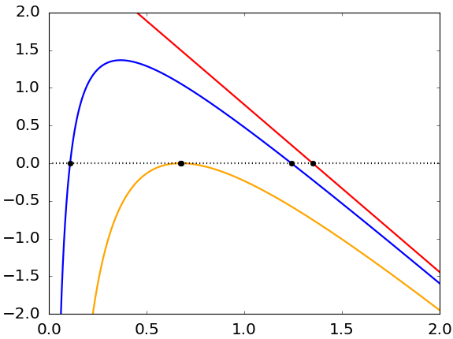
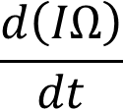
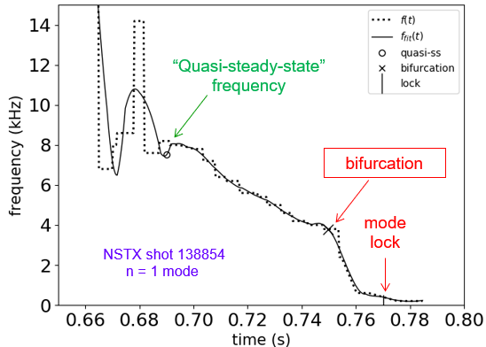
The inflection frequency can be used as a forecasted rotation threshold below which a mode locking is expected
For steady state solutions: $\left(\frac{d\left(IΩ\right)}{dt}=0 \right)$
$k_{1}$ = 0 : “red curve”
No mode present
$k_{1}$ < $\frac{{T_{aux}}^{2}τ_{2D}}{4I_{avg}}$: “blue curve”
Two steady state solutions
$k_{1}$ = $\frac{{T_{aux}}^{2}τ_{2D}}{4I_{avg}}$ : “”orange curve”
One steady state solution ($\sim \frac{Ω_{0}}{2}$)
Bifurcation
$$\frac{d\left(IΩ\right)}{dt}=T_{aux}−\frac{k_{1}}{Ω}−\frac{\left(IΩ\right)}{τ_{2D}}$$
$$Ω_{0}$$
Archetypal example
$$Ω_{inf}=\sqrt{\frac{k_{1}τ_{2D}}{I_{avg}}}$$
Bifurcation and Inflection
At close to half the steady state natural rotation frequency ($Ω_{0}$) [9]
Notes:
Showing results, not proposal. Add the slipping slide
-Can have three versions of torque balance model, no slip, slip, and island width relationship.

Slide 12
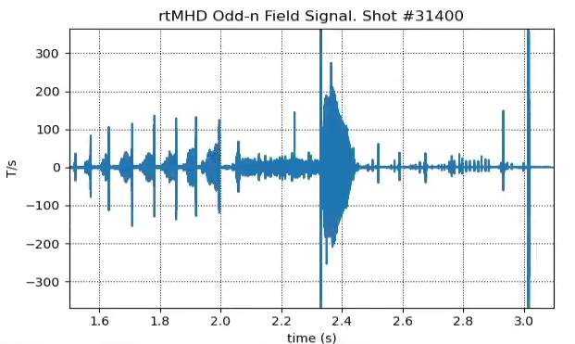
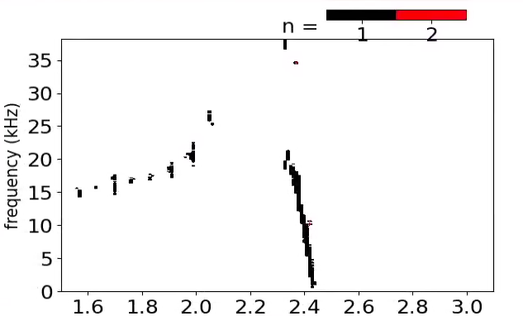
The DECAF code offers a general physics-based approach to disruption forecasting and includes a mode locking forecaster
A toroidal array of Mirnov probes picks up the field oscillations and signature of the mode.
Spectral decomposition or a more straightforward zero-crossings analysis used to identify the mode number, amplitude, and rotation frequency
Threshold conditions on these mode parameters are used to characterize the rotating MHD modes as precursor events to a plasma disruption
The locking of modes along with other physics based and technical events are used to identify the causal chains that lead to plasma disruption. This is the basis for the development of the automated and device-general DECAF code.
$\dot{B}$ (T/s)
KSTAR shot 31403
NSTX shot 130198
chain of events

Slide 13
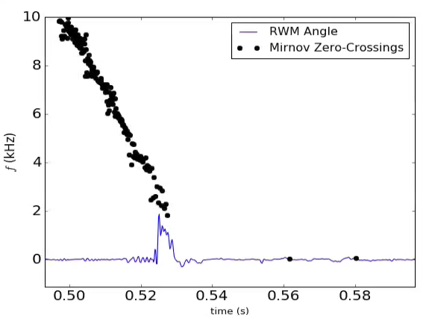
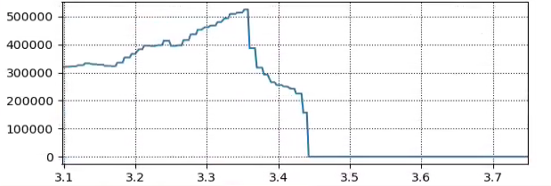
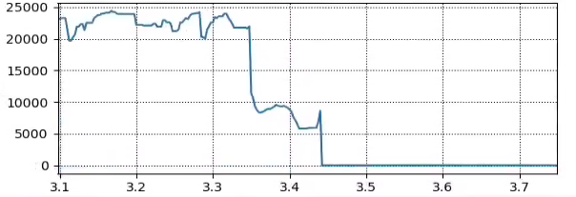
Combination of magnetic pick up and stored energy measurement conditions can be used to determine when a mode locks
Zero-Crossings analysis of opposite Mirnov probes measures the rotation frequency of the mode
Ignoring periods between zero-crossings when periods too small (high rotation frequency) or amplitude too small (noise or weak modes)
RWM sensors and saddle coils can capture lower frequency mode activity (down to few hundred Hz)
Can complement a rotation threshold with a fractional change in stored energy threshold to better identify a mode locking
NSTX shot 126963
$W_{MHD}$ (J)
$f$ (Hz)
KSTAR hot 31540
time (s)

Slide 14
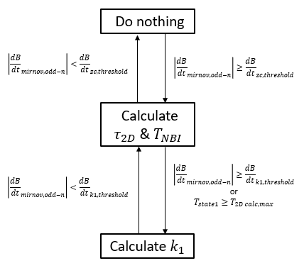
The coefficients in the torque components are determined in different regimes of mode rotation/amplitude
While the mode is highly rotating the viscous drag is larger than the EM drag. The characteristic perpendicular viscous diffusion time $τ_{2D}$is calculated and driving torque $T_{aux}$ can be calculated in this regime
$T_{aux}$ is set to a value that makes $τ_{2D}$ ~ $τ_{E}$.
Energy confinement time is estimated as $τ_{E}=\frac{W_{tot}}{P_{NBI}}$
$k_{1}$ is then calculated using the average value of the previously calculated $τ_{2D}$
Moment of inertia is calculated from line average density measurements and assumed constant throughout mode dynamics
This computational approach is used in both offline and real-time DECAF analysis
$$\frac{d\left(IΩ\right)}{dt}=T_{aux}−\frac{k_{1}}{Ω}−\frac{\left(IΩ\right)}{τ_{2D}}$$

Slide 15
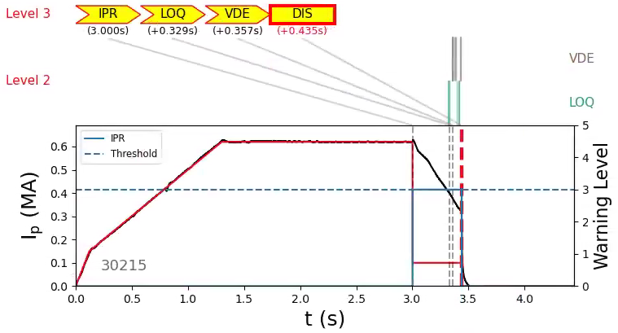
Four real-time software elements were installed and tested for use in real-time disruption forecasting
KSTAR PCS
r/t DECAF Event Modules
Offline and real-time DECAF codes follow similar design; DECAF events added as modules
VDE
GWL
LON
r/t DECAF measurements
IPR
KSTAR plasma controlled shutdown
WPC
DECAF Event Handler
rtMHD
LOQ
rtECE
PRP
rtECEI
RWM
KSTAR PCS Alarms category
KSTAR disruption mitigation
LTM-f
LTM
r/t analysis
DIS
rtEFIT
MHD
HLB
Disruption avoidance actuators
ELM
Controlled shutdown triggered
(using pre-programmed “event”)

Slide 16
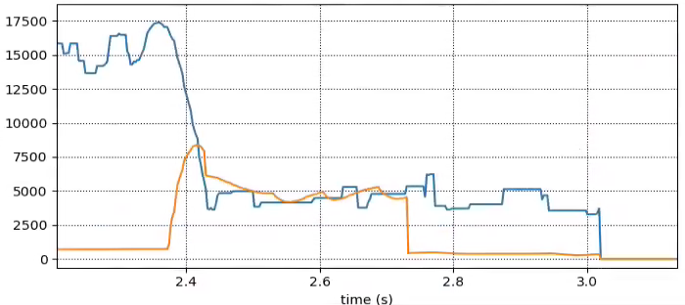
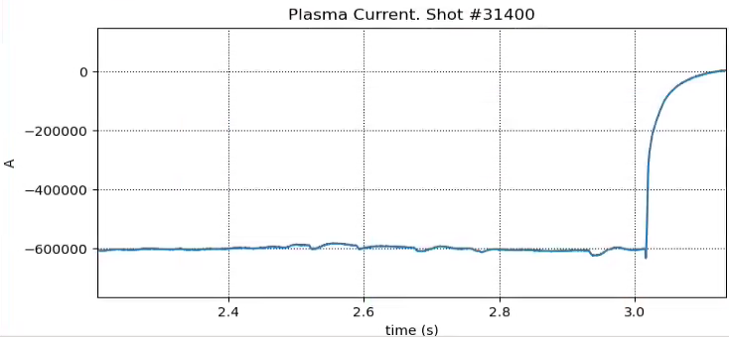
Real-time forecaster of locked modes shows good performance in forecasting mode locking and subsequent disruptions
Successfully forecasted ~50 shot with mode locking that disrupted in KSTAR 2022 run. Actuation windows of up to 2 seconds for KSTAR plasmas.
Offline and real-time analysis in close forecasting agreement
rotation
$f$ (Hz)
$f$ (Hz)
inflection
~600 ms
$I_{P}$ (A)
shot 31400

Slide 17
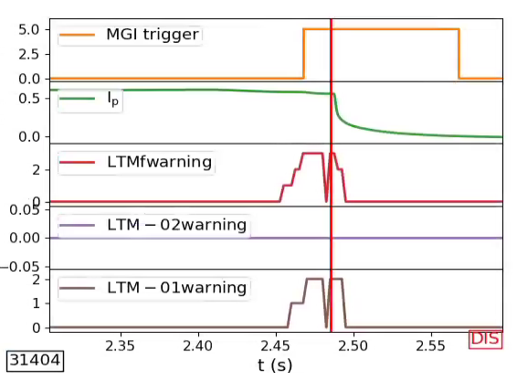
Real-time forecaster can trigger a massive gas injection as a disruption mitigation strategy
Mitigation trigger
frequency (Hz)
time (s)
Mode torque balance warning
Once the mode rotation decreases and crosses the calculated inflection frequency threshold the disruption mitigation strategy is triggered.
A forced shut-down occurs after the MGI is triggered
Mode frequency warning
Stored energy drop warning

Slide 18
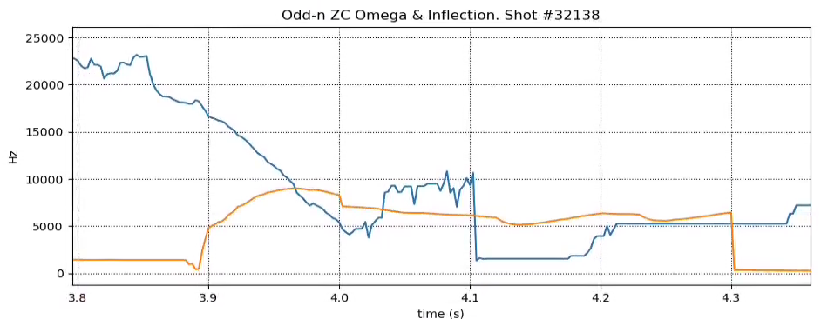
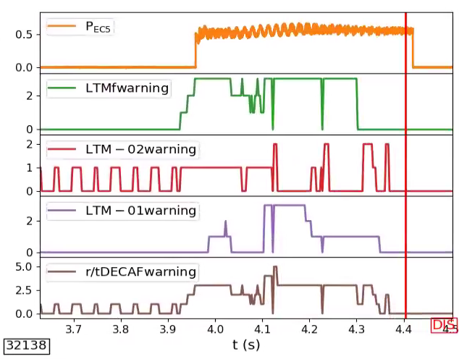
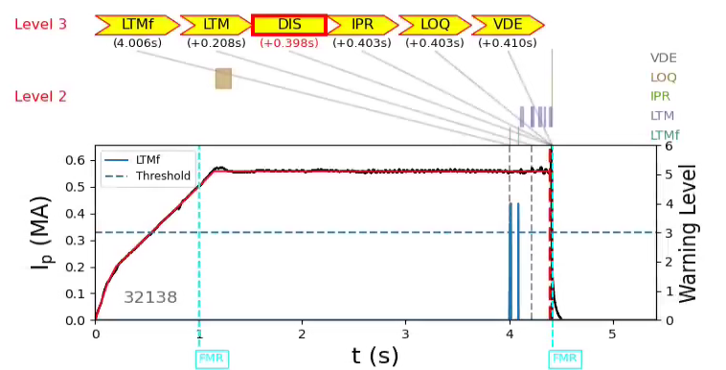
Triggered ECCD actuation of the rotating MHD mode leading to a 400 ms window before the plasma disruption
Actuation trigger
P (MW)
frequency (Hz)
Mode torque balance warning
time (s)
Mode frequency warning
Stored energy drop warning

Slide 19
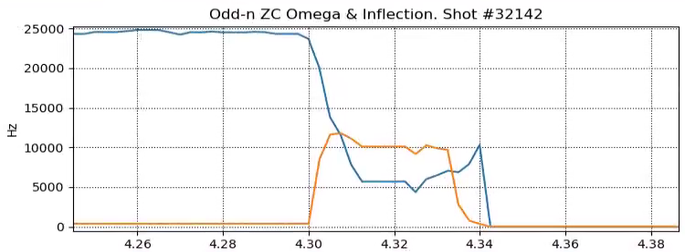
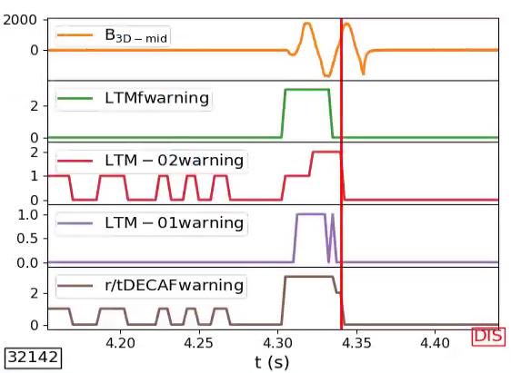
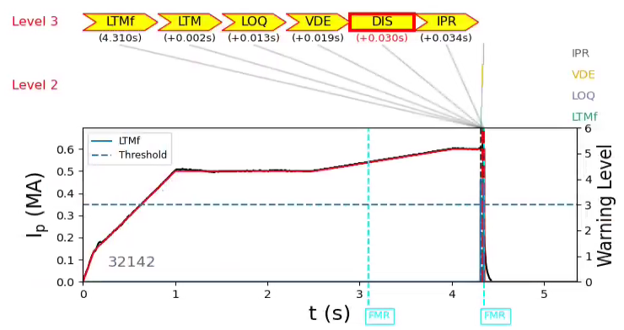
Successfully triggered an n=1 toroidally rotating field that temporarily recovered the mode rotation before locking
Mode rotation picks back up temporarily
frequency (Hz)
Mode torque balance warning
time (s)
Mode frequency warning
Stored energy drop warning

Slide 20
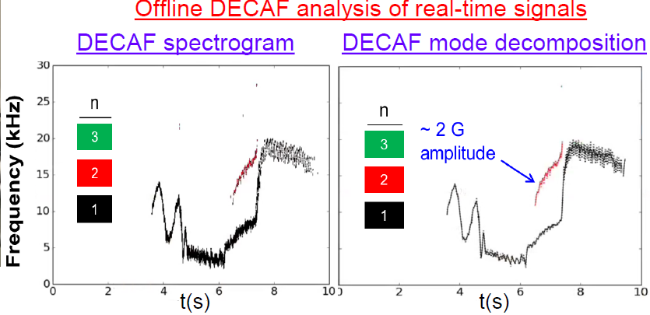
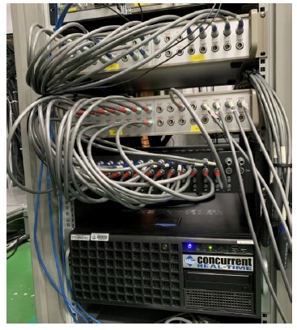
Real-time MHD diagnostic setup in KSTAR
Real-time spectral decomposition (FFT) of Mirnov probes is in final stages of being installed in KSTAR
Would allow for real-time analysis of mode dynamics before the bifurcation

Slide 21
The LTM forecaster and broader DECAF code is a promising tool for the purposes of disruption prediction, avoidance, and mitigation
Summary
Developed an algorithm to characterize and forecast the locking of rotating MHD modes as part of the general DECAF code.
Implemented the forecaster in the KSTAR PCS showing high accuracy in predicting disruptions caused by mode locks
Successfully triggered various avoidance and mitigation strategies (ECCD, 3D n=1 applied fields, and MGI)
Next Steps
Optimize the actuation strategies for successful avoidance
Use the real-time calculated spectrogram to improve the mode lock forecaster and characterization
Add more real-time precursor events in KSTAR to better forecast disruptions

