Slide 1
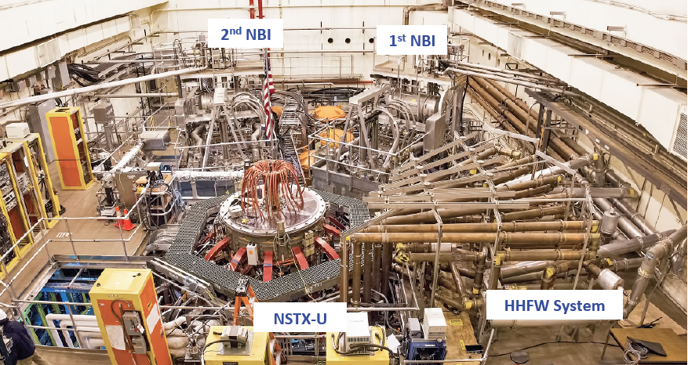
The National Spherical Torus Experiment Upgrade – Advancing the Physics of Fusion Energy
Dr. Jack Berkery, Princeton Plasma Physics Laboratory
March 1, 2024, University of Minnesota

Slide 2
Outline
Introduction
  Princeton Plasma Physics Lab (PPPL)
  Quick fusion overview
  Tokamaks, spherical tokamaks
The National Spherical Torus Experiment Upgrade (NSTX-U)
  Upgraded magnets, heating, current drive
  Testing the physics of: particle and energy confinement and turbulent transport, long-pulse operation with driven current, potentially damaging instabilities, handling very high heat fluxes
Spherical Tokamaks being considered as Fusion Pilot Plants
  NSTX-U will provide the physics knowledge for confident projection

Slide 3
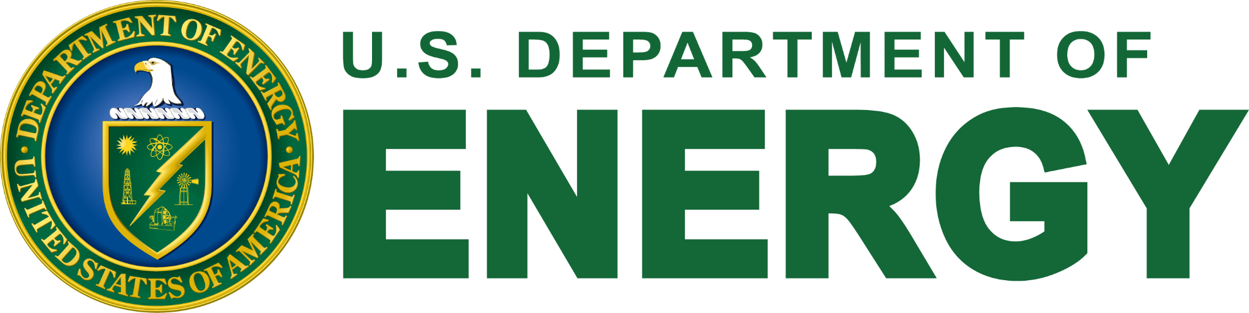
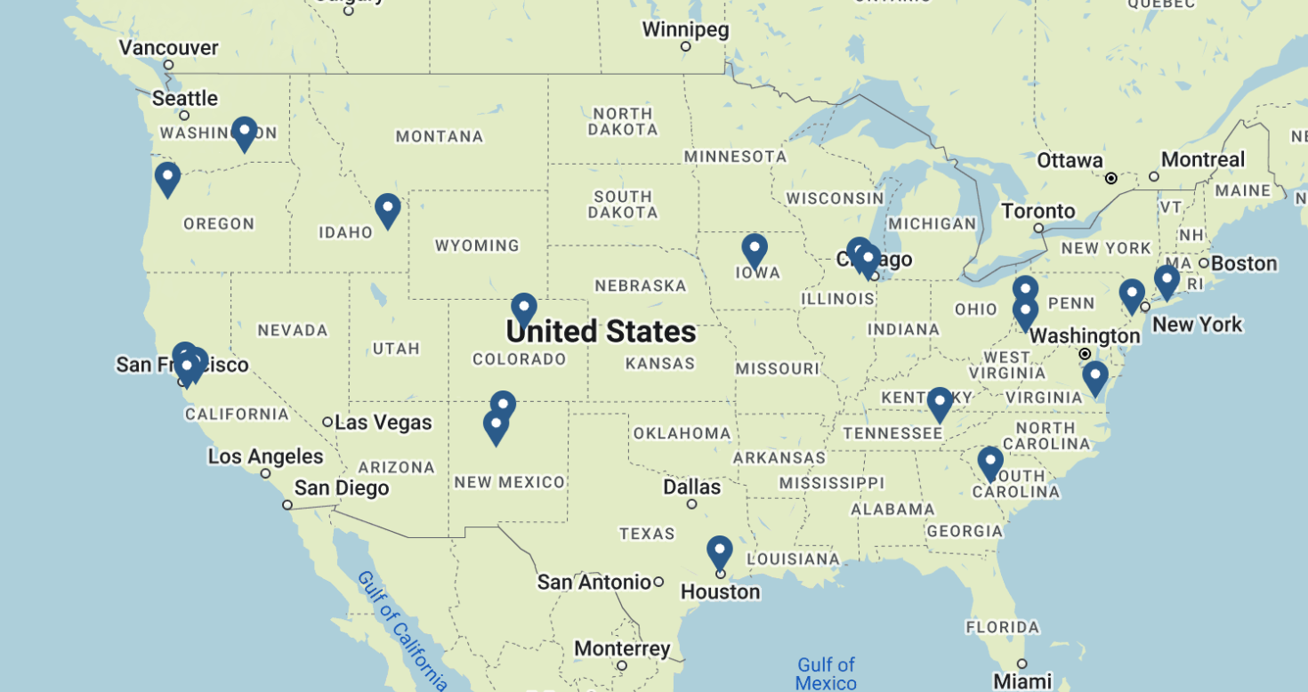

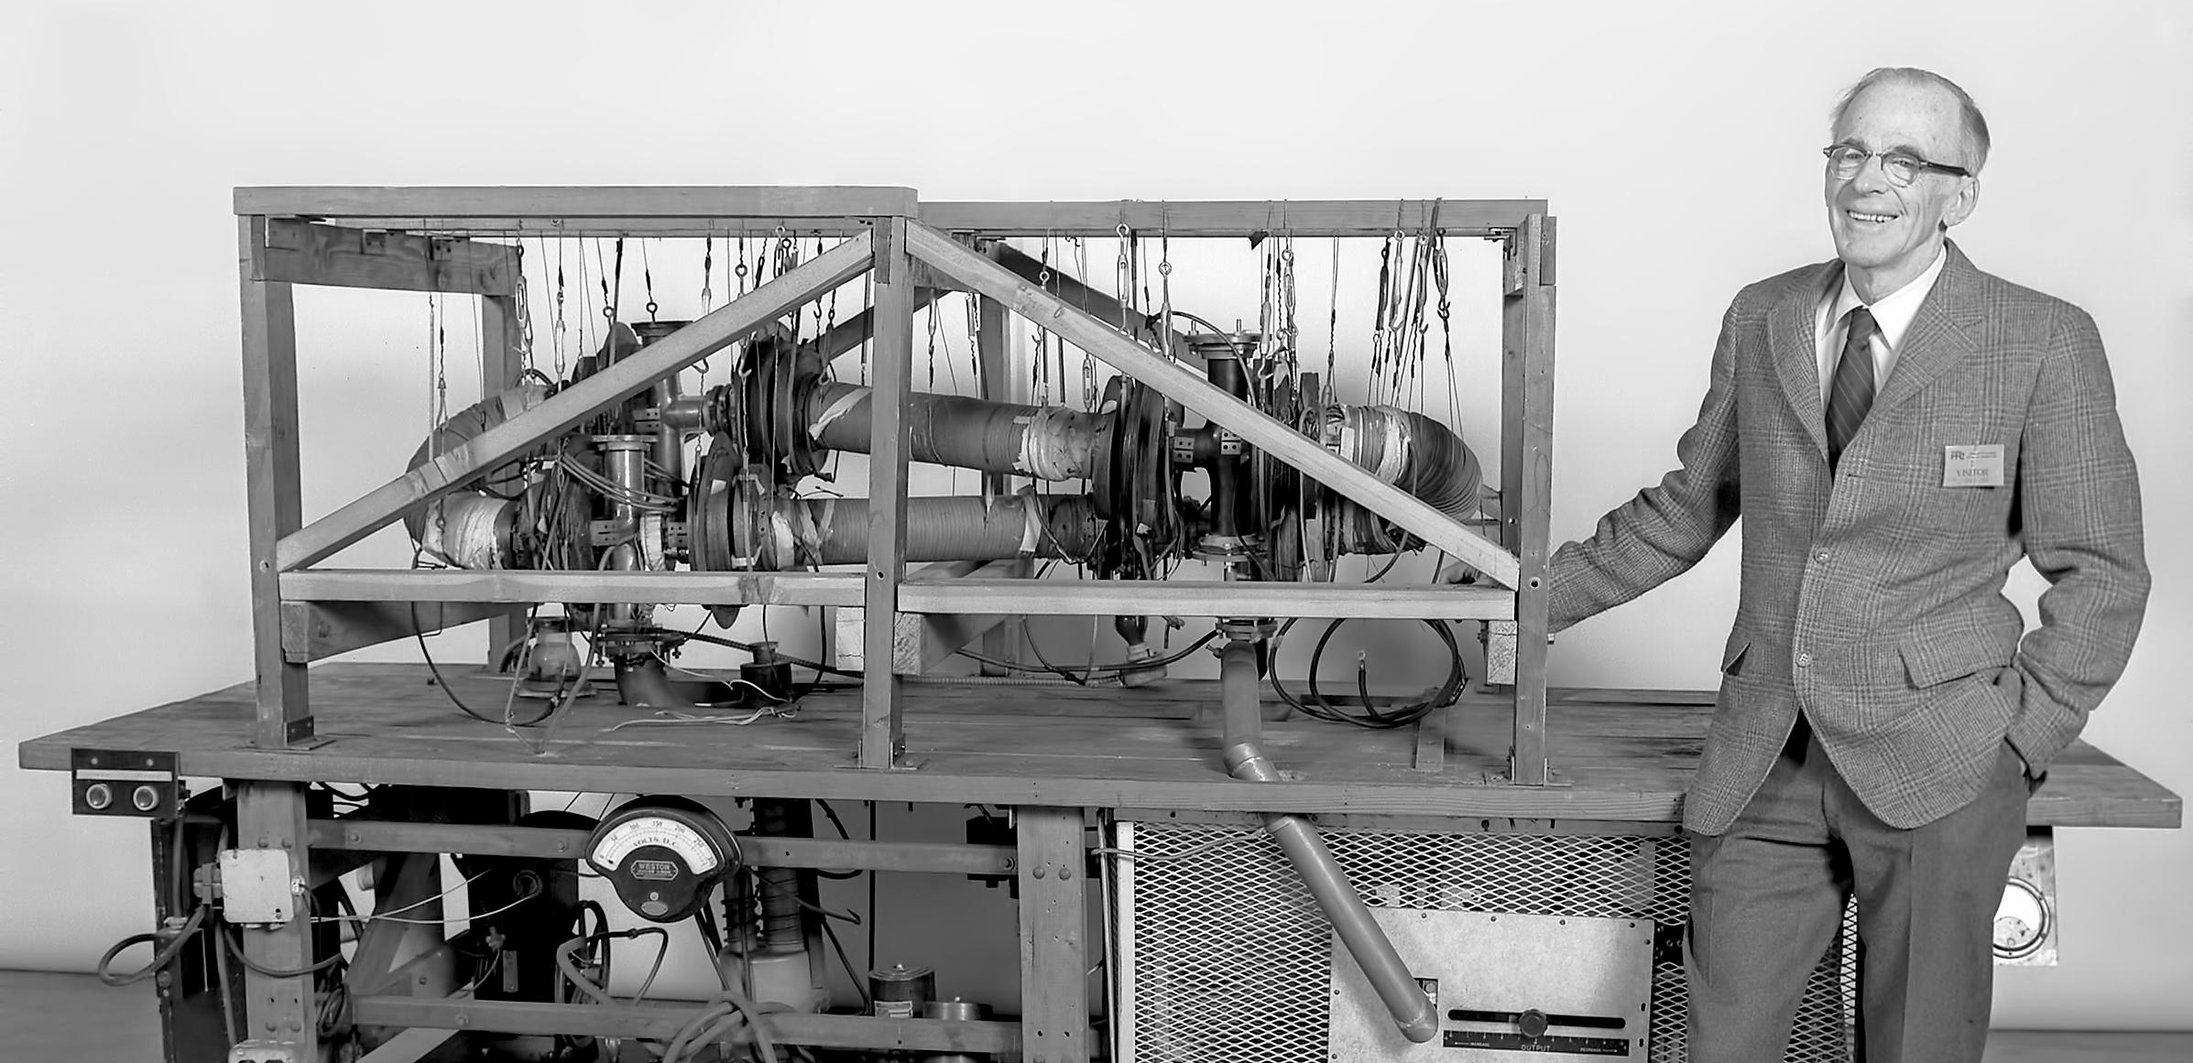

The Princeton Plasma Physics Laboratory
One of 17 Dept. of Energy National Labs
Magnetic fusion research at Princeton began as a classified government project in 1951 under renowned physicist Lyman Spitzer Jr., using the code name “Project Matterhorn.”
PPPL Today: 700+ employees, $150 Million+ government funding, 300+ annual publications
Managed by

Slide 4
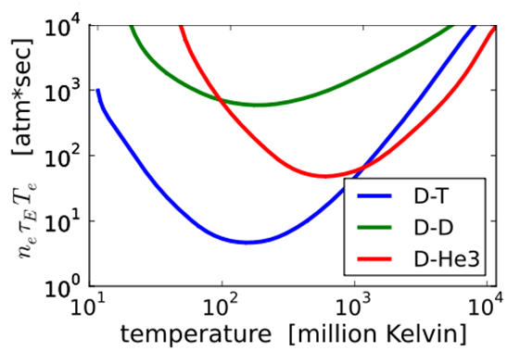
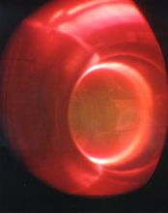
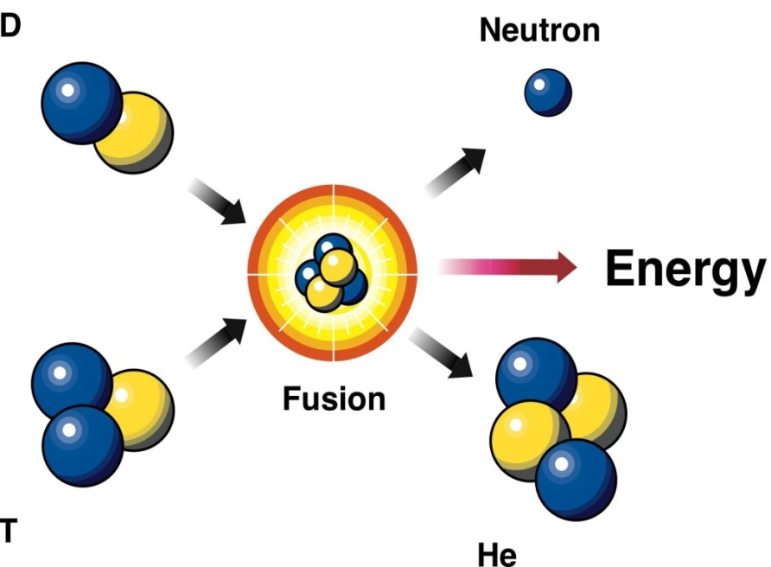
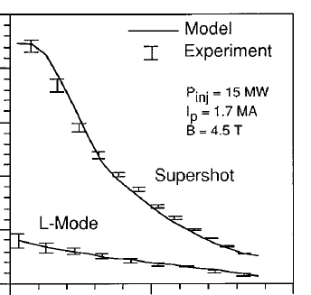
Fusion requires very high temperatures, but these can be achieved
“D-T” fusion reaction:
D: deuterium
n: neutron
E = mc²
T: tritium
α: helium
TFTR at PPPL (1990’s)
~250 million C
Fusion is easiest here at 200 million °C (!!)
  Requires lowest pressure nT and energy confinement time τ_{E}
  Minimum fusion “triple-product” value: 8 atmosphere-seconds
Magnetic fusion has already achieved the necessary high T
core
boundary

Slide 5
How close are we, really, to achieving fusion breakeven?
NSTX-U?
NSTX-U is a research device meant to investigate physics – it will never breakeven
New wave of public, and private(!) fusion devices aim to get there soon

Slide 6
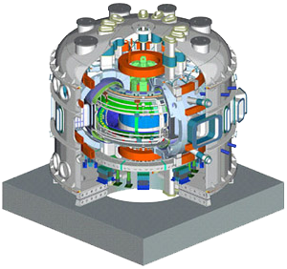
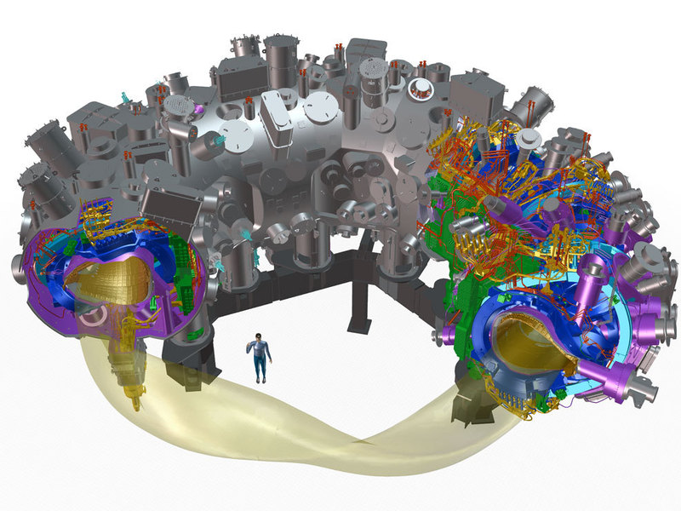
Tokamaks and stellarators are leading magnetic fusion configurations
Superconducting tokamak
Superconducting stellarator
KSTAR (Korea)
W7X (Germany)
Tokamak advantages:
  Best confinement, closest to “breakeven”
  Simpler planar coils and power exhaust
Disadvantages:
  Must drive multi MA plasma current
  Prone to rapid loss of plasma = “disruption”
Stellarator advantages:
  No plasma current drive necessary
  More stable, steady state
Disadvantages:
  More complex coils and exhaust
  Confinement < tokamaks (so far)

Slide 7
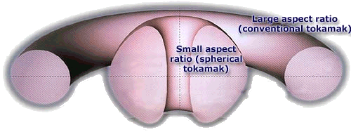
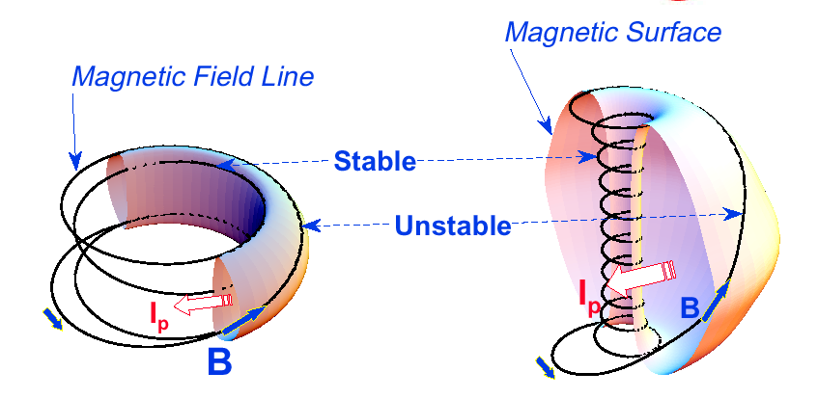
NSTX-U is a spherical tokamak (ST), which has certain advantages
Tokamak
ST
b
Plasma spends less time in unstable curvature region
a
R
a
STs are lower aspect ratio, have natural higher elongation
  Higher elongation and favorable average curvature improves stability, confinement
  Smaller size can mean lower cost
A ~ 2.5-4
κ = 1.5-2
β_{T} = 3-10%
A ~ 1.3-2
κ = 2-3
β_{T} = 10-40%
Aspect Ratio A = R /a
Elongation κ = b/a
Challenges :
  Managing the high heat flux
  Start-up and sustainment of the plasma without as much space in the center column for an induction coil
Toroidal beta β_{T} = ⟨p⟩ / (B_{T0}²/2μ₀)

Slide 8
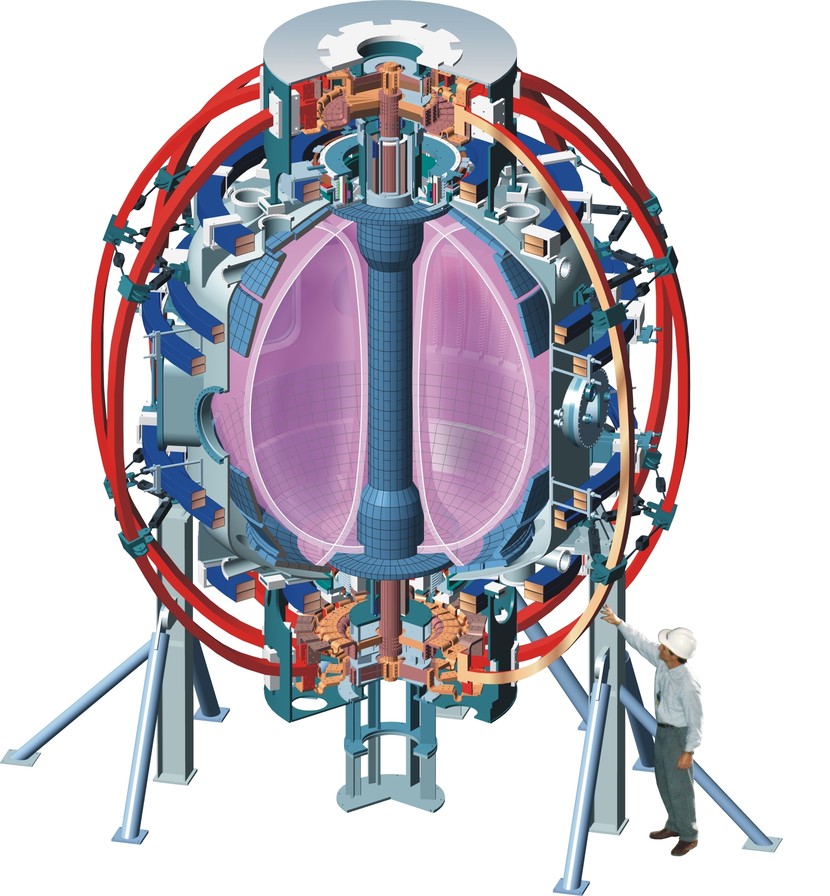
NSTX-U at PPPL is the highest power spherical tokamak in the world
NSTX-U
National Spherical Torus Experiment-Upgrade

Slide 9
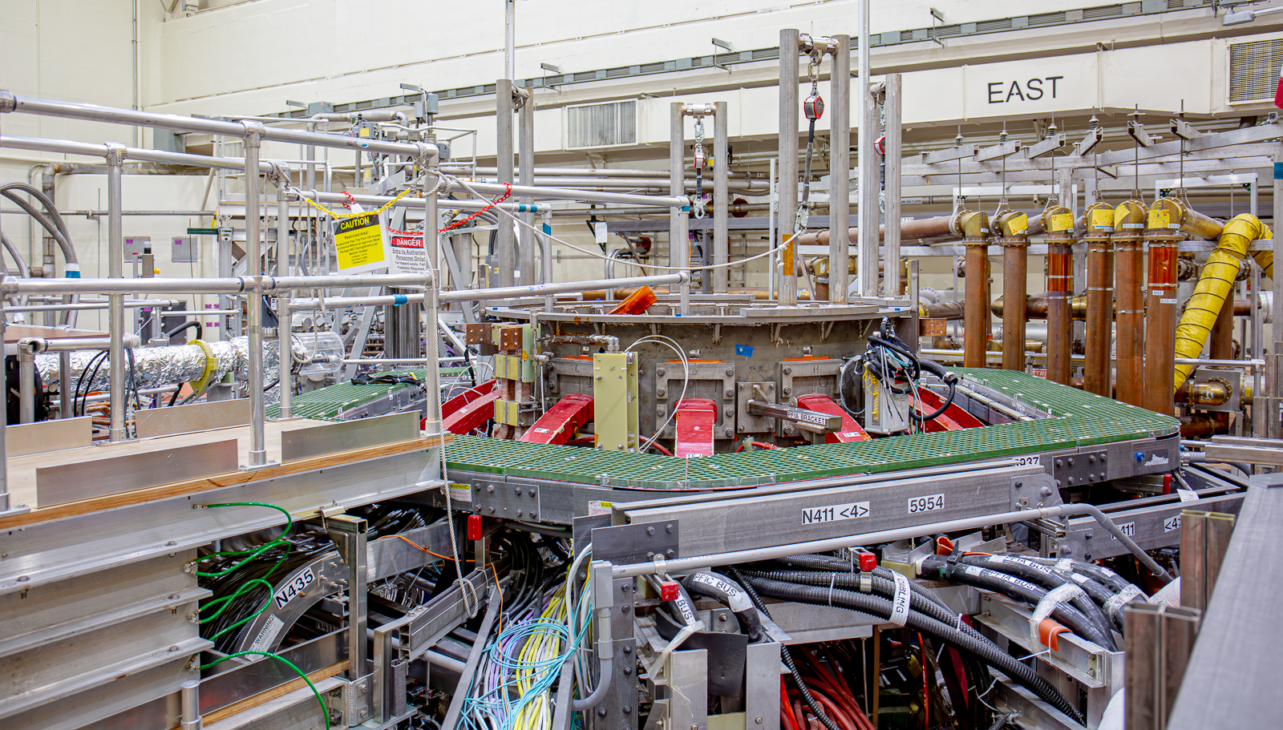
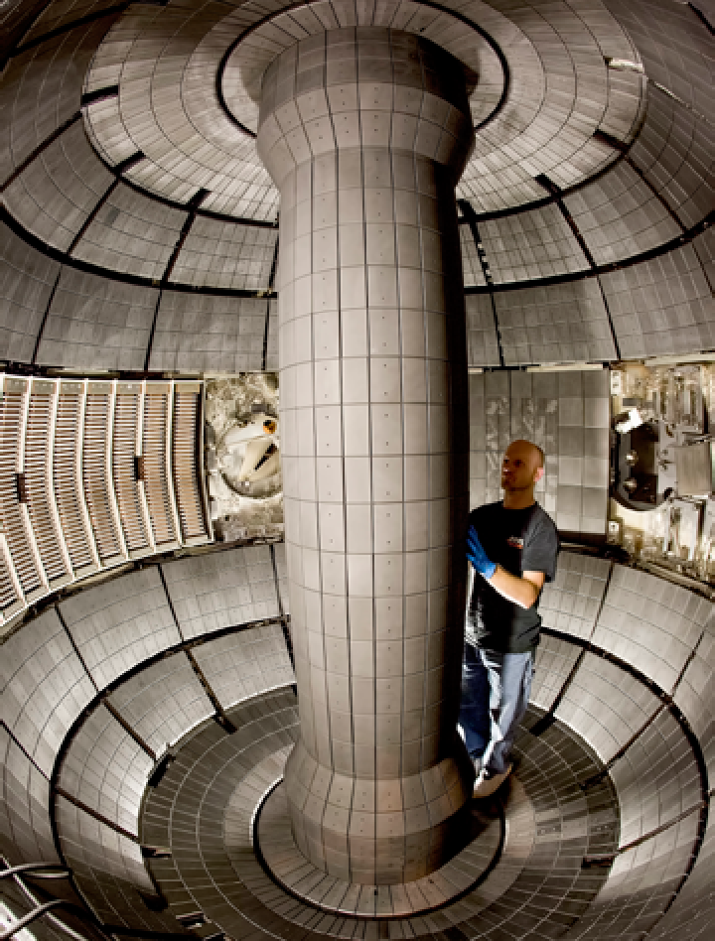
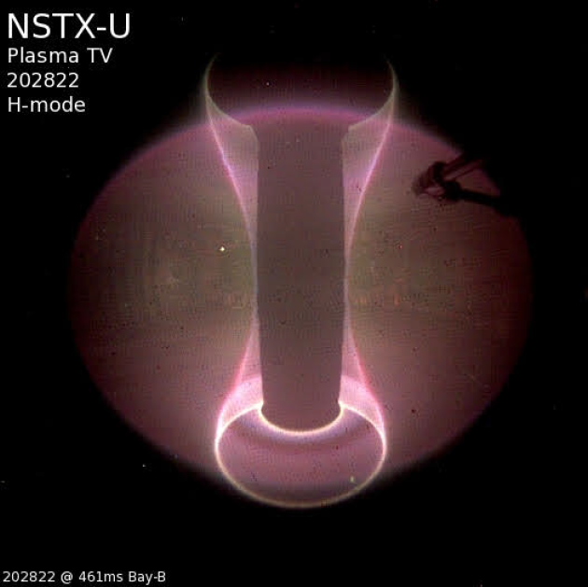
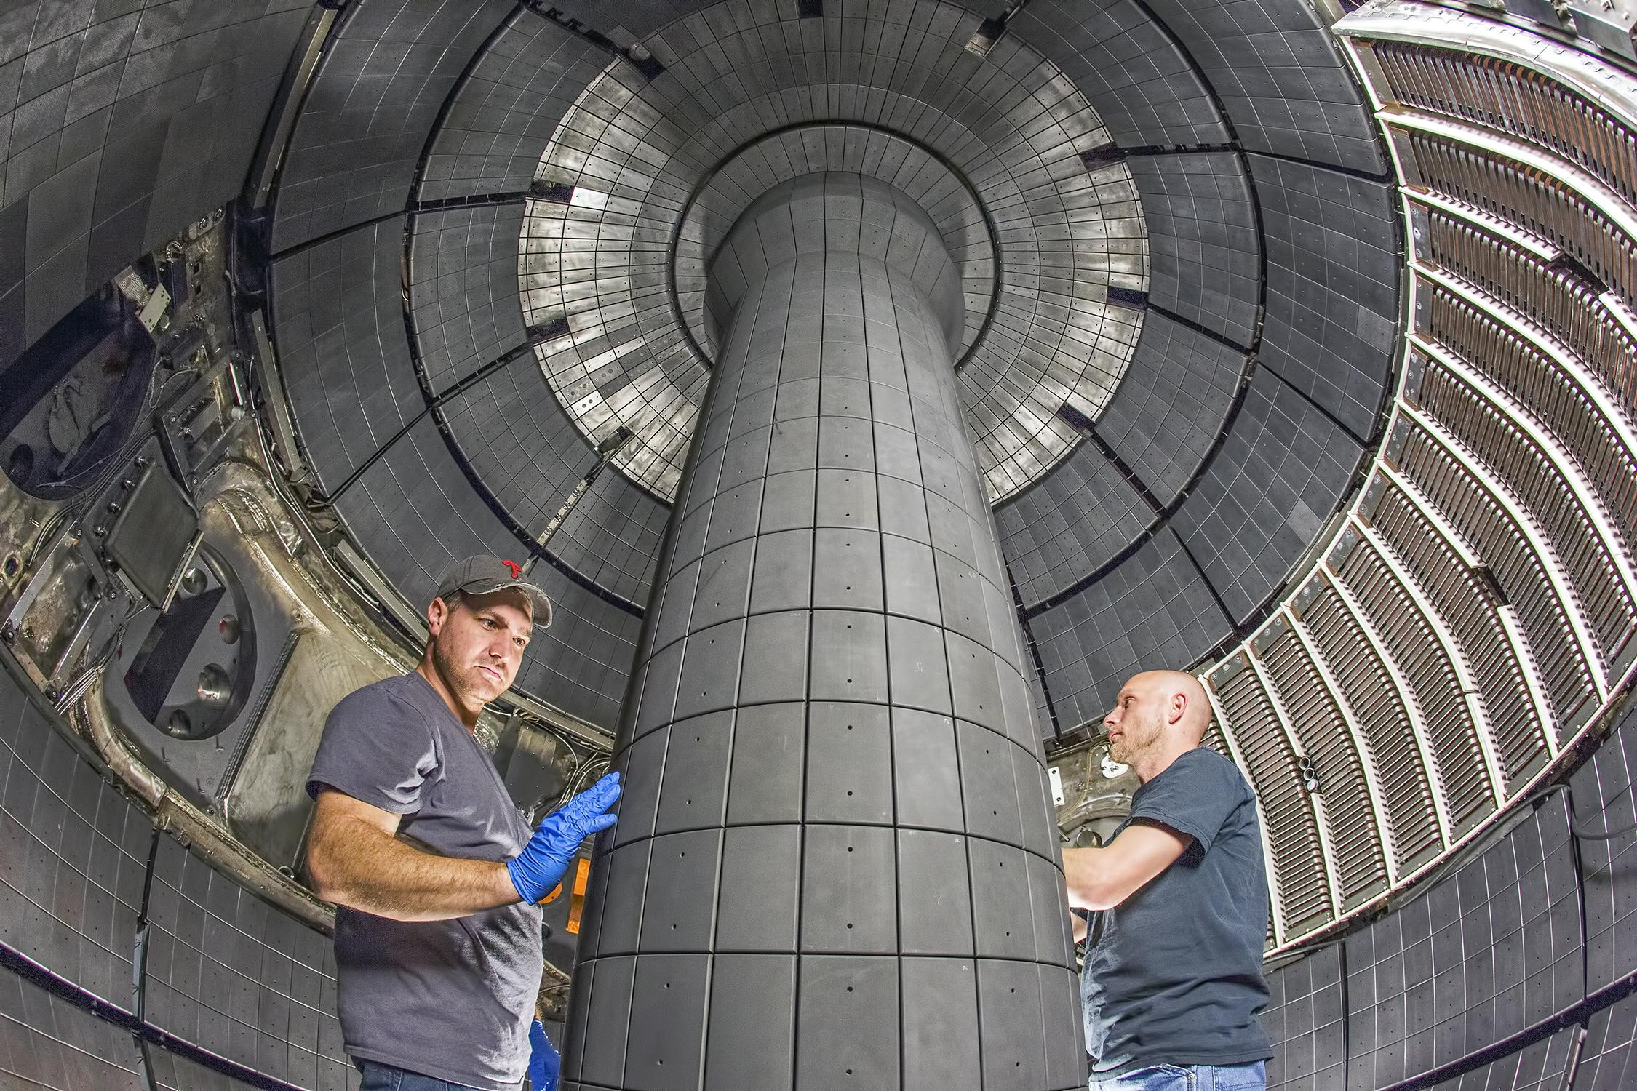
NSTX-U at PPPL is the highest power spherical tokamak in the world
NSTX-U
National Spherical Torus Experiment-Upgrade

Slide 10
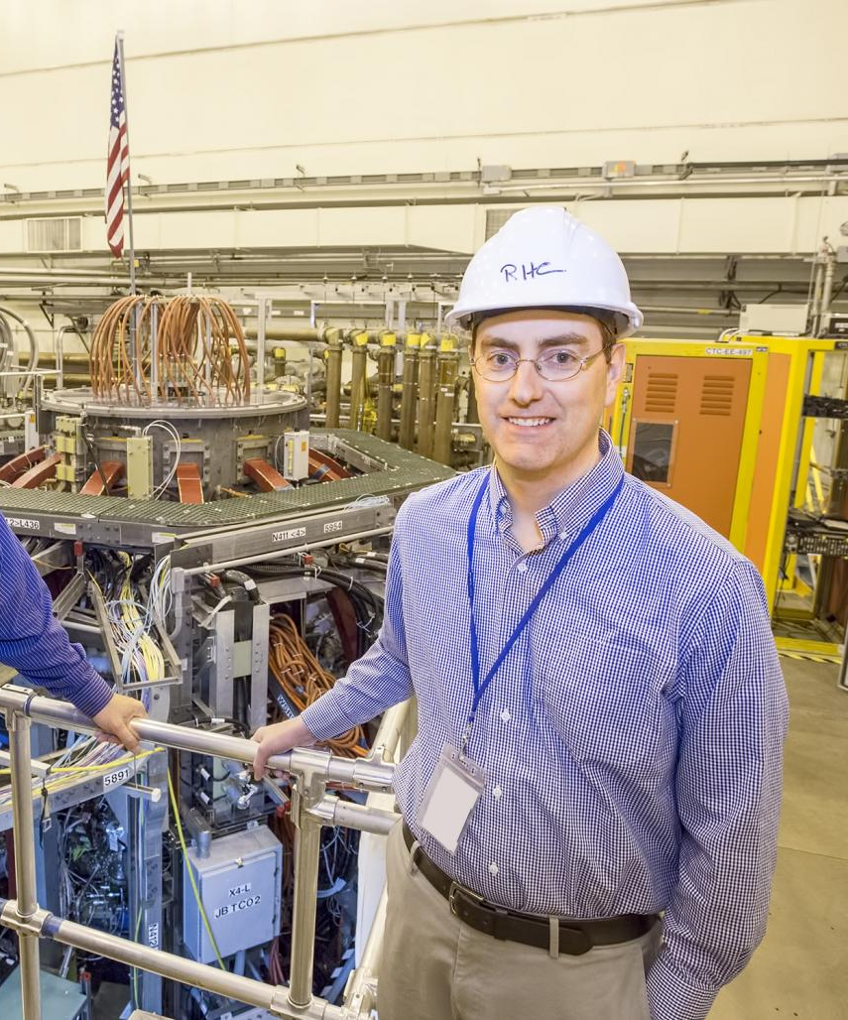
Add some of the highest achievements of NSTX?

Slide 11
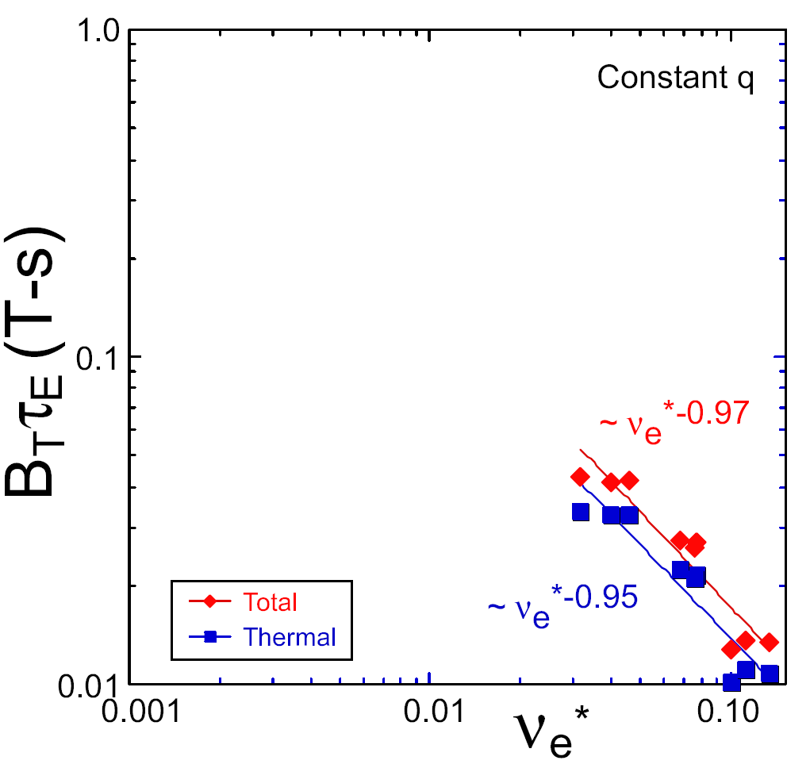
NSTX energy confinement time increased at higher T (!)
ST Pilot Plant
Will the confinement trend continue, or look like conventional aspect ratio?
Favorable confinement results could lead to more compact ST reactors
For low collisionality, need:
  Higher plasma current
  Higher toroidal field
  Higher heating power
  Density control
constant q, β, ρ∗
NSTX Upgrade
?
NSTX
Higher A scaling
Normalized electron collisionality ν_{e}* ∝ n_{e} / T_{e}²

Slide 12
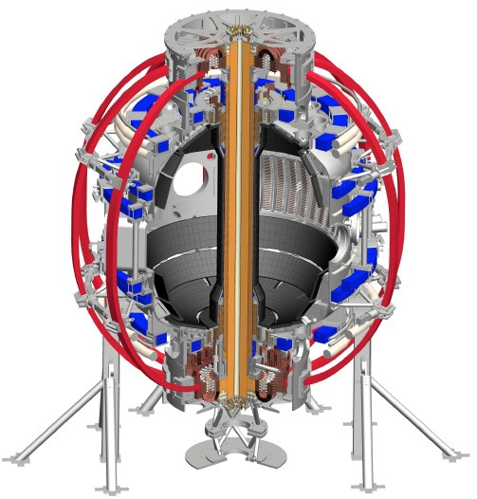
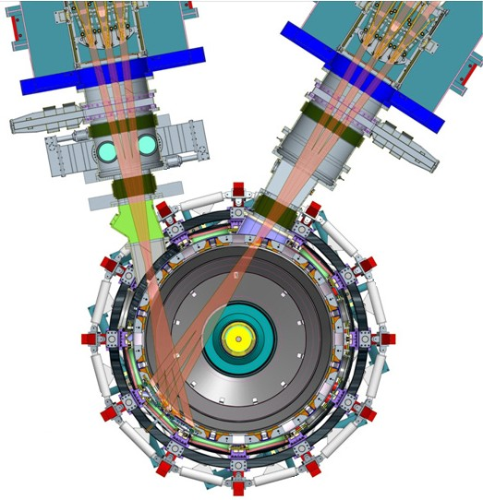
NSTX-U is currently getting an upgrade which will boost performance
New Central Magnet
Tangential 2nd Neutral Beam
NSTX-U will access new physics regimes
4× divertor heat flux
Up to 10× higher nTτ_{E} (~MJ stored energy)
Higher T → lower particle collisionality
  Unique regime at high β, study new transport and stability physics
Full non-inductive current drive
  Not demonstrated in high β ST
  Essential for future steady-state ST
2× toroidal field (0.5 → 1 T)
2× plasma current (1 → 2 MA)
5× longer pulse (1 → 5 s)
2× heating power (5 → 10 MW)
2× current drive efficiency (tangential NBI)

Slide 13
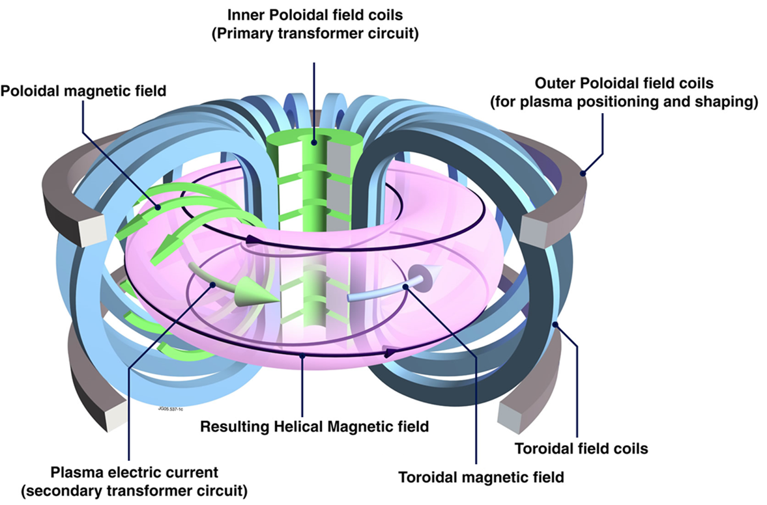
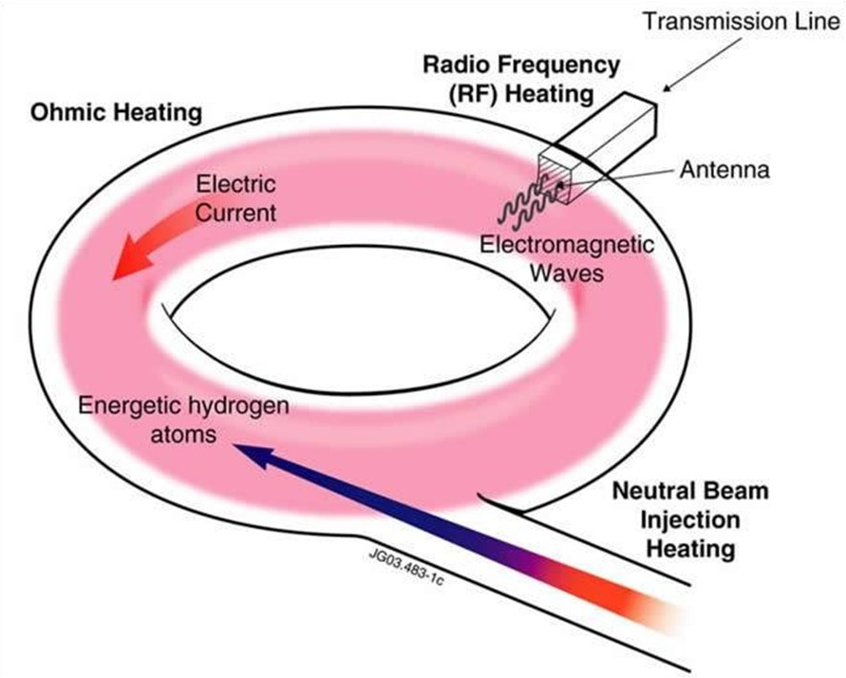
To move towards long-pulse operation, STs need to move to non-inductive current drive and stable, steady-state plasmas
Currently NSTX discharges only last about 1 second
What is the source of current?
  Ohmically induced
  Neutral beams and RF heating
  “Bootstrap” current
    Sounds magical, but plasmas create their own current! Density gradients mean more charged particles are moving in one direction than another
NSTX-U projects to 100% non-inductive operation
  Thanks to the new beam
Plasma current in tokamaks is a large source of free energy – can lead to instabilities (next slide)

Slide 14
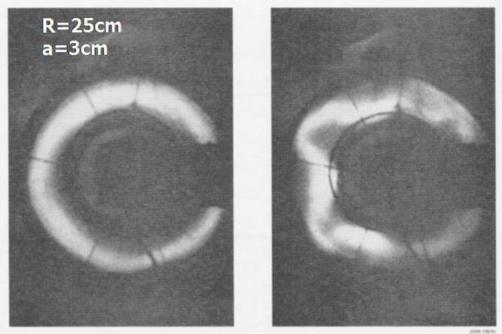
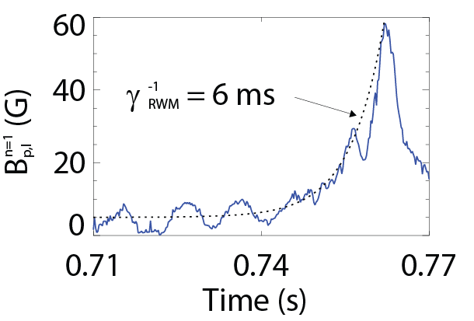
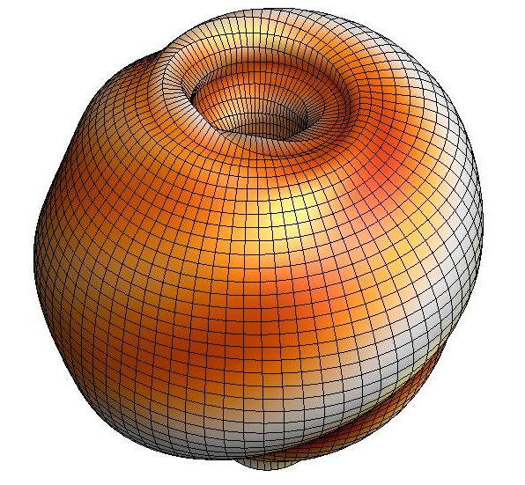

Tokamaks are subject to instabilities, which can be disruptive and dangerous
Force balance: when β gets too high, plasmas can develop kink or ballooning instabilities
  These can grow (quickly!), lead to a sudden loss of particle confinement and dump energy, damaging surfaces
But, microscopic motions of particles in the plasma can resonate with the motion of the magnetic field and sap the energy of the mode, stabilizing it
  Particles in plasmas follow complicated motions: bouncing, gyrating, drifting…
Accounting for this effect in NSTX explained plasma stability/instability
Modelled NSTX distortion (exaggerated)
Measured NSTX growth
Exponential
6ms!
B_{p}
Normalized growth rate
Predictions of experimental instabilities
Experimentally stable
Normalized time to instability

Slide 15
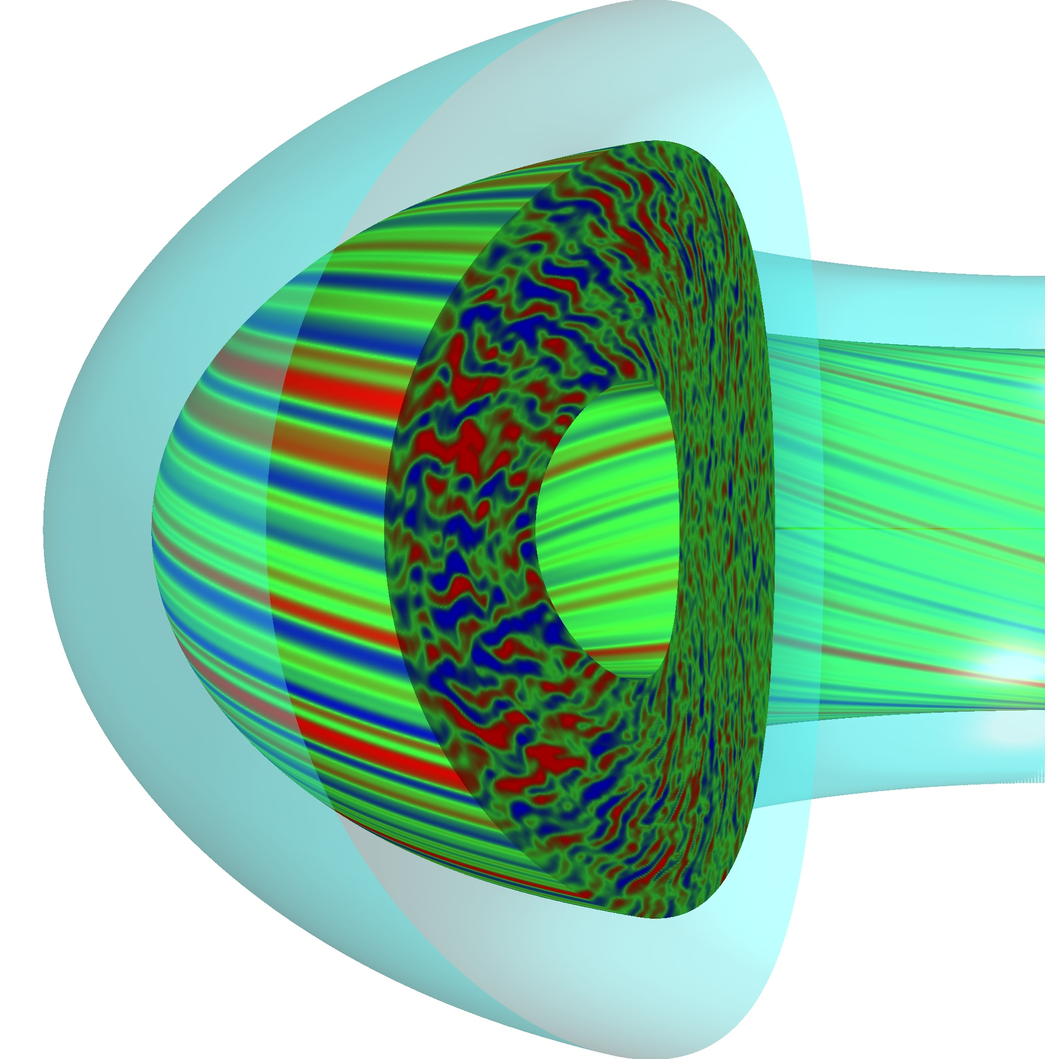
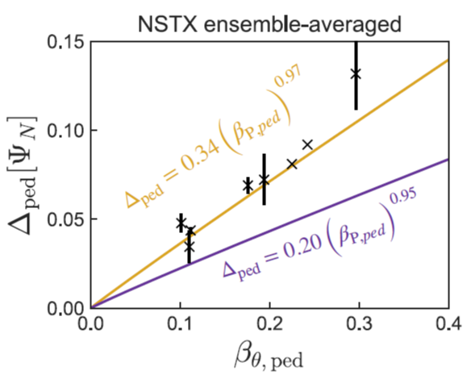
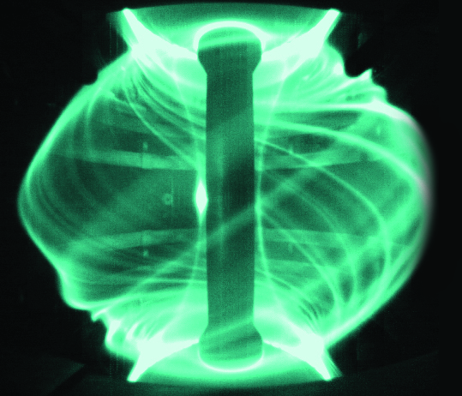
Ultimately the amount of fusion reactions depends on how high a temperature and density can be sustained, and this is determined by turbulent transport
“Gyrokinetics” follows particle motions and the turbulent eddies they create
Turbulence leads to particle transport and profiles are set up as a balance between fueling and loss
“Pedestal” predictions from large A scalings did not work for NSTX
  Gyrokinetic modeling does!
  STs can have wider pedestals
Another “mode” of instability: edge-localized modes (ELMs)
  High-confinement pedestals collapse periodically, releasing a lot of energy
Pedestal width (norm.)
NSTX
ELMs in MAST (UK ST)
Gyrokinetics
Large A scaling
Pedestal height (normalized)

Slide 16
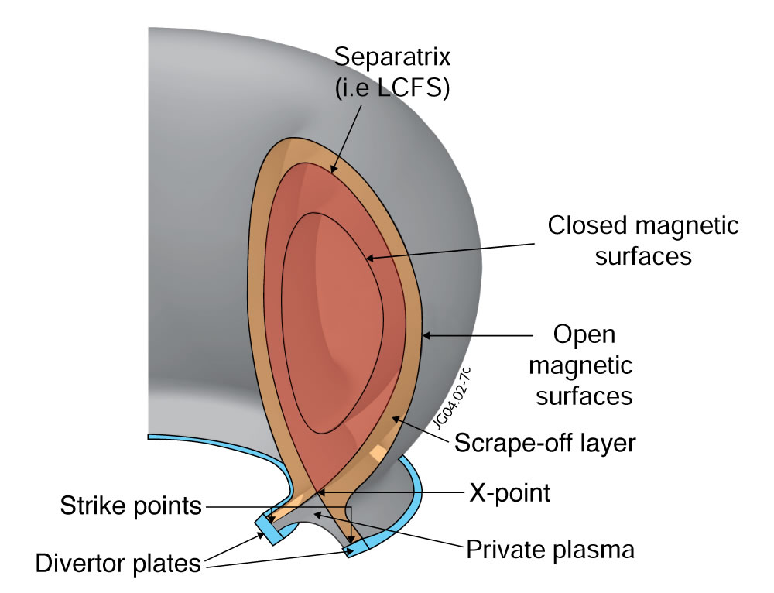
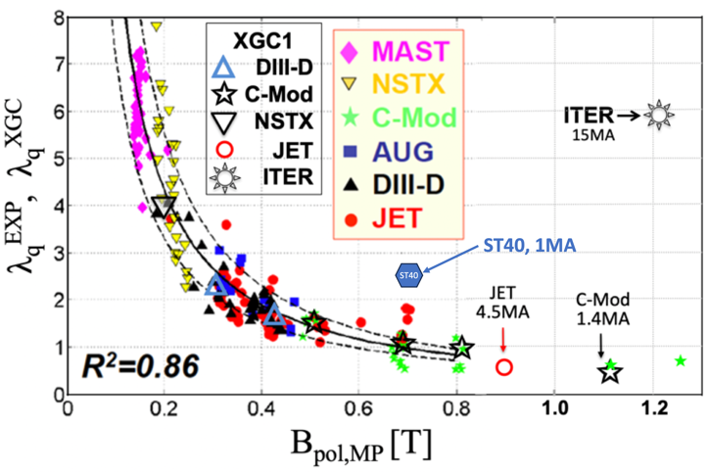
Tokamaks use a ‘’divertor” to control where power and particles are exhausted
Power exhaust width outside main plasma can be very narrow (few mm)
Tokamak + ST data: power exhaust width varies as 1/B_{p}
Issue: if peak heat flux in divertor region exceeds ~ 10 MW/m² it can lead to material damage
Simulations predict NSTX-U may be different
Wider heat-flux width may offset smaller R, may be better than tokamak
Turbulence may spread the width
Simulations
Experiment
Layer width [mm]
?
NSTX-U 2MA
Power / particles contact target plates here
Magnetic field strength [T]

Slide 17
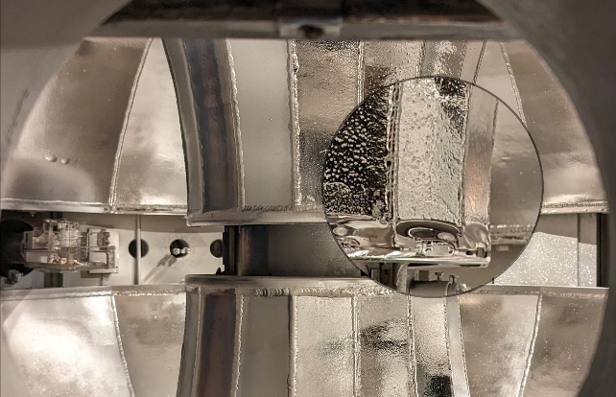
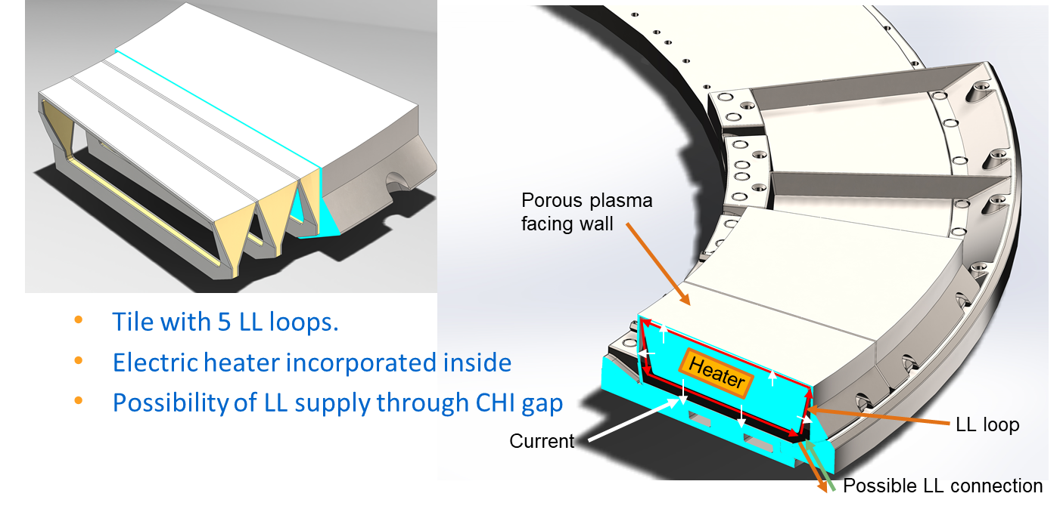
Liquid metal walls have proven beneficial for heat handling, plasma performance
LTX-β, a smaller ST at PPPL with liquid lithium walls
Lithium handles high heat fluxes (especially if it is flowing) and captures ions escaping the plasma rather than reflecting cold neutrals back in
NSTX-U explored the benefits of lithium walls by coating the divertor tiles
  Improved energy confinement time
  Reduction of impurities
  Suppression of ELM instabilities at the plasma edge
Liquid lithium divertor design for NSTX-U

Slide 18
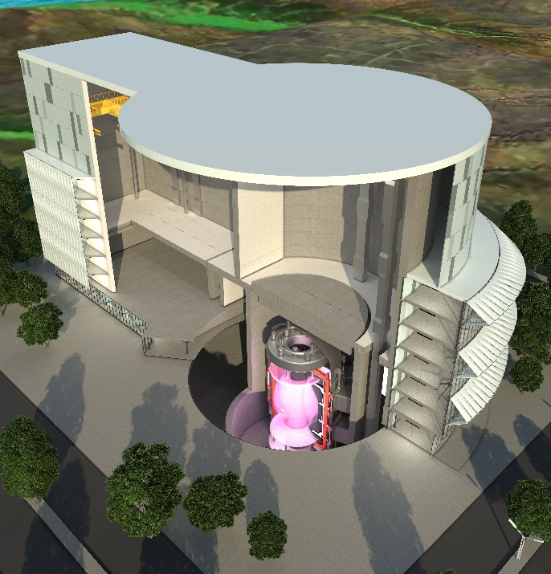
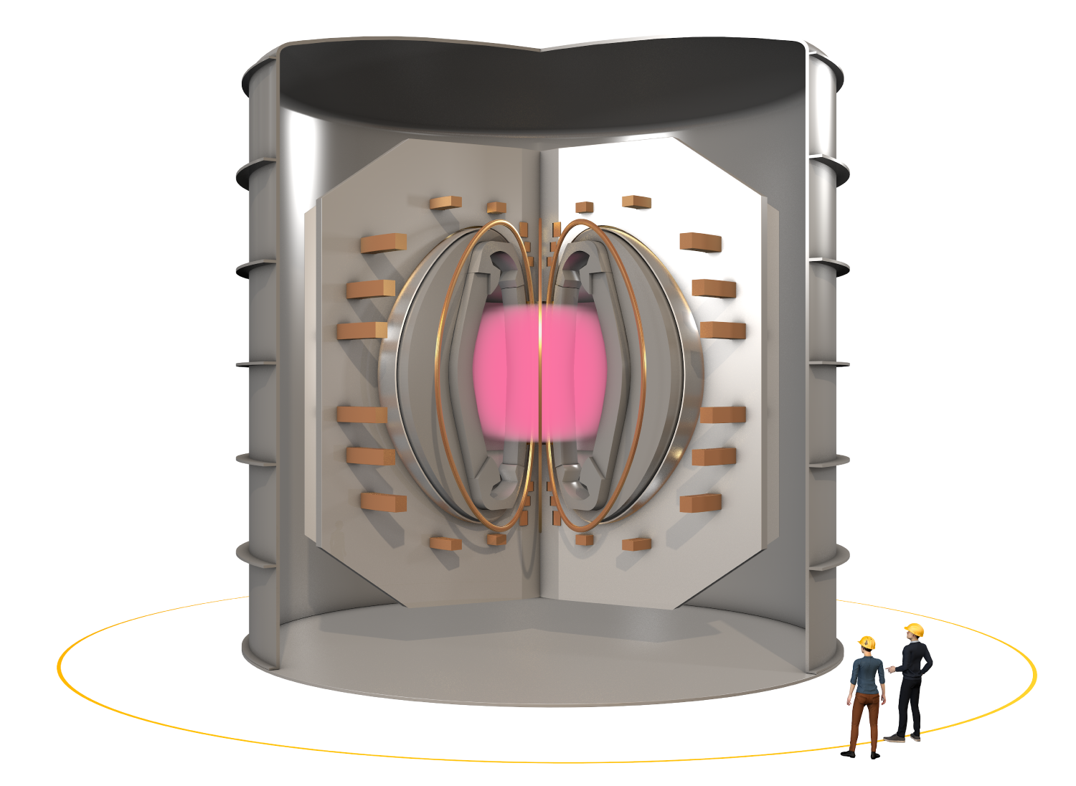
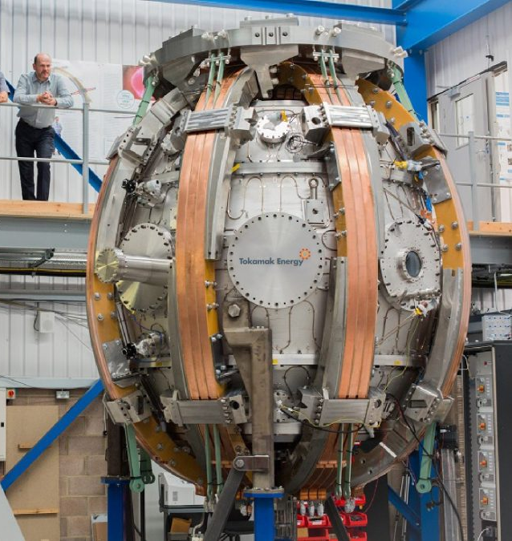
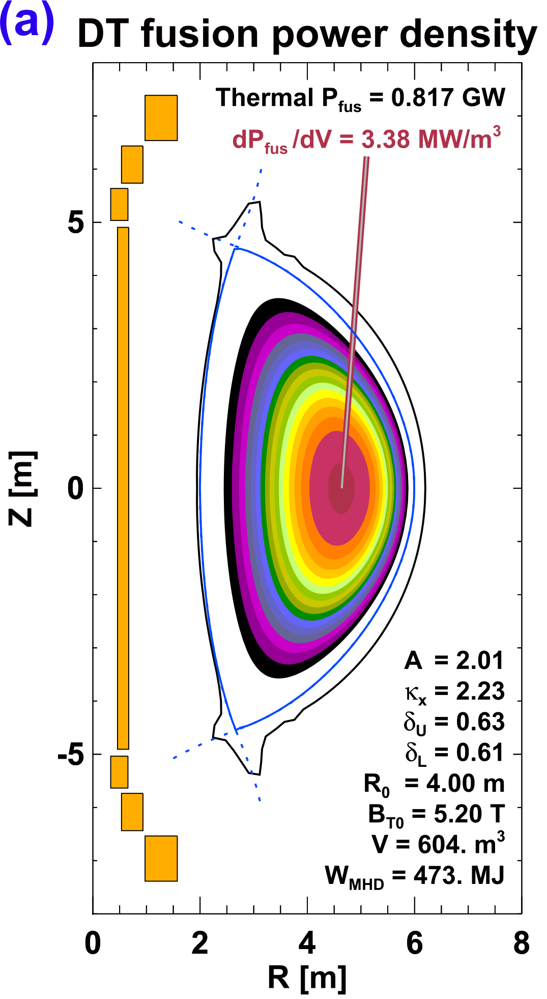
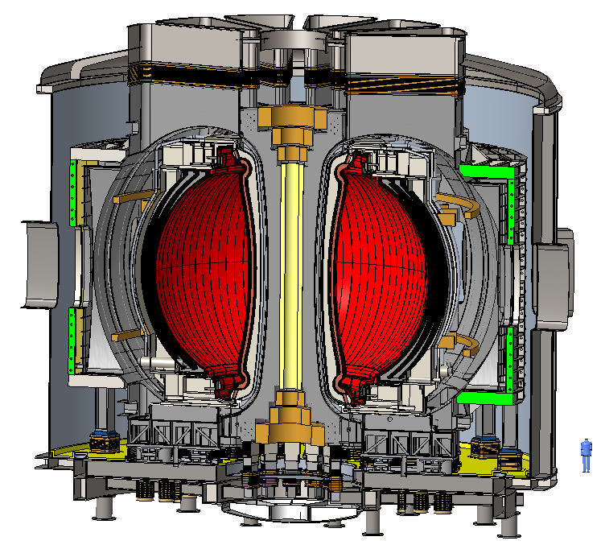
There is already substantial interest in a low-A tokamak as a Fusion Pilot Plant
Tokamak Energy
Future Pilot Plant
United Kingdom: Spherical Tokamak for Energy Production (STEP)
Tokamak Energy, Ltd.: high-temperature superconducting devices
PPPL: ST Advanced Reactor (STAR) (design study)
  Understand advantages and disadvantages of ST for a reactor
  Develop high fidelity physics and engineering models
ST40
STAR
R = 4 m, A = 2,
B_{T} = 5.2 T, κ = 2.2
P_{fus} ~ 1 GW,
P_{net} ~ 100-500 MWe

Slide 19
Conclusions
The National Spherical Torus Experiment at the Princeton Plasma Physics Lab is investigating the physics of magnetic confinement fusion
  NSTX-U is undergoing an upgrade and is designed to be the highest performance ST in the world
Spherical Tokamaks have certain known advantages, but also open questions
  Non-inductive operation, instabilities, turbulent transport, power handling
The ST concept is under consideration for a Fusion Pilot Plant
  NSTX-U will provide the physics knowledge for confident projection

Slide 20
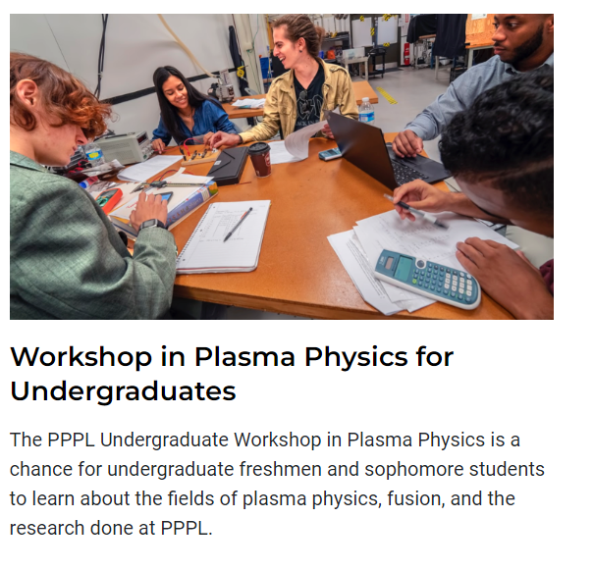
PPPL science education department has many opportunities for students
Workshop in Plasma Physics for Undergrads
  Meant for freshman or sophomores
  June 25-28, 2024
  Application closes April 9th
pppl.gov/education
science-education@pppl.gov

Slide 21
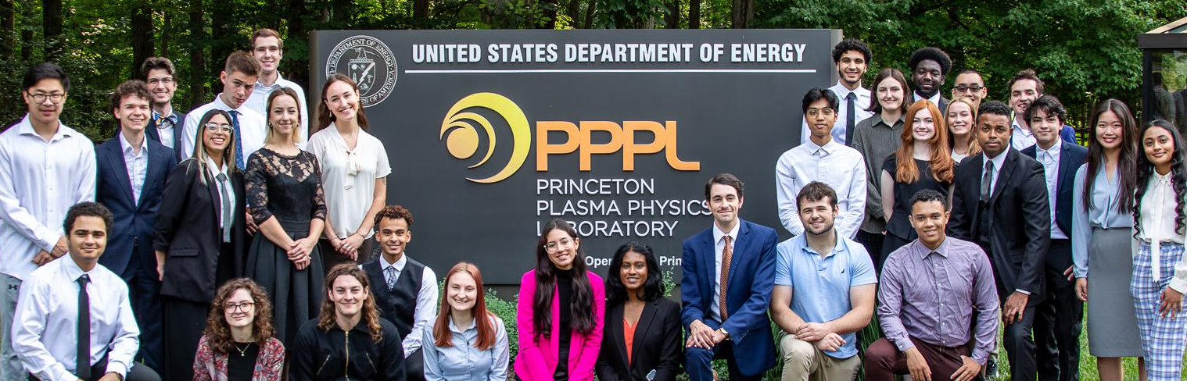
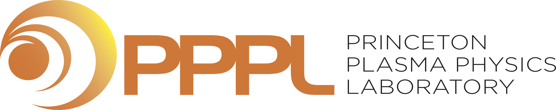
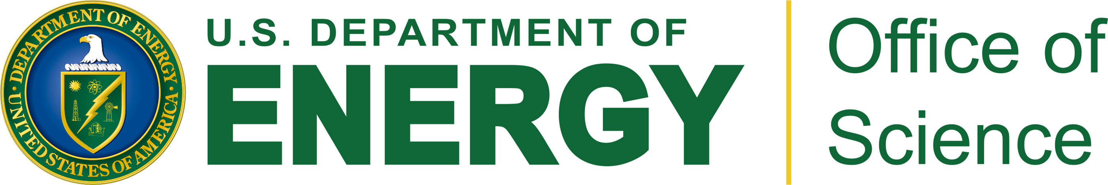

Slide 22
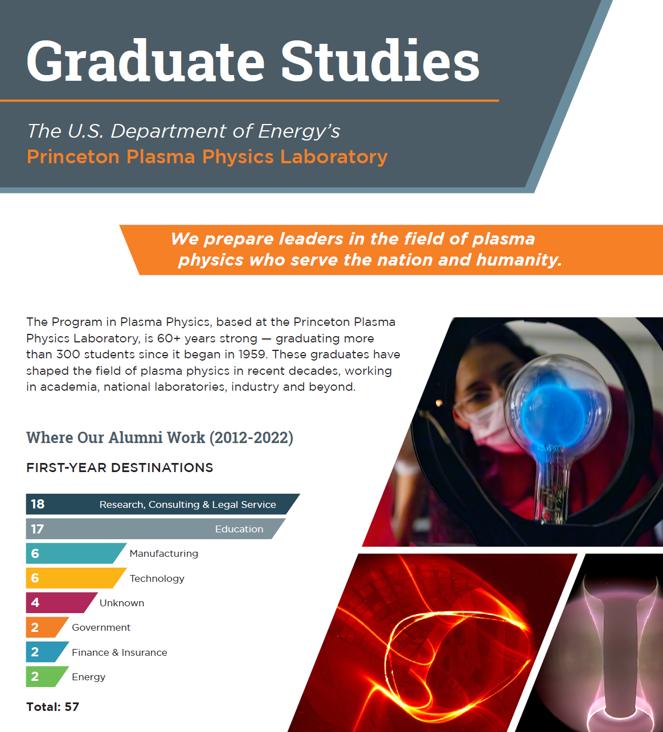

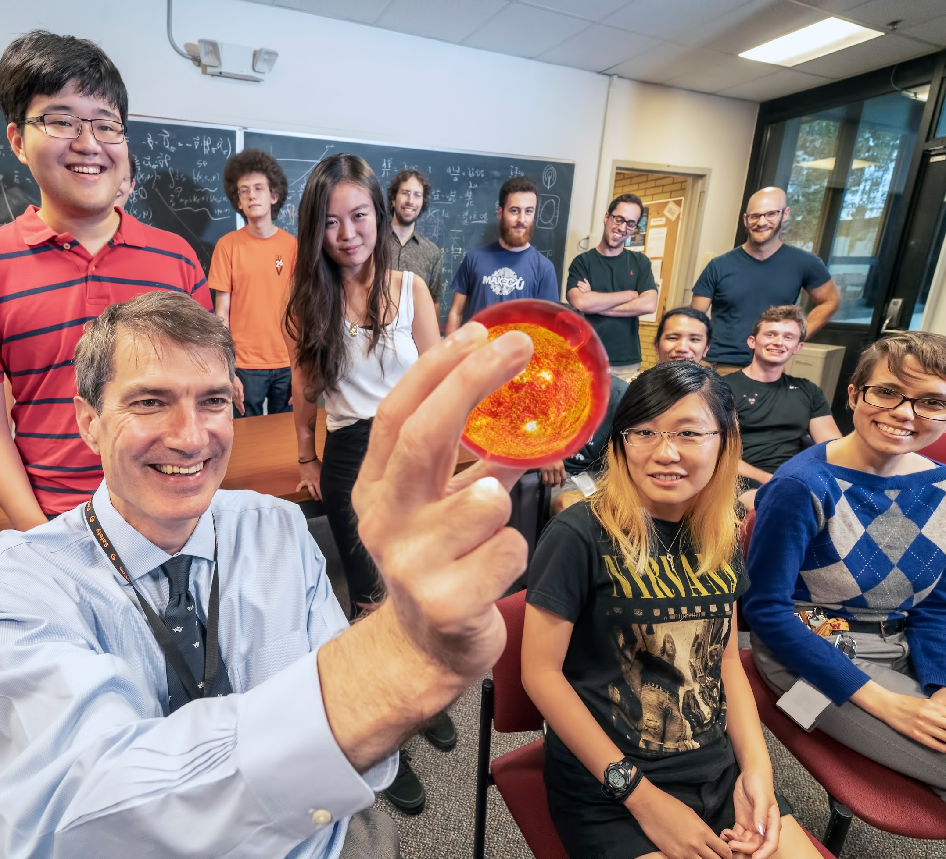
Graduate Study
300+ alumni over a 60+ year program
Program in Plasma Physics, a graduate program in the Dept. of Astrophysical Sciences at Princeton University, based at PPPL.

Slide 24

Advantages of fusion: safe, sustainable, high energy density, environmentally attractive
Cannot have runaway reaction
  Only small amount of fuel present
  If particles cool, fusion stops
Abundant fuel supply
  D from seawater: HDO, D/H = 1/6400
  T bred from lithium in earth’s crust
High energy density
  1 liter water = 500 liters gasoline
Waste short-lived, low-level
No CO₂ production
D: deuterium
n: neutron
T: tritium
α: helium

Slide 25
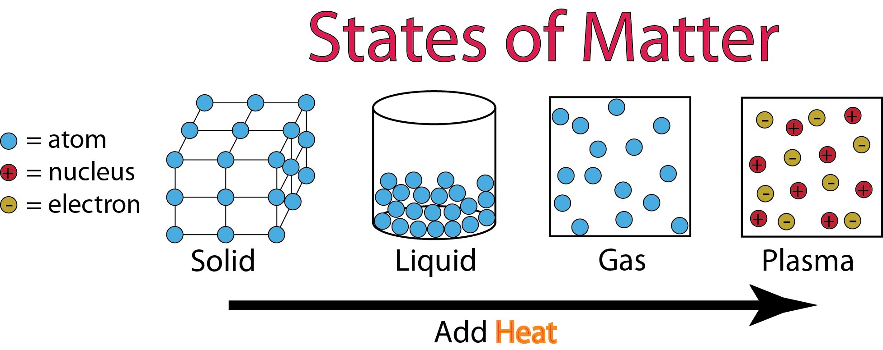
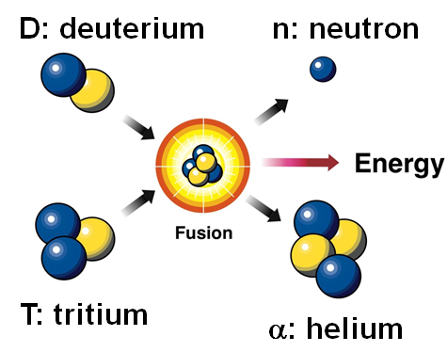
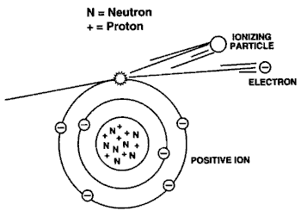
At fusion temperatures gas becomes plasma, a “soup” of electrons and positive ions
DT fusion:
200,000,000 ^{ᵒ}C
Water:
0 ^{ᵒ}C
100 ^{ᵒ}C
160,000 ^{ᵒ}C
At fusion temperatures, particles are so energetic that electrons are stripped from neutral atoms leaving positively charged (+) ions

Slide 26
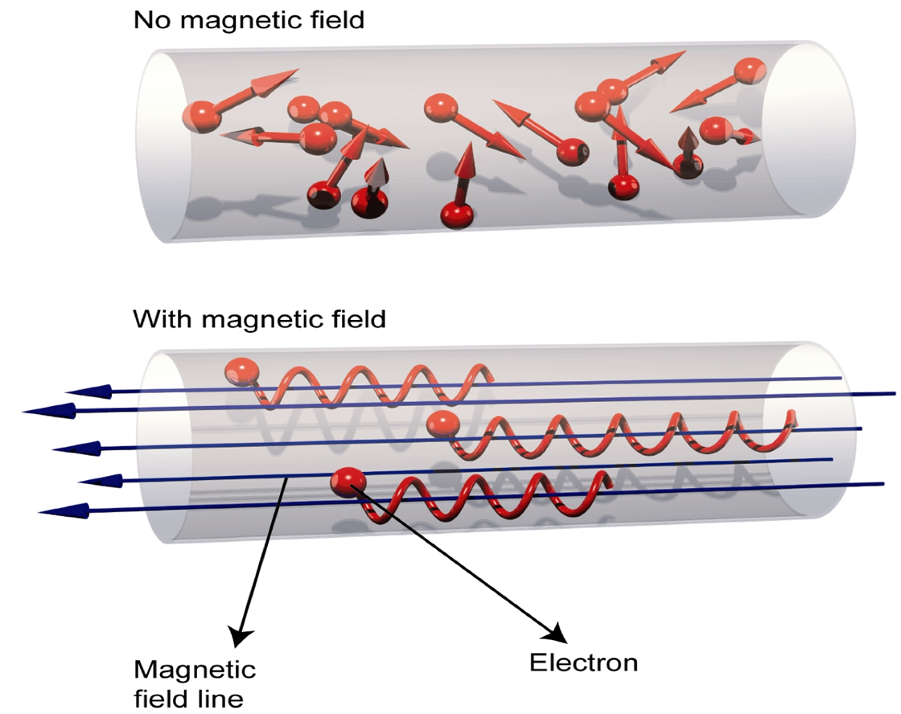
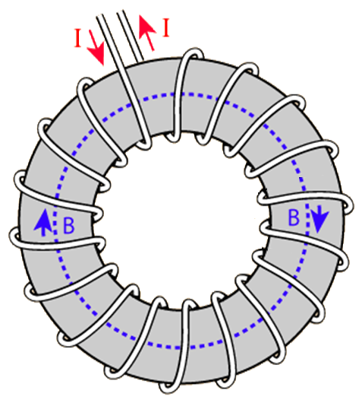
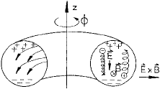

Charged particles confined by magnetic fields, but a simple toroidal field gives poor confinement
R
Charged particles spiral around field lines, move freely along field
Bending field into torus creates non-uniform B~1/R
Electrons and ions drift apart vertically → charge separation
Electric field created → particles expelled outward

Slide 27



Tokamak: toroidal field from magnets and poloidal field from plasma current + create helical field
Position many coils into a donut or “torus” shape
Magnetic field never touches the walls
With plasma current: Helical field = B-field covers toroidal surfaces
Short-circuits electric fields that would otherwise expel plasma
Particles tied to surface and theoretically never touch the walls either
× 10-20
“Tokamak”: Russian acronym for “toroidal chamber with magnetic coils”

Slide 28


Particle trajectories in a tokamak

Slide 29


To move towards long-pulse operation, STs need to move to non-inductive current drive and stable, steady-state plasmas

Slide 30



Magnetic fusion is arguably closest to ultimate goal of electricity generation
Gravitational
Confinement
Inertial
Confinement
Magnetic
Confinement
Gravity
Intense Energy
Beams
Sun
Charged particle
Fusion
Magnetic field
Fuel Pellet
Laser fusion has at best E_{fusion}/E_{electrical} ~ 5%
Lots of efficiency losses from wall plug to energy out
ITER, being constructed in France, aims for ~500 MW fusion power for similar level of electrical input
Requires at least ~7% mass of sun
And 10x diameter of Earth

Slide 31


How would magnetic fusion make electricity?
Plasma
(100 million ^{ᵒ}C)
Magnets
(-270 - 100^{ᵒ}C)
Steam or hot helium
External heating
(10’s of MW)
Neutrons
α self heating
Heat
Spin turbines, generate electricity
Blanket
(350 - 1000^{ᵒ}C)
Tritium bred from lithium in blanket
helium and deuterium exhaust

Slide 32
xxx
xxx

Slide 33
xxx
xxx

Slide 34
xxx
xxx

Slide 35
xxx
xxx

