Slide 1
Vertical instability studies and inegrated control update in the TCV tokamak
S. Marchioni, O. Sauter, C. Contre, F. Felici, A. Frank, C. Galperti, R. Masocco, A. Mele, A. Merle, F. Pastore, A. Pau, A. Tenaglia, S. Van Mulders, T. Vu, the EUROFusion tokamak exploitation team and the TCV team

Slide 2
Vertical instability theory
Elongated plasmas have better confinement time than circular ones.
Quadrupole magnetic field to elongate the plasma.
All elongated plasmas are vertically unstable.
Vessel and passive conducting structure reduce the vertical instability growth-rate to milliseconds (instead of microseconds).
Continuous feedback control of the plasma vertical position is needed to stabilise the plasma during operation.
$$F_{z}$$
$$B_{R}$$
$$B_{R}$$
$$F_{z}$$
$$I_{P}$$
$$I_{P}$$
$$F_{z}$$
$$B_{R}$$
$$B_{R}$$
$$F_{z}$$
S. Marchioni 18/04/2024

Slide 3
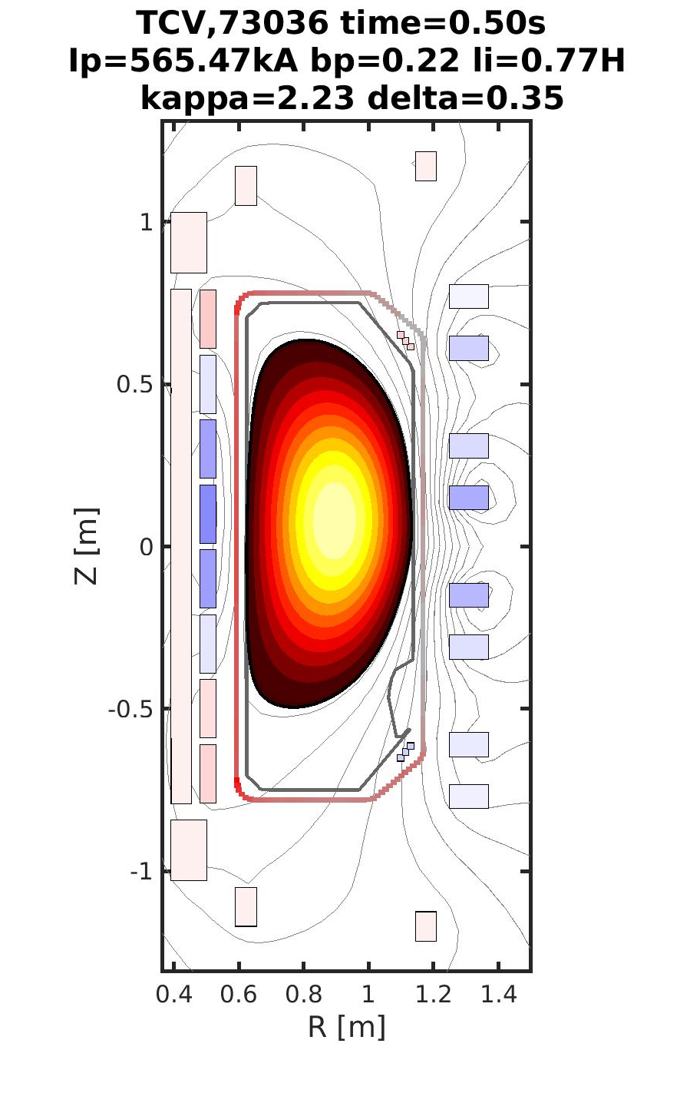
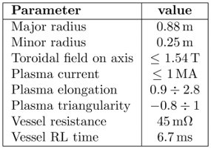
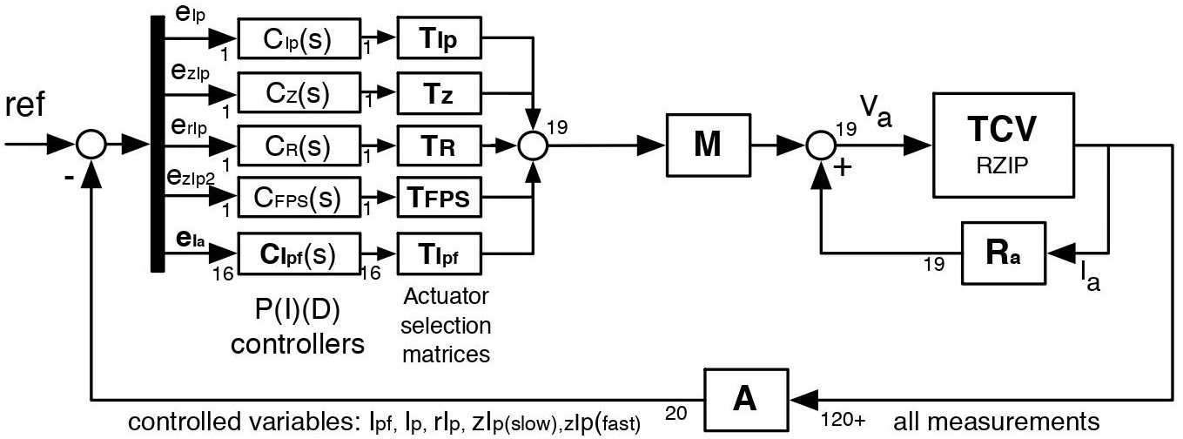
The TCV tokamak and its magnetic control system
TCV has an elongated vessel with low electrical resistivity.
Both limited and diverted plasma configurations.
16 external independently powered poloidal field coils.
1 circuit of 6 in-vessel coils.
MEQ (Matlab Equilibrium) suite of codes of SPC
TCV magnetic controller.
Discharges are still suffering for Vertical Displacement Events (VDE).
To improve operation, a proximity controller for the vertical instability growth-rate developed.
Possibility to use the same algorithms on other devices.
S. Marchioni 18/04/2024

Slide 4
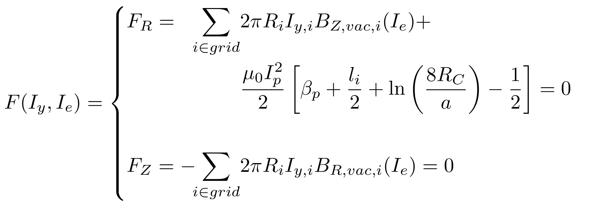
Modelling the vertical instability: equation and codes
MEQ (Matlab Equilibrium) suite of codes of SPC
LIUQE: equilibrium reconstruction code, EFIT-like: measurements -> equilibrium. RT version available.
FBT: static inverse solver, from equilibrium constraints -> coil currents + equilibrium.
FGS and FGE: static and evolutive forward solver, from coil currents/voltages -> equilibrium.
RZIp: rigid linearisation of FGE, RT implementation for vertical instability metrics.
S. Marchioni 18/04/2024

Slide 5
Vertical instability growth-rate calculation in real-time
S. Marchioni 18/04/2024

Slide 6
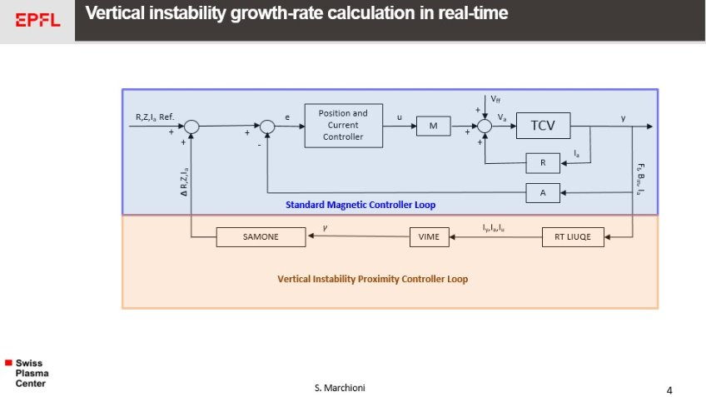
Proximity controller with SAMONE: design
Ingredients needed for the Proximity Controller:
Real-time (RT) equilibrium reconstruction.
VIME (Vertical Instability Metric Estimator): Growth-rate reference/limit to be maintained/not be exceeded.
Actuator: SAMONE [T. Vu et al. 2021] (Supervisory control, Actuator Management and Off-Normal Event Handling) to adapt plasma reference for γ control.
S. Marchioni 18/04/2024
5

Slide 7
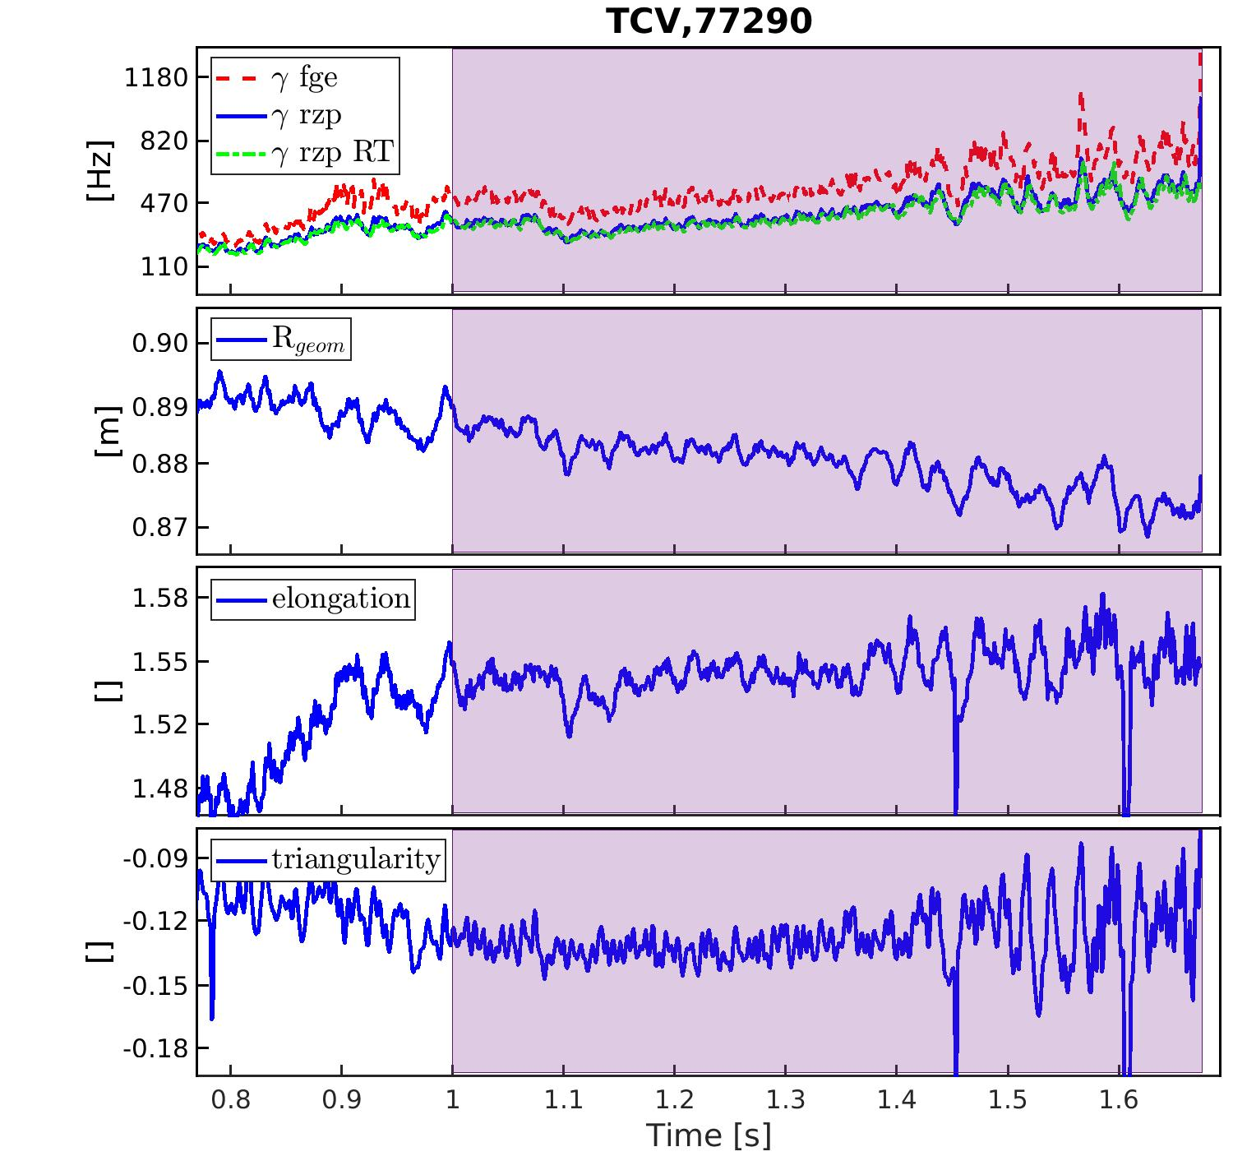
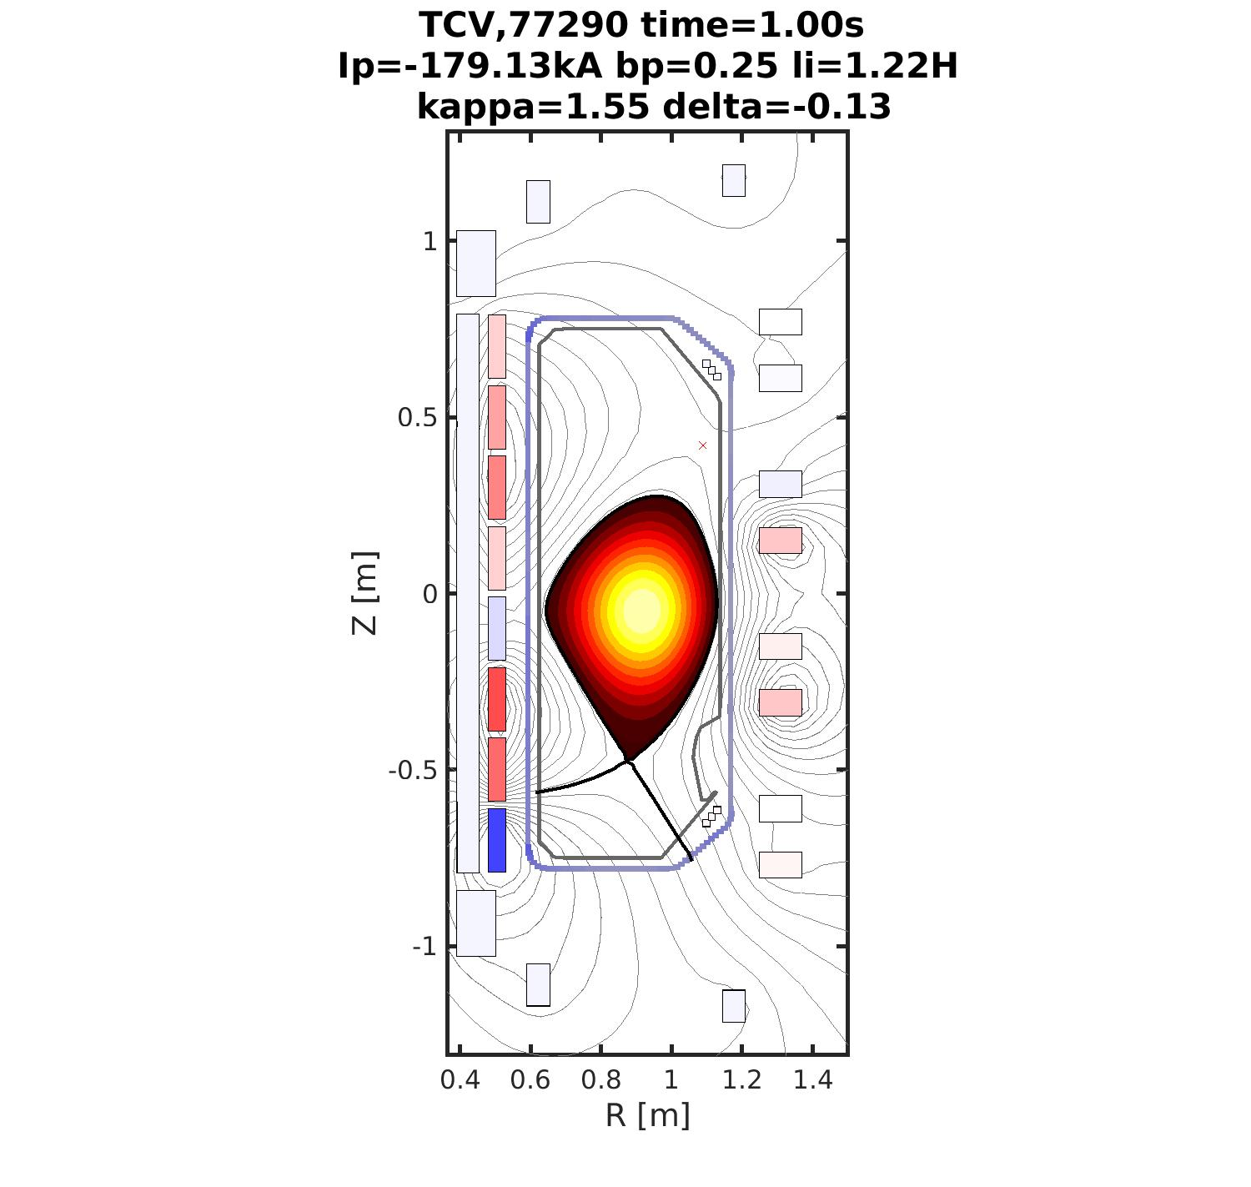
Proximity controller with SAMONE: growth-rate radial dependence
S. Marchioni 18/04/2024

Slide 8
Proximity controller with SAMONE: growth-rate radial dependence
Constant scan in the radial direction is performed.
γ rises as the plasma moves to the HFS.
RT γ estimation in agreement with offline calculations.
Plasma shape (elongation and triangularity) oscillates when the plasma is closer to the HFS.
S. Marchioni 18/04/2024

Slide 9
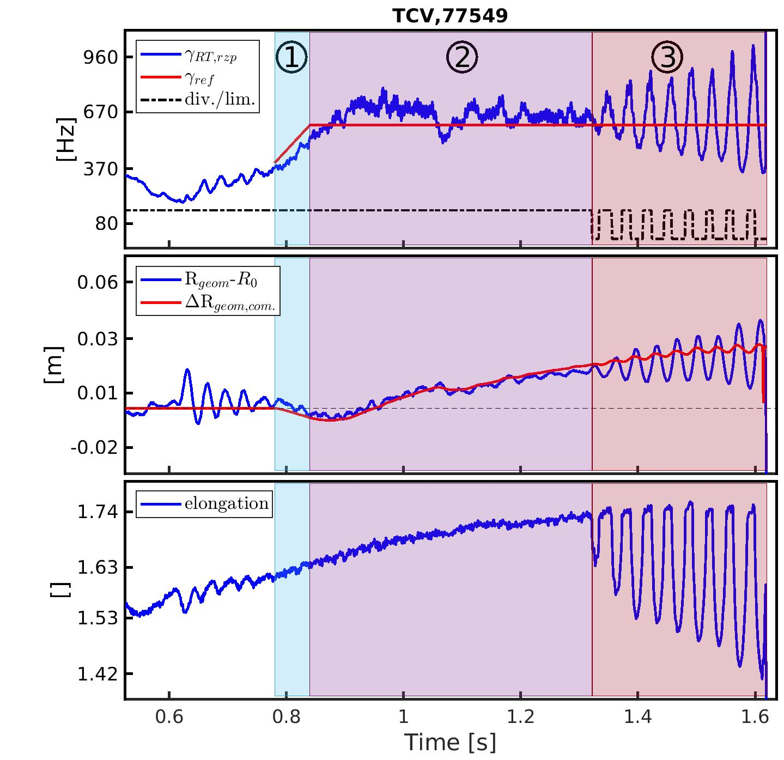
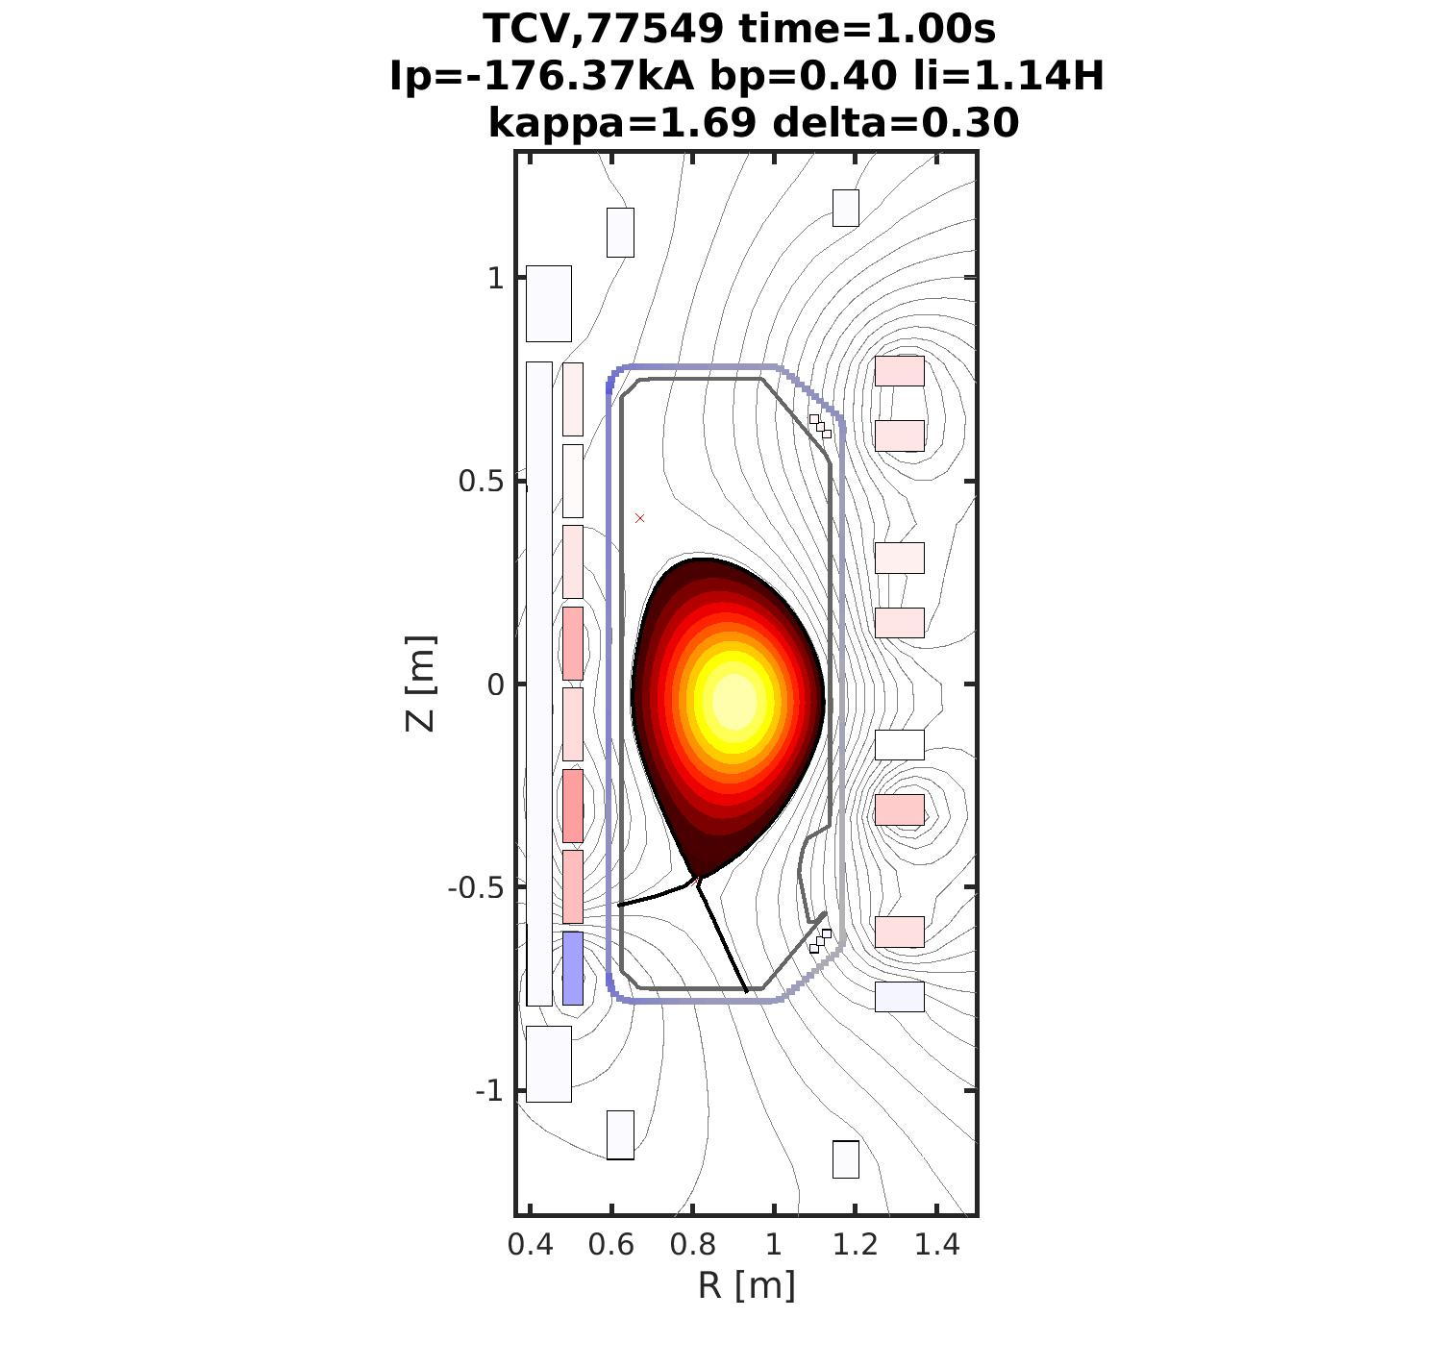
Proximity controller with SAMONE: growth-rate control
S. Marchioni 18/04/2024

Slide 10
Proximity controller with SAMONE: growth-rate control
Plasma elongation (bottom plot) constantly increased. The controller activates if γ > 350Hz or after 0.78s:
The reference γ (red, top plot) rises from 400Hz to 600Hz. The controller (red, middle plot) pushes on the HFS to increase γ.
The reference γ is maintained constant to 600Hz. Controller pushes on the LFS to maintain γ, while elongation is increased.
Limited/diverted transition make the controller unstable. The plasma disrupts.
S. Marchioni 18/04/2024

Slide 11
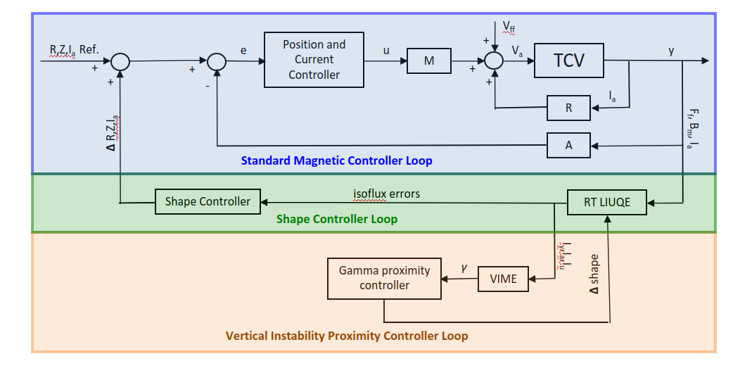
Proximity controller with shape controller: design
For procìximity control with the shape controller, a further more complex designis needed:
A module that translates elongation variations into shape control points movements has been implemented
The shape controller provides the reference to the poloidal filed coils to maintain a given plasma shape
Close the loop with an external proximity controller which changes the elongation as a function of the given growth-rate, estimated with VIME.
S. Marchioni 18/04/2024

Slide 12
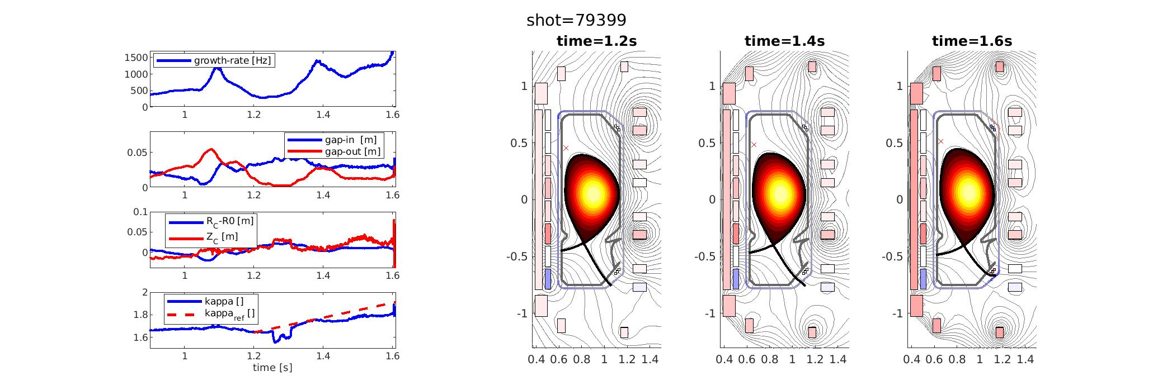
Proximity controller with shape controller: elongating the plasma
Shape controller active from 1s. Request is to elongate the plasma of 20% between 1.2s and 1.8s.
The plasma is actually elongated, but the gap and the vertical position are also changed. At high elongation, a secondary X-point appears.
Overall, the growth-rate has different trends: decreasing when the gap is decreasing, increasing when the elongation is increasing and the gaps are maintained constant.
S. Marchioni 18/04/2024

Slide 13
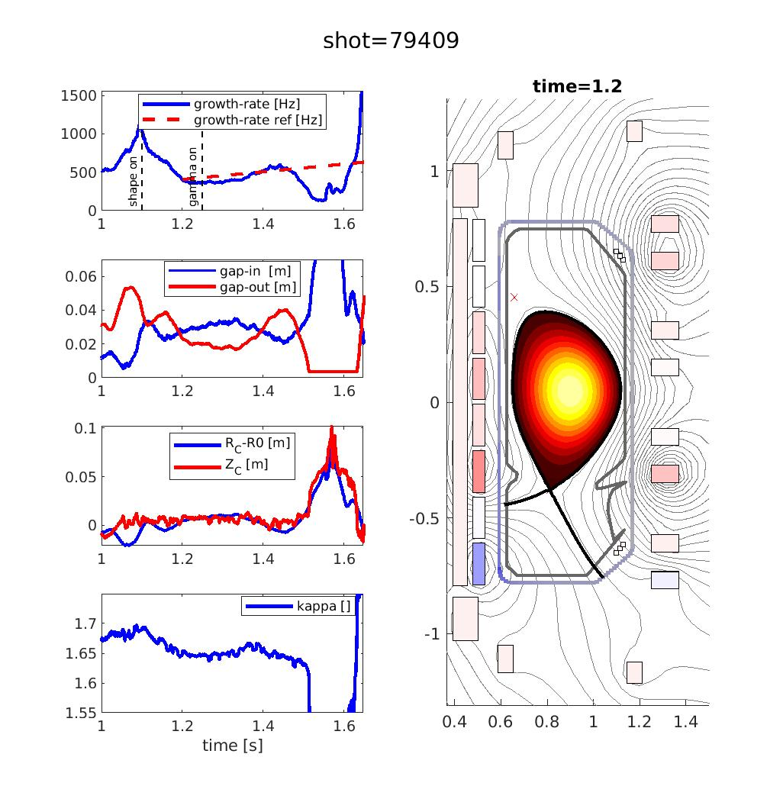
Proximity controller with shape controller: growth-rate control
Shape controller active from 1s. Gamma controller active from 1.25s. Reference is to increase the growth-rate of 300Hz between 1.2s and 1.8s. We expect a change in the elongation from the shape controller to follow the prescribed gamma increase.
No great change in the elongation. The growth-rate increases after ~1.35s due an increase in the gap-out, destabilising the plasma and moving it to the LFS.
The gamma control is not evident and must be simulated more before attempting another experiment, to clarify the main difficulties arising from its coupling with the shape controller.
S. Marchioni 18/04/2024

Slide 14
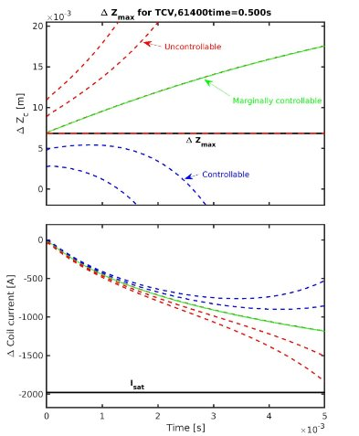
Vertical instability controllability real time estimation: dzmax
RZIp linearisation
Base change
Growth-rate (bisection algorithm)
Eigenvectors
(inverse power method or analytical)
Control coils and PS details
S. Marchioni 18/04/2024

Slide 15
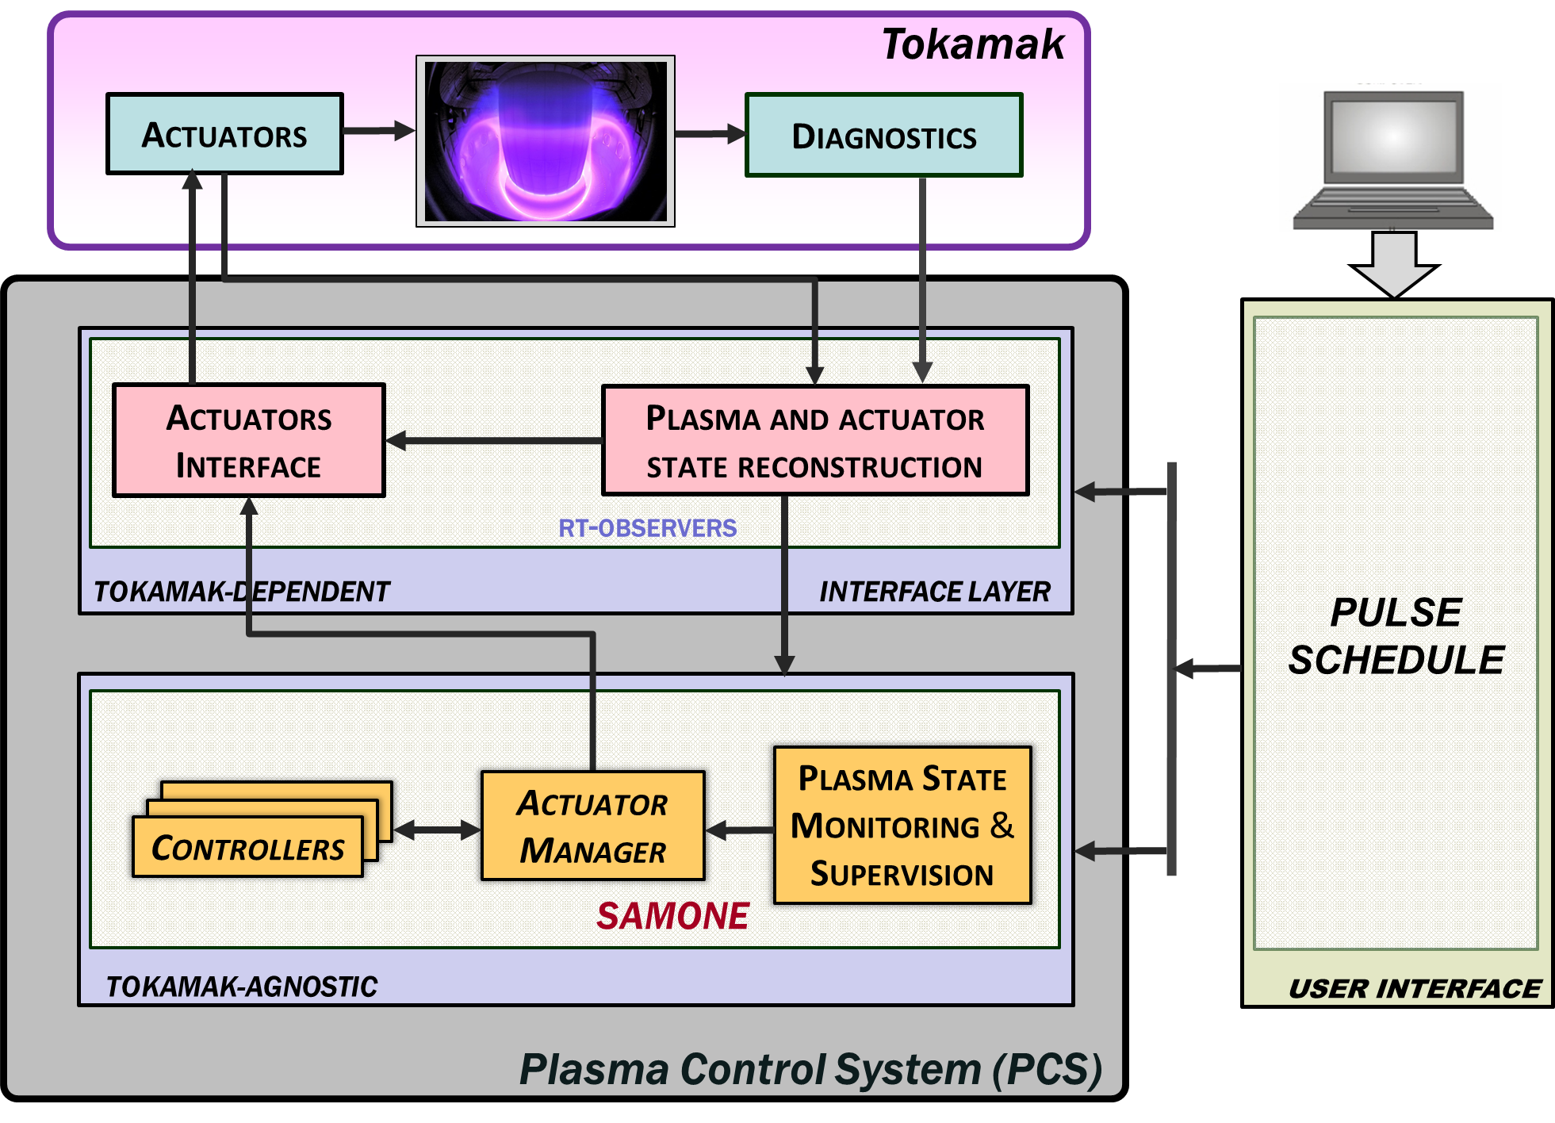
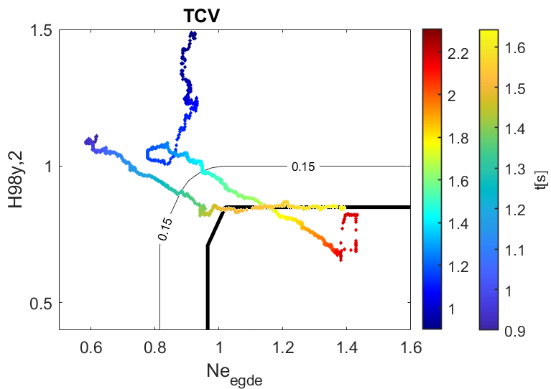
Integrate control in TCV: SAMONE and HDL pulse
S. Marchioni 18/04/2024

Slide 16
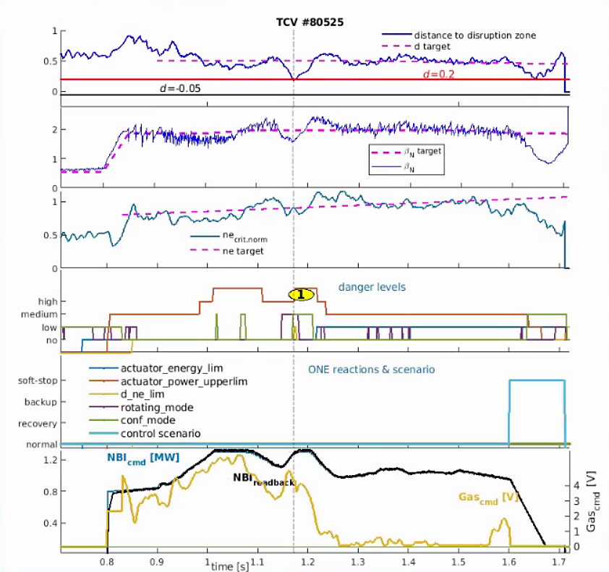
Integrate control in TCV: SAMONE and HDL pulse
Integrated control featuring the following tasks:
Proximity control to density limit
β control
Edge density control (using RAPDENS)
Shape control (constant shape)
NTM preemption
Actuators used:
Gas valve
NBI
ECCD (only in feedforward)
Change of based on danger levels
S. Marchioni 18/04/2024
13

Slide 17
Conclusions
Vertical instability growth-rate estimation working and code being imported in DIII-D.
Proximity controller development working well with simple radial controller, still in initial phase with the shape controller.
New metric developed to track the controllability of the vertical instability, also being imported in DIII-D.
Integrated control with SAMONE proved succesful in managing different tasks.
S. Marchioni 18/04/2024

Slide 18
Backup slides

Slide 19
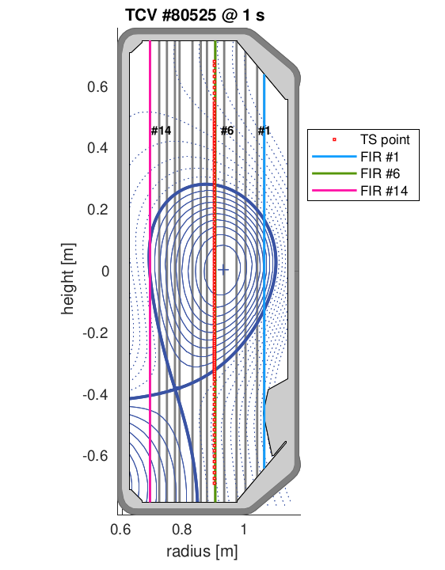
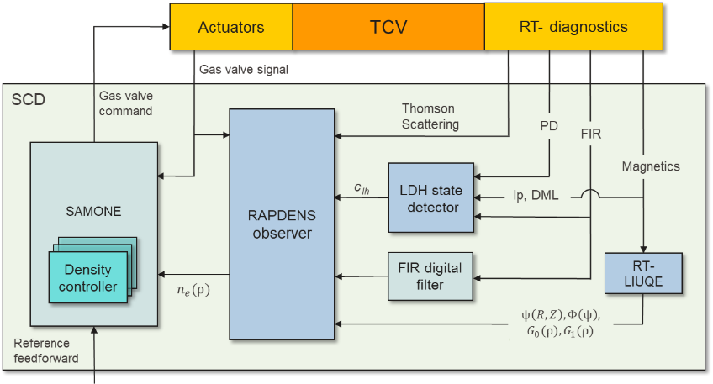
Integrate control in TCV: RAPDENS
S. Marchioni 18/04/2024

Slide 20
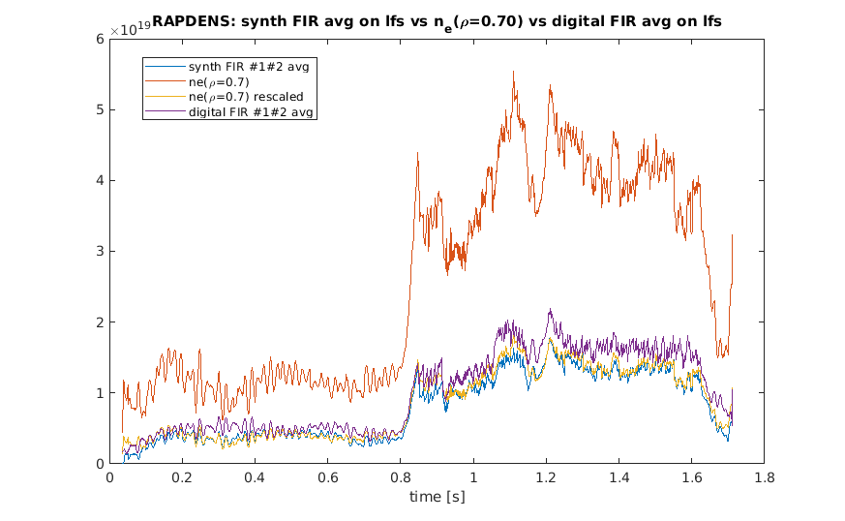
Integrate control in TCV: RAPDENS
RAPDENS results for shot 80525:
S. Marchioni 18/04/2024

