Slide 1










On FIRE mode in KSTAR
Yong-Su Na^{1*}
S.J. Park¹, H. Han², C. Sung³, D. Kim³, J.H. Lee¹, C.H.Heo¹, S.C. Hong^{1,2}, J. Kang², Y.H. Lee², J. Chung², T.S. Hahm¹, B. Kim^{1,2},
J.-K. Park¹, J.G. Bak², M.S. Cha¹, G.J. Choi¹, M.J. Choi², J. Gwak¹, S.H. Hahn², J. Jang², K.C. Lee², J.H. Kim², S.K. Kim^{4,5}, W.C. Kim²,
J. Ko^{2,6}, W.H. Ko^{2,6}, C.Y. Lee², J.H. Lee^{2,6}, J.H. Lee², J.K. Lee^{2,6}, J.P. Lee⁷, K.D. Lee², Y.S. Park^{2,8}, J. Seo⁹, S.M. Yang⁴, S.W. Yoon² and KSTAR Team
*ysna@snu.ac.kr
¹Seoul National Univ., Korea, ²KFE, Korea, ³KAIST, Korea,
⁴PPPL, U.S.A., ⁵Princeton Univ., U.S.A., ⁶KAIST, Korea, ⁷Hanyang Univ., Korea, ⁸Colmbia Univ., U.S.A., ⁹Chung-Ang Univ., Korea

Slide 2
Contents
Introduction
  Goal of tokamak research, Internal transport barrier, and FIRE mode
Experimental Approach
Characteristics of FIRE Mode
  Core: Ion transport barrier characteristics
  Edge: I-mode like structures
  MHD activities
Origin of Confinement Enhancement
  Correlation between fast ions and ITB foot
  Stabilization effects of fast ions on plasma turbulence
Comparison with Other Hot Ion Plasmas
Predictive Modeling
Conclusions

Slide 3
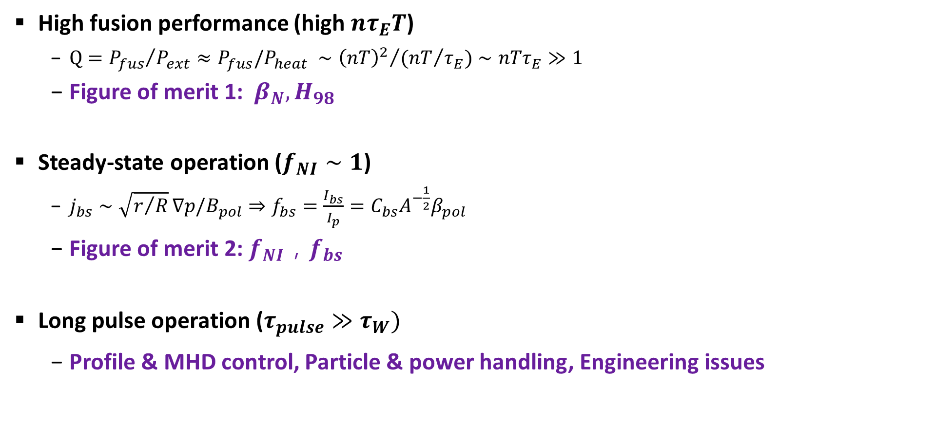
Goal of Tokamak Research
High fusion performance (high $nτ_{E}T$)
  $Q={P_{fus}}/{P_{ext}}≈P_{fus}/P_{heat} ∼{{\left(nT\right)}^{2}}/{{(nT}/{τ_{E}})}∼nTτ_{E}≫1$
  Figure of merit 1: $β_{N}, H_{98}$
Steady-state operation ($f_{NI}∼1$)
  $j_{bs}∼\sqrt{r/R}∇p/B_{pol}⇒f_{bs}=\frac{I_{bs}}{I_{p}}=C_{bs}A^{−\frac{1}{2}}β_{pol}$
  Figure of merit 2: $f_{NI}{，f}_{bs}$
Long pulse operation ($τ_{pulse}≫τ_{W})$
  Profile & MHD control, Particle & power handling, Engineering issues
⇒ “Integrated Advanced Scenarios”

Slide 4
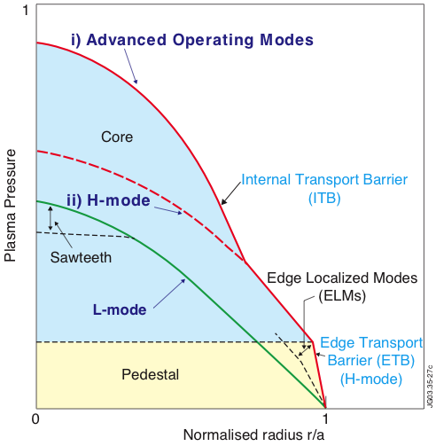
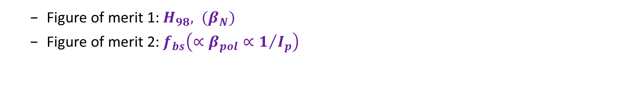
Internal Transport Barrier as an Advanced Scenario
Rationale
  Figure of merit 1: $H_{98}, (β_{N})$
  Figure of merit 2: $f_{bs}\left(∝β_{pol}∝1/{I_{p}}\right)$

Slide 5
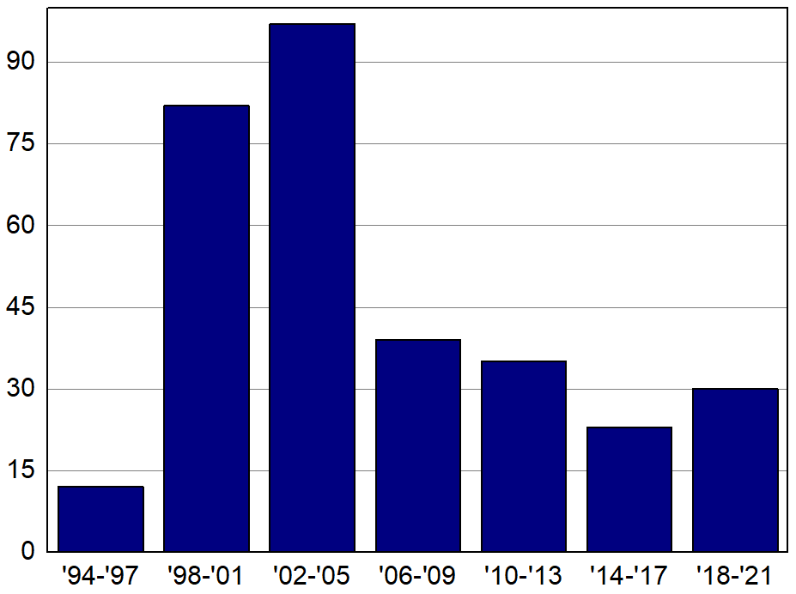
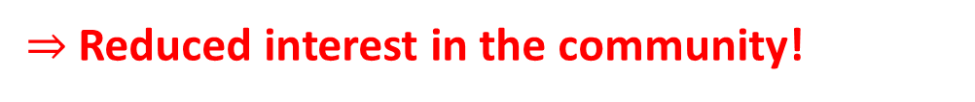
Internal Transport Barrier as an Advanced Scenario
Demerits of ITB scenarios
Difficulty in sustainment
Severe instabilities
ELMs and heat load
Impurity accumulations
Sophisticated profile control
Number of papers with titles including
“Internal Transport Barrier”
$⇒$ Reduced interest in the community!

Slide 6
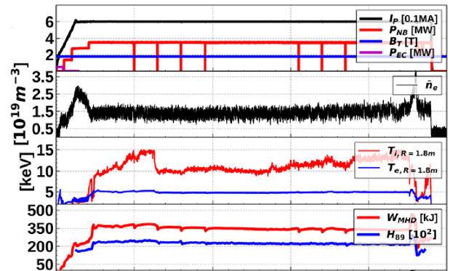
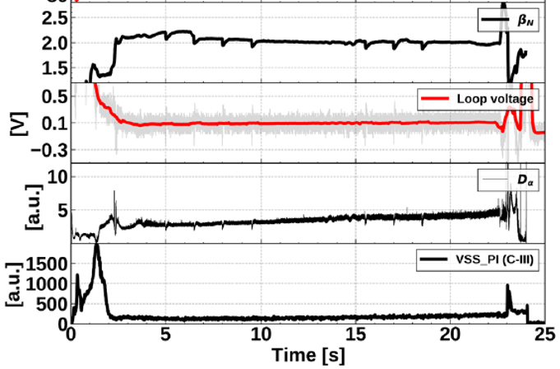
Fast Ion Regulated Enhancement (FIRE) mode^{[1]}
  KSTAR #25860: $I_{P}\sim 600 kA,B_{T}∼1.8 T,q_{95}∼4−5$
β_{N}
NBI
n_{e}
LV
T_{i}
T_{e}
D_{α}
C-III
H₈₉X100
[1] H. Han, S.J. Park and Y.-S. Na et al. Nature 609 269 (2022)
Notes:
Fortunately, we think we could find solutions with so-called Fast Ion Regulated Enhancement mode, FIRE mode.

Slide 7
Fast Ion Regulated Enhancement (FIRE) mode^{[1]}
A new ITB scenario
Difficulty in sustainment
Severe instabilities
ELMs and heat load
Impurity accumulations
Sophisticated profile control
[1] H. Han, S.J. Park and Y.-S. Na et al. Nature 609 269 (2022)
Notes:
(a), (b) time line으로 표시, EC on/off 표시

Slide 8
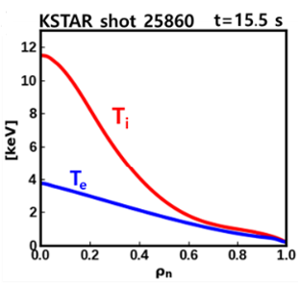
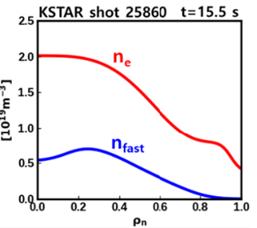

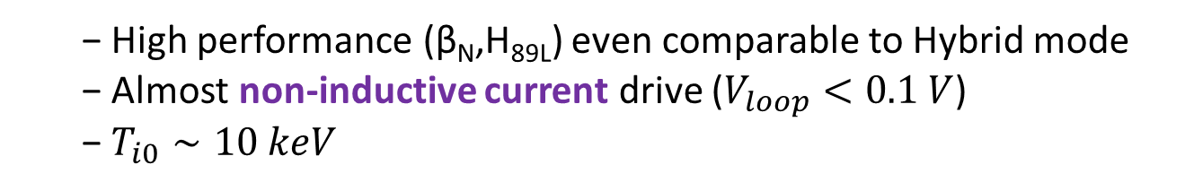
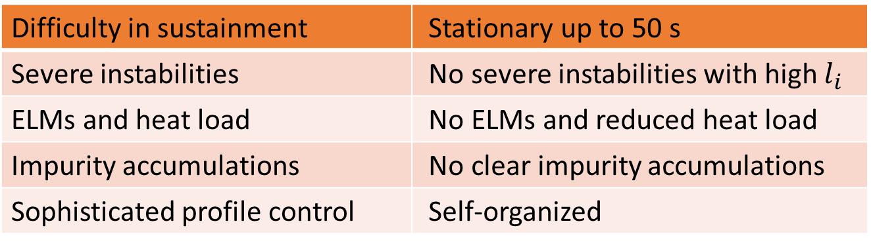
Fast Ion Regulated Enhancement (FIRE) mode^{[1]}
A new ITB scenario
  A stationary ITB in $T_{i}$ channel
  Almost non-inductive current drive ($V_{loop}<0.1 V$)
  $T_{i0}∼10 keV, B_{T}∼1.8 T, t_{pulse}∼20 s, q_{95}∼4−5$
Difficulty in sustainment | Stationary up to 50 s
Severe instabilities | No severe instabilities with high $l_{i}$
ELMs and heat load | No ELMs and reduced heat load
Impurity accumulations | No clear impurity accumulations
Sophisticated profile control | Self-organized
  High performance (β_{N},H_{89L}) even comparable to Hybrid mode
  Almost non-inductive current drive ($V_{loop}<0.1 V$)
  $T_{i0}∼10 keV$
[1] H. Han, S.J. Park and Y.-S. Na et al. Nature 609 269 (2022)
Notes:
(a), (b) time line으로 표시, EC on/off 표시

Slide 9
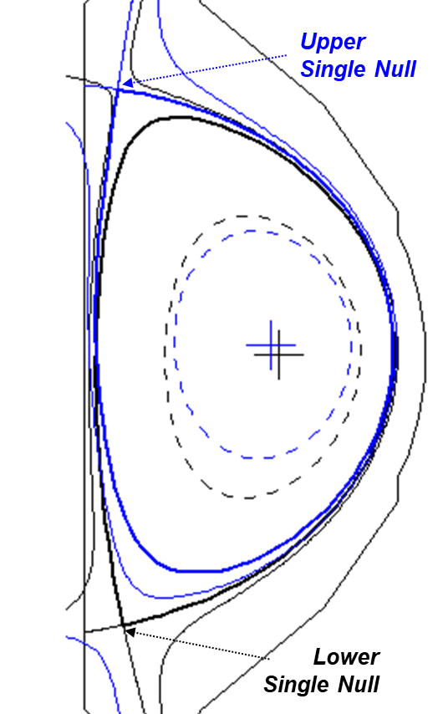
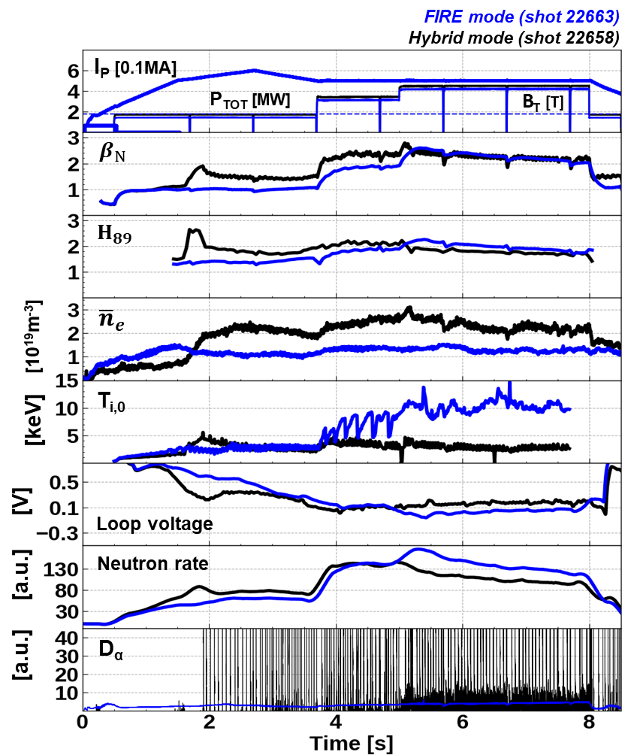
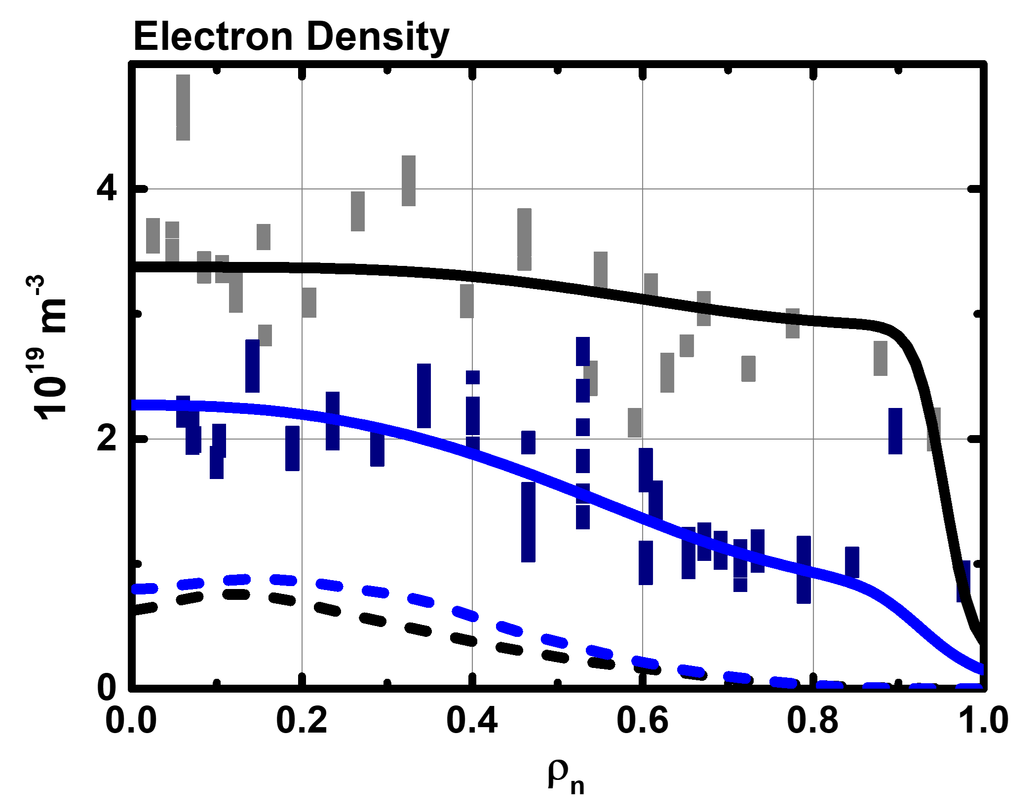
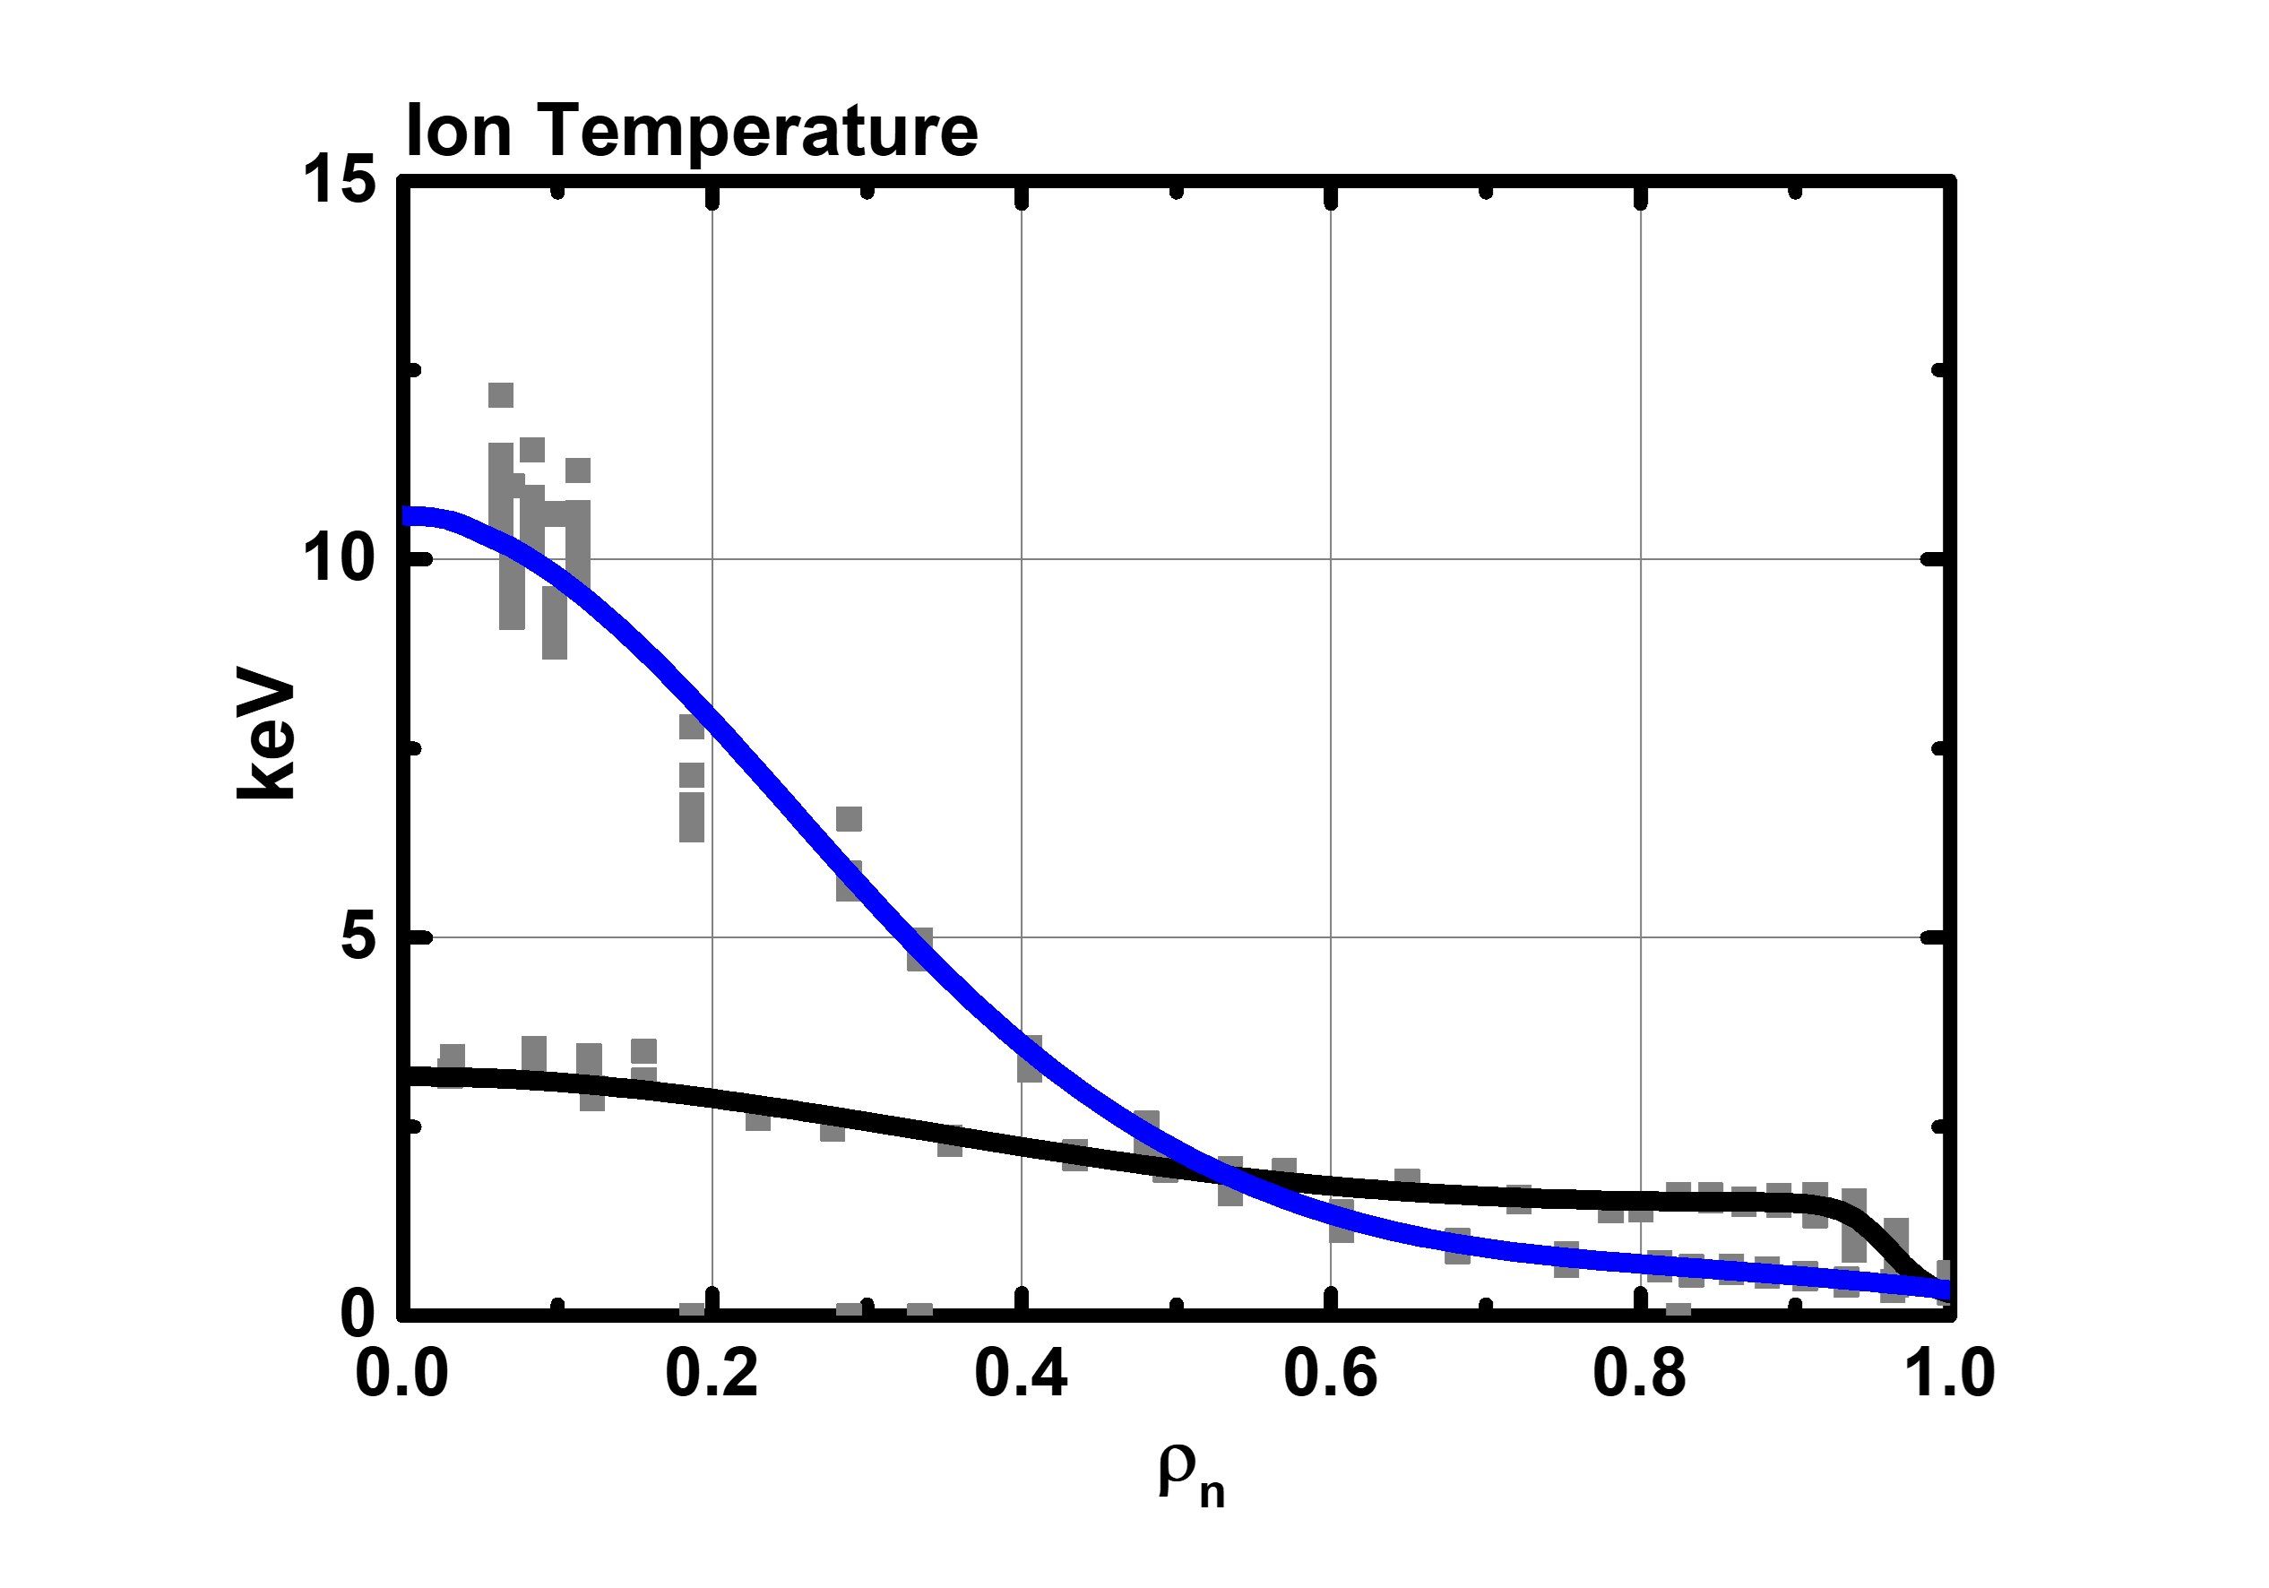
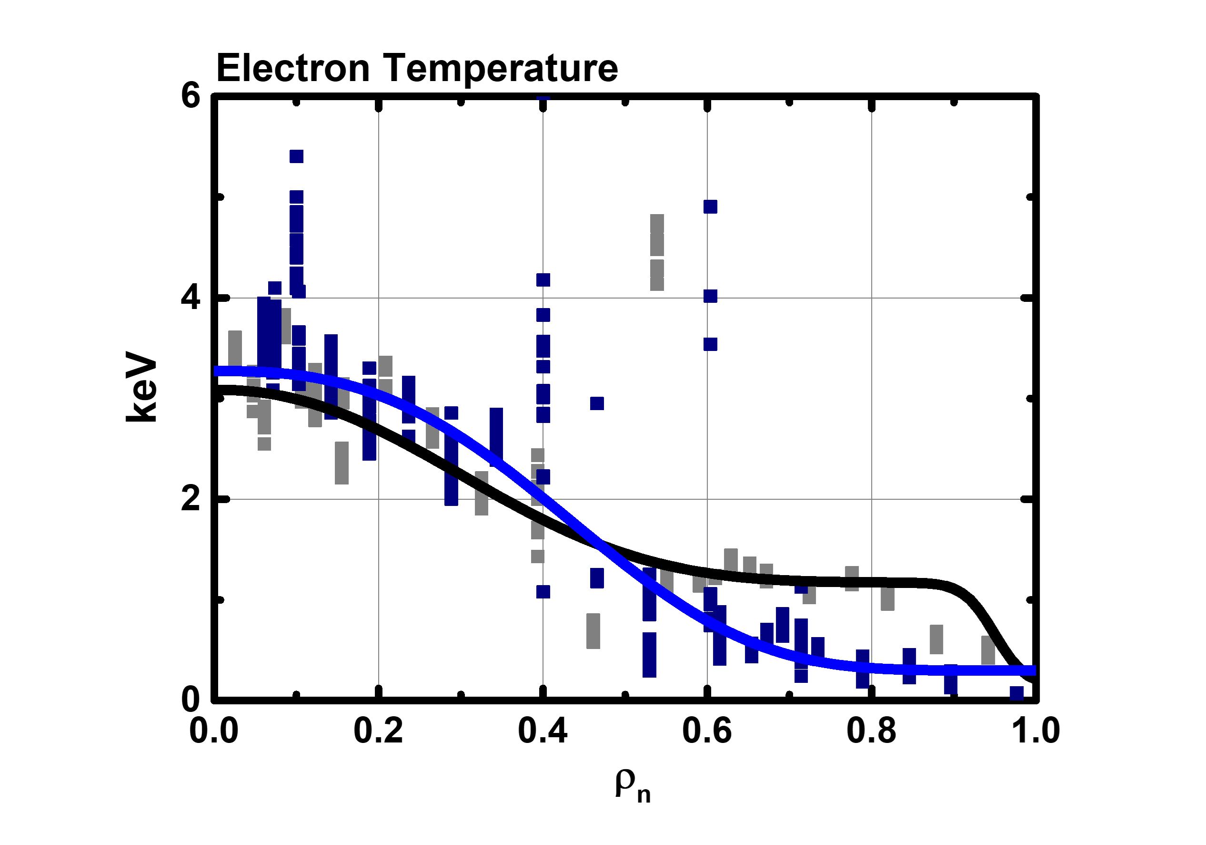
Fast Ion Regulated Enhancement (FIRE) mode^{[1]}
Comparison with hybrid scenario
Almost the same experimental conditions except for the null configuration
(USN vs LSN).
Similar performance of β_{N} < 2.6, H_{89L} < 2.4 but with higher neutron rate in FIRE mode.
Clearly different kinetic profiles (ITB vs ETB)
  <Profiles of FIRE mode and Hybrid scenario>
Comparison at 5.35 s
[1] H. Han, S.J. Park and Y.-S. Na et al. Nature 609 269 (2022)
Notes:
(a), (b) time line으로 표시, EC on/off 표시

Slide 10
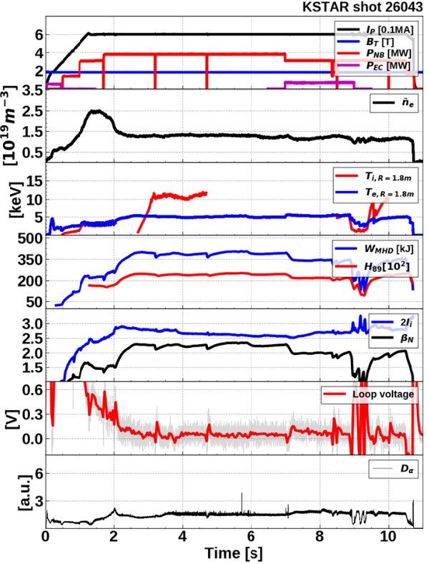
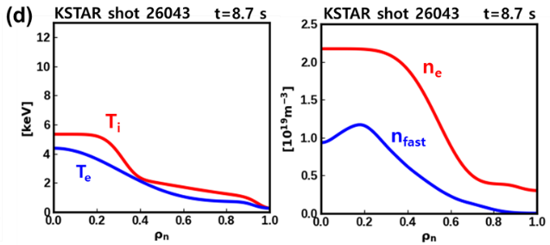

Fast Ion Regulated Enhancement (FIRE) mode^{[1]}
Time evolution of 0d parameters
Reactor relevant $Ti\sim Te$ condition in FIRE mode
  Some NBI power replaced by ECH
  Still sustained ion ITB & high content of fast ions
  $⇒$ A possible new advanced scenario
  in reactor-relevant condition of $Ti\sim Te$
EC On
[1] H. Han, S.J. Park and Y.-S. Na et al. Nature 609 269 (2022)
Notes:
(a), (b) time line으로 표시, EC on/off 표시

Slide 11
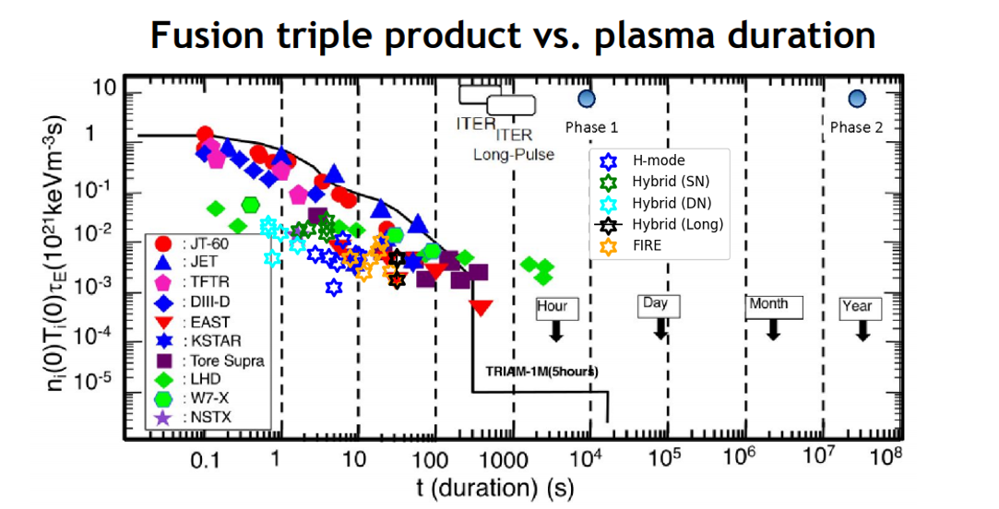
Fast Ion Regulated Enhancement (FIRE) mode
Notes:
(a), (b) time line으로 표시, EC on/off 표시

Slide 12
Contents
Introduction
  Goal of tokamak research, Internal transport barrier, and FIRE mode
Experimental Approach
Characteristics of FIRE Mode
  Core: Ion transport barrier characteristics
  Edge: I-mode like structures
  MHD activities
Origin of Confinement Enhancement
  Correlation between fast ions and ITB foot
  Stabilization effects of fast ions on plasma turbulence
Comparison with Other Hot Ion Plasmas
Predictive Modeling
Conclusions

Slide 13
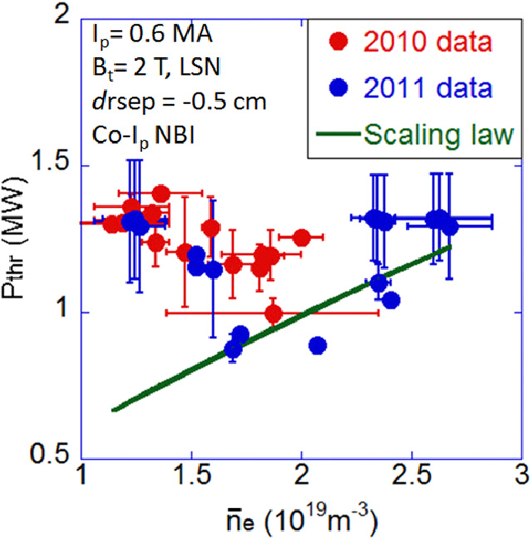
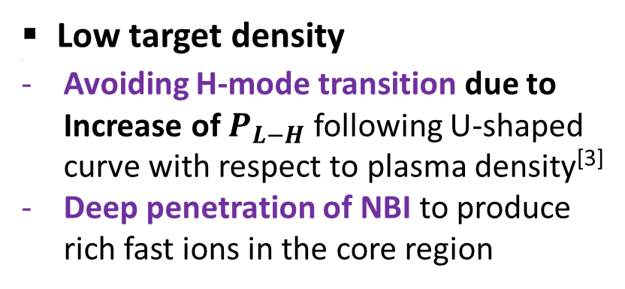
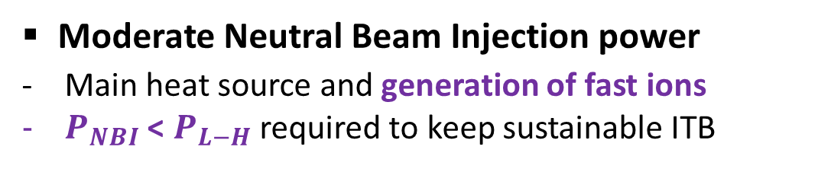
Key Factors to Access FIRE mode^{[2]}
Moderate Neutral Beam Injection power
Main heat source and generation of fast ions
$P_{NBI}$ < $P_{L−H}$ required to keep sustainable ITB
Low target density
Avoiding H-mode transition due to Increase of $P_{L−H}$ following U-shaped curve with respect to plasma density^{[3]}
Deep penetration of NBI to produce rich fast ions in the core region
Diverted configuration
Reducing influx of particles from plasma-wall interactions
[2] H.S. Han, POP 31, 032506 (2024)
[3] J. W. Ahn et al., NF 52 114001 (2012)

Slide 14
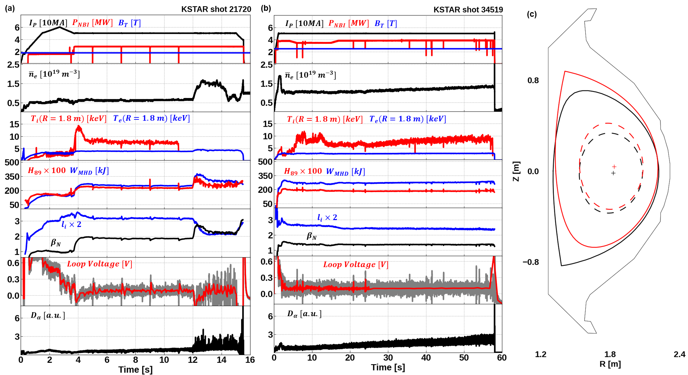
Key Factors to Access FIRE mode
1.8 T
2.5 T

Slide 15
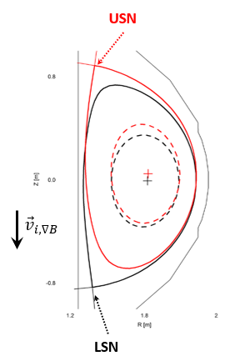
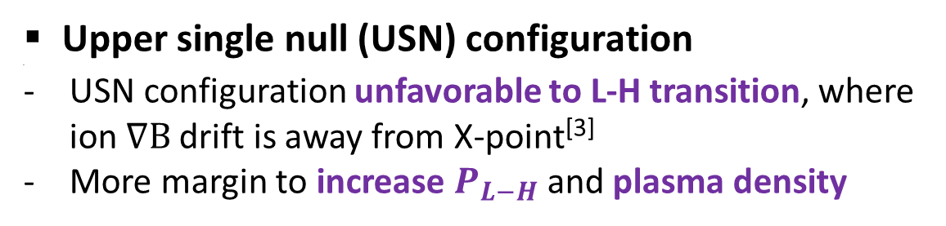
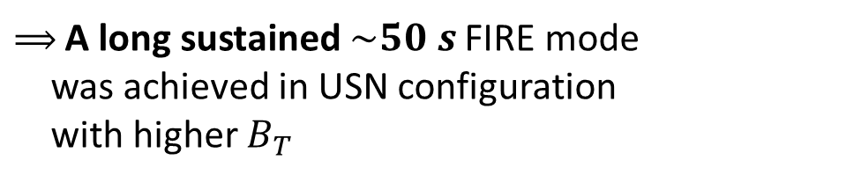
Further Optimization for FIRE mode
Upper single null (USN) configuration
USN configuration unfavorable to L-H transition, where ion $∇B$ drift is away from X-point^{[3]}
More margin to increase $P_{L−H}$ and plasma density
$⟹$A long sustained $\sim 50 s$ FIRE mode
was achieved in USN configuration
with higher $B_{T}$
The optimization between plasma performance and long-sustainability is still being investigated.
[3] L. Chen et al., PoP 25 072504 (2018)

Slide 16
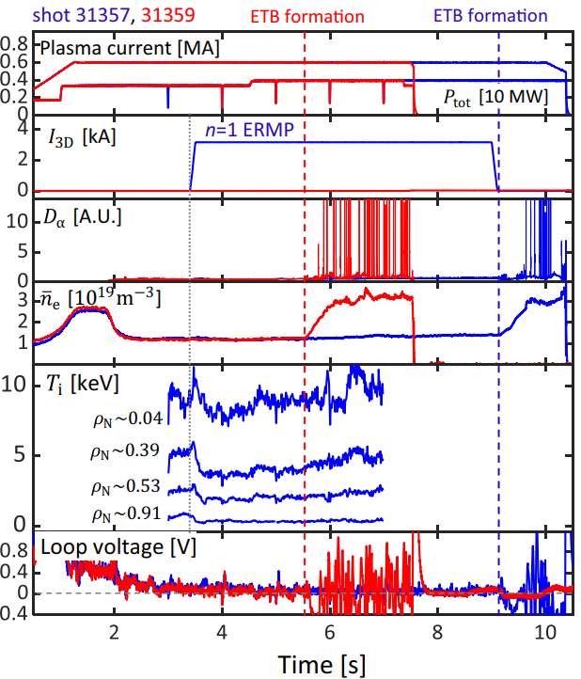
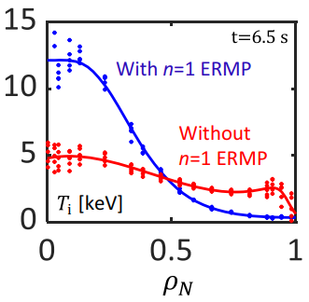
Further Optimization for FIRE mode
Avoiding H-mode transition
L-H transition avoided with n = 1 ERMP and high performance sustained*
*S. Yang et al., Naure Comm. 15 1275 (2024)

Slide 17
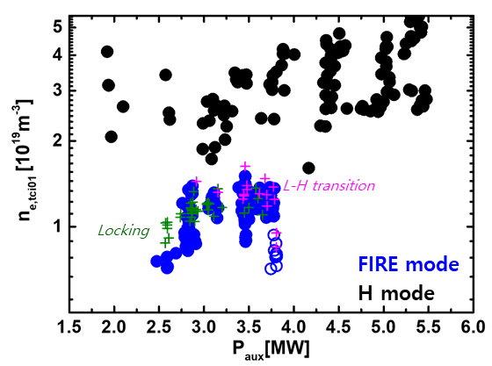
Operation Window of FIRE mode
LSN
USN
Yong-Su Na | NSTX-U 2024 | Page

Slide 18
Contents
Introduction
  Goal of tokamak research, Internal transport barrier, and FIRE mode
Experimental Approach
Characteristics of FIRE Mode
  Core: Ion transport barrier characteristics
  Edge: I-mode like structures
  MHD activities
Origin of Confinement Enhancement
  Correlation between fast ions and ITB foot
  Stabilization effects of fast ions on plasma turbulence
Comparison with Other Hot Ion Plasmas
Predictive Modeling
Conclusions

Slide 19
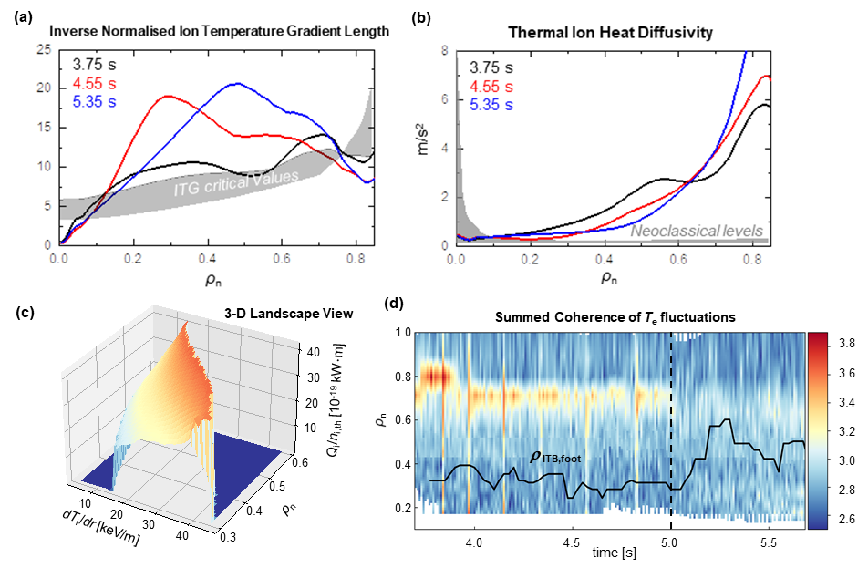
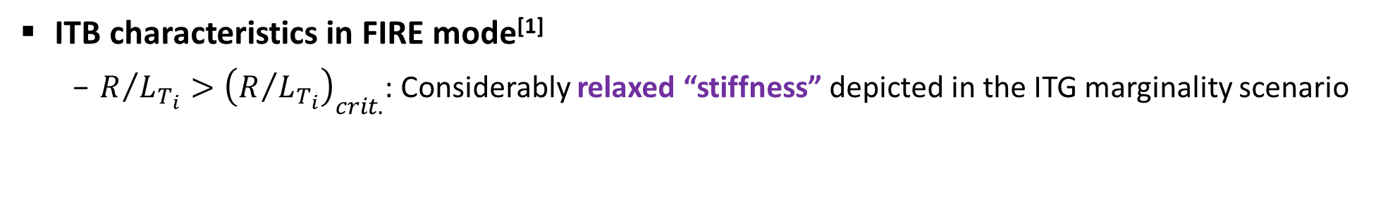
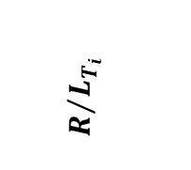
Core Characteristics in FIRE mode
ITB characteristics in FIRE mode^{[1]}
  $R/{L_{T_{i}}}>{\left(R/{L_{T_{i}}}\right)}_{crit.}$: Considerably relaxed “stiffness” depicted in the ITG marginality scenario
  $χ_{i}$ decreased over time, but above the neoclassical level,
  correlated with the expansion of the ITB foot in time
$$R/{L_{T_{i}}}$$
※ Power balance analysis
by TRIASSIC^{[4]} with
CHEASE^{[5]}, NCLASS^{[6]},
NUBEAM^{[7]}, ASTRA^{[8]}
ITB foot
[1] H. Han, et al. Nature 609 269 (2022)
[4] C.Y. Lee, et al., NF 61 96020 (2021)
[5] H. Lütjens, et al., CPC 97 219 (1996)
[6] W.A. Houlberg, et al., PoP 4 3230 (1997)
[7] A. Pankin, et al., CPC 159 157 (2004)
[8] G. Pereverzev, et al., IPP (2002)
Notes:
화질구지

Slide 20

Core Characteristics in FIRE mode
ITB characteristics in FIRE mode^{[1]}
  Transport bifurcation at $ρ_{n}∼0.3≈ρ_{ITB,foot}$
  “S-curve” between ion energy flux vs. ion temperature gradient
  Reduction in fluctuations measured by Electron Cyclotron Emission Imaging system
Ion Energy Flux Landscape
[1] H. Han, S.J. Park and Y.-S. Na et al. Nature 609 269 (2022)

Slide 21
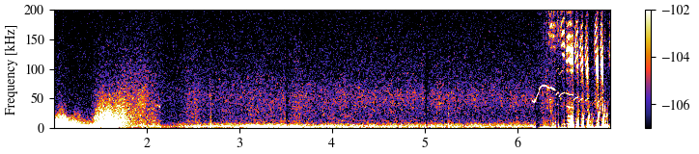
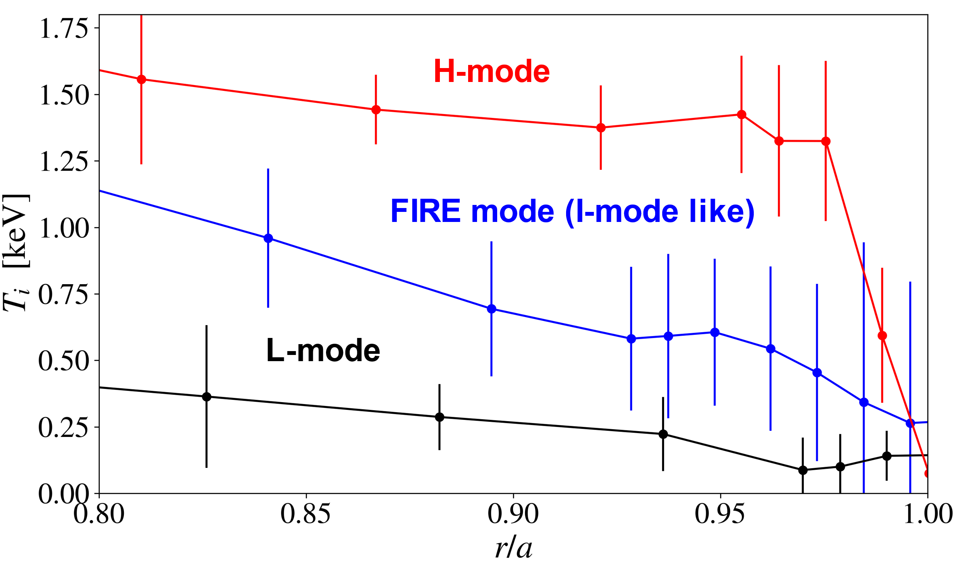
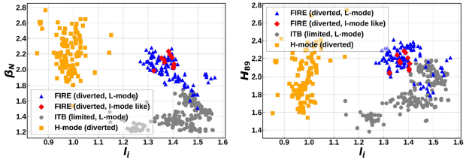

Edge Characteristics in FIRE mode
I-mode like structures at the edge region in some discharges
  ETB only in the energy channel, not in the particle channel
  Conjectured weekly coherent mode (WCM) around 50 kHz in the BES edge signals, propagating in the ion diamagnetic direction in the laboratory frame
  Higher performance ($β_{N}$, $H_{89}$) and lower $l_{i}$ due to larger $j_{bs}$ with I-mode structure
BES signal
KSTAR shot 31923 at r/a=0.95
WCM
H-mode
FIRE+I-mode
FIRE+I-mode
FIRE
FIRE
ITB
ITB
H-mode

Slide 22
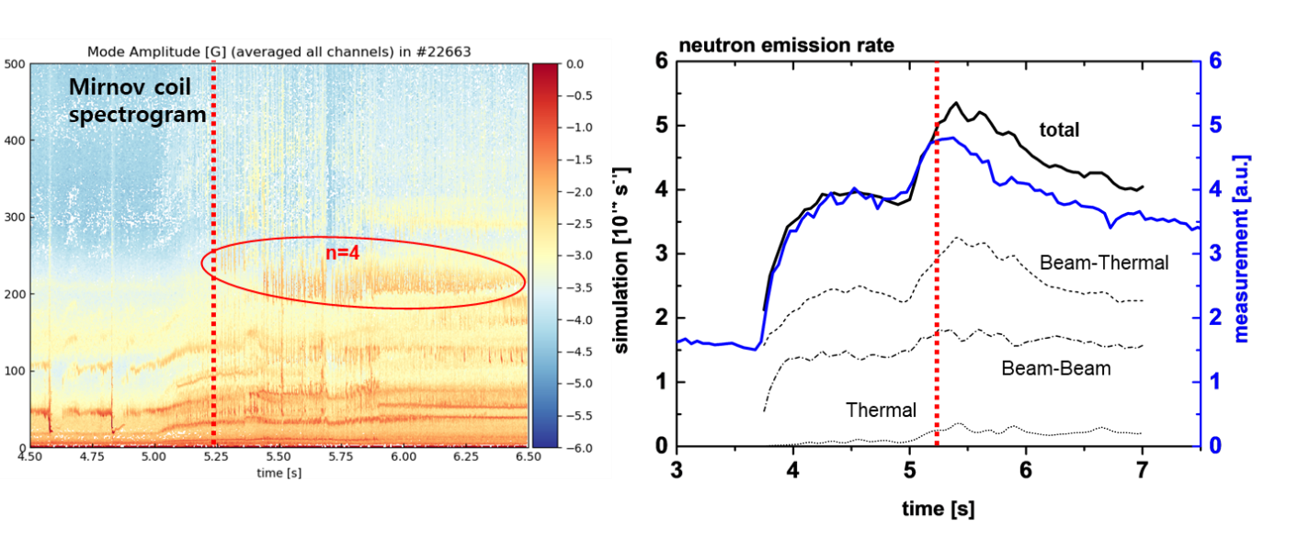
MHD Activities in FIRE mode
Fast ion driven Alfven Eigenmode
  Neutron deficit appeared after the AEs occurred compared with the NUBEAM calculation.

Slide 23
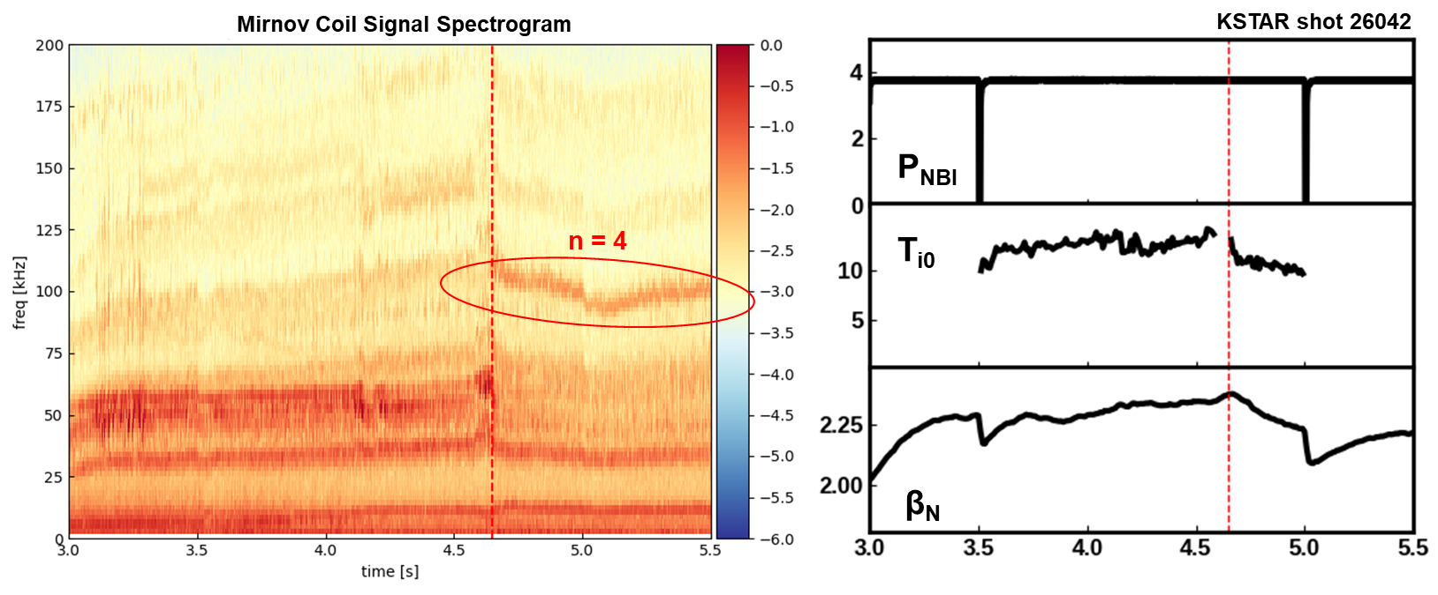
MHD Activities in FIRE mode
Other MHD modes
  High and low frequency modes (not TM) observed
  Not significant impact on plasma performance
  Details under investigation

Slide 24
Contents
Introduction
  Goal of tokamak research, Internal transport barrier, and FIRE mode
Experimental Approach
Characteristics of FIRE Mode
  Core: Ion transport barrier characteristics
  Edge: I-mode like structures
  MHD activities
Origin of Confinement Enhancement
  Correlation between fast ions and ITB foot
  Stabilization effects of fast ions on plasma turbulence
Comparison with Other Hot Ion Plasmas
Predictive Modeling
Conclusions

Slide 25
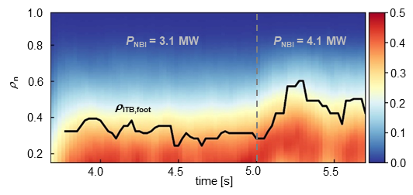


Origin of Confinement Enhancement
Correlation between fast ion density fraction and ITB foot^{[1]}
  Strong relation of the energy confinement to the fast ions
  Clearly remaining ITB with $T_{i}∼T_{e}$ condition in presence of the large fast ion density fraction
$⟹$ Significant effect of fast ions on stabilizing turbulence expected
$$n_{fast}/n_{e}$$
KSTAR shot 22663
EC On
[1] H. Han, S.J. Park and Y.-S. Na et al. Nature 609 269 (2022)

Slide 26
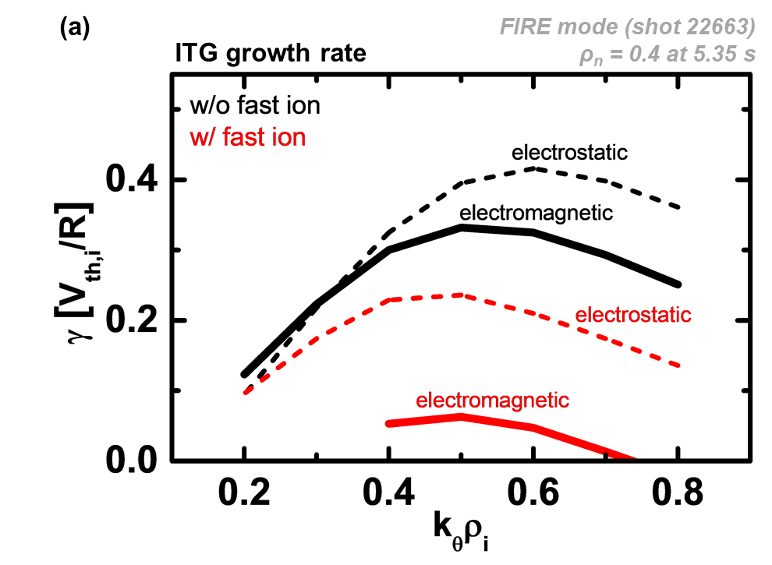
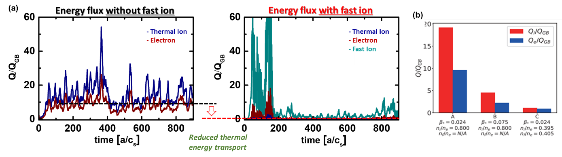
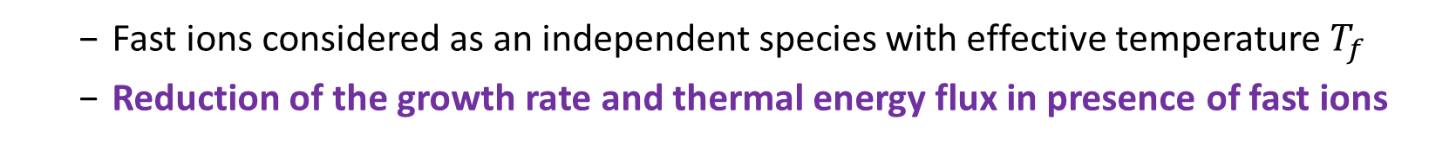
Examination of Fast Ion Effect on Turbulence
Gyrokinetic simulations with fast ions for FIRE mode
  Fast ions considered as an independent species with effective temperature $T_{f}$
  Reduction of the growth rate and thermal energy flux in presence of fast ions
GKW^{[9]} linear simulation
CGYRO^{[10]} non-linear simulation
w/o fast ion
W fast ion
[9] A. G. Peeters, et al., CPC 180 2650 (2009)
[10] J. Candy et al., JCP 324 73 (2016)

Slide 27
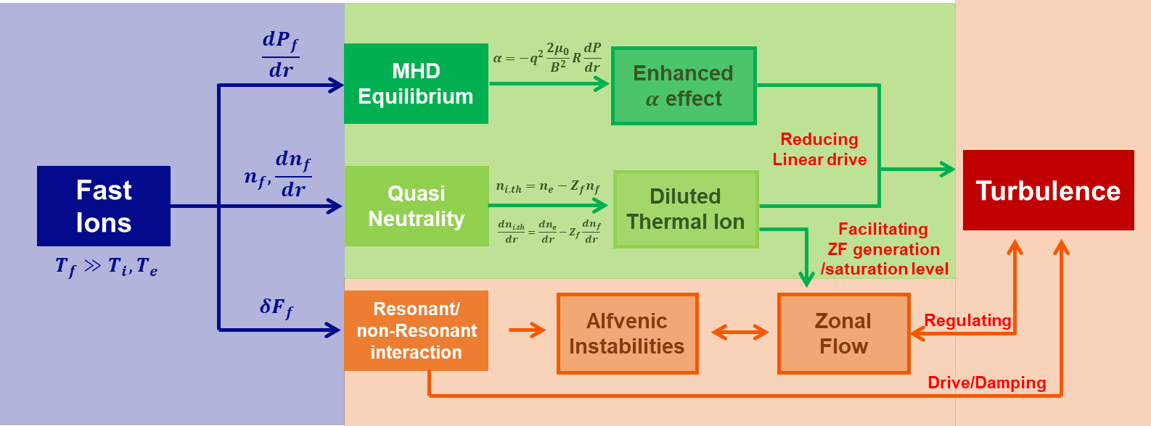
Fast Ions’ Effects on Turbulence
Stabilization effects of Fast ions on plasma turbulence

Slide 28
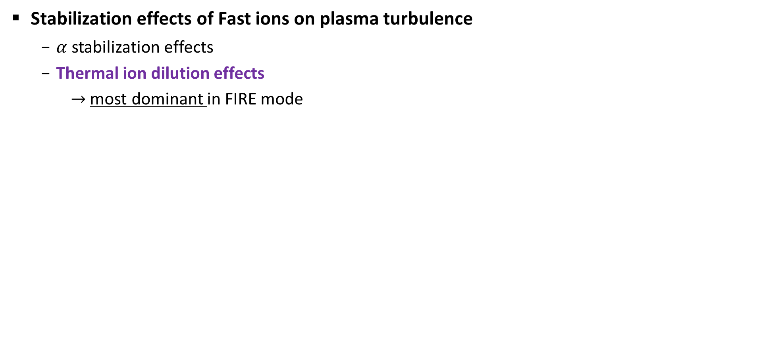


Fast Ions’ Effects on Turbulence
Stabilization effects of Fast ions on plasma turbulence
  $α$ stabilization effects
CGYRO non-linear simulations^{[11]}
$α$ effect
[11] D. Kim et al., NF 63 124001 (2023)

Slide 29
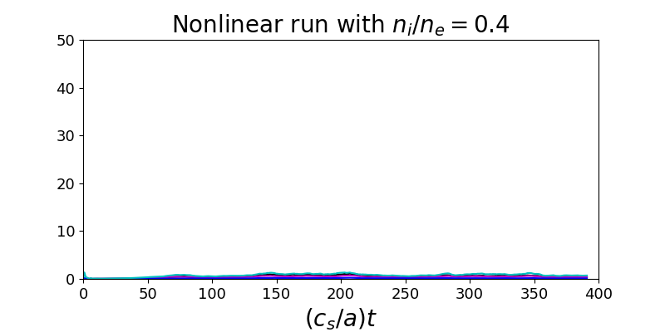



Fast Ions’ Effects on Turbulence
Stabilization effects of Fast ions on plasma turbulence
  Thermal ion dilution effects
  $→$ Energy flux reduced as n_{i}/n_{e} is reduced
  $→$ Even more reduced as a/L_{ni} is inverted
Reduction of n_{i}
due to fast ion
w fast ion
$α$ effect
Dilution
effect
w fast ion
Reduction of n_{i}
due to fast ion
∆
CGYRO non-linear simulations^{[11]}
[11] D. Kim et al., NF 63 124001 (2023)

Slide 30





Fast Ions’ Effects on Turbulence
Stabilization effects of Fast ions on plasma turbulence
  Thermal ion dilution effects
  $→$ zonal flow enhanced
Zonal flow growth rate in presence of fast ions^{[12]}
Saturated Turbulence level ^{[13]}
$$ε_{DW} ∝{\left(1−f_{h}\right)}^{3}{\left({L_{n_{e}}}/{L_{n_{i}}}\right)}^{2}$$
Zonal flow
growth rate
normalized zonal flow growth rate
Zonal flow
threshold
$f_{h}=Z_{f}n_{f0}/n_{e0}$:
fraction of fast ion charge density
amplitude of pump wave
radial wavenumber
[12] T.S. Hahm, et al., PoP 30 072501 (2023) [13] G.J. Choi et al NF 64 016029 (2024)

Slide 31












Fast Ions’ Effects on Turbulence
Direct interaction between fast ions and turbulence
  Less contribution to turbulence (ITG, TEM) than thermal ion
  Minor changes observed in the linear GKW analysis when utilizing the fast ion distribution similar to the NUBEAM calculated distribution (preliminary)
NUBEAM
$$F_{f}\left(μ,v_{∥}\right)$$
Shifted Maxwell.
$$F_{f}\left(μ,v_{∥}\right)$$
Growth Rate $γ$
Shot 30239
anisotropy
anisotropy
w/o fast ion
$$v_{∥}/c_{s}$$
$$v_{∥}/c_{s}$$
$$E=1.5T_{i}$$
$$E=1.5T_{i}$$
Dilution
thermalization
thermalization
Wave-ptl interaction
$$μB_{0}/2T_{e}$$
$$μB_{0}/2T_{e}$$

Slide 32
Contents
Introduction
  Goal of tokamak research, Internal transport barrier, and FIRE mode
Experimental Approach
Characteristics of FIRE Mode
  Core: Ion transport barrier characteristics
  Edge: I-mode like structures
  MHD activities
Origin of Confinement Enhancement
  Correlation between fast ions and ITB foot
  Stabilization effects of fast ions on plasma turbulence
Comparison with Other Hot Ion Plasmas
Predictive Modeling
Conclusions

Slide 33
Comparison with Other Hot Ion Plasmas
[1] J. Jacquinot et al 1999 PPCF 41 A13
[2] R.J. Hawryluk et al 1998 RMP 70 2
[3] A.S. Liang et al 2023 NF 63 056017
Operation mode, Tokamak | Core transport | ITB | ETB | Duration | Ti/Te | SOL limiter divertor
Supershot, TFTR^{[1,2]} | Reduced | No | No | Transient | High | Low recycling: lithium conditioning
Hot-ion H-mode, JET^{[1,2]} | Strong reduction | No | Yes no ELMs | Transient | High | Low recycling
Ion ITB with I-mode, HL-2A^{[3]} | Reduced | Yes | ETB in T_{e} | Transient | High
Ion ITB by fast ion, ASDEX-Upgrade^{[4]} | Reduced | Yes | No | Transient | High
Hot ion mode, ST-40^{[5]} | Reduced | No | No | Transient | High
Hot-ion H-mode, Globus-M2^{[6]} | Reduced | Yes | Yes | Transient | High
FIRE mode, KSTAR | Reduced | Yes | Possible | CW | Low to high | Low recycling
[4] G. Tardini et al 2007 NF 47 280, [5] S.A.M. McNamara et al 2023 NF 63 054002
[6] G.S. Kurskiev et al 2022 NF 62 104002

Slide 34
Contents
Introduction
  Goal of tokamak research, Internal transport barrier, and FIRE mode
Experimental Approach
Characteristics of FIRE Mode
  Core: Ion transport barrier characteristics
  Edge: I-mode like structures
  MHD activities
Origin of Confinement Enhancement
  Correlation between fast ions and ITB foot
  Stabilization effects of fast ions on plasma turbulence
Comparison with Other Hot Ion Plasmas
Predictive Modeling
Conclusions

Slide 35


Predictive Modelling for the Basis of Future Projections
ASTRA^{[8]}
CHEASE^{[5]}
A FIRE mode, #26043 @4.3s
Integrated suite of code, TRIASSIC^{[1]} used
$$t→t+Δt$$
Equilibrium
FRANTIC^{[15]}
Neutral source
NCLASS^{[6]}
Dominant dilution effects evaluated with TGLF^{[14]}
TRIASSIC^{[4]}
Neo-classical transport
Neutral
beam
Anomalous
transport
NUBEAM^{[7]}
TGLF^{[4]}
[4] C.Y. Lee, et al., NF 61 96020 (2021)
[5] H. Lütjens, et al., CPC 97 219 (1996)
[6] W.A. Houlberg, et al.,PoP 4 3230 (1997)
[12] G.M. Staebler, et al., PoP 12 102508 (2005)
[7] A. Pankin, et al., CPC 159 157 (2004)
[13] S. Tamor, et al., JoCP 40 104 (1981)
[8] G. Pereverzev, et al., IPP (2002)

Slide 36






Predictive Modelling for the Basis of Future Projections
ASTRA^{[8]}
CHEASE^{[5]}
A FIRE mode, #26043 @4.3s
Integrated suite of code, TRIASSIC^{[1]} used
$$t→t+Δt$$
Equilibrium
FRANTIC^{[15]}
Neutral source
TRIASSIC^{[4]}
NCLASS^{[6]}
Neo-classical transport
Several effects evaluated with TGLF^{[14]}
  Dilution effect, ExB shearing effect, electromagnetic fluctuation
Neutral
beam
Anomalous
transport
NUBEAM^{[7]}
TGLF^{[4]}
Exp.(fitting) All considered No dilution No $ω_{E×B}$ No $δB_{⊥}$
$$T_{i}$$
$$T_{e}$$
$$n_{e}$$
[4] C.Y. Lee, et al., NF 61 96020 (2021)
[5] H. Lütjens, et al., CPC 97 219 (1996)
[6] W.A. Houlberg, et al.,PoP 4 3230 (1997)
[12] G.M. Staebler, et al., PoP 12 102508 (2005)
[7] A. Pankin, et al., CPC 159 157 (2004)
[13] S. Tamor, et al., JoCP 40 104 (1981)
[8] G. Pereverzev, et al., IPP (2002)
$θ_{trapped}=0.5$ used to match the growth rate of ion-scale turbulence from GKW

Slide 37
Contents
Introduction
  Goal of tokamak research, Internal transport barrier, and FIRE mode
Experimental Approach
Characteristics of FIRE Mode
  Core: Ion transport barrier characteristics
  Edge: I-mode like structures
  MHD activities
Origin of Confinement Enhancement
  Correlation between fast ions and ITB foot
  Stabilization effects of fast ions on plasma turbulence
Comparison with Other Hot Ion Plasmas
Predictive Modeling
Conclusions

Slide 38

Conclusion
A new ITB scenario, “FIRE mode” (Fast Ion Regulated Enhancement mode)
  High performance and low loop voltage with
    Stationary long-pulse up to ~５0 s so far
    No severe instabilities including ELMs
    No impurity accumulation
    No requirement for delicate feedback control
  Recipe: Moderate NBI at low density in diverted configuration by avoiding the L-H transition
Role of fast ions in ITG turbulence stabilization in FIRE mode
  Enhanced $α$ effect, most significantly dilution effect (due to reduced $n_{i,th}$ and $R/n_{i,th}$)
  Reproduced by predictive modeling with TGLF
Remaining Issues
  Increase the performance by broadening the ITB and/or strengthening the I-mode like edge
  Increase the bootstrap current fraction (so far ~20%)
  Access the high plasma density regime for higher fusion power
  Extrapolation to future devices

Slide 39
Post-credits scene

Slide 40
Operation Window of FIRE mode
LSN
USN
Yong-Su Na | NSTX-U 2024 | Page

Slide 41

Predictive Modelling for High Density Operation
  Explored numerically using the predictive models with P_{NB} = 7.5 MW, E_{NB} = 100 keV
  The density profile prescribed twice of the experimental value at 4.2 s of shot 26043

Slide 42
High Density Operation in Experiment
High density while avoiding H mode transition
  Supersonic molecular beam injection (SMBI) or pellet injection for increase
  of the core density
  Higher Ip, Bt for higher density and better fast ion confinement
  USN or negative triangularity
  ERMP to avoid H-mode transition

Slide 43
Thank you.

Slide 44
Prospect
High density regime by avoiding L-H transition
  High beam energy
  Elongated plasmas for deeper penetration of the beam
  Negative triangularity
p-B reaction
  Two-component, Beam-target fusion
Trigger of alpha dominant heating
  NBI would be needed in fusion reactors for load control together with fuelling
  Ignite alpha heating with fast ions

Slide 45

Comparison between Hot ion mode and FIRE mode
Characteristics of tokamak modes
FIRE mode
CW
None (due to ??)
Reduced
YES
Possible
Low recycling
Ref. J Jacquinot and the JET team 1999 Plasma Phys. Control. Fusion 41 A13

Slide 46







Supershot/Hot Ion Mode vs FIRE Mode
Similarity
Difference
NBI heating low density ¹⁾
High core T_{i} ¹⁾
No ELMs ¹⁾
High fraction of fast ions n_{fast}/n_{e} $≲$ 50% ²⁾
Stationarity
Impurity issues ³⁾
Transport property ²⁾
ExB shearing model effectively works in Supershots ⁴⁾
Compatible with I-mode like edge
< FIRE >
< FIRE >
< Supeprshot >
< Supeprshot >
P_{NBI} ~ 3 - 4 MW
P_{NBI} ~ 20 – 30 MW
$$τ_{pulse} \sim 10 s$$
$$τ_{pulse} \sim 1 s$$
$\overline{n_{e}}$ ~ 0.5 - 1.5 x 10¹⁹ m⁻³
$\overline{n_{e}}$ ~ 1 - 4 x 10¹⁹ m⁻³
< FIRE >
< Supeprshot >
< FIRE >
< Supeprshot >
No sign
of impurities
degradation
due to carbon influx
T_{i,0} ~ 10 keV
T_{i,0} ~ 20 - 30 keV
< FIRE >
< Supeprshot >
$$\frac{R}{LTi} > {\left(\frac{R}{LTi}\right)}_{cri}$$
$$\frac{R}{LTi} \sim {\left(\frac{R}{LTi}\right)}_{cri}$$
J.D Strachan, PRL, ’87
S.D. Scott, PRL, ‘89
A.T. Ramsey, ‘91
D.R. Ernst, PLR, ‘98

Slide 47







Hot Ion Mode vs FIRE Mode
“Enhancement of
$R/{L_{T,crit}}$
with ${T_{i}}/{T_{e}}$”
“De-stiffening
with Fast Ions”
[S. Scott et al., PRL (1990)]
TFTR
[H. Han, et al., Nature (2022)]
KSTAR
Overall peaking in $T_{i}\left(r\right)$
ITB in $T_{i}\left(r\right)$

Slide 48








Fast ion amount in hot ion mode
KSTAR FIRE typically
$\frac{W_{f}}{\left\langle W_{total}\right\rangle } \sim 0.6$
$\frac{n_{f,0}}{n_{e,0}}< 0.4−0.5$
Usually, low density with high fast ion amount
However, not always large amount of fast ions for hot ion H-mode
TFTR supershot and hot ion mode have large amount of fast ions ($\frac{n_{f,0}}{n_{e,0}}=0.1 −0.4$)
[R.V. Budny, NF, ’16]
[S.D. Scott, PRL, ’90]
TFTR Supershot #80539
(highest P_{DT})
JET Hot ion H-mode #42976
(DTE1, highest global P_{DT})
$$\frac{n_{f,0}}{n_{e,0}} \sim 0.23$$
$$\frac{W_{f}}{\left\langle W_{total}\right\rangle } \sim 0.5$$
$$\frac{W_{f,⊥}}{\left\langle W_{dia}\right\rangle } \sim 0.12$$
[R.V. Budny, NF, ’94]
[R.V. Budny, NF, ’16]
[R.V. Budny, NF, ’16]

Slide 49






Appendix
Adjustable parameter $θ_{trapped}$ in TGLF
  Parameter to adjust $k_{∥}$ which control the resonance and fraction of trapped particle
  Default: $θ_{trapped}=0.7$
$$n_{e}$$
$$T_{e}$$
$$T_{i}$$
$$θ_{trapped}=0.7$$
$$θ_{trapped}=0.5$$
A. TZANIS(TH-C-2293) on P/6 [Oct.19(Thu) 2PM]

Slide 50








Comparison of growth rate between GKW and TGLF
KSTAR FIRE shot 26043 at t = 4.2 s
  Maximum growth rate of ion-scale turbulence is roughly same with $θ_{trapped}=0.5$ case
  Further verification of TGLF for FIRE mode is needed
A. TZANIS(TH-C-2293) on P/6 [Oct.19(Thu) 2PM]
Linear Growth rate at ρ_{n} = 0.4
Linear Growth rate at ρ_{n} = 0.6
GKW
$θ_{trapped}=0.8$
$θ_{trapped}=0.7$
$θ_{trapped}=0.6$
$θ_{trapped}=0.5$
GKW
$θ_{trapped}=0.8$
$θ_{trapped}=0.7$
$θ_{trapped}=0.6$
$θ_{trapped}=0.5$
$$c_{s}/a$$
$$c_{s}/a$$
$$k_{y}ρ_{s}$$
$$k_{y}ρ_{s}$$

Slide 51




Appendix
Some FIRE mode shots exhibit I-mode-like edge characteristics
  Weakly Coherent Mode (WCM) are observed around 50kHz.
L-mode like BES spectrogram (#31792)
I-mode like BES spectrogram (#31923)
WCM
D.G. Whyte, et al., NF 50 105005 (2010)
$$r/a≅0.95$$

Slide 52








Appendix
Some FIRE mode shots exhibit I-mode-like edge characteristics
  WCM structure is localized near the pedestal top-inner half of the $T_{i}$ pedestal.
  WCM in FIRE mode shows even less coherency compared to the WCMs of I-modes from the other tokamaks.
  $k$-$f$ spectrum also reveals WCM structure, but with less coherency.
Edge $T_{i}$ profiles measured by CES
#31923 BES 2D coherence analysis
$k$-$f$ spectrum comparison^{[b]}
● H-mode
● FIRE mode with $T_{i}$ pedestal
● L-mode
#31923
AUG I-mode
R. Bielajew, et al., PoP 29 052504 (2022)

Slide 53
Appendix
Some FIRE mode shots exhibit I-mode-like edge characteristics
  WCM structure is localized near the pedestal top-inner half of the $T_{i}$ pedestal.
  WCM in FIRE mode shows even less coherency compared to the WCMs of I-modes from the other tokamaks.
  $k$-$f$ spectrum also reveals WCM structure, but with less coherency.
Edge $T_{i}$ profiles measured by CES
#31923 BES 2D coherence analysis
$k$-$f$ spectrum comparison^{[b]}
● H-mode
● FIRE mode with $T_{i}$ pedestal
● L-mode
#31923
AUG I-mode
R. Bielajew, et al., PoP 29 052504 (2022)

Slide 54

Fishbones are found to be the main MHD activity observed during the high confinement phase.
Early in the good confinement phase a saturation of both ion and electron temperatures profiles is observed shortly after the onset of fishbones.
During the high confinement phase, fast ions are not sufficiently energetic to have a stabilizing influence on m = 1 modes.
The sawtooth free periods observed in this phase may be due to the combined stabilization of large ion diamagnetic frequencies and ion-ion collisions.
M.F.F. Nave et al 1995 Nucl. Fusion 35 409

Slide 55


JET Hot-ion H-mode

Slide 56

TFTR super shot
Distinctive features of the supershot, compared with other operating modes, include a highly peaked density profile, a broad electron temperature profile, and a very high central ion temperature Ti (0) that is several times higher than Te(0). While the pre-injection density must be low, the central density in a supershot is quite high, up to 10²⁰/m3, and the central pressure is as large as 6.5 atm.

