Slide 1
AI-ML for NSTX-U
Jack Berkery (PPPL)

Slide 2
What AI-ML has been done for NSTX/-U already?
Profile prediction
Database / experimental measurements
SXR-ML for T_{e} profile (Clayton, 2013)
MSE-ML for reversed magnetic shear (Uzun-Kaymak, 2024)
NN for n_{e} and p_{e} profiles (Boyer, 2021)
Alfvenic chirping (Woods, 2020)
ELM patterns (BES) (Smith, 2016)
ST pedestal prediction (Parisi, in progress)

Slide 3
What AI-ML has been done for NSTX/-U already?
Transport
Code surrogate model / speed-up
MTM reduced model (Curie, unfinished)
NN for electron thermal transport (Chung, in progress)
Heat flux with HEAT for NSTX-U (Looby, 2020)
ICRF power absorption with TORIC (Sanchez-Villar, 2024)
NN surrogate model of Multi-Mode-Model (Leard, 2024)

Slide 4
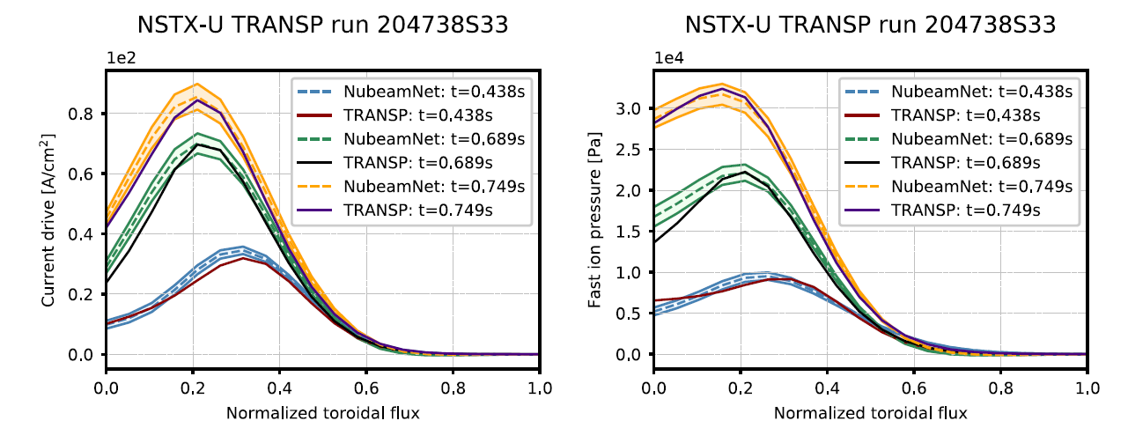
What AI-ML has been done for NSTX/-U already?
Operations / equilibrium / real-time
Stability / Disruption
ML scenario planning (Boyer, 2020)
NN for EFIT for NSTX-U (Wai, 2022)
NUBEAM-Net (Boyer, 2019) (*also code surrogate/speedup)
Ideal MHD (Piccione, 2020)
Resistive wall mode (Piccione, 2022)
Vertical stability (Tobin, 2024)

Slide 5
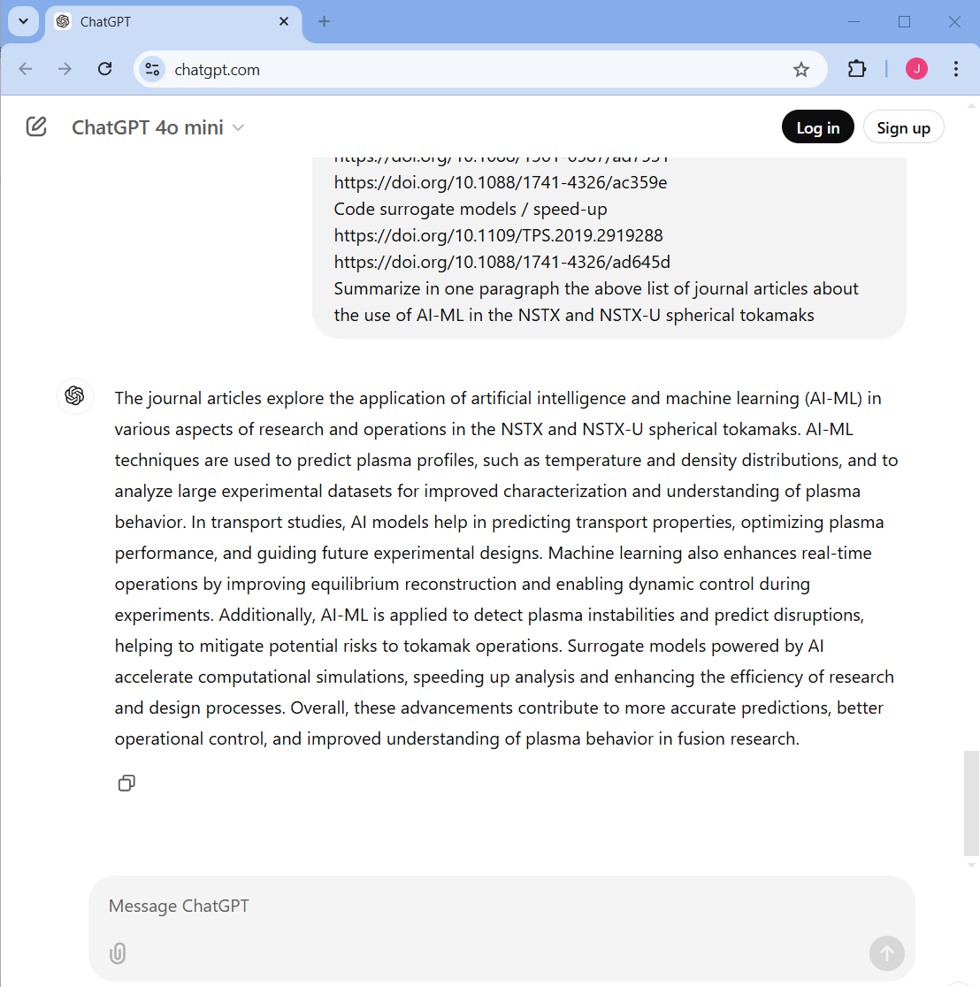
What does AI think of our AI work?

Slide 6
What should we do, going forward?
Many individual efforts, not coordinated, many not sustained
  Collaborators, students, people have left PPPL, etc…
  Revive some previous efforts?
There are, of course, other tools developed on other machines that could be brought to NSTX-U
  Ege’s group’s tools on DIII-D, etc…
Ideas:
  NSTX database curated and made public? Who’s going to do it?
    Some databases already exist: Ege’s, Steve Sabbagh’s DECAF…
    IAEA “AI for Fusion” effort
    MAST database made public (https://opendata.ukaea.uk/mast-data/)

Slide 7
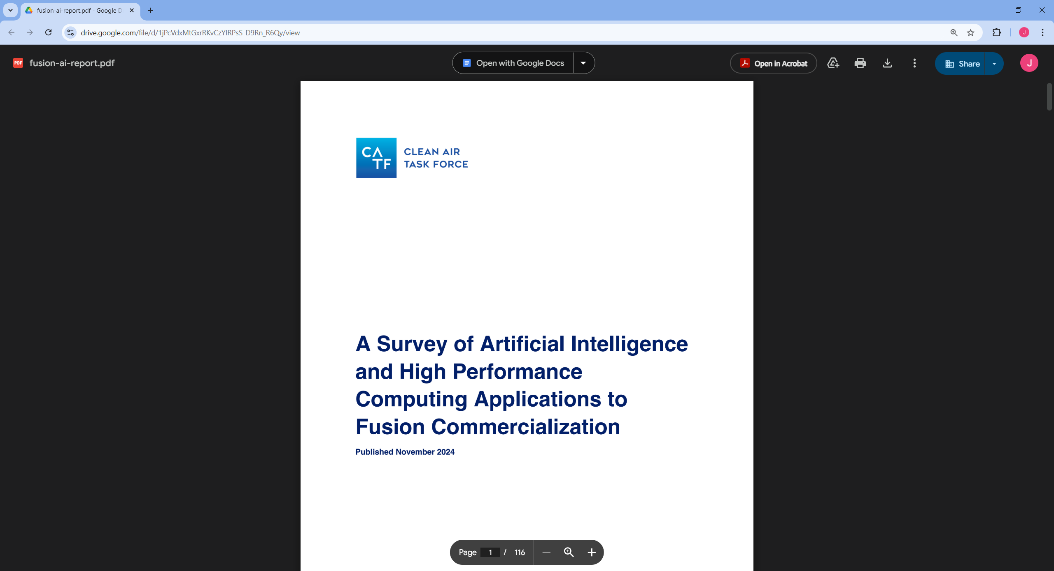
What should we do, going forward?
Ideas:
  Theory department wants to start a project on ST turbulence and FPP design
  Engineering: digital twin?
  Diagnostics: data reduction and analysis programs make use of AI-ML strategies?
  AI for plasma operations?
  etc..
Resources:
  https://drive.google.com/file/d/1jPcVdxMtGxrRKvCzYIRPsS-D9Rn_R6Qy/view

Slide 8
References
D. Clayton et al., “Electron temperature profile reconstructions from multi-energy SXR measurements using neural networks”, Plasma Phys. Control. Fusion 55 095015 (2013) https://doi.org/10.1088/0741-3335/55/9/095015
M.D. Boyer and J. Chadwick, “Prediction of electron density and pressure profile shapes on NSTX-U using neural networks”, Nucl. Fusion 61 046024 (2021) https://doi.org/10.1088/1741-4326/abe08b
I. Uzun-Kaymak et al., “Forming a database to study reversed magnetic shear from the National Spherical Torus eXperiment using machine learning”, Nucl. Fusion 31 112506 (2024) https://doi.org/10.1063/5.0222490
B. Woods, V. Duarte, et al., “Machine Learning Characterization of Alfvénic and Sub-Alfvénic Chirping and Correlation With Fast-Ion Loss at NSTX”, IEEE Trans. Plasma Sci. 48 71 (2020) https://doi.org/10.1109/TPS.2019.2960206
J. Parisi, et al., “Machine Learning Framework for Spherical Tokamak Pedestal Prediction and Optimization”, in progress
D. Smith et al., “Evolution patterns and parameter regimes in edge localized modes on the National Spherical Torus Experiment”, Plasma Phys. Control. Fusion 58 045003 (2016) https://doi.org/10.1088/0741-3335/58/4/045003
M. Curie, et al., “Microtearing mode study in NSTX using machine learning enhanced reduced model” (unfinished and unpublished) https://doi.org/10.48550/arXiv.2304.08982
H. Chung et al., “Development of a Data-Driven Neural Network Model for Electron Thermal Transport in NSTX”, in progress
B. Leard et al., “Fast Neural-Network Surrogate Model of the Updated Multi-Mode Anomalous Transport Module for NSTX-U”, IEEE Trans. Plasma Sci. (2024) https://doi.org/10.1109/TPS.2024.3377611
M.D. Boyer et al., “Toward fusion plasma scenario planning for NSTX-U using machine-learning-accelerated models”, Learning for Dynamics and Control 120 698 (2020)
J. Wai, M. Boyer, E. Kolemen, “Neural net modeling of equilibria in NSTX-U”, Nucl. Fusion 62 086042 (2022) https://doi.org/10.1088/1741-4326/ac77e6
M.D. Boyer et al., “Real-time capable modeling of neutral beam injection on NSTX-U using neural networks”, Nucl. Fusion 59 056008 (2019) https://doi.org/10.1088/1741-4326/ab0762

Slide 9
References
A. Piccione et al., “Physics-guided machine learning approaches to predict the ideal stability properties of fusion plasmas”, Nucl. Fusion 60 046033 (2020) https://doi.org/10.1088/1741-4326/ab7597
A. Piccione et al., “Predicting resistive wall mode stability in NSTX through balanced random forests and counterfactual explanations”, Nucl. Fusion 62 036002 (2022) https://doi.org/10.1088/1741-4326/ac44af
M. Tobin et al., “Vertical instability forecasting and controllability assessment of multi-device tokamak plasmas in DECAF with data-driven optimization”, Plasma Phys. Control. Fusion 66 105020 (2024) https://doi.org/10.1088/1361-6587/ad7531
M.D. Boyer et al., “Toward active disruption avoidance via real-time estimation of the safe operating region and disruption proximity in tokamaks”, Nucl. Fusion 62 026005 (2022) https://doi.org/10.1088/1741-4326/ac359e
T. Looby et al., “Convolutional Neural Networks for Heat Flux Model Validation on NSTX-U”, IEEE Trans. Plasma Sci. 48 3 (2020) https://doi.org/10.1109/TPS.2019.2919288
A. Sanchez-Villar, et al., “Real-time capable modeling of ICRF heating on NSTX and WEST via machine learning approaches”, Nucl. Fusion 64 096039 (2024) https://doi.org/10.1088/1741-4326/ad645d
MAST: S. Jackson, et al., “FAIR-MAST:A fusion device data management system”, SoftwareX 27 101869 (2024) https://doi.org/10.1016/j.softx.2024.101869

