Slide 1
NSTX-U 5YP (FY26 – FY30)
S. Kaye, Director, NSTX-U Research Program
13 January 2025

Slide 2
Outline
NSTX-U capabilities
NSTX-U mission in the context of the science and technology gaps for developing a compact Fusion Pilot Plant (FPP) design
  What has changed, and how NSTX-U fits in
NSTX-U Recovery status
Available diagnostics
Previous 5YP as a basis for developing next one
  Research Objective priorities/timelines
Next steps

Slide 3
Outline
NSTX-U capabilities
NSTX-U mission in the context of the science and technology gaps for developing a compact Fusion Pilot Plant (FPP) design
  What has changed, and how NSTX-U fits in
NSTX-U Recovery status
Available diagnostics
Previous 5YP as a basis for developing next one
  Research Objective priorities/timelines
Next steps

Slide 4
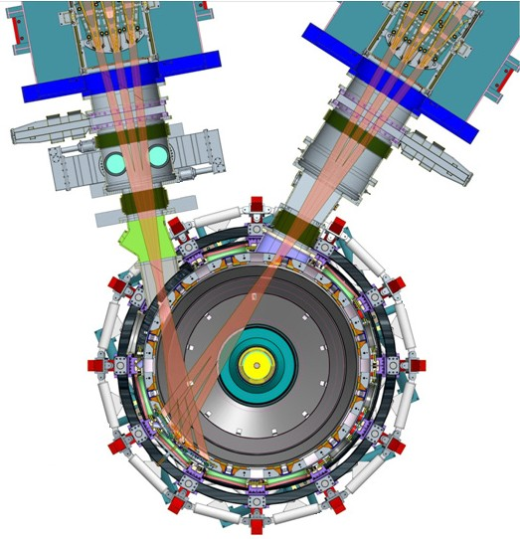
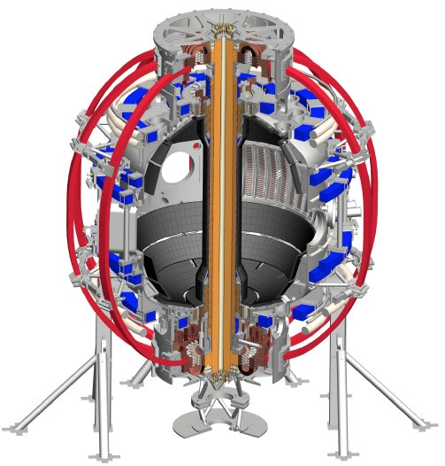
NSTX-U targeting major performance increase to explore new physics regimes at low aspect ratio
1. New Central Magnet
➢2× toroidal field (0.5 ➔ 1T)
➢2× plasma current (1 ➔ 2MA)
➢5× longer pulse (1 ➔ 5s)
2. Off-axis 2nd Neutral Beam
➢2× heating power (5 ➔ 10MW for 5s)
Tangential NBI ➔ 2× h_{cd}
Up to 15MW NBI + 4MW RF for 1-2s
➢Up to 10× higher nTt_{E} (~MJ plasmas)
➢4× divertor heat flux (➔ ITER levels)
Enhanced capabilities allow for
- Studying fundamental ST physics
- Providing the low R/a point for unifying physics across
aspect ratio
- Informing the design of a compact Fusion Pilot Plant

Slide 5
Extended operating space for NSTX-U enables exploration of key compact FPP issues
Parameter (max) | NSTX | NSTX-U
R/a | 0.85/0.65 m (A=1.3) | 0.95/0.55 (A=1.7)
B_{T} (@R₀) | 0.55 T | 1 T
I_{p} | 1.4 MA | 2 MA
κ (elongation) | 2.4 | 2.8
δ (triangularity) | 0.6 | 0.7
Pulse length | 1.5 s | 5 s
β_{N} | ≥6 | ≥6
Neutral Beam power | 6 MW | 12 MW
f_{bs} | ≥65% | 70-90%
HHFW power | 6 MW @ 30 MHz | 6 MW @ 30 MHz
Wall conditioning | B & Li evaporation | B & Li evaporation

Slide 6
Outline
NSTX-U capabilities
NSTX-U mission in the context of the science and technology gaps for developing a compact Fusion Pilot Plant (FPP) design
  What has changed, and how NSTX-U fits in
NSTX-U Recovery status
Available diagnostics
Previous 5YP as a basis for developing next one
  Research Objective priorities/timelines
Next steps

Slide 7
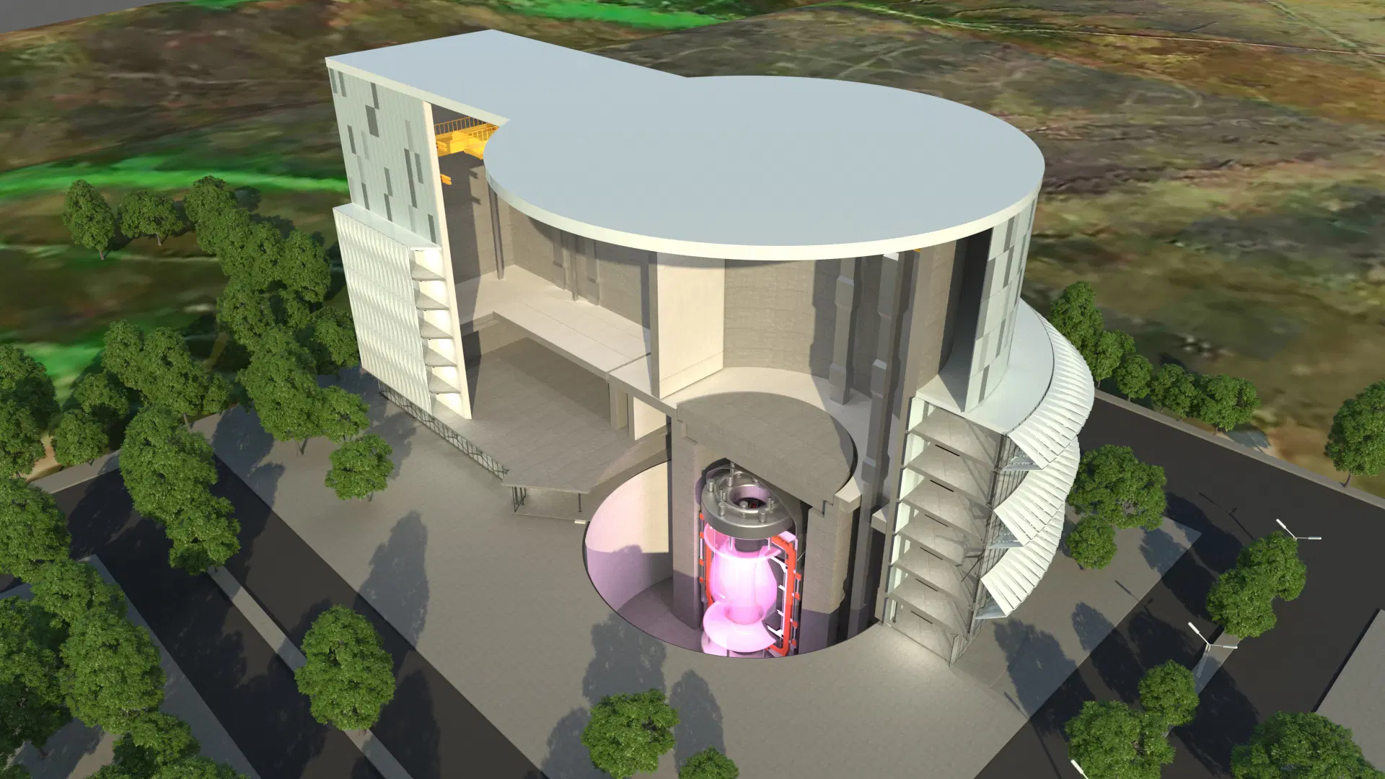
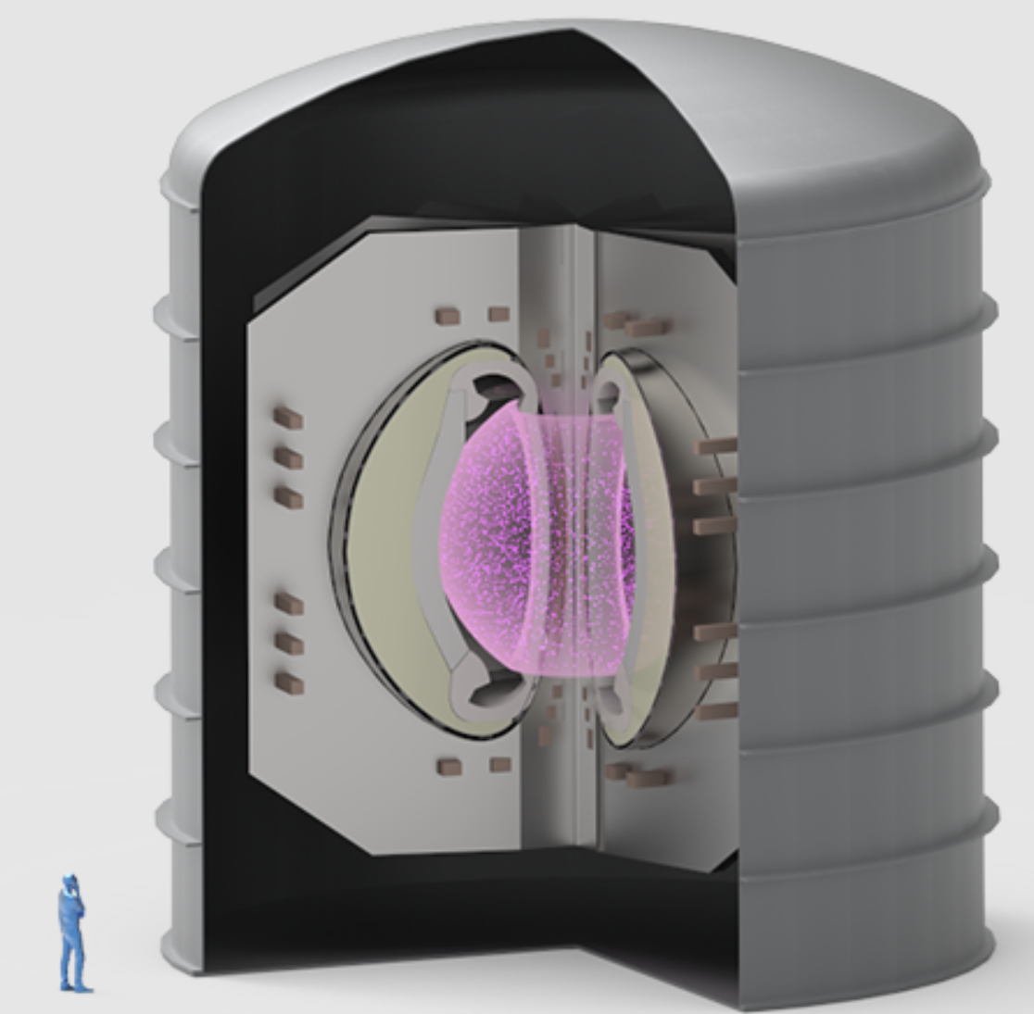
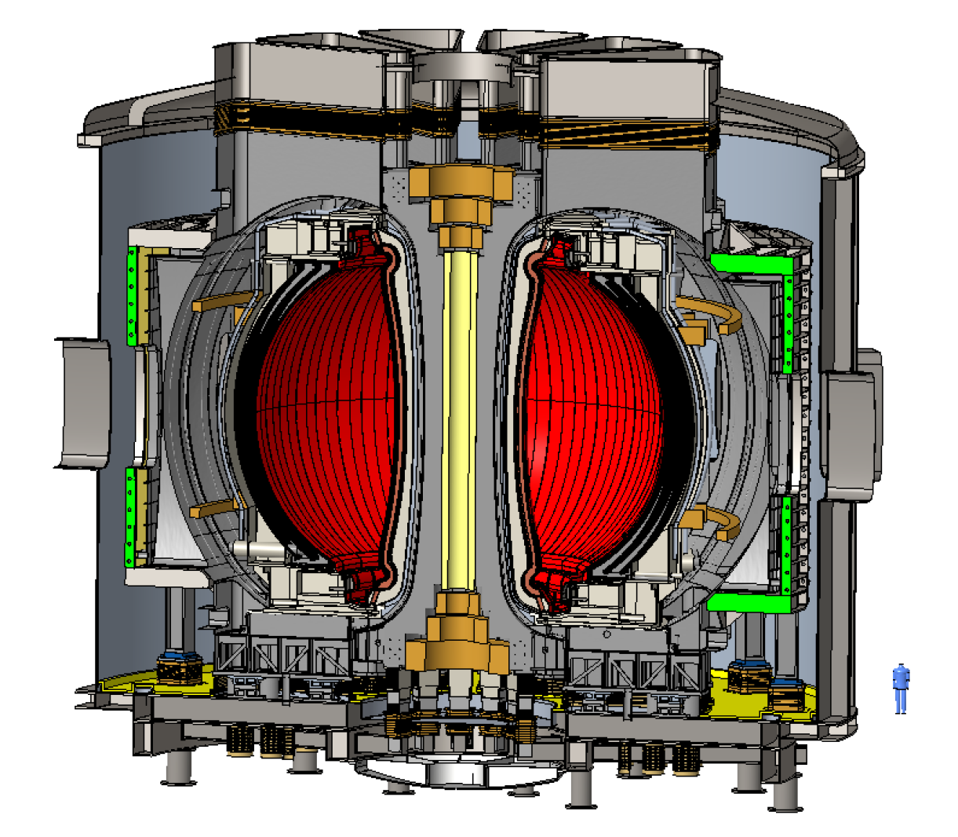
Substantial interest in spherical tokamaks (STs) for compact fusion reactor designs
Spherical Tokamak for Energy Production (STEP) – UKAEA
ST-HTS - Tokamak Energy, Ltd
ST-E1 - Tokamak Energy, Ltd
ST Advanced Reactor (STAR) led by PPPL - understand reactor potential of low-A / ST
  Menard (2016, 2019, 2021) found attractive A~2 operating point for compact, steady-state Pilot Plant
NASEM and Community reports underscore the importance of R&D leading to an FPP
Private companies actively pursuing design and construction of facilities that can lead to FPP

Slide 8
Results from NSTX-U are critical to the design of compact FPPs
NSTX-U will provide critical results required to select and optimize the science and technology approaches to compact FPPs
  NSTX-U will explore fundamental ST physics as a basis for an FPP design
  NSTX-U will provide unique regimes for studying burning plasma-related physics issues and improve predictive capabilities
    e.g., fast ion physics in super-Alfvénic regime
  NSTX-U will evaluate integrated operations with liquid lithium PFCs that will enable compact systems (Maingi, next talk)

Slide 9
NSTX-U Research Objectives support key physics and technology gaps for ST/compact FPP
A low-A compact, s-s FPP requires
NSTX-U Research Objectives
Enhanced confinement
  Reduced size, cost, heating power
Steady-state operation with high NI current fraction
  Small or no OH solenoid
Heat and particle flux mitigation
  High heat flux in compact device
Extend confinement and stability physics at low aspect ratio and high beta to lower collisionality
  Does good ST confinement extend to low collisionality fusion conditions?
  Can next-step ST meet a Q=1 target?
Develop non-inductive (NI) operation at high-performance and low-disruptivity
  Develop unique high-beta, strong shaping route to NI operation
Develop innovative power handling capability at world’s highest heat flux (≤ 90 MW/m²)
  Can adequate power exhaust via liquid lithium be achieved with attractive core performance?

Slide 10
These results are critical to informing compact FPP design
A low-A compact, s-s FPP requires
NSTX-U Research Objectives
Enhanced confinement
  Reduced size, cost, heating power
Steady-state operation with high NI current fraction
  Small or no OH solenoid
Heat and particle flux mitigation
  High heat flux in compact device
Extend confinement and stability physics at low aspect ratio and high beta to lower collisionality
  Does good ST confinement extend to low collisionality fusion conditions?
  Can next-step ST meet a Q=1 target?
Develop non-inductive (NI) operation at high-performance and low-disruptivity
  Develop unique high-beta, strong shaping route to NI operation
Develop innovative power handling capability at world’s highest heat flux (≤ 90 MW/m²)
  Can adequate power exhaust via liquid lithium be achieved with attractive core performance?
(Science Gap)
(Technology Gap)
a

Slide 11
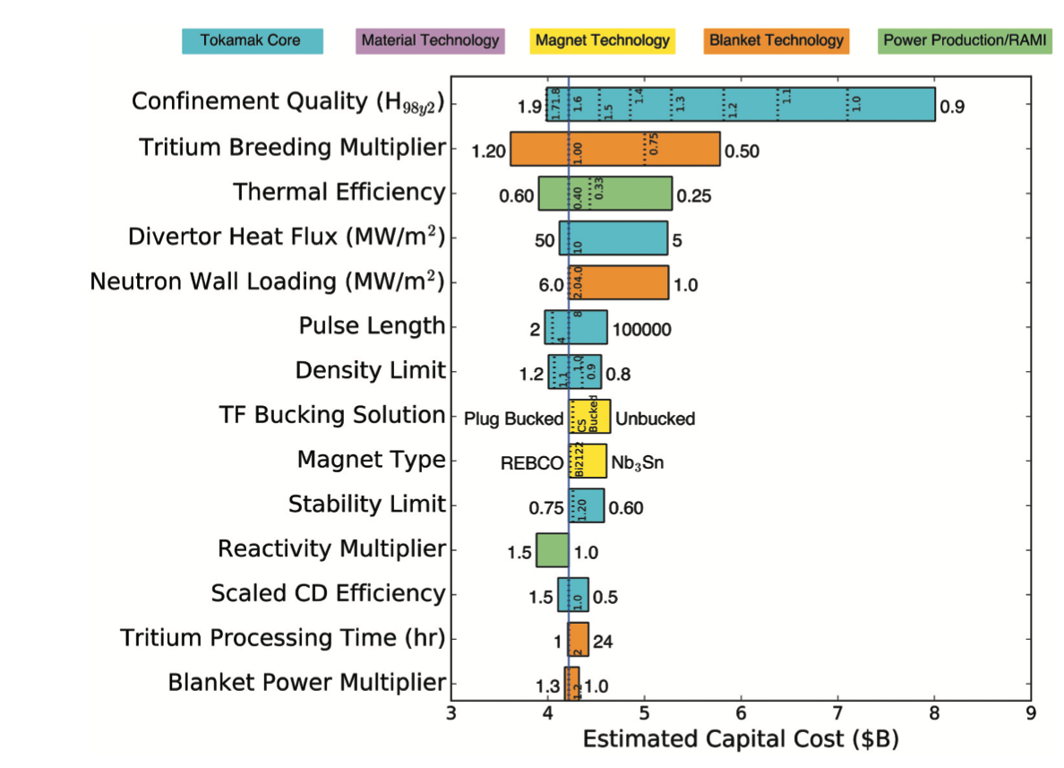
Core confinement is the single-most critical parameter for reducing FPP cost
Wade (2021)
Good ST confinement trends: τ ~B¹ , Bτ ~ν∗^{-0.8} relax FPP size and heating power requirements
Menard, NF 2022
“ST” scalings
1.5 2.0 2.5 3.0 3.5 4.0
Aspect Ratio

Slide 12
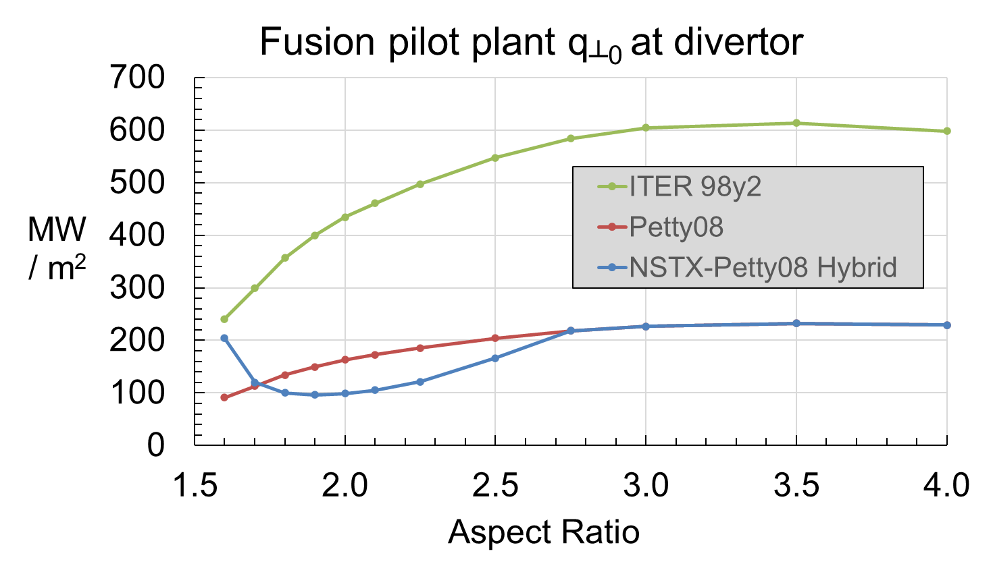
Improved confinement makes FPP heat flux handling easier
Improved confinement reduces power exhaust, but additional mitigation needed (solid PFC limit: 5 – 10 MW/m²)
Li PFCs reduce recycling and lead to increase in energy confinement time
Attractive core-edge integrated design
Menard
“ST” scalings
Conventional heat flux mitigation methods with solid targets have challenges, and can lead to a large and expensive device (i.e., EU DEMO)
  Liquid metal PFCs could be a solution because of ability to handle large heat fluxes
Maingi, PRL 2011
Downward & Upward facing LITERs, IGI planned for Day 1

Slide 13
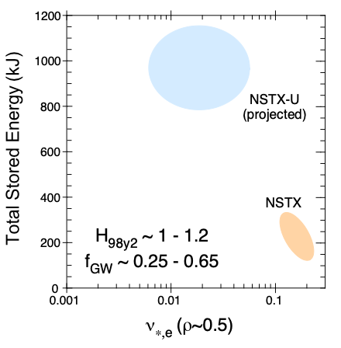
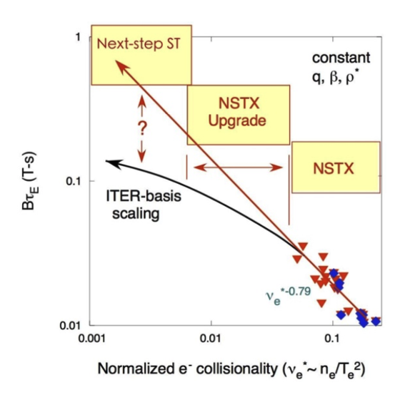
NSTX-U capabilities will assess confinement at compact FPP relevant collisionality (Research Objective 1)
Predictive simulations based on Multi-Mode transport model indicate NSTX-U can achieve 5-10x lower collisionality than NSTX
  MJ plasmas with conservative τ_{E} assumption
This will allow for confident assessment of ST confinement trends
  Does the strong dependence on collisionality continue into near fusion conditions?
Kaye

Slide 14
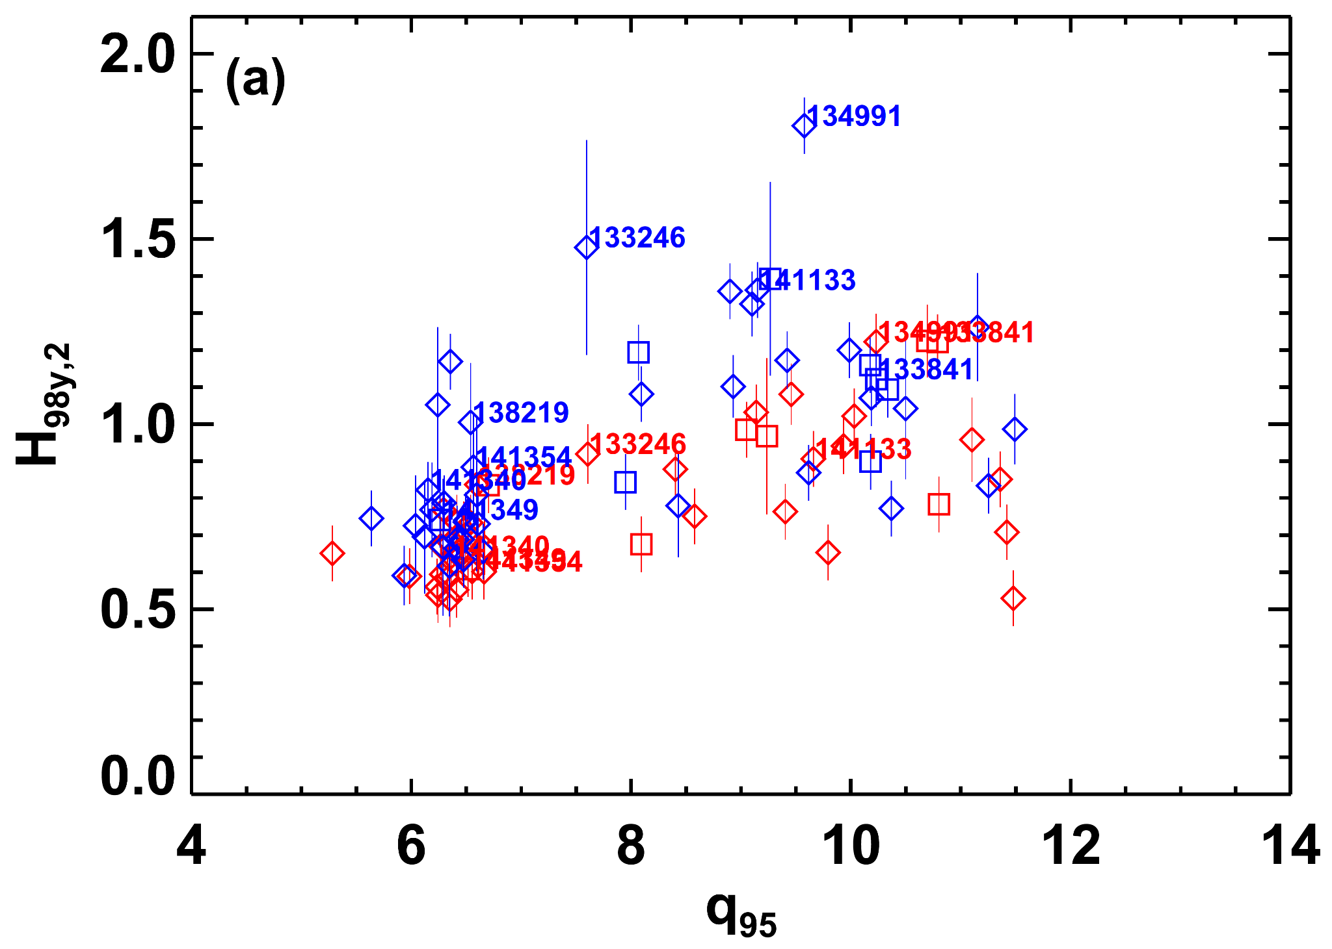
NSTX-U will operate at high elongation and high beta necessary for both high core performance and high non-inductive current drive (Research Objective 2)
NSTX-U will produce stable high κβ_{N}, required for high non-inductive current levels at high core performance
  P_{fusion} ∝ A⁻¹ [κβ_{N}B_{T}]⁴
  f_{bs} ∝ κβ_{N}/l_{i}
High-β_{n} was required to maximize confinement in NSTX
  Active MHD mode control critical to achieving high-β_{N}
Enhanced Pedestal H-mode with Li
β_{n}=6.5
Sabbagh, NF 2013
Gerhardt, NF 2014

Slide 15
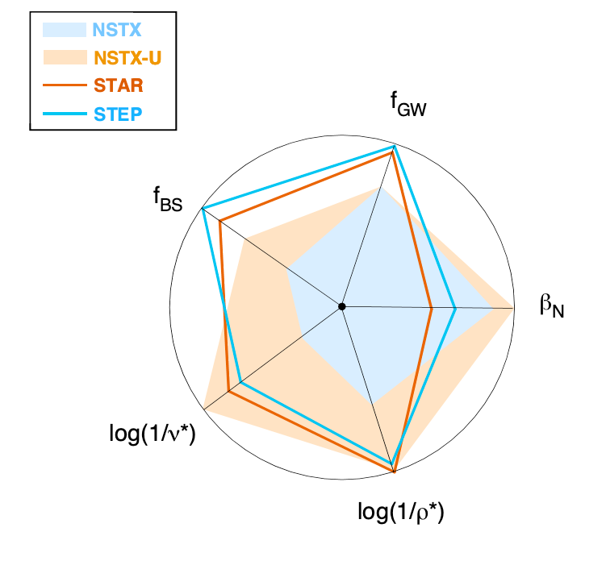
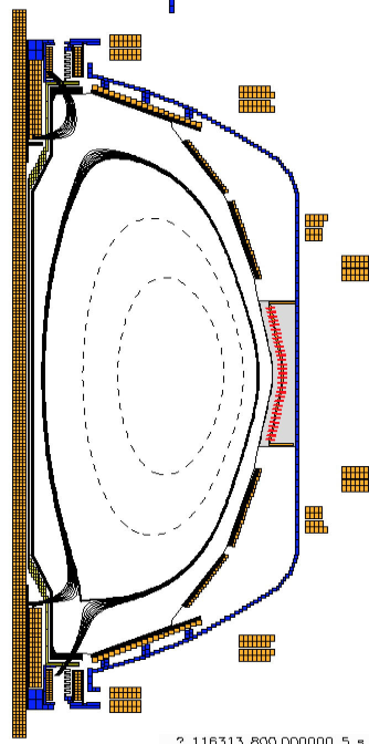
NSTX-U parameter range allows for exploration of confinement & power exhaust mitigation at parameters near those in FPP designs (Res. Obj. 3)
NSTX-U is uniquely positioned to address heat flux mitigation through use of Liquid Lithium divertor components (Maingi – next talk)
NSTX-U can purposefully achieve q⊥ ≤ 100 MW/m² for PFC tests
R&D ongoing to develop a Lithium Vapor Box
  Heat flux of ~ 90 MW/m² can be reduced to <10 MW/m² with low core contamination
90 MW/m²

Slide 16
Outline
NSTX-U capabilities
NSTX-U mission in the context of the science and technology gaps for developing a compact Fusion Pilot Plant (FPP) design
  What has changed, and how NSTX-U fits in
NSTX-U Recovery status
Available diagnostics
Previous 5YP as a basis for developing next one
  Research Objective priorities/timelines
Next steps

Slide 17
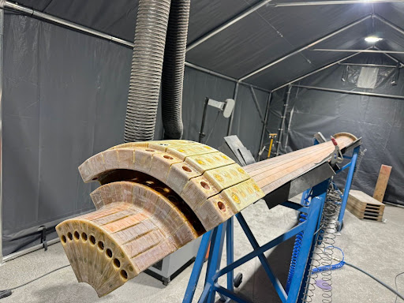
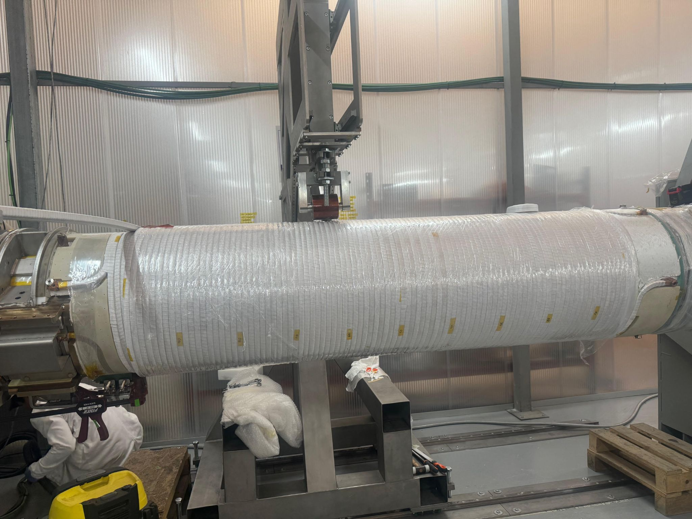
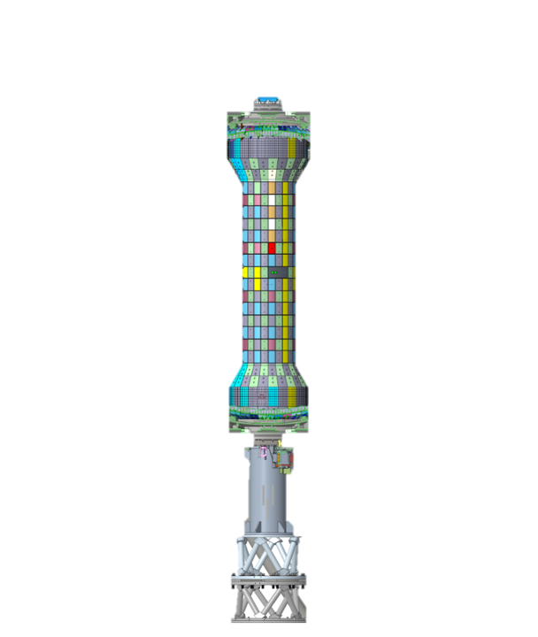
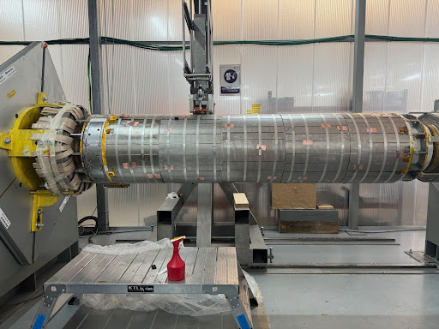
Bundle construction highlights
Successfully completed quadrant 4 VPI
OH prototype ready for VPI in January (right)
OH/TF Delivery –
Early Finish -
Temporary fitup of divertor coils in casing

Slide 18
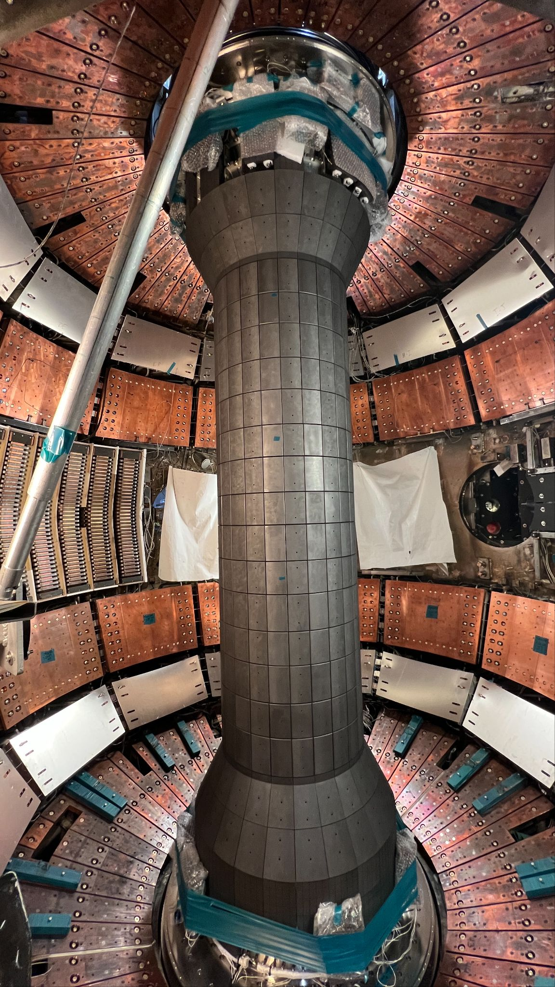
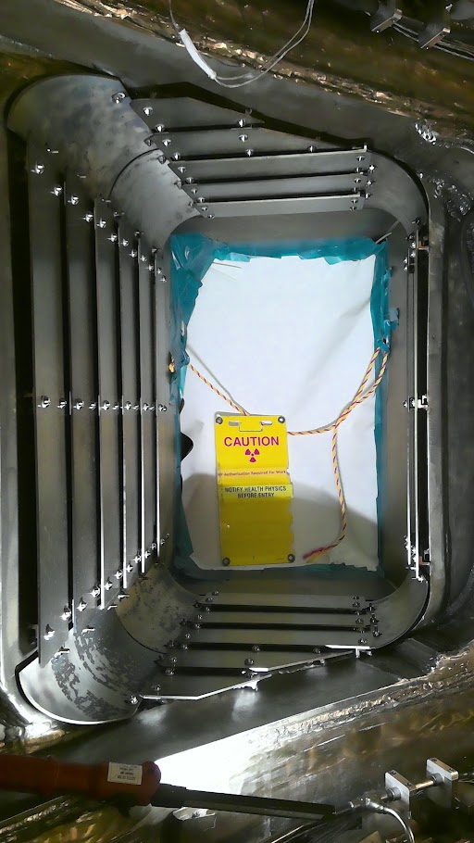
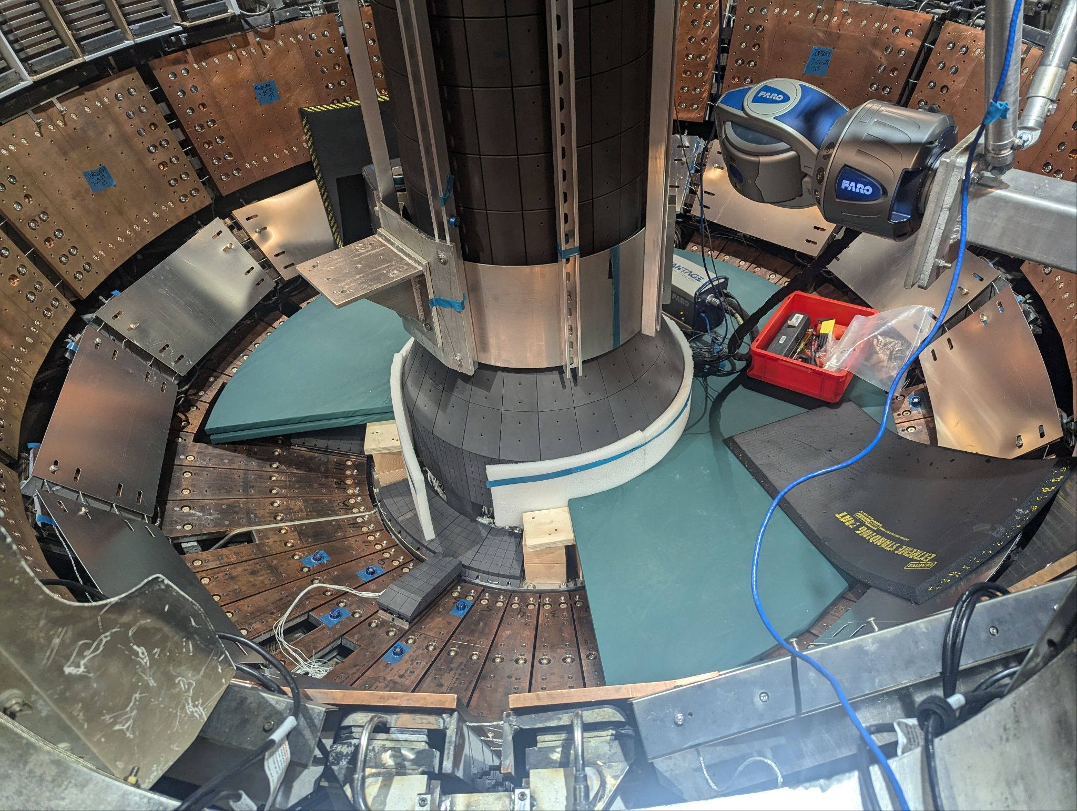
Fitup and reassembly highlights
Achieved excellent alignment of casing in vessel
Armor installed inside NB #2 duct; protects against beam reionization
In-vessel tile fitups and installations

Slide 19
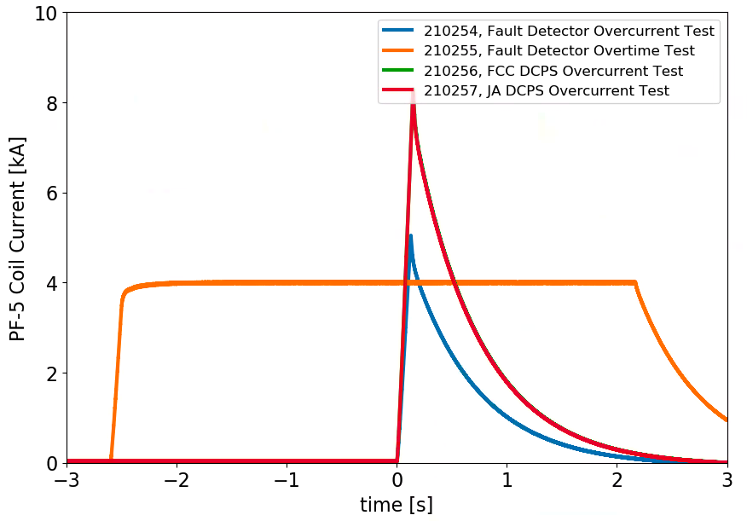
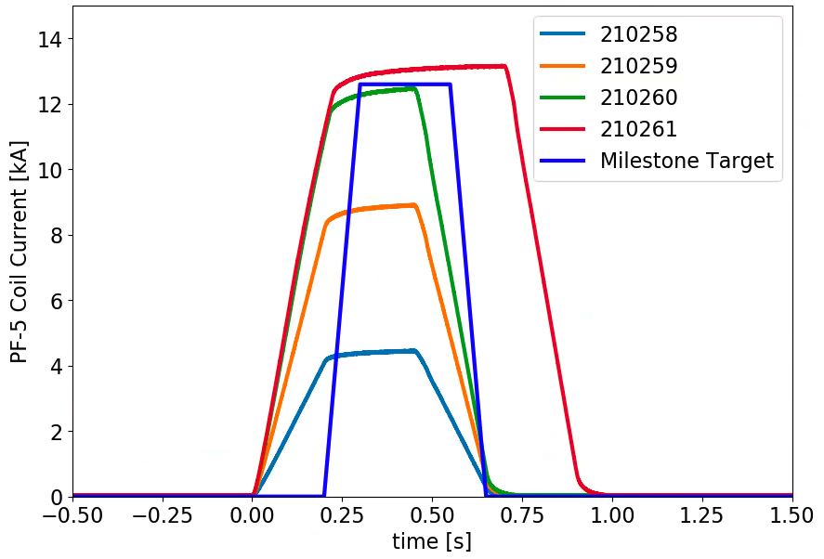
Commissioning highlight – Early coil testing
PPPL Milestone to complete a 1kV, 13 kA test of PF-5 in CY 2024
Team worked though the complete set of I&C, power systems, protection systems, test cell pre-operational test procedures
  Fully function power supply control from PCS
Completed tests efficiently - note sequential shot numbers
Important step toward reconstituting the operating team
Four successful live tests of coil protection systems
Four pulses in increasing magnitude, final exceeding milestone target

Slide 20
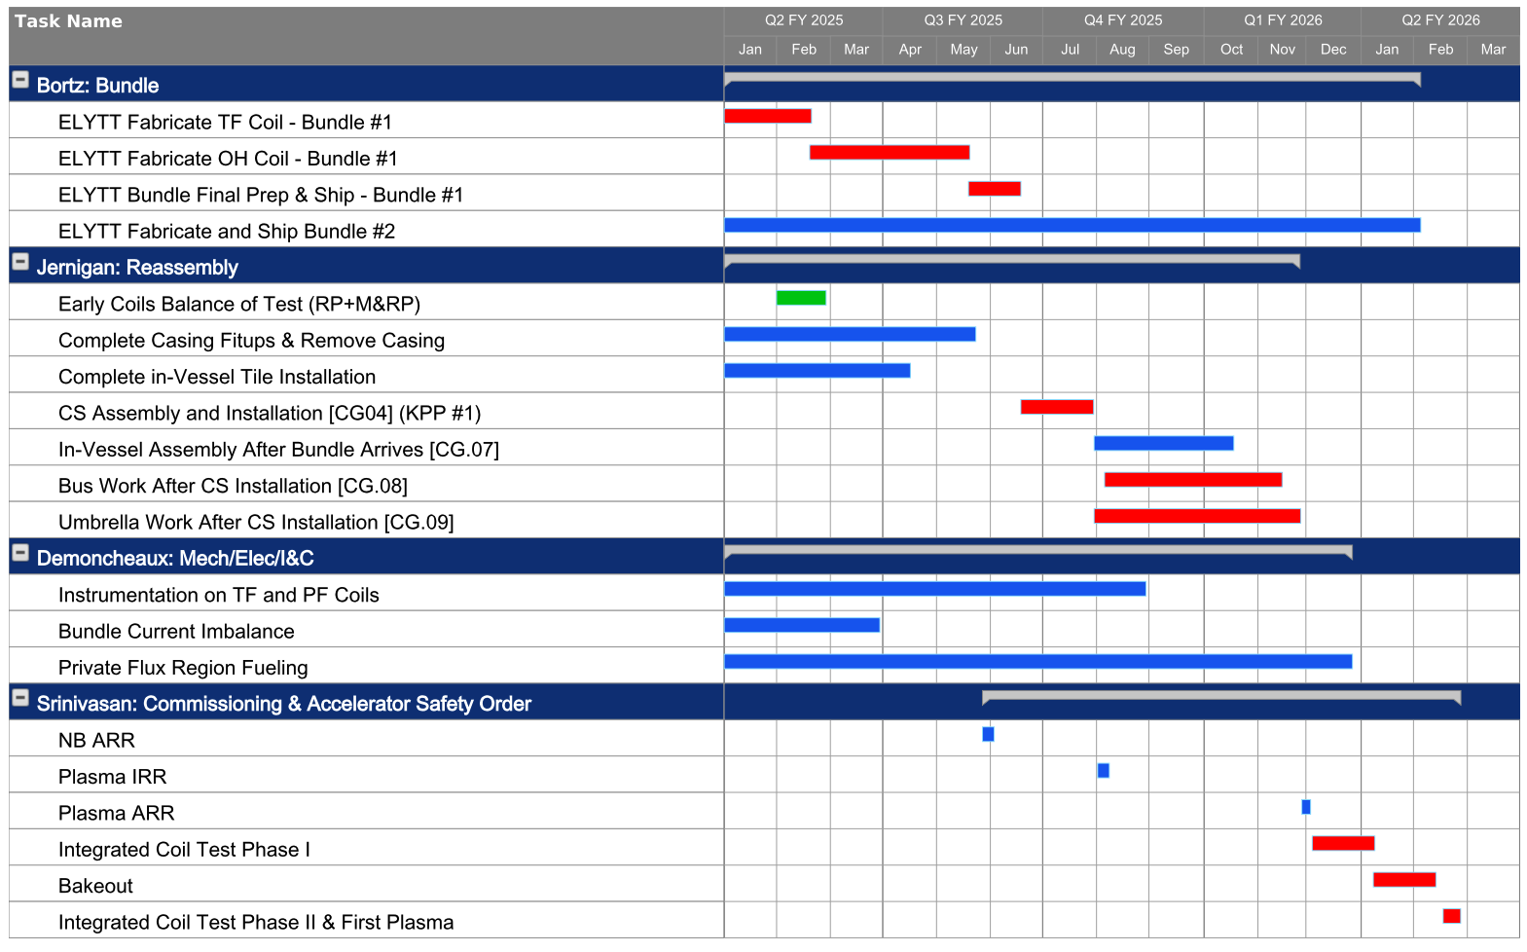
Schedule – November Close Forecast
Key Dates to Watch
Full TF VPI:
2/17/25
OH VPI:
5/16/25
Delivery of TF/OH to PPPL:
6/17/25
CS Installed in NSTX:
7/29/25
Pump Down:
10/17/25
Start Coil Tests:
12/4/2025
First Plasma:
2/28/26

Slide 21
Outline
NSTX-U capabilities
NSTX-U mission in the context of the science and technology gaps for developing a compact Fusion Pilot Plant (FPP) design
  What has changed, and how NSTX-U fits in
NSTX-U Recovery status
Available diagnostics
Previous 5YP as a basis for developing next one
  Research Objective priorities/timelines
Next steps

Slide 22
Planned diagnostics
Operations
  Visible Camera – Main chamber: PPPL
  Four 2-D Fast Vis Cameras for Lower & Upper Divertors: LLNL
  Neutron Scintillator: UC Irvine
  Magnetics: PPPL
  Wide-Angle IR Thermography: UTK
Turbulence
  Poloidal USXR Ultra Soft X-Ray: JHU
  ME-SXR Multi Energy Soft X-Ray: JHU
  FIReTIP Far IR Tangential Interferometer/Polarimeter: UCDavis
  High-K Scattering ex-vessel: UCD
  DBS-CPS Doppler Back-Scattering: UCLA
  RAPID - Faraday Effect Polarimetry Interferometer: UCLA
  BES 2D Beam Emission Spectroscopy: Univ. Wisconsin
  Fluctuation Reflectometer: UCLA
  High Frequency Mirnov Arrays: PPPL
  BES deep core: Univ. Wisconsin
Fast particles
  t-SSNPA & r-SSNPA Solid State Neutral Particle Analyser: UC Irvine
  v-FIDA & t-FIDA Fast Ion D-Alpha: Univ. Wisconsin
Profiles
  MSE-CIF Motional Stark Effect Collisionally Induced Fluorescence: NP
  AXUV Tangential Bolometer - Array Photodiodes: PPPL
  Resistive Bolometer: PPPL
  MPTS multi-point Thomson scattering: PPPL
  Toroidal CHERS Charge Exchange Recombination Spectroscopy: PPPL
  Real-Time MPTS Multi Point Thomson Scattering: PU
  HAL High-throughout Accurate-wavelength Lens-based Spectrometer: PPPL
  ERD Edge Rotation Diagnostic: PPPL
Boundary and Divertor Physics
  ENDD Edge Neutral Density Diagnostic: LLNL
  UV Extreme Ultra-Violet Spectrometers (3): LLNL
  EIES Edge Impurity Emission Spectroscopy, aka Filterscopes: LLNL
  VIPS Visible Plasma Spectrometry (UV-VIS survey spectrometer)| LLNL
  LADA (Lower divertor radiometer AXUV diode array): LLNL
  IMS (UV-VIS imaging divertor spectrometer) & DIBS (Divertor Control Spectrometer): LLNL
  TWICE Duo-chromatic divertor imaging radiation-hardened cameras (2 CIDTEC cameras ): LLNL
  IR Thermography Lower Outer Diverter: UTK
  UV-VIS-NIR Spectroscopy: UTK
  PFC/CS Langmuir Probes: PPPL
  HHFW Reflectometer: PPPL

Slide 23
Outline
NSTX-U capabilities
NSTX-U mission in the context of the science and technology gaps for developing a compact Fusion Pilot Plant (FPP) design
  What has changed, and how NSTX-U fits in
NSTX-U Recovery status
Available diagnostics
Previous 5YP as a basis for developing next one
  Research Objective priorities/timelines
Next steps

Slide 24
Previous 5YP write up framework a good basis for next
Chapter 1: Overview
Chapter 2: Research Objective 1
  Overview outlining background, Objective milestones
  Thrust 1-1
  Thrust 1-2
  Thrust 1-3
  Measurement and Analysis Needs
  Timeline of Objective elements, milestones, facility capabilities
Chapter 3: Research Objective 2
Chapter 4: Research Objective 3
Appendices
  Facility capabilities
  Measurement needs
  Theory and simulation codes
  Research Thrusts from previous 5YP
  ITPA Joint Experiments and Activities

Slide 25
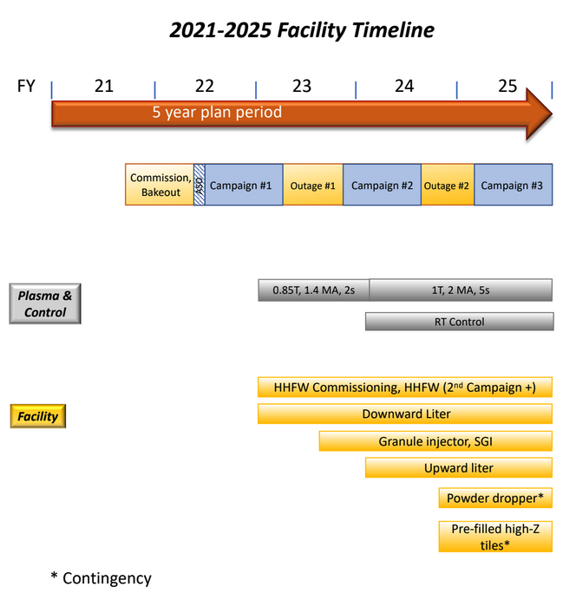
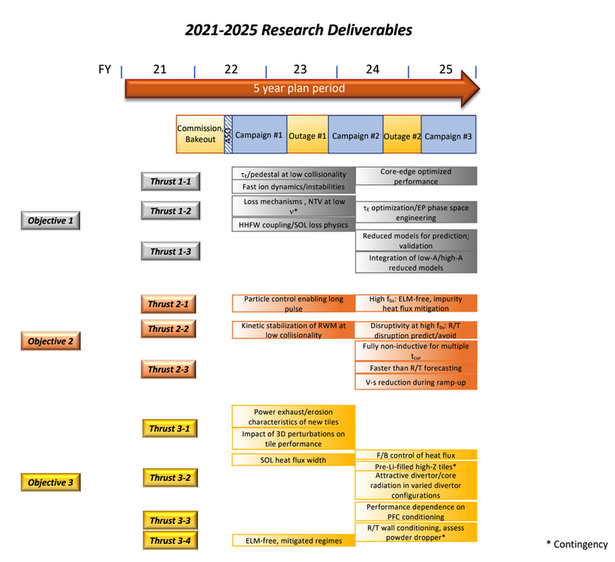
From previous 5YP – Overview (Chap. 1)

Slide 26
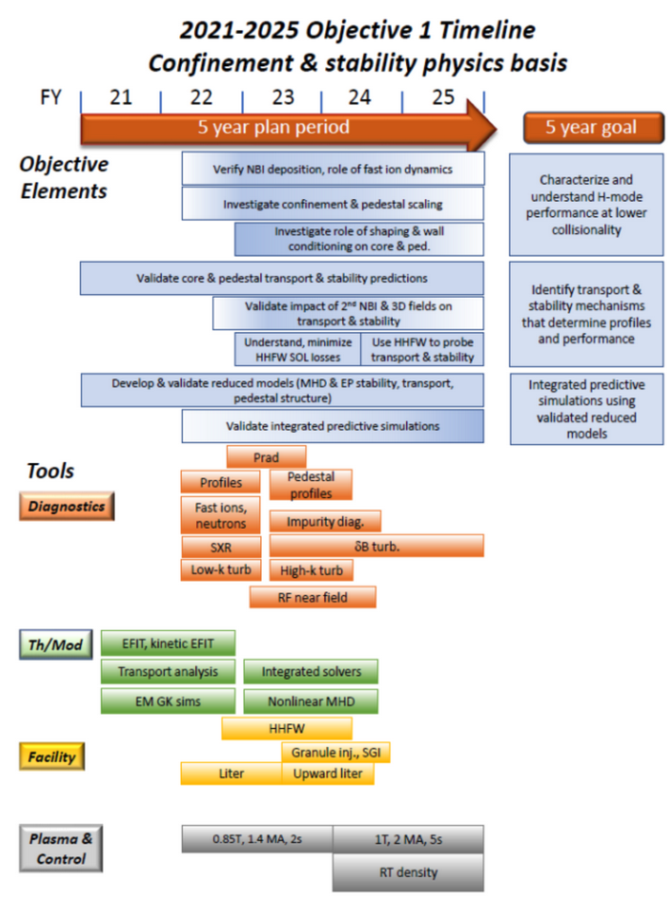
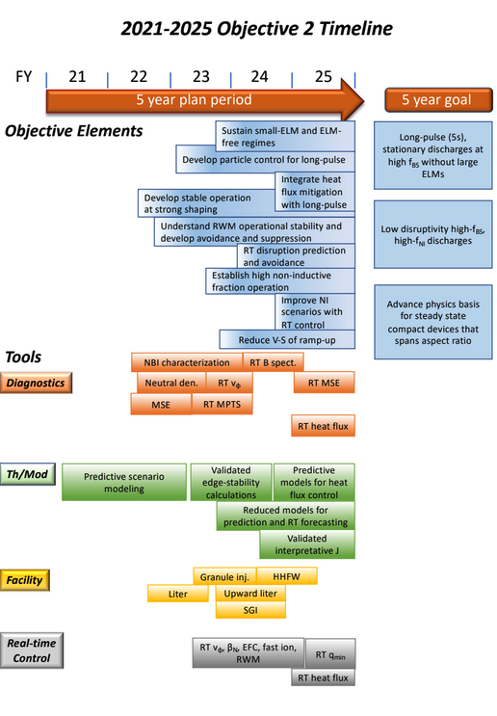
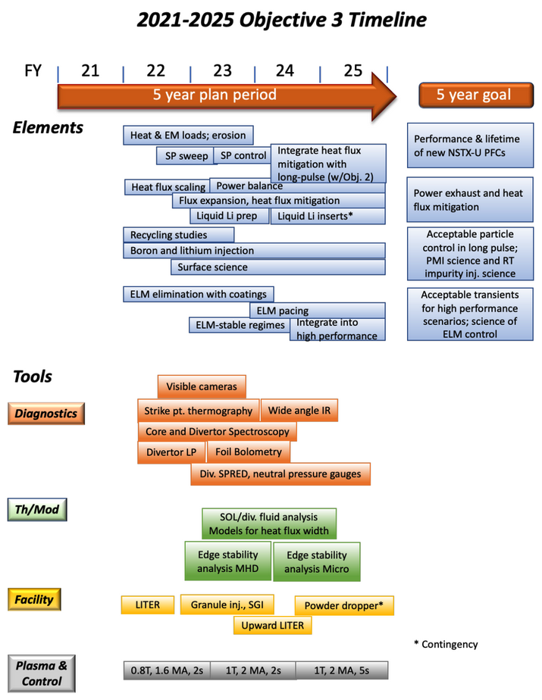
From previous 5YP – Overview (Chaps. 2 to 4)

Slide 27
Notional Physics Campaign timelines and capabilities

Slide 28
Outline
NSTX-U capabilities
NSTX-U mission in the context of the science and technology gaps for developing a compact Fusion Pilot Plant (FPP) design
  What has changed, and how NSTX-U fits in
NSTX-U Recovery status
Available diagnostics
Previous 5YP as a basis for developing next one
  Research Objective priorities/timelines
Next steps

Slide 29
5YP Process
Chapter Leads hold Zoom meetings with Team and interested parties, write up draft chapters, then circulate
Chapters revised based on input received
  Including recommendations from FESAC (Jan-Feb 2025), FES Roadmap (Q2 CY25)
5YP vetted to PAC
5YP reviewed by formal Review Committee
Plan finalized by end of FY25
5YP to follow FES guidance
  Confinement/stability/scenarios (first two Research Objectives) remain important
  Extend Chapter 3 to development and testing of Liquid Lithium components
  Develop plans for both full and reduced funding scenarios
  Will be important to prioritize elements of each Research Objective, and across Research Objectives, even more than before
    Scope added to Plan, but runtime, (inflation adjusted) budgets relatively constant

Slide 30
Jan. 13, 2025 (Monday Physics Mtg): Presentation on details and motivation for NSTX-U Research Objectives, how to fold in changes over past five years
1/22 (11 AM), 23 (11 AM), 24 (2 PM): Initial Chapter Zoom meetings
Early March 2025: Second set of Chapter Zoom meetings
Mid-Late March 2025: Prioritization across Research Objectives
Mid April 2025: Draft of 5YP circulated to Team and other interested parties
Mid-May 2025: 5YP plan vetted to PAC
Late May-June 2025: 5YP revisions based on PAC input
Summer 2025: Formal review of 5YP/Alignment with new FES Roadmap
Late Summer/Fall 2025: Revisions of Plan based on review, input from FES
Sept. 30, 2025: Plan finalized

Slide 31
NSTX-U will address science and technology gaps for the development of a compact (ST) Fusion Pilot Plant
Assess whether the Spherical Tokamak (ST) is a viable route to a compact Fusion Pilot Plant (FPP)
  Does enhanced confinement extrapolate to low collisionality?
  Are the stable, high-elongation, high-𝜷_{N} plasmas a basis for high performance and steady-state operation?
Be a testbed with both public and industrial partners to develop and implement transformative power handling solutions in a high heat flux environment (aspect ratio agnostic)
  Will liquid lithium technology in a heated high-Z wall device reduce power exhaust to acceptable levels while maintaining enhanced confinement?
We welcome participation in our program by researchers from both public and private institutions

Slide 32
Backup

Slide 33
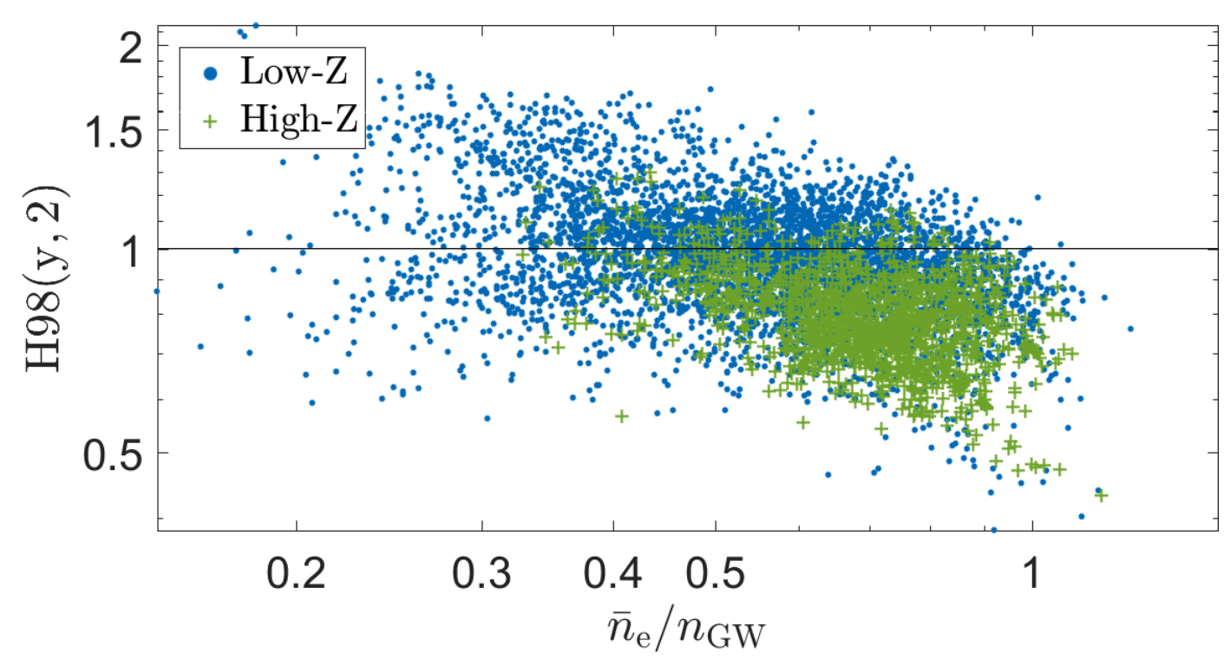
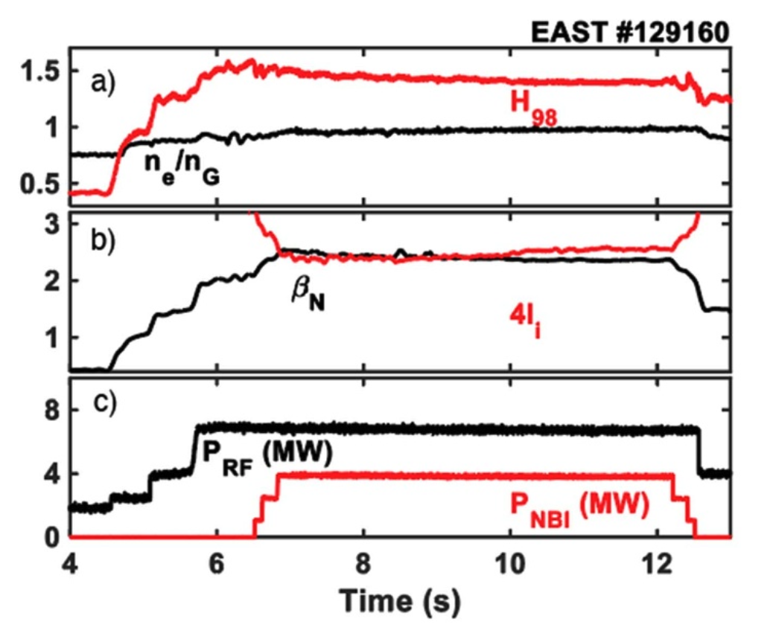
Use of lithium especially beneficial in high-Z-wall devices (later stage in NSTX-U 5 YP can include installation of high-Z sectors)
FPP relevant high-Z-wall devices (ITER-ILW, ASDEX-U, C-Mod) exhibit degraded energy confinement relative to carbon-wall devices
Enhanced confinement restored in high-Z-wall device using lithium coatings
EAST: Mo CS, W divertor
Verdoolaege, NF 2021
25-30% reduction in H_{98y,2}
H_{98y,2} typically remains <1 even with impurity seeding
Q_{fusion} ~ H²⁻⁵
Gong, NF 2024
H_{98y,2} up to 1.5 at n_{e}/n_{GW} ~ 1

Slide 34
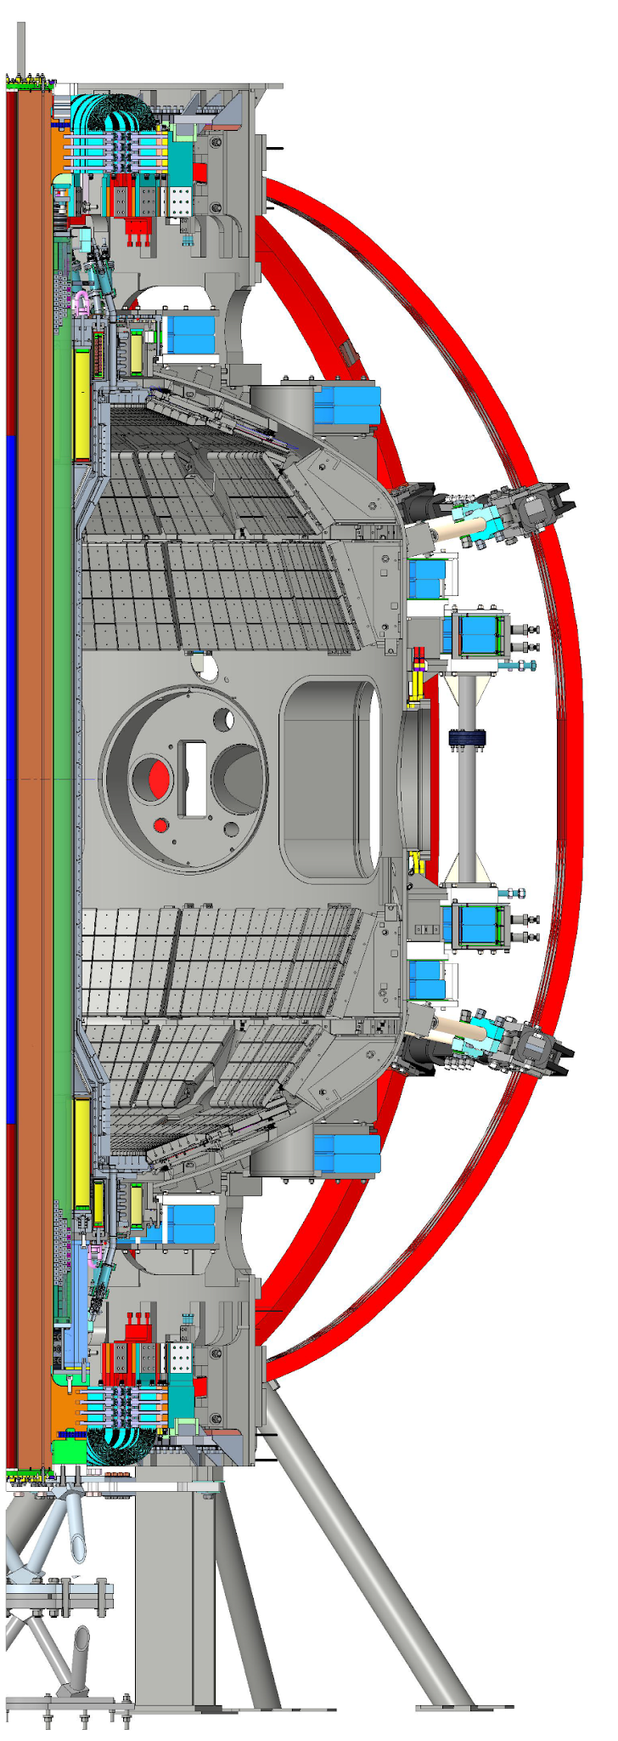
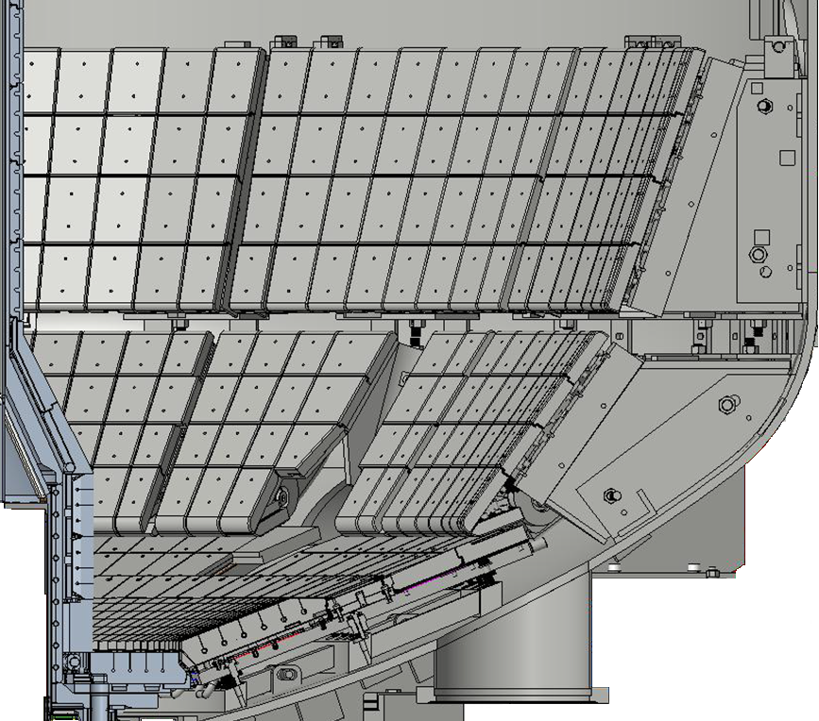
Heat flux mitigation using LM technology will become focus of NSTX-U R&D
NSTX-U will pivot toward heat and particle control with liquid metal PFCs (targeting lithium) after fulfilling initial core physics mission in first one to two years of operation
  Initially testing small LM components
Liquid Metal Core Edge Facility (LMCE): (Maingi, next talk) – Aspire to:
  Replace all carbon PFCs with high-Z
  Use bakeout system to control PFC/LM temperature
  Test range of lithium divertor concepts
    Lithium Vapor Box
    Capillary porous system with flow
    Divertorlets for reduced lithium flow speed
    Concepts for LM, components suggested by community
Passive Plates, Outer Divertor:
Low heat flux, hot
Inner divertor:
High heat flux, hot

