Slide 1




NSTX-U
Supported by
Study of the chemical evolution during transition from B to Li-based conditioning on D retention in NSTX-U with the Materials Analysis Particle Probe (MAPP)
Coll of Wm & Mary
Columbia U
CompX
General Atomics
FIU
INL
Johns Hopkins U
LANL
LLNL
Lodestar
MIT
Lehigh U
Nova Photonics
ORNL
PPPL
Princeton U
Purdue U
SNL
Think Tank, Inc.
UC Davis
UC Irvine
UCLA
UCSD
U Colorado
U Illinois
U Maryland
U Rochester
U Tennessee
U Tulsa
U Washington
U Wisconsin
X Science LLC
Culham Sci Ctr
York U
Chubu U
Fukui U
Hiroshima U
Hyogo U
Kyoto U
Kyushu U
Kyushu Tokai U
NIFS
Niigata U
U Tokyo
JAEA
Inst for Nucl Res, Kiev
Ioffe Inst
TRINITI
Chonbuk Natl U
NFRI
KAIST
POSTECH
Seoul Natl U
ASIPP
CIEMAT
FOM Inst DIFFER
ENEA, Frascati
CEA, Cadarache
IPP, Jülich
IPP, Garching
ASCR, Czech Rep
Jean Paul Allain
Rajesh Maingi, Felipe Bedoya, Robert Kaita, Robert Ellis,
Matt Lucia, Charles Skinner
NSTX-U Research Forum
PPPL
February 24-27, 2015

Slide 2
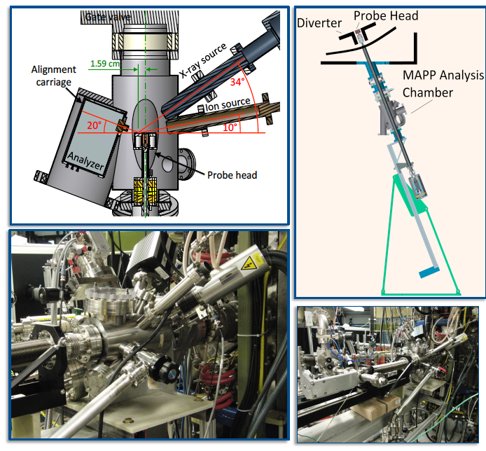
Background
The Materials Analysis Particle Probe (MAPP) is an in situ characterization device for diagnosing samples exposed to fusion reactor plasmas.
Scientific Objective
Correlate plasma performance to the chemical and compositional state of the plasma-facing surface

Slide 3
What can we learn from MAPP?
PFC analysis after a full campaign (e.g. “post-mortem) is difficult to relate to plasma behavior
  Reflects cumulative effect of multiple evaporations and surface compound formation
  Hard to determine surface conditions during any specific discharge
Knowledge gap: where are the active plasma-facing surfaces responsible for controlling particle retention?
Previous PMI probe gave clues about potential to learn from plasma-material interactions outboard at the MAPP location
  Ability to expose samples in-between NSTX plasma shots
  Understanding results required both in-situ single-effect experimental surface science facilities and computational modeling

Slide 4
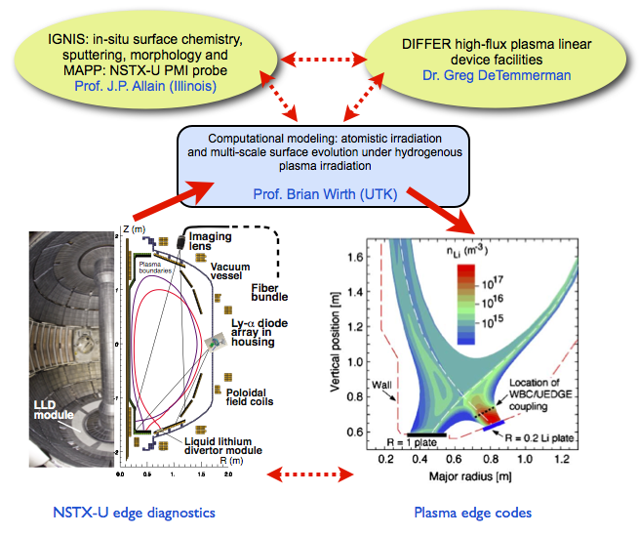
Coupling computational modeling, controlled ex-vessel experiments and NSTX-U diagnostics

Slide 5
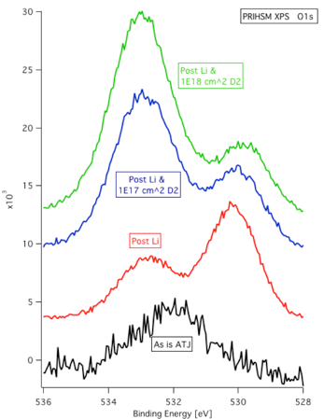
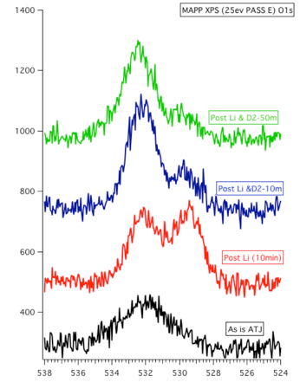
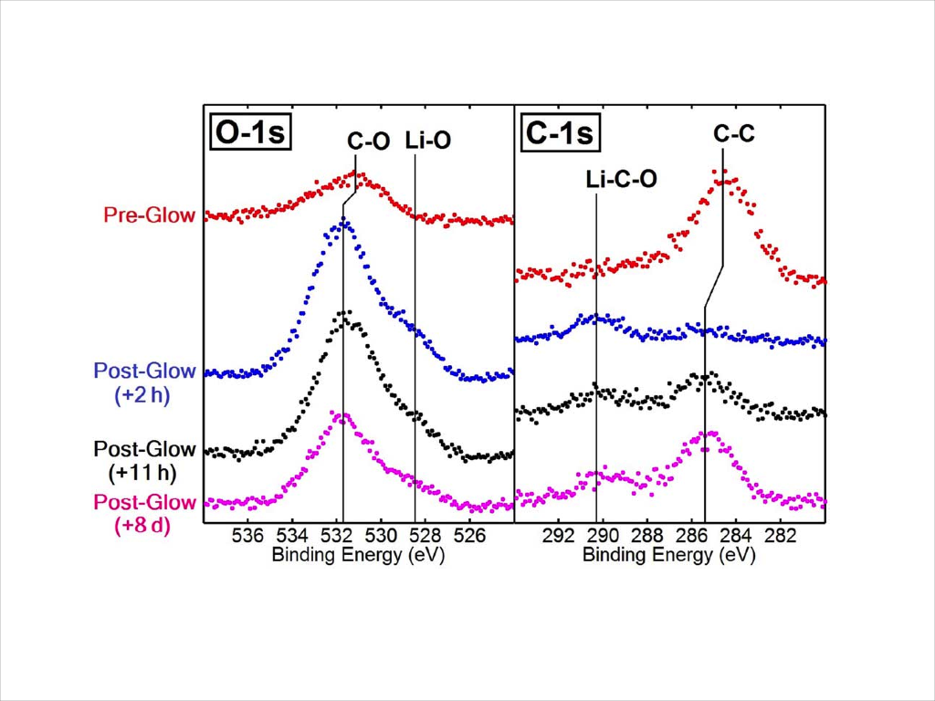
Results from LTX and current status
Langmuir probes operational
Thermal desorption spectroscopy 90% developed
XPS operational
Sputtering cleaning operational
Temperature control of samples operational
XPS scans of C-1s and O-1s photoelectron regions before and after MAPP sample exposure to an argon glow in LTX, showing the appearance of chemical shifts following the glow. M. Lucia et al Rev. Sci. Instrum. 85, 11D835 (2014)
Comparisons between lab experiments and MAPP, Taylor et al. Rev. Sci. Instrum. 2012

Slide 6
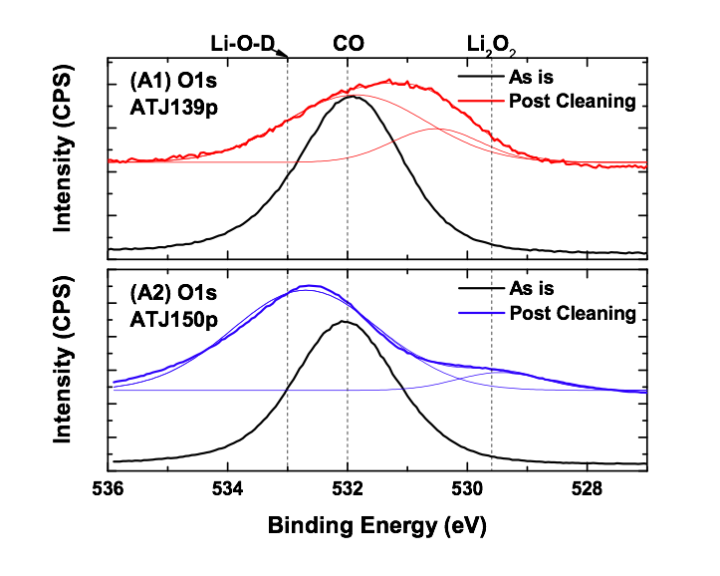
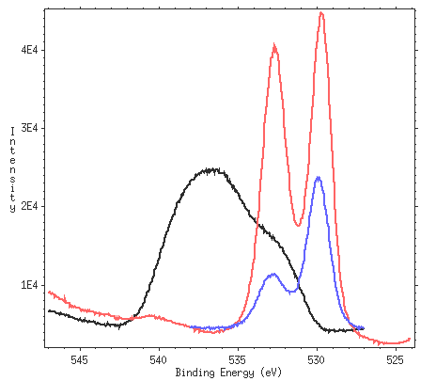
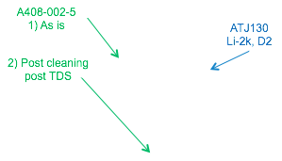
Laboratory experiments consistent with surface chemistry of NSTX tiles
PMI Probe NSTX samples
Lab Flux ~ 10⁻⁴ NSTX Flux
NSTX tile
~ 60 nm Li
Lab sample
~ 800 nm Li
Connecting controlled “single-effect” studies in lab experiments to complex environment in NSTX by examining post-mortem surface chemistry “buried” under oxidized layer (left)
Connect shot-to-shot NSTX plasma behavior with in-situ PMI diagnostics and connect back to lab data (right)
C.H. Skinner, J.P. Allain et al. 2011, J. Nucl. Mater.
C.N. Taylor, J.P. Allain et al. 2011, J. Nucl. Mater.

Slide 7
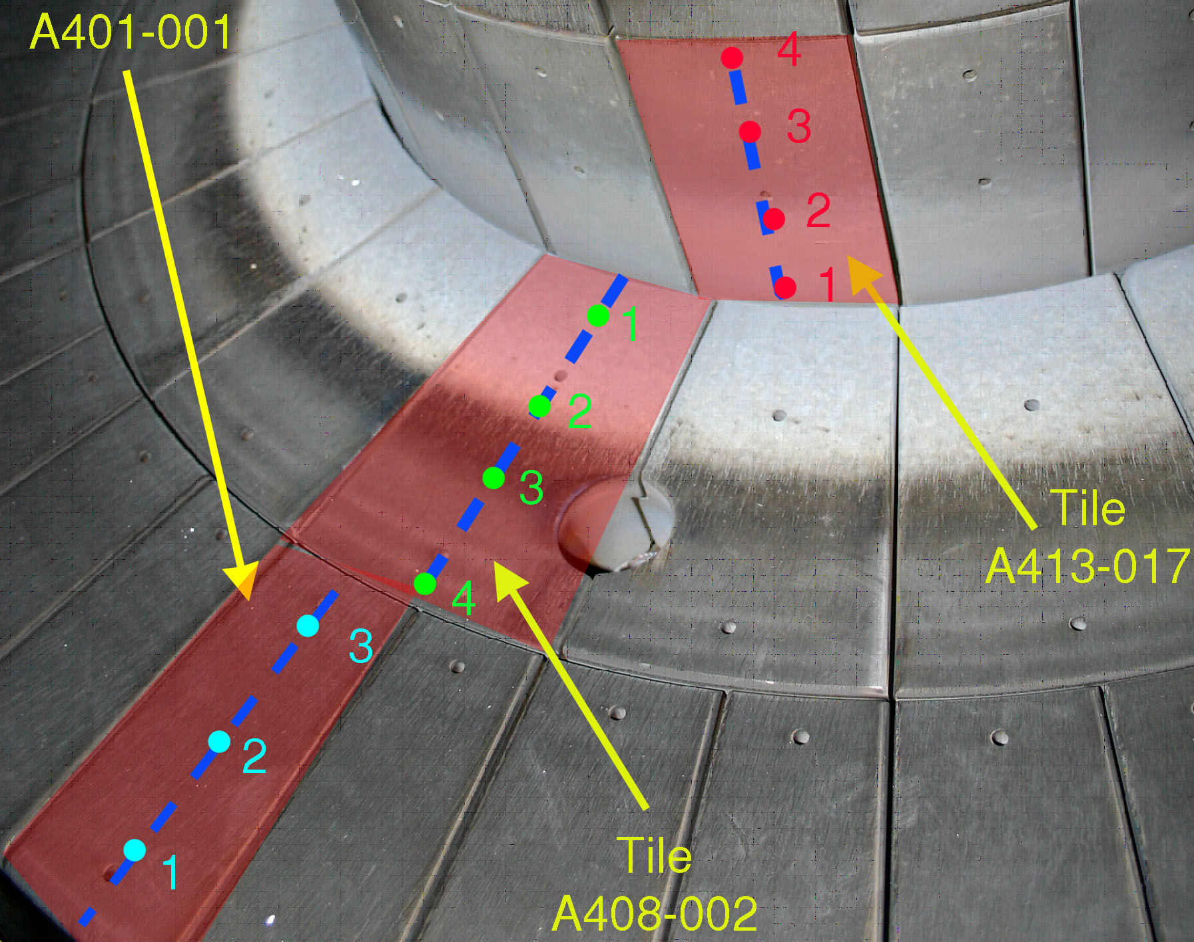
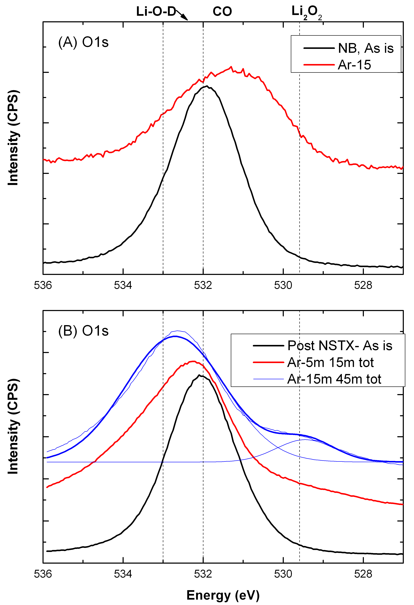
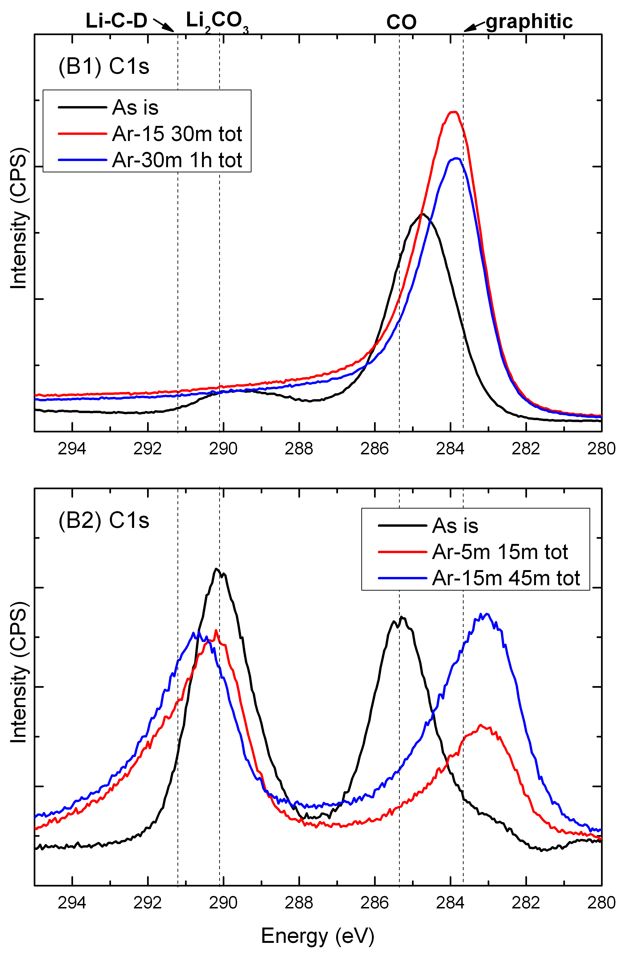
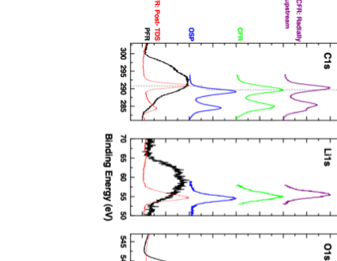
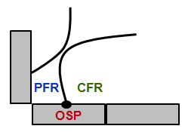
In-situ PMI probe data coupled to ex-vessel NSTX tile surface analysis pointed to significant D retention in various radial locations
XP911: April 24, 2009
Low lithium dep.: 213 nm
Piggyback: April 24, 2009
High lithium dep.: 1,841 nm
Estimated D concen. from probe
Pd sample ~ 5.2 x 10²² m⁻²

Slide 8
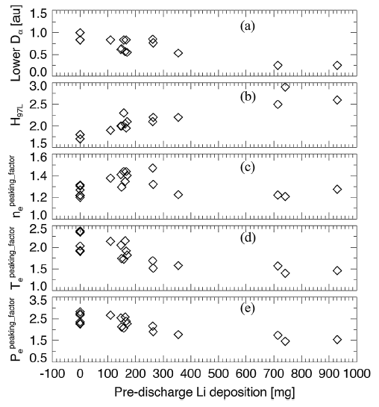
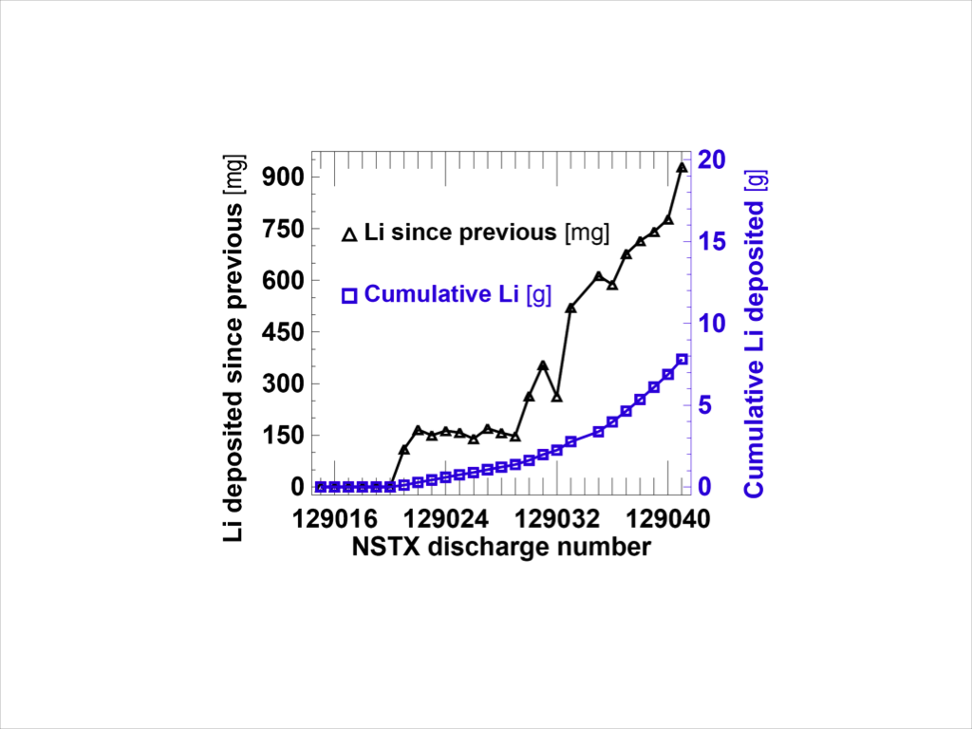
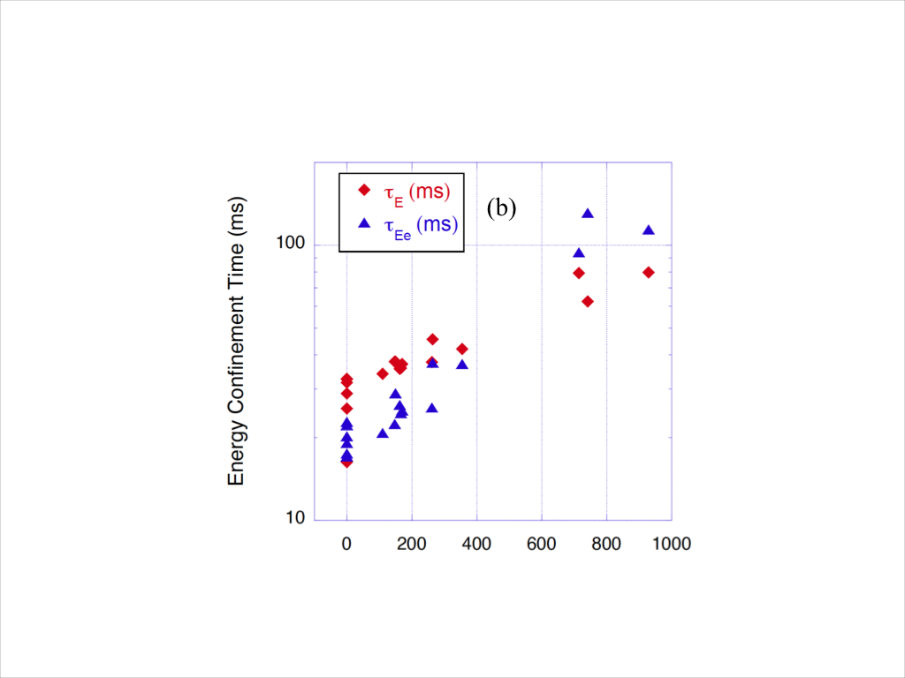
Motivation
Maingi et al Nuclear Fusion (2011)
Boronization and Lithiumization improve plasma performance, however:
  Improvements are strongly dependent on:
    Time
    Plasma exposures
    Li passivation
    Li intercalation in graphite
  The effect of longer pulses has to be considered now
    On hydrogen retention
    On stability of the coatings
    On presence of impurities

Slide 9
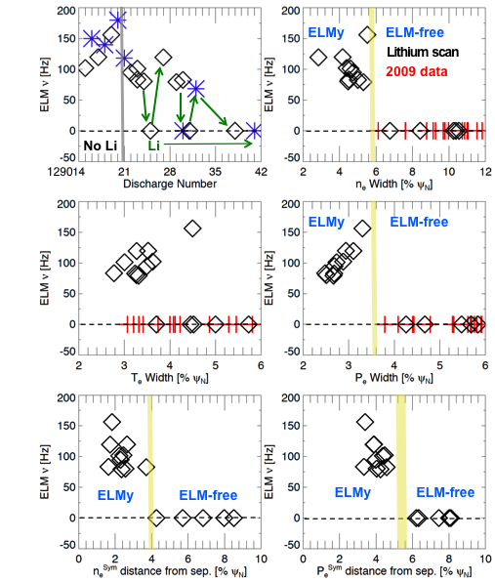
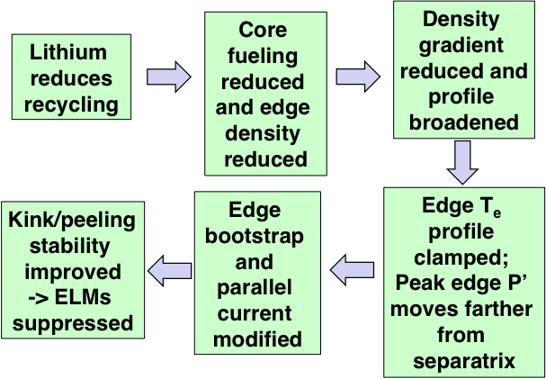
Deciphering mechanism that controls “reduction” in recycling by the plasma-material interface
Clues given by previous in-situ PMI probe data showing strong complexes of D retention in oxygen and carbon XPS lines
Controlled single-effect surface analysis pointed to irradiation-driven mechanisms driving oxygen in lithiated graphite during D-plasma exposure across many orders of magnitude fluxes

Slide 10
Objectives
Study and relate to plasma conditions the effect of boronization in NSTX-U.
Chemical characterization of the Boron/Lithium transition in NSTX-U first wall conditioning.
Study evolution of plasma performance as a function of Li deposited on graphite surfaces.

Slide 11
Proposed experiments
Two graphite samples required (XPS and TDS) plus Au calibration sample. Remote insertion and retraction of probe required*.
Clean graphite:
  Obtain XPS baselines i.e. prior to boronization or plasma discharges
  Obtain XPS data after plasma discharges
  Step 2 can be repeated depending on the schedule of the machine. This set can be done in “piggyback” mode.
  Run TDS scan after last plasma exposure on TDS sample
* If second requirement is not fulfilled, insertion can be done at beginning of day, retraction and data collection at end of the day.

Slide 12
Proposed experiments
Same assumptions and requirements as in experiment 1 apply **.
Study of boronized surfaces
  Obtain XPS data after boronization procedures.
  Obtain XPS data after plasma discharges.
  Step two can be repeated depending on machine time availability. This step can be run in “piggyback” mode.
  Run TDS scan after last plasma exposure on TDS sample.
** Can be equally modified in case remote insertion is not possible

Slide 13
Proposed experiments
Assumptions and possible modifications apply as before
Study on Boron/Lithium transition
  Obtain XPS data after initial Li deposition (after a known amount of boron is deposited; e.g. amount of mg of TMB used)
  Obtain XPS data after plasma discharge
  Steps 1 and 2 can be repeated after each boron treatment, Li deposition or plasma discharge.
  Run TDS scan after last plasma exposure on TDS sample

Slide 14
Proposed experiments
Same assumptions and potential modifications
Study of lithium coatings
  Obtain XPS data after Li deposition
  Obtain XPS data after plasma discharges (varying time of discharge vs OSP location)
  Steps 1 and 2 can be repeated after each deposition or plasma discharge.
  Run TDS scan after last plasma exposure on TDS sample

Slide 15
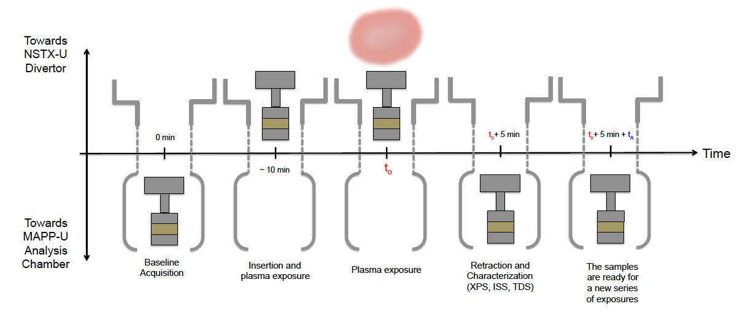
Background
Main Objectives of MAPP:
In-vacuo analysis of materials exposed to plasma discharge.
Provide immediate, shot-to-shot analysis.
Remote Control interface.
Operate within 12 min minimum between-shot time window⁺
⁺This sequence can be modified if remote control of insertion/retraction is not available. Manual insertion (beginning of day) and retraction (end of day) must be performed then. Access to test cell required.

Slide 16
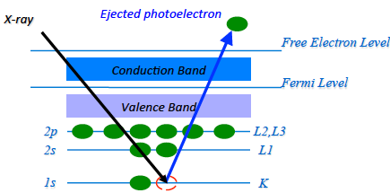
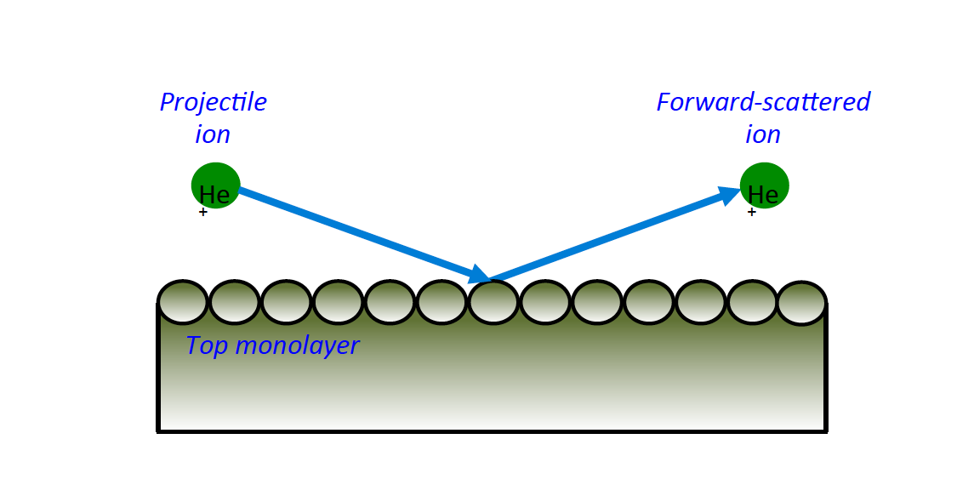
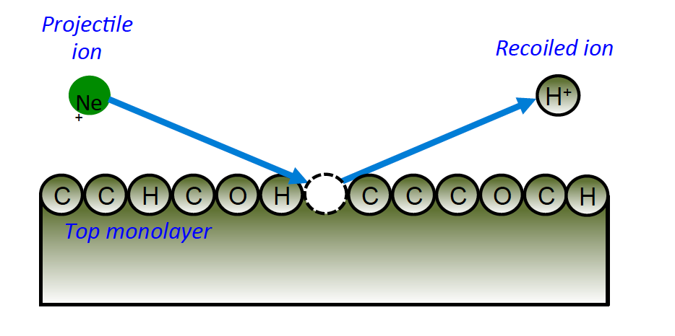
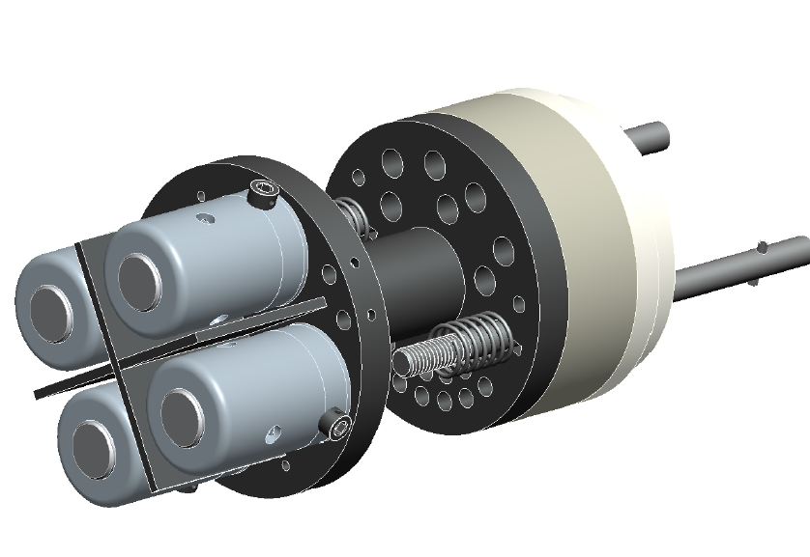
Background
XPS
Identifies elemental
and chemical
composition.
ISS
Provides qualitative
identification of
surface species.
TDS
Provides information
of binding energies
and allows us to identify
desorption products.
DRS
Similar to ISS, but capable
of detecting low
Z such as H.
Sample Holder
Holds four samples.
Independent heating of each sample.
Quick release probe head.
Built in Molybdenum alloy to prevent
unwanted sputtering.

Slide 17
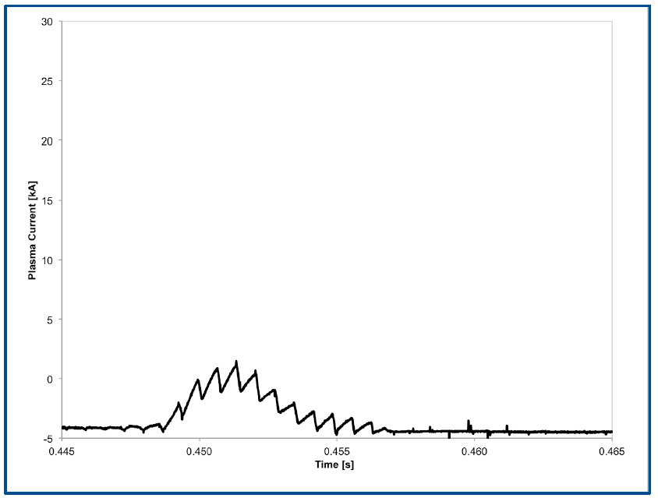
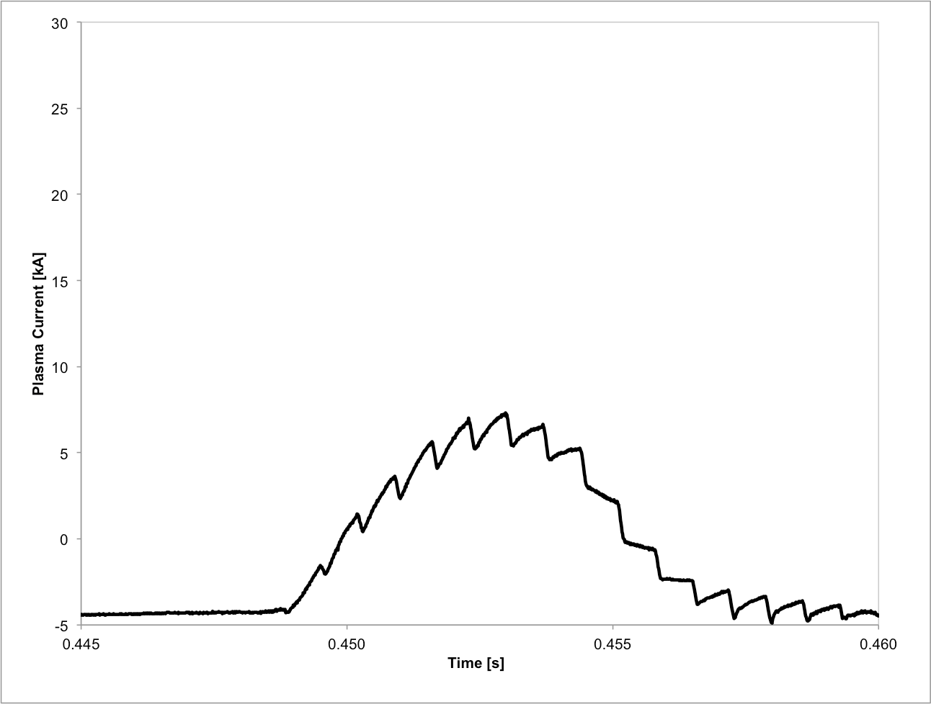
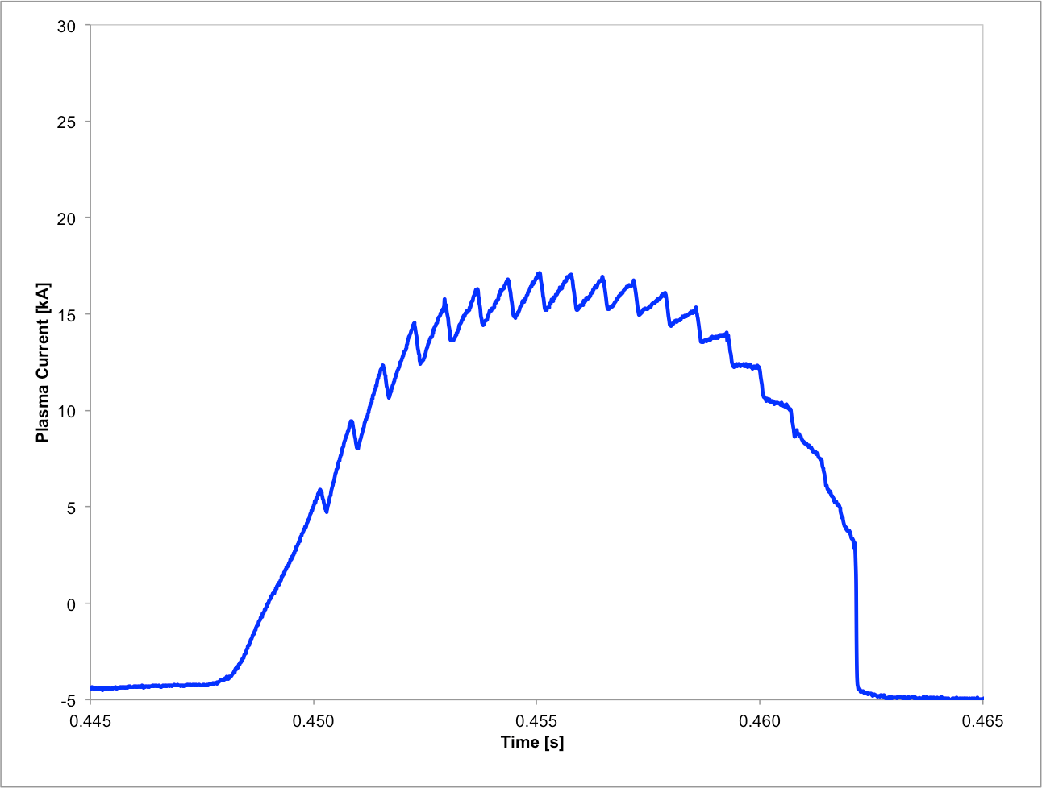
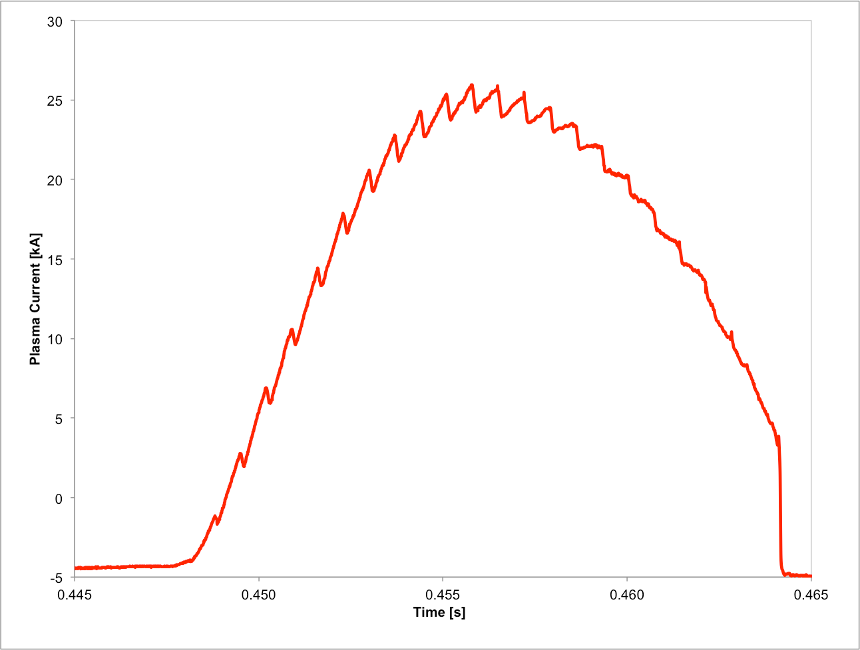
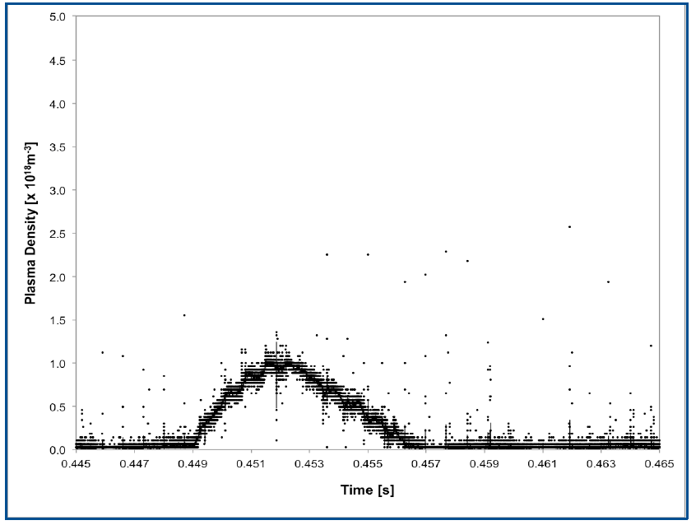
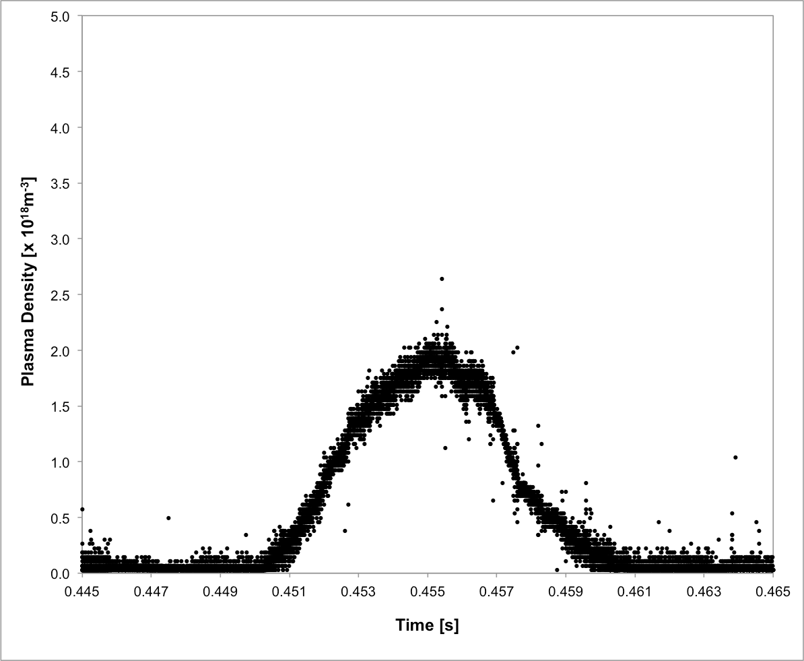
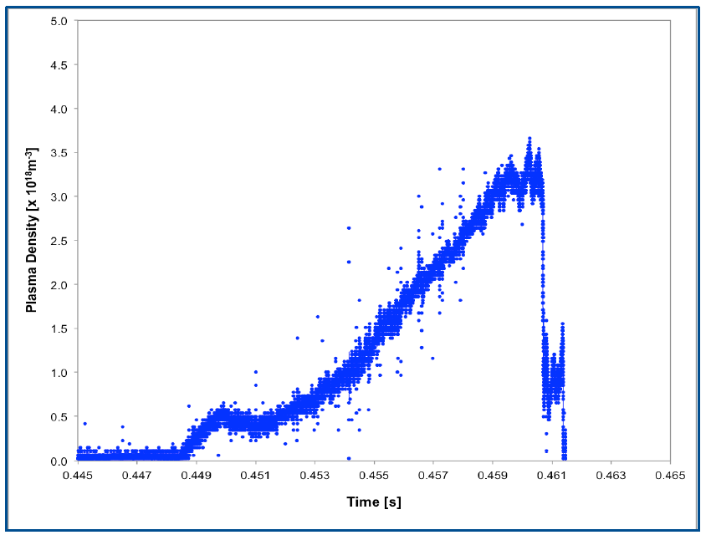
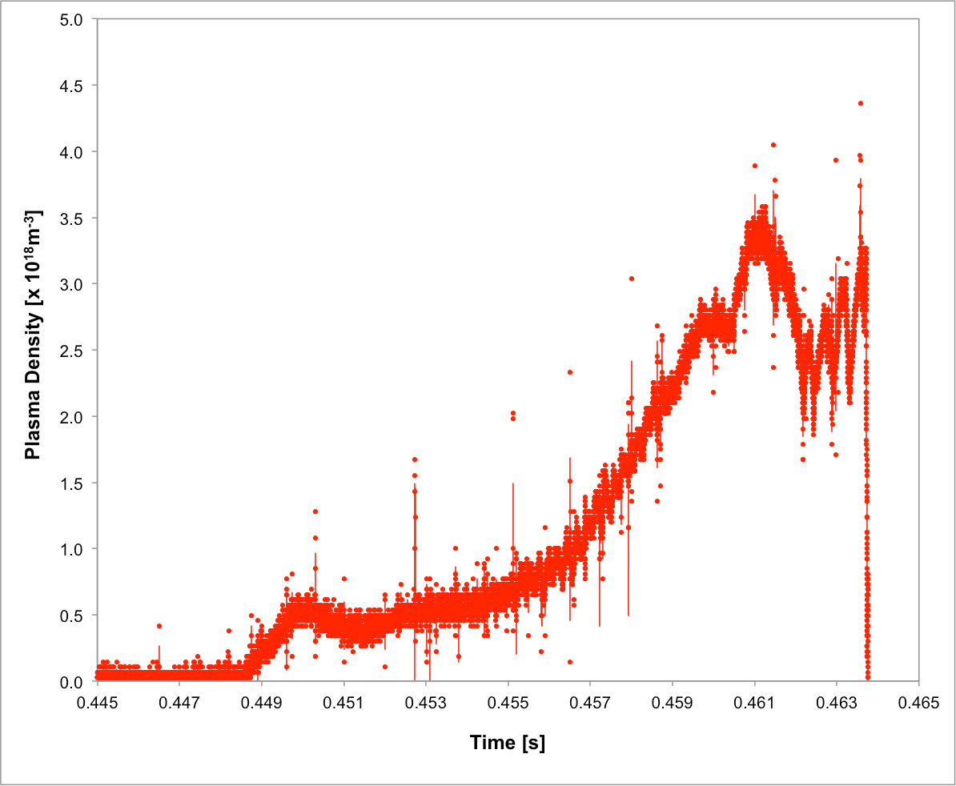
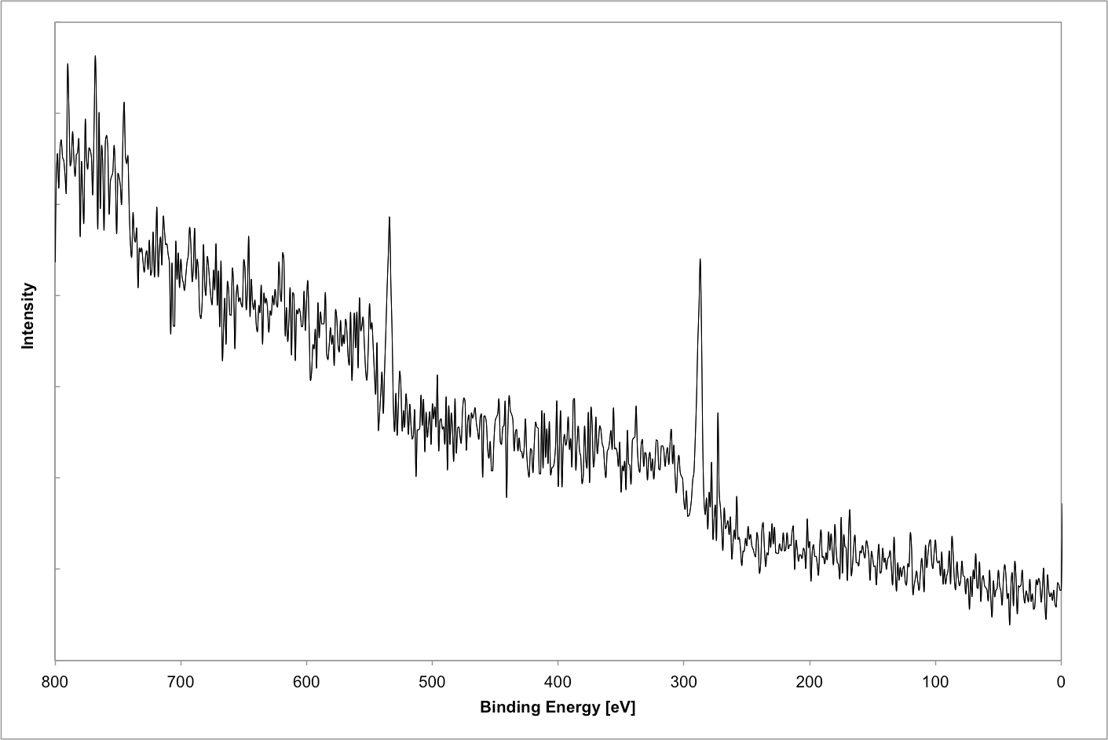
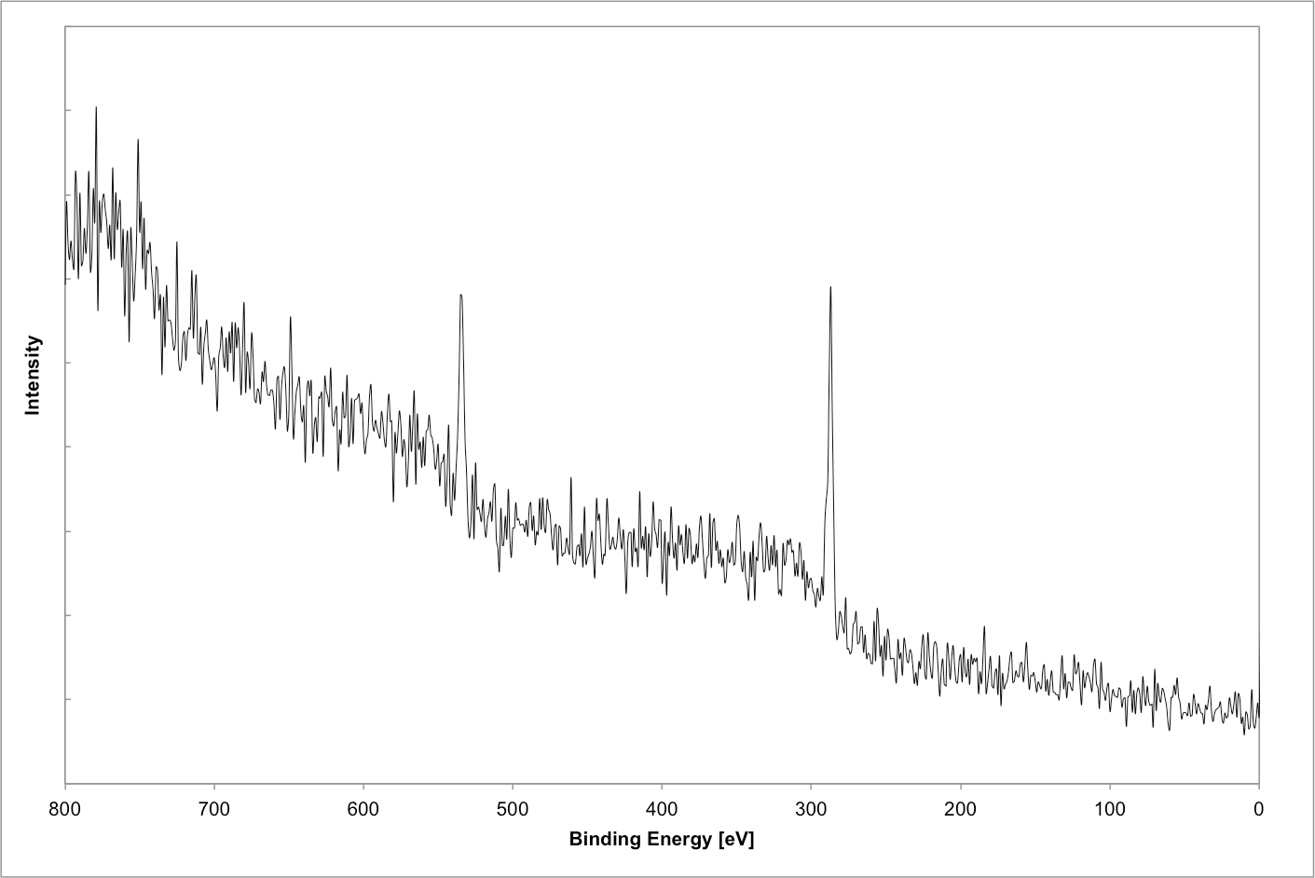
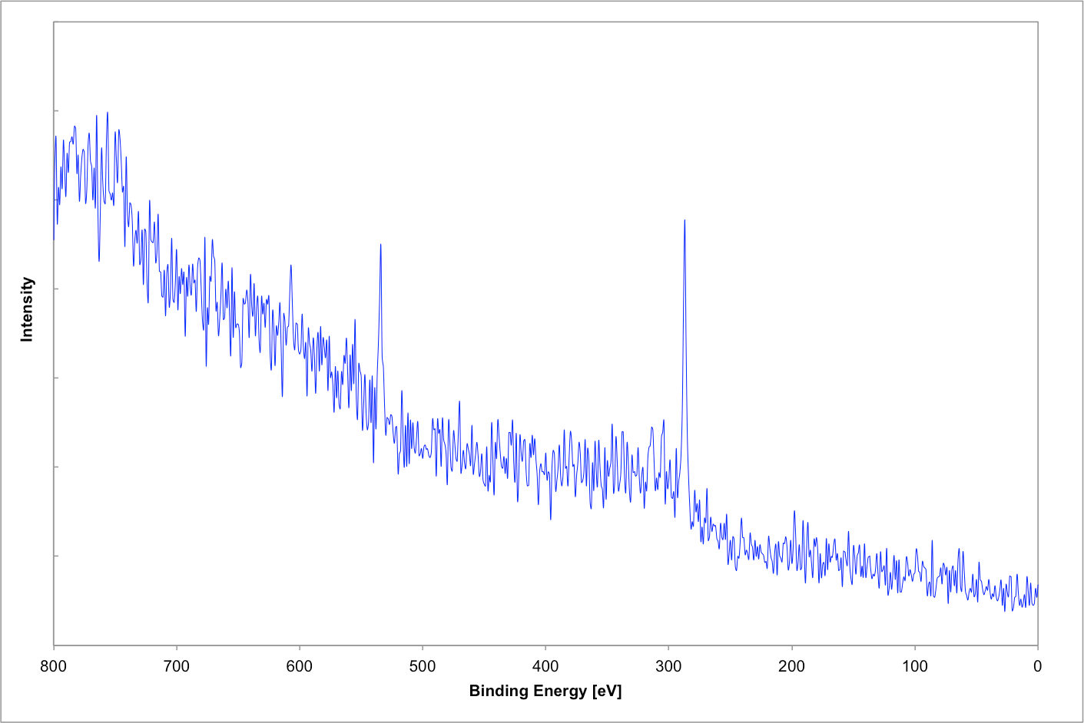
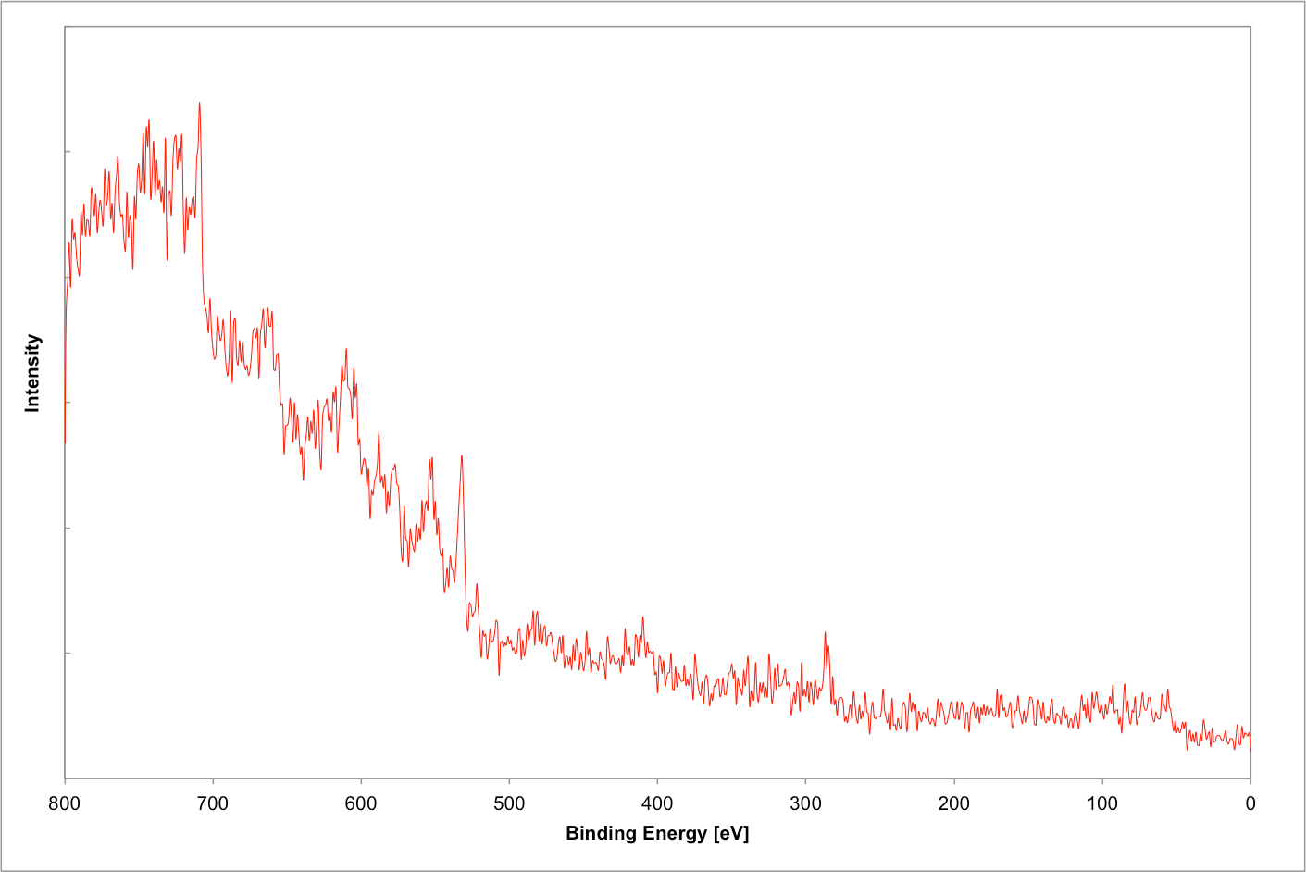
Initial results from LTX
Baseline Scans
Ar glow cleaning followed by Li deposition
9 hours of Ar glow discharge
cleaning (ArGDC)
4 hours of additional ArGDC
with samples exposed
Plasma
Density
Plasma
Current
XPS
Spectrum

