Slide 1
Understanding of anomalous transport reduction/increase from L-mode to Type I ELMy H-mode and back A. Loarte, A. Diallo and R. Maingi

Slide 2
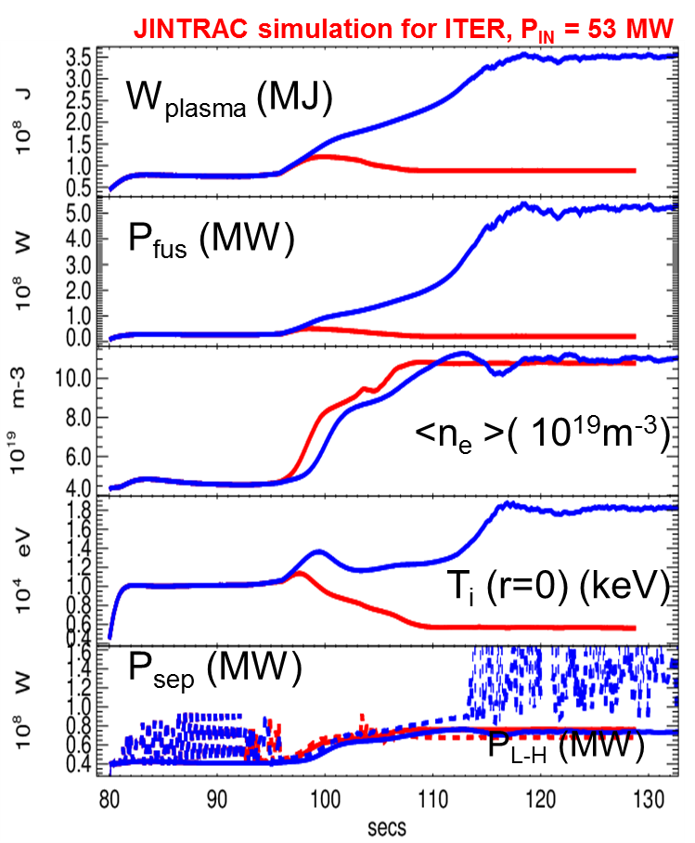
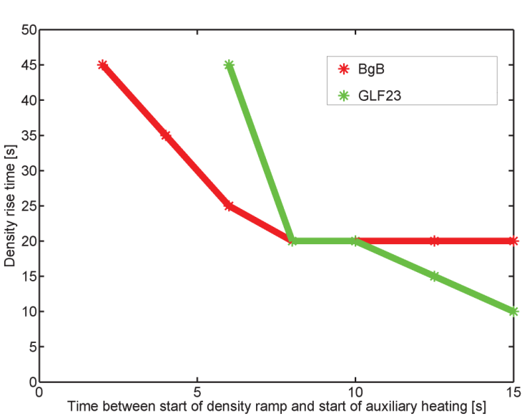
Pedestal transport in ITER confinement transients (L-H)
Access to high performance H-mode is not trivial in ITER → requires careful control of n_{ped} (pellet)-n_{sep} (gas) in addition to P_{add}
Increase of P_{aux} with only gas fuelling for 5-15s to maintain n_{sep}
Followed by increase of n_{ped} using pellets in 10-30 s + gas fuelling
Key unknown is energy and transport behaviour after H-mode transition to fully developed pedestal
F. Köchel IAEA 2014
Access to high Q_{DT}
No access to high Q_{DT}
Notes:
Larmor radius (D+) = 1.44 E-4*sqrt(T)/B

Slide 3
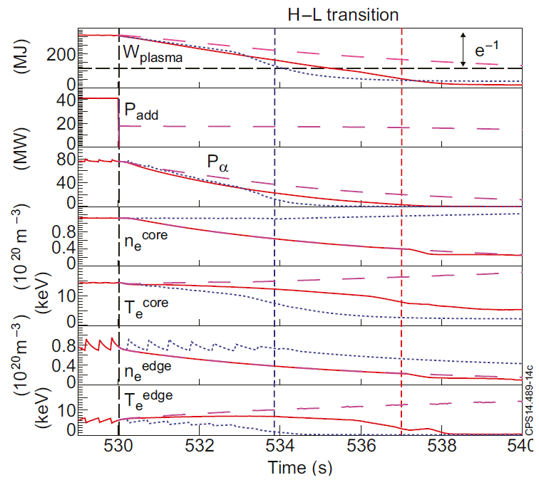
Pedestal transport in ITER confinement transients (H-L)
Exit from high performance H-mode is not trivial in ITER → large fluxes to PFCs and large radial displacements (β changes faster than we can change the vertical field)
High n_{sep} by gas fuelling keeps low T_{div} and divertor W source
Slow ramp of P_{add} to lengthen medium performance H-mode phase
Fast switch of pellets to decrease <n_{e}>, drop P_{L-H} keep T_{i} high (more P_{α}) to make long H-mode collapse phase → lower dW/dt and q_{div} in H-L collapse phase
Key unknown is energy and transport behaviour from fully developed pedestal to L-mode
ITER 15 MA Q ~ 10
JINTRAC
Loarte – NF 2014
Notes:
Larmor radius (D+) = 1.44 E-4*sqrt(T)/B

Slide 4
NSTX-U Experiments
For given I_{p}/B_{t} develop regimes (with Li conditioning) in NSTX-U with wide pedestals to diagnose evolution of plasma transport (turbulence, grad-n and grad-T, etc.) in time and space within the ETB
Measure ETB transport evolution in H-mode access and exit phase with square NBI waveform at three power levels (near L-H threshold and highest value and point in-between) and no gas fuelling
Choose one NBI power level and repeat with various levels of gas fuelling (square waveform)
Choose NBI square waveform or gas fuelling square waveform and vary the gas or NBI waveform to study effect on time varying ETB transport
Repeat at another level of I_{p}/B_{t} to determine if ETB transport behaviour scales as expected from margin to L-H threshold

