Slide 1




NSTX-U
Supported by
Columbia U. Group – NSTX-U Macrostability TSG XPs
Coll of Wm & Mary
Columbia U
CompX
General Atomics
FIU
INL
Johns Hopkins U
LANL
LLNL
Lodestar
MIT
Lehigh U
Nova Photonics
ORNL
PPPL
Princeton U
Purdue U
SNL
Think Tank, Inc.
UC Davis
UC Irvine
UCLA
UCSD
U Colorado
U Illinois
U Maryland
U Rochester
U Tennessee
U Tulsa
U Washington
U Wisconsin
X Science LLC
S. A. Sabbagh, J.W. Berkery, J.M Bialek
Y.S. Park, (et al…)
Department of Applied Physics, Columbia University, New York, NY
Culham Sci Ctr
York U
Chubu U
Fukui U
Hiroshima U
Hyogo U
Kyoto U
Kyushu U
Kyushu Tokai U
NIFS
Niigata U
U Tokyo
JAEA
Inst for Nucl Res, Kiev
Ioffe Inst
TRINITI
Chonbuk Natl U
NFRI
KAIST
POSTECH
Seoul Natl U
ASIPP
CIEMAT
FOM Inst DIFFER
ENEA, Frascati
CEA, Cadarache
IPP, Jülich
IPP, Garching
ASCR, Czech Rep
NSTX-U Research Forum
February 25th, 2015
PPPL
V1.2

Slide 2
Columbia U. Group 2015 Macrostability TSG XPs (Short Summary)
XPs (related XPs assigned numbers for “2011 run”)
  RWM stabilization dependence on neutral beam deposition angle (~XP1149) (Berkery)
  RWM stabilization physics at reduced collisionality (~XP1148) (Berkery)
  RWM state space active control physics (independent coil control) (~XP1145) (Sabbagh)
  RWM control physics with partial control coil coverage (JT-60SA) (~XP1147) (Y-S Park)
  RWM PID control optimization based on theory and experiment (~XP1111) (Sabbagh)
  RWM state space active control at low plasma rotation (~XP1146) (Y-S Park)
  Neoclassical toroidal viscosity - reduced ν (independent coil control) (~XP1150) (Sabbagh)
  NTV steady-state rotation at reduced torque (HHFW) (~XP1062) (Sabbagh)
  Multi-mode error field correction using the RWMSC (to follow initial EFC XP)
  NTM Entrainment in NSTX-U (Y.S. Park)
Piggyback XPs
  Disruption PAM characterization, measurements, and criteria (Sabbagh, for DPAM WG)
NOTE: - some shot plans already scoped out in web submissions (not repeated here)
- run day requests mostly assume leveraging “2nd NBI XP”, “Ip/Bt scaling XP”

Slide 3
XP: RWM state space active control physics (independent coil control) – Sabbagh, et al.
Motivation
  RWM state space controller (RWMSC) allowing influence of conducting structures, plasma mode shape / response expected to improve control performance, allows greater shielding of control coils needed in future devices
  Improve capability of present NSTX-U RWMSC by using new 2nd SPA, more plasma modes, etc.
Goals / Approach
  Examine control aspects of different high performance target plasmas
    Key step to prepare the RWMSC for general use in the future
  Determine control physics advantages of including influence of wall, choice of input eigenfunction set, inclusion of n > 1 eigenfunctions
  Determine effect of control with 6 independent RWM coils
  Determine influence of reducing effect of conducting structure
  Examine influence of adding n = 1 RWM PID control using B_{r} sensors
Addresses
  NSTX Research Milestones R(15-3),JRT-16
  ITPA joint experiments MDC-17, MDC-21

Slide 4
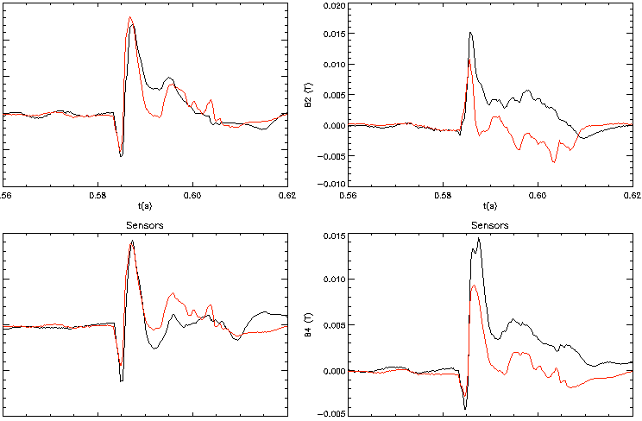
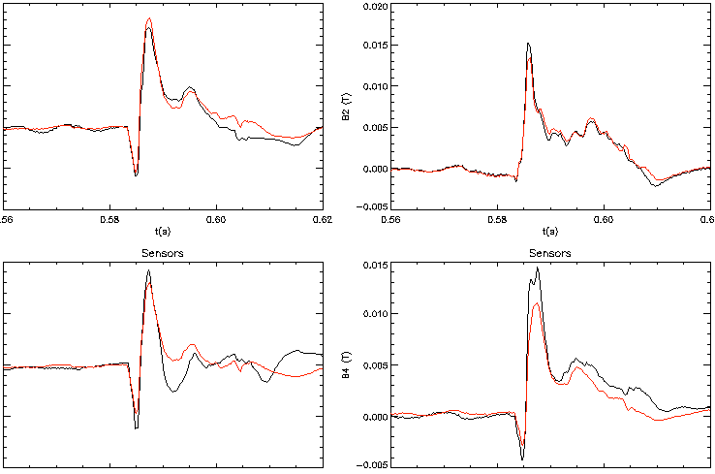
Increased number of states in RWM state space controller improves match to sensors over entire mode evolution
RWM Upper B_{p} Sensor Differences (G) – 2 States
RWM Upper B_{p} Sensor Differences (G) – 7 States
150
200
150
200
100
RWM
180 degree
differences
180 degree
differences
100
RWM
180 degree
differences
180 degree
differences
50
100
50
100
0
0
0
0
-50
-50
-100
0.56
0.58
0.60
0.62
-100
0.56
0.58
0.60
0.62
-100
0.56
0.58
0.60
0.62
-100
0.56
0.58
0.60
0.62
100
150
100
150
90 degree
differences
90 degree
differences
90 degree
differences
90 degree
differences
50
100
50
100
0
50
0
50
-50
0
-50
0
137722
-50
137722
-50
-100
0.56
0.58
0.60
0.62
0.56
0.58
0.60
0.62
-100
0.56
0.58
0.60
0.62
0.56
0.58
0.60
0.62
t (s)
t (s)
t (s)
t (s)
Sensor not functioning
Sensor not functioning
Reasonable match to all B_{p} sensors during RWM onset, large differences later in evolution
Some 90 degree differences not as well matched
  Indicates potential need for an n = 2 eigenfunction state
  Attempt n = 2 control in 2015
Black: experiment Red: offline RWM state space controller

Slide 5
Upgrades of new RWM state space controller will leverage new 2nd SPA power supply to study physics effects
2nd SPA power supply allows independent control of the 6 RWM coils
  We need new phase and gain scans (test new control matrices) – this was not performed in 2011
New RWM state space controller physics studies
  Addition of n > 1 eigenfunction will then yield n = 1, 2 feedback, and higher n based on observer match to wall states
  Test controller on various high performance targets
    E.g. (i) fiducial, (ii) low li, (iii) snowflake divertor
    Eigenfunction variations: e.g. does snowflake divertor configuration reduce divertor mode?
  Compare controller with influence of wall vs. without influence of wall
XP needs
  Request: 1.5 run days
n = 1 multi-mode RWM spectrum (mmVALEN)
NSTX 133775
t = 0.495 [s]
n = 1 ideal eigenfunctions for fiducial plasma
Z(m)
RWM B_{R} and B_{p} sensor locations
R(m)

Slide 6
XP: RWM control physics with partial control coil coverage – Y.S. Park, et al.
Motivation
  Effect of partial coil coverage (e.g. JT-60SA)*, and impact of internal coil loss (e.g. ITER) may lead to “mode non-rigidity” during RWM feedback – the effect on mode control needs to be understood
  NSTX active RWM control failed with 2 coils missing
Goals / Approach
  RWM control in NSTX will be attempted with partial coverage of the RWM coils to test the physics of RWM mode rigidity
  Leverage new independent control of the RWM coils
  Determine the change in the computed multi-mode RWM spectrum and compare to experiment
  Compare attempted control with both the RWM PID controller, and RWM state space controller
Addresses
  *Collaborative RWM stabilization research with JAEA (for JT-60SA) – IEA joint research task
  ITPA joint research MDC-17, MDC-21
JT-60SA passive plates and RWM control coils
Request:
1 run day

Slide 7
XP: RWM PID control optimization based on theory and experiment – Sabbagh, et al.
Motivation
  Experiments using n = 1 RWM control in 2010, and subsequent analysis using the VALEN code show that some settings for control using dual B_{R} and B_{p} sensor feedback were optimal, others could have been improved
  Active RWM PID control settings need to be re-optimized for NSTX-U
  Support general NSTX-U experiments by optimizing RWM PID control
Goals / Approach
  Optimize n = 1 RWM PID control focusing on scans of key parameters
    Vary B_{p} feedback phase, B_{R} feedback gain – which differ in the most in the analysis from the experimental settings
    B_{p} sensor gain will also be examined in this experiment (never scanned with r/t AC compensation).
    Perform on high performance target plasmas (fiducial; low l_{i}; snowflake)
Addresses
  General support for NSTX-U high beta experiments, R(15-3), JRT-16
  ITPA joint experiment MDC-17
Request: 0.5 – 1.0 run days (depends on desired targets, number of parameter variations/shot)

Slide 8
RWM B_{r} sensor n = 1 feedback phase variation shows superior settings when combined w/B_{p} sensors; good agreement w/theory so far
NSTX Experiments: B_{p} + B_{R} feedback
n = 1 B_{R} + B_{p} feedback
(B_{p} gain = 1, B_{R} gain = 1.5)
VALEN calculation of NSTX B_{r} + B_{p} control
Feedback on
0 deg FB phase
Radial field n = 1 (G)
90 deg FB phase
Vacuum EF + RFA
180 deg FB phase
Vacuum error field
Δt (s)
VALEN calculation of B_{r}+B_{p} feedback follows XP
  stable plasma (negative “s”)
  Now examining plasma response model variation
    impact of “s”, and diff. rotation (“α”) on results
Favorable (experimental) B_{p} feedback settings, varied B_{R} settings
  Positive/negative feedback produced at theoretically expected phase values

Slide 9
XP: RWM state space active control at reduced plasma rotation – Y.S. Park, et al.
Motivation
  Present theory shows ITER advanced scenario plasmas are kinetic RWM unstable just above the n = 1 no wall limit, and alpha particle stabilization is required; Amount of kinetic resonance stabilization at low rotation is uncertain
Goals / Approach
  Demonstrate RWM control over a greater range of plasma rotation using RWM state space control (incl. (i) low ω_{φ}, (ii) intermediate ω_{φ} at marginal stability)
  Determine control physics differences of varying input eigenfunction set (including allowance of n > 1 eigenfunctions) at various ω_{φ}
  Vary key controller parameters to examine influence on stability
  Test compatibility with applied fields for NTV rotation damping
    Ensure controller doesn’t reduce n = 2, n = 3 braking field significantly
  Examine influence of adding n = 1 RWM PID control using B_{r} sensors
Addresses
  NSTX Research Milestones R(15-3)
  ITPA joint experiment MDC-17, MDC-21

Slide 10
Kinetic stability calculations show reduced stability in low l_{i} target plasma as ω_{φ} is reduced; also at low ω_{φ}
Ideal stability
RWM stability vs. ω_{φ} (contours of γτ_{w})
MISK code
140132, t = 0.704s
w/fast particles
thermal
2.0
ω_{φ}/ω_{φ}^{exp}
1.0
Experiment
(marginal)
unstable
Can RWM unstable regions be controlled using the RWMSC, including low rotation?
  Ideal stability analysis shows high margin over no-wall limit
    RWM stabilization by kinetic effects large
  MISK: RWM marginal stability at various ω_{φ}
    Demonstrate control in these regions!
Find RWMSC matrices most effective for control
  Includes n > 1 control, variation of eigenfunctions used in controller, etc.
Request: 1 run day

Slide 11
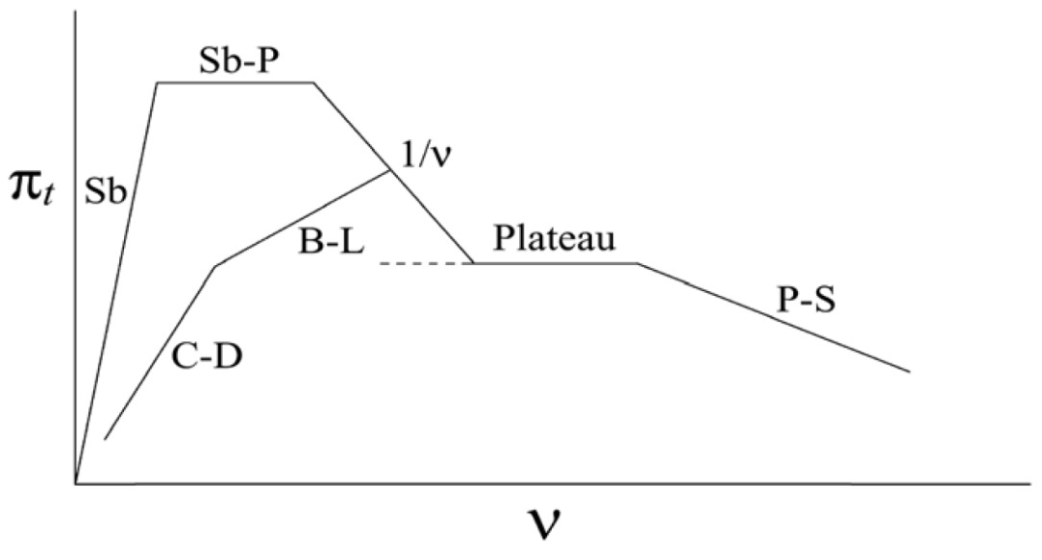
XP: Neoclassical toroidal viscosity at reduced collisionality (independent coil control) – Sabbagh, et al.
NTV strength varies with plasma collisionality ν, δB², rotation
Motivation
  Experimentally, the dependence of neoclassical toroidal viscosity (NTV) at low collisionality is not well known
  Understanding important for NSTX-U V_{φ} control, other tokamaks, future devices
Goals / Approach
  Examine the dependence of NTV on ion collisionality
    expected to increase with decreasing ν_{i} from present experiments, and theory
  Determine if superbanana plateau increase of NTV depends on ν_{i}
  Operate with pre-programmed n = 2, 3 applied fields for V_{φ} feedback control testing at reduced ν_{i}
Addresses
  NSTX Milestones R(15-3), closed-loop rotation control with 3D fields
  ITPA joint experiment MDC-21
NSTX-U
NSTX
ν_{i}* ~ 1
K.C. Shaing, M.S. Chu, C.T. Hsu, et al., PPCF 54 (2012) 124033
“offset” rotation
NTV force in “1/ν” collisionality regime
K.C. Shaing, et al.,
PPCF 51 (2009) 035004
T_{i}^{5/2}
plasma rotation
1/aspect ratio (compare to KSTAR)

Slide 12
Measured NTV torque density profiles quantitatively compare well to computed T_{NTV} – NTVTOK code interfaced to NSTX-U
n = 2 coil configuration
n = 3 coil configuration
NSTX
NSTX
x1.7
x0.6
NTVTOK code
Experimental
-dL/dt
Experimental
-dL/dt
NTVTOK
ψ_{N}
ψ_{N}
S.A. Sabbagh, et al., IAEA FEC 2014, paper EX/1-4
Scale factor ((dL/dt)/T_{NTV}) = 1.7 and 0.6 (for cases shown above) – O(1) agreement
Comparison to full Shaing, et al. theory with NTVTOK code (applicable for all collisionality (as shown above) is possible to compute between shots for NSTX-U
Comparisons will also be made to other NTV codes (e.g. by J-K. Park, K. Kim, Z. Wang)

Slide 13
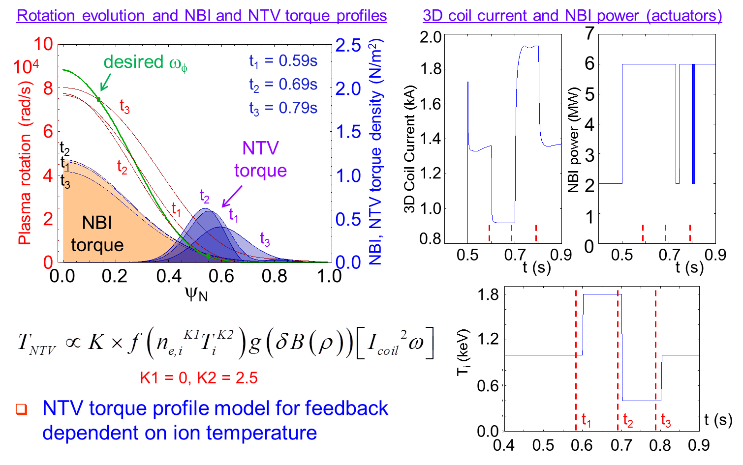
NTV experiment at reduced ν is a key step for closed-loop V_{φ} feedback using 3D fields in NSTX-U
Expect stronger NTV torque at higher T_{i} (-dω_{φ}/dt ~ T_{i}^{5/2} ω_{φ})
  Initially shown in NSTX
  Shown in our recent KSTAR XPs
Present XP
  Operate with larger change in ν_{i}
  Attempt to reach quasi-steady-state ω_{φ} for each ν_{i}
  Use braking fields envisioned for V_{φ} FB
Request: 1 run day
S.A. Sabbagh, et al, NF 50 (2010) 025020
Y.S. Park, et al, IAEA FEC 2014, paper EX/P8-05
I. Goumiri (PU), S.A. Sabbagh (Columbia U.), D.A. Gates (PPPL)
S.A. Sabbagh, et al., IAEA FEC 2014, paper EX/1-4

Slide 14
XP: NTV steady-state offset velocity at reduced torque with HHFW – Sabbagh, et al.
Motivation
  Measure and understand neoclassical toroidal viscosity (NTV) steady-state offset velocity physics to gain confidence in extrapolation of the effect to future devices
    Background: NSTX low ω_{φ} NTV experiments with co-NBI + non-resonant magnetic braking do not show NTV steady-state offset velocity to be in the counter-I_{p} direction (e.g., shown in DIII-D (Garofalo, PRL 2008), claimed consistent with theory)
Goals
  Complete XP1062, partially run in 2010 (**but excluded HHFW portion of shot list**)
  Determine NTV offset rotation in plasmas with no, varied NBI torque (HHFW heated)
    Use demonstrated technique to measure ω_{φ} in RF plasmas
    Use n = 3 applied field, compare to results with n = 2 applied field configuration
  Demonstrate for the first time NTV with strong electron component
  Key code validation in new regime: for the NTVTOK code, and other NTV codes
  Determine if low ω_{φ} (low ω_{E} superbanana plateau (SBP) regime) can be reproduced during the NBI portion of these discharges with non-resonant braking
    Can attempt to measure NTV steady state offset velocity this way as well when varying non-resonant applied field magnitude
Addresses
  NSTX Milestone R(15-3)
  Desire to understand potential sources of momentum input for ITER

Slide 15
Zero input torque ω_{φ} profile diagnosed in 2009 RF XPs
Determine NTV offset rotation – RF approach
  Generate ω_{φ} with RF at highest T_{i}, W_{tot} possible, diagnose similar to Hosea/Podesta 2009
  Repeat for different *initial* values of n = 3 (and/or 2) field, determine if pre-NBI ω_{φ} changes
  Note that if NTV offset is indeed only in counter-I_{p} direction, the ω_{φ} profile will change (it’s presently counter in core, co at the edge
Attempt to maintain near-zero ω_{φ} during NBI phase
  New way to enter/sustain low ω_{E} SBP regime
J. Hosea, APS DPP 2009
Since SBP regime yields maximum NTV
  Entering it by lowering ω_{φ} yielded an observed increase in NTV without mode locking (2009-10)
  Conversely, attempt to measure decrease in NTV as SBP regime is exited
Request: 0.5 – 1.0 run days (depends on goals, and leveraging RF+NBI development )

Slide 16
XP: Multi-mode error field correction with the RWM state-space controller (RWMSC) – Sabbagh, et al.
Motivation
  Produce multi-mode error field correction for the first time using the inherent capability of the RWMSC to include multiple modes (different n; different poloidal spectra)
  High interest for ITER and other tokamaks
Goals / Approach
  Demonstrate reduction of applied n = 1, 2, 3 error fields
    Test the need for matching n values between applied field and modes
    Test the influence of wall states in the error field reduction effectiveness
  Demonstrate reduction of NSTX-U intrinsic error fields
    Use “best” set of RWMSC control matrices determined from above step (including n > 1, and sufficient number of wall states)
  Demonstrate reduction of dynamic error fields (at higher β_{N})
    Determine if increase of plasma permeability is required in control model for best performance at increased β_{N}
Addresses
  Milestone R(15-3), JRT-16
  ITPA joint experiment MDC-17, MDC-19, MDC-21

Slide 17
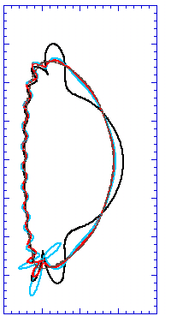
Multi-mode RWM computation shows 2nd eigenmode component has dominant amplitude at high β_{N} (vs. 1st eigenmode dominant at lower β_{N})
NSTX δB_{n} RWM multi-mode spectrum
at high β_{N}
Multi-mode error field correction experiment differs from RWM active control experiments
  Theoretically, the multi-mode spectrum is simplified away from RWM marginal stabilty points
    Are different control matrices needed for the best error field correction compared to RWM control at marginal stability?
  Compare effect on RWM PID and RWMSC for error field correction
    PID should be more subject to failure by n > 1 mode content, error in tracking toroidal phase
    State space controller with n > 1 eigenfunctions and wall effects is expected to provide greater EFC
Request: 1 run day (should run after PID EFC experiment (by C. Myers))
β_{N} = 6.1
2.0
133775
mode
2
t = 0.655s
1.0
mode 1
Z(m)
θ
0.0
mode
3
δB^{n} amplitude (arb)
-1.0
mode 3
-2.0
mode 2
0.0
1.0
2.0
R(m)
mode
1
Unstable
Stabilized by rotation
ideal eigenmode number
mmVALEN code

Slide 18
XP: NTM Entrainment on NSTX-U – Y.S. Park, et al.
Motivation
  NTM “entrainment”, in which tearing modes are partially controlled to avoid locking, can be used for disruption avoidance (or at least in conjunction with controlled shutdown)
Goals / Approach
  Attempt entrainment for the first time on NSTX-U with a somewhat novel technique
    Slow NTM (attempt both 3/1, and 2/1 modes) using non-resonant NTV (n = 3) to slow the plasma
    With NTM slowed to near, or below the critical rotation speed for mode locking, apply an n = 1 AC field to attempt to keep the NTM rotating at low frequency ~ 50Hz (far slower speed than the critical mode rotation speed for locking)
    Attempt to use n = 1 “slow” feedback with a phase that sustains the n = 1 mode rotation to avoid mode lock
Addresses
  NSTX-U Milestones R(15-3), JRT-16
  ITPA joint experiment MDC-8, MDC-17, MDC-22

Slide 19
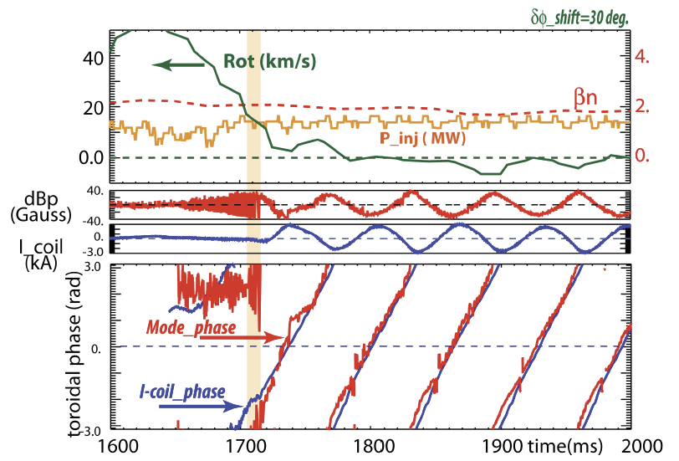
Present entrainment experiment would be similar (could be compared to) past DIII-D experiments
Will entrainment be different at varied aspect ratio, higher edge q shear?
  DIII-D / NSTX-U comparison
  Also NSTX-U / KSTAR (A = 3.5) comparison (we will propose XP on KSTAR in 2015)
A key motivation for NSTX-U is disruption avoidance by mode locking avoidance
Request: 0.5 – 1.0 run days
Tearing mode entrainment with n = 1 feedback in DIII-D
M. Okabayashi, et al., ITPA MHD Stability meeting, April, 2013

Slide 20
Piggyback XP: Disruption PAM (DPAM) Characterization, Measurements, and Criteria - Sabbagh, for the DPAM WG
Motivation
  Serve NSTX-U DPAM Working group main goal: Satisfy gaps in understanding prediction, avoidance, and mitigation of disruptions in tokamaks, applying this knowledge to move toward acceptable levels of disruption frequency/severity using quantified metrics
Goals / Approach
  Initial discussion held at first DPAM Working Group meeting
  ( see http://nstx.pppl.gov/DragNDrop/Working_Groups/DPAM/2015 )
  Start early in NSTX-U operation to
    Characterize NSTX-U disruptions (similar to P. deVries, et al. approach taken on JET)
    Quantify results with measurements (similar to S. Gerhardt, et al. pioneering work on NSTX)
    Expand disruption determination/avoidance models - as stated in NSTX-U 5 Year Plan
  Tools are presently being developed for this purpose
  Analysis will be conducted/communicated to/by NSTX-U DPAM WG meetings, planned as a multi-year effort
  This step is expected to be conducted in piggyback – NO RUN TIME request
Addresses
  NSTX-U Milestones: R(15-3), JRT-16, NSTX-U DPAM WG charges
  ITPA joint experiment MDC-21, MDC-22

Slide 21
Example of disruption physics elements interconnected to describe paths toward disruption
Elements
  Provide a logical and quantifiable set of components in the disruption chain, with underlying physics
Connections
  Shows interrelations of the elements, arrow thickness showing relative probability of path
  Can have multiple inputs / outputs
Example: Disruption Elements and Connections Diagram (JET)
P.C. de Vries et al., Nucl. Fusion 51, 053018 (2011)

Slide 22
Supporting slides follow

Slide 23
(Incomplete) List of physics elements tied to disruption prediction, avoidance (individual involvement) – 1/30/15 mtg
Impurity control (NC)
  bolometry-triggered shutdown (SPG); "tailoring” radiation-induced TM onset (LD, DG)
  change plasma operational state / excite ELMs, etc. (TBD – perhaps JC)
Greenwald limit (GWL)
  density/power feedback, etc. (DB)
Locked TM (LTM)
  TM onset and stabilization conditions, locking thresholds (JKP,RLH,ZW)
  TM entrainment (YSP)
Error Field Correction (EFC)
  NSTX-U EF assessment and correction optimization (CM,SPG)
  NSTX-U EF multi-mode correction (SAS, YSP, EK)
Current ramp-up (IPR)
  Active aux. power / CD alteration to change q (MDB, SPG)
Shape control issues (SC)
  Active alteration of squareness, triangularity, elongation – RFA sensor (SPG,MDB)
Transport barrier formation (ITB)
  Active global parameter, V_{φ}, etc. alteration techniques (SAS,JWB,EK)
H-L mode back-transition (HLB)
  Active global parameter, V_{φ}, etc. alteration techniques (SAS,JWB,EK)
Approaching vertical instability (VSC)
  Plasma shape change, etc. (SPG, MDB)
Resistive wall mode (RWM)
  Active global parameter, V_{φ}, etc. alteration techniques (SAS,JWB)
  Active multi-mode control (SAS,YSP,KT)
Ideal wall mode (IWM)
  Active global parameter, V_{φ}, etc. alteration techniques (JEM)
Internal kink/Ballooning mode (IKB)
  Active global parameter, V_{φ}, etc. alteration techniques (SAS,JWB)
  Active multi-mode control (SAS, YSP, KT)
Abbreviations:
JWB: Jack Berkery
AB: Amitava Bhattacharjee
DB: Devon Battaglia
MDB: Dan Boyer
JC: John Canik
LD: Luis Delgado-Aparicio
DG: Dave Gates
SPG: Stefan Gerhardt
MJ: Mike Jaworski
EK: Egemen Kolemen
RLH: Rob La Haye
JEM: Jon Menard
CM: Clayton Myers
JKP: Jong-Kyu Park
YSP: Young-Seok Park
RR: Roger Raman
SAS: Steve Sabbagh
KT: Kevin Tritz
ZW: Zhirui Wang
TBD: (To be decided)
Interest from Theory
  Amitava Bhattacharjee, Allen Boozer, Dylan Brennan, Bill Tang have requested involvement

