Slide 1
Divertor conditions and detachment characteristics in plasmas with 3D fields A. Loarte, J.W. Ahn, A. Diallo, R. Maingi, O. Schmitz and J. Lore

Slide 2
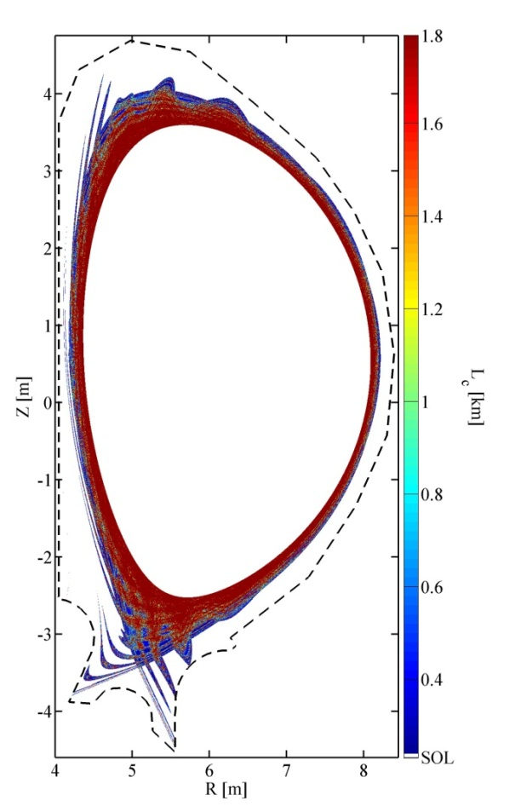
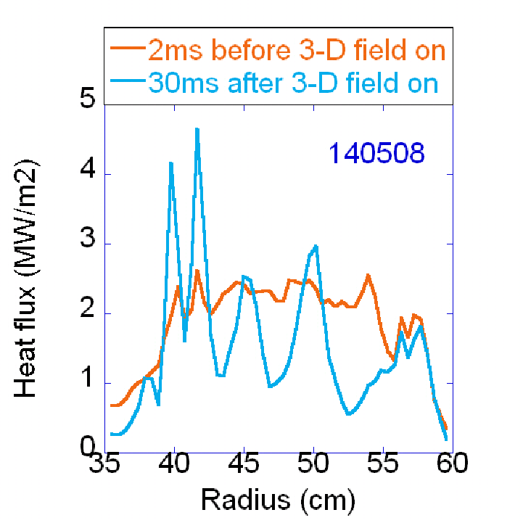
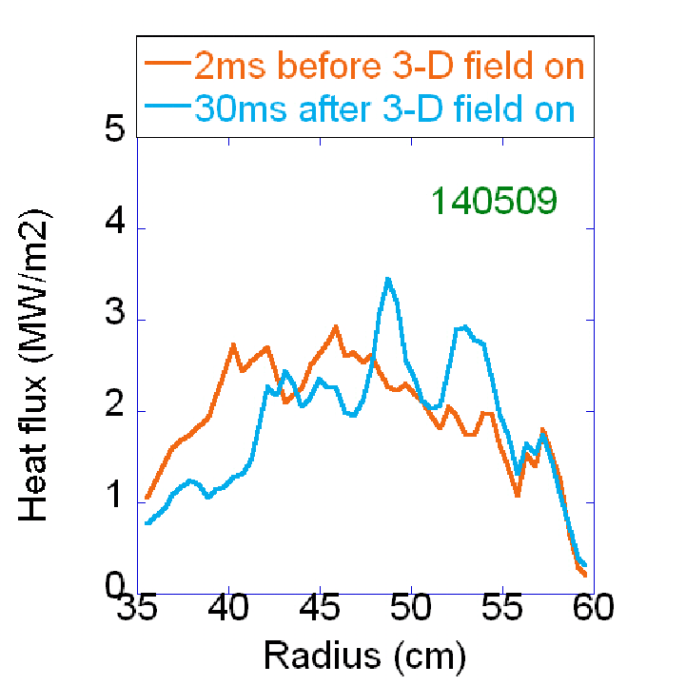
3-D fields an divertor conditions
ITER plans to use 3-D field perturbations for ELM control and in addition to operate in a high density/radiative divertor for stationary divertor power load control
Very few experiments done so far to study in details physics of high density divertor with 3-D fields and on their influence for radiation with extrinsic impurities
Studies at NSTX have shown that high radiation and detachment are compatible with 3-D fields but there is a clear influence of 3-D fields on divertor plasma
NSTX - J.W. Ahn
Detached (low gas puff)
Detached (high gas puff)
Notes:
Larmor radius (D+) = 1.44 E-4*sqrt(T)/B

Slide 3
NSTX-U Experiments
For given I_{p}/B_{t} and 2 NBI power levels (at least one level in H-mode) in perform gas fuelling scans to determine low recycling-high recycling-detachment behaviour without 3-D fields
Repeat gas fuelling scans from main chamber and divertor with 3-D fields at two levels of current in coils with optimum perturbation alignment (maximum with H-mode operation and minimum for detection of striations in q_{div} at low <n_{e}>)
Choose one <n_{e}> and one NBI power level in which plasma is in H-mode and the divertor is in the high recycling regime and inject impurities (Nitrogen preferably or Neon) to various levels to create a highly radiative divertor at medium <n_{e}> without 3-D fields with D gas puffing from main chamber and divertor
Repeat with 3-D fields at two coil current levels
Repeat at another NBI power level/<n_{e}> level

