Slide 1
Investigating small-scale edge turbulence with GPI
Noah Mandell, Stewart Zweben, Walter Guttenfelder, Yang Ren, Steve Sabbagh
NSTX T&T Forum 2015
2/25/2015

Slide 2
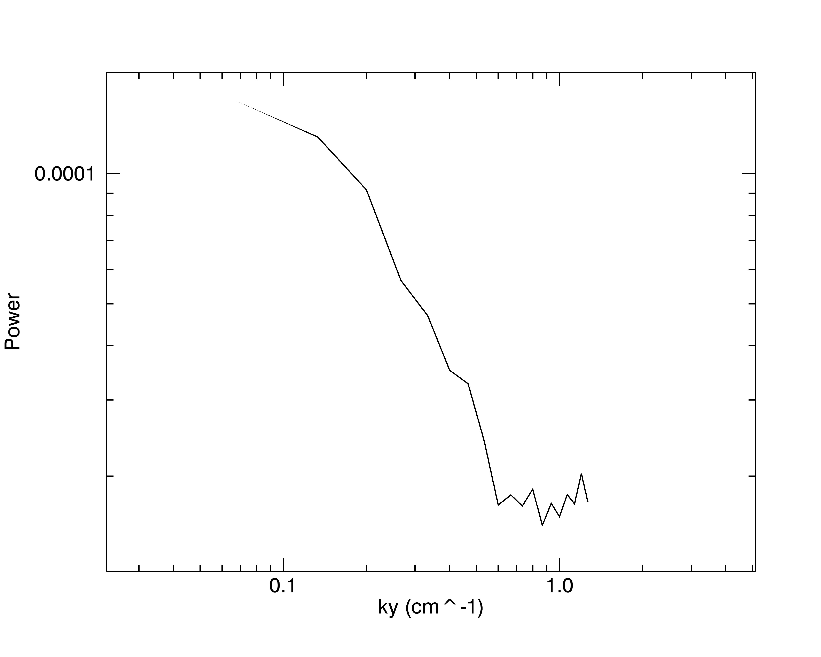
Motivation & GPI Optics Upgrades
2010 GPI data included shots that showed small-scale (sub-cm) structure → consistent with ETG turbulence
Zoom optics upgrade will allow 2-3x zoom to enhance spatial resolution of optics so that ~2-3mm structure can be resolved
Other upgrades to fiber bundle, etc will allow better signal-to-noise ratio, possibly faster frame rate for movies
Shot 139955, t=365.9-366.1 ms (80 frames)
Notes:
current GPI region: 25x30 cm → zoom region 12x15 cm. current frame rate: 400,000 fps, could double.

Slide 3
Experiment Goals
Measure fluctuation (w,k) spectra of edge turbulence from GPI movies made using new magnifying zoom lens
Examine how edge turbulence changes with ∇T_{e}, ∇n_{e} near separatrix
Compare with theory (Guttenfelder) and other diagnostics (e.g. high-k scattering, Ren) to assess whether observed fluctuations are characteristic of ETG turbulence or other theorized modes
Determine role of turbulence in stiff T_{e} profiles near separatrix (as suggested by Canik et al, 2011)

Slide 4
Plasma Conditions
Calibration: Require scans of B_{T} or I_{P} to align local B field with GPI optical view to optimize small-scale resolution, guided by EFIT (Sabbagh)
This will require 5-10 dedicated shots (~2 hours), with GPI gas puffing. Could be an XMP.
Main experiment: H-mode, with and without Lithium wall conditioning
With lithium, density gradient is weakened and ETG is predicted to be more unstable in pedestal (Canik et al)
Can piggy-back on other XPs for additional data as allowed

