Slide 1
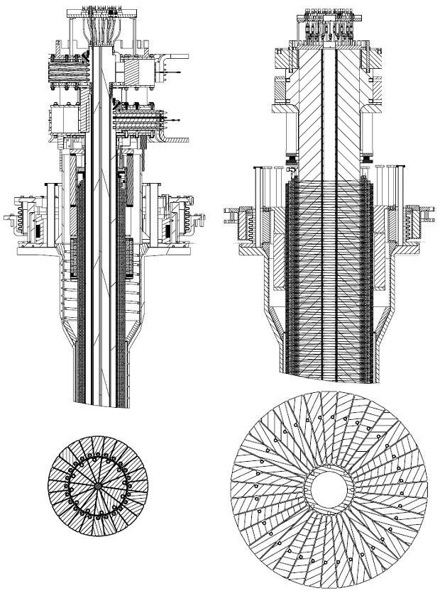
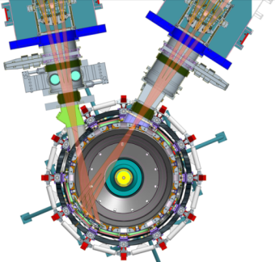
FY2015 (and 2016) research milestones will guide prioritization of eXperimental Proposal (XP) ideas
Incremental (full ops)
FY2015
FY2016
Expt. Run Weeks:
12
14
15
18
Previous
center-stack
New
center-stack
R15-1
R16-1
Assess H-mode confinement, pedestal, SOL characteristics at higher B_{T}, I_{P}, P_{NBI}
Assess scaling, mitigation of steady-state, transient heat-fluxes w/ advanced divertor operation at high power density
Boundary Science
Develop snowflake configuration, study edge and divertor properties
R16-2
Assess high-Z divertor PFC performance and impact on operating scenarios
IR15-1
R15-2
IR16-1
TF OD = 20cm
TF OD = 40cm
Core Science
Assess effects of NBI injection on fast-ion f(v) and NBI-CD profile
Assess confinement and local transport and turbulence at low ν* with full range of B_{T}, I_{P}, and NBI power
R16-3
R15-3
Assess fast-wave SOL losses, core thermal and fast ion interactions at increased B_{T}, I_{P}
Integrated Scenarios
Develop physics + operational tools for high-performance discharges (κ, δ, β, EF/RWM)
Present NBI
New 2nd NBI
R16-4
Develop high-non-inductive fraction NBI H-modes for ramp-up & sustainment
FES 3 Facility Joint Research Target (JRT)
NSTX-U leads JRT
C-Mod leads JRT
Quantify impact of broadened J(r) and p(r) on tokamak confinement and stability
Assess disruption mitigation, initial tests of real-time warning and prediction techniques

Slide 2
Expected progression of NSTX-U operational performance
 | NSTX (Max.) | FY 2015 NSTX-U Operations | FY 2016 NSTX-U Operations | FY 2017 NSTX-U Operations | Ultimate Goal
I_{P} [MA] | 1.2 | ~1.6 | 2.0 | 2.0 | 2.0
B_{T} [T] | 0.55 | ~0.8 | 1.0 | 1.0 | 1.0
Allowed TF I²t [MA²s] | 7.3 | 80 | 120 | 160 | 160
Longest Likely I_{P} Flat-Top at max. I²t, I_{P}, and B_{T} [s] | ~0.4 | ~3.5 | ~3 | 5 | 5
Limits to assume for Research Forum idea submissions
1st year goal: operating points with forces up to ½ way between NSTX and NSTX-U, ½ design-point heating limit of PF/TF coils.
Will permit up to ~5 second operation at B_{T}~0.65
2nd year goal: Full field & current, but still limiting coil heating
Will revisit year 2 parameters once year 1 data has been accumulated
3rd year goal: Full capability

Slide 3
Provisional schedule for the 2015 research campaign
Diagnostic Considerations
Magnetic Calibrations
MSE Calibrations
CHERS Calibrations & XMPs
Neutron Calibration Transfer
More…
MPTS Rayleigh/Raman Scattering
Feb. 2015
Mar. 2015
Apr. 2015
May 2015
June 2015
July 2015
Aug 2015
Sept. 2015
Bakeout
ISTP & Commissioning
Research Plasma Operation
First Plasma
Commissioning
I_{p}<=1.0 MA, B_{T}<=0.5
Breakdown and current ramp scenarios
EFIT & rtEFIT Reconstructions
Shape & position control
Reliable H-mode
Diagnostic operations
DCPS under plasma operations
Boronizaton +He GDC for PFCs
Data Acquisition Commissioning for Diagnostics
Ex-Vessel Diagnostic Installations
Gas Delivery System Final Checks
Magnetics Debugging
Beamline Final Checks and Conditioning
IR Camera Calibrations
Rectifier Dummy Load Testing
Research Operations
LITERs when the operational status allows and physics program desires
Continued discharge, control, and diagnostic commissioning

Slide 4
Run schedule scope of Research Forum
FY15
Early FY16
Run Weeks 1-4
Run Weeks 5-8
Run Weeks 9-12
Run Weeks 13-16
17-18
Commissioning
Science
Science
Science
Mid-run assessment
Scope of pre-forum meetings - see next page for additional details
Scope of Research Forum
Pre-forum meetings emphasized XMP/XP title, goal, author identification to cover first 2 run months (weeks 1-8)
Forum should emphasize prioritization of XPs for weeks 3-18, but also document commissioning XMP/XP goals + run-time
Mid-run (re-)assessment after first 6-8 Science run-weeks

Slide 5
Operations assumptions for first 2 run-months
Machine Commissioning…assume 1 month (run weeks 1-4)
Develop basic breakdown, current ramp, shape/position control, diverted plasmas, H-mode access, basic fuelling optimizations.
Goal: 1 MA, 0.5 T, NBI-heated H-mode (i.e. ~NSTX fiducial levels)
Diagnostic commissioning
Boronized PFCs
Mostly eXperimental Machine Proposals (XMPs)
1st Month of Science Campaign (run weeks 5-8)
Boronized PFCs, possibly begin lithium coatings
Operations and basic profile diagnostics, neutron rate,…
Operation up to 1.4 MA and 0.65 T, 2 seconds
6 beam sources up to 90 kV
HHFW available for commissioning

Slide 6
Operational tools for density and impurity control
Years 1 & 2 of ops.: Examine Wall Conditioning, Fueling, and ELM Pacing
Boronized PFC Studies
Plan to start NSTX-U operations with TMB.
Utilize regimes with natural ELMs to control impurity accumulation
Between-shot He glow for wall conditioning
Deuterium inventory likely to rise throughout the discharge
Lithiated PFC Studies
High-τ_{E}, ELM-free regimes w/ Li conditioning
Pulsed 3D fields or lithium granules for ELM pacing to provide impurity control
Deuterium inventory likely well controlled, but unclear if target Z_{eff}~2 can be achieved
Realtime Density Measurements via FIReTIP
Supersonic Gas Inj. for Density Control
Both Scenarios:
Out Years: Utilize Cryo-pumping and Partial NCC

Slide 7
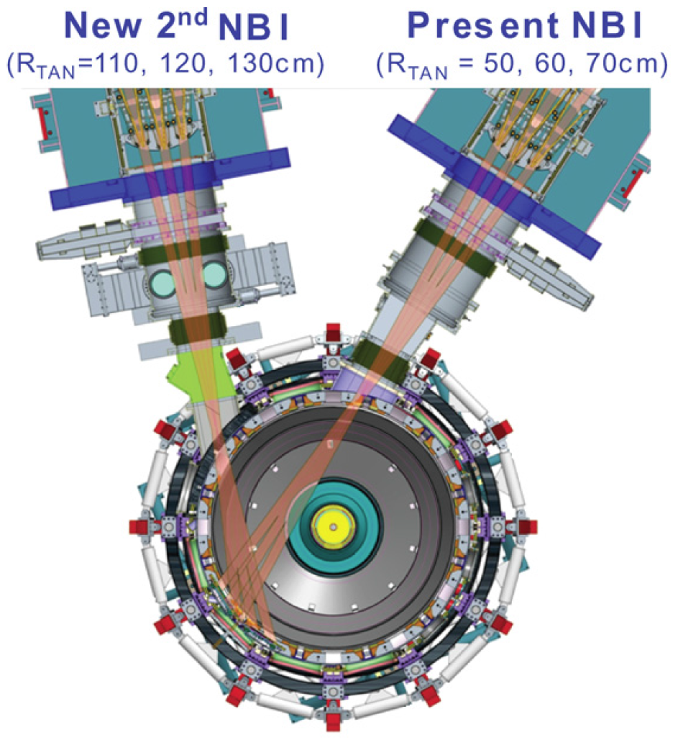
Naming convention for NSTX-U NBI systems
Tangency Radius [cm] | Engineering Designation
50 | 1C
60 | 1B
70 | 1A
110 | 2C
120 | 2B
130 | 2A
Notes:
1. MSE-CIF collects light from the 1A source
2. CHERS collects light from the first beamline
3. Additional information on the NB upgrade and capabilities can be found in J.E. Menard, et al, Nuclear Fusion 52 (2012) 083015

