Slide 1




NSTX-U
Supported by
New organization, issue discussion, roles and responsibilities, and so much more…
Coll of Wm & Mary
Columbia U
CompX
General Atomics
FIU
INL
Johns Hopkins U
LANL
LLNL
Lodestar
MIT
Lehigh U
Nova Photonics
Old Dominion
ORNL
PPPL
Princeton U
Purdue U
SNL
Think Tank, Inc.
UC Davis
UC Irvine
UCLA
UCSD
U Colorado
U Illinois
U Maryland
U Rochester
U Tennessee
U Tulsa
U Washington
U Wisconsin
X Science LLC
J. Menard
For the NSTX-U Research Team
Culham Sci Ctr
York U
Chubu U
Fukui U
Hiroshima U
Hyogo U
Kyoto U
Kyushu U
Kyushu Tokai U
NIFS
Niigata U
U Tokyo
JAEA
Inst for Nucl Res, Kiev
Ioffe Inst
TRINITI
Chonbuk Natl U
NFRI
KAIST
POSTECH
Seoul Natl U
ASIPP
CIEMAT
FOM Inst DIFFER
ENEA, Frascati
CEA, Cadarache
IPP, Jülich
IPP, Garching
ASCR, Czech Rep
NSTX-U Pre-Forum Meeting #1
PPPL LSB B318
December 16, 2014

Slide 2
Upcoming meetings / events
Pre-forum meeting #1 – December 16, 2014 (i.e. today)
  Discuss new SG/TSG structure, roles, responsibilities, “other issues”
  Discuss actions/experiments needed for restart, initial physics-ops
Pre-forum meeting #2 – January 28-29, 2015 (Wed, Thu)
  Goal: Provide up-to-date operations status to aid scheduling
  Day 1: Diagnostics/operations readiness meeting
    Status updates and projections for all systems needed for research ops
  Day 2: Update from SG/TSGs on XMP/XP solicitations
Research Forum – Feb 24-27th (Tue-Fri) at PPPL
  Plenary session, TSG break-outs, SG sessions, team joint session, summary (also safety session and team photo)
CD-4 / first plasma – Mid March
Research operations – Mid May (12-14 run weeks)
NSTX-U PAC-36 – Sept/Oct 2015 (end of/after FY15 run)

Slide 3
Agenda
NSTX-U organizational structure
Roles and responsibilities of various groups
Discussion of issues raised during 1-on-1’s
Preparation for Research Forum
XP approval and execution - S. Gerhardt
XMP/XPs for restart, 1st run month – TSGs/TF

Slide 4
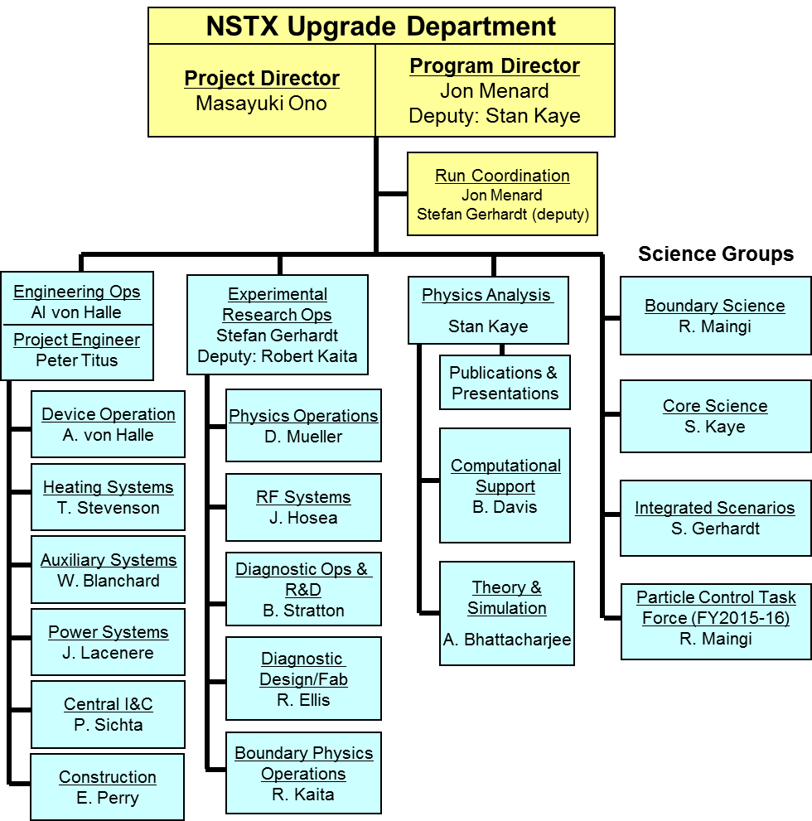
NSTX-U Organization for FY2015

Slide 5
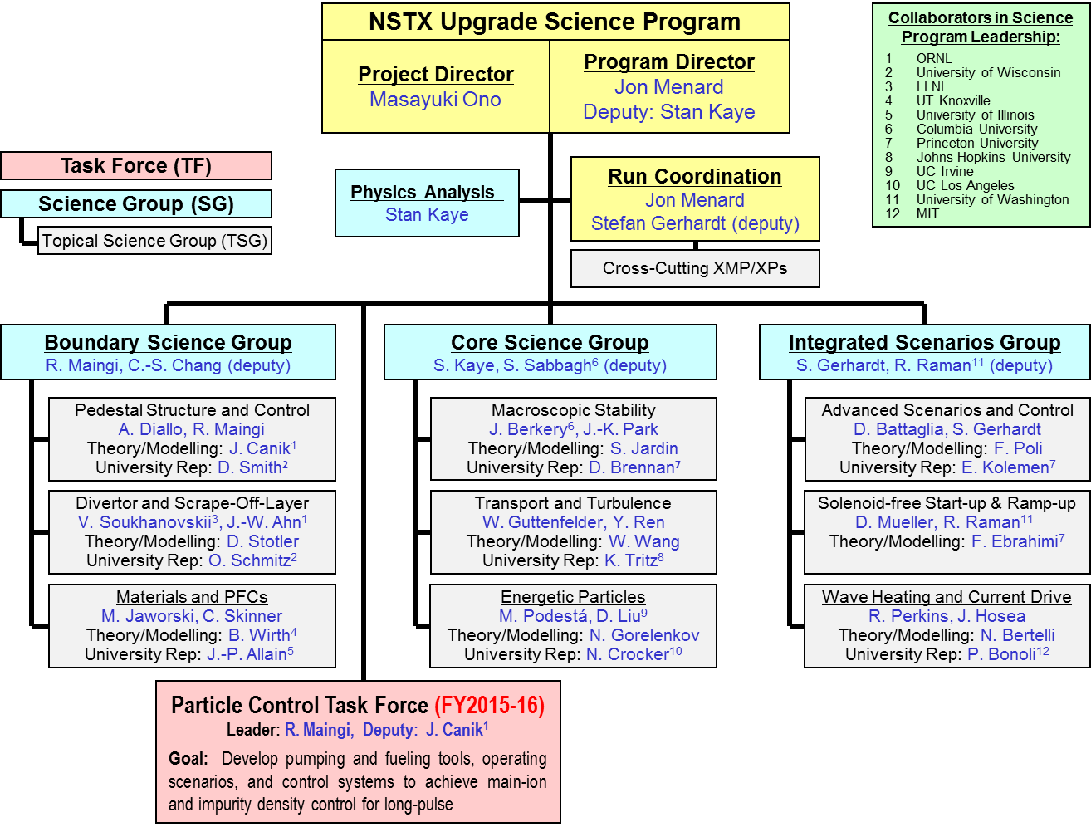
NSTX-U research program will be (re-)organized along 3 “Science Groups” starting with FY15 run
Each TSG will have a leader, deputy, theory rep, and at least 1 university rep to enhance university participation

Slide 6
Motivations for restructuring science program
TSGs provide expertise in broad range of topics, but program would benefit from better coordination between TSGs
  SG leader responsibility: Coordinate TSG physics research plans, experimental/shot plans, diagnostic coverage & usage
Experiments that engage more than one TSG will receive increased priority for run-time
  Example: experiment on 3D fields generating data for: plasma response, turbulence, energetic particle loss
Efficient shot usage especially important during first run year (many systems need to be re-commissioned)
Incorporate much wider set University researchers/PIs in planning + coordination of research program (FES/PPPL goal)
NEW: Task-force for long-pulse particle control → cross-cutting goal supporting entire research program

Slide 7
Roles and Responsibilities for Science Groups
Coordinate research of TSGs within the SG – promote experiments / plans that achieve multiple scientific goals
  Critical to maximizing scientific output per shot
  “Coordinated” XPs will receive higher priority / more run time
Inform Run Coordinator when XP is ready for final review
Provide summaries and highlights of scientific progress at/for NSTX-U team meetings, FES/quarterly reviews, other venues
Aid dissemination of results with Physics Analysis Division
  Journal publications, invited talks, seminars, colloquia, conferences, ITPA, BPO
Coordinate / down-select milestone ideas from TSGs in SG
Provide feedback / comment on annual Field Work Proposal
Assist / report to the NSTX-U Program and Project directors

Slide 8
Roles and Responsibilities for Topical Science Groups
Lead brainstorming, organization, writing of 5 year plan topics
Determine and address highest priority scientific issues through discussion and consensus at open meetings
Organize the NSTX-U Research Forum sessions for the TSG
Draft scientific milestone ideas utilizing expertise of the TSG
Propose and execute experiments to achieve milestones and address priorities
With SG leaders, define facility and theory resources to achieve research goals
Assist / report to the NSTX-U Science Group leaders

Slide 9
Roles / Responsibilities for University Representatives (1)
Contribute to prioritization within TSGs
  Help decide/draft milestones, XMP/XP prioritization
  Help identify how your tools/codes/diagnostics/personnel can contribute to the group and the larger NSTX-U program
Advocate for your own research (up to a point…)
  We understand that data, presentations, publications, participation are important for achieving grant deliverables
If you are willing and able:
  Be an advocate and resource for the research of your TSG outside of NSTX-U
  i.e. seek input/interest from those not funded by NSTX-U, particularly from your own University and other universities

Slide 10
Roles / Responsibilities for University Representatives (2)
Help identify best tools for remote participation
  The TSGs will hold many, many meetings
  We want feedback on what works, and what doesn’t
    Zoom vs ReadyTalk vs Google chat vs. other
      Zoom can provide videocon, slide sharing, and teleccon
      → JEM: TSGs should probably migrate towards Zoom…
Help identify best tools for remote experimentation
  If you are interested, help develop/prototype a “remote control room” to run experiment(s) from your institution
    Employ multiple/key control room stations with web-cams + Zoom (?)
    On-site deputy session leader arguably essential for this to work…
    Expect best implementation will come from the users of these tools
Summary: In short, help lead and manage your TSG

Slide 11
Roles for Task Forces
Wikipedia: “A task force (TF) is a unit or formation established to work on a single defined task or activity. Originally introduced by the United States Navy, the term has now caught on for general usage and is a standard part of NATO terminology. Many non-military organizations now create "task forces" or task groups for temporary activities that might have once been performed by ad hoc committees.”
For NSTX-U:
  Focus on specific goal that cuts across SGs / TSGs
  Must be very high priority goal within research program
  Finite duration - nominally 1-2 years (maybe up to 3 for PC-TF)
  Receives dedicated run-time, session at Forum – similar to a TSG
    But reports directly to Program / Project (at least for Particle Control TF)

Slide 12
May be beneficial to have an additional NSTX-U organizational structure: “Working Groups”
FESAC-SPP Priorities (and Tiers):
  Control of deleterious transient events, Taming plasma-material interface
  Experimentally validated integrated prediction, FNS sub-program
FES will soon announce follow-on “workshops” on:
  Transients, PMI, Integrated Simulation, (+ Plasma Science Frontiers)
“Working Groups” will be needed to organize/present NSTX-U vision/plans at FES workshops, FESAC, ITPA, other venues
  “PMI” arguably already well covered by Boundary SG / LM initiative
  “Transients” WG could help organize/present disruption PAM plans
  “Integrated Simulation” WG could help organize/present validation plans, build upon and/or prioritize NSTX-U/Theory partnership/CPPG activities
Working groups would not have dedicated run-time, but would:
  Hold periodic meetings to assess progress, recommend next-steps
  Make recommendations on XP/milestone priorities to SGs/TSGs/Program
  Solicit input/XP ideas from team, domestic & international collaborators

Slide 13
Other governance issues / ideas
There were some inquiries whether it would be valuable to have something like a:
  “Collaborator Council”
  “Research Council”
  “Board of Directors”
Most of these ideas aim at giving collaboration PIs (more) meaningful input into NSTX-U management
Pros:
  Could increase collaborator actual/apparent influence on Program
Cons:
  Yet another committee/group (already have NSTX-U PAC, PPPL AC)
  Dividing into collaborator and non-collaborator potentially divisive
Present position: Try new SG/TSG structure, include SG leader input to FWP, focus on WGs/workshops, revisit in 1yr

Slide 14
Comments / queries from one-on-one meetings (1)
Would it be beneficial to have diagnostic “tsar”?
  i.e. someone tasked with helping to ensure diagnostics are fully functional for the XPs that require them
  FY15 XP form has explicit comment that XP author needs to check with responsible diagnostic physicist or research operations management to ensure diagnostic coverage
  Beyond that, NSTX-U should have updated list of diagnostic capabilities, responsible personnel, and up-to-date e-mail/phone number
    http://nstx-u.pppl.gov/diagnostics
    Hasn’t been updated since 2011 – will task B. Stratton to update
  Automated e-mail reminders for diagnostic coverage would be useful, but need to get DAQ, MDS+, etc. functional first…

Slide 15
Comments / queries from one-on-one meetings (2)
Substantial NSTX data remains unanalyzed, and could be made more available to team, and public
  Should some NSTX / NSTX-U databases (team and “private”) be more publicly available?
Crowd-sourced code library for data access, analysis, and visualization could be valuable
  Manage with modern software development practices, i.e. have feature request tracking, bug tracking mechanisms
    Have not historically viewed such software as a “research product”, but should we change this paradigm?
  Reduce “reinventing the wheel”, enhance efficiency and scientific productivity
  Need help from advocates, CS/IT to ID best tools for this…

Slide 16
Comments / queries from one-on-one meetings (3): Paraphrasing: “Should Science Groups map to FNSF goals?”
Answer: SGs map well to NSTX-U missions, which include FNSF goals
Mission Elements and 5YP 5 Highest Priorities
NSTX-U Science Groups:
Advance ST for FNSF
  Demonstrate 100% non-inductive sustainment at performance that extrapolates to ≥ 1MW/m² neutron wall loading in FNSF
  Develop and understand non-inductive start-up and ramp-up (overdrive) to project to ST-FNSF with small/no solenoid
Develop solutions for PMI challenge
  Develop / utilize high-flux-expansion “snowflake” + radiative detachment to mitigating high heat flux
  Begin to assess high-Z PFCs + liquid Li to develop high-duty-factor integrated PMI solutions
Explore unique ST parameter regimes to advance predictive capability - for ITER and beyond
  Access reduced ν* + high-β + varied q and rotation to dramatically extend ST understanding
Integrated Scenarios
Boundary Science
Core Science

Slide 17
Research Forum Overview
Science groups will nominally follow priorities/detailed plans developed for 5 year plan (until they are obsolete…)
Abbreviated eXperimental Proposals (XPs) (developed in Dec-Jan) will be presented at the forum
  Motivation, goal, shot plan, # of run days, diagnostics, analysis…
Prioritization carried out at forum using abbreviated XPs
~70-90% of prioritization completed by end of forum
  Highest priority research in research milestones / task forces
  Proposals that address milestones will receive the most run time
  If abbreviated proposal idea is “priority 1”, the author is asked to develop full proposal for operational + program review/approval
Expect ~1/3 of all XPs for year to be approved, ready at start of physics campaign (April/May 2015), then roll forward
  Typically schedule XPs ~1-2 months in advance

Slide 18


FY2015-16 research milestones target exploitation
of new capabilities, exploration of new regimes
Incremental (full ops)
FY2015
FY2016
Expt. Run Weeks:
12
14
16
20
Previous
center-stack
New
center-stack
R15-1
R16-1
Assess H-mode confinement, pedestal, SOL characteristics at higher B_{T}, I_{P}, P_{NBI}
Assess scaling, mitigation of steady-state, transient heat-fluxes w/ advanced divertor operation at high power density
Boundary Science
Develop snowflake configuration, study edge and divertor properties
R16-2
Assess high-Z divertor PFC performance and impact on operating scenarios
IR15-1
R15-2
IR16-1
TF OD = 20cm
TF OD = 40cm
Core Science
Assess effects of NBI injection on fast-ion f(v) and NBI-CD profile
Assess confinement and local transport and turbulence at low ν* with full range of B_{T}, I_{P}, and NBI power
R16-3
R15-3
Assess fast-wave SOL losses, core thermal and fast ion interactions at increased B_{T}, I_{P}
Integrated Scenarios
Develop physics + operational tools for high-performance discharges (κ, δ, β, EF/RWM)
Present NBI
New 2nd NBI
R16-4
Develop high-non-inductive fraction NBI H-modes for ramp-up & sustainment
FES 3 Facility Joint Research Target (JRT)
NSTX-U leads JRT
C-Mod leads JRT
Quantify impact of broadened J(r) and p(r) on tokamak confinement and stability
Assess disruption mitigation, initial tests of real-time warning and prediction techniques

Slide 19
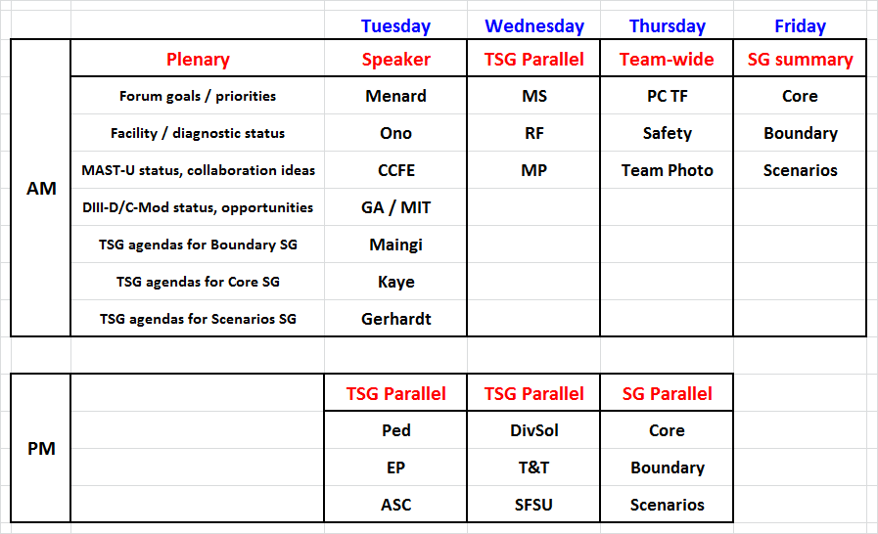
Draft FY2015 Research Forum Agenda

