Slide 1



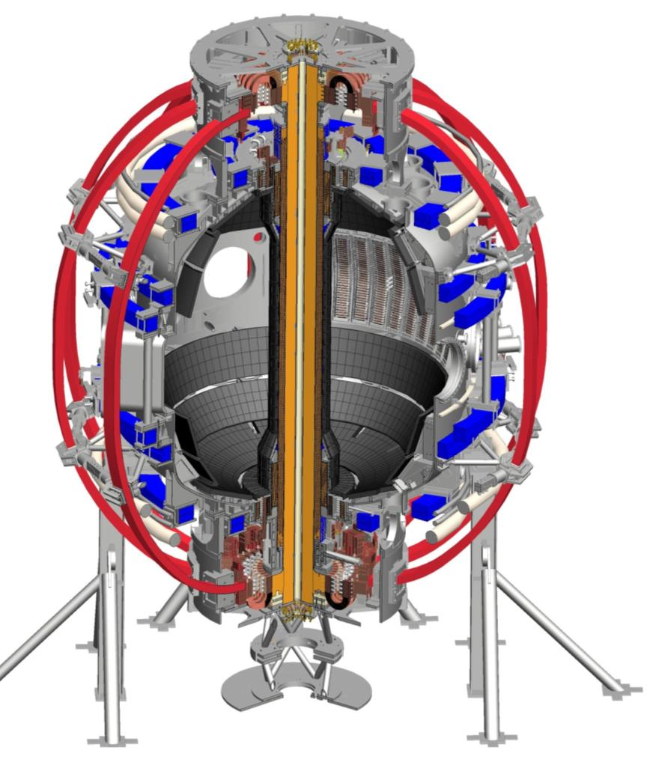



NSTX-U
Supported by
NSTX Facility Operations Year-End Review
Culham Sci Ctr
U St. Andrews
York U
Chubu U
Fukui U
Hiroshima U
Hyogo U
Kyoto U
Kyushu U
Kyushu Tokai U
NIFS
Niigata U
Tsukuba U
U Tokyo
JAEA
Hebrew U
Ioffe Inst
RRC Kurchatov Inst
TRINITI
NFRI
KAIST
POSTECH
Seoul National U
ASIPP
ENEA, Frascati
CEA, Cadarache
IPP, Jülich
IPP, Garching
ASCR, Czech Repz
Columbia U
CompX
General Atomics
FIU
INL
Johns Hopkins U
LANL
LLNL
Lodestar
MIT
Nova Photonics
New York U
ORNL
PPPL
Princeton U
Purdue U
SNL
Think Tank, Inc.
UC Davis
UC Irvine
UCLA
UCSD
U Colorado
U Illinois
U Maryland
U Rochester
U Tennessee
U Washington
U Wisconsin
Masayuki Ono
For the NSTX-U team
FY 2012 Year End Review
Dec. 19, 2012

Slide 2
The NSTX Team Had Strong Participations at IAEA and APS
Most IAEA Presentations Given by the NSTX-Team
NSTX-U researchers participated in the 24th IAEA Fusion Energy Conference held in San Diego, CA from Oct. 8-13, 2012.
  NSTX overview talk entitled “Overview of Physics Results from the NSTX” by S. Sabbagh (Columbia U).
  “The Dependence of H-mode Energy Confinement and Transport on Collisionality in NSTX “ by S. Kaye (PPPL),
  “Progress in simulating turbulent electron thermal transport in NSTX” by W. Guttenfelder (PPPL),
  “Disruptions in the High-β Spherical Torus NSTX” by S. Gerhardt (PPPL),
  “The nearly continuous improvement of discharge characteristics and edge stability with increasing lithium coatings in NSTX“ by R. Maingi (ORNL)
  “Progress on developing the spherical tokamak for fusion applications” by J. Menard (PPPL).
  NSTX also had 23 poster presentations.
  NSTX collaboration contributed to two post deadline talks (NTM control and Snowflake divertor on DIII-D) and a poster (ELM pacing by lithium granular injection on EAST).
NSTX-U Team participated in the 54th Annual Meeting of the Division of Plasma Physics of the American Physical Society in Providence, RI, October 29 – November 2, 2012.
  “Modifications of impurity transport and divertor sources with lithium wall conditioning in NSTX” by F. Scotti (PPPL),
  “Interplay between coexisting MHD instabilities mediated by energetic ions in NSTX H-mode plasmas” by A. Bortolon (UCI),
  “Physics of tokamak plasma start-up” by D. Mueller (PPPL),
  “Assessing low wavenumber pedestal turbulence in NSTX with measurements and simulations” by D. Smith (U of Wisconsin).
  NSTX also had 11 contributed talks and 48 contributed posters.

Slide 3
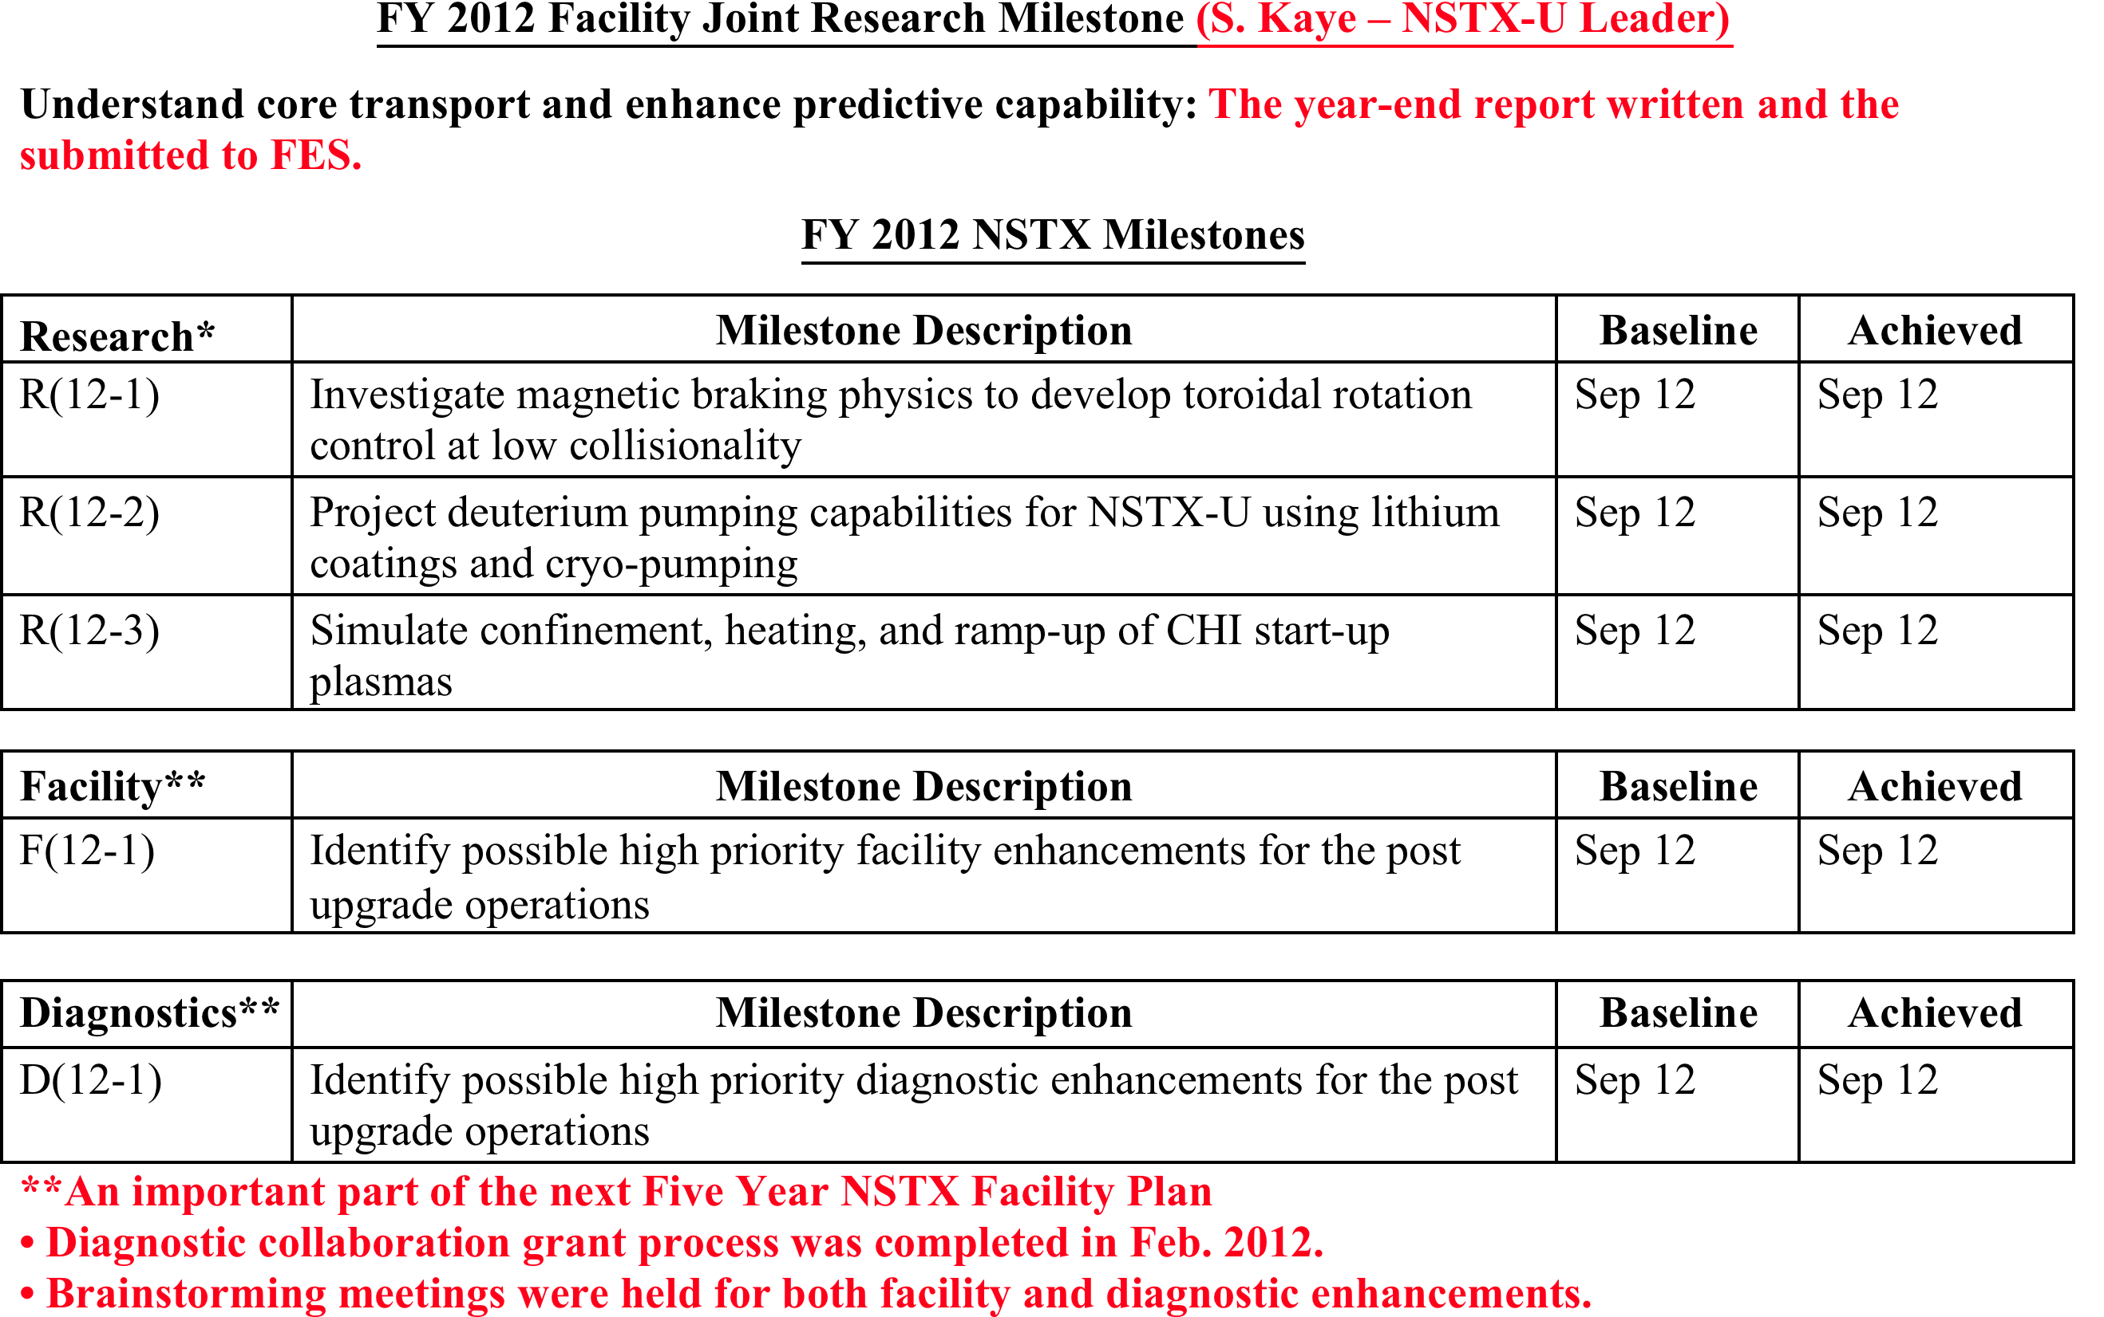
All of the FY12 Milestones Completed On Schedule
Through Data Analyses, Theory/Modeling, and Collaborations
Notes:
3

Slide 4
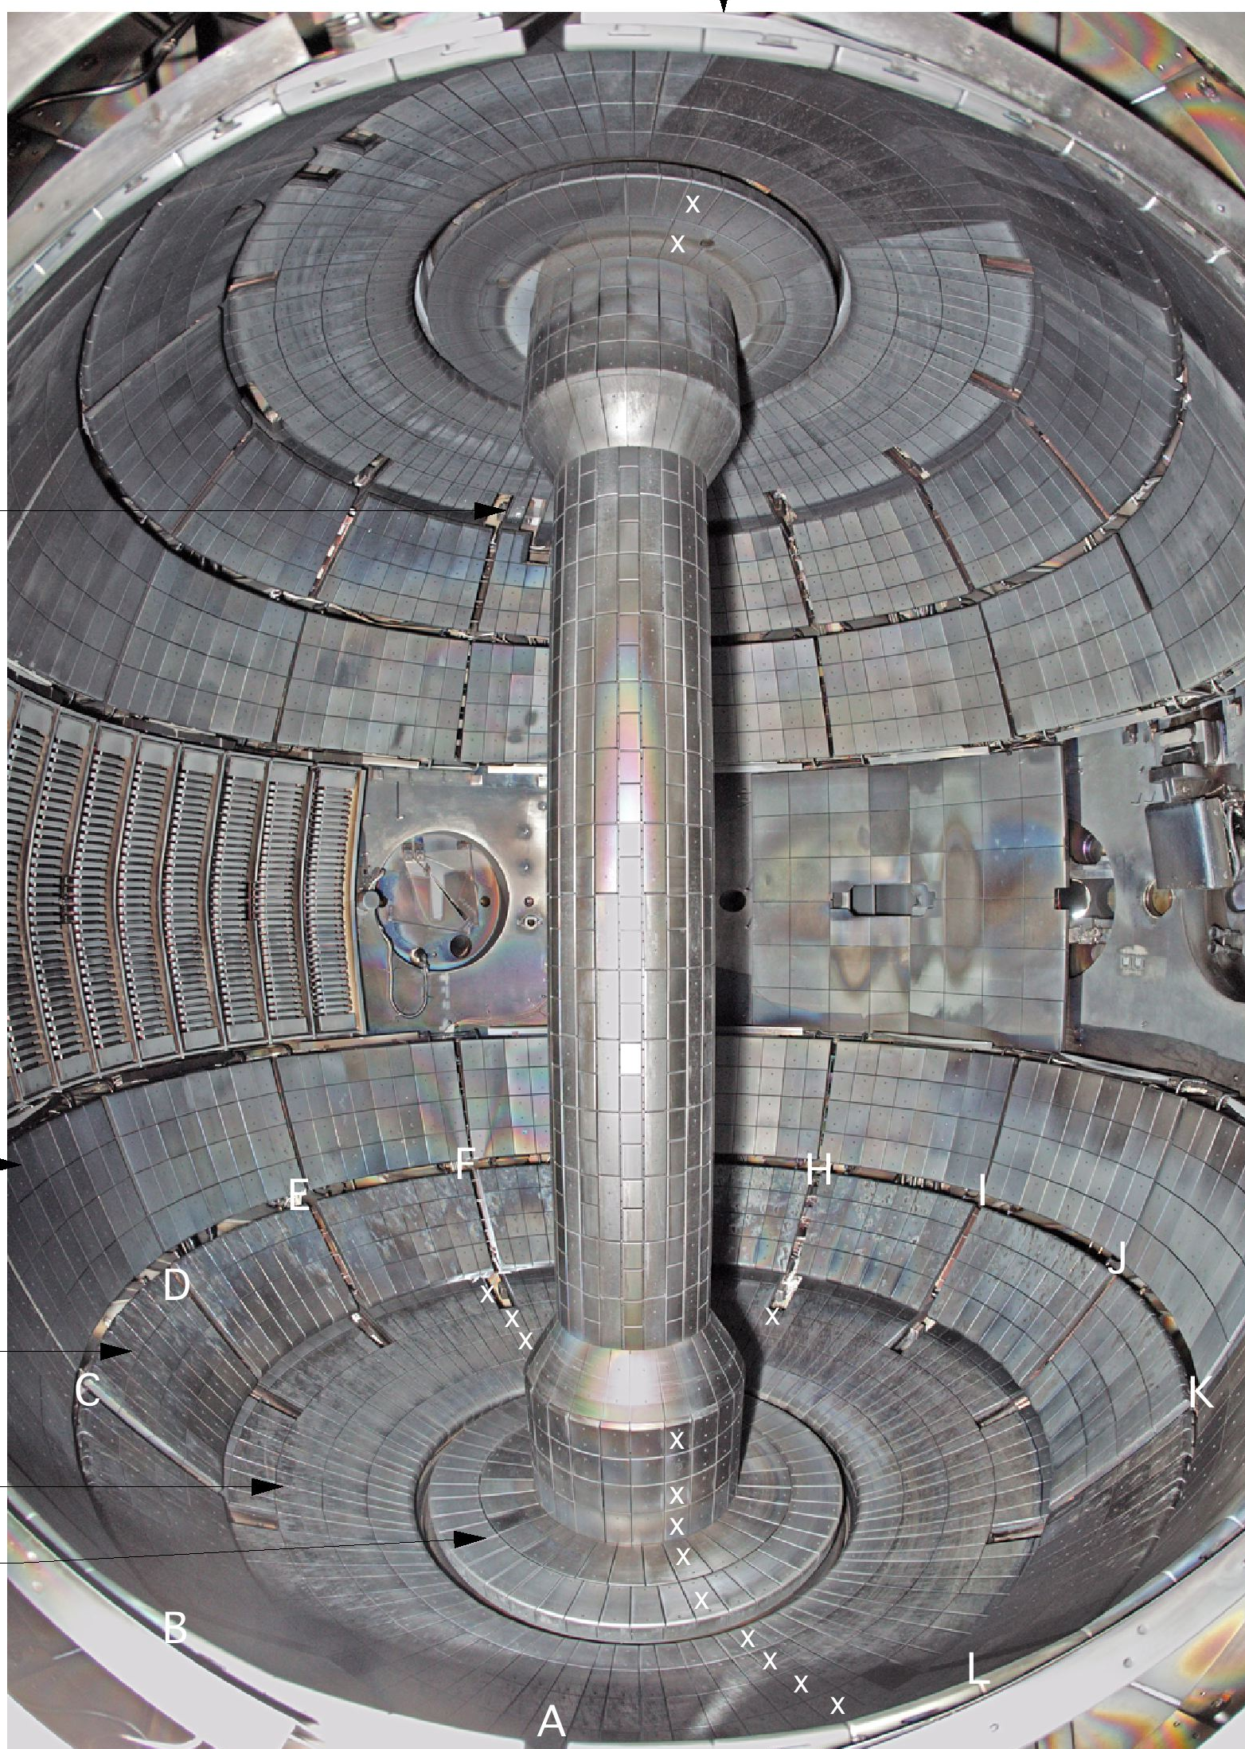
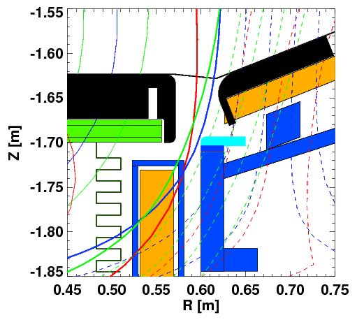
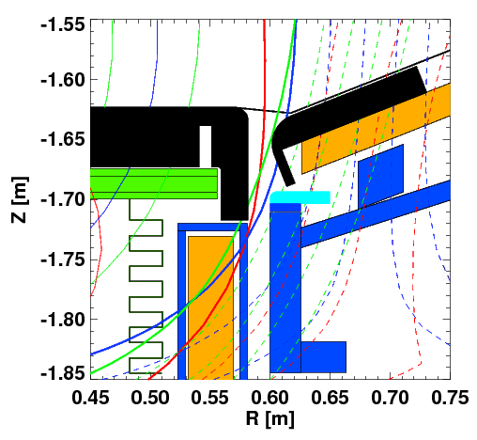
CHI Gap Are Protection Enhanced
Improved gap tiles to protect PF1C and Exposed SS surfaces
NSTX-U plasma operation may increase the gap area thermal loading by ~ x 10
Existing Tile Design
New Gap Overhung Tiles to Provide Necessary Protection
Preliminary design completed
5 MW/m² for 5 sec tolerable with ATJ but not with Poco TM
ATJ graphite tile material secured
CHI Gap
Center Stack
Secondary Passive Plates
PF 1C
HHFW
Antenna
NBI Armor
Improved Tile Design
Primary Passive Plates
CHI Gap
CHI Gap
In-board
Divertor
PF 1C
Out-board
Divertor

Slide 5
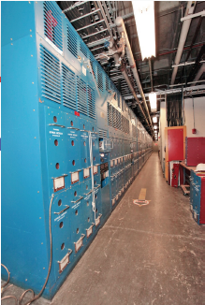
Transrex AC/DC Convertors of the NSTX FCPC
Upgrading of Firing Generators and Fault Detectors
Transrex AC/DC Convertors of the NSTX Field Coil Power conversion System (FCPC) provide a pulsed power capability of 1800 MVA for 6 seconds. The modular converter concept of 74 identical (with a paired sections A & B), electrically isolated 6-pulse “power supply sections” was originally used on TFTR, and then adapted to NSTX.
  Many parts from 1984 are nearing end-of-life due to age and wear, replacement parts are rare or unavailable, and that performance can be improved using more modern equipment.
  Precise control of thyrister firing angles by the FCPC firing generators becomes more critical for the new 8-parallel, 130kA TF system configuration.
  Ability to separately control the “A” and “B” sections of each power supply unit allows for more efficient utilization of the 74 available sections.
  The new Firing Generator (FG) will deliver firing pulses with greater resolution, precision, and repeatability, and can receive and process separate commands to the A and B sections
Status:
The prototype FG has been fully tested in a Transrex rectifier, and production units are being fabricated.
The new Fault Detector (FD) provides improved external interface compatible with the NSTX-U data acquisition system.
The FD prototype has been completed in conjunction with the new FG in a Transrex rectifier.

Slide 6
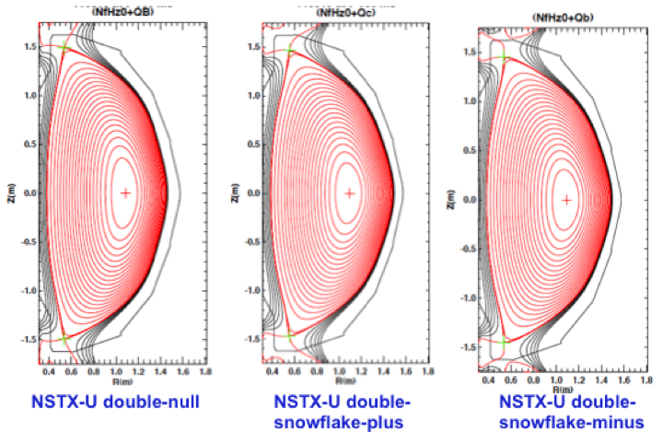
NSTX-U PF Coil Power System Upgrade
Enables up-down symmetric divertor operations
The first-year power supply capabilities of NSTX-Upgrade will yield considerable experimental flexibility, namely, up-down symmetric PF-1C coils compared to only at the bottom.
By powering the PF-1A & PF-1C coils, it will be possible to generate up-down symmetric snowflake divertors
  Capability did not exist in NSTX.
  Bipolar PF-1C allows easy comparison between snowflake and standard divertors.
The new configuration should provide better control for the CHI absorber region.
Longer-term, upgrades to the power supply systems may add considerable new capability:
  - The PF-2 coils may be upgraded to bipolar operations. This will allow those coils to either create the snowflake divertor or to control the lower plasma-wall gap in the high-triangularity shapes, without changes to the power supply links.
  - The PF-1B coil, which will not be powered during initial upgrade operations, may be important for maintaining a steady snowflake divertor through the full OH swing.

Slide 7
NSTX-U Plasma Control System Upgrade
Migration to more modern computer for real-time applications
Sample rate: 5 → 20 KHz
Added 32 channels
PC Links replaced with much faster “Firing Generator” Serial Links
Analog Inputs
Coil Currents
Power Supplies
Magnetics
(including upgrades)
Neutral Beams
(1st and 2nd BLs)
Gas Injection
Vacuum
Rotation data
Pitch angle data
FPDP: 1 → 4 links
Analog Inputs
416 channels
PC Links
Power Supplies
(inc. 3 new coils)
Neutral Beams
(including new BL)
Gas Injection
Real-Time
Computer
Digital Inputs
12 words
FPDP
FPDP
Digital Outputs
Time Stamp
micro seconds
Analog Outputs
Hardware Upgrades
New computer: cores: 8 → 32
Commercial Linux Real-Time operating system & advanced real-time debug tools.
New quad-port fiber optic FPDP I/O boards.
Software Upgrades
Ported PPPL code and GA PCS to 64-bit.
Generate commands for new firing generators .
Coil Protection (DCPS) functions incorporated in PSRTC.
Numerous new control algorithms.
PCS algorithms re-written using GA format.
PSRTC to be re-written.
Physics Algorithms For Development Once Hardware/Software Infrastructure is Complete
Modified shape control
Snowflake Control
Dud Detection & Soft Landings
Rotation, Current, β_{N}
SGI and density control
new diagnostic algorithms
A second instance of this real-time computer will be acquired before operation providing a backup for NSTX-U operations and allowing parallel testing of control code during NSTX-U operations.

Slide 8
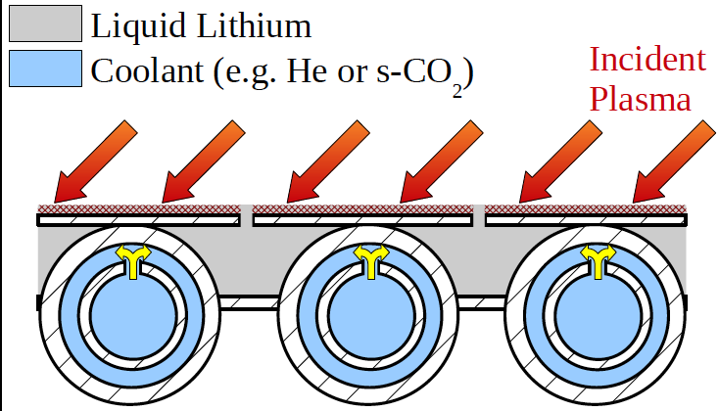
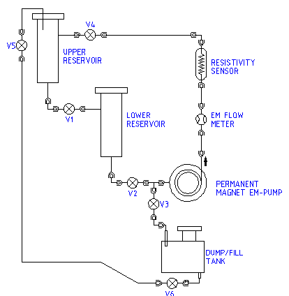
Active Liquid Lithium R&D Activities for NSTX-U
Gaining Visibility Internationally Though Collaborations and Presentations
• Design studies focusing on thin, capillary-restrained liquid metal layers
• Laboratory work establishing basic technical needs for PFC R&D
      - Construction ongoing of liquid lithium loop at PPPL with internal funding
      - Tests of lithium flow in PFC concepts
      Coolant loop for integrated testing proposed
• Radiative Liquid Lithium Divertor (RLLD) Concept proposed. Reactor applicability and compatibility examined.
• Collaboration with
          - Magnum-PSI (Holland) facility for lithium-plasma interaction research
          NIFS (Japan) liquid lithium loop facility for RLLD simulation
• International invited talks
      - M. Ono gave invited talks at OS2012&PMIF2012 and JPS Plasma and Fusion Meeting
      - M. Jaworski was invited to give a talk at European Fusion Physics Workshop
      - M. Jaworski was selected to give an invited talk at 2013 EPS meeting

Slide 9
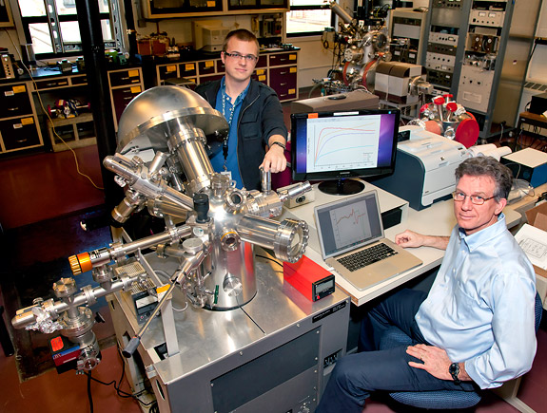
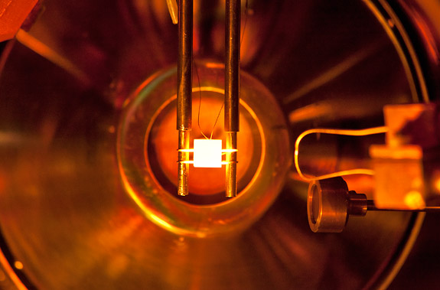
Surface Analysis Facilities to Elucidate Plasma-Surface Interactions
PPPL Collaboration with B. Koel et al., Princeton University
The Surface Science and Technology Laboratory (SSTL) with three surface analysis systems and an ultrahigh vacuum deposition chamber.
The Surface Imaging and Microanalysis Laboratory (SIML) with a Thermo VG Scientific Microlab 310-F High Performance Field Emission Auger and Multi-technique Surface Microanalysis Instrument.
Recently solid lithium and Li coated TZM were examined using X-ray photoelectron spectroscopy (XPS), temperature programmed desorption (TPD), and Auger electron spectroscopy (AES) in ultrahigh vacuum conditions and after exposure to trace gases. - Determined that lithiated PFC surfaces in tokamaks will be oxidized in about 100 s depending on the tokamak vacuum conditions. (C. H. Skinner et al., PSI_20 submitted to J. Nucl. Mater. )
X-ray photo-electron spectroscopy
Lithium coated TZM being examined by TPD and AES.

Slide 10
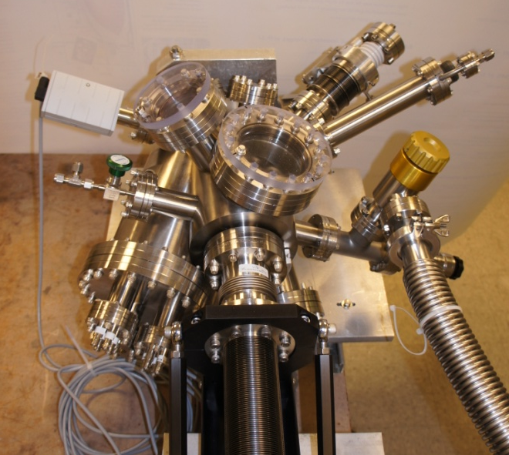
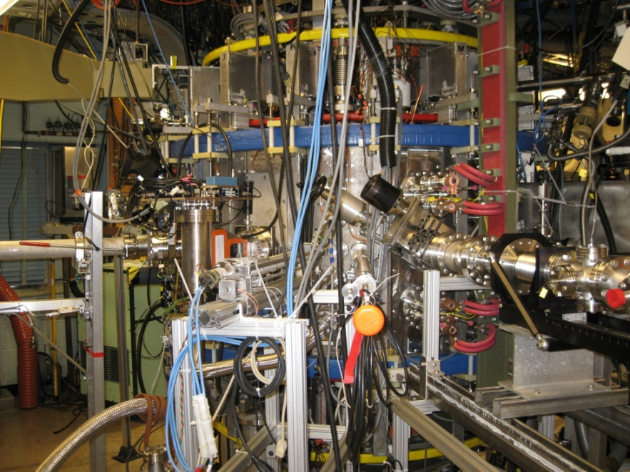
LTX complements NSTX-U research on lithium plasma facing components and their effects on plasma performance
Lithium Tokamak Experiment (LTX) to investigate:
• Plasma interactions with lithium surfaces and temperature dependence of lithium influx
• Effect of lithium walls on confinement and electron temperature profiles
• Liquid metal flows in B fields up to 0.3T
LTX lithium plasma-facing components include:
• Lithium-filled movable limiter - 120 cm² dendritic W heated to temperatures up to 500 C
• Lithium surfaces - 100 micron films on upper shell & liquid lithium “pool” in lower shell
Specialized Materials Analysis and Particle Probe (MAPP) allows samples to be exposed to plasmas and withdrawn between shots for X-ray and ion scattering measurements
MAPP
MAPP will be installed on midplane LTX port
J.P. Allain (Purdue), R. Kaita, et al.,

Slide 11
Formulating Strategy Toward Full NSTX-U Parameters
After CD-4, the plasma operation could enter quickly into new regimes
 | NSTX | Year 1 NSTX-U | Year 2 NSTX-U | Year 3 NSTX-U | Ultimate Goal
I_{P} [MA] | 1.4 | 1.6 | 2.0 | 2.0 | 2.0
I_{P}I_{P} [MA²] | 2.0 | 2.5 | 4.0 | 4.0 | 4.0
B_{T} [T] | 0.55 | 0.8 | 1.0 | 1.0 | 1.0
B_{T}B_{T} [T²] | 0.3 | 0.65 | 1.0 | 1.0 | 1.0
I_{P}B_{T} [MA*T] | 0.61 | 1.3 | 2 | 2.0 | 2
Allowed I²t Fraction On Any Coil | 1.0 | 0.5 | 0.75 | 1.0 | 1.0
I_{P} Flat-Top at max. allowed I²t, I_{P}, and B_{T} [s] | ~0.7 | ~3.5 | ~3. | 5 | 5
Table based on assessment of physics needs for first year of operations.
1st year goal: operating points with forces 1/2 the way between NSTX and NSTX-U, ½ the design-point heating of any coil:
  OH F_{Z} apparently requires full influence matrices for essentially ANY operations.
2nd year goal: Full field and current, but still limiting the coil heating.
  Of course, will revisit year 2 parameters once year 1 data has been accumulated.
3rd year goal: Full capability
Key question: path forward for assuring confidence in these operating points.

