Slide 1


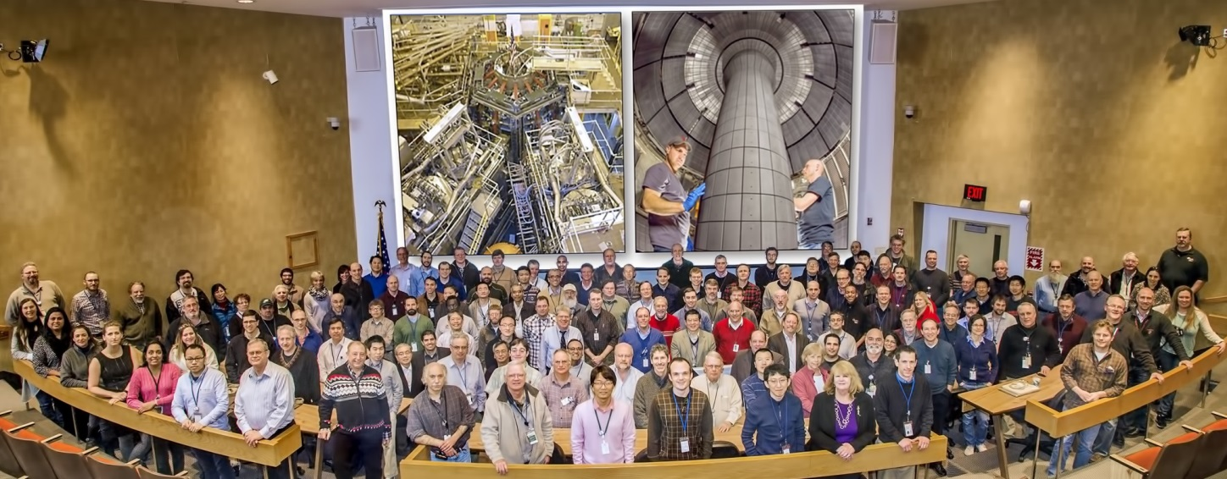
NSTX-U
Supported by
NSTX-U Program Update
Coll of Wm & Mary
Columbia U
CompX
General Atomics
FIU
INL
Johns Hopkins U
LANL
LLNL
Lodestar
MIT
Lehigh U
Nova Photonics
Old Dominion
ORNL
PPPL
Princeton U
Purdue U
SNL
Think Tank, Inc.
UC Davis
UC Irvine
UCLA
UCSD
U Colorado
U Illinois
U Maryland
U Rochester
U Tennessee
U Tulsa
U Washington
U Wisconsin
X Science LLC
J. Menard
For the NSTX-U Research Team
Culham Sci Ctr
York U
Chubu U
Fukui U
Hiroshima U
Hyogo U
Kyoto U
Kyushu U
Kyushu Tokai U
NIFS
Niigata U
U Tokyo
JAEA
Inst for Nucl Res, Kiev
Ioffe Inst
TRINITI
Chonbuk Natl U
NFRI
KAIST
POSTECH
Seoul Natl U
ASIPP
CIEMAT
FOM Inst DIFFER
ENEA, Frascati
CEA, Cadarache
IPP, Jülich
IPP, Garching
ASCR, Czech Rep
NSTX-U Team Meeting
PPPL – B318
June 5, 2015

Slide 2
Outline
Diagnostic Solicitation
Impact of Schedule on Research Milestones
Draft Run Schedule

Slide 3
FES solicitation for U.S. University and Industry
DIAGNOSTIC Collaboration on NSTX-U
Expected Issue Date for FOA: 07/01/2015
  Letter of Intent Due Date: Not Applicable
Pre-Application Due Date: 07/29/2015 at 5 PM Eastern Time
  Pre-Application is required, 2-3 pages (Title, abstract, collaborators, …)
Application Due Date: 09/18/2015 at 11:59 PM Eastern Time
Gathering diagnostic idea updates from team via Google form
  Will share these with SG/TSG leaders once gathered (i.e. next week)
NSTX-U PAC-36 will review draft Program Letter via videoconference later in June (probably on June 23)
Program letter will be available no later than July 7

Slide 4
Impact of restart schedule on milestones
For now, to zeroth order, assume FY15 milestones will be shifted to FY16, FY16 → FY17, etc.
  Will likely run early FY18, then have outage for major enhancement(s)
Some milestones and all run-week distributions will need to be revised based on when we actually begin operations
FY15 JRT will have to be based on NSTX data, NSTX-U simulations, and/or analysis of results from other devices
MS and ASC TSGs should assess ability to meet JRT-16 goals using only hardware that will be available in early FY16
  We can/should modify text/deliverables accordingly

Slide 5
Latest / possible / tentative run plan for 2015-16
Goal is to operate 14-16 run weeks as per research forum
September: 0-2 run weeks
October: 3-4 run weeks
November: 0-2 run weeks
  May want to pause for ST workshop, APS, Thanksgiving
December: 3 run weeks
January: Mid-run assessment (if applicable), PAC-37
Feb/Mar: Complete FY16 run
Mar/Apr: Start outage to install high-k, high-Z tiles, …
Resume operations fall 2016 for FY17
Fiscal Year Boundary

Slide 6
Very preliminary (and unvetted) modified milestone schedule
FY2016
FY2017
FY2018
Run Weeks:
Incremental
14
16
18
20
10
12
R16-1
R17-1
R18-1
Boundary Science
+ Particle Control
Assess H-mode confinement, pedestal, SOL characteristics at higher B_{T}, I_{P}, P_{NBI}
Assess scaling, mitigation of steady-state, transient heat-fluxes w/ advanced divertor operation at high power density
Assess impurity sources and edge and core impurity transport
R17-2
IR18-1
Assess high-Z divertor PFC performance and impact on operating scenarios
Investigation of power and momentum balance for high density and impurity fraction divertor operation
R17-3
Begin long
outage
for major
facility
enhancement(s)
R16-2
?
Assess role of fast-ion driven instabilities versus micro-turbulence in plasma thermal energy transport
Core Science
Assess effects of NBI injection on fast-ion f(v) and NBI-CD profile
Timing TBD pending
resources, readiness
R17-4
R18-2
R16-3
Assess fast-wave SOL losses, core thermal and fast ion interactions at increased field and current
Control of current and rotation profiles to improve global stability limits and extend high performance operation
Integrated Scenarios
Develop physics + operational tools for high-performance: κ, δ, β, EF/RWM
R17-5
R18-3
Develop high-non-inductive fraction NBI H-modes for sustainment and ramp-up
Assess transient CHI current start-up potential in NSTX-U
FES 3 Facility Joint Research Target (JRT)
C-Mod leads JRT
DIII-D leads JRT
Assess disruption mitigation, initial
tests of real-time warning, prediction
TBD

Slide 7
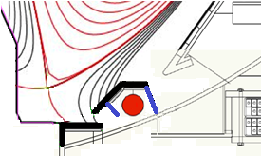

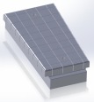
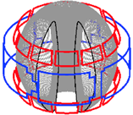

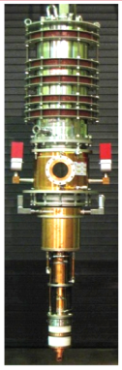
Five Year Facility Enhancement Plan (green – ongoing)
2015: Engineering design for high-Z tiles, Cryo-Pump, NCC, ECH
Fiscal Year:
2015 | 2016 | 2017 | 2018 | 2019
Major enhancements:
Base funding
+15% incremental
Upgrade Outage
1.5 → 2 MA, 1s → 5s
Run Weeks:
14-16
18-20
10-12
10-12
New
center-stack
Pulse-burst MPTS
Lower divertor cryo-pump
Boundary Science
+ Particle Control
Boronization
High-Z tile row on lower OBD
High-Z PFC diagnostics
Li granule injector
Upward
LiTER
LLD using bakeable cryo-baffle
MAPP
MGI disruption mitigation
Upgraded halo sensors
Off-midplane 3D coils (NCC)
Core Science
δB diag. - incremental
Enhanced MHD sensors
Laser blow-off
42 ch MPTS
DBS, PCI, or other intermediate-k
48 ch BES
High k_{θ}
MSE/LIF
Charged fusion product
Neutron collimator
4 coil AE antenna
Establish control of:
Rotation
q_{min}
HHFW limiter upgrade
Snowflake
Integrated Scenarios
FIReTIP
n_{e}
Divertor P_{rad}
2nd NBI
1 MW ECH/EBW
Upgraded CHI for ~0.5MA
0.5-1 MA CHI
up to 1 MA plasma gun

