Slide 1
Program status, run coordination
J. Menard
NSTX-U Team Meeting
PPPL B318
June 10, 2016

Slide 2
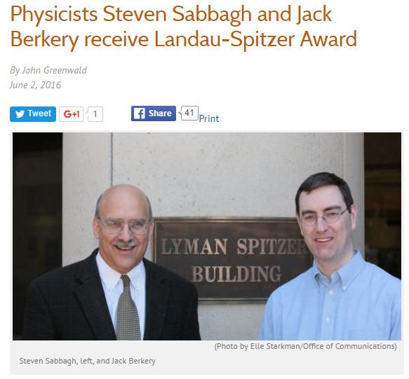
Congrats to Jack and Steve!
This year’s award, to be given in July at the EPS 43rd Conference on Plasma Physics in Leuven, Belgium, honors advances in experimentally validated understanding of the stability of resistive wall modes (RWMs)

Slide 3
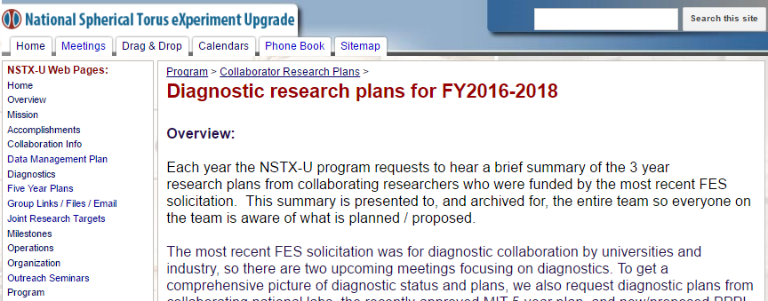
FES NSTX-U diagnostic collaborations
All previous collaborations renewed
Plus 2 new ones:
Den Hartog / Reusch (UW Madison) Integrated Data Analysis
Kolemen (Princeton) – real-time Thomson for kinetic rtEFIT

Slide 4
XMP status
30 XMPs have been started, 6 of which are will likely be revisited in very near future:
ssNPA and FIDA checkout (XMP-110)
More NB modulation shots for diagnostic validation
RWM control checkout (XMP-121)
Test RWM B_{P} and B_{R} feedback, DEFC
Proportional EFC Testing (XMP-141)
Look for very early EFC
L-Mode Development in Support of Core and Boundary XPs. (XMP-151)
Primarily looking at effect of NB tangency radius on L-mode scenario in remaining shots
H-mode access and control development in boronized wall conditions (XMP-153)
Development of long-pulse, MHD quiescent H-modes for transport and MHD studies.
Inner gap control checkout (XMP-154)
Complete development and L-mode optimization of algorithm

Slide 5
Near-term XMPs to be initiated
LGI Checkout (XMP-130)
First granule injection into L- and H-mode plasmas
CHERS NB Modulation Study (XMP-150)
Determine optimum NB modulation patterns for getting CHERS data while using NB#2.
MGI Commissioning (XMP-136)
First test of the MGI system with plasma

Slide 6
Progress toward Milestones (I)
R16-1: Assess H-mode energy confinement, pedestal, and SOL characteristics with higher B_{T}, I_{P} and NBI heating power
All key diagnostics are taking data, except MSE (want 90kV NB1A, already in mid-80s, may need to accept lower voltage)
Checking data consistency via TRANSP
Need robust / longer-pulse higher current H-mode scenarios
R16-2: Assess effects of NBI parameters on fast ion distribution function and neutral beam driven current profile
Neutron, FIDA, ssNPA functional, needs MSE
Started studies of fast ion confinement vs. R_{tan} and effect of NB#2 on *AE modes, NBI source scans in L-modes

Slide 7
Progress toward Milestones (II)
R16-3: Develop physics and operational tools for high-performance discharges.
Developed shape & vertical control, new inboard gap control, EFC, HFS & LFS fueling, automated shutdown
EF not fully understood, tried ∝ V_{loop} EFC, may test static early EFC
Next goals: commission n=1 DEFC, RWM control, test LGI
Notable Outcome: Perform experimental research …at magnetic field, I_{P}, pulse length beyond that achieved in NSTX….
Already using discharges that exceed NSTX durations, at field exceeding maximum NSTX field
Increasing I_{P} > NSTX I_{P} requires improved H-mode scenarios, under development (JEM goal: 1.4MA, τ_{pulse} = 1-2s)

Slide 8
Progress toward Milestones (III)
The JRT overlaps with a Notable Outcome:
JRT: Conduct research to detect and minimize the consequences of disruptions in present and future tokamaks
Notable Outcome: Conduct NSTX-U experiments and data analysis to support the FES joint research target ….
We are making good progress on these tasks:
Automatic shutdown algorithms developed
Detecting disruptions in real-time via the I_{P} error, vertical motion, and (soon) the n=1 locked mode signature.
MGI will use an electromagnetic valve similar to ITER design
2 MGI valves are installed on the machine
Need 1 more week of NTC time to complete gas controls – will likely drive scheduling of next planned maintenance week

Slide 9
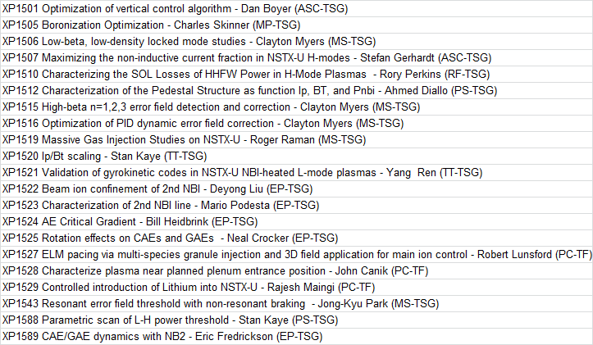
21 Priority 1 XPs fully approved, nearly all targeting research milestones
R16-3
R16-3
R16-3
R16-1
R16-3
R16-3
JRT-16
R16-1
R16-1
R16-2
R16-2
R16-2
R16-2
R16-3?
Notable?
R16-1
R16-2
Above XPs could easily take 30-40 run days to complete

Slide 10
Considering operating in Q1 FY17
Above XMP+XP time likely consumes most of remainder of available FY16 run-time
Q1 2017 operations would help us get:
More data for 2017 APS invited (+ other meetings)
Head start on accruing FY17 run time
Head start on some FY17 milestones
Provide enough time to (?):
Reinforce PF1C leads → snowflake divertor studies
Complete CHI commissioning → get first NSTX-U CHI data
Potential down-sides: end of FY17 shortened, could make completion of JRT, high-Z, high-k milestones challenging
Let us know your thoughts on this possibility
Much depends on how next ~1 month goes…

