Slide 1
NSTX-U Team Meeting
S.P. Gerhardt
NSTX-U Team Meeting
B-318
6/10/2016

Slide 2
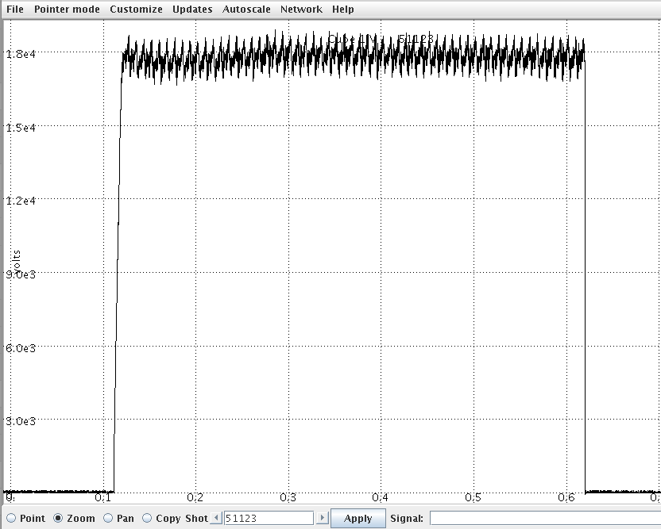
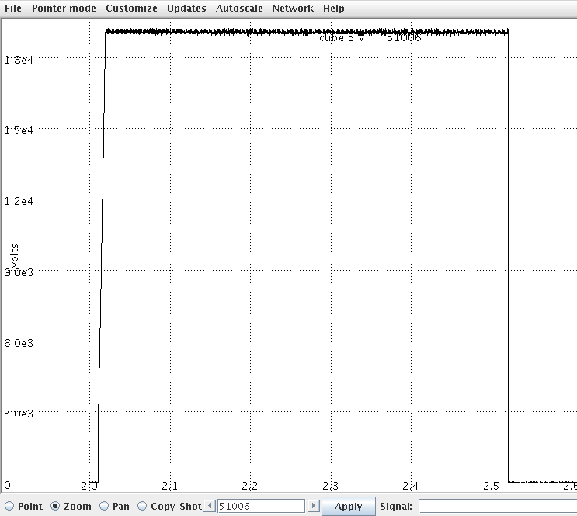
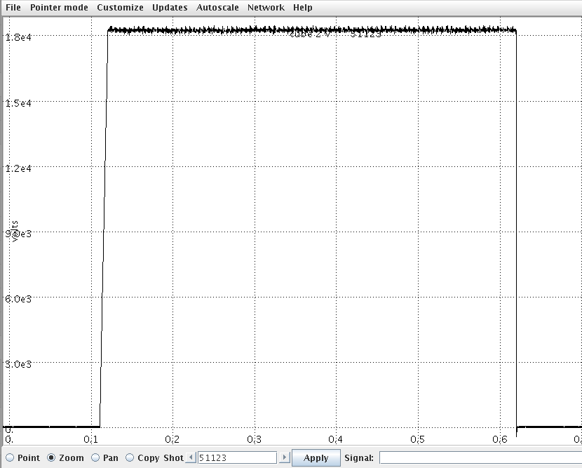
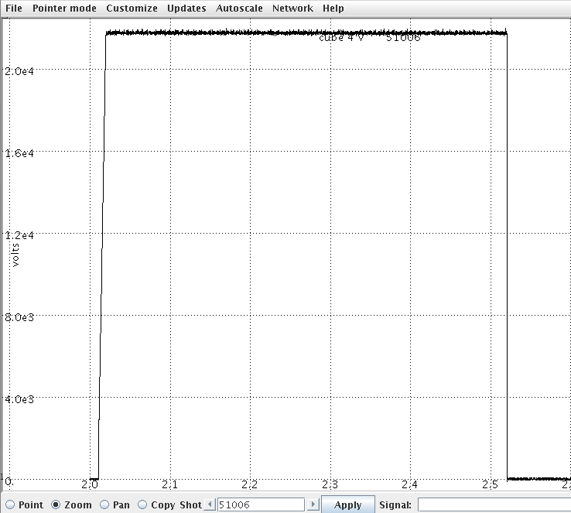
Status of HHFW operations
All 6 sources have been recommissioned with AC power upgrades
Dummy load testing of all sources completed 6/9/2016
Vacuum conditioning of sources 5 and 6 to begin Friday (today)
Sources 1 – 4 have been applied to the antenna in NSTX-U and the antenna elements conditioned up to 18 – 21 kV
Vacuum voltages for Sources 1 – 4
for 0.5 second pulses
Source 1
~ 18 kV
Source 3
~ 19.5 kV
Source 2
~ 18 kV
Source 4
~ 21 kV

Slide 3
Physics Operations Update
Two more Physics Operators have been qualified
Roger Raman and Walter Guttenfelder
there are now 4 total (Dennis, Devon, Roger, Walter), with a 5th getting OJT
There is still time for you to volunteer!
The center stack and shoulder gas injectors now have their fill pressures and change in pressure archived
(Thanks to Paul Sichta and Mark Cropper)
Massive Gas Injection is making good progress
Doing final trouble-shooting of control and interlock signals in the test cell.
Sensotech cables have been terminated, air lines being rerouted.
Control logic for the plenum filling yet to be completed.
We are looking at bridging the inner-outer vessel at the top with three parallel 200 Ohm resistors.

Slide 4
Continued improvement in PCS control
Running multi-threaded rtEFIT with vessel fitting on.
dr-sep and X-point location control are now well established
Have now tested real-time inner gap vs X-Point radius control tradeoff algorithm
Identification of the improved gains and scenario incorporation is an ongoing task.
PCS triggering of MGI valves and LGI tested.
Routine n=1 EFC helping the scenario, though probably not fully optimized.
RWM feedback basically ready for testing when needed/allowed by the scenario.
Calibrated NB powers now available in realtime

Slide 5
Diagnostics Update (I)
FIReTIP
Mechanical installation procedure for waveguide nearly complete, optics box installation procedure is complete.
Major components received from UC Davis
Includes lasers, detectors, and optics for steering beam into NSTX-U
Installation of electrical utilities complete for UC Davis laser enclosure "cage” in gallery
Laser power supply, chiller, and cabinet for high-k laser chemical storage moved to cage.
MPTS calibration probe assembly underway.
Electrical installations for the IRVB is done, and TGIS installation electrical installation is underway.
Steady progress on MSE-LIF
Beam fired into plasma with no adverse impacts, laser is undergoing installation, and beam-into-gas calibrations ongoing.

Slide 6
Diagnostics Update (II)
Other major diagnostics that we are trying to install this run:
Fusion Products diagnostic (FIU collaboration)
Divertor SPRED
sFLIP and iFLIP electrical
Bay L IR and Bay G Visible views of the RF antenna
RF Langmuir probe electrical
Design work ongoing for systems to be installed during outage
High-k Scattering
Pulse Burst Laser
Resistive Bolometers
Imaging X-Ray Crystal Spectrometer
LBO

Slide 7
Boundary Operations Update (I)
Testing of remote insertion control complete for two LITERS
ISTP in progress for commissioning between shots lithium evaporation
Additional NSTX-U test cell access needed for remote control testing of two remaining LITERs to avoid stopping NSTX-U operations to reload with lithium
Now dry-running the LIFTER LITER fill procedure.
Argon Purge System (APS) fully functional
Completed PTP testing of Torus Vacuum Pumping System (TVPS) control for APS
APS must be operation whenever LITERs are evaporating to flood vacuum vessel with argon if window is damaged or other loss of vacuum occurs

Slide 8
Boundary Operations Update (II)
Boronization studied with Materials Analysis Particle Probe – MAPP
Surface analysis of ATJ graphite and Titanium-Zirconium-Molybdenum (TZM) samples performed before and after exposure to boronization of NSTX-U plasma-facing components with X-ray photoelectron spectroscopy – XPS
Results reported by F. Bedoya and C. H. Skinner in papers at 22nd International Conference on Plasma Surface Interactions in Rome
Remote motion control for MAPP to be implemented same as LITERs.
Impurity granule injector installed and PTPs completed
May test via XMP as early as the week of 6/20.
Langmuir probe electronics deployed over the outage, system will get first data when operations resume.

