Slide 1
Program update
J. Menard
for the NSTX-U Team
NSTX-U Team Meeting
MBG auditorium
September 15, 2016

Slide 2
Outline
Program status and plans
Collaboration opportunities
Engineering reviews

Slide 3
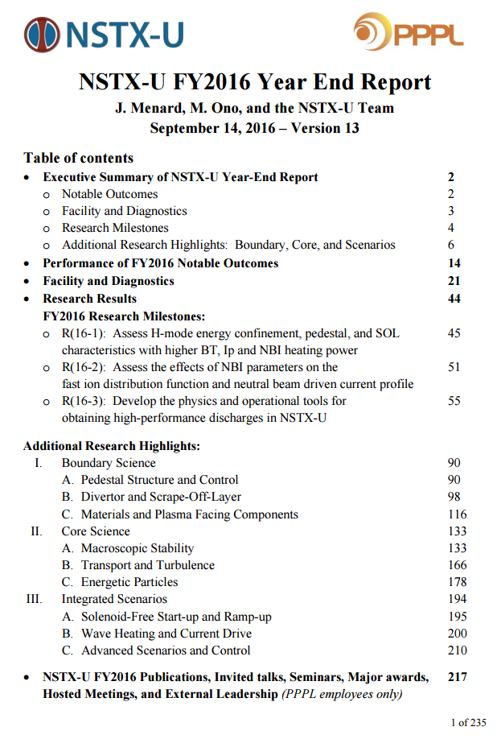
Very scientifically productive year
Thank you for contributions to FY16 year-end report
Many capabilities brought online and provided new data
Substantial new physics results + continued analysis of NSTX data
~200+ pages of research content
Shared with FES for their assessment of our performance
Highly useful for IAEA, APS, FWP
Link on NSTX-U homepage:
http://nstx.pppl.gov/DragNDrop/Reports/Quarterly_Reports/2016/Q4/

Slide 4
Near and long-term NSTX-U schedule
Results Review – Wed-Thu, Sept 21-22 in B318
Draft agenda circulated by Stan
Run Assessment – Wed, Sept 28 also in B318
Q1 FY2017: Data analysis and preparation for major fusion meetings including IAEA FEC, APS, and ITPA.
Q3 - PAC-38 - date TBD
Q4 - Diagnostic and operations preparations and experimental planning (aka Research Forum)
Opportune time for collaborations on other facilities: Dec 2016 to Aug/Sept of 2017

Slide 5
Outline
Program status and plans
Collaboration opportunities
Engineering reviews

Slide 6
Recently solicited PPPL NSTX-U researchers regarding collaboration interests
Collaboration ideas should ideally complement / extend NSTX-U research results and plans
Initial feedback - total of ~3 FTE years of collaboration ideas proposed (in addition to existing collaborations)
DIII-D: Core transport and MHD/EP, pedestal physics, support FY2017 joint research target on dissipative divertors
EAST: Edge physics, plasma material interactions (high-Z, Li)
JET: Energetic particle studies and plasma ramp-down scenario development and modelling
KSTAR: Core MHD and rotation physics, plasma control
MAST-U: Control, scenario modelling supporting 1st plasma
Similar interests? want to join forces? let us know!

Slide 7
Off-site facility operations schedules (1) (Questions? Ask R. Hawryluk, R. Maingi, D. Gates, J. Menard)
ASDEX-U: Start Feb 2017, run thru year except Aug/Sep (RH)
DIII-D: Start Jan 23 and run thru July (RH)
6 run weeks, perhaps additional week for “Frontier Science” and another for “National Campaign”
EAST: not finalized - normally operate April-June, Nov-Dec (RM)
JET: Next campaign: Oct. 10- Nov. 11 (RH)
Pre-DT Shutdown: Nov. - August 2017
Restart: September – Dec 2017, physics experiments: Dec. 2017
KSTAR: start ops in April 2017, end August 2017 (RH, JK Park, S. Sabbagh)

Slide 8
Off-site facility operations schedules (2) (Questions? Ask R. Hawryluk, R. Maingi, D. Gates, J. Menard)
LHD: H-ops Feb 8, D expts starting Mar 7 (DG)
MAST-U goal: 1st plasma in ~1 year, research by end of CY17 (JM)
TCV: Nearly continuous operation (RH)
Except 4-5 weeks in January-February and 4-5 weeks between August and September
Probably avoid the EUROfusion campaign in June and July
W7-X: Start July 2017 with 20 week run (DG)
Taking proposals now, run planning workshop Feb/Mar 2017

Slide 9
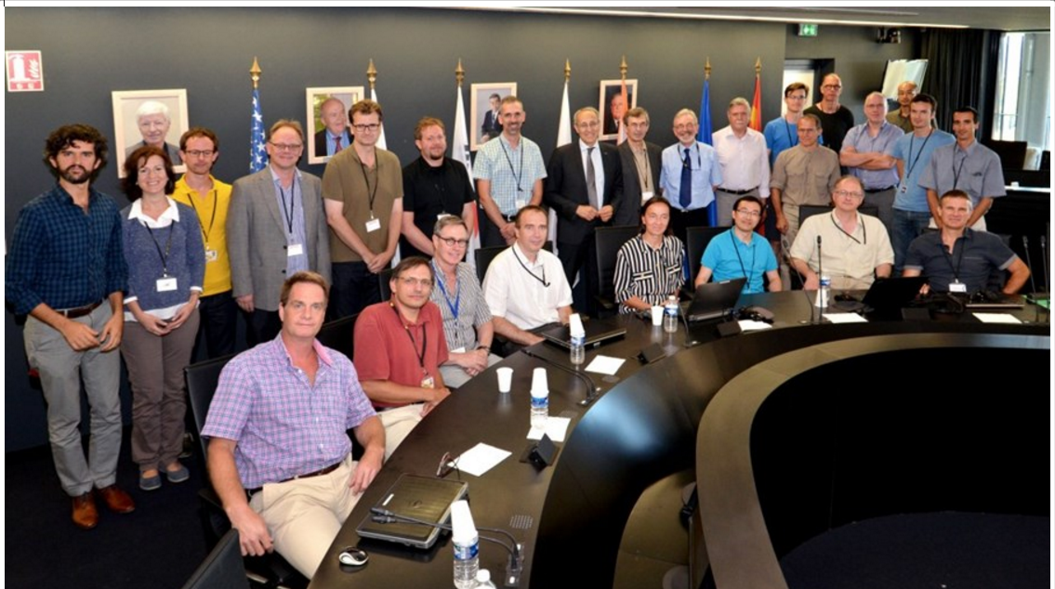
ITER Science Fellows Program (1) (more info on the web…)
ITER goal for program:
“Create a network of scientists and physicists working on simulation and theory within the research laboratories and institutes of the ITER Members, with strongly reinforced ties to ITER Project and team.”

Slide 10
ITER Science Fellows Program (2) (more info on the web… or talk to Rich H / Jim Van Dam)
ITER Scientist Fellows will:
Be drawn from the leading researchers in the Members' fusion communities who have achieved international recognition for their contributions to fusion research.
Be chosen by the Director-General, supported by the Executive Project Board, based on nominations from the heads of institutions.
Remain in the employ of their home institutions
Interact closely with the ITER Science & Operations Department in the definition of a research program and with other Fellows in its implementation.
Spend average of 25-30% of time on ITER-related issues
4 priority research areas: ELM control, disruption mitigation, edge plasma modelling, and integrated modelling (focus areas which may expand as the program evolves).

Slide 11
Outline
Program status and plans
Collaboration opportunities
Engineering reviews

Slide 12
FY17 FES “Notable Outcomes” emphasize getting NSTX-U to full performance, improving processes
Thorough assessment of coils and in-vessel components
“Complete an extent-of-condition review of NSTX-U, chaired by an independent subject matter expert, to identify possible design and construction deficiencies in the experimental device that might affect NSTX-U operation at full parameters....”
Reviews of new coils, tubes + any extent of condition items
“Complete a final engineering design review, chaired by an independent subject matter expert, certifying that all engineering analysis tasks identified in the preceding notable outcome have been successfully executed….”
Improve engineering review and design change procedures
“Conduct a review of policies and procedures for engineering changes made during construction, installation, and operational startup of NSTX-U and develop corrective actions to ensure that they effectively and efficiently identify, consider, and avoid or mitigate technical and operational risks.”

Slide 13
Additional comments from JEM
Research and engineering need to continue to work as a team to make the best long-term decisions about facility modifications
When replacing/upgrading components, should revisit design requirements as needed, based on FY16 ops experience
Need to be open to suggestions about how to improve engineering processes, procedures, organization
We will get help from external committees, but our own personnel know and experience the issues first-hand
Insufficient analysis of electromagnetic effects on nominally “mechanical” objects is a persistent issue – need to remedy
“Critical systems” need to be identified, trigger higher/highest level of design review scrutiny – magnet systems are a prime candidate

Slide 14
Summary
Thanks for all your contributions during FY16!
In FY17, we will work together to move NSTX-U toward full capability safely, diligently, and ASAP
FES, PSO, PU, PPPL remain highly supportive of NSTX-U, we thank them for their support
Questions?

Slide 15
Backup

Slide 16
Comments on milestones / research goals
H-mode confinement, pedestal, SOL vs. current and field research incomplete (not really started)
This milestone will be carried forward in FY18
Similarly, fast-ion confinement & AE vs. tangency radius needs MSE + run-time (and supports JRT-18)
Milestone will also be carried forward in FY18
Need sufficient time for scenario development
Will support 2017 JRT on dissipative divertors
Participate more in DIII-D since no NSTX-U ops in FY17
Still assessing high-Z tile installation…
Rajesh led first Boundary SG discussions on high-Z
Issues: Diagnostic coverage and scientific utility if on upper OBD, installation and alignment procedure, schedule impact

