Slide 1
NSTX-U facility status / updates
S. Gerhardt
NSTX-U Team Meeting
MBG Auditorium
December 21, 2016

Slide 2
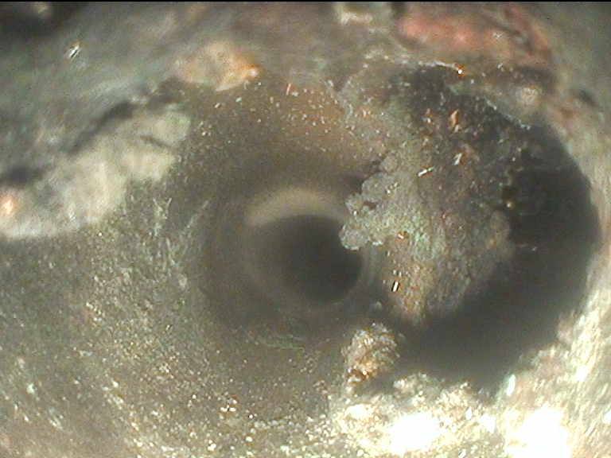
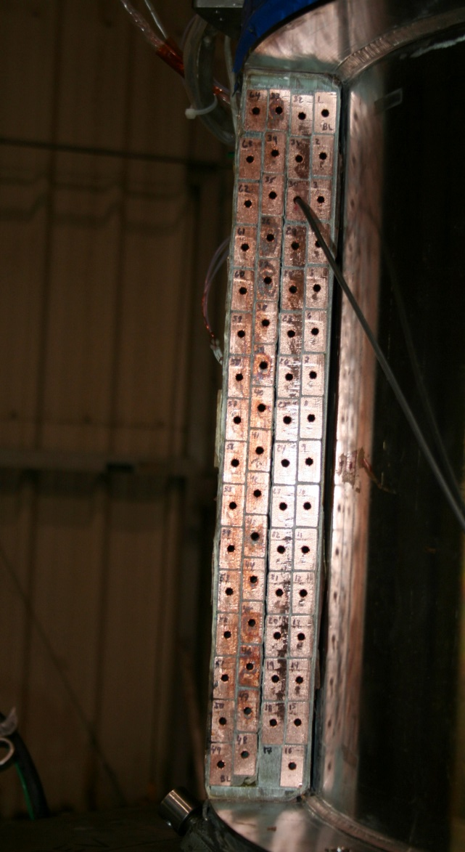
PF-1aU Coil Status at Last Team Meeting
Shorted Turns
Region of Shorted Turns
Section A-B, Layer 3, Row 9 Void Anomaly
Large Void on This Turn

Slide 3
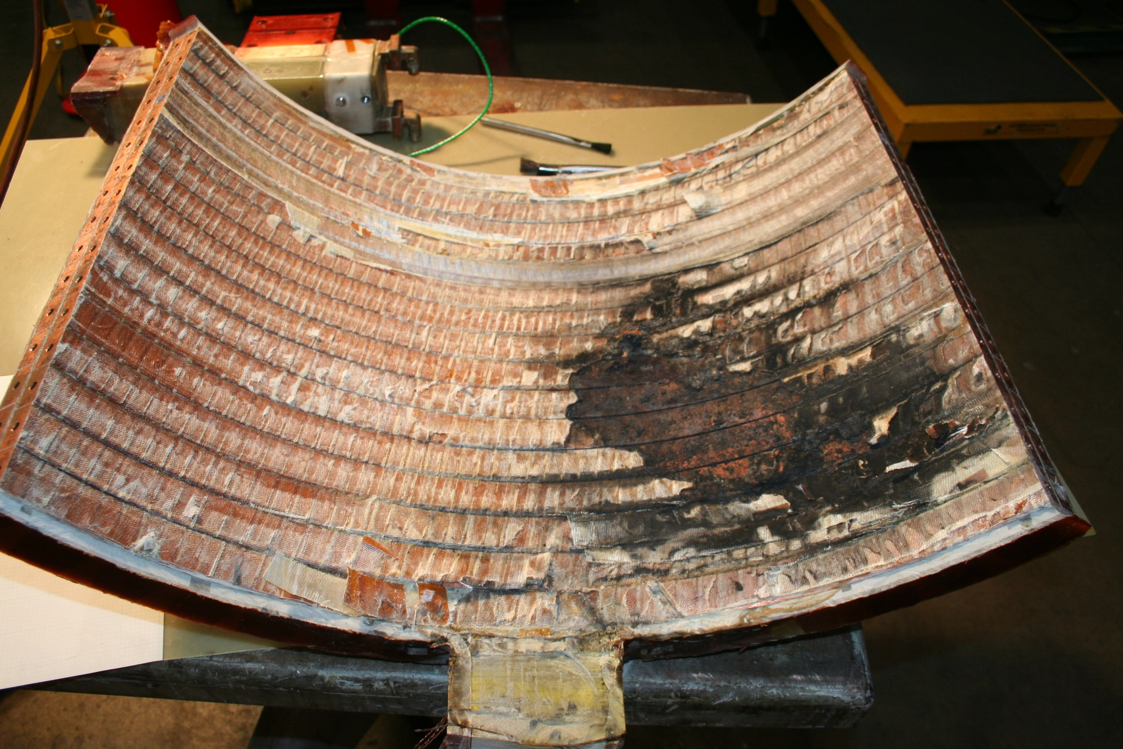
Coil Has Been Opened - Concave Side

Slide 4
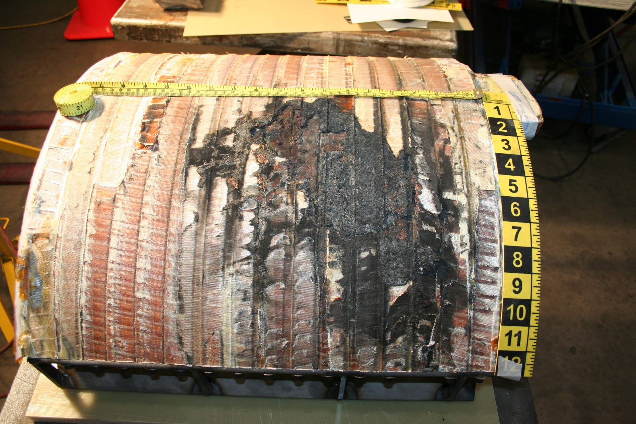
Coil Has Been Opened- Convex Side

Slide 5
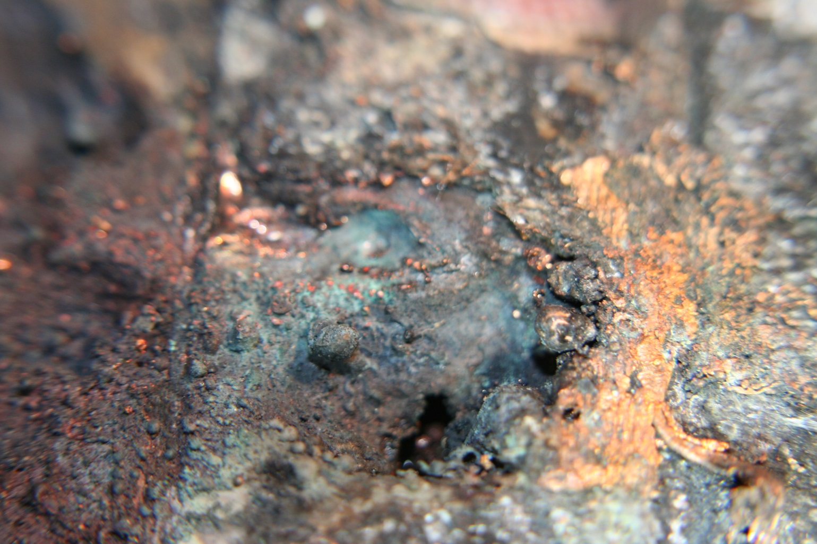
Hole in the Conductor has been Found

Slide 6
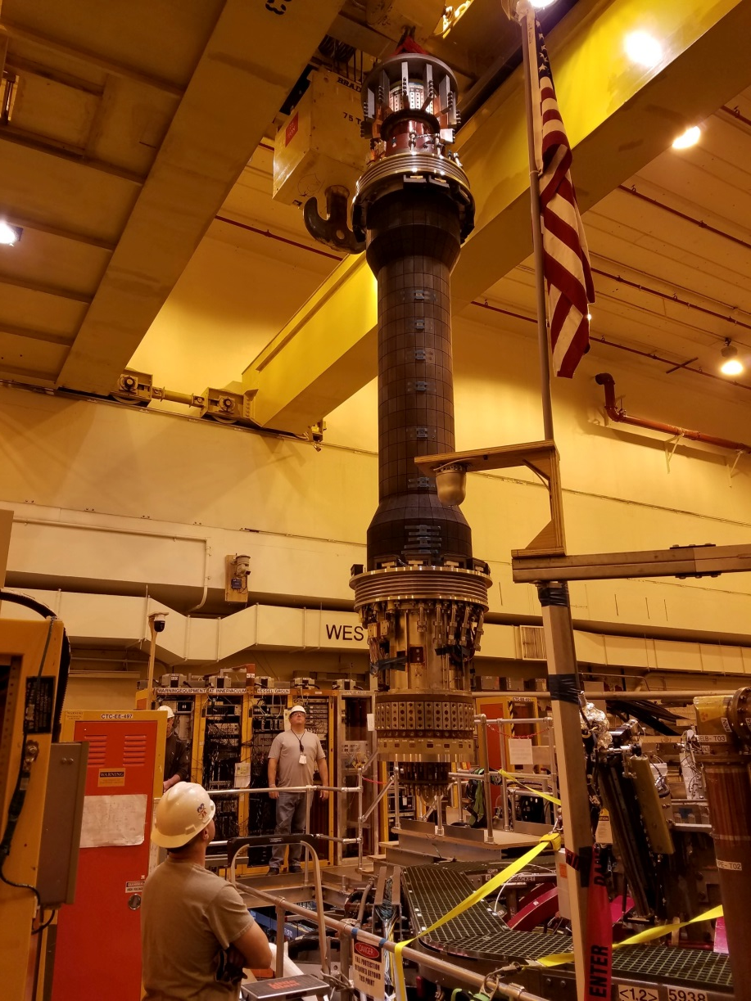
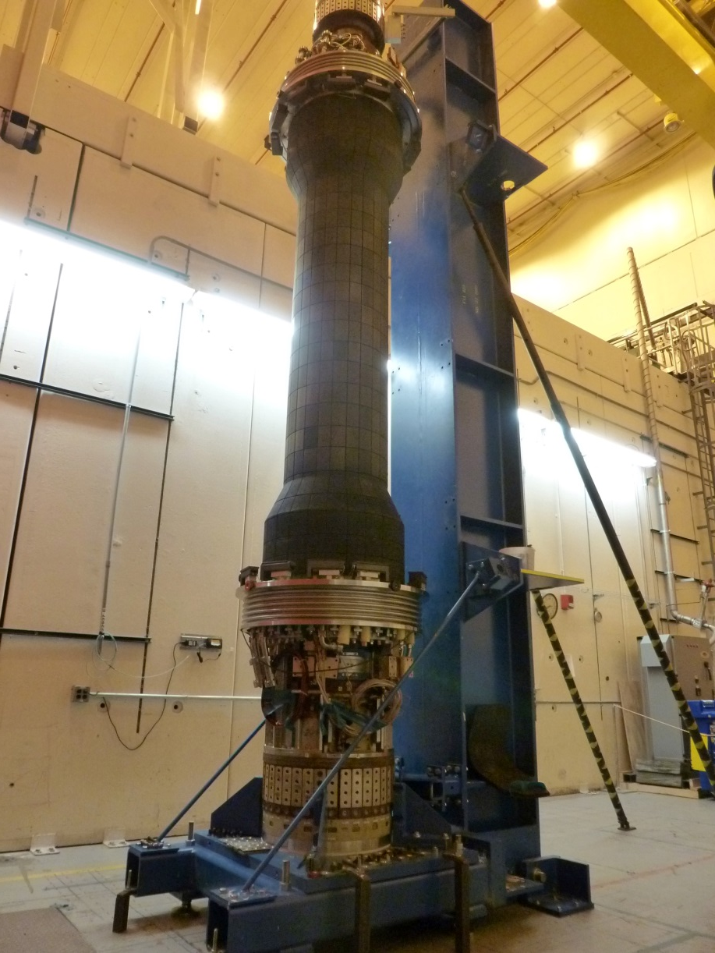
Status at Last Meeting - CS Had Been Pulled

Slide 7
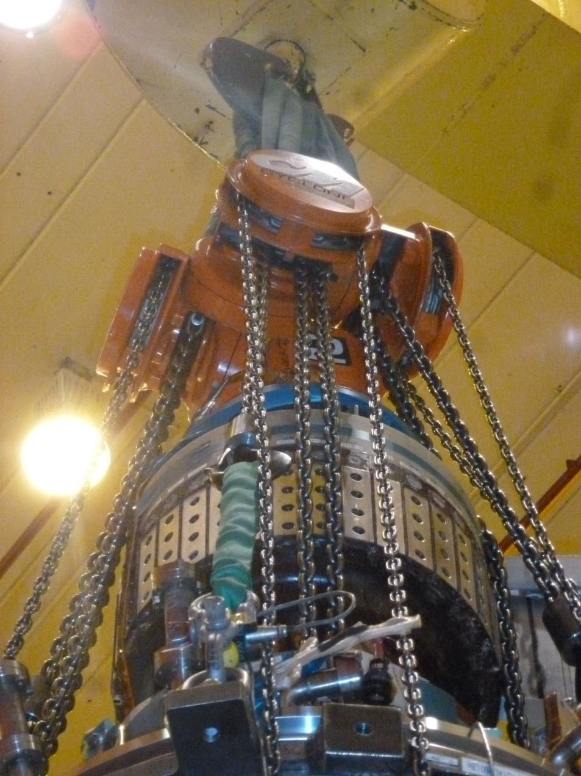
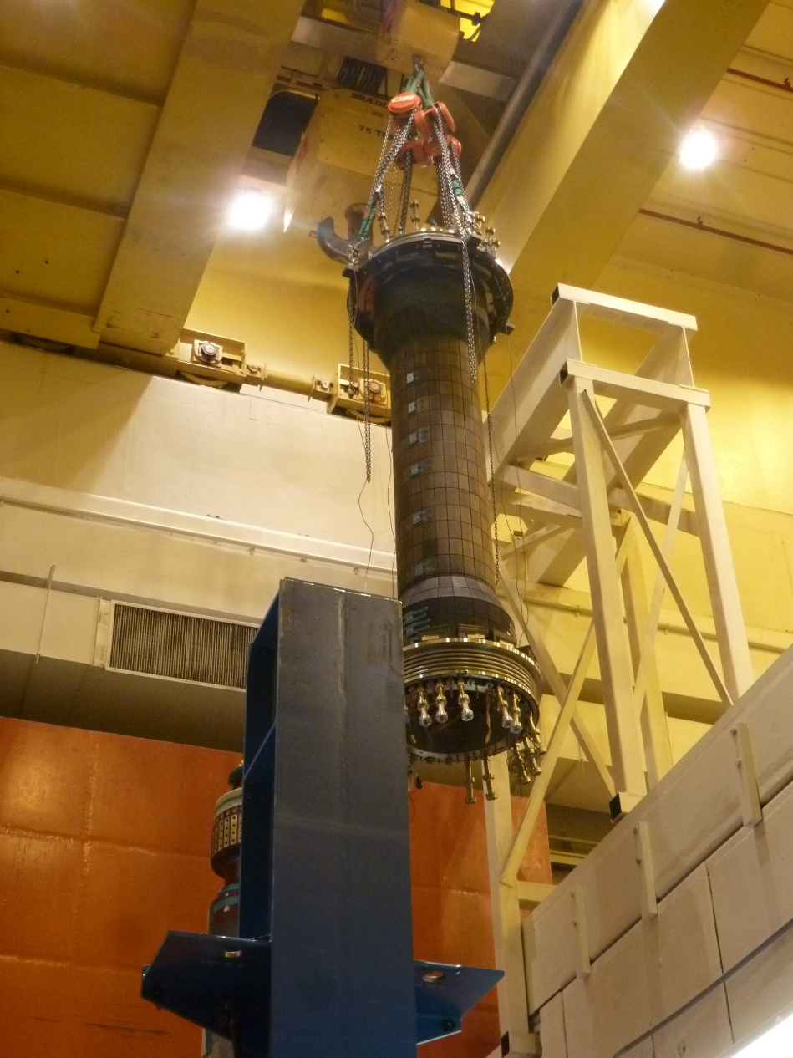
CS Casing Has Been Lifted Off

Slide 8
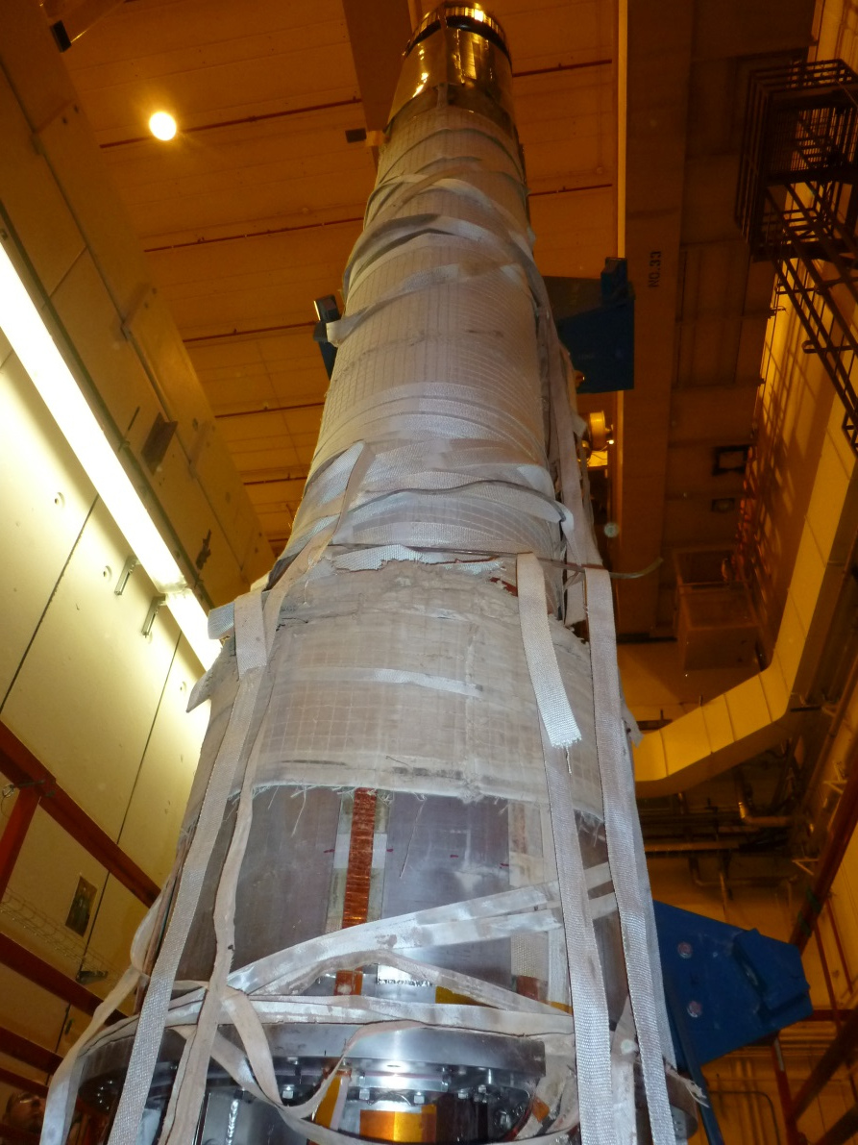
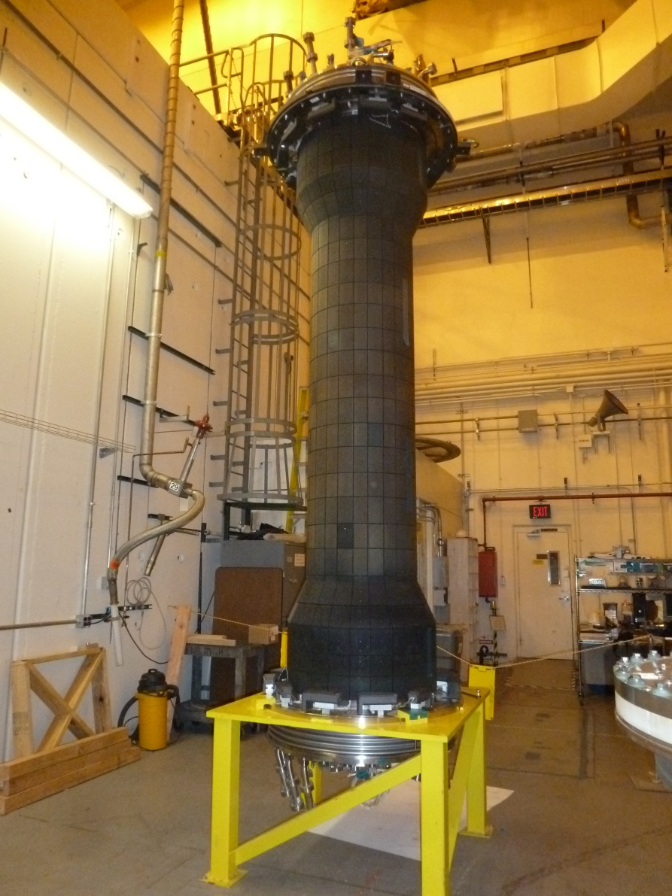
Casing is Fully Separated from Bundle

Slide 9
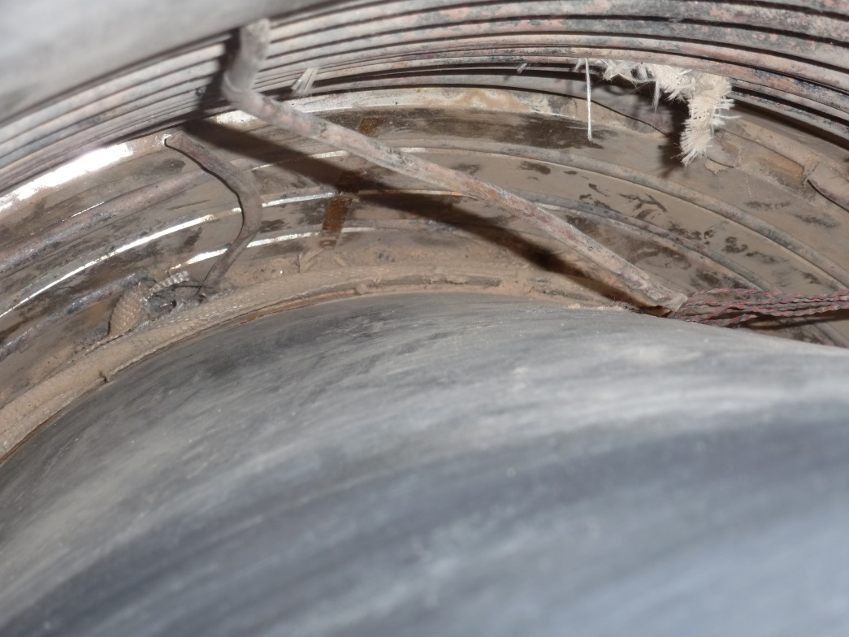
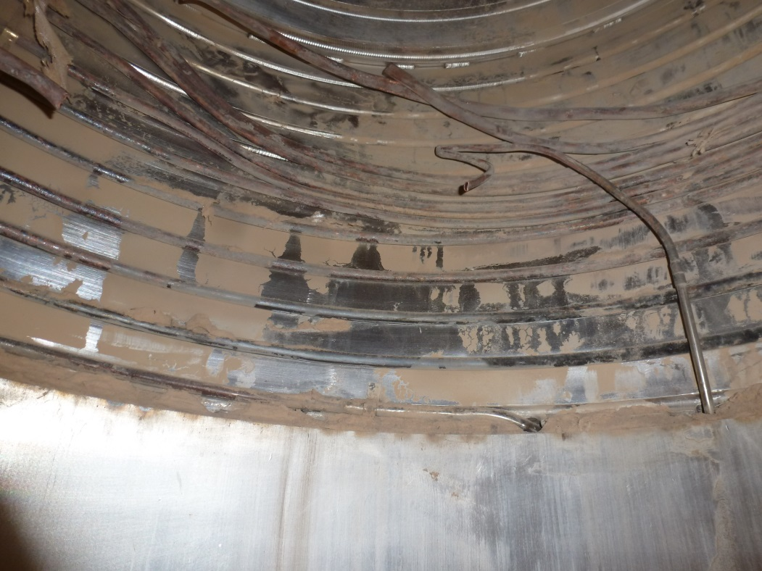
Lower Cooling Tubes Are Also Damaged
Failed Upper Cooling Tube
(Previously Reported)
Discovered a Failed Lower Cooling Tube
Lots of Microtherm Dust
Note: This Result Anticipated Based on
Pressure Testing of the Tube
Now have access to redesign/replace lower cooling tubes, remove PF1AL

Slide 10
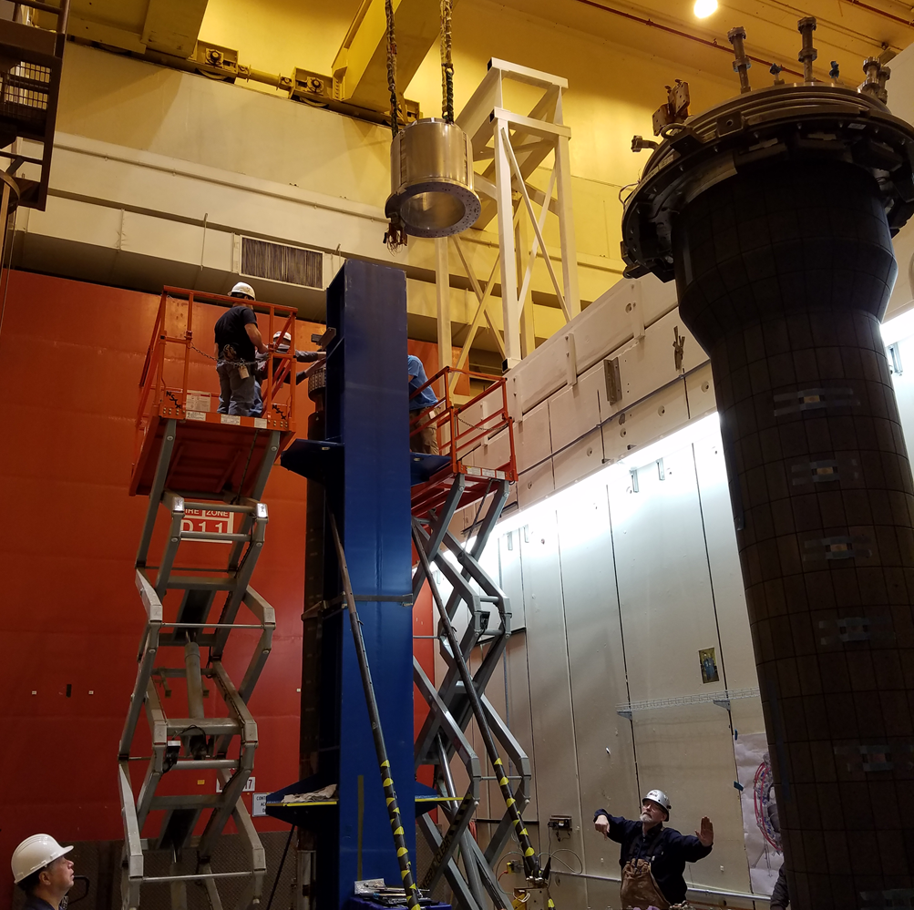
PF1A lower successfully removed

