Slide 1

Highlights from DVVRs & Recent Recovery Project Engineering Activities
S.P. Gerhardt, R. Hawryluk and C. Neumeyer
NSTX-U Team Meeting
3/22/2017
MBG Auditorium

Slide 2
Outline
Introduction (R. Hawryluk)
DVVR Process (S. Gerhardt)
Key DVVR Findings (S. Gerhardt)
Overview of the Correction Action Plan and Extent of Condition Process (R. Hawryluk)
Engineering Progress (S. Gerhardt)

Slide 3
Outline
Introduction (R. Hawryluk)
DVVR Process (S. Gerhardt)
Key DVVR Findings (S. Gerhardt)
Overview of the Correction Action Plan and Extent of Condition Process (R. Hawryluk)
Engineering Progress (S. Gerhardt)

Slide 4
DOE Notable Outcomes Have Been the
Near-term Focus
EXTENT OF CONDITION
  FES: Complete an extensive extent-of-condition review of NSTX-U to identify all design, construction, and operational issues. Prepare correction action plan (CAP) to include cost, schedule, scope, and technical specifications of actions. Provide an interim progress report by March 31, 2017 and complete the CAP review and send the final report to DOE by September 30, 2017.
EXTENT OF CAUSE
  SC/PSO: Conduct a review of policies and procedures for design, construction, installation, commissioning and operations of NSTX-U and other construction activities and projects. Develop corrective actions to ensure the highest quality project management across the lab.

Slide 5
Design Verification & Validation Review
System Design Description (SDD) is Key
DVVR looks for potential gaps in design basis or as-built configuration developed by Responsible Engineers
Corrective Action Plan (CAP), derived from the DVVRs, determines path forward

Slide 6
Outline
Introduction (R. Hawryluk)
DVVR Process (S. Gerhardt)
Key DVVR Findings (S. Gerhardt)
Overview of the Correction Action Plan and Extent of Condition Process (R. Hawryluk)
Engineering Progress (S. Gerhardt)

Slide 7
Practical Understanding of a DVVR
Described in NSTX-U-GUIDE-001-01
External and internal reviewers
  External reviewers have been hugely valuable
Review system to assess the suitability for use.
  Look for issues in design, fabrication, installation, testing, operations.
Examine (for instance):
  Guiding requirements
  The design + supporting analysis
  Fabrication & test records and issues
  Installation and operations records and issues
When a “gap” or issue is potentially identified, it is recorded as a electronic chit.
All with a view of ensuring high reliability of NSTX-U of NSTX-U operations over the full parameter range.

Slide 8
We have had 8 DVVRs to Date
 | Date | # of Days | Responsible Engineer |  | # of Chits | Included in Interim CAP
Central I&C | 1/18 | 1.5 | Tchilinguirian |  | 72 | Yes
Integrated Design | 1/24 | 1 | Neumeyer |  | 82 | Yes
Heating Systems | 1/30 | 2 | Stevenson |  | 98 | Yes
Magnets | 2/7 | 4 | Raftopoulos |  | 185 | Yes
Vacuum Vessel and Internal Hardware | 2/14 | 3 | Sibilia |  | 220 | Yes
Cooling Systems | 2/22 | 1 | Atnafu |  | 72 | No
Power Systems | 2/27 | 1.5 | Dellas |  | 84 | No
Interim EoC Committee, 3.5 days
Test Cell | 3/16 | 1 |  | Perry | 25 | No
This Presentation: Highest of Highlights
Total: ~920

Slide 9
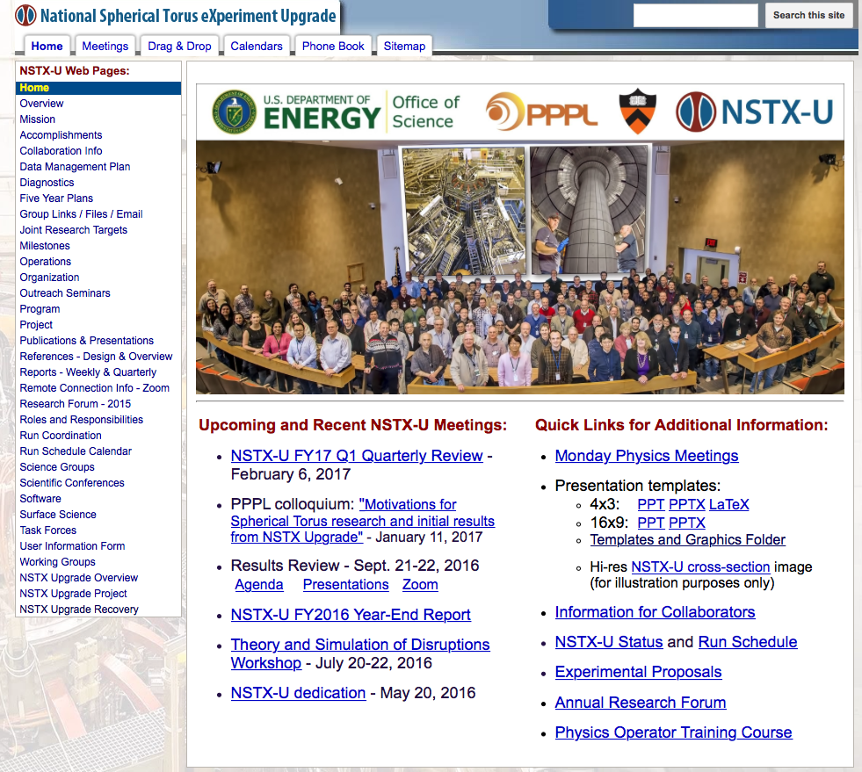
You Have Access to All this Information!
Click Here!

Slide 10
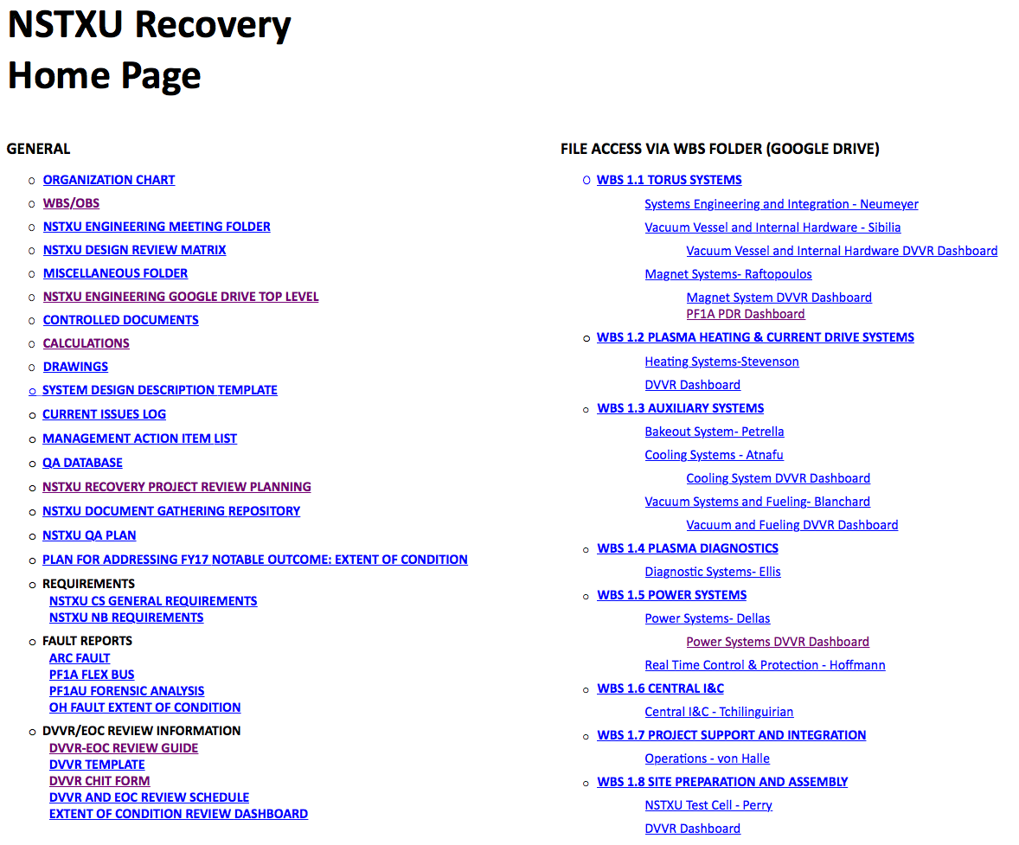
Everything About the Recovery Project

Slide 11
Outline
Introduction (R. Hawryluk)
DVVR Process (S. Gerhardt)
Key DVVR Findings (S. Gerhardt)
Overview of the Correction Action Plan and Extent of Condition Process (R. Hawryluk)
Engineering Progress (S. Gerhardt)

Slide 12
Findings: Central I&C
Many issues of hardware obsolescence
  CAMAC in the data acquisition and clock
  Numerous older computers
Need to incorporate more rigorous modern version & configuration control methods across the breadth of I&C software.
Need to develop reliable bare metal restore capability for computers that operations relies on.

Slide 13
Heating Systems (NBI)
Need to assemble more ion sources
  And a new source isolation valve for 1A
Needs to improve spare situation
  Source isolation valves, autotransformers, grid modules, TIV, source Langmuir probes,…
Refrigerator is a single point of failure for the full NB system
  Should procure spare heat exchanger assembles, turbine controller.
Recommendation to reconstitute species mix spectroscopic diagnostic

Slide 14
Heating Systems (HHFW+ECH)
Numerous issues with availability of spares
  Especially on RF sources 1 & 2: HVPS, FPA, LPAs, etc.
RF PLC is very antiquated
ECH-PI
  Need to look at system refurbishment.
  Is an 18 GHz system…assess if the frequency needs to change.
Assess suitability of the present RF antenna guards as the sole outboard limiter.

Slide 15
Magnets
Three days of reviews + a peer review of new PF-1a design.
A range of opinions from the assembled experts regarding the remaining inner PF coils
Much discussion, for example:
  role of the insulation system in the carrying the inner-TF torsional shear
  Role of the mechanical properties of the glass-kapton-resin insulation systems on the OH.
  Recommended additional calculations, tests, and instrumentation.
Discussion of the legacy NSTX coils, with support for instrumentation to monitor health.

Slide 16
Vacuum Vessel
Review committee questioned the reliability of 5 single O-rings at each of the top and bottom of the machine.
Need to repair failed or improper components
  Water leak on the beam armor heating/cooling lines
  Damaged copper cooling tubes
  Poorly sealed O-rings on the bellows flange
  Inner horizontal target PFCs
Reassess the design of the PF-1c can, which is a vacuum boundary, can draw plasma heat flux and halo currents.
Ensure high temperature bakeout capability.
Assess outboard divertor for upgrade thermo-mechanical and electro-mechanical loads.
Many many analysis and inspection related chits.

Slide 17
Water Cooling Systems
Many comments & chits on modernizing the legacy controls.
Many comments & chits on potential single point failures and the need for spares.
Comments on need to improve the water systems procedures and documentation.

Slide 18
Power Systems
Reviewed modernizations:
  Cycloconvertor controls, fault detectors, HCS, XST-1 & XST-2 transformers, underground 13.8 kV cables, DCCTs, various switchgear
Reviewed maintenance & repairs:
  Repair the cracked welds on MG#2, MG thrust bearings, MG stators
Discussion of reducing PF-1a/b/c current ripple via in-line inductors
Infamous SPA noise

Slide 19
NSTX-U Test Cell
Facility related issues:
  HVAC controls, compressed air system, leaking roof
E-Stops & Hardwired Interlock System
  Extended discussion on whether an e-stop during the pulse would damage FCPC hardware.
Health physics & radiation
  Warning lights linked to gamma/neutron detectors
  Need to improve shielding at various penetrations/doors.

Slide 20
Outline
Introduction (R. Hawryluk)
DVVR Process (S. Gerhardt)
Key DVVR Findings (S. Gerhardt)
Overview of the Correction Action Plan and Extent of Condition Process (R. Hawryluk)
Engineering Progress (S. Gerhardt)

Slide 21
Issues Recorded as Chits
Large number of chits were received to date
  ~940 chits so far
Very thoughtful chits enabling a comprehensive review of these systems
  Thanks to PPPL staff and external reviewers
.

Slide 22
Categorizing and Organizing the Chits
Combined similar chits into an issue (super-chit)
  Decrease duplication and provide clear tracking of all chits.
System “Verification”
  Design basis reviewed with respect to requirements in SDD
Component “Validation”
  Identified major components associated with issues
    Example: Heating system: (EC, NBI: sources/beamlines, power train, cryogenics, HHFW: power train, in-vessel components
Bin the issues into corrective action category
    Examples: redesign and rebuild, analyze and test, maintenance/repair, modernize/replace, spares

Slide 23
Estimated Risk Reduction due to Corrective Action for Each Issue
System (OBS) | Issues | Applicable Chits | Affected Component | Issue to be Addressed (Event) | Unmitigated Event Duration | Unmitigated Event Impact | Unmitigated Event Likelihood
Magnets | Fabricate new PF1AU coil to replace failed coil | IPF1 | PF1A-U | Coil has failed | Duration > 1 year | Dead Stop | Present State
The analysis is detailed in CAP spreadsheet.
  Severity index is a qualitative assessment used as a guide.
    Product of three variables representing the event duration, impact and likelihood, with a maximum value of 28665, weighted to emphasize major issues.
The results are summarized in terms of CAP categories by component.

Slide 24
Status of Developing a Comprehensive
Corrective Action Plan
Current assessment is for the five systems that had a DVVR.
  ~2 weeks since the end of the vacuum vessel DVVR and posting analysis, limiting the development of the CAP
Seeking input from the Extent of Condition Review on whether corrective actions are: necessary for start-up, strongly recommended or recommended for start-up (integrated testing) or recommended future operations, investigate further or not endorsed.
Actions have not been transformed into a detailed workplan.
Output from this review will result in an interim report to FES to be submitted at the end of the month.

Slide 25
Panel Recommendations on
Major Strategic Choices
Panel strongly recommended replacing existing PF1 coils
  Identified benefit of PF1B for flux expansion and operational flexibility
  Benefit of deleting PF1B is 3-4 months schedule improvement, if CF(R)C tiles were not on the critical path and it reduces risk to the schedule
    Tradeoff study for CFC vs graphite tiles recommended and is ongoing
Recommended consideration of removable mandrels on PF1 coils to facilitate turn-to-turn acceptance testing
  Note: we are exploring this on PF1B and PF1C for other reasons, but we are not pursuing this for PF1A.
  We will respond to the input from the EOC review
Retaining 300-350C bakeout strongly recommended
Recommended “indefinite deferral” of CHI to allow modification and simplification of the end-flanges of the Vacuum Vessel to improve the reliability of the machine
  Would eliminate ceramic insulator and a reduction/elimination of O-rings
  Would reduce requirements on vacuum boundary around PF1C coil
  Note: this is a new idea and cost and schedule implications are not yet understood

Slide 26
Subsequent Steps in Developing a
Corrective Action Plan
Need to complete the remaining DVVRs
Need to categorize the new chits and address them
  This provides the basis for developing a detailed workplan.
  Focus of next EOC meeting
Develop an agreed upon approach with FES
Develop a detailed cost and schedule
  Approach will enable a value engineering assessment to prioritize actions
  Develop a re-commissioning plan leading to start of operations and qualification of the machine.

Slide 27
Reassigning Staff From DVVRs to Design
Moving mechanical engineering staff to focus on the what are viewed as critical path activities
  Increasing the staff assigned to work on magnets and vacuum vessel
Developing WAFs with schedules and cost estimate
  Resource loaded
Aim to have a CDR in April to develop an integrated approach to the in-vessel and magnet issues.
  Some options discussed in next part of this talk

Slide 28
Outline
Introduction (R. Hawryluk)
DVVR Process (S. Gerhardt)
Key DVVR Findings (S. Gerhardt)
Overview of the Correction Action Plan and Extent of Condition Process (R. Hawryluk)
Engineering Progress (S. Gerhardt)

Slide 29
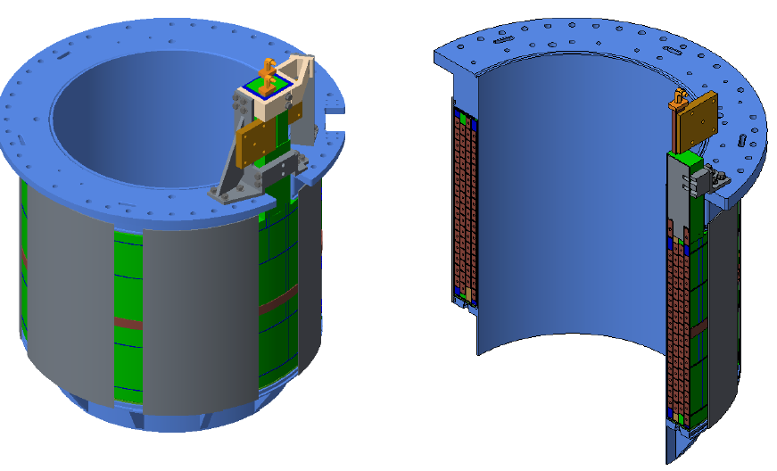
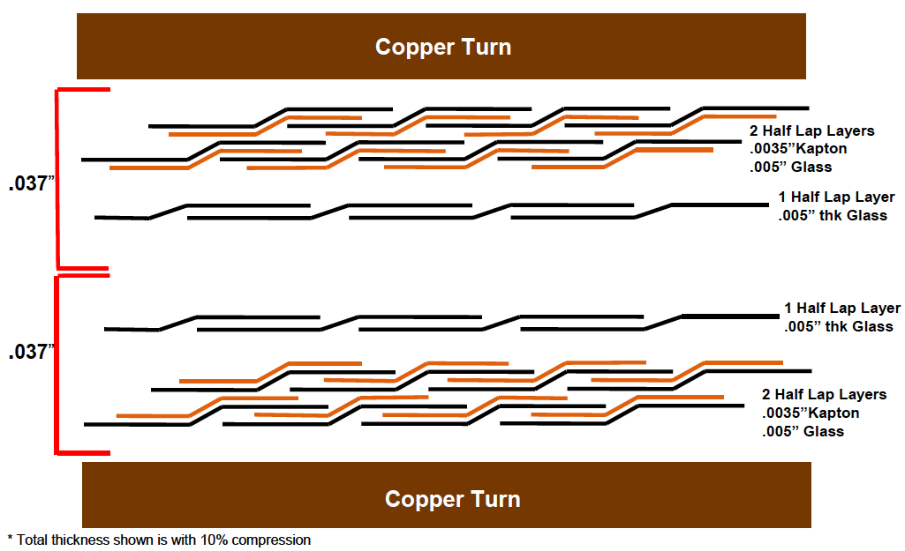
Preliminary Design Review for New PF-1a Coils Held on 3/17
Three presentations:
  Mechanical design
  Electrical Insulation design and testing
  Analysis
Key design updates:
  No joggles
  More turn insulation compared to previous case
  No in-line conductor brazes w/ softer copper
Considerable discussion of thermal shock issues when cold water enters a hot coil.
  Assessing the required I²t for scenarios of interest.
VPI cycles and manufacturing considerations not covered in this review and are planed for the next review.

Slide 30
We Have Been Examining Many Options For Coil Winding
DoE National labs:
  Extensive contacts, but no credible path forward established.
Industry:
  Pursuing many credible options, including in Europe
PPPL:
  Setting up a winding line in the C-site Test Cell

Slide 31
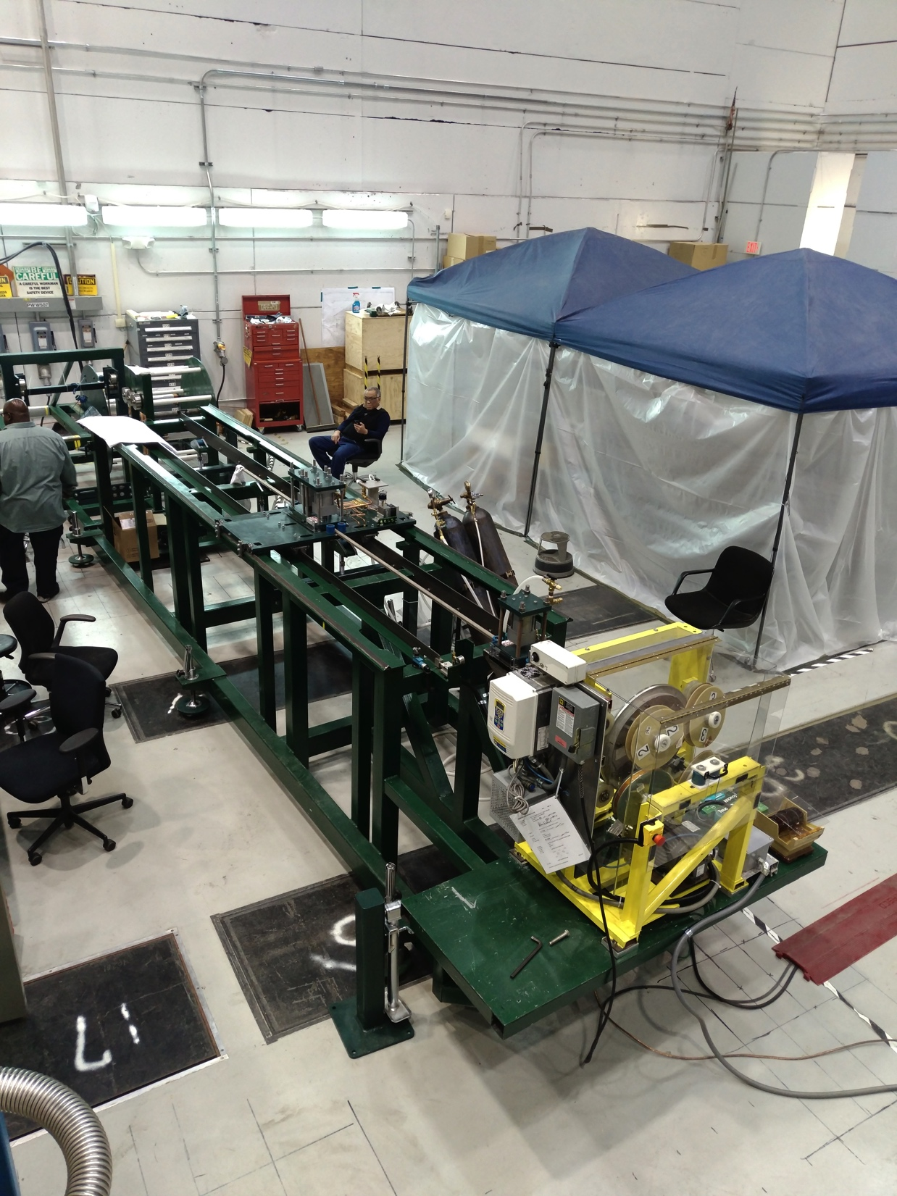
PPPL Winding Line is in the Shake-Down Phase
On the verge of pulling some spare copper onto a mandrel as a test.
Conductor is at vendor being grit blasted and primed.
Intend to wind a prototype after:
  Resolution of critical PDR chits.
  Development of full manufacturing procedure & documentation system
  Review of manufacturing.

Slide 32
4 DVVRs Yet to Complete
 | Date | # of Days | Responsible Engineer
Vacuum and Fuelling | 3/23/17 | 2 | Blanchard
Bakeout | 3/30/17 | 1 | Petrella
Diagnostics | 4/5/17 | 2 | Ellis
Realtime Protection and Control | 4/19/17 | 2 | Hoffmann

Slide 33
Other Engineering Notes
For those areas that have not yet had DVVRs, preparing for those DVVRs is the highest priority
For others, key steps are refining cost/schedule via WAFs, then doing the work!
A team of design and analysis engineers has been identified to resolve the outstanding conceptual design issues for the vessel:
  How to thermally isolate the PF-1b coil while supporting the CS casing?
    Casing support on large- or small-R side of coil?
  How to define the vacuum boundary around the PF-1c?
    Considering options that eliminate or retain the CHI insulators
  What is the proper material and fixturing for the inner-target tiles?
    And refining heat flux, halo current requirements.

Slide 34
NSTX-U Recovery is Moving Forward
To ensure reliable and predictable operation in the future:
  Addressing the issues comprehensively
  Taking a deep dive into all systems
    Applying a rigorous systems engineering approach.
Thanks to those participating in the DVVRs and Extent of Condition Review
A much better understanding of the issues that need to be addressed is being achieved.

