Slide 1
NSTXU Recovery Project Status
NSTX-U Team Meeting – March 4, 2020
John N. Galayda

Slide 2
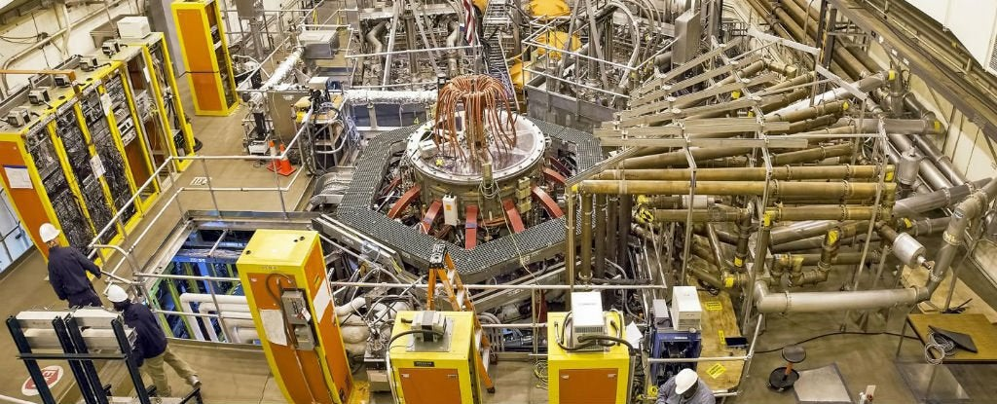
NXTXU Project: What We’re Up To
Recovering and re-commissioning the lab’s centerpiece research facility

Slide 3
Project Overall/Construction Status
Project Budget is $199.4M
Project is 58% complete on work in the “baseline plan” at end of January
Getting the parts in house
$81M spent on materials & labor, another $4M on order
Work is advancing @ $3.6M+/month

Slide 4
Project Status: Design
The project has arrived at Final Design
Very robust design verification and validation process
Clear line connecting requirements thru concepts to final design

Slide 5
As the Design Has Progressed
The 100% complete design will be presented to a committee of international experts on 17-19 March
Basis of design, calculations, drawings, recommendations of every reviewer (in-house and external) and Project response to each
Admirably thorough, disciplined and documented process

Slide 6
As the Design Has Progressed
Focus has been shifting to purchasing and receiving
Getting orders out the door and monitoring vendors has been and will continue to be ESSENTIAL
The project has had great support from the purchasing organization
All told, the work of 250 people, focused on
NSTXU Project
Maintenance and Run Preparations – Getting associated systems ready to support NSTXU operations

Slide 7
What’s Next
More buying/receiving
Inspecting/staging parts and materials
A lot MORE work!
Creation & maintenance of inventory, associated records
A lot of parts that are almost identical….
Care/attention to detail

Slide 8
What’s Next
Prepare for installation, get it done
Parts going inside the torus must be “vacuum-clean”
And they must be “vacuum clean” AFTER installation is done!
Good vacuum in operation is an extremely important performance measure
Problem during installation? Question about wiring/labelling? Call it out so it can be fixed
Not sure everything is OK? Raise the issue to your supervisor & ask for info from NSXTU mgmt

Slide 9
Tech Oversight During Installation
NSTXU mgmt committed to ensure that you have access to engineers in the field or anybody else necessary to ensure
Installation is as designed
Necessary final adjustments are made
YOU WILL GET the attention of cognizant engineers & project management when you need it- make sure you ask

Slide 10
Managing Safety
A lot of hands-on activity:
BE SURE energy sources are secured
Working inside and outside the torus
Ergonomics - body position, ingress/egress
Repetitive motions, fatigue
Lighting
Ventilation
Working at elevation, fall protection
Plan carefully
Cooperation
Look out for each other

Slide 11
Managing Safety
I like the STOP Program – Observation of safe working habits
Life-threatening risks
Control of energy sources – LOTO, GFI
Fall protection
Hoisting and rigging
Injury risks
Repetitive motion, awkward or stressful body position
Using manual or powered tools
Fatigue, loss of focus on the work increases risk of injury
Try to create the best working conditions you can
Lighting, Ventilation, Ergonomics

Slide 12
There is Time to Do the Work Right
Think ahead to the hazards and how to handle them
PPE: proper shoes, gloves & hardhats
Take the extra time to
Get the right equipment- work with good lighting-
Be aware of workers & work going on around you
Look out for your co-worker- thank your co-workers looking out for you
NSTXU w/o a single injury is doable – Everybody in the project is committed to helping you get it done this way

Slide 13
Backup Slides

