Slide 1
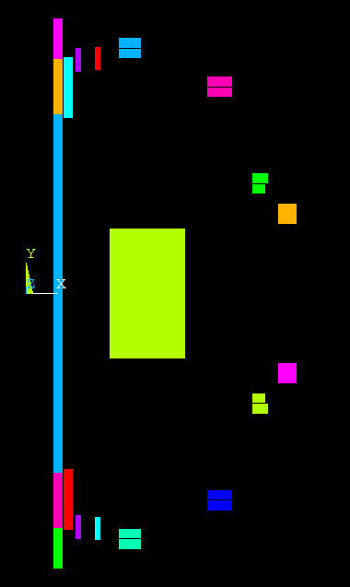
zero
! Influence Coefficient Matrix including segments near PF1a,U&L
read
stef
ron7
divi
0,2,2,1
snal
1
merge
1,.0001
redu
!real no.,nx , ny , nturns, terminal current
rcoi
19
1,4,7,64,250 !PF1AU Note that
2,2,5,32,250 !PF1bU Current is not 1000 Amp
3,2,5,20,250 !PF1cU But 250 Because of divi 0,2,2,1
4,4,14,28,250 !PF2U
5,3,10,30,250 !PF3U
6,1,17,17,250 !PF4U
7,4,6,24,250 !PF5U
8,4,6,24,250 !PF5L
9,1,17,17,250 !PF4L
10,3,10,30,250 !PF3L
11,4,14,28,250 !PF2L
12,2,5,20,250 !PF1cL
13,2,5,32,250 !PF1bL
14,4,7,64,250 !PF1aL
15,10,26,574.6,250 !OH
16,10,4,88.4,250 ! OH Near PF1aL
17,10,3,66.3,250 ! OH Lower End
18,10,4,88.4,250 ! OH Near PF1aU
19,10,3,66.3,250 ! OH Upper End
20,6,8,1,250, !Plasma
infl
19
copt
r
plce
pl

Slide 2
To get the average hoop stress in the coil divide the Fr/radian in N/radian results from the influence matrix multiplication by the area of the coil. This is the “smeared” stress at the center of the coil – to get the ID stress scale it by 1/r and increase by dividing by a packing fraction (~.85)
area of 16 the lower OH region near the PF1aL is .02778 m^2
area of 18 the Upper OH region near the PF1aU is .02778 m^2
area of 1 PF1au is .028934 m^2
area of 14 pf1aL is .028934 m^2

