Slide 1


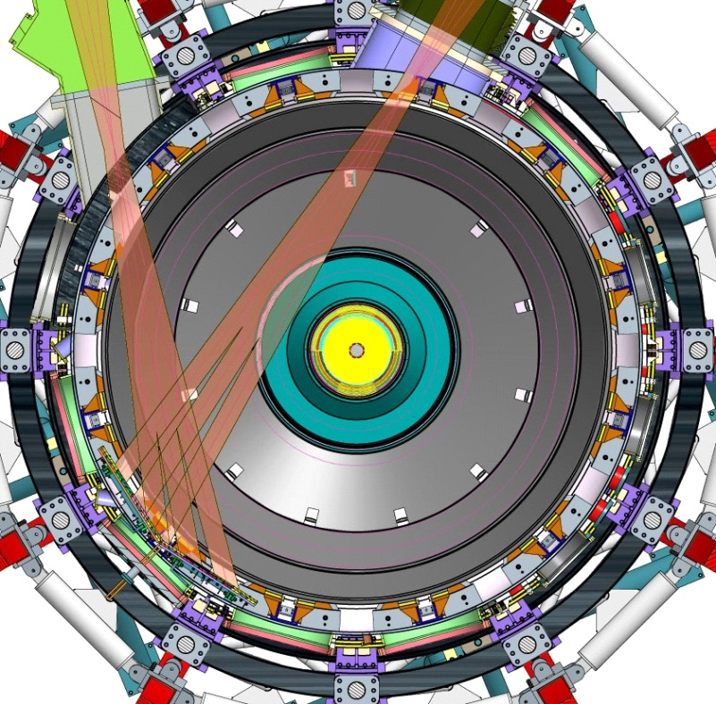
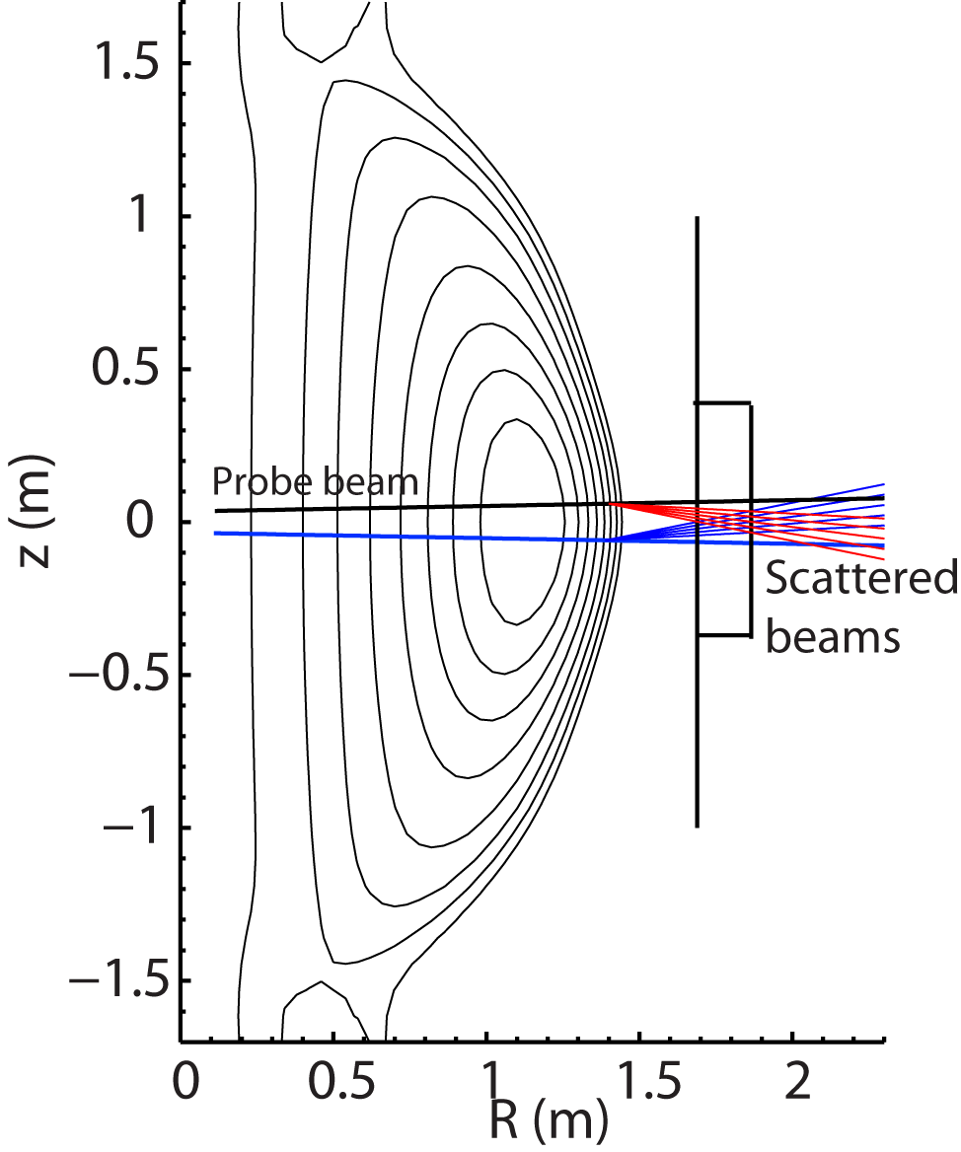
NSTX-U
Supported by
NSTX-U Collaboration Status and Plans for:
University of California at Davis
N.C. Luhmann, Jr.,
R. Barchfeld, C.W. Domier, C.M. Muscatello, M. Sohrabi
Coll of Wm & Mary
Columbia U
CompX
General Atomics
FIU
INL
Johns Hopkins U
LANL
LLNL
Lodestar
MIT
Lehigh U
Nova Photonics
ORNL
PPPL
Princeton U
Purdue U
SNL
Think Tank, Inc.
UC Davis
UC Irvine
UCLA
UCSD
U Colorado
U Illinois
U Maryland
U Rochester
U Tennessee
U Tulsa
U Washington
U Wisconsin
X Science LLC
Culham Sci Ctr
York U
Chubu U
Fukui U
Hiroshima U
Hyogo U
Kyoto U
Kyushu U
Kyushu Tokai U
NIFS
Niigata U
U Tokyo
JAEA
Inst for Nucl Res, Kiev
Ioffe Inst
TRINITI
Chonbuk Natl U
NFRI
KAIST
POSTECH
Seoul Natl U
ASIPP
CIEMAT
FOM Inst DIFFER
ENEA, Frascati
CEA, Cadarache
IPP, Jülich
IPP, Garching
ASCR, Czech Rep
NSTX-U Collaborator Research Plan Meetings
April 25, 2014
High k_{θ}
High k_{θ}
FIReTIP

Slide 2
Research plans and needs for this year (FY2014) in preparation for NSTX-U operations in FY2015
Reconfigure FIReTIP system
  FIReTIP chord #1 (with two additional chords planned) to employ entrance window on Bay G, with internal retroreflector on Bay B
    Will provide core plasma density monitoring, and density calibration of Thomson scattering system
    Design new optics layout; needs to coexist with other diagnostics on Bay G
  CO₂ and FIR lasers to be relocated to “cage” area outside test cell
    Dielectric-coated waveguides (2) plumbed through radiation wall to couple FIR beams to Bay G launch optics
Develop high power, high k_{θ} source
  Optimize CO₂-pumped FIR laser performance at 693 GHz, to be launched into Bay G as high k_{θ} probe source
    Will coexist with the reconfigured FIReTIP system on a 3-level optical table in NSTX cage outside test cell
    Corrugated waveguides remachined at UC Davis for low loss at 693 GHz, and plumbed through radiation wall to couple FIR beam to Bay G launch optics

Slide 3
Research Plans for FY2015
Commission and operate FIReTIP system
  Collect first data with redesigned system and verify data integrity of FIReTIP chord #1
  Install heterodyne HeNe laser interferometer for real-time vibration compensation
  Develop and test prototype real-time feedback control electronics
Fabricate and characterize high k_{θ} optics and receivers
  Fabricate 4x1 pixel array receivers
    FIR subharmonic mixer arrays fabricated jointly by UC Davis in collaboration with researchers at Hübner GmbH
  Design and fabricate launch and imaging optics
    Translatable optics and multi-element receiver provides access to both k_{θ} and k_{r} wavenumbers in the NSTX core
  Characterize and optimize system performance at UC Davis

Slide 4
Research Plans for FY2016 Forward
Install real-time feedback control electronics on FIReTIP
  Feedback control software to be developed by PPPL
Install and commission high k_{θ} system
  Install high power FIR laser source in NSTX cage area
  Install source optics and steering mirrors on Bay G
  Install imaging optics and receiver electronics on Bay L
  Collect first data with redesigned system and commission system
Develop Microwave Imaging Reflectometer (MIR) system
  Design and modeling carried out under Diagnostics program
  Current contract funding ends on Feb. 28, 2016; fabrication of imaging hardware and electronics to take place in FY2016 (assuming successful renewal by DoE), with installation in FY2017

Slide 5
Microwave imaging reflectometry (MIR) to provide 2D images of density fluctuations in NSTX-U
  Envisage 12 (poloidal) x 8 (radial) system to make localized measurements of low-k density fluctuations over a wide extent of the NSTX-U plasma
  MIR optics to share the same large aperture (34 cm x 13 cm) window employed by the high k_{θ} scattering system
  Preliminary optics design underway and operating frequency range under discussion
12x4 system implemented on DIII-D (to be upgraded to 12x8 and eventually to 12x16)
Example from DIII-D: type-I ELM precursor
Mapping to DIII-D cross-section
ELM
ELM
Rich spectrum of inter-ELM modes
t₀
+2 µs
+4 µs
+6 µs
+8 µs
+10 µs
+12 µs
+14 µs
Time-lapse images show vertical rotation of encircled 58 kHz mode through viewing window

Slide 6
Ideas to enhance participation in NSTX-U research/program by U.S. Universities, early-career researchers, and students
Offer low cost housing options for graduate students working on NSTX-U
  Possibility to allow graduate students outside of Princeton University to have access to Princeton University graduate housing?
Offer introductory seminar(s) on NSTX-U
  Would improve the learning curve for inexperienced graduate students and assimilate them into the facility quicker

Slide 7
Highest-priority incremental measurement capability
(For diagnostic solicitation grantees funded for 2012-2015)
New FIReTIP Mixers
  FIReTIP was designed and operated with the 2.54 THz corner-cube mixers from the TFTR MIRI system because of funding constraints
  Additional funds would allow these whisker-contacted mixers to be replaced with modern waveguide mixers
    Will increase signal levels by 10-20 dB, yielding significantly increased S/N ratios and enhanced density fluctuation sensitivity and provide increased reliability due to their robustness
Additional high k_{θ} receiver array
  Initial high-k_{θ} system (to be installed and commissioned in FY2016) to consist of one 4-element poloidal array
  Additional funds would permit fabrication of a second 4-element array, permitting simultaneous 2-D imaging (2 radial x 4 poloidal channels)
    Second array to be installed together with the first array in FY2016

