Slide 1




NSTX-U
Supported by
NSTX-U Collaboration Status and Plans for:
Turbulence & Instability Studies - U. Wisconsin
Coll of Wm & Mary
Columbia U
CompX
General Atomics
FIU
INL
Johns Hopkins U
LANL
LLNL
Lodestar
MIT
Lehigh U
Nova Photonics
ORNL
PPPL
Princeton U
Purdue U
SNL
Think Tank, Inc.
UC Davis
UC Irvine
UCLA
UCSD
U Colorado
U Illinois
U Maryland
U Rochester
U Tennessee
U Tulsa
U Washington
U Wisconsin
X Science LLC
G. McKee, D. Smith, R. Fonck
University of Wisconsin-Madison
Culham Sci Ctr
York U
Chubu U
Fukui U
Hiroshima U
Hyogo U
Kyoto U
Kyushu U
Kyushu Tokai U
NIFS
Niigata U
U Tokyo
JAEA
Inst for Nucl Res, Kiev
Ioffe Inst
TRINITI
Chonbuk Natl U
NFRI
KAIST
POSTECH
Seoul Natl U
ASIPP
CIEMAT
FOM Inst DIFFER
ENEA, Frascati
CEA, Cadarache
IPP, Jülich
IPP, Garching
ASCR, Czech Rep
NSTX-U Collaborator Research Plan Meetings
PPPL – LSB B318
May 5, 2014

Slide 2
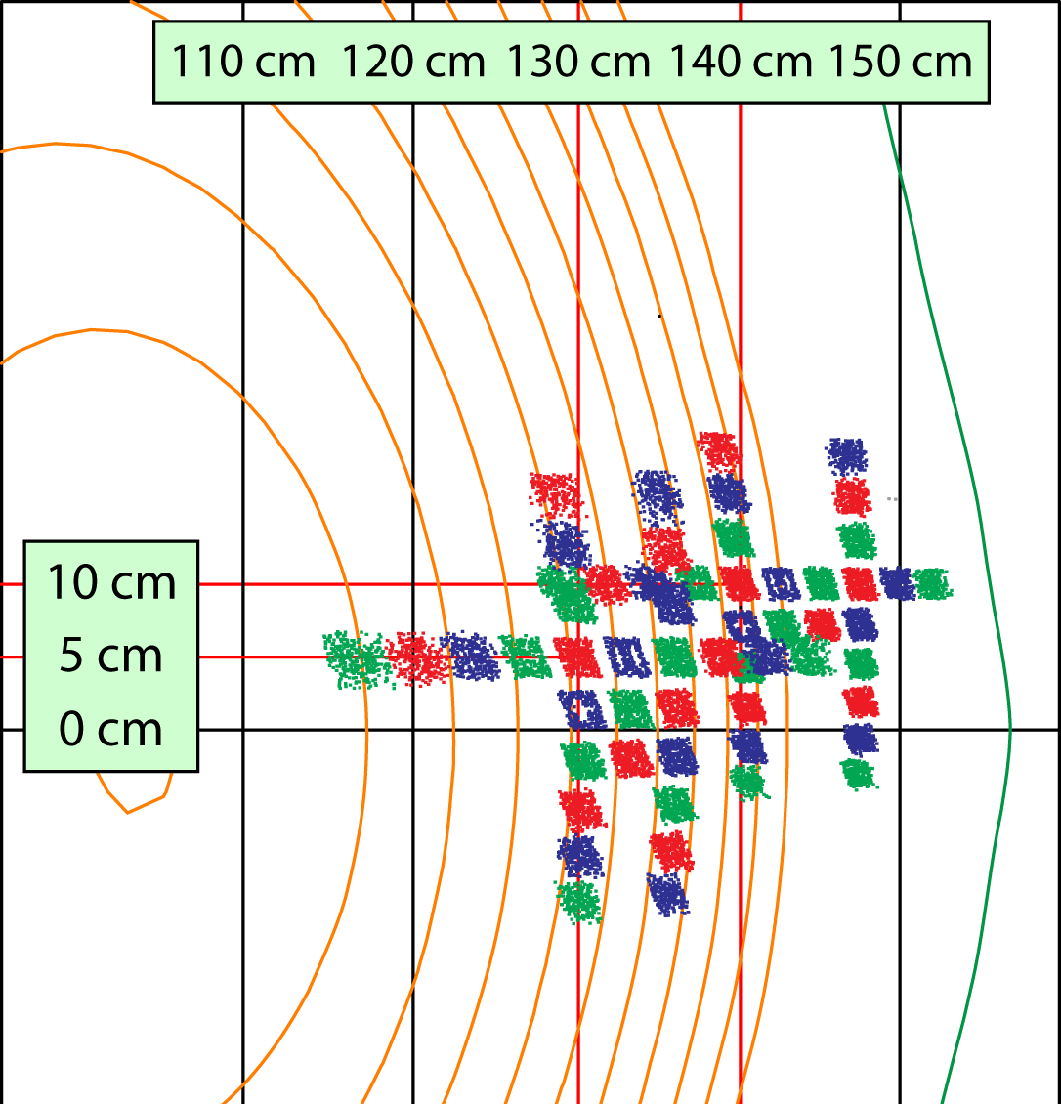
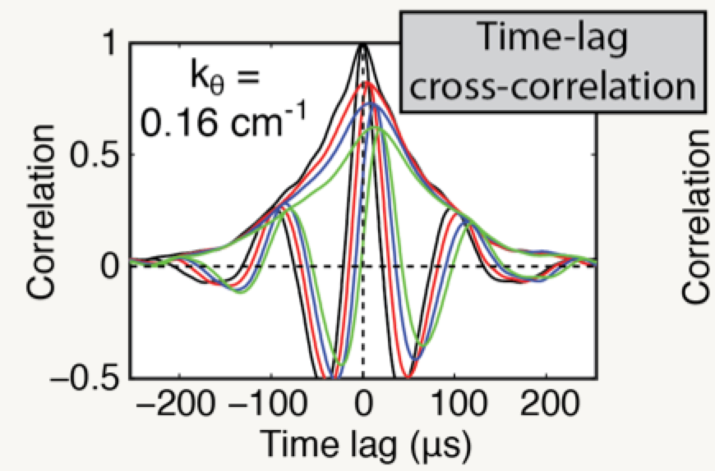
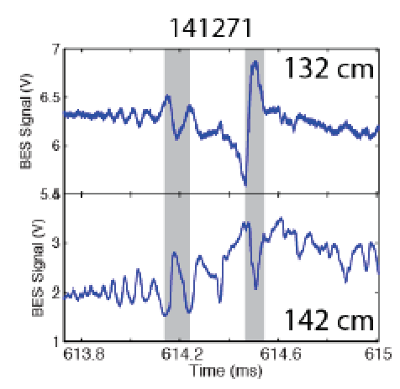
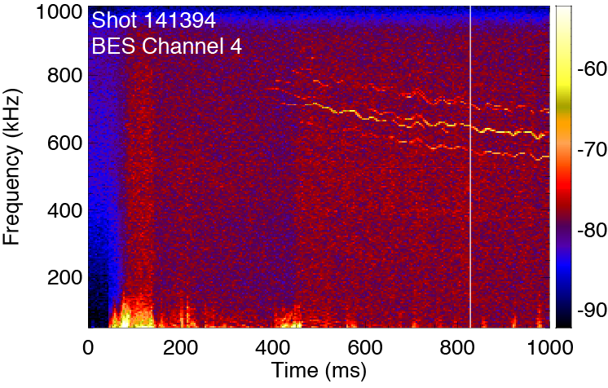
U. Wisconsin Research at NSTX-U:
Investigations of long-wavelength turbulence/instabilities in the ST
Pedestal Turbulence
Beam
Emission
Spectroscopy:
-- Low-k ñ
fluctuations
-- Multipoint
-- 2 MHz ñ
-- Turbulence,
xAE, EHO,
ELM
ELM Dynamics
GAE?
(w/K. Tritz, JHU)

Slide 3
Research plans and needs for this year (FY2014) in preparation for NSTX-U operations in FY2015
Enhancing BES fluctuation diagnostic for NSTX-U
  16 new detector channels: 32➔48 spatial channels
    Expanded simultaneously sampled field of view
  2D ñ measurement capability
    New 2D fiber mount being designed & fabricated
Investigating low-k pedestal turbulence & instabilities
  Scaling properties of turbulence characteristics with local parameters
    Comparison with simulation (GEM, BOUT++)
    D. Smith et al., Nucl. Fusion (2013), Phys. Plasmas (2013) [IAEA, APS]
  ELM time series analysis: similarity, cluster linkage [TTF-2014]
Needs: 2D array (potential schedule delay)
  Engineering w/UW-PSL, tech. assist, schedule, spatial calibration
    Would greatly benefit from calibration between CD4 and 2015 Ops
  Additional fiber bundles (26 new fiber bundles 56➔84)-B. Stratton

Slide 4
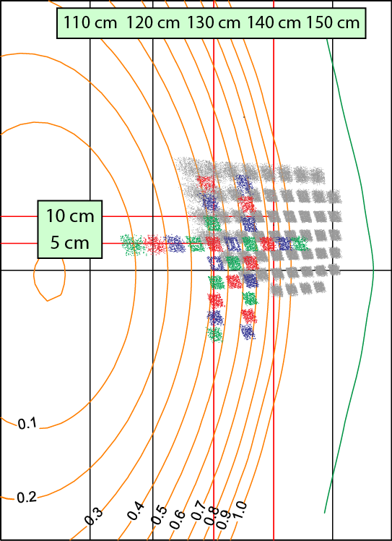
BES Upgrade: Expansion and 2D Measurement Array
New BES Spatial Coverage:
2D (outer) + core radial/poloidal
Expansion from 32 ➔ 48 Spatial Channels
  Optics, detectors, preamplifiers
  Sig. conditioning/control electronics
  2 MHz digitizer (D-tAcq)
2D Measurement array
  Design in progress @UW-PSL
  Installation: Summer, 2014
  Research capabilities
    Turbulence imaging, S(k_{r},k_{𝜃})
    Sheared flow measurement
    ELM dynamics: SOL propagation
  Core radial/poloidal arrays

Slide 5
Research Plans for FY2015-FY2017
Characterize core/edge turbulence properties in ST
  L-mode, H-mode, EP, QH
    Neoclassical vs. Anomalous transport: particle, momentum, heat
  L-H transition dynamics, parametric dependencies
    Edge flows: equilibrium, zonal flow, GAM
  ELM/Pedestal instability dynamics (e.g., EHO, ELM post-cursors)
  Simulation comparison (GYRO, GEM, GTS, BOUT++)
  Advanced analysis: Time-delay-estimation, velocimetry, non-linear
Expanded collaborations with UW & DIII-D
  Recruiting new UW graduate student for future NSTX-U activity
  Pegasus collaboration (H-mode physics, pedestal/edge dynamics)
  DIII-D: Core, Pedestal, comparison/contrast (BES), e.g., A. Diallo
    3D field effects (RMP, EFCC ➔ turbulence response, ELM effects)

Slide 6
Ideas to enhance participation in NSTX-U research/program by U.S. Universities, early-career researchers, and students
On-campus scientist support needed for stronger ties
  Integrated graduate student theses research
  Increase “attractiveness” of NSTX-U to prospective graduate students
  Combine research (e.g., NSTX-U, Pegasus, DIII-D)
Broaden research connections and integration
  Studies of nonlinear ELM dynamics across NSTX-U, Pegasus and DIII-D via integrated UW team
    N(r,t), P(r,t) and j(r,t): pedestal dynamics, filament formation, etc.
  Expanded theory/simulation collaboration
    NIMROD, BOUT++ for nonlinear ELM dynamics
Physics-based research programs (facility-agnostic)
  Pedestal/edge stability: turbulence, ELMs, P-B, KBM
  3D field physics via RMP, EFCC: ELM-mitigation/suppression
  Simulation validation: aspect ratio, beta, rho* scaling
    ITG, TEM, Micro-tearing(ST), KBM (tokamak), hybrid

Slide 7
Highest-priority incremental measurement capability
(For diagnostic solicitation grantees funded for 2012-2015)
Higher-resolution edge ñ measurement
  Higher-k intra-pedestal instability ñ measurements
Simultaneous full-radius low-k ñ measurement
  Expand BES coverage: procure additional fiber bundles
    26 new bundles fully exploit 2D + inboard radial/poloidal capability (~100k)
    Additional detector channels (16 to bring to 64)
Comprehensive spectroscopy measurements
  High-resolution spectrometer & detector
    Beam manifold/impurity lines: E~ feasibility (Fonck-UW diagnostic dev.)
Toroidal n-number measurement capability
  Toroidally displaced BES viewport observing new heating beam
  Determine structure, e.g, n=0 for zonal flow/GAM?
  Finite n measurement for xAE modes, EHO

