Slide 1




NSTX-U
Supported by
NSTX-U Columbia U. Group Research Plan Summary (2014-2018)
Coll of Wm & Mary
Columbia U
CompX
General Atomics
FIU
INL
Johns Hopkins U
LANL
LLNL
Lodestar
MIT
Lehigh U
Nova Photonics
ORNL
PPPL
Princeton U
Purdue U
SNL
Think Tank, Inc.
UC Davis
UC Irvine
UCLA
UCSD
U Colorado
U Illinois
U Maryland
U Rochester
U Tennessee
U Tulsa
U Washington
U Wisconsin
X Science LLC
S.A. Sabbagh, J.W. Berkery, J.M. Bialek, Y.S Park
Culham Sci Ctr
York U
Chubu U
Fukui U
Hiroshima U
Hyogo U
Kyoto U
Kyushu U
Kyushu Tokai U
NIFS
Niigata U
U Tokyo
JAEA
Inst for Nucl Res, Kiev
Ioffe Inst
TRINITI
Chonbuk Natl U
NFRI
KAIST
POSTECH
Seoul Natl U
ASIPP
CIEMAT
FOM Inst DIFFER
ENEA, Frascati
CEA, Cadarache
IPP, Jülich
IPP, Garching
ASCR, Czech Rep
NSTX-U Collaborator Research Plan Meeting
PPPL – LSB B318
May 5, 2014
V1.5

Slide 2
Columbia U. Group research plan for NSTX-U aims at mode control for disruption prediction / avoidance
Physics areas as written in DOE proposal
  Global mode active control
    Model based RWM state-space active control, use of observer for disruption avoidance, comparison to PID, internal mode control scopic study, etc.
  Global mode stabilization at low collisionality
    Test kinetic RWM theory at low ν, maintain stability, etc.
  Applied NTV research and physics-based rotation control
    NTV dependence on ν, NTV offset, application to rotation control to avoid beta-limiting instabilities (incl. at low V_{φ})
  RFA and MHD spectroscopy for disruption avoidance
    Including simple models to be used in real-time
  NCC physics design and usage for disruption control
Disruption categorization (NSTX database)
% Having strong low frequency
n = 1 magnetic precursors
55%
% Associated with large core rotation evolution
46%
S. Gerhardt et al., NF 53 (2013) 063021

Slide 3
Research plans and needs for this year (FY2014) in preparation for NSTX-U operations in FY2015
Present attention is on NSTX analysis / paper publication
  Two papers accepted for publication in 2014
  One presently under review
  2 – 3 further NSTX papers expected before the start of NSTX-U Ops
Transition to computational analysis preparation ~ mid 2014
  RWM State-space Controller generalization – to be available on “Day 0”
    Offline IDL version of code already generalized
    Changes to r/t version to be made. Small PCS programming support will be needed
  NSTX EFIT (of course, “Day 0”)
    Plan to upgrade to faster processing to support increased between-shots spatial resolution / time resolution (eta 2014-2015); present code available as default
    New code components acquired Dec 2013; new dedicated prototype 32 core CPU computer online at PPPL (planned to be expanded); consistent with PPPL IT plan
  NSTX rotation control
    Continuing work with PU student (I. Goumiri) on rotation control algorithm
    Present quantitative NTV analysis of Columbia U. NSTX experiments supports this, and the paper publication goals above

Slide 4
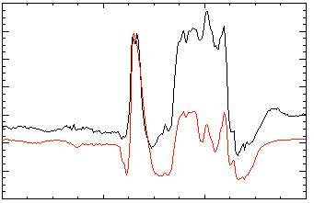
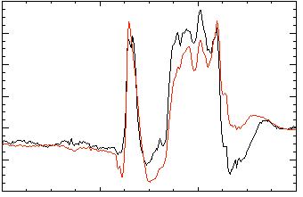
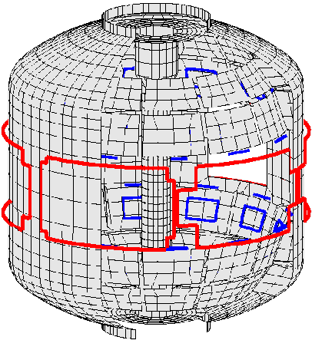
Model-based RWM state space controller including 3D plasma response and wall currents used at high β_{N} in NSTX
RWM state space controller in NSTX at high β_{N}
Effect of 3D Model Used
No NBI Port
80
δB_{p}⁹⁰
Measurement
40
Controller
(observer)
0
-40
137722
0.56
0.58
0.60
0.62
t (s)
With NBI Port
80
δB_{p}⁹⁰
40
Potential to allow more flexible control coil positioning
  May allow control coils to be moved further from plasma, and be shielded (e.g. for ITER)
0
137722
0.56
0.58
0.60
0.62
t (s)
3D detail of model is important to improve sensor agreement
Katsuro-Hopkins, et al., NF 47 (2007) 1157
S.A. Sabbagh, et al., Nucl. Fusion 53 (2013) 104007

Slide 5
Dual-component PID (B_{r} + B_{p}) and model-based RWM state-space (RWMSC) active control will enable long pulse, high β operation
2014:
  Expand/analyze RWMSC for 6 coil control and n > 1 physics
Active n = 1 B_{p} + B_{R} feedback control
6
β_{N}
Feedback on
140124
140125
140126
140127
4
2
B_{r} phase = 225º
0
6
B_{r}^{n = 1} (G)
2015 and 2016:
  Establish B_{r} + B_{p} active control capability in new machine, use with snowflake divertor
4
2
B_{r} phase = 180º
0
0.0
0.2
0.4
0.6
0.8
1.0
1.2
t (s)
B_{r} phase = 0º
B_{r} phase = 90º
  Examine RWMSC with:
    independent actuation of six coils
    multi-mode control with n up to 3
    rotational stabilization in the model
RWMSC
  Advantages:
  potential for use of external coils with less power
2017 and 2018:
  Upgrade for NCC, utilize model-based active control with the new NCC to demonstrate improved global MHD mode stability and very low plasma disruptivity, producing highest-performance, longest-pulse plasmas

Slide 6
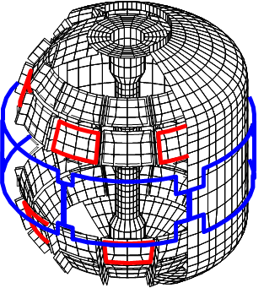
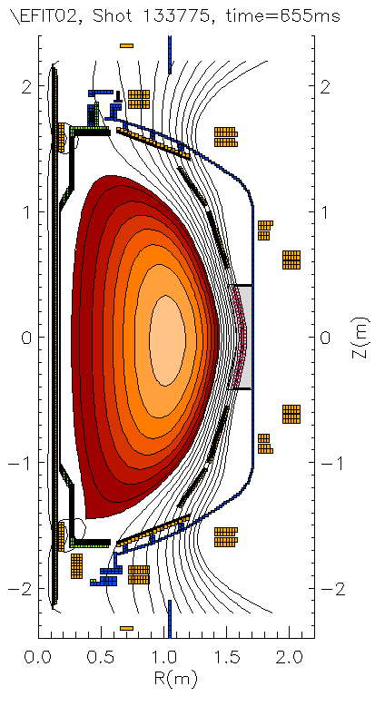
NCC will greatly enhance physics studies and control;
Enhanced magnetics near divertor will measure multi-modes
Years 2017 and 2018:
  Implement improvements to active feedback of n =1-3 modes via RWMSC control allowed by the NCC
  Utilize rotation profile control capabilities allowed by the NCC to demonstrate reduced disruptivity by actively avoiding global instability boundaries
Partial NCC
Existing coils
Multi-mode n = 1 ideal eigenfunction for fiducial plasma
Present sensor locations
Proposed new sensor locations
Mode diagnosis:
  If two modes are near marginal, need to be able to distinguish
  Measure increased amplitude near divertor (3D analysis shows >2x increase over present sensors)
  Similar results in ITER simulations
Significant toroidal phase change would be measured
  Can help constrain the RWMSC
mmVALEN
6

Slide 7
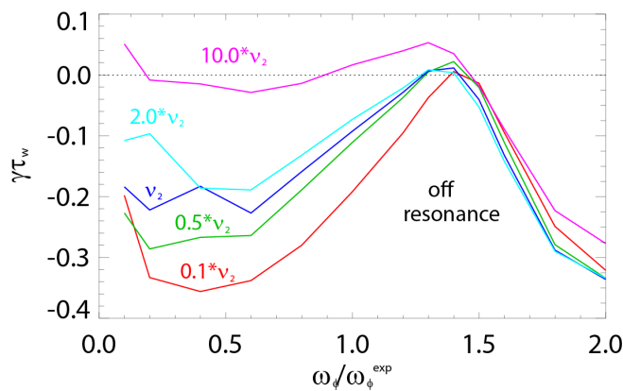
MHD spectroscopy shows improved stability at high β_{N}/l_{i}; kinetic RWM stability to be studied at lower ν in NSTX-U
Resonant Field Amplification (RFA) vs. β_{N}/l_{i}
Theory: RWM γ vs. ν and ω_{φ}
0.1
0.0
-0.1
-0.2
-0.3
-0.4
unstable
mode
Decreasing
Collisionality
Growth rate γτ_{w}
off
resonance
on resonance
0.0 0.5 1.0 1.5 2.0
Rotation ω/ω_{exp}
J.W. Berkery, et al., PRL 106 (2011) 075004
2015 and 2016:
  Investigate the dependence of stability on reduced ν through MHD spectroscopy; compare to kinetic stabilization theory
2017 and 2018:
  Utilize rotation control, NCC, and cryo-pump (for reduced ν) to change proximity to kinetic resonances for RWM control
J.W. Berkery, et al., Phys. Plasmas (2014)
Mode stability directly measured in experiment using MHD spectroscopy
  Decreases up to β_{N}/l_{i} = 10, increases at higher β_{N}/l_{i}
  Agrees with larger NSTX disruption database

Slide 8
Scoping study planned to determine / improve stability of internal (global) MHD modes
Low frequency mode activity measured with multi-energy soft X-ray
NSTX-U: Combinations of NB sources
(steady-state)
L. Delgado-Aparicio
S.P. Gerhardt
Years 2015 and 2016:
  Measure (global) internal modes non-magnetically with ME-SXR, examine vs. r/t model with RWMSC observer
Years 2017 and 2018:
  Examine time-evolution of global mode internalization using newly-installed, additional toroidally-displaced ME-SXR diagnostic
  Combine results with rotation and q control to demonstrate improved RWM/internal MHD mode stability

Slide 9
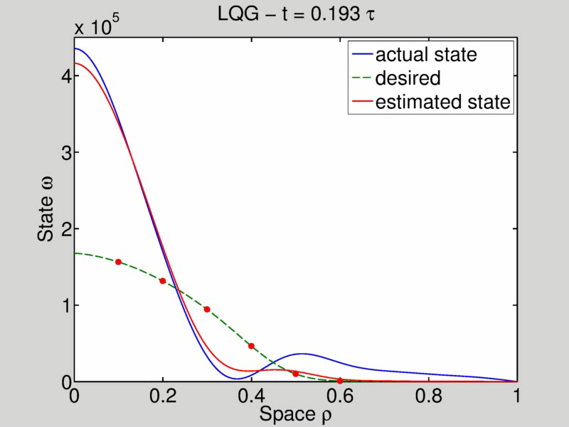
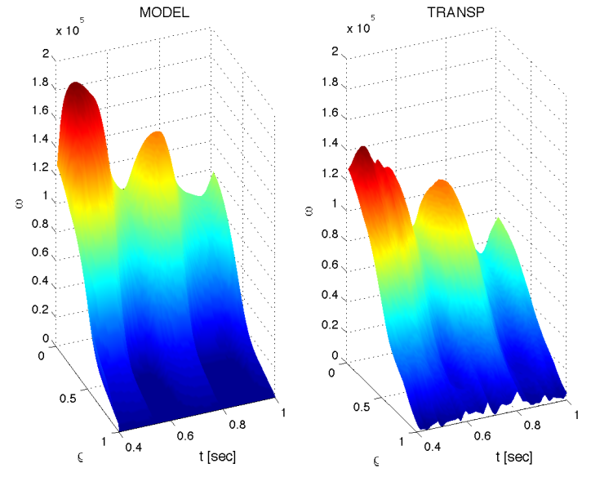
Columbia U. group actively supporting model-based, state-space rotation controller designed to NTV profile as actuator
Momentum force balance – ω_{φ} decomposed into Bessel function states
NTV torque:
(non-linear)
Feedback using NTV: “n=3” δB(ρ) spectrum
State-space model
TRANSP run
133743
Desired
Plant
w/ Observer
Plasma rotation
NTV
region
radius
t(s)
t(s)
I. Goumiri (PU)
  (from Sabbagh, et al. APS DPP 2013)

Slide 10
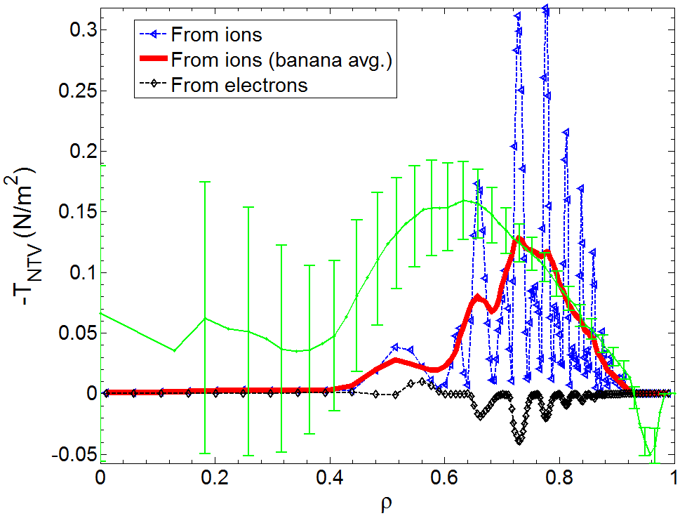
Columbia U. group investigating neoclassical toroidal viscosity (NTV) at reduced ν, important for rotation control
NTV torque profile (n = 3 configuration)
2014:
  Presently analyzing existing Columbia U. NTV experimental data on ν dependence and other NTV characteristics
Years 2015 and 2016:
  Assess NTV profile and strength at reduced ν of NSTX-U, examine NTV offset rotation at long pulse
  Utilize initial real-time model of NTV profile for use in NSTX-U plasma rotation control system
Years 2017 and 2018:
  Utilize NCC, demonstrate low rotation profile operation (ITER-like) in steady-state with closed-loop rotation control
Experimental
-dL/dt
(scaled x 0.51)
NTVTOK
New analysis: NTVTOK code
  Modified for NSTX, incl. Shaing’s connected NTV model, covers all ν, superbanana plateau regimes
  Full 3D coil spec, ions & electrons, all A
  Initial plasma response models include “vacuum field assumption” and M3D-C¹ single and two-fluid models
(Sun, Liang, Shaing, et al., NF 51 (2011) 053015)
(Shaing, Sabbagh, Chu, NF 50 (2010) 025022)
  (with Evans/Ferraro)

Slide 11
Columbia U. group will strongly contribute to disruption prediction in NSTX-U by multiple means
Predictors
Disruption Warning System
Mitigation
γ contours
Control Algorithms
Kinetic Physics
Evaluate simple physics criteria for global mode marginal stability in real-time
Avoidance Actuators
MHD Spectroscopy
Use real-time MHD spectroscopy while varying rotation, q_{min}, and β_{N} to predict disruptions
q, v_{φ} , β_{N} control
Resonant Field
Amplification (G/G)
RWMSC observer
Compare mismatch between the RWMSC observer and sensor measurements, and disruption occurrence
3D fields, feedback

Slide 12
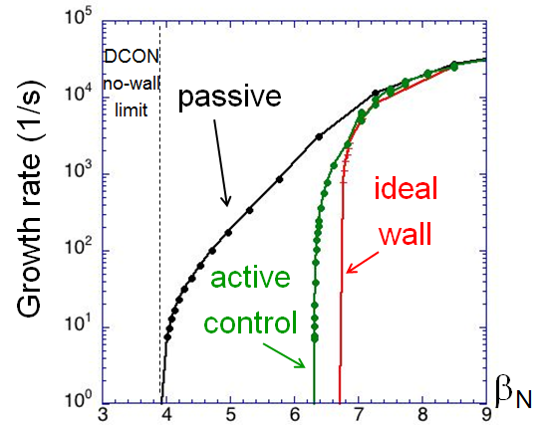
Columbia U. group continues to assess RWM active control capability of the NCC
NCC 2x6 odd parity, with favorable sensors
NCC 2x12 with favorable sensors, optimal gain
Full NCC coil set allows control close to ideal wall limit
  NCC 2x6 odd parity coils: active control to β_{N}/β_{N}^{no-wall} = 1.61
  NCC 2x12 coils, optimal sensors: active control to β_{N}/β_{N}^{no-wall} = 1.70
  (RWM coil β_{N}/β_{N}^{no-wall} = 1.25)
NCC full
2x12 coils
Existing
RWM
coils
NCC partial
2x6 coils
  Design now needs sensor assessment

Slide 13
Columbia U. group will contribute to disruption prediction in NSTX-U by multiple means
2014:
  Continue “benchmarked” MISK code analysis of kinetic RWM stabilization on NSTX database
  Evaluate initial simple physics model for marginal stability based on kinetic stability physics (suitable for r/t use)
Years 2015 and 2016:
  Measure NSTX-U plasma stability using MHD spectroscopy vs. key variables and compare to theory
  Compare the mismatch between the RWMSC observer model and sensor measurements, and disruption occurrence
Years 2017 and 2018:
  Implement real-time evaluations of kinetic stability model, MHD spectroscopy, and RWMSC observer disruption prediction for input to profile control algorithms; use NCC for RWM active mode control

Slide 14
Some Columbia U. group experiments proposed for last NSTX campaign are appropriate to run in NSTX-U
Columbia U. Group 2011-12 Macrostability TSG experiments
Macrostability TSG (proposed for 2011)
  XP1144: RWM stabilization/control, NTV V_{φ} alteration of higher A ST targets (Sabbagh)
  XP1145: RWM state space active control physics (independent coil control)(Sabbagh)
  XP1146: RWM state space active control at low plasma rotation (Y-S Park)
  XP1062: NTV steady-state rotation at reduced torque (HHFW) (Sabbagh)
  XP1111: RWM PID optimization (Sabbagh)
Macrostability TSG (proposed for FY 2012)
  XP1149: RWM stabilization dependence on energetic particle profile (Berkery)
  XP1147: RWM control physics with partial control coil coverage (JT-60SA) (Y-S Park)
  XP1148: RWM stabilization physics at reduced collisionality (Berkery)
  XP1150: Neoclassical toroidal viscosity at reduced ν (independent coil control) (Sabbagh)
(of course) further experiments specific to NSTX-U will be proposed

Slide 15
Ideas to enhance participation in NSTX-U research/program by U.S. Universities, early-career researchers, and students
Columbia U. Group at PPPL has always encouraged students and young researchers (total of 8 since we started)
  Most recent example: co-advising PU student I. Goumiri
  Last Columbia Ph.D. student on NSTX was W. Zhu (Ph.D. 2009)
Key issue in bringing in Columbia students is funding
  Tony Peebles gave excellent summary of significant limitations of present DOE solicitations to universities vs. solicitations to national labs (see Tony’s talk)
  Abed Balbaky (Columbia SEAS EE student) recently very helpful in supporting Columbia reseach plan for NSTX; could not continue at present funding level
    Wrote important modifications to low frequency MHD spectroscopy software
    Supported last paper by J. Berkery, et al.; co-author on two NSTX papers
  At present, co-advising PU students is most logical (doesn’t help home dept.)
With sufficient funding, there are many avenues
  Additionally need exciting/attractive work atmosphere to attract students – difficult to even get office space at the moment
  CU off-campus students face other challenges (e.g. housing / travel costs)

