Slide 1




NSTX-U
Supported by
NSTX-U Collaboration Status and Plans for:
Johns Hopkins University
Coll of Wm & Mary
Columbia U
CompX
General Atomics
FIU
INL
Johns Hopkins U
LANL
LLNL
Lodestar
MIT
Lehigh U
Nova Photonics
ORNL
PPPL
Princeton U
Purdue U
SNL
Think Tank, Inc.
UC Davis
UC Irvine
UCLA
UCSD
U Colorado
U Illinois
U Maryland
U Rochester
U Tennessee
U Tulsa
U Washington
U Wisconsin
X Science LLC
Culham Sci Ctr
York U
Chubu U
Fukui U
Hiroshima U
Hyogo U
Kyoto U
Kyushu U
Kyushu Tokai U
NIFS
Niigata U
U Tokyo
JAEA
Inst for Nucl Res, Kiev
Ioffe Inst
TRINITI
Chonbuk Natl U
NFRI
KAIST
POSTECH
Seoul Natl U
ASIPP
CIEMAT
FOM Inst DIFFER
ENEA, Frascati
CEA, Cadarache
IPP, Jülich
IPP, Garching
ASCR, Czech Rep
Dan Stutman,
Kevin Tritz, Jorge Munoz Burgos (Aug. 2014)
NSTX-U Collaborator Research Plan Meetings
PPPL – LSB B318
April / May 2014

Slide 2
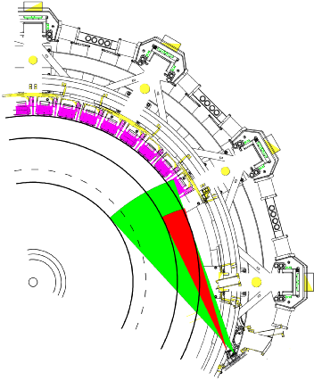
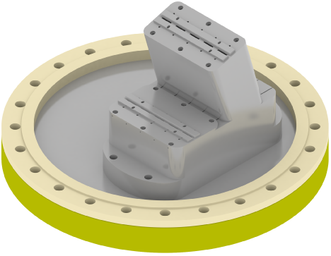
FY14 status in preparation for FY15 operations (1)
New Core/Edge ME-SXR arrays (2x100 channels)
  Detectors, port electronics, DAQ components ready
  Mechanical and port integration design ready for FDR review
  Installation end of this summer
    Spatial calibrations after FY15 run (not needed with new NN analysis)
Transmission Grating Imaging Spectrometer (TGIS)
  Fast detector upgrade (from 400 to 20 ms)
  Tested and calibrated in the lab
  Installation before FY15 physics run
NSTX-U ME-SXR system
core Δr: 3 cm
edge Δr: 1 cm
Speed: 10 kHz
10 energy bands

Slide 3
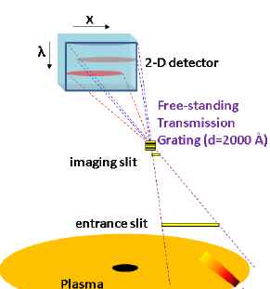
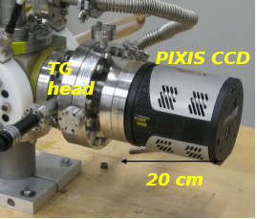
FY14 status in preparation for FY15 operations (2)
Poloidal USXR arrays operational
  Sharing D-tacq DAQ system with ME-SXR
Partnering with LLNL to implement impurity LBO system
TG Imaging Radiometer (TGIR) successfully tested on LTX
  Developed under Advanced Diagnostics program
  Ready for further testing on NSTX upper divertor

Slide 4
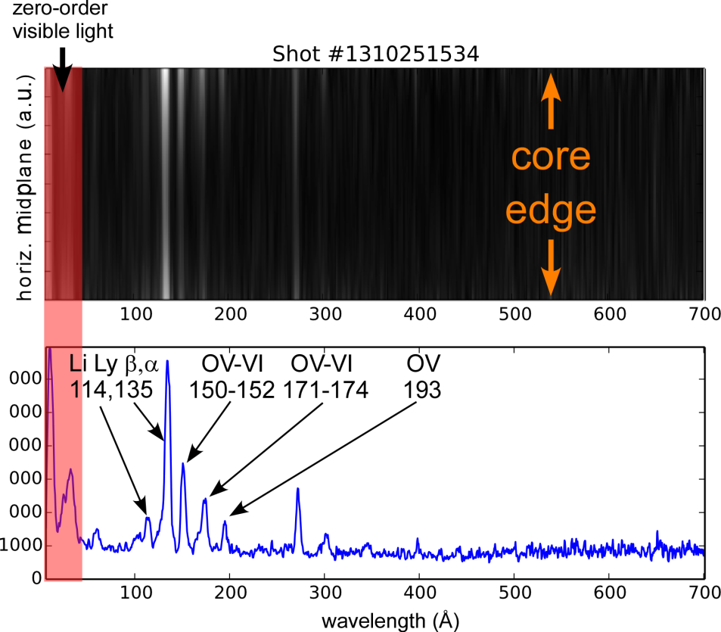
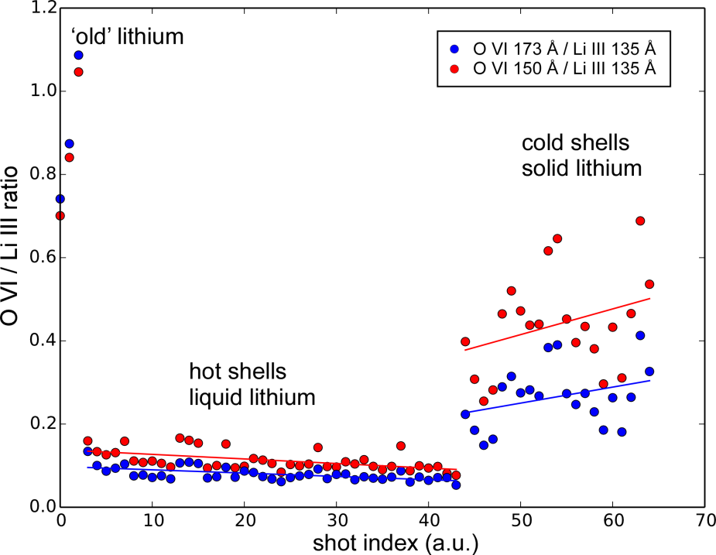
TGIR on LTX reveals effects of solid/liquid lithium PFC on oxygen impurity
TGIR space resolved XUV spectrum
O VI / Li III Ratio
‘Old’ lithium
Cold shells
solid lithium
Hot shells
liquid lithium
K. Tritz et al, in preparation

Slide 5
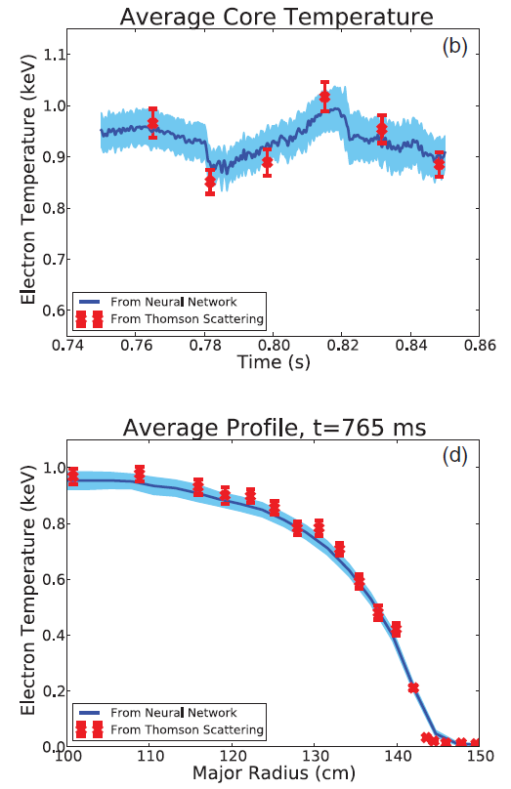
Research Plans for FY2015 and FY2016 (1)
Provide routine fast ME-SXR T_{e} profiles
  10 kHz T_{e}(r) diagnostic [1]
  Neural network analysis:
  ME-SXR + MPTS + TGIS
Rebase NSTX ME-SXR edge and core transport results
  Impurity transport using Neon gas puffs [2-4]
  Perturbative electron transport using ELMs [5]
  GAE intermittent electron transport using new fast T_{e} capability [6]
D. Clayton et al PPCF 2014
ME-SXR
Thompson

Slide 6
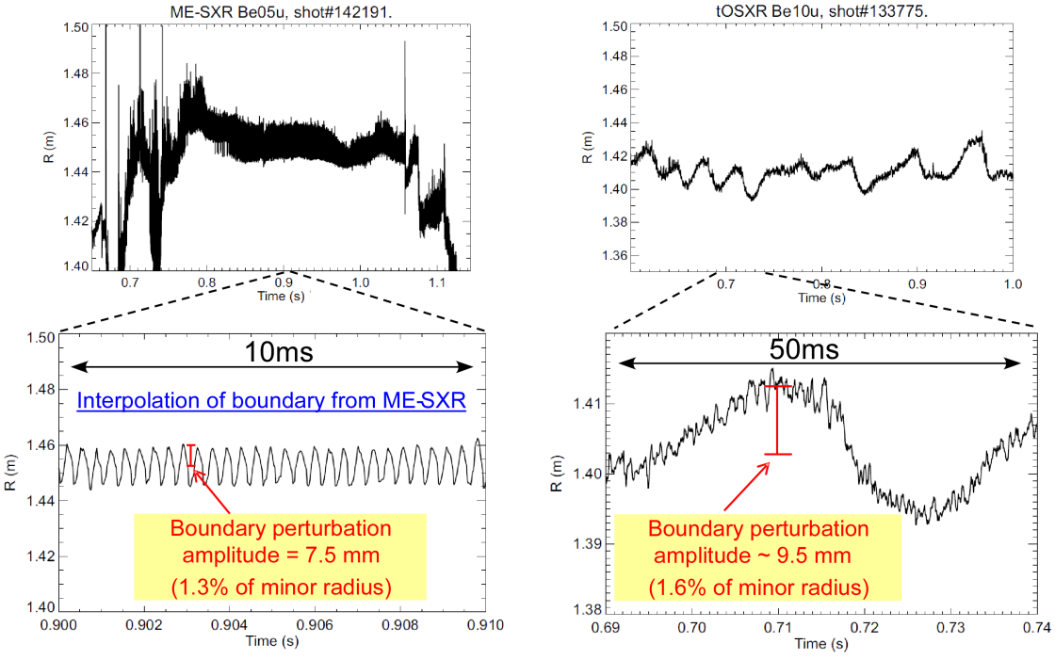
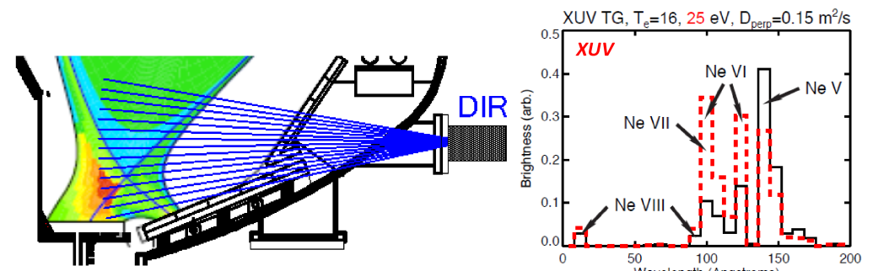
Research Plans for FY2015 and FY2016 (2)
ME-SXR with repetitive LBO for multi-channel transport
  Evaluate neural networks for transport analysis (STRAHL/TRANSP)
ME-SXR boundary diagnostic
  MHD radial displacements [7], ELM and RWM dynamics [8]
Computational study of TGIR based divertor T_{e} and impurity diagnostic using neural networks
ME-SXR boundary displacement
Divertor TGIR concept
Core 1/1 kink
n=1 external kink/RWM
Wavelength (Å)
K. Tritz et al, in preparation D. Clayton et al RSI 2012

Slide 7
Ideas to enhance participation in NSTX-U research/program by U.S. Universities, early-career researchers, and students
Stabilize funding to prevent loss of personnel and
to enable engaging graduate students in research

Slide 8
Highest-priority incremental measurement capability
(For diagnostic solicitation grantees funded for 2012-2015)
Additional D-Tacq DAQ system to enable simultaneous operation of core/edge ME-SXR and poloidal USXR arrays
  At present we can run only 2 of 3 systems simultaneously
XUV CCD detector for core TGIS spectrometer
  Eliminate complex differential pumping system
  Significantly improve measurement linearity and SNR
  Enable synchrotron absolute calibration

Slide 9
References
“Electron temperature profile reconstructions from multi-energy SXR measurements using neural networks” D.J. Clayton, K. Tritz, D. Stutman, R.E. Bell, A. Diallo, B.P. LeBlanc, M. Podesta`, Plasma Phys. Contr. Fus., 55, 095015 (2013)
“Multi-energy Soft-x-ray Technique for Impurity Transport Measurements in the Fusion Plasma Edge” D.J. Clayton, K. Tritz, D. Stutman, M. Finkenthal, S.M. Kaye, D. Kumar, B.P. LeBlanc, S. Paul, S.A. Sabbagh, Plasma Phys. Contr. Fus., 54, 105022 (2012)
“Impurity Transport Experiments and Effects on MHD in the National Spherical Torus Experiment (NSTX)” L. Delgado-Aparicio, D. Stutman, K. Tritz, F. Volpe, K.L. Wong, R.E. Bell, M. Finkenthal, E. Fredrickson, S.P. Gerhardt, S.M. Kaye, B.P. LeBlanc, J.E Menard, S. Paul, L. Roquemore, Nucl. Fus., 51, 083047 (2011)
“ Impurity transport measurements in beam heated low-confinement mode discharges in the National Spherical Torus Experiment” D. Stutman, M. Finkenthal, R.E. Bell, S.M. Kaye, B.P. LeBlanc, J.E Menard, E.J. Synakowski, D.S Darrow, V. Soukhanovskii, C. Bourdelle, Phys. Plasmas, 10, 4387 (2003)
“Relationship between edge localized mode severity and electron transport in the National Spherical Torus Experiment” K. Tritz, S.M. Kaye, R. Maingi, S.A. Sabbah, D. Stutman, R.E. Bell, L. Delgado-Aparicio, C.W. Somier, M. Finkenthal, B.P. LeBlanc, W. Lee, N.C. Luhmann, E. Mazzucato, H. Park, D.R. Smith, Phys. Plasmas, 15, 056119 (2008)
“Correlation between electron transport and shear Alfven activity in the national spherical torus experiment” D. Stutman, L. Delgado-Aparicio, N. Gorelenkov, M. Finkenthal, E. Fredrickson, S.M. Kaye, E. Mazzucato, K. Tritz, K., Phys. Rev. Let., 102, 115002 (2009)
“Three dimensional distortions of the tokamak plasma boundary: I. Boundary displacements in the presence of saturated MHD instabilities” I.T. Chapman, D. Brunetti, P. Buratti, W.A. Cooper, J.P. Graves, J.R. Harrison, J. Holgate, S. Jardin, S.A. Sabbagh, K. Tritz, submitted Nucl. Fus. (2014)
“Soft X-ray Measurements of Resistive wall mode Behavior in NSTX” L. Delgado-Aparicio, D. Stutman, S.A. Sabbagh, R.E. Bell, J.W. Berkery, K. Tritz, S.P. Gerhardt, B.P. LeBlanc, M. Finkenthal, J.P. Levesque, K.C. Lee, J.E. Menard, S. Paul, L. Roquemore, Plasma Phys. Contr. Fus., 53, 035005 (2011)

