Slide 1


LLNL-operated diagnostics in support of NSTX-U Research Program
V. A. Soukhanovskii, F. Scotti, M. Weller,
P. Beiersdorfer, E. Magee, T. Rognlien
NSTX-U diagnostic collaborator research plan meeting
PPPL
17 May 2016

Slide 2
LLNL Collaboration Research Focus Areas support NSTX-U priorities in FY2016-2018
Scrape-off Layer and Divertor physics
  Snowflake divertor transport, turbulence and radiation
  Radiative (detached) divertor and detachment front control
  Experiment support for cryo-pump design
Plasma-surface interactions and material migration
  Divertor and wall recycling with lithium
  Divertor and wall material erosion and migration
  Mixed-material interactions (Li, B, C, O, Mo, W)
Core impurity studies
  Low and high-Z impurity transport
  Laser blow-off impurity injector for impurity transport experiments
  Impurity spectroscopy and Atomic physics
Coaxial helicity injection (CHI) modeling
  NIMROD modeling of MHD effects on CHI
LLNL leads experiments, diagnostic development and operation, and edge modeling in these areas on NSTX-U

Slide 3
LLNL collaboration supports a number of edge and core diagnostics on NSTX-U to enable divertor, plasma-surface interaction and impurity transport studies
Diagnostic
1. EIES (Edge Impurity Emission Spectroscopy, aka Filterscopes)
2. LADA (Lower divertor radiometer AXUV diode array)
3. 1D CCD arrays (Lower divertor, Upper divertor, Center Stack)
4. Divertor SPRED (VUV spectrometer)
5. UV-VIS survey spectrometer VIPS2
6. UV-VIS imaging divertor spectrometer DIMS
7. Divertor Control Spectrometer DIBS (Lower divertor)
8. NIRS (Near-Infrared Spectrometer, 800 – 2200 nm)
9. Divertor imaging cameras (three Phantom, Lower divertor and Upper divertor)
10. Divertor Turbulence and Control Camera (Phantom, lower divertor)
11. Duo-chromatic divertor imaging radiation-hardened cameras TWICE (two CIDTEC cameras )
12. ENDD (Edge Neutral Density Diagnostic) camera
13. Optical Penning Gauge
14. EUV spectrometer (MonaLisa, 60-220 Å region)
15. EUV spectrometer (LoWEUS, 220 - 400 Å region)
16. EUV spectrometer (XEUS, 5 - 60 Å region)
17. Laser Blow-Off system

Slide 4
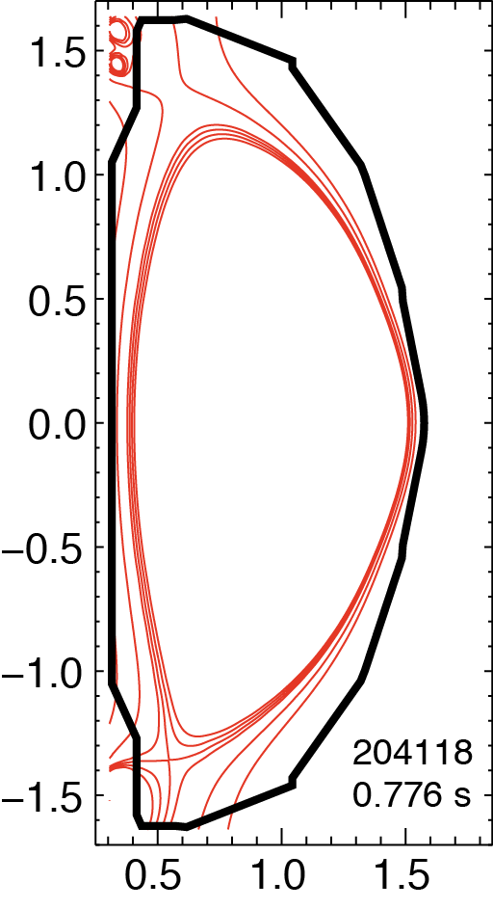
1. EIES (aka filterscopes): monitoring of edge recycling and impurity emissions for operations and protection
NSTX and NSTX-U system summary at
  http://nstx.pppl.gov/DragNDrop/Operations/Diagnostics_&_Support_Sys/EIES/
EIES - about 32 channels, each includes
  TFTR-age high voltage power supply
  TFTR-age PMT in shielded housing
  New 1” narrow band-pass interference filter
  2 kHz amplifiers
One tunable EIES channel
  0.3 m monochromator with accurate wavelength calibration and PMT detector
  Can be tuned to any line 400-700 nm, any sightline
Fast EIES – 5 channels (20 kHz) for IGI
  B II, B III, Li I, Li III, C II, CIII ,C IV filters to monitor granule penetration
ORNL fast (<50 kHz?) filterscopes for ELM detection
  4-channel module being installed
Main sightlines
  Bay D top, viewing entire lower divertor
  Bay E bottom, viewing entire upper divertor
  Bay I midplane, viewing CS (spot 2 cm diameter)
  Bay G tangential midplane, VB monitor view
  Bay L midplane (CHERS fiber mount), edge views

Slide 5
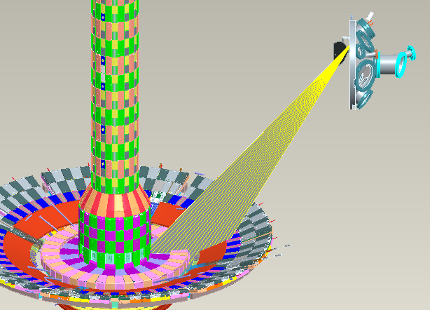
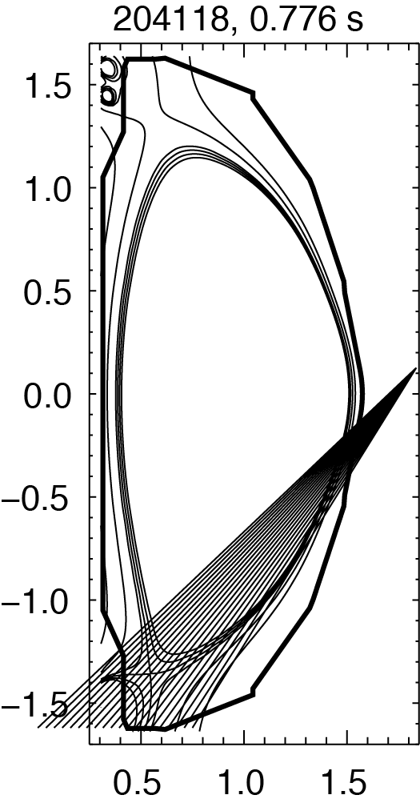
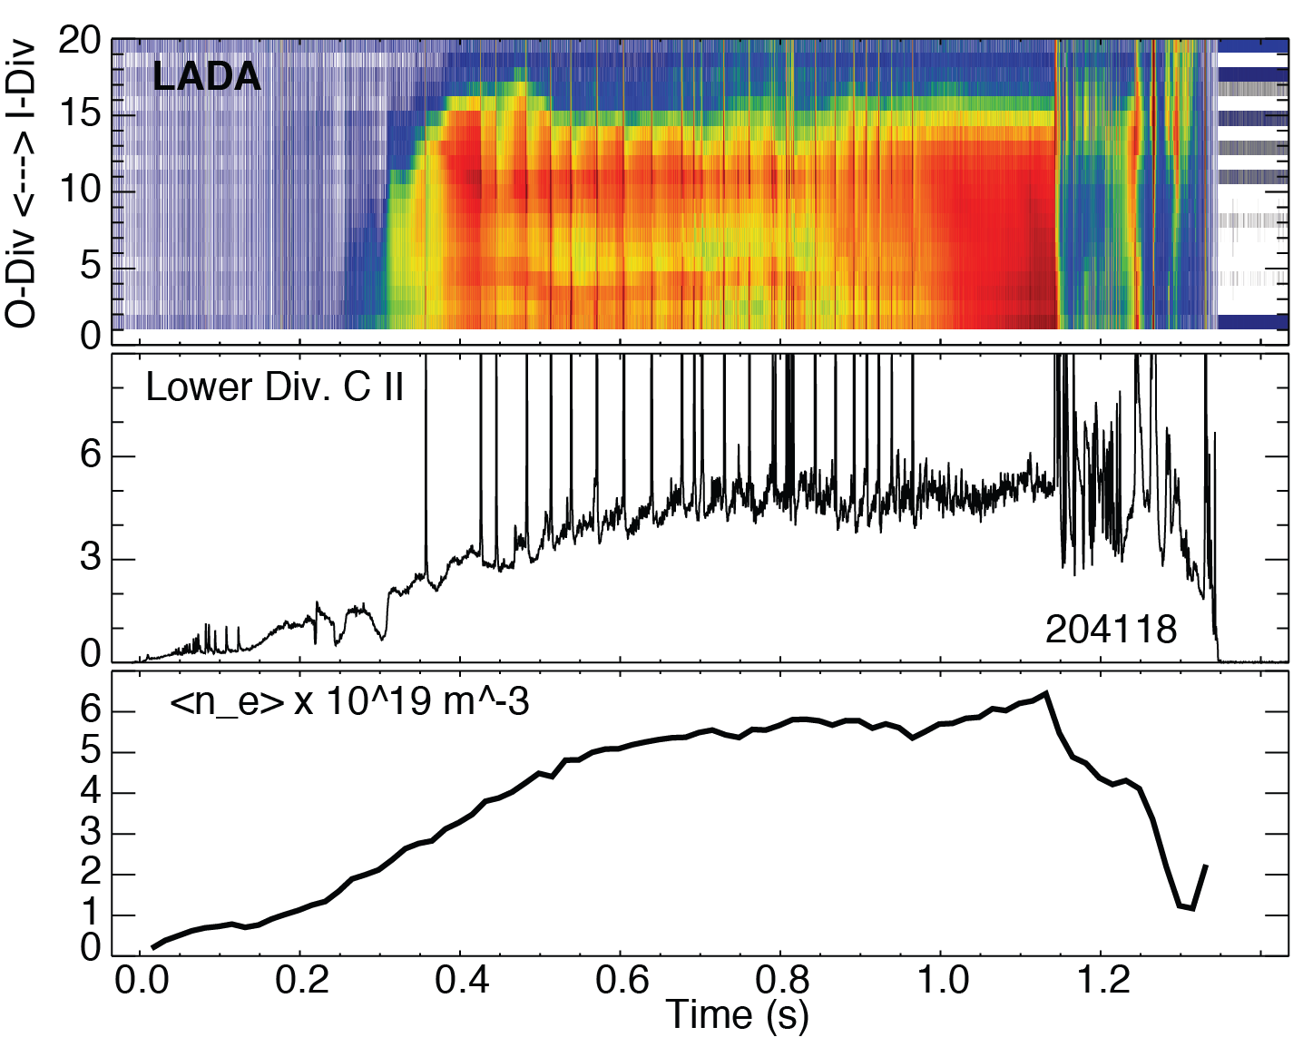
2. LADA: Lyman-α AXUV diode array is used as divertor radiometer in NSTX-U
Described in V. A. Soukhanovskii, RSI 81, 10D723 (2010)
LADA – Lyman Alpha (Ly_{α}) Diode Array
  Operated without Ly-alpha filter (2016)
  20-channel AXUV-20EL diode array from IRD
  20-channel 10 kHz trans-impedance amplifier from Clear-Pulse, Inc.
  D-tacq data acquisition module
  cm-scale resolution in lower divertor
LADA placement on NSTX (and NSTX-U).

Slide 6
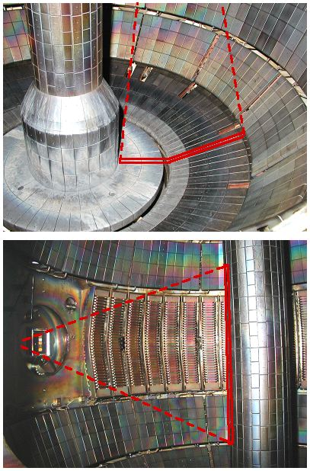
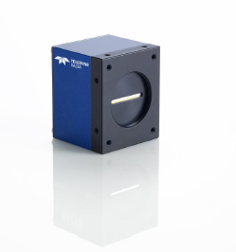
3. 1D CCD arrays: high spatial and temporal resolution recycling and impurity emission profiles for physics analysis
Described in V. A. Soukhanovskii, RSI 74, 2093 (2003)
  New DALSA Spider 3 SG-14 cameras (36 kHz, 1024 pixels, GigE)
  Primary data for edge transport code comparisons
  Used for recycling, ELM, impurity analysis
NSTX-U system includes 3 views at 3 wavelengths
  Bay D top, viewing lower divertor (3 cameras)
  Bay E bottom, viewing upper divertor (3 cameras)
  Bay B midplane, viewing CS (3 cameras)
Redesigned optics and detector system
  Imaging lens on port
  Schott 15 ft fiberoptic bundle
  Detector box with image splitter, lenses, filters and 3 cameras
  Candidate filters D_{β}, C II, and Li I, possible filter wheel
Need to develop data acquisition system
  Looking into options, 1 PC per three cameras
  Considering Linux and Python based solution
1D CCD views.
A DALSA Spider 3 camera.

Slide 7
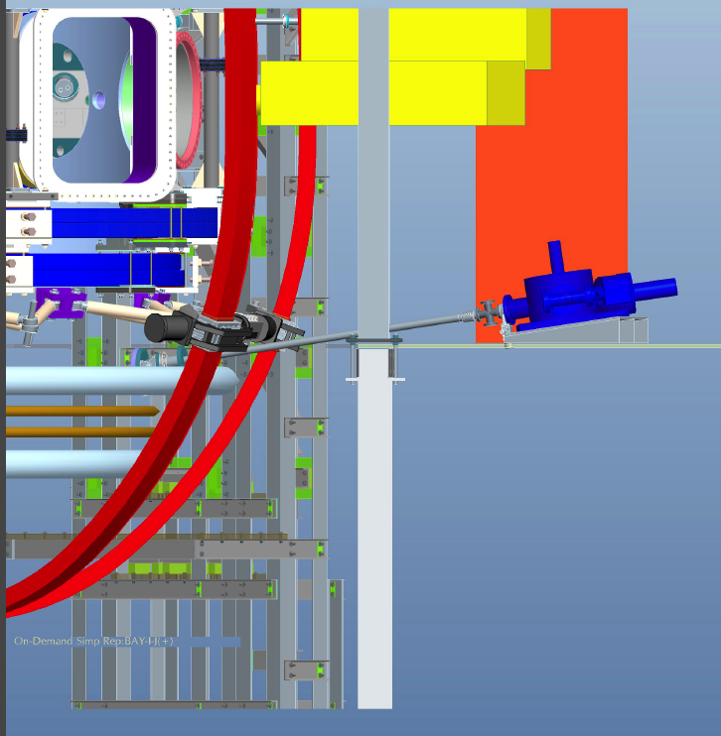
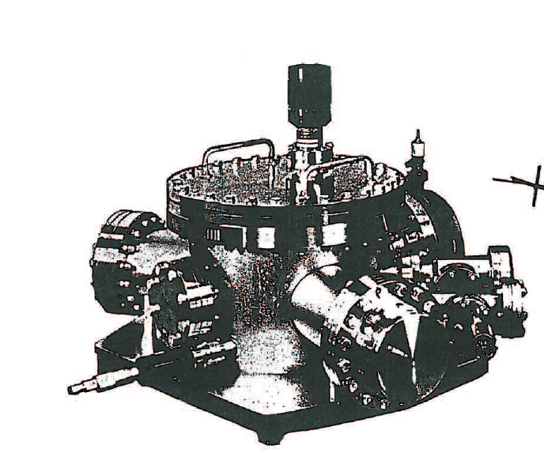
4. Divertor SPRED VUV spectrometer for impurity emission measurement in outer divertor leg, real-time T_{e}
Steady-state and transient divertor impurity measurements
  Li II-III, C II-IV, N II-V, Ne, Ar, Mo, W line emission
  Radiative divertor control via T_{e} analysis
12.5’ fiberoptic imaging bundle
Shielded CCD detector
Divertor SPRED spectrometer
  McPherson Model 251 flat-field 0.3 m spectrograph (Weight: 250 lb)
  Two-grating turret with Au-coated gratings 290 and 2105 l/mm
  MCP-based detector with CsI-coated photocathode and P46 phosphor
  Ion pump with controller
  Schott 12 ft imaging bundle 25x4 mm
  Princeton Instruments Pro-EM 1600x200 camera
Divertor SPRED
Described in V. A. Soukhanovskii, APS DPP 2015; HTPD 2016 poster, RSI paper to be submitted

Slide 8
5. UV-VIS spectrometer VIPS2: general purpose surveys for wall conditioning studies
Described in V. A. Soukhanovskii, RSI 77, 10F127 (2006)
Applications on NSTX-U
  H/D ratio monitoring
  Survey of impurity emissions
  Penning, GDC emission studies
VIPS 2 spectrometer
  Acton Research SpectraPro 500i, 0.5 m, f / 6.5 Czerny-Turner scheme
  Three gratings: 600, 1200, 2400 l/mm
  CCD detector - 1340 x 100 pixel Princeton Instruments Model Spec-10:100B
  4-fiber input interface
  Presently connected to Bay D Lower divertor, Bay E upper divertor, Bay B midplane EIES sightlines
VIPS2 divertor lines of sight

Slide 9
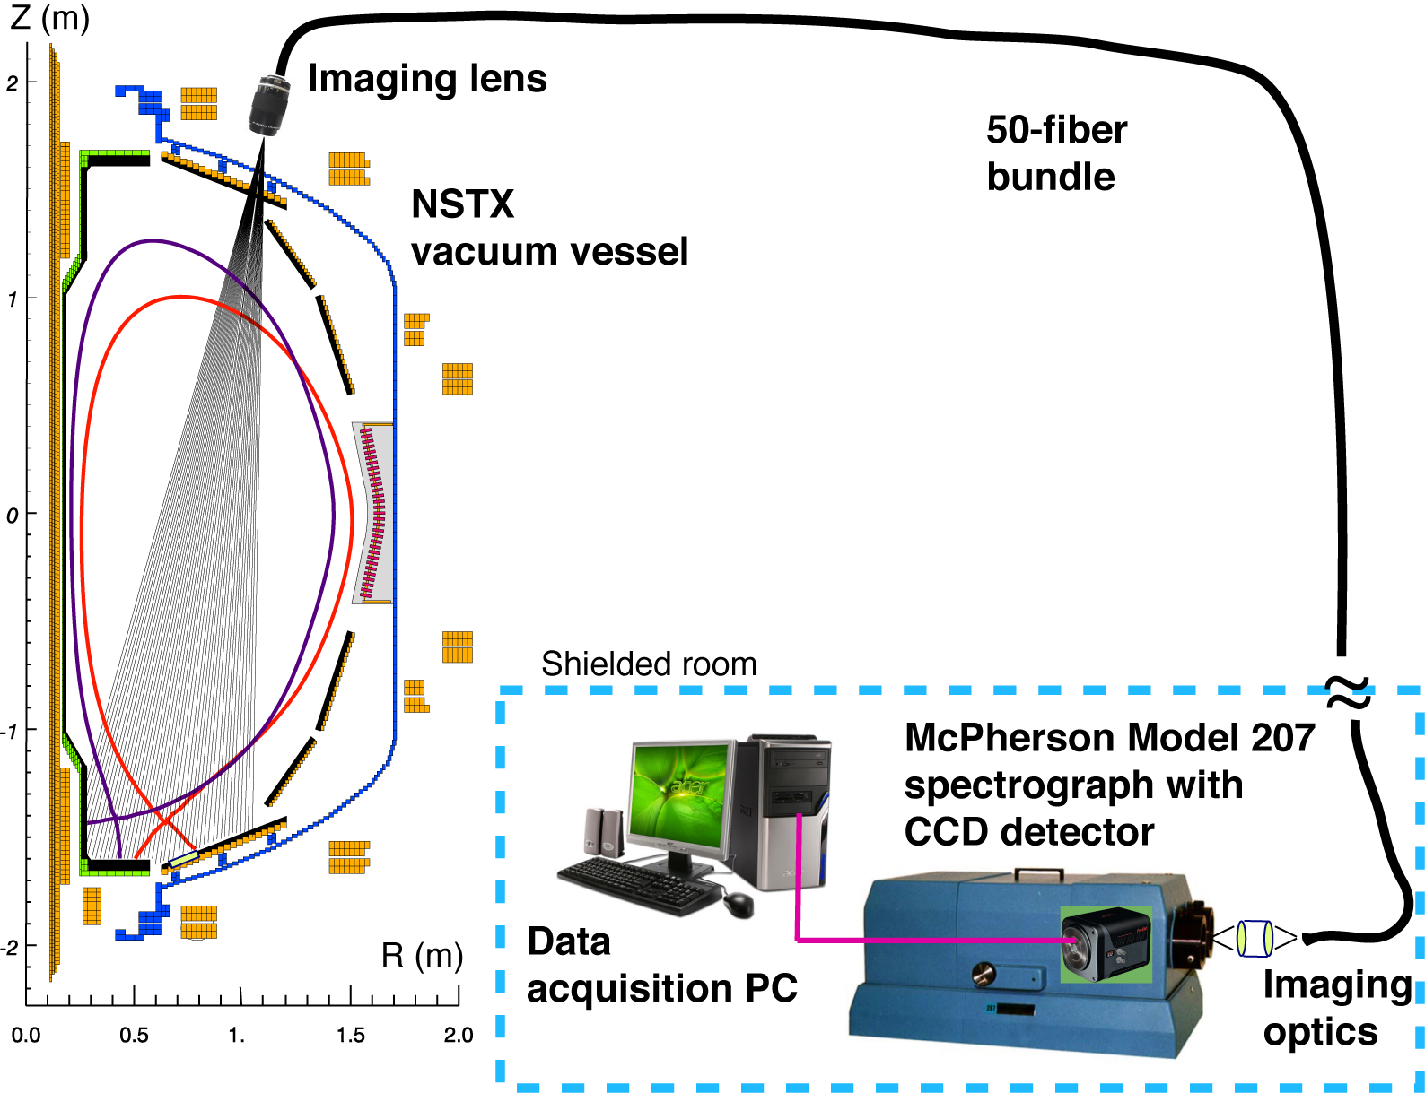
6. UV-VIS-NIR DIMS divertor imaging spectrometer designed for impurity profile and T_{i} measurements
Described in V. A. Soukhanovskii, RSI 81, 10D723 (2010)
DIMS – Divertor Imaging Spectrometer
  high-resolution imaging spectroscopy from 250 nm to 1100 nm
  18-chord divertor profiles with 1 cm spatial resolution, 1-10 ms time resolution
  Tochigi Nikon UV 105mm f/4.5 imaging lens
  50-fiber optical relay bundle, 400-um FBP400 broadband fibers from Polymicro, Inc.
  McPherson Model 207 R=0.67 m f/4.7 spectrograph
  Three gratings (3600, 2400, 1800 lines/mm) for ultraviolet, visible, and near-infrared line spectra
  Princeton Instruments Pro EM 512 CCD camera
DIMS lines of sight and layout

Slide 10
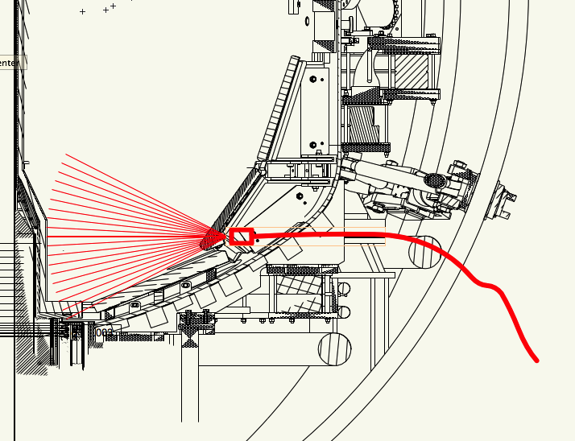
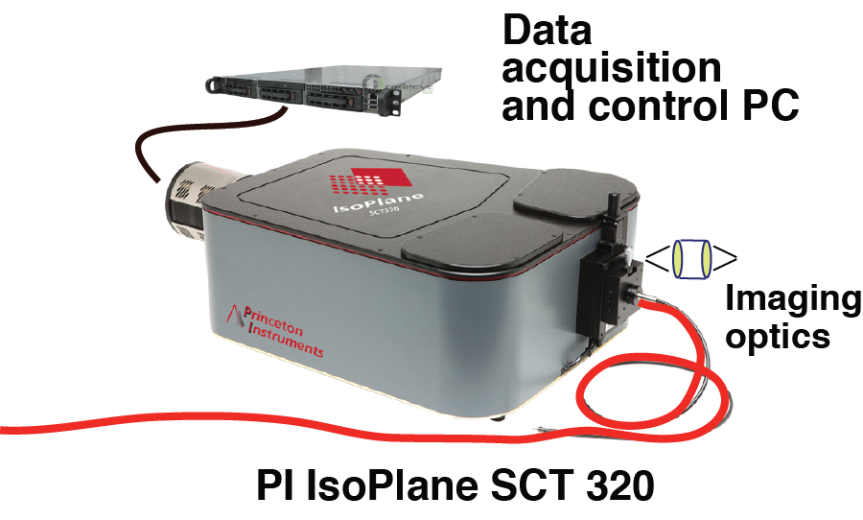
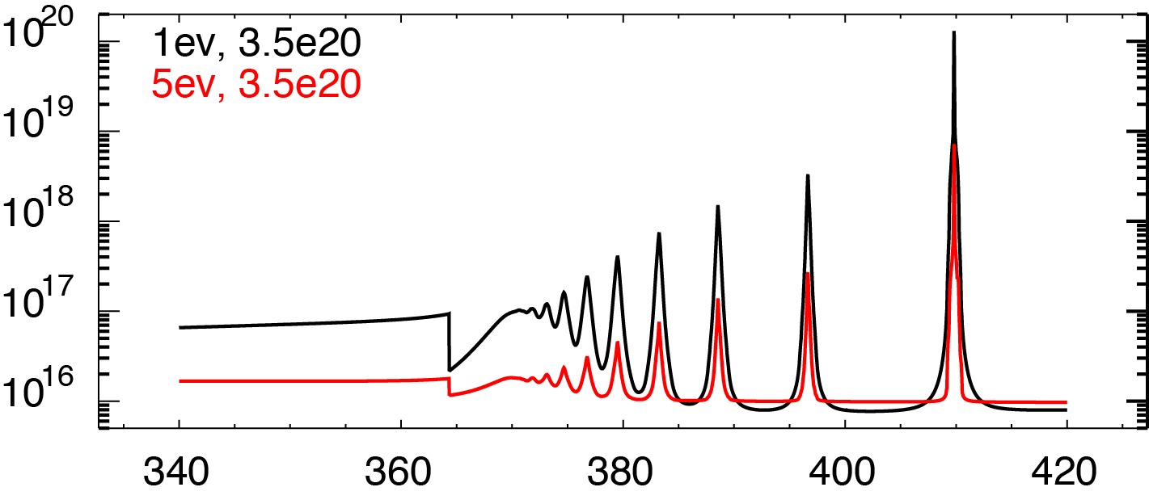
7. Divertor Imaging Balmer Spectrometer (DIBS) enables fast line and continua meas’ts for radiative divertor control
26-fiber bundle (Radiation resistant Molex FVP 200 um)
10-fiber bundle (Molex FBP 200 um)
30 m length
Kogaku 8 or 12 mm imaging UV lens
Fiber projection spot size 2-6 mm
SCT 320 Czerny-Turner-Schmitt spectrograph
  600, 1200, 1800 gr/mm UV-VIS 68 mm gratings
CCD camera PI ProEM 1600x400
Real-time DAQ via WinSpec32 (pvcam)
Described in V. A. Soukhanovskii, APS DPP 2015; HTPD 2016 poster, RSI paper to be submitted
Multi-chordal deuterium and impurity measurements for
  Radiative divertor control via T_{e}
  Recombination front studies
  Divertor C, N, Ar, Mo, .. distribution
Simulated DIBS Balmer series spectra

Slide 11
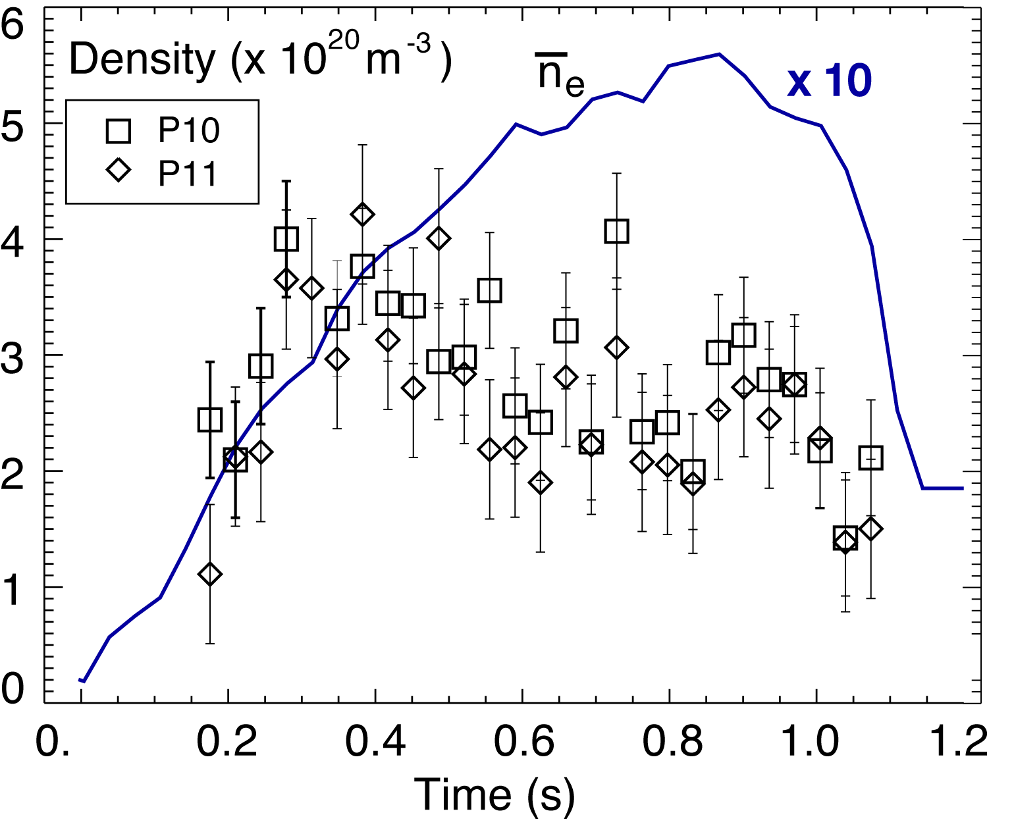
8. Near-Infrared Spectrometer (NIRS) to be used for divertor impurity and detachment studies
  Described in
  V. A. Soukhanovskii et. al. Rev. Sci. Instrum. 77, 10127 (2006)
  V. A. Soukhanovskii, Rev. Sci. Instrum. 79, 10539 (2008)
    V. A. Soukhanovskii, RSI 85, 11E418 (2014)
    ICAPiP 2016 Invited Talk
  Measurement goals
  Evaluate NIR spectroscopy application for ITER
  Paschen series and Brackett series lines in DIII-D divertor for T_{e} and n_{e}
NIRS is currently operating at DIII-D
NIRS includes
  Princeton Instruments OMA V
  1024-2.2 detector (LLNL)
  Acton SP2500 spectrometer
    (previously SP300i)
    Focal length 500 mm
    Three NIR-blazed gratings on a turret
NSTX divertor density from Paschen line Stark broadening
DIII-D divertor spectrum

Slide 12
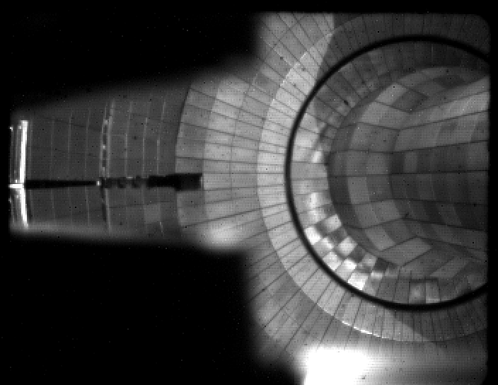
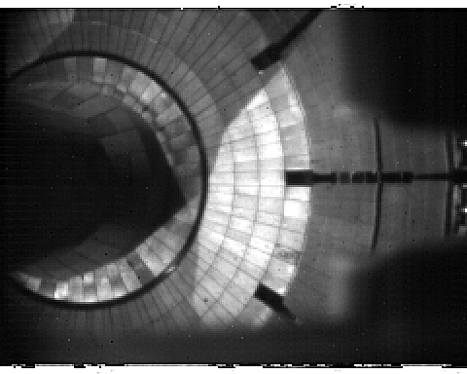
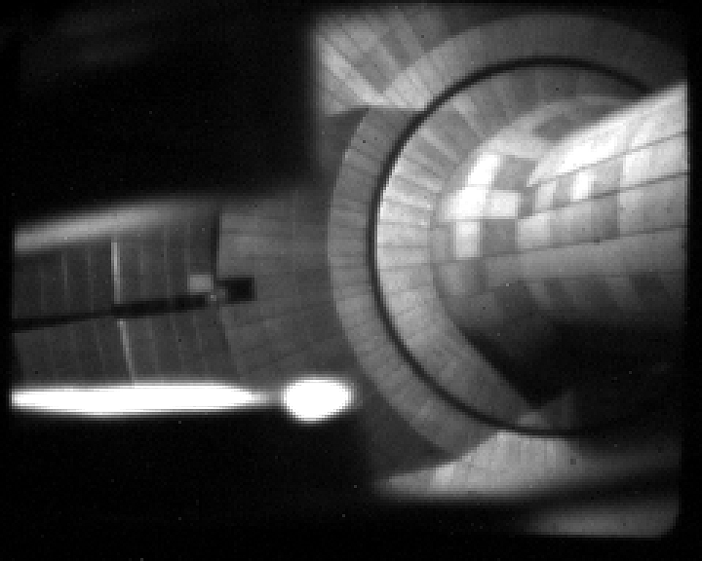
9. Photometrically-calibrated, fast cameras with wide angle view provide full toroidal divertor imaging
Described in F. Scotti, RSI 83, 10E532 (2012)
Cameras Phantom v710, Phantom v7.3, Miro 4
Spatial resolution better than 1cm/pixel, framing 10-100kHz w/o cropping
Fast optics and narrow bandpass filters allow studies of impurity emission, non-axisymmetric effects, turbulence
Available filters: C I, C II, C III, C IV, B III, Li I, Li II, D-α, D-γ, Gero band (CD), O II on remotely controlled filter wheels
Lower divertor view (Bay E)
Lower divertor view (Bay J)
Upper divertor view (Bay H)

Slide 13
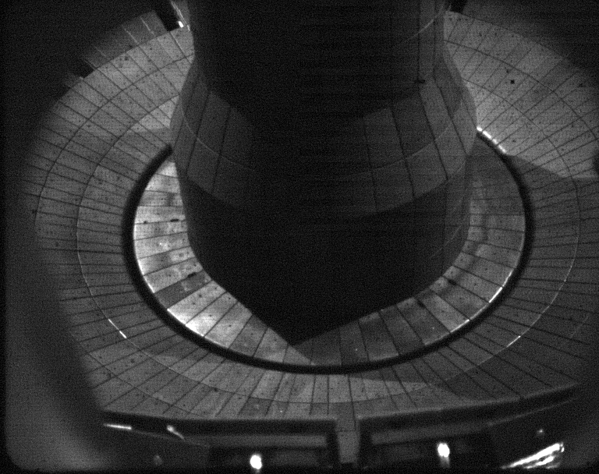
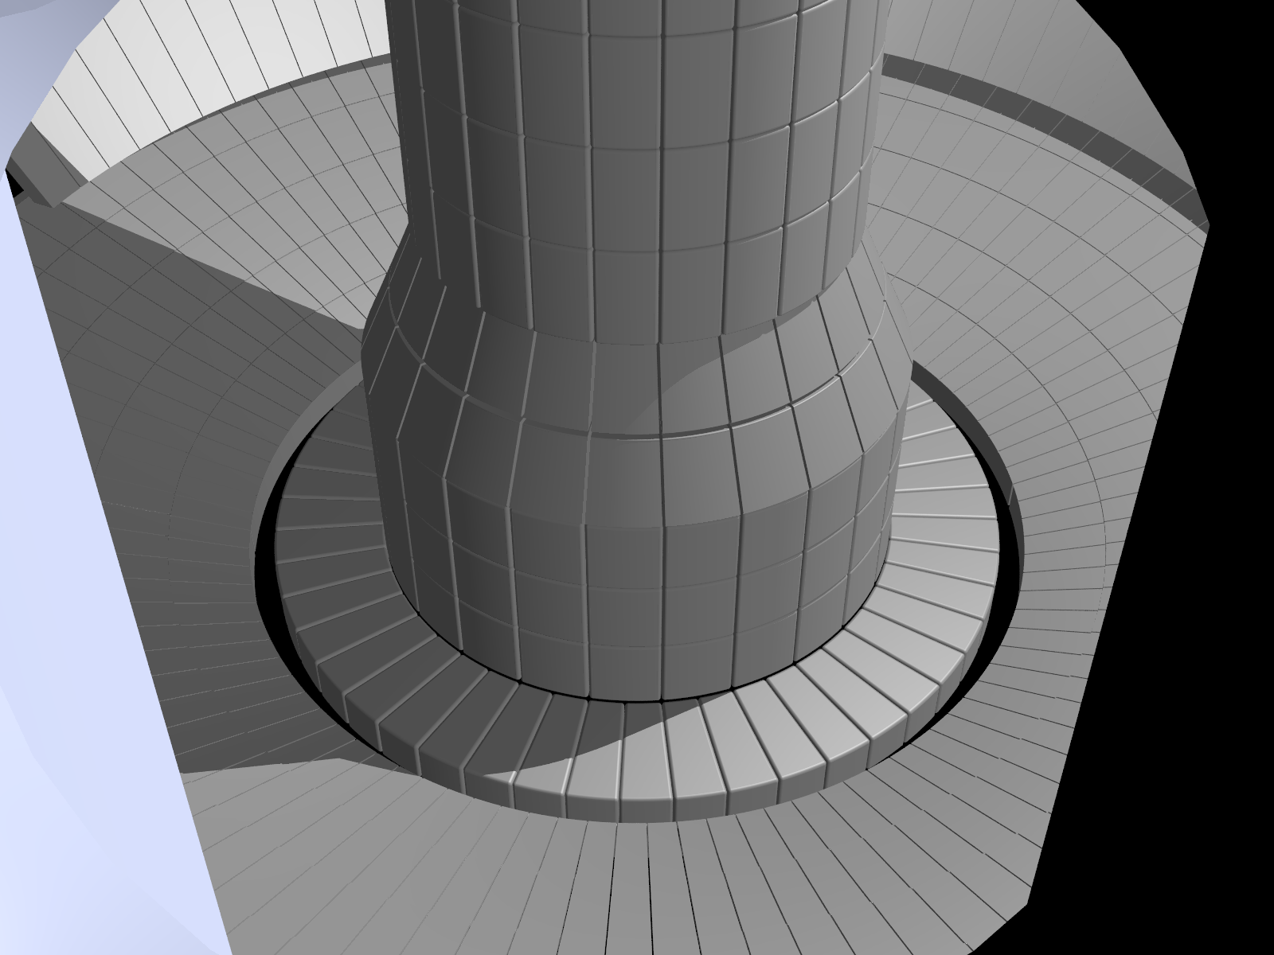
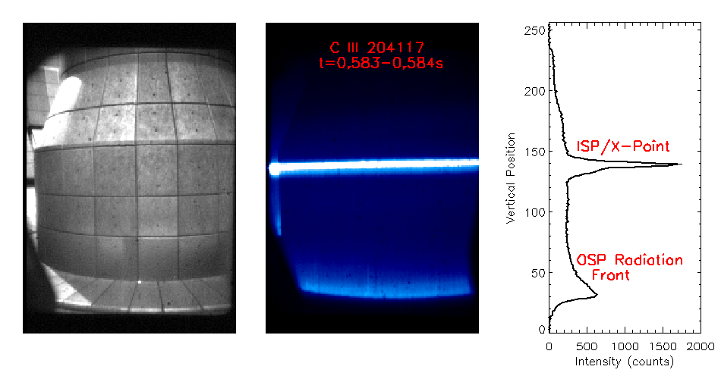
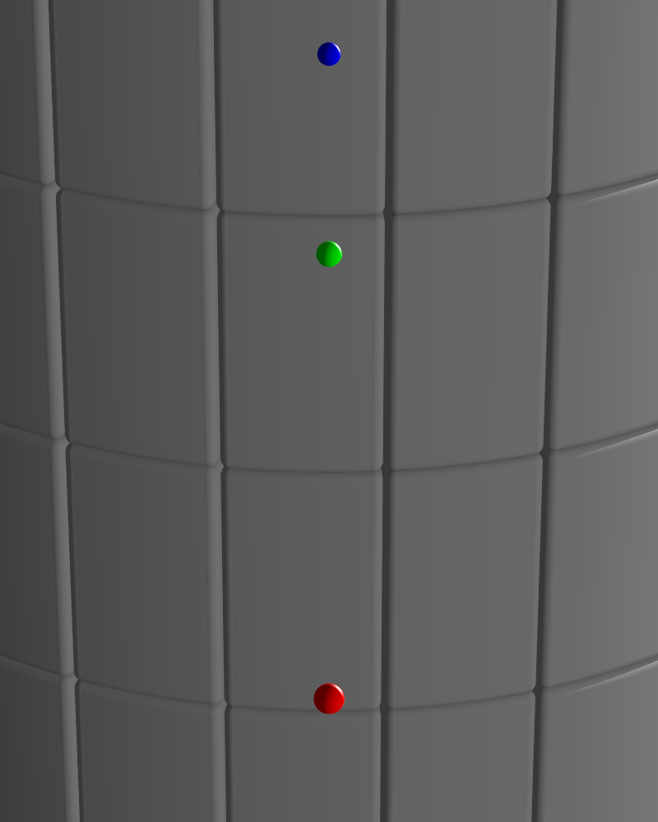
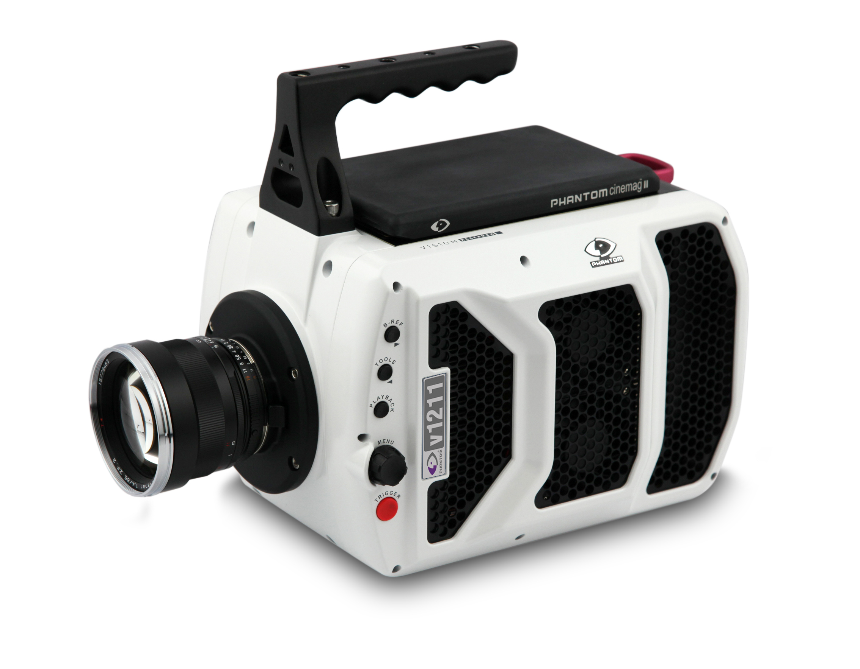
10. New LLNL Phantom camera dedicated to divertor turbulence, divertor control, LGI imaging
Described in F. Scotti, APS 2015
Physics goals
  Support divertor turbulent filaments measurements
    Cross correlation with midplane blobs (GPI)
    Churning mode studies in snowflake configurations
  Support radiative divertor control via imaging of carbon radiation front
  LGI granule emission imaging
Two setups will be used for turbulence studies and radiative divertor control
  Midplane port (6” flange) on Bay J port cover
  Radial divertor port (2” window) on Bay B lower dome
New Vision Research Phantom v1211 camera
  Coherent fiber bundle 1000x800 10 μm fibers, 15’ long
  1:1 imaging on detector
  Resolution: 360x288 pixels (crop 360x100)
  Max fps: 76.6kHz (crop 182.7kHz),
  Max. recording time: 2s
Lower divertor from Bay J mid
POV-Ray
Lower divertor from Bay B H.Div.
3 granules:
  Ψ_{N}=0.6
  Separatrix
  Limiter
Rendered field of view (POV-Ray) with imaging bundle and 50 mm lens

Slide 14
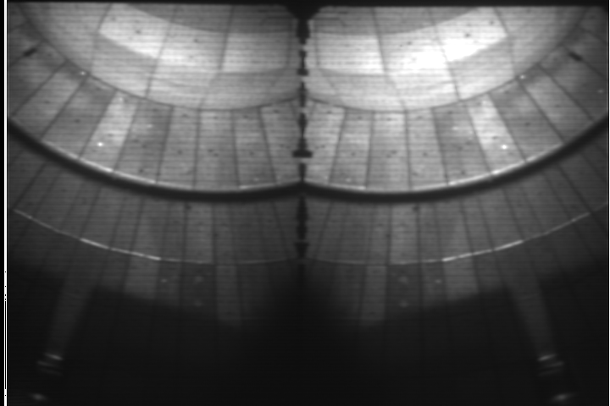
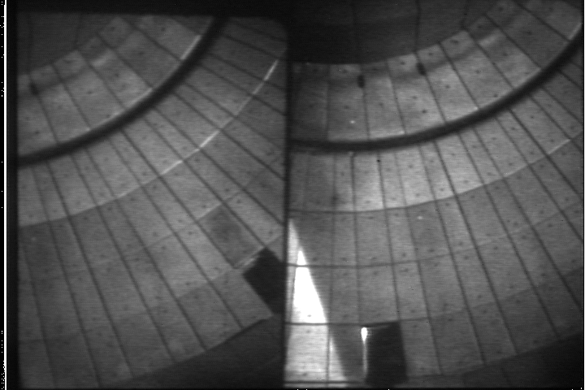
11. Duo-chromatic intensified camera systems (TWICE-1,2) for mixed material plasma surface interaction studies
Described in F. Scotti, RSI 86, 123103 (2015);
  Single filtered cameras described in
    M. E. Fenstermacher,W. H. Meyer, R. D.Wood, D. G. Nilson, R. Ellis, and N. H. Brooks, Rev. Sci. Instrum. 68, 974 (1997)
    A. James et.al.,, Plasma Phys. Control. Fusion 55, 125010 (2013)
Duo-chromatic imaging with rad-hardened intensified cameras
  ThermoScientific CIDTEC cameras CID8710, CID 3710
  VGA resolution (720x480) – 8 bit, 30 Hz interlaced
TWICE-I
  Beam splitter for simultaneous 2-color imaging on same detector
  Four filter wheels (2 for bandpass filters, 2 for neutral density filters)
  B I, B II, Li I, D- γ, CD, O-II
TWICE-II
  2.5x higher light throughput, 2 orders of magnitude higher intensifier
  Fixed filters, currently dedicated to CD/D γ
TWICE-I (Bay J)
TWICE-II (Bay I)

Slide 15
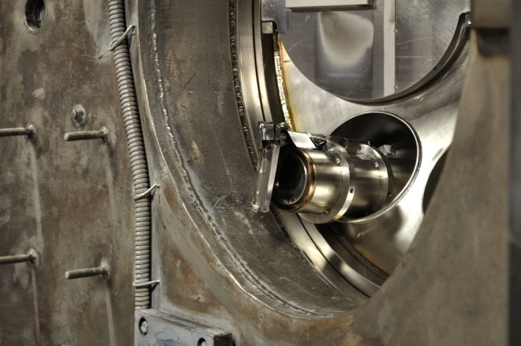
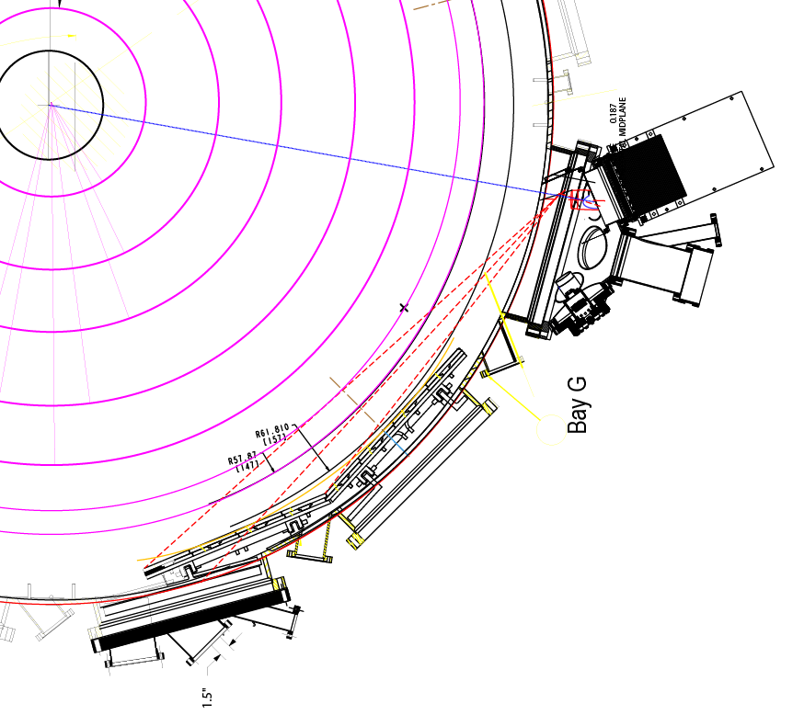
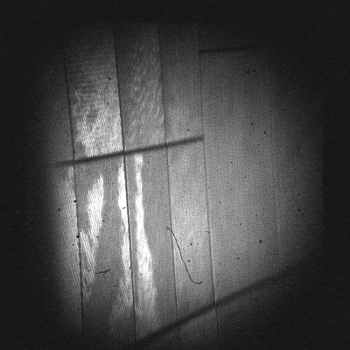
12. ENDD diagnostic updated with imaging bundle and new view aimed at NBI dump
Described in D. Stotler, F. Scotti, R. Bell, A. Diallo, B. LeBlanc, M. Podesta, A. Roquemore, and P. Ross, Phys. Plasmas 22, 082506 (2015).
Dedicated to carbon sources monitoring and edge neutral density studies via DEGAS2
DALSA D256T camera
  128x128 pixels, up to 250 Hz
  Schott imaging bundle, 4 ft 1000x800 fibers

Slide 16
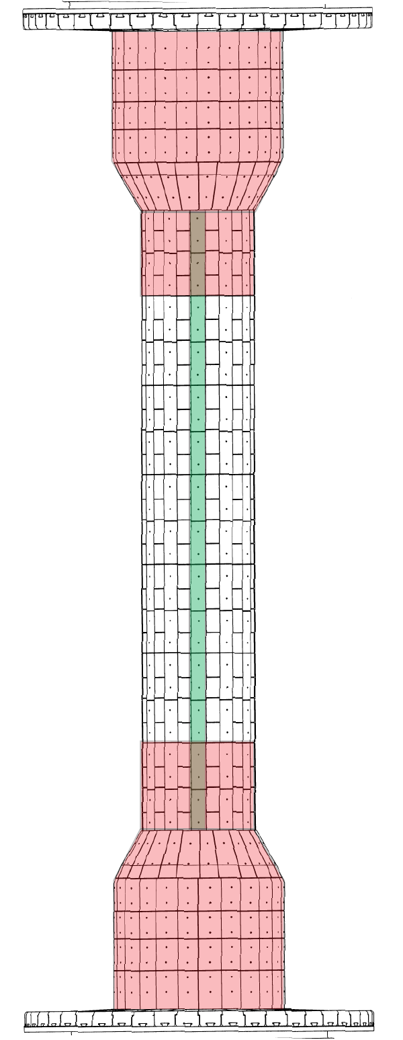
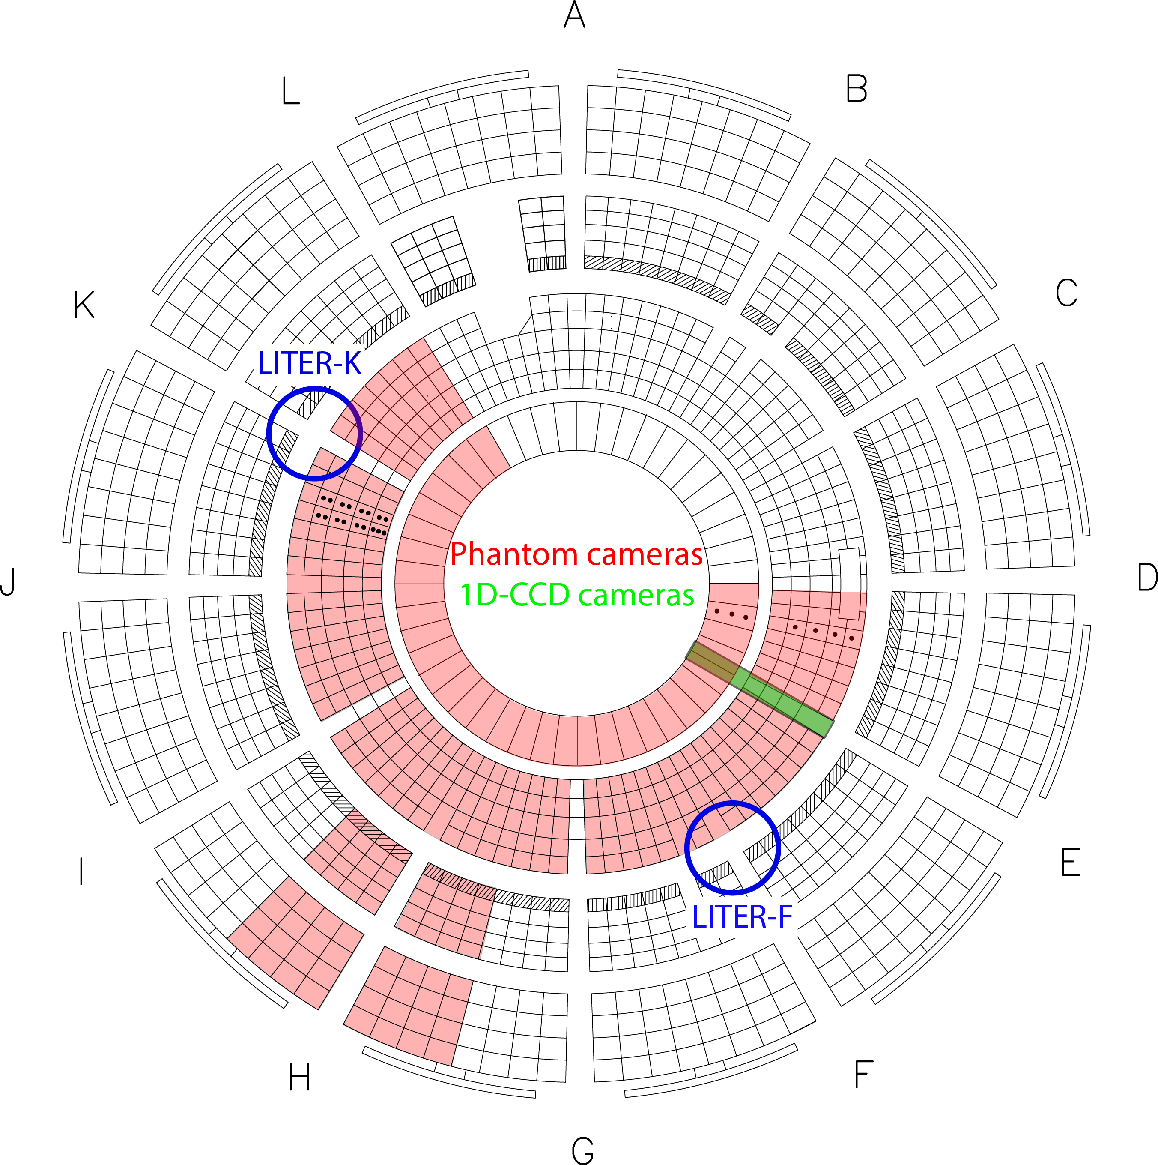
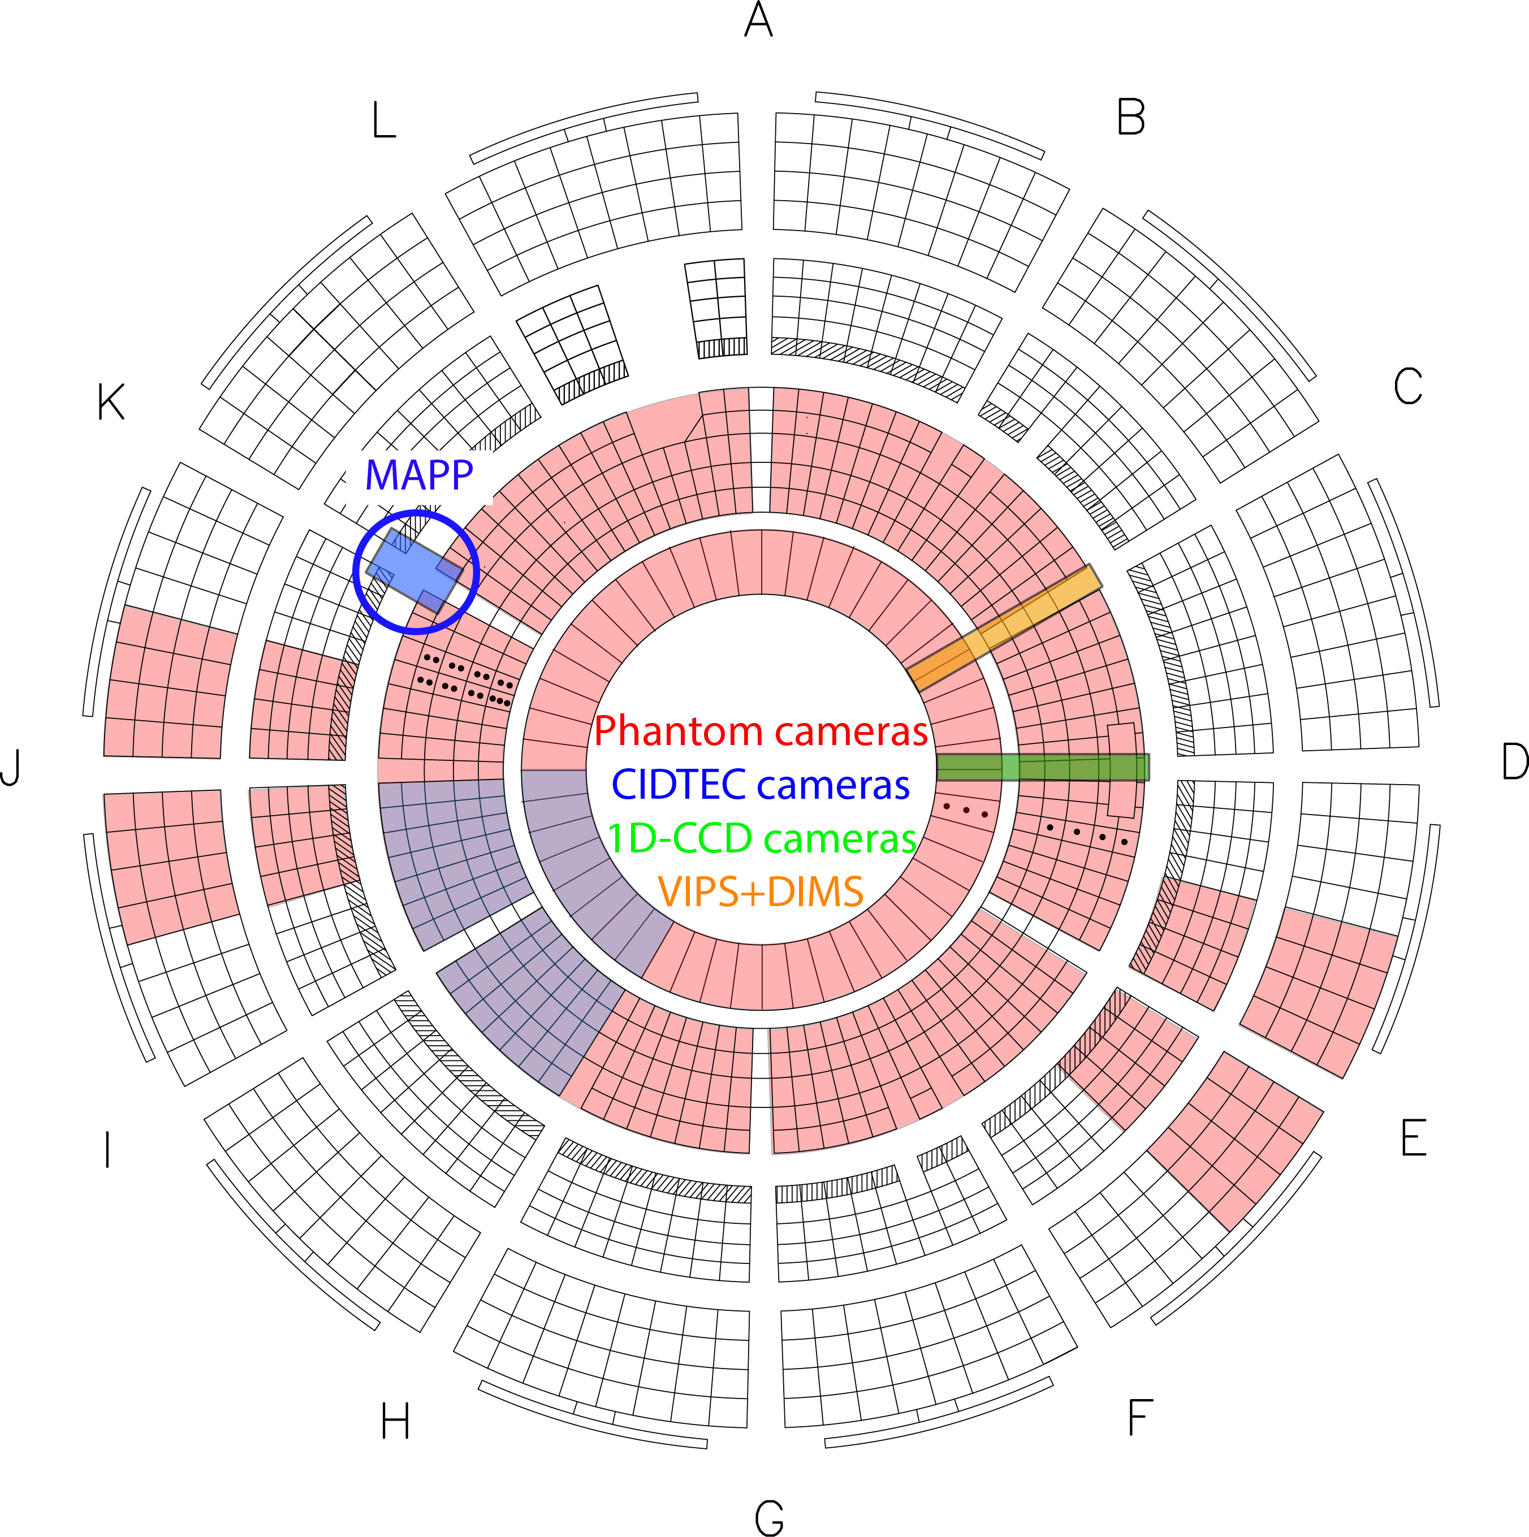
LLNL diagnostics provide full poloidal and toroidal coverage of SOL and divertor impurity emission at multiple wavelengths
Center Stack
Upper divertor
Lower divertor

Slide 17
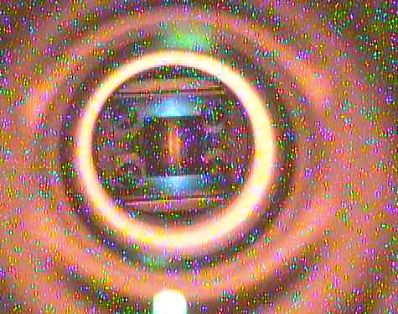
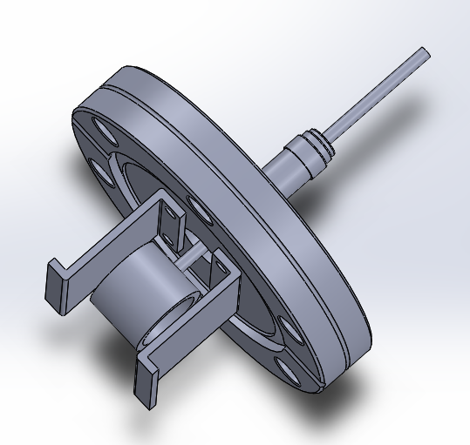
13. Optical Penning Gauge to be used for divertor and wall conditioning studies
Potential applications
  Divertor seeding gas pressure
  HeGDC product analysis
  Gaseous molecular impurity analysis
Project started on NSTX as collaboration between PPPL, LLNL and U Washington (R. Raman)
Potential for collaboration with U Wisconsin (Prof. O. Schmitz)
One Optical Penning gauge installed on NSTX-U at Bay H lower divertor
EIES or spectrometers (VIPS2, DIMS) to be used for emission monitoring and analysis
Color-camera image of Penning gauge operated during helium glow discharge cleaning on NSTX
NSTX-U Penning gauge

Slide 18
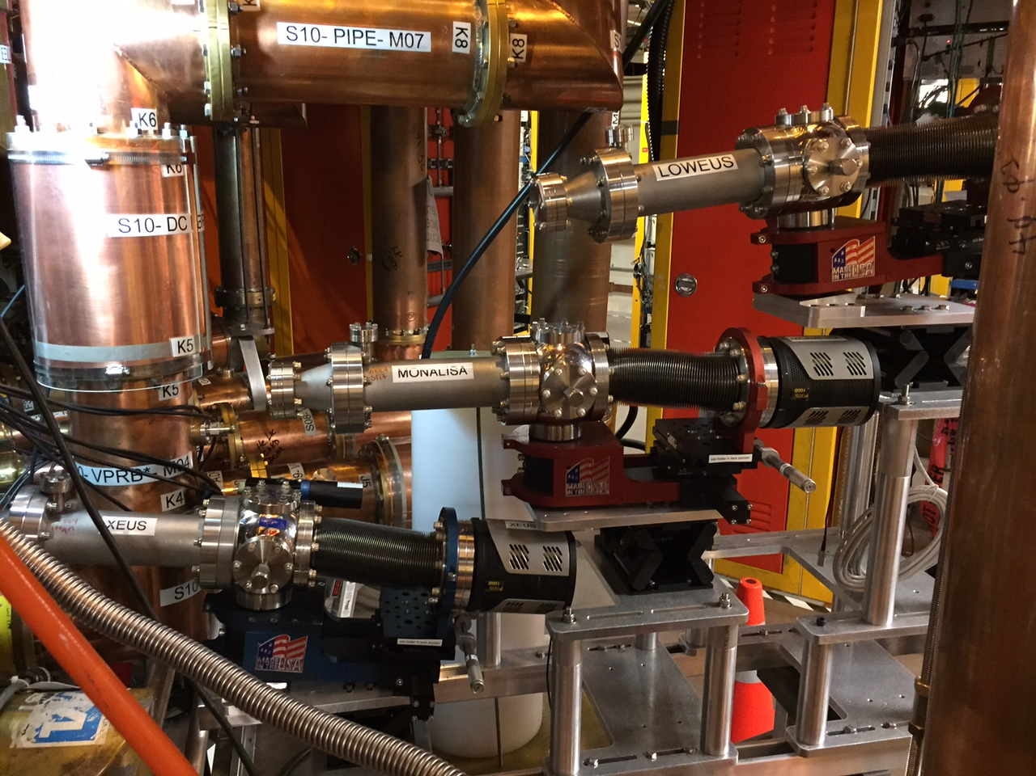
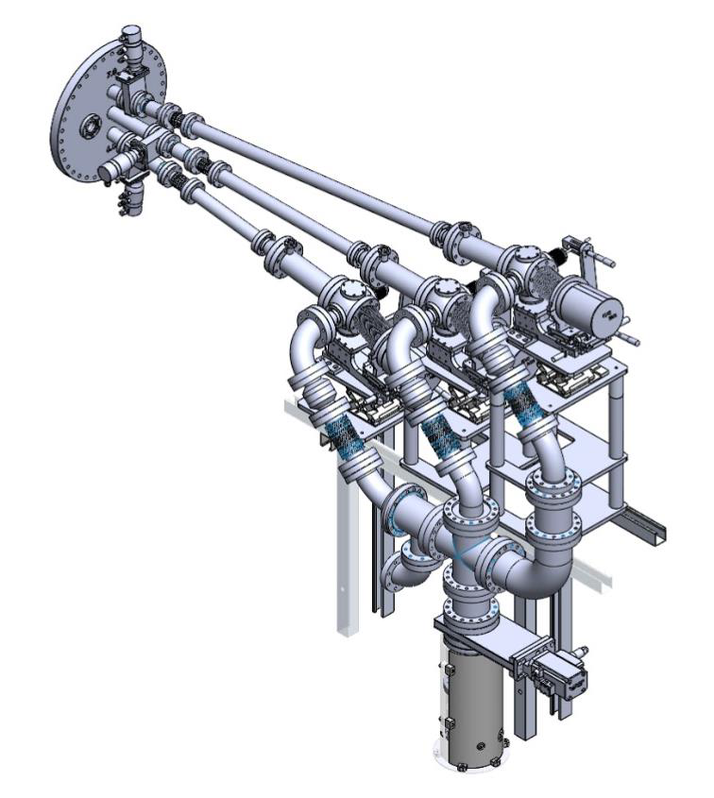
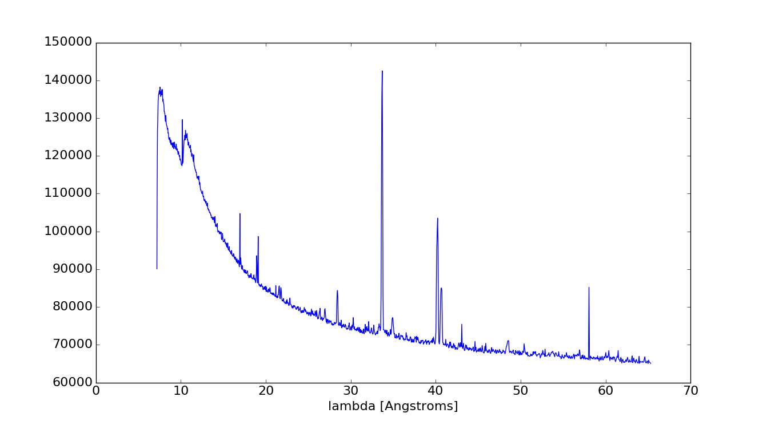
13-15. Three EUV spectrometers provide simultaneous measurements of all low Z, medium-Z, and high-Z impurities
Described in
  J. K. Lepson, J. Phys. B: At. Mol. Opt. Phys. 43, 144018 (2010)
  J. Clementson, RSI 81, 10E326 (2010)
  J. K. Lepson, RSI 83, 10D520 (2012)
  M. Weller, APS 2015, HTPD 2016, to be
  submitted to RSI
Midplane sightlines
Two upgraded NSTX spectrometers
  XEUS, 5 to 60 Å region, 2400 gr/mm grating
  LoWEUS, 200 to 400 Å region, 1200 l/mm grating
  Princeton Instruments PIXIS XO 100B CCD detector
New MonaLisa (Metal Monitor and Lithium Spectrometer Assembly) spectrometer, 60 to 220 Å
  0.23 m, 1200 l/mm grating
  Princeton Instruments PIXIS XO 100B CCD detector
LLNL EUV Spectrometers Mounted on NSTX-U
First Xeus spectrum
First Loweus spectrum
First MonaLisa spectrum

Slide 19
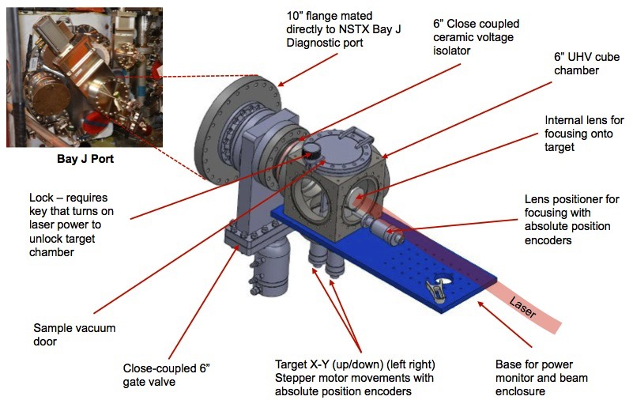
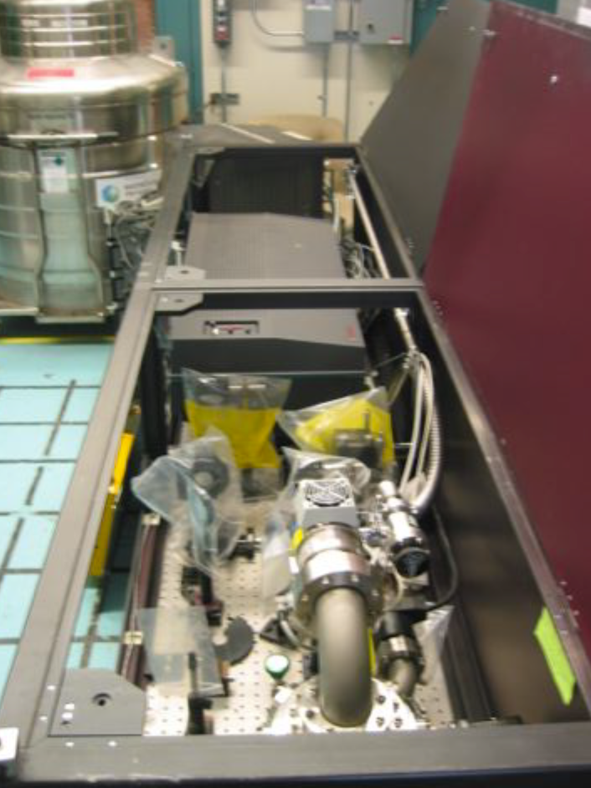
16. New Laser Blow-Off System for impurity transport and atomic spectroscopy studies
Laser Blow-Off physics goals:
  Study edge and core impurity transport
  Transport and turbulence code development and benchmarking
  Time-dependent ionization studies for astrophysics
NSTX-U User Facility
Injection material is evaporated from glass slide
Injection amount per shot is variable
10 Hz laser, allowing single and multiple injections at Δt 100 ms between injections
LLNL Q-switched Nd-YAG laser Continuum model NY82-10
  Infrared beam at 1064 µm
  16 ns pulse duration
  12 mm beam diameter
  Linearly polarized
  1.4 J output energy
  Previously used as LBO system on LLNL EBIT (Niles 2006)
LBO Target Chamber
LBO Laser and Optic System

