Slide 1




NSTX-U
Supported by
NSTX-U Collaboration Status and Plans for
University of Tennessee, Knoxville
Coll of Wm & Mary
Columbia U
CompX
General Atomics
FIU
INL
Johns Hopkins U
LANL
LLNL
Lodestar
MIT
Lehigh U
Nova Photonics
ORNL
PPPL
Princeton U
Purdue U
SNL
Think Tank, Inc.
UC Davis
UC Irvine
UCLA
UCSD
U Colorado
U Illinois
U Maryland
U Rochester
U Tennessee
U Tulsa
U Washington
U Wisconsin
X Science LLC
Culham Sci Ctr
York U
Chubu U
Fukui U
Hiroshima U
Hyogo U
Kyoto U
Kyushu U
Kyushu Tokai U
NIFS
Niigata U
U Tokyo
JAEA
Inst for Nucl Res, Kiev
Ioffe Inst
TRINITI
Chonbuk Natl U
NFRI
KAIST
POSTECH
Seoul Natl U
ASIPP
CIEMAT
FOM Inst DIFFER
ENEA, Frascati
CEA, Cadarache
IPP, Jülich
IPP, Garching
ASCR, Czech Rep
Brian D. Wirth (UTK)
R. Maingi (PPPL/UTK), K. Gan (UTK)
NSTX-U Collaborator Research Plan Meetings
PPPL, May 16, 2016

Slide 2
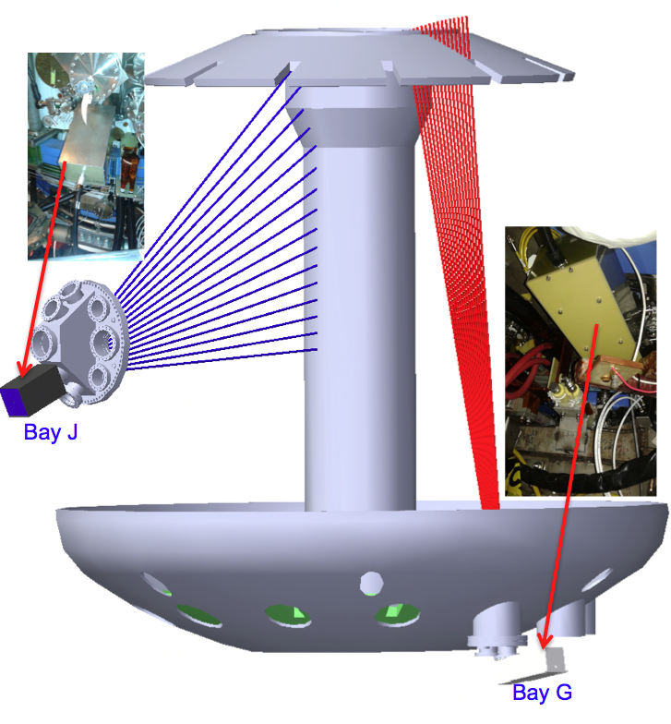
Development of spectroscopic and IR views of central stack and upper divertor of NSTX-U
Extend diagnostic coverage to support Li program
  Effectiveness of Li evaporation
  Studies of material evolution and migration
  Tight collaboration with ORNL researchers on NSTX
Upper divertor views (Bay G bot)
  16 LOS for UV-NIR spectroscopy
  “Fast” (1.6kHz) IR camera (ORNL)
Central stack view (Bay J mid)
  16 LOS, for UV-NIR spectroscopy
  “Slow” (30Hz) IR camera
ProEM-HS 512 camera with
IsoPlane SCT320 spectrometer in
DARM, with 16 fibers input to spectrometer

Slide 3
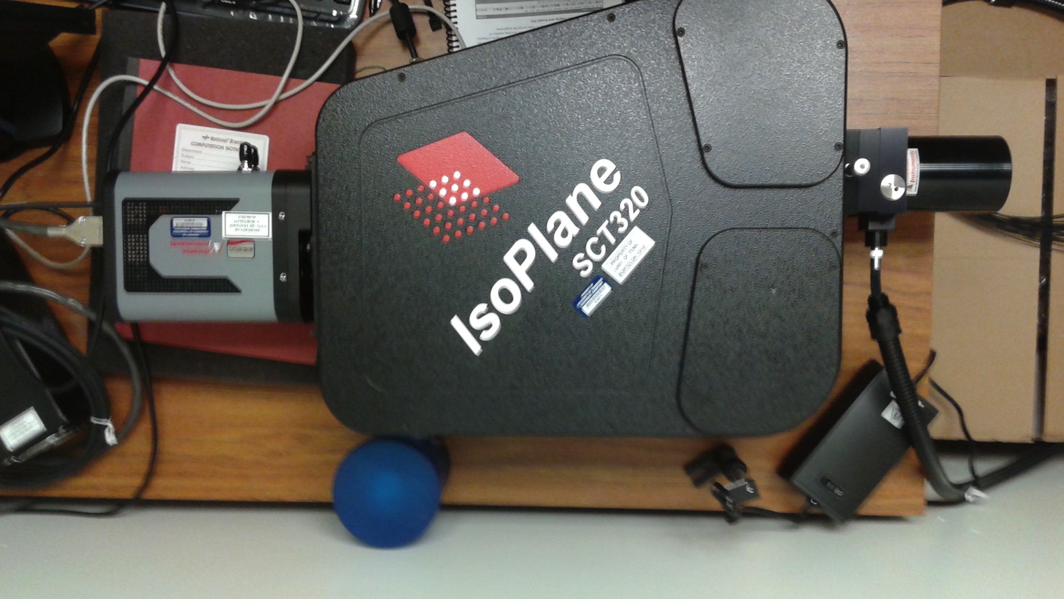
Spectrometer and camera
Present status
spectrometer
camera
Spectrometer: IsoPlane SCT320
  Grating: 600g/mm, 2400g/mm and 3600/mm
Camera: ProEM HS 512 camera
  CCD, back illuminated, 512x512
  frame rate: ~600hz (512x16)

Slide 4
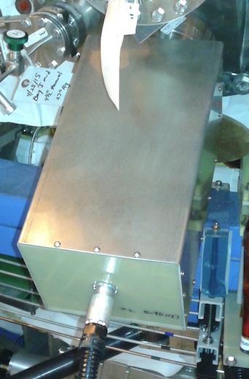
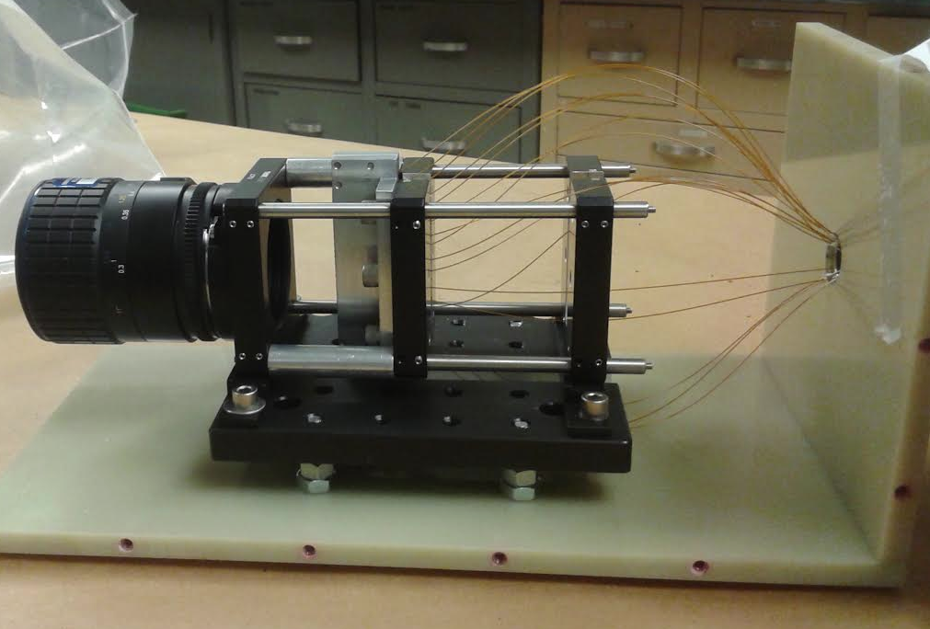
Central stack spectroscopy diagnostic
  16 sightlines
  field of view: 40º
  10cm radial resolution, spots size 1.3mm
  Nikon 105mm UV-VIS-NIR lens
    wavelength 315-1100nm
  Fiber: Polymacro FBP400440480

Slide 5
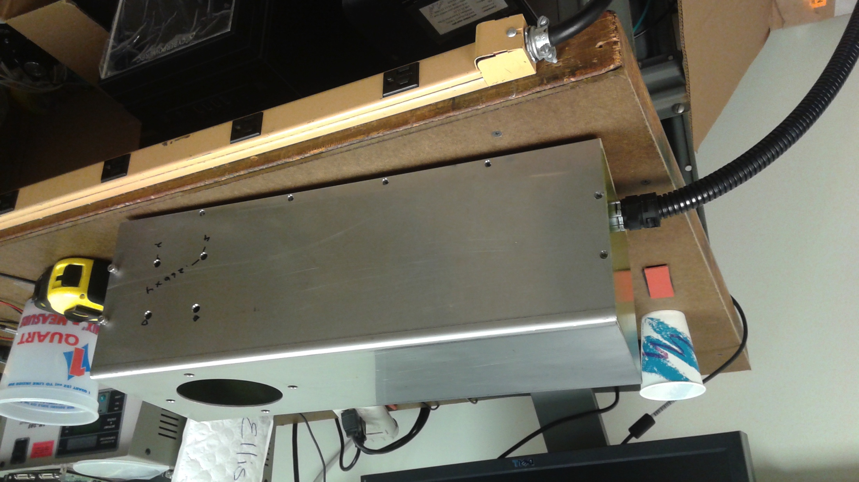
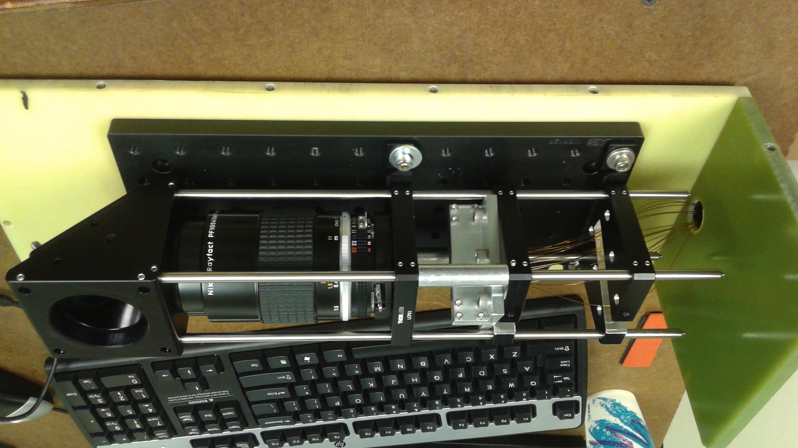
Upper divertor spectroscopy diagnostic
  16 sightlines
  field of view: 8º
  5cm radial resolution, spots size 9mm
  Nikon 105mm UV-VIS-NIR lens
    wavelength 220-900nm
  45º UV enhanced mirror

Slide 6
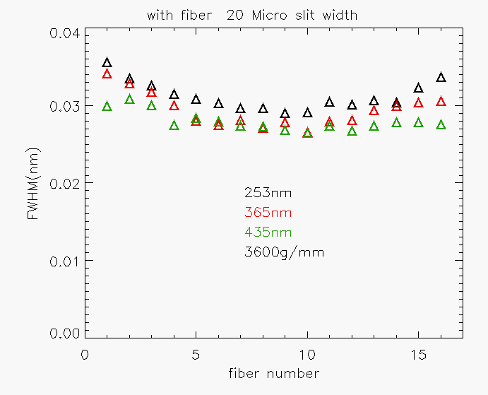
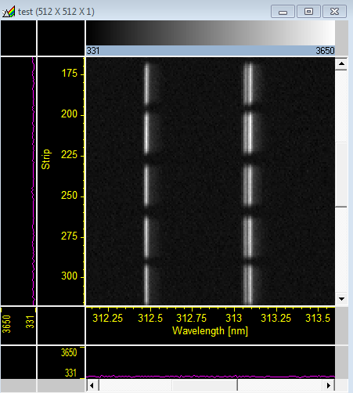
Resolution test
313.155, 313.184nm mercury spectral line

Slide 7
Research activity in FY2016 focused on diagnostic commissioning and analysis of initial data
Research Plans for FY2016
  Commissioning of spectroscopy and IR thermography
  Monitor evolution of PFC observing ratio of spectrally close C an Li lines (e.g. CI / Li I : 493/497nm, 601/610nm, 805/812nm)
  Acquire and install “slow” IR for CS view (from Bay J mid-plane) – subject to continual discussion with PPPL & ORNL colleagues (but some funds remain for equipment)
FY2017-[…]
  plan and perform experiments to address specific aspects of effectiveness of Lithium evaporation, enabled by the extended coverage
  Initiate modeling of observations in terms of transport (SOLPS, EIRENE)
  and evolution of material morphology/composition (leverage SciDAC–Xolotl -PSI and joint UIUC/UTK project)
  New graduate student expected to begin in Aug 2016

Slide 8
Backup slides follow, if needed

Slide 9
Motivation: understanding Li coating effectiveness
Li proved to be focal point in NSTX experiments
  Improved energy confinement, profile peaking ,ELM stabilization
Open question
  Improvement increases linearly with pre-discharge evaporation
  But… Nominal coating thickness >> ion implantation
  What governs the effectiveness of Li deposition?
Possible mechanism at play:
  Role of regions low Li coverage
  Erosion and re-deposition
  Deposition of carbon-rich films during discharge
  Lithium-Carbon chemistry
Spatial distribution of Li coating is a key element

Slide 10
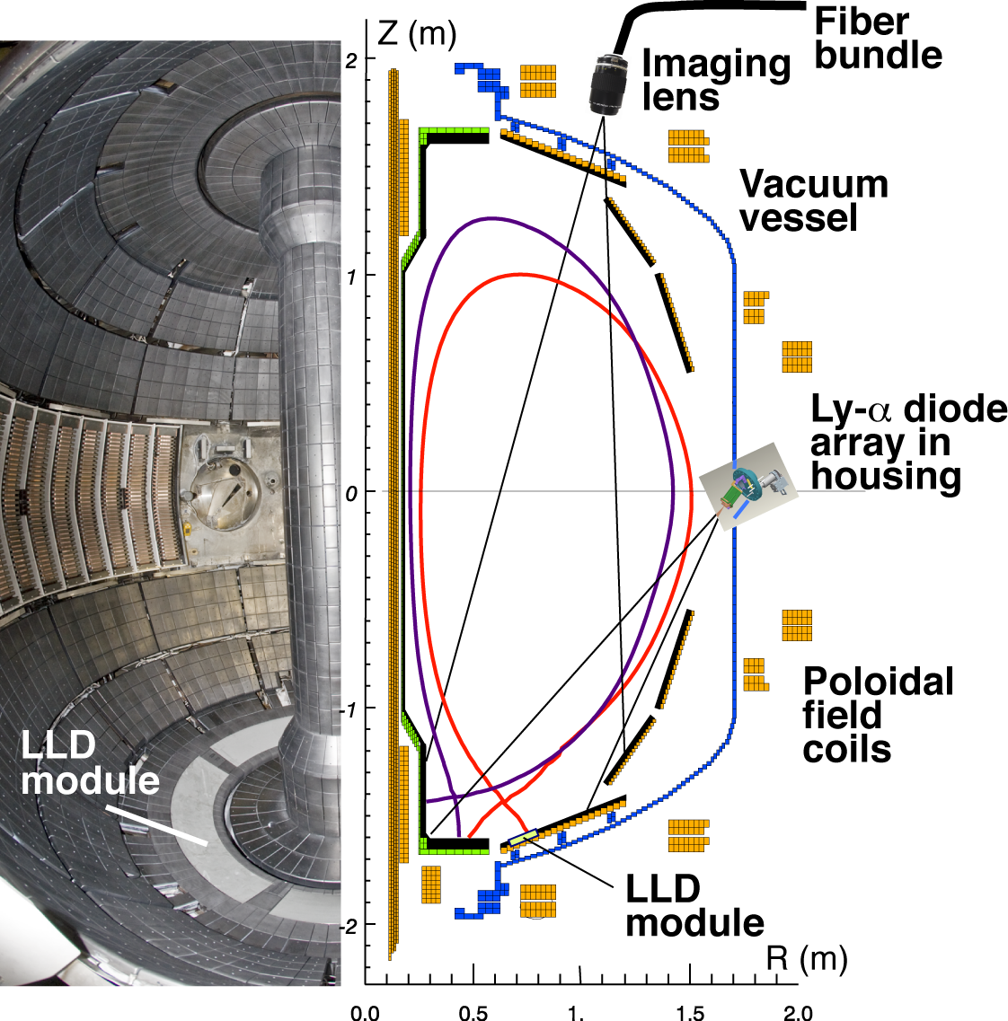
Lower divertor was well diagnosed on NSTX
DIMS
VIPS2
CAMERAS
Multi channel spectrometers (DIMS/VIPS2, LLNL/PPPL)
  UV-VIS-NIR range, high resolution
  48 chords (30 simultaneously)
Single channel spectrometers (ORNL)
  4X, VIS-UV, low resolution
Diodes array (LADA/filter-scopes)
  Lyα, Dα, C III, Li I
Visible cameras (1D/2D)
  Li I, Li II, C II, C III
LADA
Bolometry
IR cameras (ORNL)
  Fast dual band (L/MWIR, 1.6 kHz)
  Wide angle (180° divertor coverage)
Poor coverage of the central stack and upper divertor

Slide 11
UTK-PPPL collaboration
Scope of the collaboration:
Evaluation of the dependence of the effectiveness of Lithium evaporation on the spatial asymmetries in the coatings, on NSTX-Upgrade
Experimental part:
  Spatially resolved spectroscopic measurements of the upper divertor and central stack regions
  IR imaging of the same regions
Modeling part (supported by measurements)
  Boundary/SOL transport (SOLPS-B2, EIRENE)
  Evolution of material morphology/composition (TRIM, LAMMPS)

Slide 12
The project fits the NSTX-U program
NSTX-Upgrade operation scenario
  Additional off-axis NBI sources (6→12 MW)
  Increased B_{tor} and achievable I_{p} (0.5 → 1T, 1 → 2MA)
  Longer discharge duration (1 → 2 s)
Challenging power handling and conditioning
  Larger exhausted power to PFC
  Smaller area of deposition (strike-point footprint) as I_{p} increases
  Time evolution of coating efficiency over discharge time
Graphite PFC on upper and lower divertor
  Double-Null as standard operation configuration (snowflake)
  Li evaporation as baseline procedure for wall conditioning
  New Li evaporator for coating of the upper divertor foreseen

Slide 13

PFC spectroscopy of upper divertor and central stack
2 light collection lenses
  105mm (UD), 60mm (CS), F/4.5,
  transmission UV-VIS-NIR
2 bundles of optic fibers (16x)
  400 um core, high OH (UV transmission)
Patch panel to relay with spectrometer
High resolution spectrometer
  f=0.32 m, F/4.7,
  3600, 2400, 1800 G/mm for UV, VIS, and near-infrared
CCD detector (multichannel acquisition)
  512x512, 8.2x8.2mm, back illuminated
  Borrowed from ORNL
NSTX-U
Limiter
Collection
lens
Fiber optic
bundle
Patch
panel
CCD
Collection
lens
Monocrhomator

Slide 14
High resolution spectroscopy provides key information
Spatially resolved, photometrically calibrated measurement of emission from PFC
  Low charge states of from Li, C (350-800 nm)
  Molecular bands (LiD, CD, Li₂, etc.)
  Deuterium (Balmer, Paschen series)
Assess ability of affecting erosion of graphite
  Monitor ration of spectrally close C an Li lines
  e.g. CI / Li I : 493/497nm, 601/610nm 805/812nm
Document the evolution of PFC
Influxes of impurities
(from S/XB, but local T_{e}, n_{e} are required)
Ion temperature (Doppler broadening)
Estimate of n_{e} from Stark broadening

Slide 15
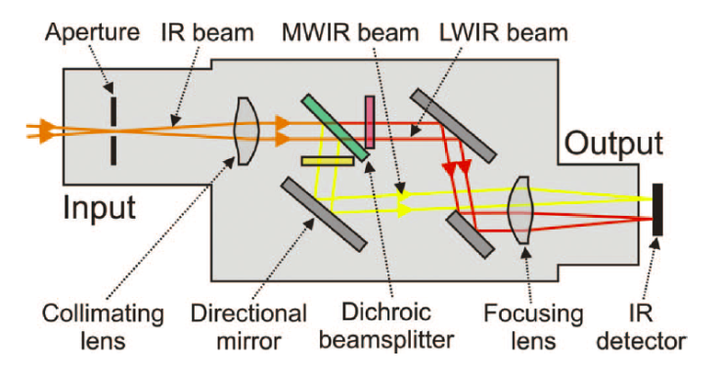
Dual band thermography for UD and CS
Plasma heat flux to the PFC serves input and data constraints to modeling of surface physics (morphology, sputtering)
Emissivity of Li coated PFC can vary significantly with temperature and morphology (under ion and impurity flux)
Dual band approach: PFC temperature from ratio of signal in 2 wavelength ranges (e.g. 7-10μm LWIR, 4-6 μm MWIR):
  Greatly reduced effect of variation of PFC emissivity and optic transmission
  Successfully implemented and exploited on NSTX [McLean RSI 2012]
Dual band adapter
  Dichroic beam splitter
  MWIR and LWIR filters

Slide 16
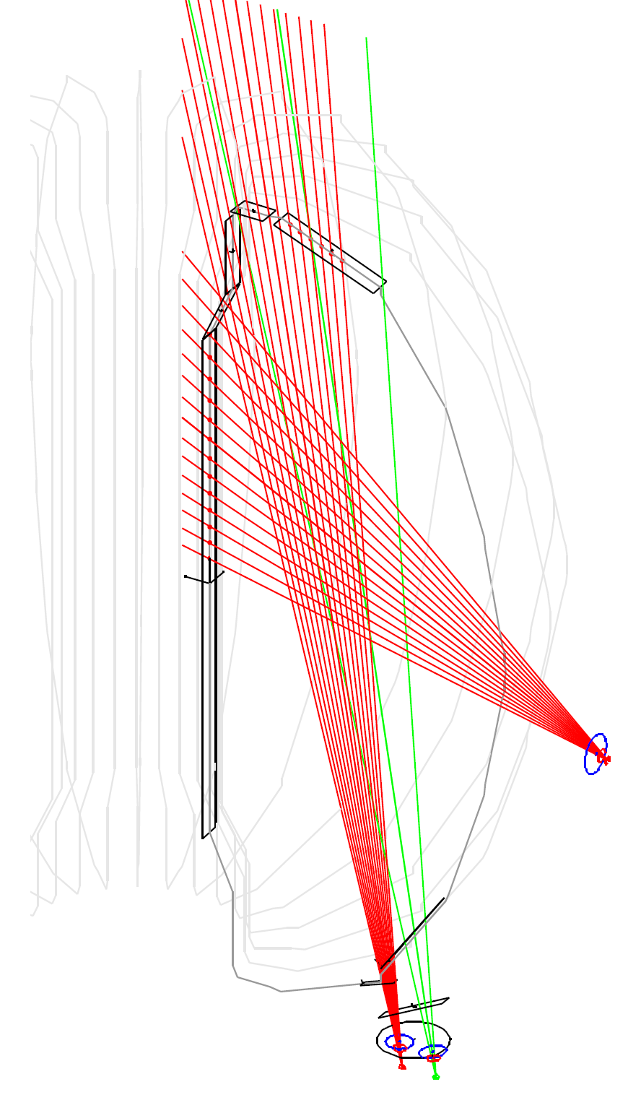
Schematic of observation configuration
Upper divertor spectroscopy
  16 LOS, FOV 30deg
  Radial resolution 4 cm, spot size 1.3 cm
Central stack spectroscopy
  16 LOS, FOV 30deg
  Vertical resolution 8 cm, spot size 0.6 cm
Upper divertor infrared camera
  Radial coverage R=0.6-1.2 m

Slide 17
Molecular radiation
D₂, revealing the molecular hydrogen flux near the surface, its rotational and vibrational excitation, and its prevalence for recombination and subsequent chemical decomposition and/or surface reaction
the bands of CD (A-X at 425-431 nm, B-X at 386-400 nm, the primary signature of chemical erosion
Li₂ (lithium molecule). (A-X) and (B-X) bands emit in the red and blue-green portions of the visible spectrum, and provide information about the nature of Li.
LiH, LiD, LiT (isotopic Lithium hydrides), A-X band emit throughout the 300-500 nm
Li₂C₂ (lithium carbide, Li⁺ ⁻C triple bond C⁻ Li⁺), LiC₆, Li₂O (lithium oxide), Li₂O₂ (lithium peroxide), LiOH (lithium hydroxide), Li₂CO₃ (lithium carbonate), LiBH₄ (lithium borohydride), and CO₂ (carbon dioxide).

