Slide 1




Real-time Electron Temperature and Density Profile Measurements for NSTX-U
Egemen Kolemen
Ahmed Diallo, Greg Tchilinguirian
Mechanical & Aerospace Engineering
Jointly appointed with the Andlinger Center for Energy and the Environment
and the Plasma Physics Laboratory (PPPL)

Slide 2
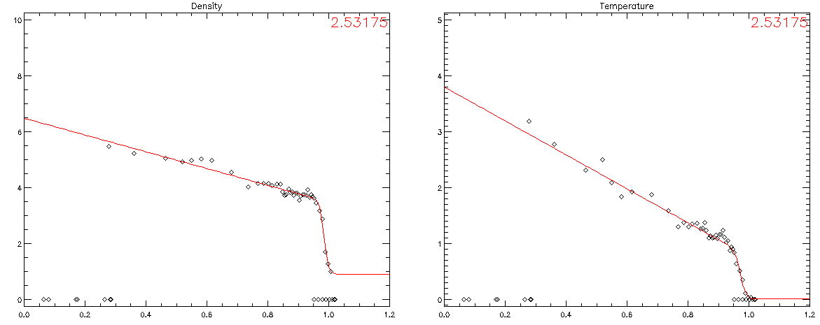
Technical Aim: Real-time Thomson Diagnostics
We want to acquire the Thomson (MPTS) data in real-time.
Share with PCS. Calibrate and fit it.
➔ Use during the shot for better control to achieve physics goals

Slide 3
RT-Kinetic EFIT
ITER RT-Control Development:
  Pedestal Control
  ELM Stability/Control
Achieve Advanced Regimes
  Lithium ELM Free Scenario
  Enhanced Pedestal H mode

Slide 4
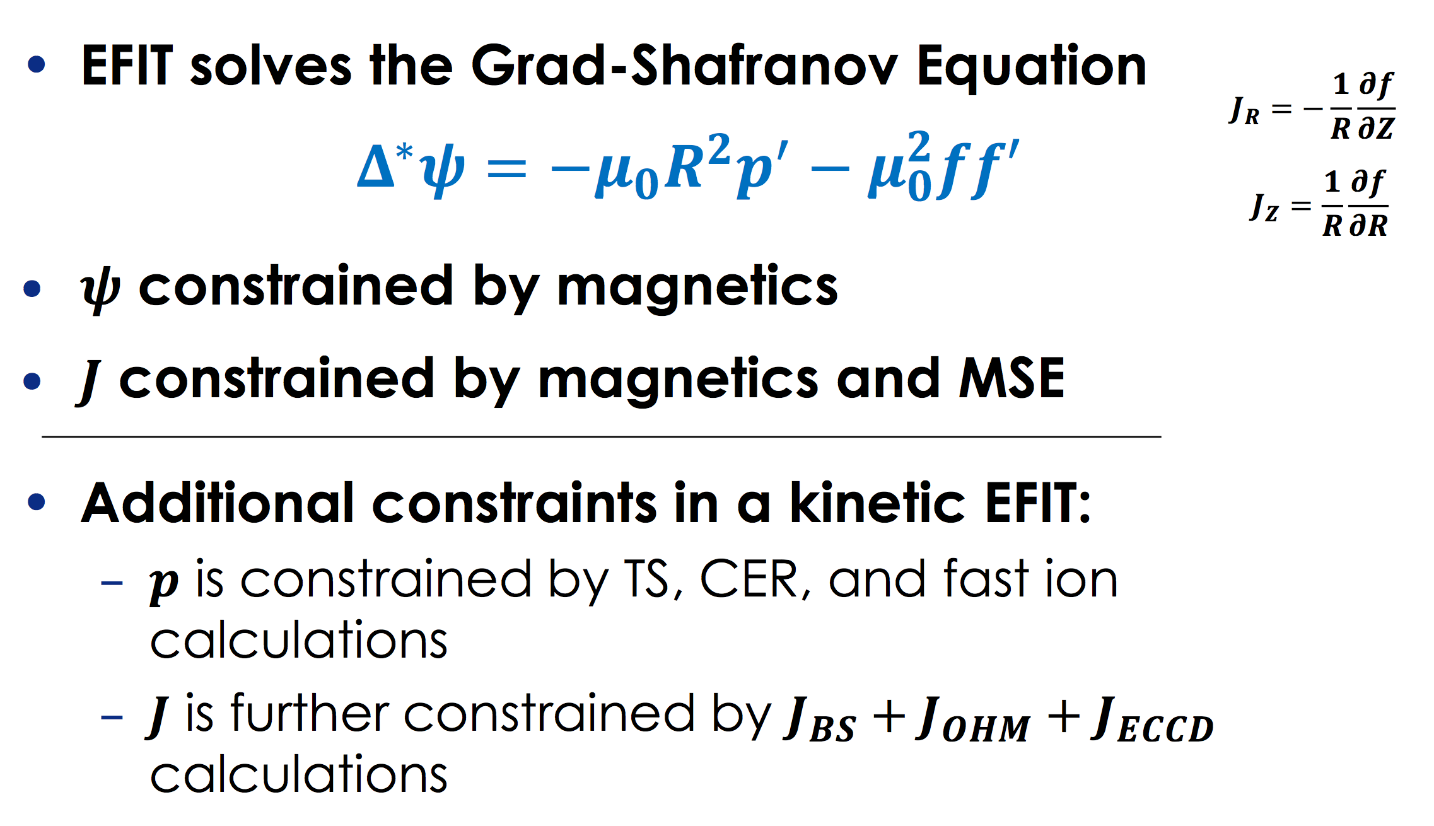
Real Time Kinetic Equilibrium Reconstruction Can be Implemented by Adding P and J Constraints to EFIT
First the Thomson Scattering only addition for kinetic EFITs
With Steve Sabbagh, Keith Ericsson, Dan Boyer

Slide 5
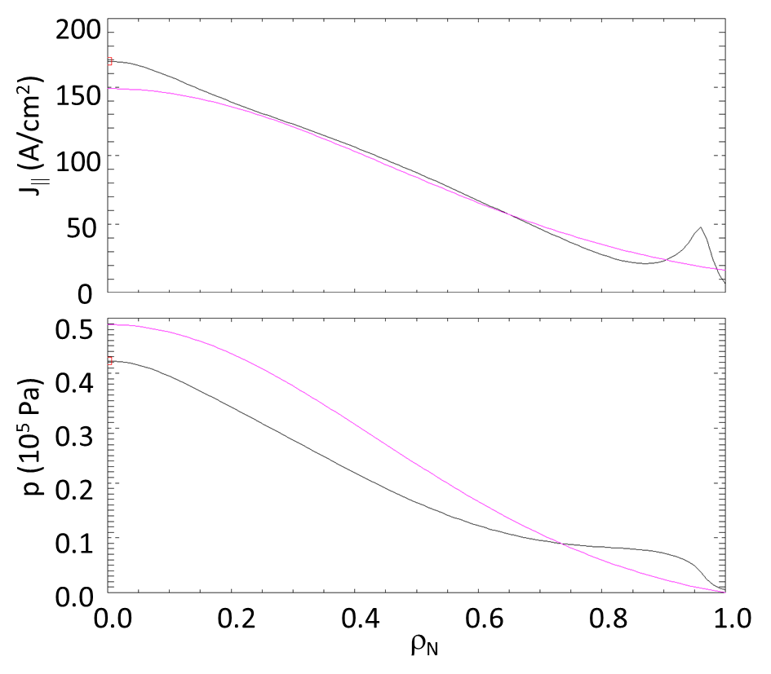
Real Time Kinetic Equilibrium Reconstruction Difference between regular versus kinetic-EFIT
Example profiles of parallel current density and total pressure for a kinetic EFIT (black) and a basic, magnetics-only EFIT (magenta).
Failure to properly account for the pedestal pressure gradient and the resulting bootstrap current introduces errors throughout the profiles.
Thus, it is critical that pressure constraints be used when constructing equilibria for stability analysis.

Slide 6
Add constraints on the Current and Pressure to EFIT
Constraint from TS, CER Measurements
Constraint from TS, CER Measurements (J_{BS}+J_{OH})
Constraints from MSE
p
J
ψ
ψ
RT-Thomson (two-three years of the proposal), MSE (in development – Howard)

Slide 7
RT-Kinetic EFIT
ITER RT-Control Development:
  Pedestal Control
  ELM Control
  RWM Control
Achieve Advanced Regimes
  Lithium ELM Free Scenario
  Enhanced Pedestal H mode

Slide 8
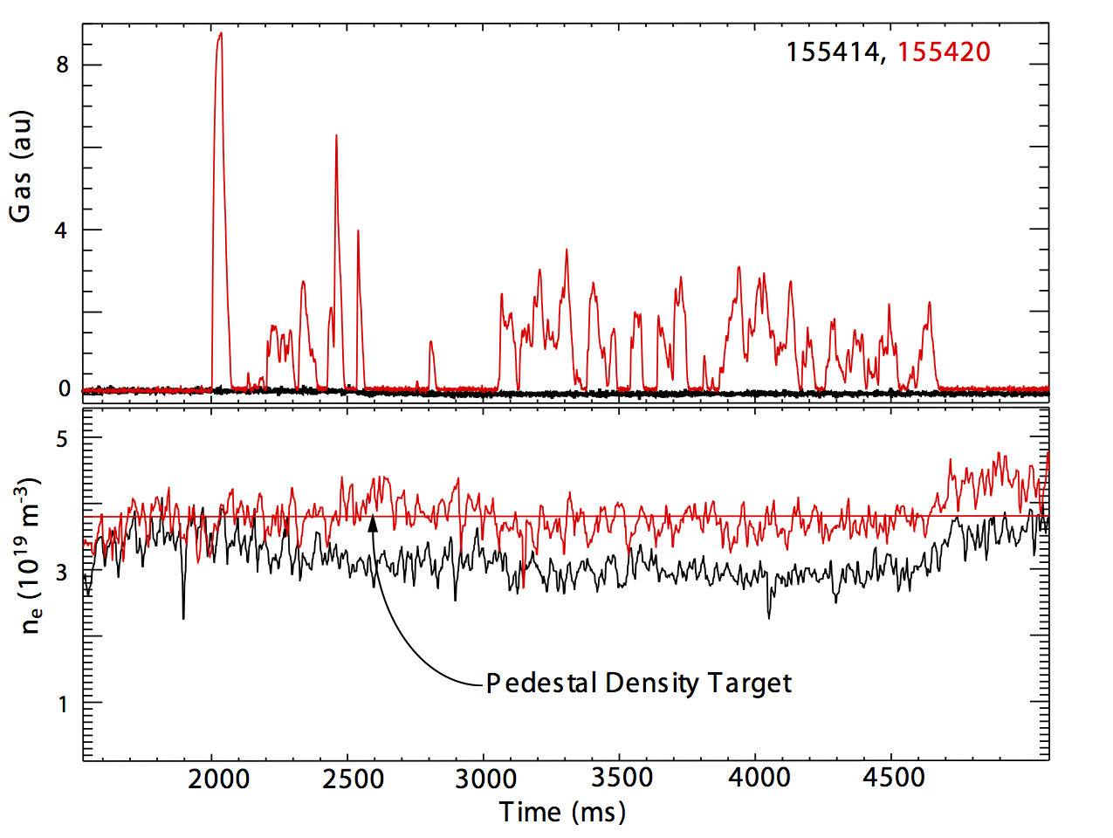
Pedestal Control with Gas: Real-time Thomson
Example pedestal density height feedback at DIII-D using Deuterium fueling: uncontrolled discharge shown in black and controlled shot shown in red

Slide 9
Detachment Control with Gas: Real-time Thomson (Divertor)
Data showing feedback control of divertor detachment. Red—detachment feedback control on. Black––detachment control off (no divertor fueling). Top: line average core density. Middle: divertor density. Bottom: electron temperature above divertor plate.

Slide 10
Pedestal Control with 3D Coils: Real-time Thomson
3D coils for pedestal control:
Left) Effect of the n=3 RMP at DIII-D on the pedestal electron pressure (the blue line shows the undisturbed flattop pedestal electron pressure).
Right) Pedestal electron pressure in RMP regulation

Slide 11
RT-Kinetic EFIT
ITER RT-Control Development:
  Pedestal Control
  ELM Stability/Control
Achieve Advanced Regimes
  Lithium ELM Free Scenario
  Enhanced Pedestal H mode

Slide 12
Adaptive ELM Control Implemented and Tested on DIII-D
Vacuum Calculation Online
➔
Plasma Response Calculations Offline
(Jong-Kyu, Paz-Sol)
➔
RT-ELM Control Algorithm
3D coil
currents
Rt-EFIT
(q_{R,Z},Ψ_{R,Z)}
W_{p} matrix:
Vacuum to Full Plasma Response Conversion Matrix
Find Island sizes (w_{p}) and Chirikov island over lap parameter (σ_{chir}) in pedestal
For Vacuum+Plasma
Biot-Savart ➔ δB_{Ped-Top}
I_coil = Find I Coil Direction Current to Max(σ_{chir}) or Max(kink-resonant)
Straight-line field coords
SURFMN (Schaffer).
Find response for all modes
➔B_{r(m,n)}
  Tested the control at DIII-D (kink-resonance, n=2, I coil) ➔ 20-100 ms
  Results ~ good correspondence with offline prediction with q variation

Slide 13
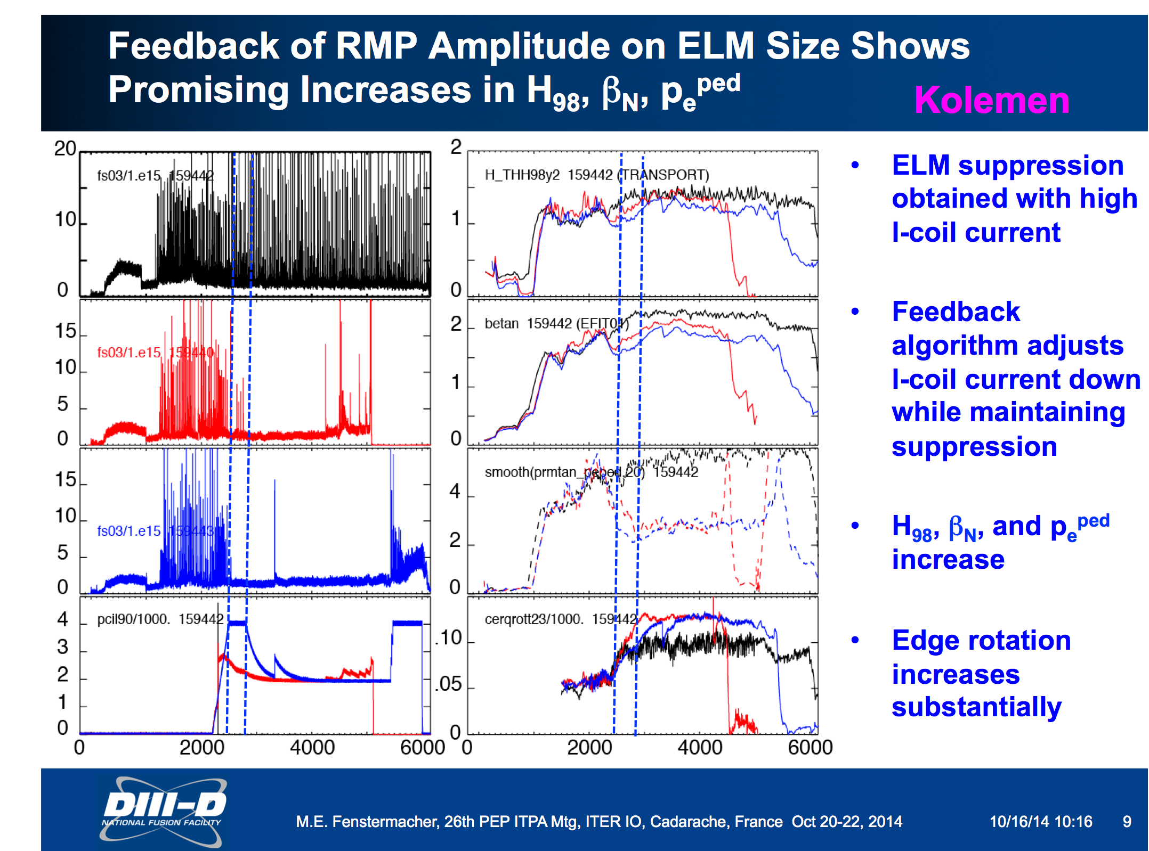
Adaptive ELM Control Implemented and Tested on DIII-D
Adaptive ELM Control Algorithm reduces the coil current down while maintaining ELM Suppression
Suppression with 1.9 kA I coil current
~ H98 recovered
BetaN increased (not fully recovered)
H98 and BetaN recovery dependent on the initial coil currents

Slide 14
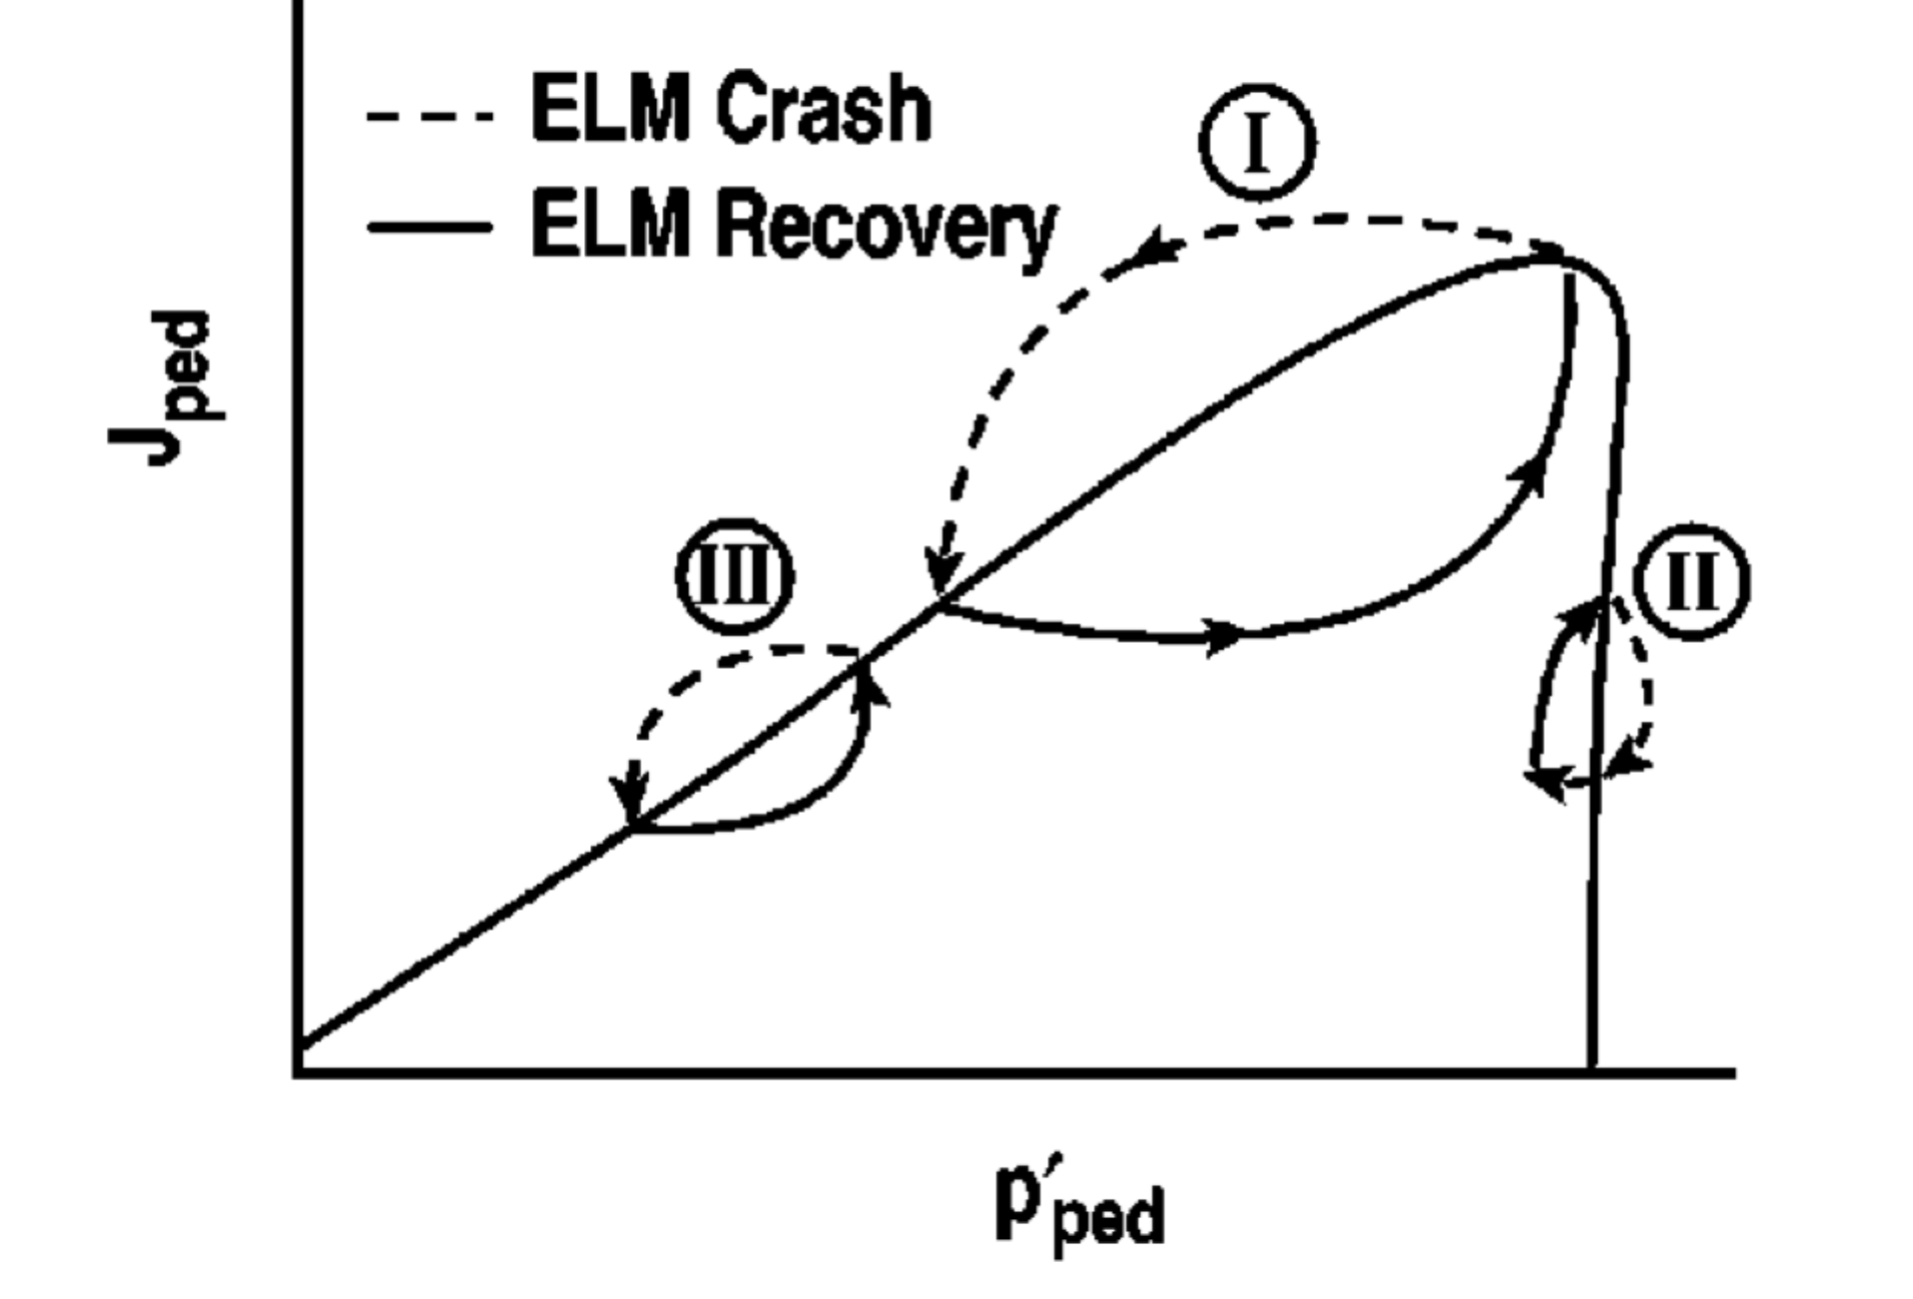
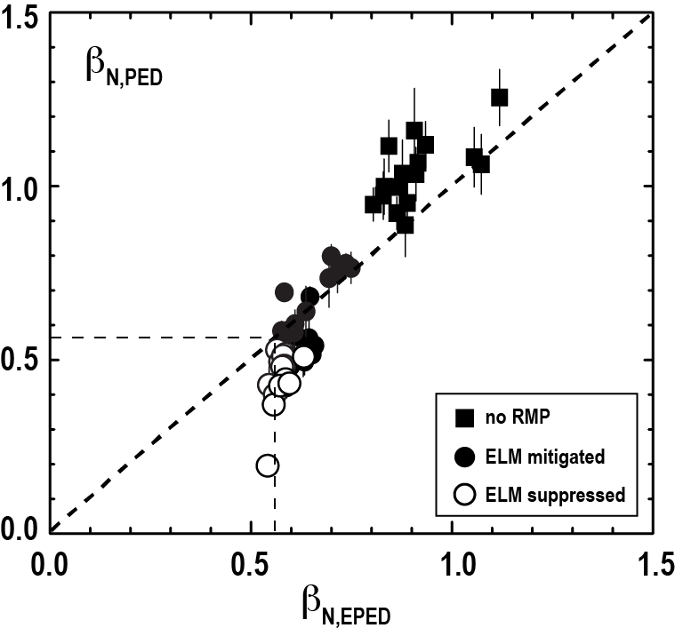
RT-ELM Stability Using NEUPED for NSTX-U
Normalized pedestal beta (vertical axis) vs the EPED prediction for the DIII-D ELM experiments. (Nazikian 2014)
Simplified model of small and large ELM cycles
Train neural network based fit to EPED1 simulations – nueped (with O. Meneghini)
RT capable simplified model with regression fit to EPED1 simulations
10 input parameters: ^{n}_{e,ped}^{, Z}_{eff,ped}^{, β}_{N} ^{, I}_{p}^{, B}_{T} ^{, a, R, κ, δ, m}_{i}
4 input parameters: ^{p}_{ped}^{, p}_{top}^{, w}_{ped}^{, w}_{top}

Slide 15
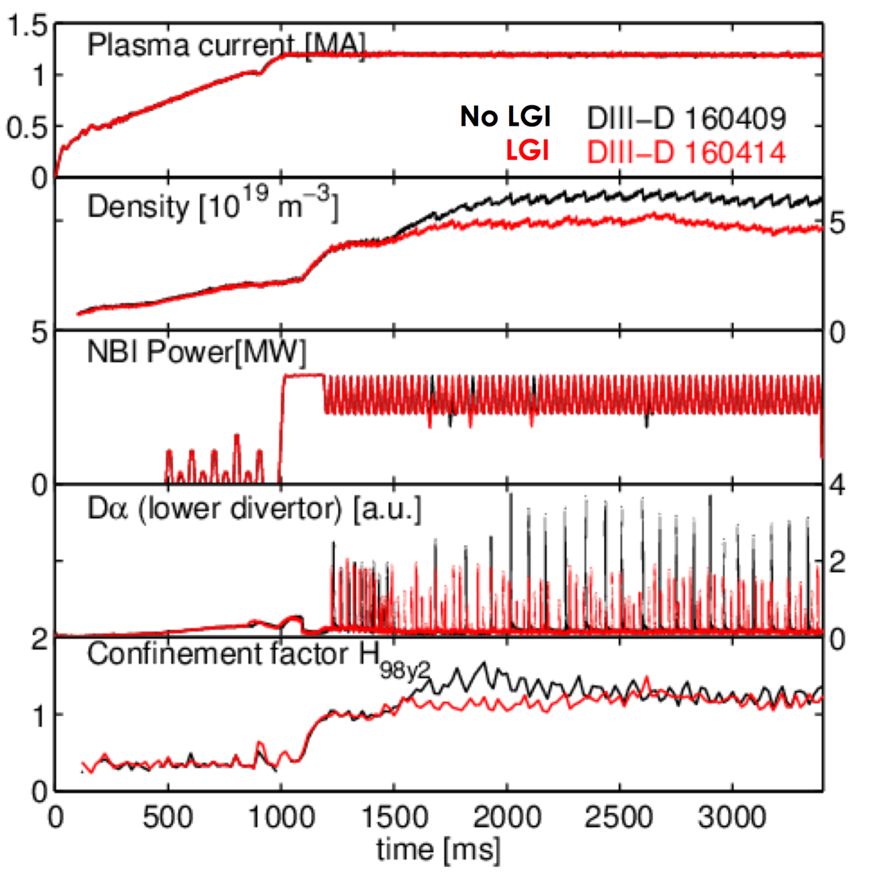
RT-ELM Control Using rt-LGI for NSTX-U
LGI is ready for experiments!
Turn on/off and change the frequency of LGI based on the rt-ELM-stability calculations

Slide 16
RT-Kinetic EFIT
ITER RT-Control Development:
  Pedestal Control
  ELM Stability/Control
Achieve Advanced Regimes
  Lithium ELM Free Scenario
  Enhanced Pedestal H mode

Slide 17
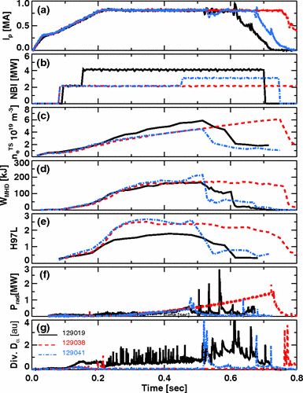
Control of ELM Free Regimes in Lithium Conditions
Core density accumulation in Lithiated conditions will be a challenge for NSTX-U
Calculation of the ELM stability and control using the rt-LGI to trigger ELMs
Gas, HHFW and shape change etc. can be incorporated when the stability is knows
Figure 4. Comparison of pre-lithium ELMy discharge (black), and two post-lithium discharges with different NBI power (blue, red)

Slide 18
RT-Kinetic EFIT
ITER RT-Control Development:
  Pedestal Control
  ELM Stability/Control
Achieve Advanced Regimes
  Lithium ELM Free Scenario
  Enhanced Pedestal H mode

Slide 19
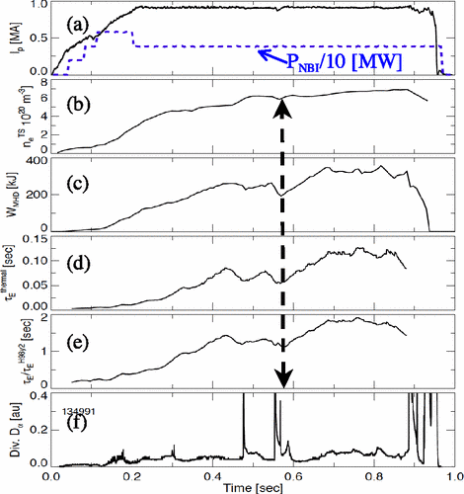
Control of Enhanced Pedestal H-mode
EP H-mode is a new high performance regime has been observed in NSTX
EP H-mode can be generated reliably
But it can not be maintained
We will test the monitoring of the pedestal parameters in real-time and take action when the plasma comes close to EP H-mode drop threshold with the pedestal and ELM control techniques mentioned.
Time evolution of discharge with transition to the enhanced pedestal
H-mode. The H-mode to EP H-mode transition is indicated by an arrow.

Slide 20
RT-Kinetic EFIT
RT-DCON
ITER RT-Control Development:
  EFC
  ELM Control
  Rotation Control
  RWM Control
ITER Stability Control Vision

Slide 21
Real Time Kinetic Equilibrium Reconstruction Will be Implemented by Adding P and J Constraints to EFIT
With David Eldon and John Ferron

Slide 22
Real Time Kinetic Equilibrium Reconstruction Difference between regular versus kinetic-EFIT
Example profiles of parallel current density and total pressure for a kinetic EFIT (black) and a basic, magnetics-only EFIT (magenta).
Failure to properly account for the pedestal pressure gradient and the resulting bootstrap current introduces errors throughout the profiles.
Thus, it is critical that pressure constraints be used when constructing equilibria for stability analysis.

Slide 23
Add constraints on the Current and Pressure to EFIT
Constraint from TS, CER Measurements
Constraint from TS, CER Measurements (J_{BS}+J_{OH})
Constraints from MSE
p
J
ψ
ψ
RT-Thomson (two years ago), RT-CER (this year), Corrected MSE (Er)

Slide 24
RT-Kinetic EFIT
RT-DCON
ITER RT-Control Development:
  EFC
  ELM Control
  Rotation Control
  RWM Control
ITER Stability Control Vision

Slide 25
Stability Analysis: Using RT-EFIT + DCON
Start with non-resistive DCON with the wall
Solves the ideal MHD
Using the Energy Principle
Find the total potential energy
by adding the plasma and the vacuum (Vacuum code)
Obtain the closeness to the stability boundary for low torodial numbers
More importantly obtain Plasma Response Matrix: W_{p}

