Slide 1
Critical Need for Disruption Prediction, Avoidance, and Mitigation in Tokamaks
S.A. Sabbagh¹, N. Commaux², N. Eidietis³, S.P. Gerhardt⁴, B. Granetz⁵, J.M. Hanson¹, V. Izzo⁶, E. Kolemen⁴, R. La Haye³, J.E. Menard⁴, R. Raman⁷, M. Walker³
¹Columbia. U., ²ORNL, ³General Atomics, ⁴PPPL, ⁵MIT, ⁶UCSD, ⁷U. Washington
presented at the
2014 FESAC Meeting
Gaithersburg, MD
July 9th, 2014
v1.6s

Slide 2
Near 100% disruption avoidance is an urgent need for ITER, FNSF, and future tokamaks
This is the new “grand challenge” in tokamak stability research
  Can be done! (JET: < 4% disruptions w/C wall, < 10% w/ITER-like wall)
    ITER disruption rate: < 1 - 2% (energy load, halo current); << 1% (runaways)
  Disruption prediction, avoidance, and mitigation (PAM) is multi-faceted, best addressed by focused, national effort (multiple devices/institutions)
  Serves FES strategic planning charge; pervades 3 of 5 ReNeW themes
Strategic plan summary: Utilize and expand upon successes in stability and control research – synergize elements
  Add focused, incremental support for US research programs to show near 100% disruption PAM success using quantifiable figures of merit
  Leverage upgraded facilities with heightened focus on disruption PAM
Leverage US university expertise, international collaborations
  e.g. JET high power operation, KSTAR long-pulse operation above ideal MHD stability limits, US university scientists, post-docs, and students
A relatively modest incremental investment will greatly enhance quantifiable progress

Slide 3
Increase success of disruption PAM by exploiting more opportunities/actions to avoid/mitigate disruption
EXAMPLE: active RWM feedback control
Potential actions
Time periods
1
2
3
1
Prediction
  Measure stability
  Theory-based predictions
Avoidance
  Profile control
  Active instability control
Mitigation
  Impurity injection
  Controlled shutdown
NSTX
1
2
0.5
I_{A}(kA)
0
-0.5
Feedback
current
-1.0
-1.5
Mode
amplitude
Mode amplitude
reduced
2
3
20
ΔB_{p}^{n=1}(G)
10
RWM
0
300
Mode phase
200
(rotation)
3
φ_{Bp}^{n=1}(deg)
100
0
0.606
0.610
0.614
t (s)
0.618
Successful control, but action only taken during mode growth (period )
Status and Initiatives in these areas are shown in remainder of talk
2
S.A. Sabbagh, et al., Nucl. Fusion 50 (2010) 025020

Slide 4
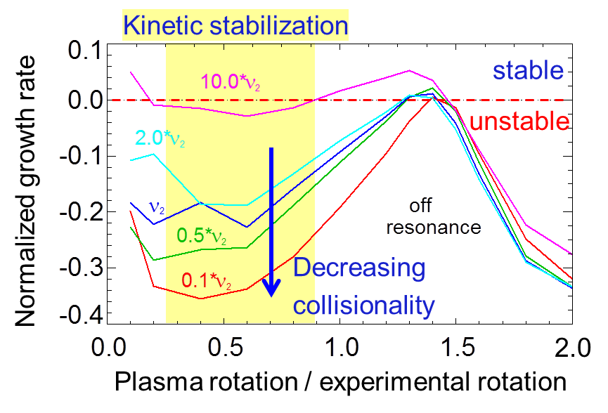
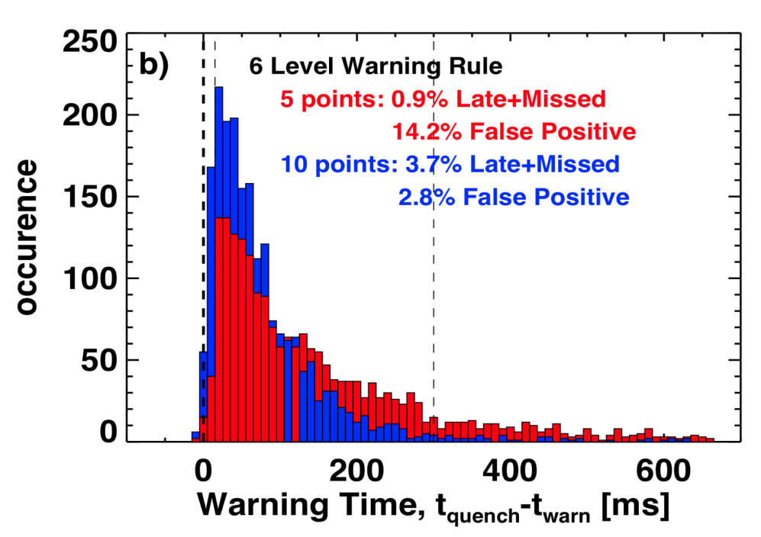
Disruption Prediction / Detection: Status
Kinetic RWM stability may increase at lower ν
Theoretically-based prediction
  e.g. kinetic RWM theory - tested against experiment (NSTX, DIII-D)
MHD Spectroscopy
  Used to measure global plasma stability in DIII-D and NSTX, not yet used routinely
Disruption Warning System
  Some implementations exist (e.g. on DIII-D, JET)
  Recent analysis, highly successful in disruption prediction with low % of false positives when applied to NSTX database
J.W. Berkery, et al., PRL 104 (2010) 035003
J.W. Berkery, et al., PRL 106 (2011) 075004
Disruption warning system assessment
S.P. Gerhardt, et al., NF 53 (2013) 063021

Slide 5
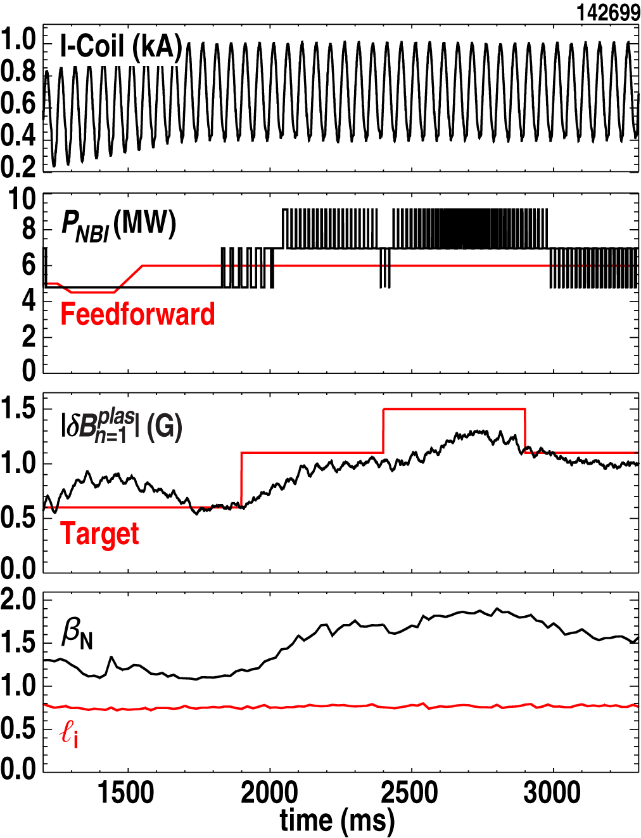
Disruption Prediction / Detection: Initiatives
First real-time β_{N} control using measured field amplification
Physics models
  Real-time (r/t) ideal MHD calculations (DCON), simplified models of kinetic MHD stabilization physics
  Utilize results from non-linear MHD codes
  Expand real-time MHD mode control models, more general plasma response
Measurements
  Demonstrate general effectiveness of MHD spectroscopy in r/t stability prediction
  Develop predictions based on large data-driven statistics (incl. JET)
  Non-magnetic mode diagnosis, especially detection of internal modes
Disruption Warning System
  Introduce additional real-time measurements, theoretical models to further improve performance
  Implement on major US tokamaks, (potentially international devices as well)
Tracer field
NBI actuator
δB sensor
DIII-D
J.M. Hanson, et al., Nucl. Fusion 52 (2012) 013003

Slide 6
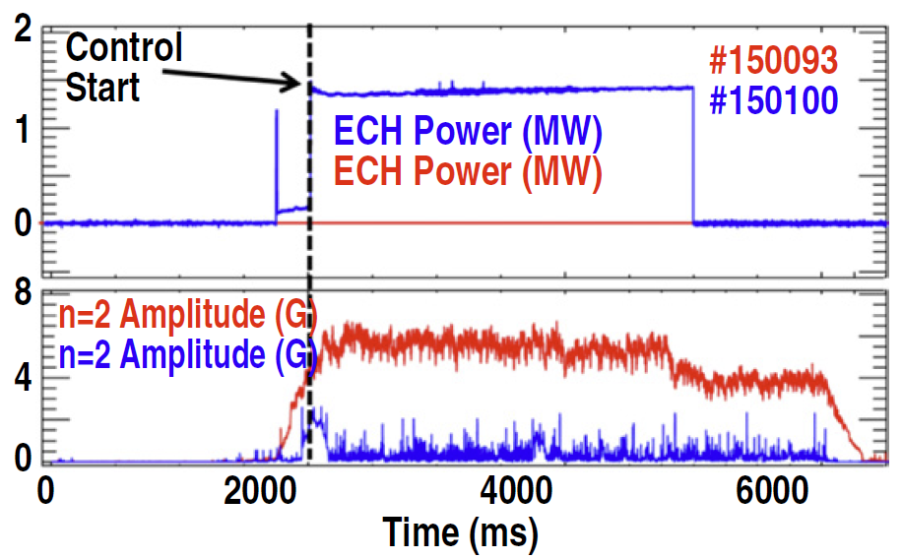
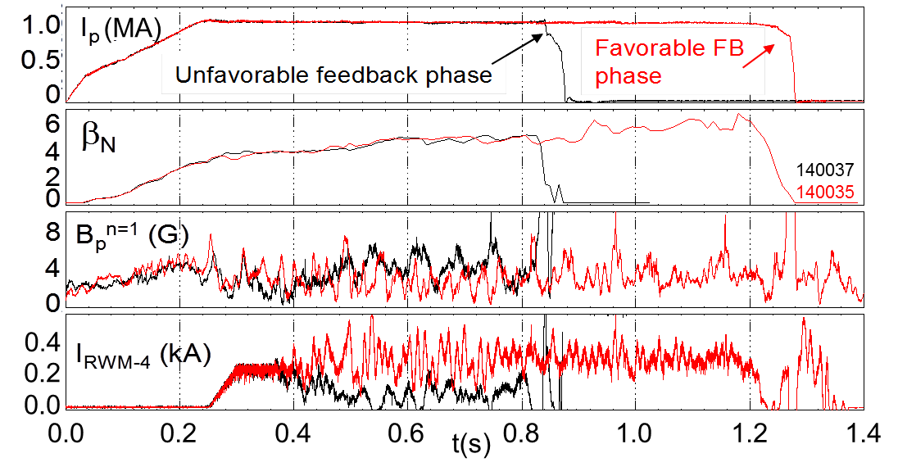
Disruption Avoidance: Status
Advanced NTM Control (DIII-D)
Advanced profile control algorithms
  Being implemented, but profile control is still a relatively untapped opportunity
Active mode control
  Physics-based, state-space algorithms, sensors, and magnetic/ECCD actuators have shown significant successes for RWM / NTM control
MHD spectroscopy (direct stability measurement)
  Not yet generally used for disruption avoidance
  Real-time use for disruption avoidance will be significantly enhanced by profile control
E. Kolemen, et al., Nucl. Fusion 54 (2014) 073020
Model-based RWM control (NSTX)
δB sensor
actuator field
S.A. Sabbagh, et al., Nucl. Fusion 53 (2013) 104007

Slide 7
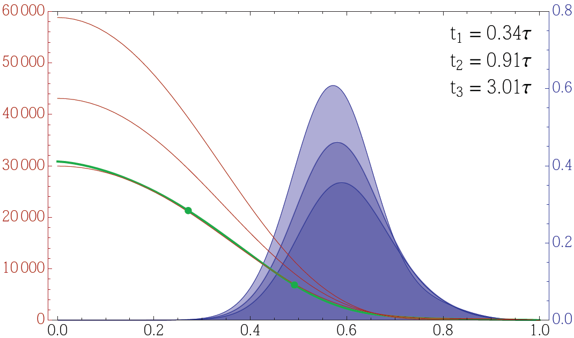
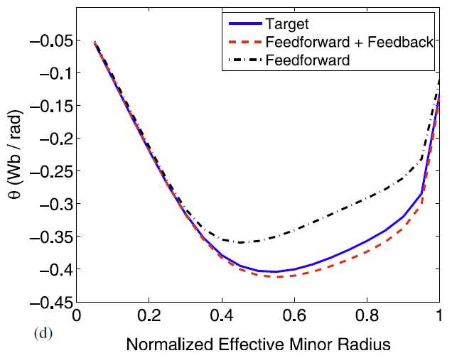
Disruption Avoidance: Initiatives
Plasma rotation controller using 3D fields (NSTX-U)
Advanced profile control
  Significant opportunities using NBI, 3D fields, and innovative core fueling / momentum injection techniques
Active mode control
  Generalize RWM, NTM control: improve performance, prove over long-pulse
Greater utilization of real-time physics models/ MHD spectroscopy
  Utilize real-time guidance from stability gradients to steer away from instability
Computational simulations
  Develop to test control algorithms to make faster progress
Disruption Warning Systems
  Increase and more intelligently use input, prioritize multiple actuators
6
10⁴
t₁
t₂
4
t₃
3D field torque
See R. Raman talk
3D field torque density (N/m²)
Plasma rotation (rad/s)
2
desired
rotation
0
ρ
I. Goumiri, et al. (Princeton University)
Magnetic profile control tested (DIII-D)
J.E. Barton, et al., Nucl. Fusion 52 (2012) 123018

Slide 8
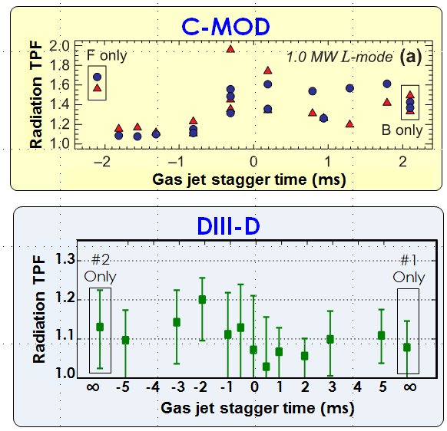
Disruption Mitigation: Status
Effort being made to support ITER mitigation system final design review (2017)
Multiple injectors do not reduce radiation toroidal asymmetry
Heat and radiation loads
  Massive Gas Injection has demonstrated partial success
  …but gas penetration too slow / requires MHD mixing to reach core
  Radiation asymmetries could cause first wall melting – magnitudes differ across devices
Runaway Electron Generation
  Can cause intense melting / erosion
  Innovative ideas now being tested to reduce RE beam
Induced Halo Currents
  Vessel forces associated with halo current asymmetry and rotation are key ITER concern now
N. Eidietis, et al., DIII-D 5 Year Plan talk (2014)

Slide 9
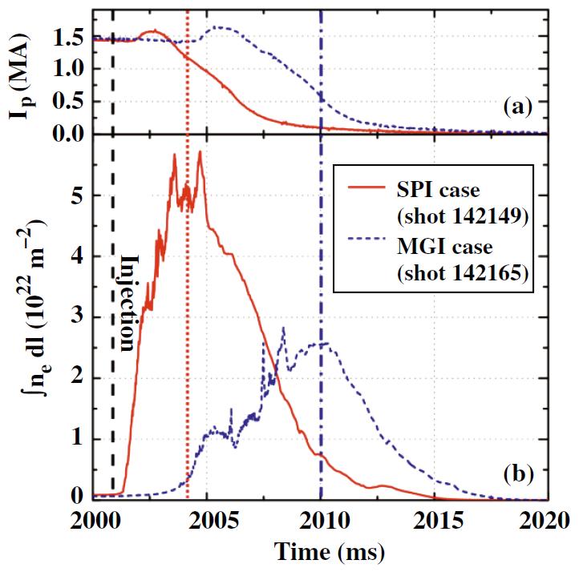
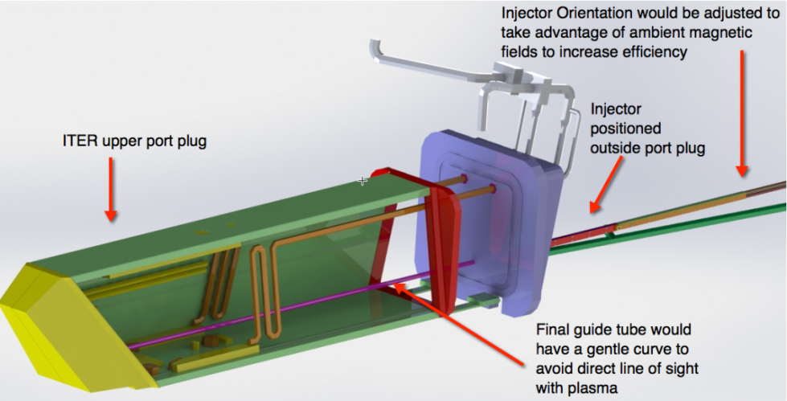
Disruption Mitigation: Initiatives
Shattered Pellet Injector results (DIII-D)
Massive Gas Injection
  Understand gas penetration efficiency vs poloidal location (including X-point); spatial distribution of heat / radiation
Shattered / Shell Pellet Injection
  promising alternative to MGI
Halo current diagnosis
  Expand to understand toroidal asymmetries, rotation, related forces
Electromagnetic Particle Injection
  Adequate to meet < 10 ms response time needed for ITER, test on NSTX-U
Active control of disrupting plasma
  Reduce impact of halo currents and runaway electrons
Sacrificial limiters
  including low-Z liquid metals
N. Commaux, et al., Nucl. Fusion 51 (2011) 103001
Electromagnetic Particle Injector in ITER (schematic)
  Related theoretical modeling needed for extrapolation to ITER, FNSF, etc.
R. Raman, et al., EPS 2014, Paper P5.015

Slide 10
  Building on present program strengths in disruption PAM is the most efficient path for best progress
Fund a “National Initiative for Disruption Elimination”
  A unique, world-leading effort with quantifiable objectives, leveraging significant US investment in major facilities and university expertise
  Funded leaders (including university collaborations) to be responsible for key elements, conduct work as a synergistic team
Initiative supports incremental elements of disruption PAM in the present, complementary efforts at major US facilities
  Five-year plan of significantly upgraded NSTX device is shifting focus of stability and control research to disruption PAM
  Significant and complementary disruption PAM elements exist in DIII-D 5 Year Plan, esp. advanced NTM control and mitigation research
Leverage international programs
  Gain experience from JET, utilize KSTAR high β long-pulse plasmas
  Apply US-developed techniques to high power / long-pulse devices
Estimated cost of 10 year mission: +$5M/year – $7.5M/year
  Based on up to 50% increase in present FTEs, and international funding
  NOTE: includes $3M/year cost of major facility hardware upgrades

Slide 11
Supporting Slides Follow

Slide 12
Disruption PAM research is critically important – it pervades 3 of 5 ReNeW Themes
Key PAM
extrapolations
Theme 1: Burning Plasmas in ITER
  Thrust 2: Control transient events in burning plasmas
Theme 2: Creating Predictable, High-Performance, Steady-State Plasmas
  Thrust 5: Expand the limits for controlling/sustaining fusion plasmas
  Thrust 6: Develop predictive models for fusion plasmas, supported by theory, challenged with experimental measurement
Theme 5: Optimizing the Magnetic Configuration
  Thrust 16: Develop the ST to advance fusion nuclear science
    Element 3: “…understanding of ST confinement and stability at fusion-relevant parameters”
    Element 4: “Implement and understand active and passive control techniques to enable long-pulse disruption-free operation…”
    Element 5: “Employ …beams, …waves, particle control, core fueling techniques to maintain the current and control the plasma profiles.”
reduced collisionality
+ non-inductive sustainment
+ high β, profile control

Slide 13
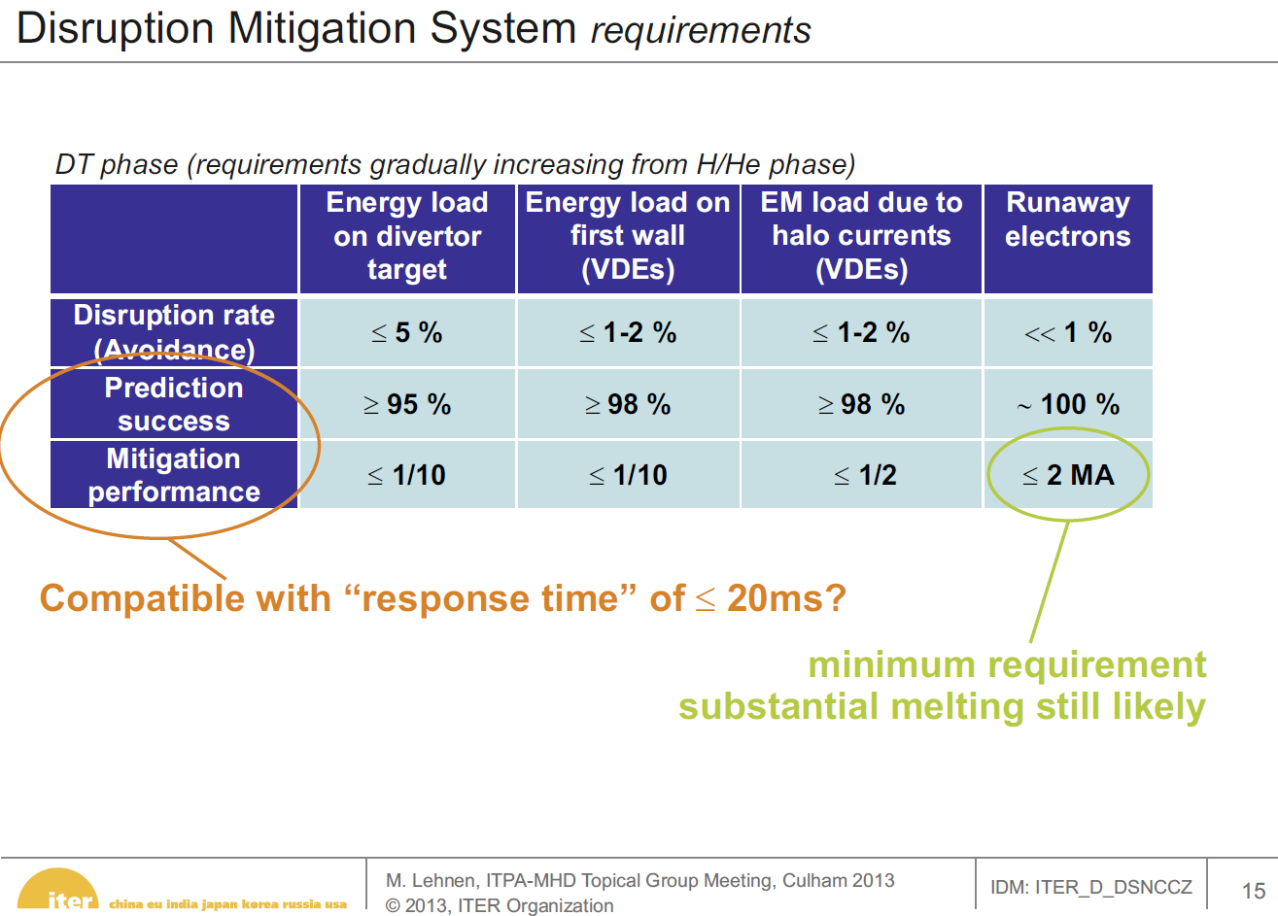
ITER Disruptivity Requirements (Lehnen 2013)

