Slide 1

Overview of Initial NSTX-U
Plasma Operations
Devon Battaglia
On Behalf of the NSTX-U team
NSTX-U PAC 37
January 26 - 28, 2016

Slide 2
Summary of NSTX-U Plasma Operations
CD-4 milestone (I_{p} > 50kA) completed August, 2015
  I_{p} ~ 150 kA with GDC and CS bake
2.5 days of operation following full vessel bake, before boronization (December, 2015)
  I_{p} = 500 kA flattop with inner-wall limited L-mode
  Progress enabled by I_{p}, gap and Z feedback control
2.5 weeks of operations in January, 2016
  Neutral beam heating: up to 4MW total from four sources
  Diverted L-mode and H-mode operations at I_{p} = 600 kA
    Good progress toward goal: 1.4 MA, 2s ELMy H-mode by week 8
  Three boronizations completed

Slide 3
Significant progress over the first few weeks in commissioning NSTX-U
Boronization
First NBI
H-mode
Boronization
Boronization
Maximum Stored Energy (kJ)
Diverting

Slide 4
Reliable H-mode access has been achieved on NSTX-U
H-mode with NBI > 1.5 MW at I_{p} > 500 kA, B_{T} = 0.65T
  H-mode achieved with only 0.9 MW NBI in a few cases
  B_{T} exceeds maximum in NSTX
202946
Odd n MHD (G)
Lower divertor
Stored energy (kJ)
MHD efit01
Inner gap
(cm) efit01

Slide 5
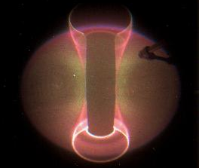
Excellent diagnostic availability has enabled rapid progress
202946
L-mode 0.30s
H-mode 0.48s
I_{p} | 0.58 MA
B_{T0} | 0.61 T
P_{NBI} | 3 MW
P_{OH} | 0.2 MW
A | 1.6
κ | 1.53
l_{i} | 0.97
δ_{lower} | 0.55
W | 151 kJ
β_{T} | 7.86%
β_{P} | 1.22%
β_{N} | 4.66
τ_{e} | 50 ms
ψ_{N}
Lower div D_{α}
L-H transition
Mid D_{α}
LFS gas
ELMs
HFS gas
Divert

Slide 6
Stationary diverted L-mode operations has also been achieved
202814
1 MW NBI
26 kA swing
These discharges have already been used to support research operations

Slide 7
Significant progress has been made on a number of commissioning activities
XMP-101: Inductive startup on NSTX-U
XMP-106: Magnetics calibration
XMP-126: Initial I_{p} and R control
XMP-105: Initial n=0 control
XMP-118: Boronization characterization
XMP-127: Neutral beam checkout
XMP-132: Automated rampdown development
XMP-107: Neutron calibration transfer
XMP-133: Increase elongation in L-mode
XMP-116: Initial H-mode access in NSTX-U
XMP-121: Six SPA and RWM coil checkout
XP-1506: Low-beta locked mode studies

Slide 8
Inductive startup scenario informed by vacuum field modeling
Solenoid provides confining B_{Z}
  Bipolar PF3 coils null this field
  V_{loop} via ramping OH and PF3 fields
Null properties sensitive to fields from induced wall currents
  LRDFIT wall model used to prepare scenarios in advance
  About 200 kA total wall current at breakdown
PF3 and PF5 coils provide additional B_{p} following breakdown
  Must maintain passive R and Z stability
Simulated B_{p} fields at breakdown
PF3

Slide 9
Startup scenario identified via calculations enabled rapid progress in achieving CD-4
Shot #11
50 kA CD-4 requirement
Shot #5

Slide 10
Loop voltage required for breakdown in good agreement with calculations
NSTX
I_{TF} = 65 kA
I_{OH} = 24 kA
NSTX-U
I_{TF} = 80 kA
I_{OH} = 8 kA
NSTX-U
I_{TF} = 80 kA
I_{OH} = 20 kA
Lloyd parameter:
Model:
V_{loop} = 2.0 V
V_{loop} = 2.4 V
V_{loop} = 2.5 V
V_{loop} = 3.3V
V_{loop} = 3.7 V
Experiment:

Slide 11
Routine startup at two OH precharge levels has been demonstrated
Goal: scalable scenario for arbitrary OH precharge
  Some experiments desire flexible precharge to optimize constraints from coil heating and coil current limits
202567
202573
Limited L-mode Helium

Slide 12
New capability: automated rampdown used in routine operations
Plasma control system detects loss of control
  OH solenoid near maximum current
  Vertical oscillations exceed threshold
  Abs( I_{p} - I_{p request} ) too large
Feedback control switches to new “states” that attempt to gently end the discharge
See S. Gerhardt’s talk
I_{P}
I_{P} Request
(including asynchronous transition to rampdown)
  Z_{P}(dZ_{P}/dt) threshold
  Z_{P}(dZ_{P}/dt)
“State”
Insufficient I_{P}
Fast I_{P} Rampdown
Normal
  Z_{P} from EFIT

Slide 13
Digital coil protection system successful in preventing unacceptable coil operation
Example of a hard shutdown in response to a force limit
- I_{OH}
+ I_{PF1A}
Vertical force on PF1A
More details in Facility Status talk (M. Ono)

Slide 14
First boronization had positive impact on discharge performance
Flux consumption and oxygen content reduced
Measurements of boron deposition and impurity migration have been completed (see M. Jaworski’s talk)
Limited L-mode Helium
202439
202532

Slide 15
Operations will restart with continued goal of developing fiducial ELMy H-mode discharge
H-mode operations open path to lower l_{i}
  Permits larger κ and I_{p} range
  Target l_{i} ~ 0.5 via an earlier L-H transition, larger NBI power and improved wall conditions
Target fiducial for FY2016 is an ELMy H-mode discharge at I_{p} = 1.4 MA
140
120
100
80
60
40
20
0
Average stored energy over flattop
<W>_{FT} (kJ)
Average l_{i} over flattop
1.5
1.0
0.5
0
<l_{i}>_{FT}
First 66 shots: L-mode He

Slide 16
Operations will restart with continued goal of developing fiducial ELMy H-mode discharge
H-mode operations open path to lower l_{i}
  Permits larger κ and I_{p} range
  Target l_{i} ~ 0.5 via an earlier L-H transition, larger NBI power and improved wall conditions
Target fiducial for FY2016 is an ELMy H-mode discharge at I_{p} = 1.4 MA
140
120
100
80
60
40
20
0
Average stored energy over flattop
<W>_{FT} (kJ)
First H-mode
Average l_{i} over flattop
1.5
1.0
0.5
0
<l_{i}>_{FT}
First H-mode
First 66 shots: L-mode He
Next 66 shots: L-mode D, NBI

Slide 17
Operations will restart with continued goal of developing fiducial ELMy H-mode discharge
H-mode operations open path to lower l_{i}
  Permits larger κ and I_{p} range
  Target l_{i} ~ 0.5 via an earlier L-H transition, larger NBI power and improved wall conditions
Target fiducial for FY2016 is an ELMy H-mode discharge at I_{p} = 1.4 MA
140
120
100
80
60
40
20
0
Average stored energy over flattop
<W>_{FT} (kJ)
Average l_{i} over flattop
1.5
1.0
0.5
0
<l_{i}>_{FT}
First 66 shots: L-mode He
Next 66 shots: L-mode D, NBI
Last 66 shots: Diverted

Slide 18
Ongoing commissioning activities will prepare NSTX-U for research program
Near-term activities include …
  Optimization of vertical control (see S. Gerhardt’s talk)
  ISOFLUX shape control
    rtEFIT has been successfully running and is ready to support operations
  Error field identification and correction
    Low-beta error field measurements have been completed
  Diagnostic commissioning and calibration
    MPTS, CHERS, MSE, NPAs, FIDA
  NBI power modulation for β control from PCS
    PCS control of beam termination has been used
  MHD spectroscopy and RWM control
    Real-time mode detection in PCS is nearly complete
Covered in detail in Jon Menard’s talk

Slide 19
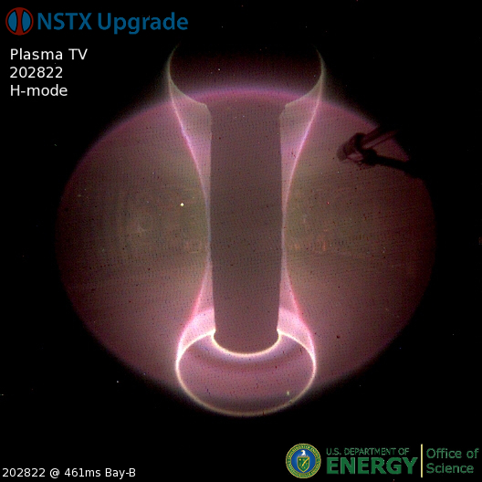
Plasma operations on NSTX-U is off to a great start!
First days of NSTX-U have produced H-mode and stationary diverted L-mode discharges
Control and diagnostic capabilities established quickly
Research program starting in parallel with commissioning activities

