Slide 1

Plasma control algorithm development on NSTX-U using TRANSP
Dan Boyer
for the Integrated Scenarios science group
NSTX-U Program Advisory Committee Meeting (PAC-37)
January 26, 2016

Slide 2
NSTX-U Mission Elements
5 Highest Research Priorities
Explore unique ST parameter regimes to advance predictive capability - for ITER and beyond
  Understand confinement and stability at high beta and low collisionality
  Study energetic particle physics prototypical of burning plasmas
Develop solutions for PMI challenge
3.Dissipate high edge heat loads using expanded magnetic fields + radiation 4.Compare performance of solid vs. liquid metal plasma facing components
Advance ST as possible FNSF / Pilot Plant
5.Form and sustain plasma current without transformer for steady-state ST

Slide 3
TRANSP routinely used in interpretive mode, increasingly in predictive mode
Equilibrium
n_{e}, T_{e} profiles, Z_{eff}
Injected power
Interpretive TRANSP
Transport parameters
Coil currents or desired boundary
Transport model
Injected power
Predictive TRANSP
T_{e}, n_{e} profiles, Z_{eff}
Notes:
Revise title, less passive

Slide 4
High-fidelity control simulations needed for model-based control design and validation
Control design typically relies on reduced modeling to make the design problem easier
  Simplified analytical or empirical expression used to capture dominant phenomena
  Linearization, time-scale separation, or other means are often used to further simplify the model used for design
When tested experimentally, the nonlinearities and coupling of the actual system may degrade performance
  Dedicated experimental time needed for commissioning
Testing controllers using the integrated modeling code TRANSP prior to implementation may:
  Improve controller performance and reduce time for commissioning and fine tuning
  Enable demonstration of new control techniques to justify implementation and experimental time
TRANSP
Design
Actual system
First-principles model
Simplified model
(empirical/analytical scalings)
Model for control design
Control design
Testing
Notes:
Put TRANSP on figure. More active voice in title, ‘high-fidelity control simulations…’

Slide 5
NSTX-U TRANSP feedback control simulations based on scenario development
Desired boundary
MHD equilibrium
n_{e}, T_{e} profiles, Z_{eff}
Injected power
Transport
Heating/current drive
ISOLVER
T_{i}: Chang-Hinton
NUBEAM
T_{e}: prescribed
Sauter
n_{e}: prescribed
n_{i}: based on Z_{eff}
Z_{eff}: prescribed
S. Gerhardt, NF 2012

Slide 6
Now using TRANSP as a virtual tokamak for control design
Desired boundary
MHD equilibrium
n_{e}, T_{e} profiles, Z_{eff}
Injected power
Transport
Heating/current drive
ISOLVER
T_{i}: Chang-Hinton
NUBEAM
T_{e}: prescribed
H₉₈, H_{ST}
Sauter
n_{e}: prescribed
f_{GW}
n_{i}: based on Z_{eff}
Electron temperature and density no longer a priori inputs
Ability to change actuators in `real-time’, i.e., based on feedback control
An analog to the plasma control system (PCS)
Z_{eff}: prescribed
Notes:
Explicit constraints, equations, next to bubbles, change order

Slide 7
Now using TRANSP as a virtual tokamak for control design
Desired boundary
MHD equilibrium
n_{e}, T_{e} profiles, Z_{eff}
Injected power
Transport
Heating/current drive
ISOLVER
T_{i}: Chang-Hinton
NUBEAM
T_{e}: prescribed
Sauter
n_{e}: prescribed
n_{i}: based on Z_{eff}
Electron temperature and density no longer a priori inputs
Ability to change actuators in `TRANSP real-time’, i.e., based on feedback control
An analog to the plasma control system (PCS)
Z_{eff}: prescribed
Notes:
‘TRANSP as virtual tokamak’

Slide 8
Now using TRANSP as a virtual tokamak for control design
PCS
Desired boundary
MHD equilibrium
n_{e}, T_{e} profiles, Z_{eff}
Injected power
Transport
Heating/current drive
ISOLVER
T_{i}: Chang-Hinton
NUBEAM
T_{e}: prescribed
Sauter
n_{e}: prescribed
n_{i}: based on Z_{eff}
Electron temperature and density no longer a priori inputs
Ability to change actuators in `real-time’, i.e., based on feedback control
An analog to the plasma control system (PCS)
Z_{eff}: prescribed

Slide 9
Ability to change actuators in `TRANSP real-time’, i.e., based on feedback control
Heating/CD
Plasma current
NTV torque
Toroidal field
Physics layer
Density
Plasma boundary
Confinement factor
Engineering layer
Hardware layer
Implemented
Implementing
Not yet implemented

Slide 10
Ability to change actuators in `TRANSP real-time’, i.e., based on feedback control
Heating/CD
Plasma current
NTV torque
Toroidal field
Physics layer
Density
Plasma boundary
Confinement factor
Engineering layer
NBI power
Gas puff
OH coil current
PF coil currents
RWM coil currents
TF current
RF sources
Pellets
OH coil voltage
PF coil voltages
RWM coil voltages
TF voltage
Hardware layer
Implemented
Implementing
Not yet implemented

Slide 11
Ability to change actuators in `TRANSP real-time’, i.e., based on feedback control
Heating/CD
Plasma current
NTV torque
Toroidal field
Physics layer
Density
Plasma boundary
Confinement factor
Engineering layer
NBI power
Gas puff
OH coil current
PF coil currents
RWM coil currents
TF current
RF sources
Pellets
OH coil voltage
PF coil voltages
RWM coil voltages
TF voltage
Hardware layer
NBI modulation
PF power supplies
PF power supplies
RWM power supplies
TF power supplies
Implemented
Implementing
Not yet implemented

Slide 12
Several on-going projects using
TRANSP feedback control framework
Stored energy and q₀ control on NSTX-U
  M. D. Boyer, PPPL, Experiment: XP-1509
Stored energy, q₀, and I_{p} control on NSTX-U (non-inductive scenarios)
  M. D. Boyer, PPPL, Experiment: future XP, possibly XP-1507
Rotation profile control on NSTX-U
  I. Goumiri, Princeton U., Experiment: XP-1564
Current profile control on NSTX-U
  Z. Ilhan, Lehigh U., Experiment: part of XP-1532
Rotation profile control on DIII-D
  W. Wehner, Lehigh U.
Shape control on NSTX-U
  M. D. Boyer, PPPL
NTM control on ITER
  F. Poli, PPPL

Slide 13
Several on-going projects using
TRANSP feedback control framework
Stored energy and q₀ control on NSTX-U
  M. D. Boyer, PPPL, Experiment: XP-1509
Stored energy, q₀, and I_{p} control on NSTX-U (non-inductive scenarios)
  M. D. Boyer, PPPL, Experiment: future XP, possibly XP-1507
Rotation profile control on NSTX-U
  I. Goumiri, Princeton U., Experiment: XP-1564
Current profile control on NSTX-U
  Z. Ilhan, Lehigh U., Experiment: part of XP-1532
Rotation profile control on DIII-D
  W. Wehner, Lehigh U.
Shape control on NSTX-U
  M. D. Boyer, PPPL
NTM control on ITER
  F. Poli, PPPL

Slide 14
Several on-going projects using
TRANSP feedback control framework
Stored energy and q₀ control on NSTX-U
  M. D. Boyer, PPPL, Experiment: XP-1509
Stored energy, q₀, and I_{p} control on NSTX-U (non-inductive scenarios)
  M. D. Boyer, PPPL, Experiment: future XP, possibly XP-1507
Rotation profile control on NSTX-U
  I. Goumiri, Princeton U., Experiment: XP-1564
Current profile control on NSTX-U
  Z. Ilhan, Lehigh U., Experiment: part of XP-1532
Rotation profile control on DIII-D
  W. Wehner, Lehigh U.
Shape control on NSTX-U
  M. D. Boyer, PPPL
NTM control on ITER
  F. Poli, PPPL

Slide 15
Using TRANSP to test q₀ and β_{N} control via beam power and outer gap size actuation
Boundary can have strong effect on q profile through
  Effect on beam deposition profile
  Effect on bootstrap current through change in elongation
Two reference boundaries with different outer gap sizes were chosen, and interpolated between based on the feedback controller request
Small outer gap
Large outer gap
M.D. Boyer, NF 2015

Slide 16
State-space system identification used for designing simultaneous q₀ and β_{N} controller
Open loop signals applied to each actuator in several TRANSP runs
Linear dynamic model optimized to predict outputs
Notes:
Denote validation region

Slide 17
Optimal controller achieves good target tracking in TRANSP simulations
Evolution tracks step change in requested values
Controller increases outer gap and decreases beam power to track change in request
Controller has important implications for MHD stability – ability to avoid q=1, or to move radius of the q=2 surface to avoid 2/1 NTMs.
Notes:
Qmin vs q0, scenario optimization (change q0 without large change in beta)

Slide 18
Several on-going projects using
TRANSP feedback control framework
Stored energy and q₀ control on NSTX-U
  M. D. Boyer, PPPL, Experiment: XP-1509
Stored energy, q₀, and I_{p} control on NSTX-U (non-inductive scenarios)
  M. D. Boyer, PPPL, Experiment: future XP, possibly XP-1507
Rotation profile control on NSTX-U
  I. Goumiri, Princeton U., Experiment: XP-1564
Current profile control on NSTX-U
  Z. Ilhan, Lehigh U., Experiment: part of XP-1532
Rotation profile control on DIII-D
  W. Wehner, Lehigh U.
Shape control on NSTX-U
  M. D. Boyer, PPPL
NTM control on ITER
  F. Poli, PPPL

Slide 19
β_{N} and q₀ control with beam line 1 and outer gap improves response and tracks targets
Reference
Closed loop Target
Power reduced for first β_{N} target, increased for second
Outer gap decreased to speed q₀ response, increased to maintain elevated target
Plasma current (not controlled) response varies from reference
  q₀ approaches 1 after target change (could adjust target trajectories or control gains)
Notes:
X74

Slide 20
Several on-going projects using
TRANSP feedback control framework
Stored energy and q₀ control on NSTX-U
  M. D. Boyer, PPPL, Experiment: XP-1509
Stored energy, q₀, and I_{p} control on NSTX-U (non-inductive scenarios)
  M. D. Boyer, PPPL, Experiment: future XP, possibly XP-1507
Rotation profile control on NSTX-U
  I. Goumiri, Princeton U., Experiment: XP-1564
Current profile control on NSTX-U
  Z. Ilhan, Lehigh U., Experiment: part of XP-1532
Rotation profile control on DIII-D
  W. Wehner, Lehigh U.
Shape control on NSTX-U
  M. D. Boyer, PPPL
NTM control on ITER
  F. Poli, PPPL

Slide 21
Simplified model used for rotation profile control design in NSTX-U [I. Goumiri]
Using simplified form of toroidal momentum equation for design, profiles derived from TRANSP
Rotation
Notes:
\sum_i n_i m_i \langle R^2\rangle\frac{\partial \omega}{\partial t} = \left(\frac{\partial V}{\partial \rho}\right)^{-1}\frac{\partial}{\partial\rho}\left[\frac{\partial V}{\partial \rho}\sum_i n_i m_i \chi_\phi\langle R^2(\nabla\rho)^2\rangle\frac{\partial\omega}{\partial\rho}\right]+T_{NBI}+T_{NTV}

Slide 22
Simplified model used for rotation profile control design in NSTX-U [I. Goumiri]
Using simplified form of toroidal momentum equation for design, profiles derived from TRANSP
Rotation
Notes:
\sum_i n_i m_i \langle R^2\rangle\frac{\partial \omega}{\partial t} = \left(\frac{\partial V}{\partial \rho}\right)^{-1}\frac{\partial}{\partial\rho}\left[\frac{\partial V}{\partial \rho}\sum_i n_i m_i \chi_\phi\langle R^2(\nabla\rho)^2\rangle\frac{\partial\omega}{\partial\rho}\right]+T_{NBI}+T_{NTV}

Slide 23
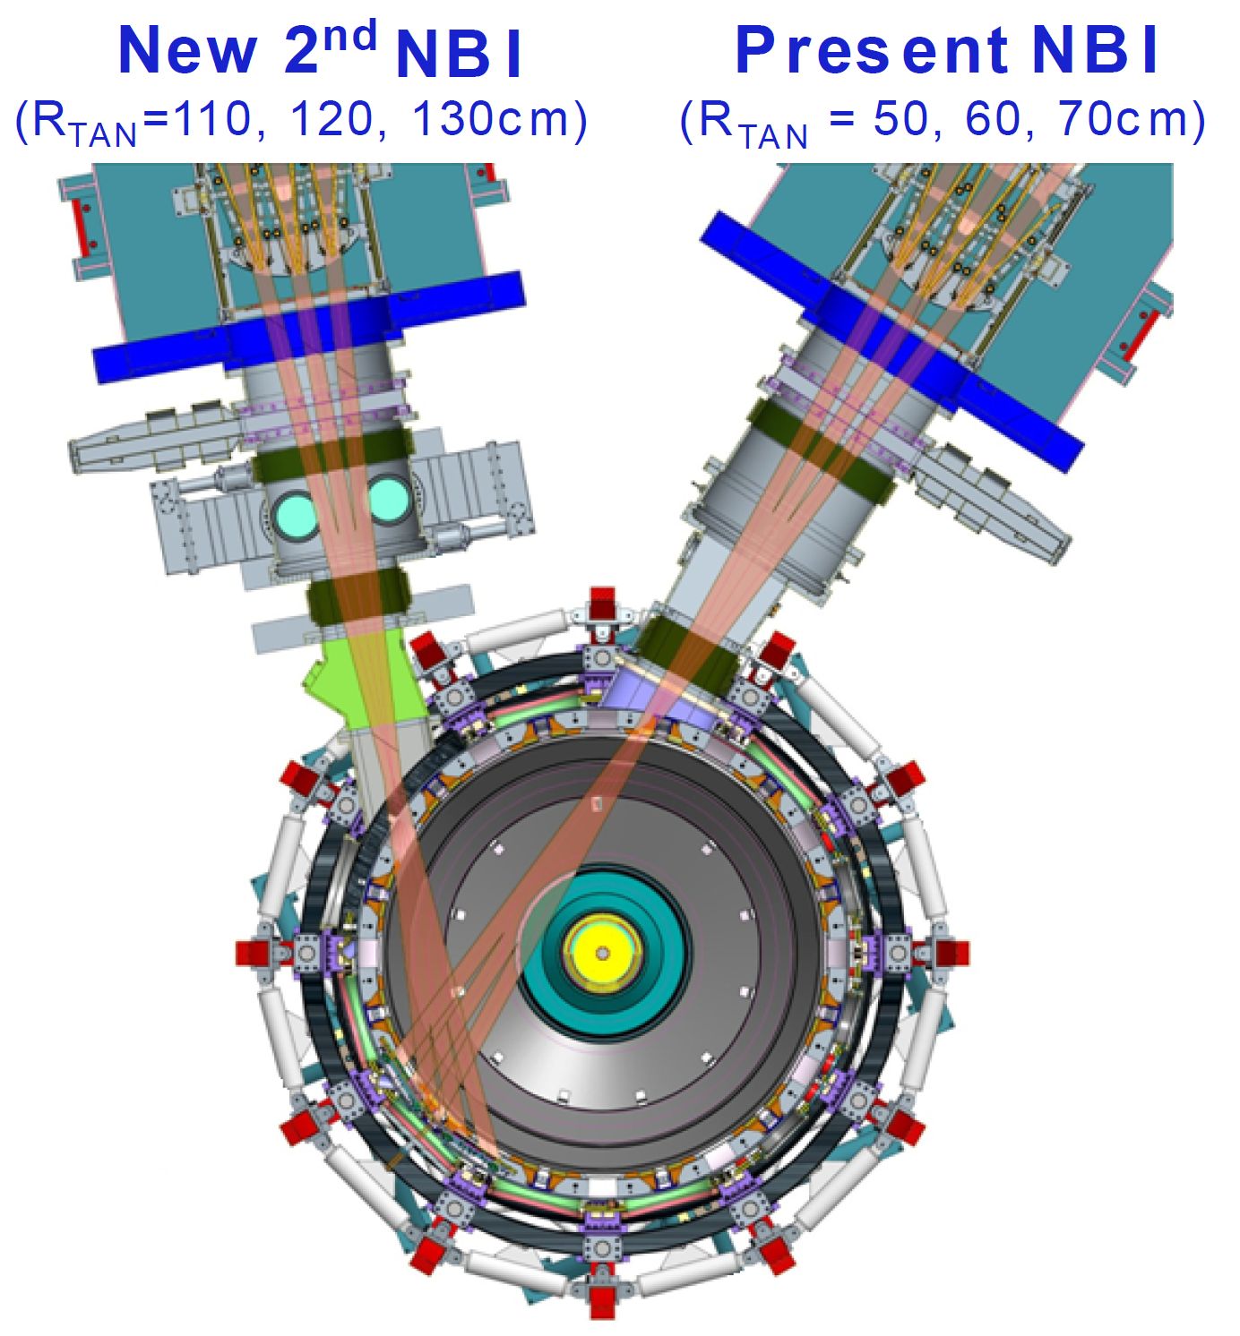
Simplified model used for rotation profile control design in NSTX-U [I. Goumiri]
Using simplified form of toroidal momentum equation for design, profiles derived from TRANSP
Rotation
New NBI
(central torque)
3D Field Coil
(edge torque)
Notes:
\sum_i n_i m_i \langle R^2\rangle\frac{\partial \omega}{\partial t} = \left(\frac{\partial V}{\partial \rho}\right)^{-1}\frac{\partial}{\partial\rho}\left[\frac{\partial V}{\partial \rho}\sum_i n_i m_i \chi_\phi\langle R^2(\nabla\rho)^2\rangle\frac{\partial\omega}{\partial\rho}\right]+T_{NBI}+T_{NTV}

Slide 24
State-space controller achieves good tracking in TRANSP simulations [I. Goumiri]
Rotation
Coil current
First
target
Second
target
Rotation (rad/s)
Coil current [A]
Stored energy
Beam power
Beam 1
Beam 2A
Beam 2B
Beam 2C
Energy (MJ)
Beam Power (MW)
First
target
Second
target
Time (s)
Time (s)

Slide 25
Several on-going projects using
TRANSP feedback control framework
Stored energy and q₀ control on NSTX-U
  M. D. Boyer, PPPL, Experiment: XP-1509
Stored energy, q₀, and I_{p} control on NSTX-U (non-inductive scenarios)
  M. D. Boyer, PPPL, Experiment: future XP, possibly XP-1507
Rotation profile control on NSTX-U
  I. Goumiri, Princeton U., Experiment: XP-1564
Current profile control on NSTX-U
  Z. Ilhan, Lehigh U., Experiment: part of XP-1532
Rotation profile control on DIII-D
  W. Wehner, Lehigh U.
Shape control on NSTX-U
  M. D. Boyer, PPPL
NTM control on ITER
  F. Poli, PPPL

Slide 26
Simplified current profile model used for feedback and feedforward control design
Magnetic diffusion equation
  Similar form to momentum diffusion equation
  Enables similar modeling approach
Multiple actuators considered:
  Loop voltage
  Individual beam heating
  Density
Feedback controller for tracking and disturbance rejection designed and tested in TRANSP
Feedforward control optimization based on reduced model
Z. Ilhan, W. Wehner, E. Schuster

Slide 27
Feedforward actuator trajectory optimization to match target q profile
Optimizing for target matching
Optimizing for stationarity
Optimizing for both
Time (s)
Time (s)
Time (s)
Z. Ilhan, W. Wehner, E. Schuster

Slide 28
Summary and future work
Complexity of the control requirements for NSTX-U motivates use of model-based control
A TRANSP framework for testing feedback controllers prior to experiments has been developed:
  Generate and test control-oriented models
  Test/tune feedback control algorithms
  Test new algorithms, demonstrate new control approaches
Future work
  Test on NSTX-U!

Slide 29
Backup Slides

Slide 30
Feedback control of NSTX-U is a complex task but model-based design can help
Performance requirements
Dynamics
Competing goals
Constraints (MHD stability)
Actuators
Nonlinearities
Control design problem
Multiple actuators
Coupling
Actuator limitations
Spatially distributed
Real-time measurements
Limited
Noisy
By incorporating dynamic models in the design process, control algorithms can be made to handle all of these issues

Slide 31
Modifications have been implemented using external code: the Expert file
Expert subroutine called at many places throughout TRANSP production code
An identifier is passed along with the call
  different snippets of code can be run at different points during the simulation
Custom run-specific code can be run at each call to manipulate certain variables (which would typically be input ahead of time) based on the state of the simulation

Slide 32
Profiles and coil currents during optimal controller simulation
7s: change in outer gap shifts q₀ up
  Less peaked NBCD
  Increased bootstrap cur.
Coil currents appear physically achievable

Slide 33
Reference simulation w/ fixed OH current: slow response, sensitivity to disturbances
NB sources: 1B, 1C, 2A, and 2B
Outer gap: 14cm
Broad n_{e}, T_{e} profiles from NSTX 142301
Particle inventory held fixed during simulation
Reference
Perturbed density
Slow evolution to 100% non-inductive
  Can feedback control speed up response or track different targets?
Perturbations in density, confinement, and profile shapes can affect response
  Can feedback recover performance?
q₀ < 1
earlier
with lower density

Slide 34
β_{N} and q₀ feedback using beam line 1 and outer gap control during confinement pert.
Reference
Perturbed Closed loop
Beam line 1 power increased to track reference β_{N}
Increasing beam power and β_{N} leads to increased current
  Reference current nearly recovered despite no feedback control on current
Outer gap adjusted to maintain q₀
Notes:
X80

Slide 35
Left: β_{N} control w/ beam line 1
Right: q₀ control w/ outer gap
Target
tracking
Reference
Closed loop Target
Targets tracked in both cases
q₀ drops below 1 since it is not controlled
Notes:
X66, X69

Slide 36
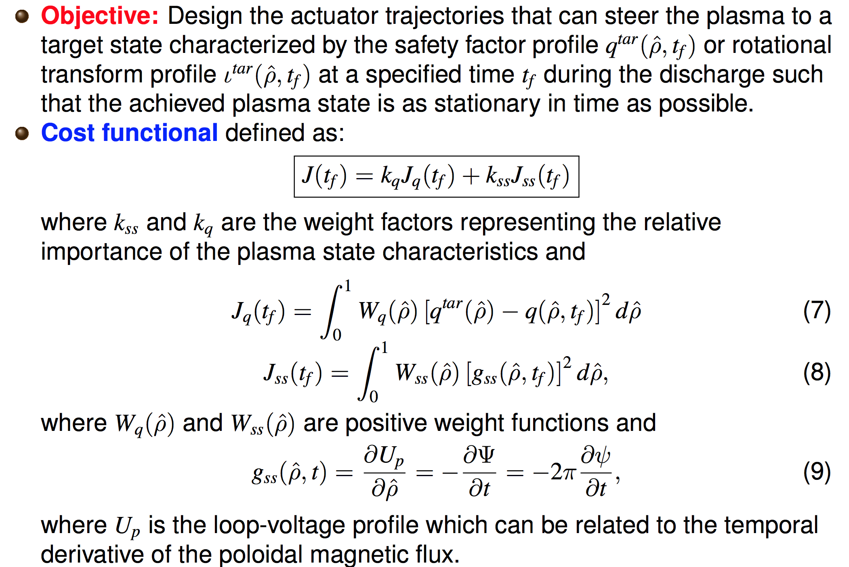
Feedforward actuatory trajectory optimization

