Slide 1

ECH/EBWH Research Plans and progress in the modeling of non-inductive ramp-up
Francesca Poli, Gary Taylor
for the Integrated Scenarios science group
PAC37
Princeton, NJ
January 26, 2016

Slide 2
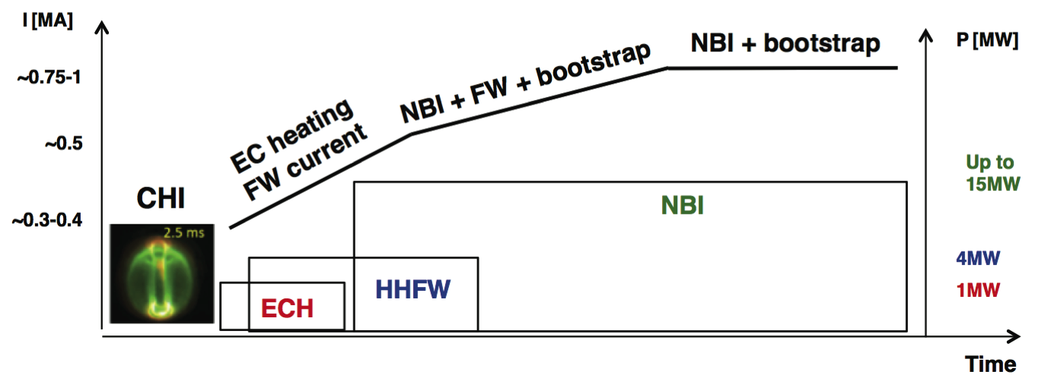
Strategy: combine integrated modeling and experiments to address rampup challenges
startup
Heat startup plasma with EC to maximize H/CD efficiency
Combine RF and NBI for current profile optimization
Optimize NBI source combination for CD and stability.
Maintain control over position, current profile, MHD stability.

Slide 3
2nd NB line can ramp current from HHFW-heated plasma and sustain 900kA
At the previous PAC meeting
Focus was on ramp-up and
sustainment with NBI
HHFW @ t<0.5 ➔ ~400kA
n_{e,lin} = 0.85 n_{GW} ➔~900kA non-inductive,
~60% bootstrap
Focus today is on start-up and early ramp-up
[F. Poli et al, Nucl. Fusion 55 (2015) 123011]

Slide 4
Assumptions in the simulations
Select NSTX discharges, compare transport models on:
  RF and NB at low, constant current
  NB in the ramp-up and at high current flattop
CAVEAT: Startup/rampup not the same as relaxed, flattop plasma.
Transport assumptions will be updated using new NSTX-U data
  pedestal structure, confinement, rotation, turbulence ...
All simulations run with free-boundary TRANSP
  ISOLVER for equilibrium evolution and coil currents
  TORIC (full wave) for HHFW,
  NUBEAM (Monte Carlo) for NBI,
  GENRAY (ray-tracing) for ECH
  Multi Mode Model for thermal transport [Lehigh univ.]
  Prescribe I_{P} waveform and maximize non-inductive current drive

Slide 5
Identify challenges and needs towards non-inductive operation
Optimizing non-inductive current at startup with NBI.
Optimizing non-inductive current at startup with HHFW.
Prepare a target plasma with EC Heating.
Why is ECH a game changer?

Slide 6
NBI losses too large in low-density, low-current plasma target
2C
1C
~50% of NBI power lost due to low density shine-thru
Results in low current drive
1B
1A
Need: optimization of the first 200ms of discharge
non-inductive
Experiments: optimize NBI @low density:
  􏰀minimize shine-thru and losses
  􏰀maximize non-inductive current
Modeling: current and q profile control
[W. Wehner, Lehigh univ., D. Boyer, PPPL]
L-H transition

Slide 7
HHFW can provide the needed current, but efficiency drops after L-H transition
dominant electron heating
in the early ramp-up
L-H transition
Issue: after L-H transition
- HHFW heating less efficiency
current drive efficiency drops
Issue: expect peaked pressure and current profiles.
MHD stability to be assessed
time (s)
Modeling: validation of wave absorption against experiments
Experiments: Wave coupling and FWCD at low density, low current [see presentation by Gerhardt]

Slide 8
Combine HHFW and NBI to drive current when HHFW becomes less efficient
Issue: large absorption to fast ions
=> reduces efficiency
Path: switch from HHFW to NBI
and ramp-up to full current
delay NBI to minimize losses and
maximize current drive
L-H transition
Need: optimization of the first 100ms of discharge
Experiments (future): HHFW+NBI at low current and density
Modeling: validation of fast ion absorption

Slide 9
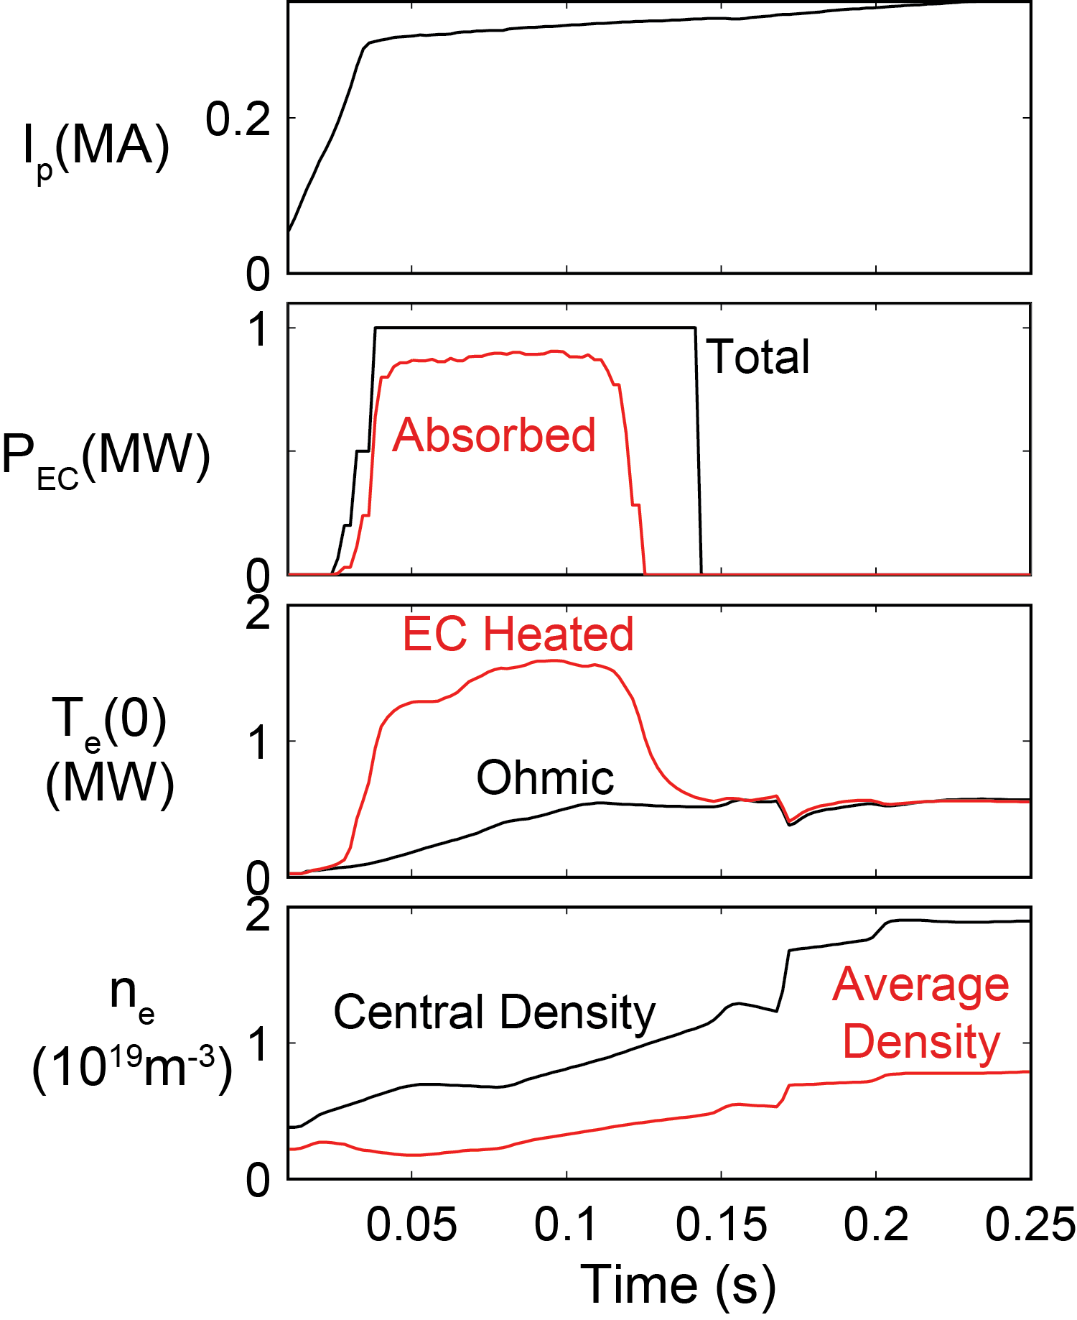
Simulations predict that 28 GHz ECH is very effective at heating NSTX-U start-up plasmas
TRANSP time-dependent simulations with 1 MW of 28 GHz O-mode ECH predict a rapid increase in first-pass absorption from 5% to 75%
as T_{e}(0) increases from 10 eV
to 1 keV in ~10 ms
Issue: ECH can be used for ~150 ms before the plasma n_{e} > n_{cutoff}
Experiments: get new density information
from CHI and low-I_{P} RF target plasmas
Modeling: assess EC heating against plasma parameter variations

Slide 10
ECH generates a high T_{e} start-up plasma that can significantly improve HHFW current drive
No ECH
With ECH
Even with unfavorable CD phasing (k//=3 m⁻¹)
Strong synergy observed in simulations of NI plasma start-up that combine EC and HHFW heating
No FWCD w/o ECH
almost 400kA with 1MW of ECH
HHFW
HHFW
Modeling: assess EC+HHFW heating against plasma parameter variations and HHFW phasing [backup slide]

Slide 11
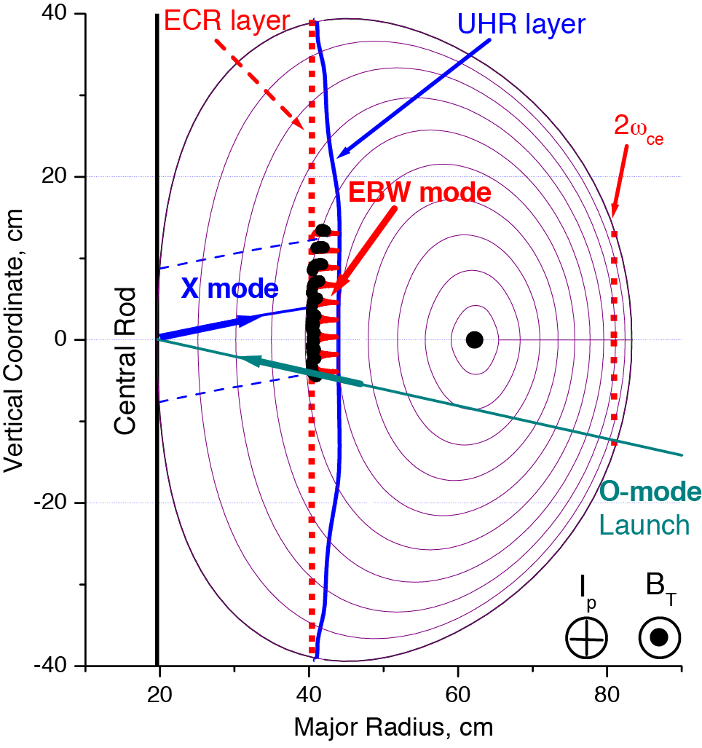
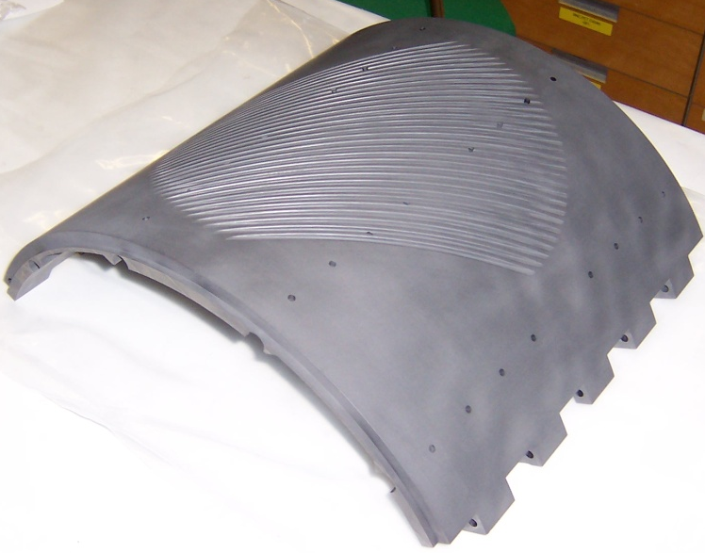
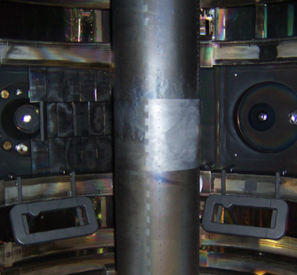
28 GHz EBW start-up on NSTX-U will test power scaling of MAST and QUEST results
Grooved reflecting polarizer machined into center column in MAST => 100% O-X-B conversion
MAST achieved I_{p}~75 kA with ~75 kW power.
EBW start-up on NSTX-U at megawatt level
will test viability of technique at much higher RF power
EBW current drive might scale much weaker than linearly with RF power
=> Pursuing modeling of EBW at startup and flattop using kinetic models
future collaboration with QUEST on EBW startup modeling
SAMI diagnostic on loan from University of York [see backup slide]

Slide 12
Summary and future work
All sources needed for non-inductive current ramp-up
  EC: game changer => reduces by 4 HHFW power needed to drive 300kA on CHI-like target.
  HHFW: drives current where NBI losses are larger
Close connection between integrated modeling and experiments is critical for development of this phase
Longer term: EBW start-up may allow more time to control plasma position and discharge evolution than CHI start-up
  In progress: EC/EBW startup simulations for direct transition to NBI phase [N. Lopez, Princeton University]

Slide 13
Backup slides

Slide 14
HHFW can provide the needed current, but good heating is critical
time (s)
Need 4 MW for ∼350kA current (to be verified in exp.)
FWCD drops after L-H: higher n_{e}, lower electron absorption.
Current profiles peaked => challenge for control and MHD.

Slide 15
ECH improves HHFW efficiency
when combined with EC, lowest phasing most favorable
􏰀 half power needed to drive 400kA compared to w/o EC

Slide 16
Dynamic phasing of HHFW antenna needed to maximize FWCD.
High k// => lower fast ions absorption
Low k// => higher CD efficiency
Synergy: with 1 MW of EC heating, only 1 MW of absorbed HHFW power is predicted to drive 300 kA
Experiments: assess phase changing (response time)
Modeling: optimize EC->HHFW->NBI transition based on experiments

Slide 17
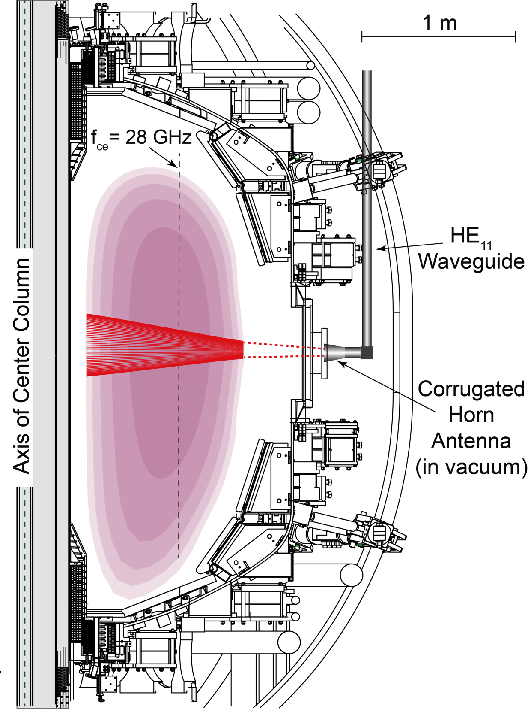
Design and implement 28 GHz EC/EBW heating system to support NI operation*
Plan to use ~2 MW Gyrotron being developed by Tsukuba Univ.**
    Fixed horn antenna & low-loss
    HE11 corrugated waveguide
    Initially use 28 GHz system to heat CHI start-up plasmas
    Later install grooved tile on center
    column to allow EBW plasma start-up
    EBW start-up technique will be same as used successfully on MAST
* G. Taylor et al., EPJ Web Conf. 87 (2015) 02013
** T. Kariya et al., Fusion Science and Technology 68 (2015) 147

Slide 18
MMM95 reproduces amplitude and peaking of electron temperature during the HHFW phase
#138498
Profiles averaged over the heating phase
MMM95 reproduces the average amplitude and peaking in HHFW discharges and in discharges with HHFW+NBI.
Ion temperature overestimated in NBI discharges
Electron temperature too peaked in NBI discharges
HHFW only, 300kA
High density
#140353
#138506
HHFW+NB
HHFW only, 300kA
low density

Slide 19
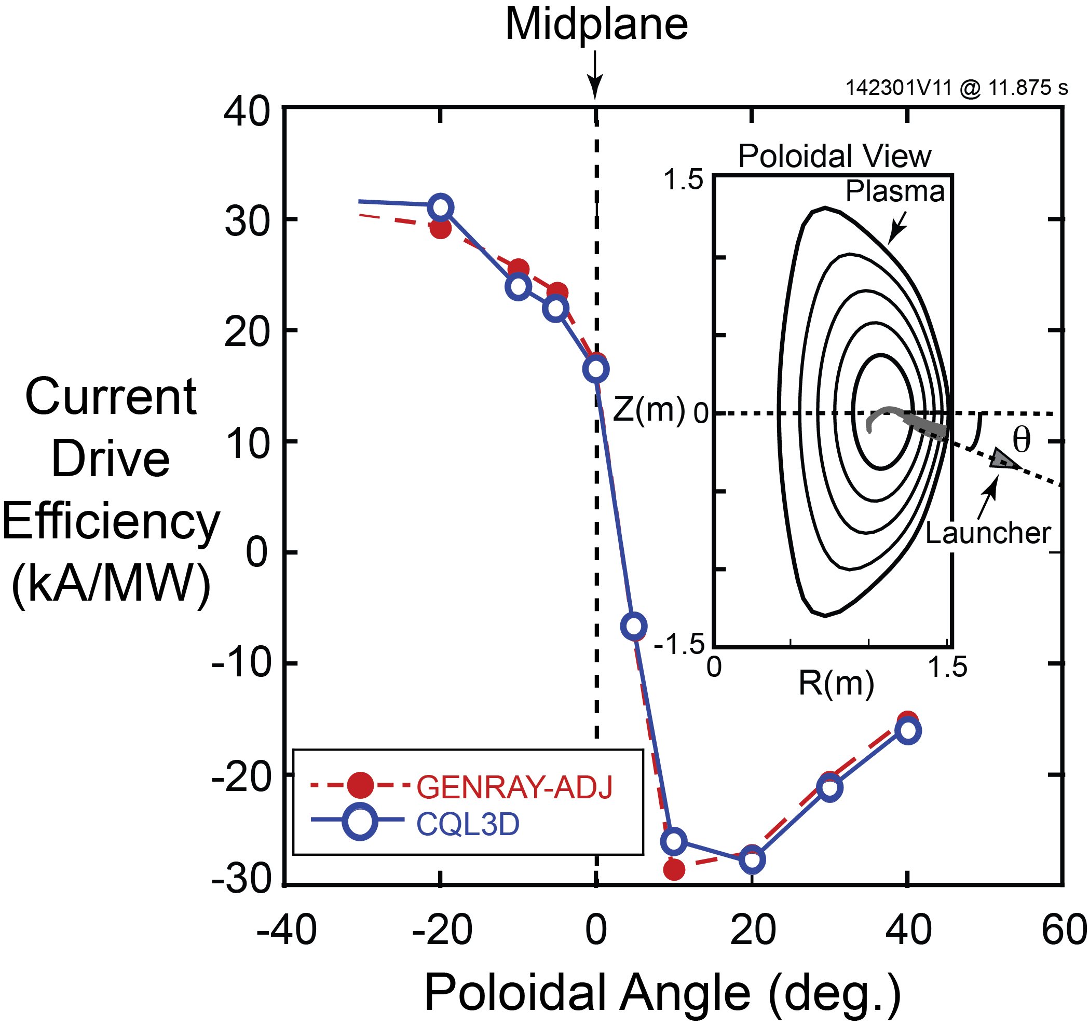
Develop 28 GHz EBW (O-X-B) heating and current drive system for NSTX-U H-modes
EBW simulations for an NSTX-U H-mode
predict η_{eff} ~ 25 kA/MW on axis for
n_{e}(0) = 9 x 10¹⁹m⁻³ and T_{e}(0) = 1.2 keV:
  Can generate significant EBWCD
  at r/a > 0.8, where NBICD is negligible
  Extend simulations to include realistic
  SOL and edge fluctuations
In FY16 measure O-X-B coupling on NSTX-U with synthetic aperture microwave imaging (SAMI)* [Collaboration with UK]
Can test 28 GHz O-X-B heating with
fixed horn antenna:
  Use B-X-O emission data acquired
  by SAMI to guide antenna aiming

Slide 20
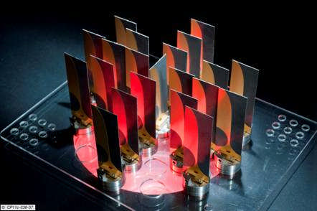
Develop 28 GHz EBW (O-X-B) heating and current drive system for NSTX-U H-modes
EBW simulations for an NSTX-U H-mode
predict η_{eff} ~ 25 kA/MW on axis for
n_{e}(0) = 9 x 10¹⁹m⁻³ and T_{e}(0) = 1.2 keV:
  Can generate significant EBWCD
  at r/a > 0.8, where NBICD is negligible
  Extend simulations to include realistic
  SOL and edge fluctuations
In FY16 measure O-X-B coupling on NSTX-U with synthetic aperture microwave imaging (SAMI)* [Collaboration with Univ. York, UK]
Can test 28 GHz O-X-B heating with
fixed horn antenna:
  Use B-X-O emission data acquired
  by SAMI to guide antenna aiming
Synthetic aperture microwave imaging (SAMI) antenna array
* V.F. Shevchenko et al., AIP Conference Proceedings 1612 (2014) 53

Slide 21
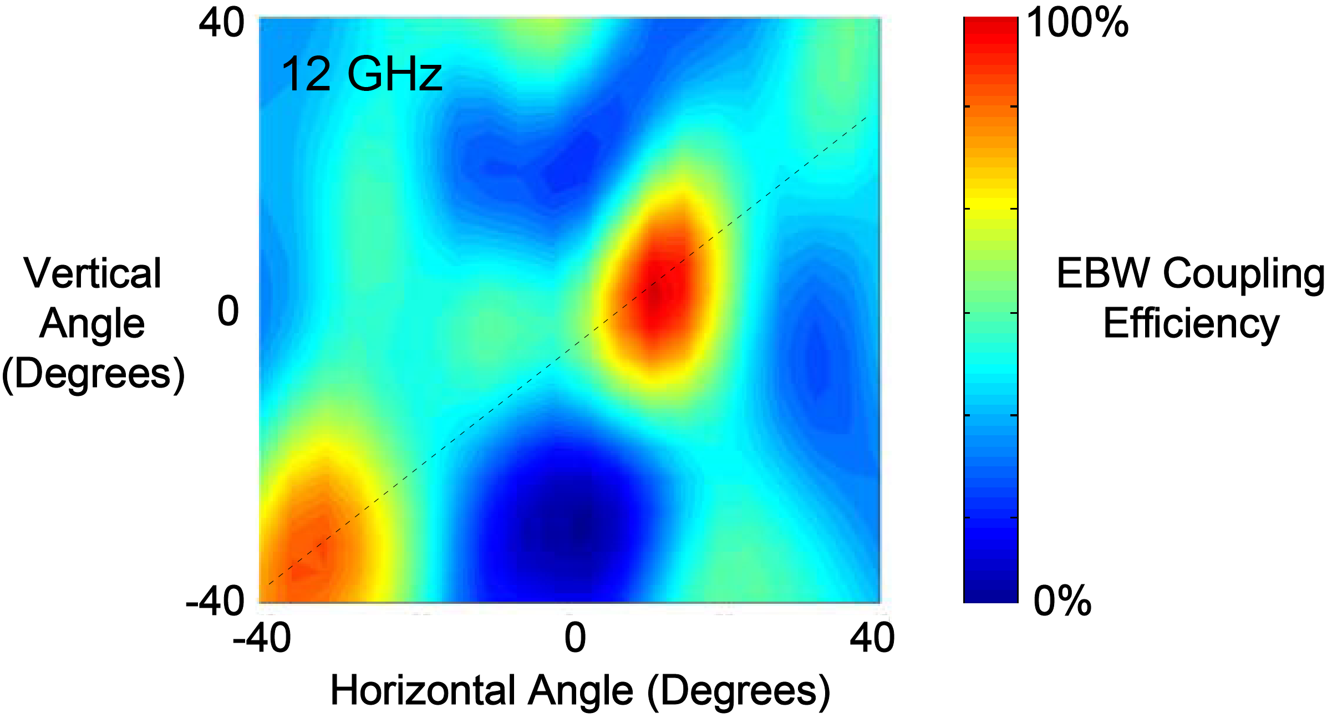
Develop and design 28 GHz EBW (O-X-B) heating and CD system for NSTX-U H-modes
EBW simulations for an NSTX-U H-mode
predict η_{eff} ~ 25 kA/MW on axis for
n_{e}(0) = 9 x 10¹⁹m⁻³ and T_{e}(0) = 1.2 keV:
  Can generate significant EBWCD
  at r/a > 0.8, where NBICD is negligible
  Extend simulations to include realistic
  SOL and edge fluctuations
In FY16 measure O-X-B coupling on NSTX-U with synthetic aperture microwave imaging (SAMI)* [Collaboration with UK]
Can test 28 GHz O-X-B heating with
fixed horn antenna:
  Use B-X-O emission data acquired
  by SAMI to guide antenna aiming
Synthetic aperture microwave imaging (SAMI) antenna array
* V.F. Shevchenko et al., AIP Conference Proceedings 1612 53 (2014)
MAST SAMI EBW Emission Data

