Slide 1



NSTX-U/Theory Partnership
Amitava Bhattacharjee
Head, PPPL Theory Department
Stanley M. Kaye
NSTX-U Deputy Program Director,
Head of Physics Analysis
NSTX-U PAC
January 26, 2016

Slide 2
Charge to the NSTX-U PAC
Charge: Please comment on the plans for the NSTX-U/PPPL Theory Partnership, and how well this Partnership and the broader NSTX-U research activities support “integrated predictive capability.”
Response: To help answer this charge, we will provide a discussion of NSTX-U Theory Partnership status and future plans, and how the plans are aligned with the recent FES Workshop on Integrated Simulations for MFE Sciences.

Slide 3
NSTX-U/Theory Partnership well-integrated into the
NSTX-U Science and Topical Group structures
Theory Department leadership in SGs/TSGs
$1M funding, which was incremental in ≤2014, is now a permanent part of NSTX-U budget
NSTX-U funding of Theory Department researchers ~ 4.7 FTEs
Synergistic support through SCIDAC/Base Theory funding/Collaborators/NSTX-U project theorists (e.g., W. Guttenfelder, J.-K. Park, Z. Wang)
Partnership facilitates collaboration over a wide range of topics

Slide 4
PPPL Flagship Codes
“The committee considers the three “Flagship codes” to be a very positive step.” (Advisory Board, November 2014)
Extended MHD
M3D-C¹ (supported by SciDAC project CEMM, S. Jardin, Lead): Extended MHD, fully implicit algorithm, enabling long runs over transport time scales.
Gyrokinetics
XGC (supported by SciDAC project EPSI---C.-S. Chang, Lead): full-f code, focused on edge physics, including X-point geometry, electromagnetic effects (implemented).
GTS (W. Wang, Lead): δf code focused on core physics with options for shaped boundary, electromagnetic effects (in progress).
(DOE Notable Outcome on Electromagnetic Effects in Gyrokinetic PIC codes, 2015)
Other major codes
TRANSP (Report of a new PPPL Committee, R. Hawryluk, Chair)
In addition to PPPL codes, we use GYRO, GENE, GS2, NIMROD, AORSA, and TORIC for design, analysis, and interpretation of experiments.
Notes:
4

Slide 5
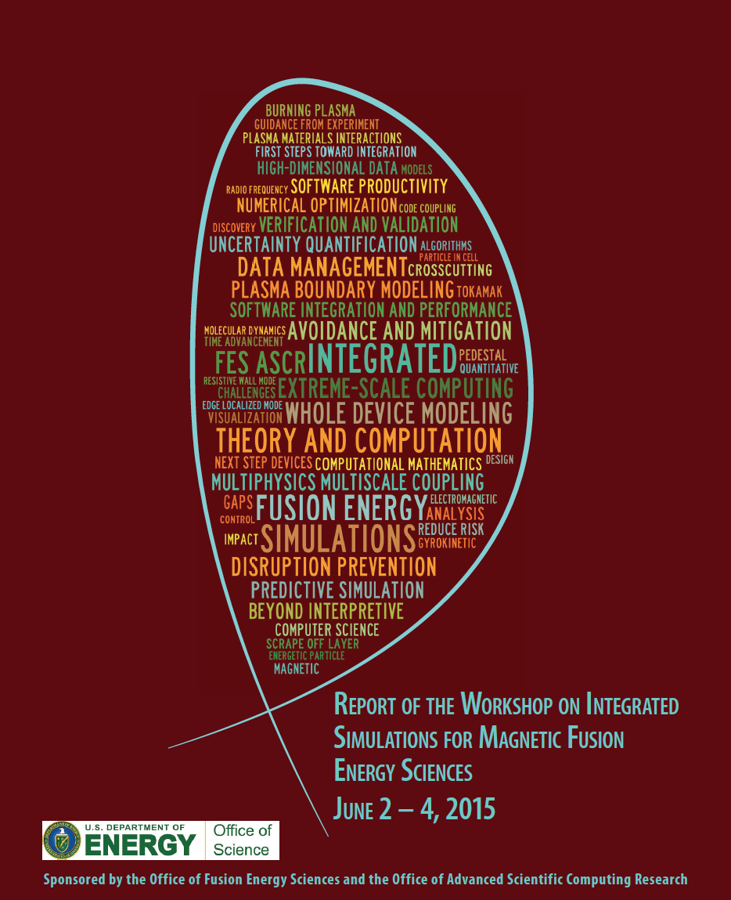

Slide 6
FES Workshop Report, June 2-4, 2015
Assessed recent progress and gaps and challenges in fusion theory and computation directly related to theory and computation directly related to integrated simulations. The science applications were focused on:
Disruption physics (aligned with goals of M3DC¹/M3DC¹-K) (PPPL participants: Brennan, Ferraro, Fu, Gerhardt, Jardin)
Plasma boundary physics (aligned with goals of XGC1) (PPPL participants: Chang, Hammett)
Whole device modeling (aligned with goals of TRANSP modernized) (PPPL participants: Grierson, Kaye, Poli)
The crosscutting ASCR areas in mathematical and computational enabling technologies were:
Multiphysics and multiscale coupling
Numerical optimization and uncertainty quantification
Data analysis, management, and assimilation
Software integration and performance
PPPL observers: Bhattacharjee, Zarnstorff
Notes:
6

Slide 7
NSTX-U/Theory Partnership well-integrated into the
NSTX-U Science and Topical Group structures

Slide 8
NSTX-U Mission Elements
5 Highest Research Priorities
Explore unique ST parameter regimes to advance predictive capability - for ITER and beyond
  Understand confinement and stability at high beta and low collisionality
  Study energetic particle physics prototypical of burning plasmas
Develop solutions for PMI challenge
3.Dissipate high edge heat loads using expanded magnetic fields + radiation 4.Compare performance of solid vs. liquid metal plasma facing components
Advance ST as possible FNSF / Pilot Plant
5.Form and sustain plasma current without transformer for steady-state ST

Slide 9
Theory addresses NSTX-U research priorities, using analytical and simulation tools that produce novel insights
  Several aspects of NSTX-U (and more generally, ST) research require rethinking ideas and mechanisms in conventional tokamaks, leading often to new and exciting insights. Examples are:
  Energy confinement scaling at low collisionality, produced by interplay of micro-tearing, trapped electron modes, and strong sheared flows.
  Copious generation of super-Alfvenic ions due to low magnetic fields, exciting Alfven eigenmodes (AEs) which can provide new mechanisms for beam and thermal transport.
  Novel mechanisms for thermal quench during disruptions. Simulations of new planned experiments for complete maps of halo currents and current ramp-down scenarios, validated by experiments.
  Understanding new physics underlying pedestal structure, and SOL heat flux profiles.
Directly ITER relevant

Slide 10
Global, non-linear GTS simulations giving insight into causes of thermal electron and ion transport
Previously reported role of ITG/K-H in driving ion thermal transport in NSTX L-mode
E-M capability presently being implemented in GTS (Startsev, Wang)
  Supported by Partnership
  Theory “Notable Outcome” 2015 (available as a pedagogical report)
XP1520 (Kaye): I_{p}/B_{T} scaling
  Extend to lower ν_{*e}
  Impact of microtearing, DTEM
XP1521 (Ren): Validation of gyrokinetic codes in L-mode plasmas (assess importance of e-m vs. e-s modes)
Recent simulations have shown possible role of DTEM in contributing to observed favorable collisionality scaling (Bτ_{th}~ν_{*e}^{-0.8})
  In addition to microtearing
  Synergy with DIII-D work
Energy Flux MW/m²
Collisionality
W. Wang et al., NF Letters (2015)
R16-1, 17-3, 18-1, ITER

Slide 11
Latest Development of EM capabilities in GTS
Recently, Startsev-Lee EM scheme has been extended to including key toroidal effect and ion dynamics and has been implemented into GTS.
Currently the scheme is being tested in GTS against recently available results by A. Swamy (IPR India) for collisionless MTM and KBM eigenmodes in tokamaks with circular flux surfaces.
Result of the GTS simulation with n=10 most unstable mode with tearing parity.
The general geometry version of the Startsev-Lee em scheme including all magnetic drifts has been formulated and is currently being implemented into GTS.

Slide 12
Theory addresses NSTX-U research priorities, using analytical and simulation tools that produce novel insights
  Several aspects of NSTX-U (and more generally, ST) research require rethinking ideas and mechanisms in conventional tokamaks, leading often to new and exciting insights. Examples are:
  Energy confinement scaling at low collisionality, produced by interplay of micro-tearing, trapped electron modes, and strong sheared flows.
  Copious generation of super-Alfvenic ions due to low magnetic fields, exciting Alfven eigenmodes (AEs) which can provide new mechanisms for beam and thermal transport.
  Novel mechanisms for thermal quench during disruptions. Simulations of new planned experiments for complete maps of halo currents and current ramp-down scenarios, validated by experiments.
  Understanding new physics underlying pedestal structure, and SOL heat flux profiles.
Directly ITER relevant

Slide 13
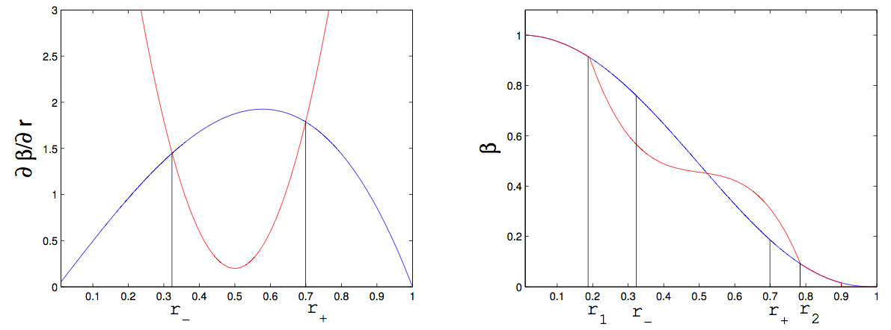
Beam ion confinement: Models for fast ion profile relaxation in presence of AEs under development
“Kick” model (Podesta)
  PDF computed by ORBIT (White) in presence of TAEs
  Mode structures computed by NOVA (Gorelenkov)
  Kicks ~ mode amplitude
  Being used in DIII-D analysis
Critical Gradient Model (Gorelenkov)
  Compute critical due to AE
  Mode growth/damping computed by NOVA-K (Fu, Gorelenkov)
  Originally benchmarked on DIII-D
Critical gradient
β
ΔP_{ζ}
Classical profile
r₋
r₊
r₁
r₋
r₊
r₂
ΔE (keV/ms)
CG used to relax EP profile. It is broadened from the initially unstable one between r± → r_{1,2}
R16-2, R18-2, IR18-2, ITER

Slide 14
CGM recently validated for NSTX
Multiple TAE unstable discharge chosen for validation
XP1524 (Heidbrink) directly tests CGM
  Fashioned after successful DIII-D expt.
  Different AE activity on NSTX(-U) crucial test for validating theory
Frequency (kHz)
Neutron Deficit (%)
Other related XPs include XP1522, 1523 (characterize 2nd beam, beam confinement)
Time (ms)

Slide 15
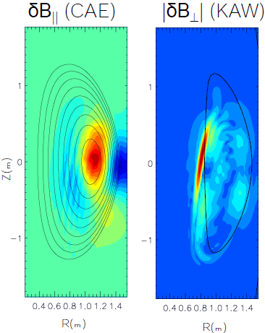
Non-linear HYM simulations of CAE/KAW coupling address power channeling and effect on T_{e} profile
Full non-linear simulations including multiple (n≥4) unstable modes have been performed (Belova)
n=4 (largest mode) saturation amplitude (δB/B~6.6e-3) comparable to that inferred from reflectometer displacement measurements (δB/B≤3.4e-3)
Calculate channeling of 0.3 to 0.5 MW for n=4
Can result in several hundred eV modification of T_{e} profile (T_{e} broadening observed during periods of high CAE activity, with no δT_{e0})
XP1525 (Crocker): Rotation effects on CAE/GAEs
XP1520 (Kaye), 1523 (Podesta): Effects of collisionality, power on transport
Belova PRL 2015
R16-1,2, 17-3, 18-2, IR18-2, ITER

Slide 16
Theory addresses NSTX-U research priorities, using analytical and simulation tools that produce novel insights
  Several aspects of NSTX-U (and more generally, ST) research require rethinking ideas and mechanisms in conventional tokamaks, leading often to new and exciting insights. Examples are:
  Energy confinement scaling at low collisionality, produced by interplay of micro-tearing, trapped electron modes, and strong sheared flows.
  Copious generation of super-Alfvenic ions due to low magnetic fields, exciting Alfven eigenmodes (AEs) which can provide new mechanisms for beam and thermal transport.
  Novel mechanisms for thermal quench during disruptions. Simulations of new planned experiments for complete maps of halo currents and current ramp-down scenarios, validated by experiments.
  Understanding new physics underlying pedestal structure, and SOL heat flux profiles.
Directly ITER relevant

Slide 17
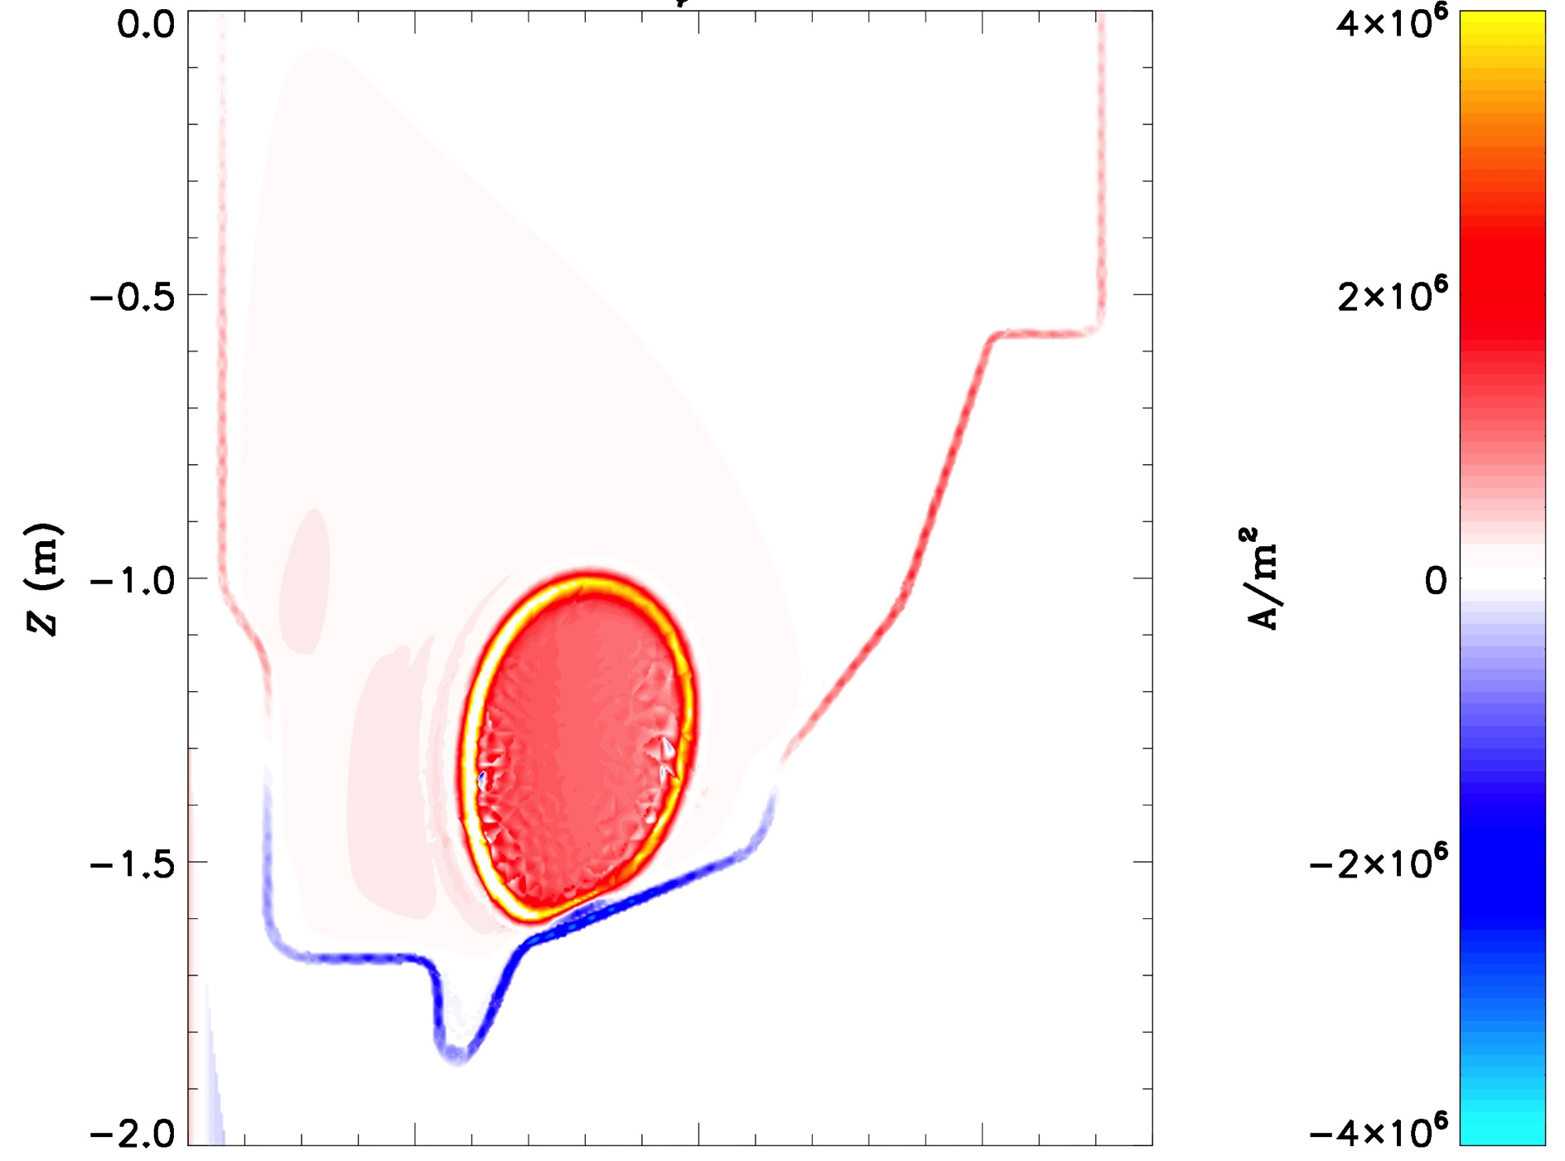
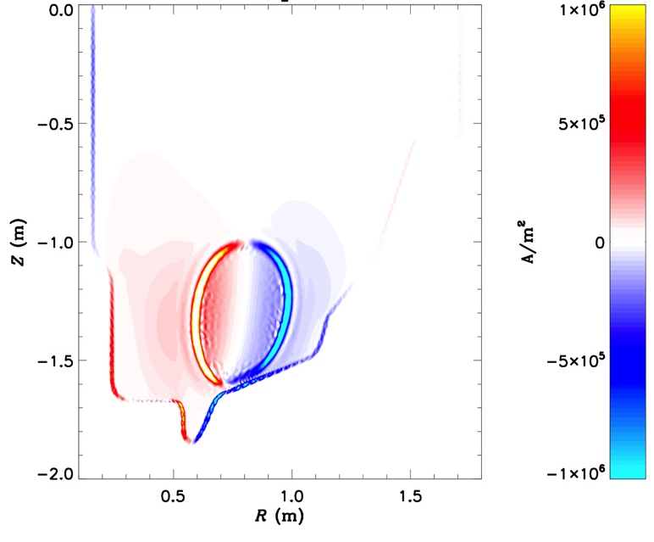
Simulating Disruptions and Halo Currents Using New Modeling Capabilities
New resistive wall model in M3D-C1 allows unique capability to simulate mode locking and current-quench
Includes self-consistent treatment of rotation and Halo currents
  We will seek to validate these models against NSTX-U data
J_{φ}
Halo currents
J_{Z}

Slide 18
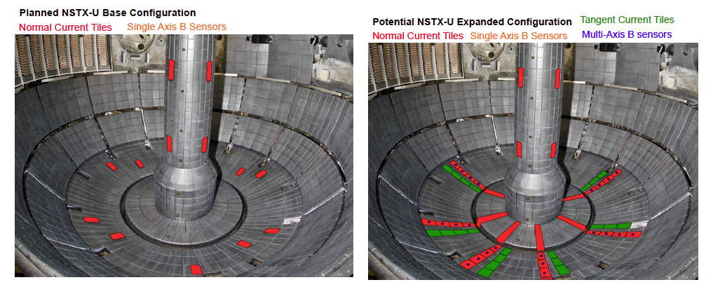
M3D-C¹ with RW capability will be used to map out optimal placement of new B-sensors to study halo currents
Dynamics of halo currents and forces critical for ITER: particular concern are halo current asymmetries and rotation
New sensors will measure halo currents, B-fields and JxB forces in NSTX-U
Critical theoretical issues: (i) role of boundary conditions (ii) halo current distributions in 3D conducting structures (D. Pfefferle)
  joint NSTX-U/Theory task R16-3, 17-2, 18-2, 2016 JRT, ITER

Slide 19
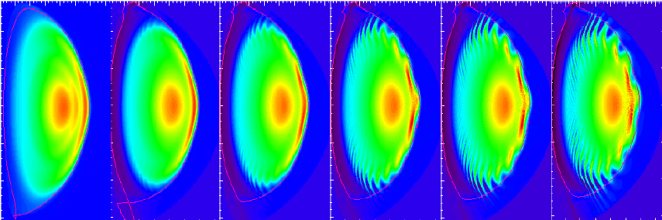
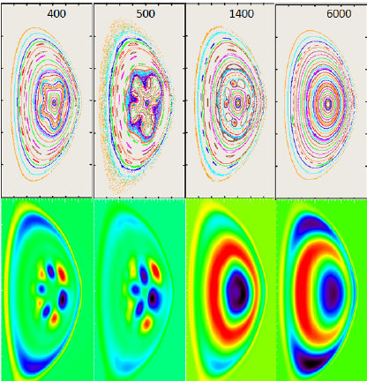
Which linear instabilities lead to thermal quench and disruption?
Rapid end-of-shot current ramp-down in NSTX led to disruption. Nonlinear modeling of this is improving understanding.
Toroidal current density time→
Heating NSTX past the ideal MHD β-limit in some cases just leads to enhanced transport
  Goal is to predict when this leads to a thermal quench
Poincare
Temperature
difference

Slide 20
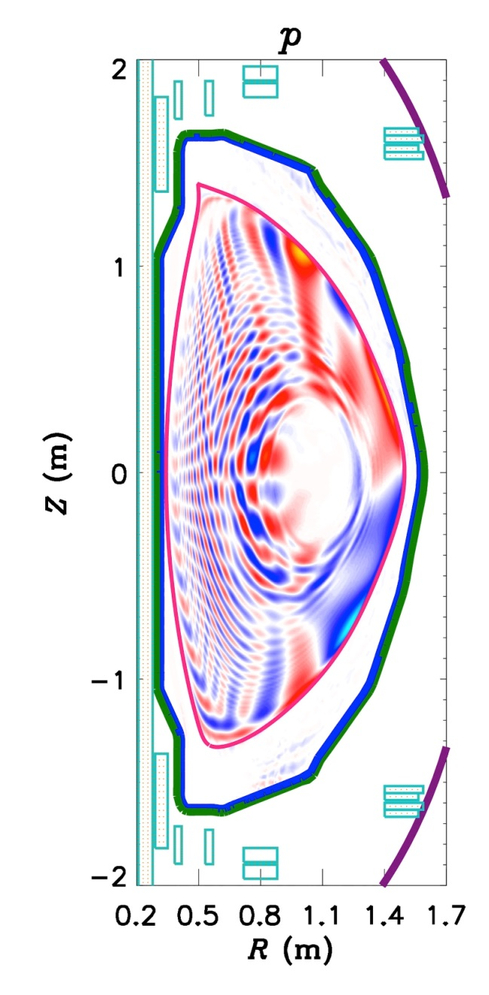
Understanding RMP ELM Mitigation in New Regimes
ELMs in STs and tokamaks respond to applied 3D fields in opposite ways
  Understanding this discrepancy would substantially improve our confidence in scaling RMP ELM mitigation to ITER
NSTX-U offers a unique capability to validate ELM suppression models across the ST and tokamak regimes
Combining models of 3D perturbed equilibrium (M3D-C1) and transport (XGC) will yield a quantitative, predictive model for transport in 3D fields
M3D-C1 is being used to predict and optimize plasma response to NCC coils in NSTX-U

Slide 21

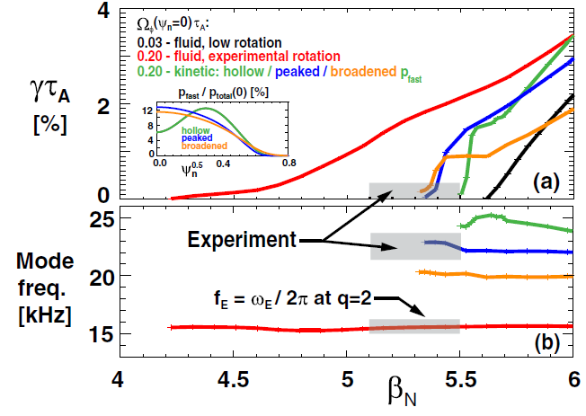
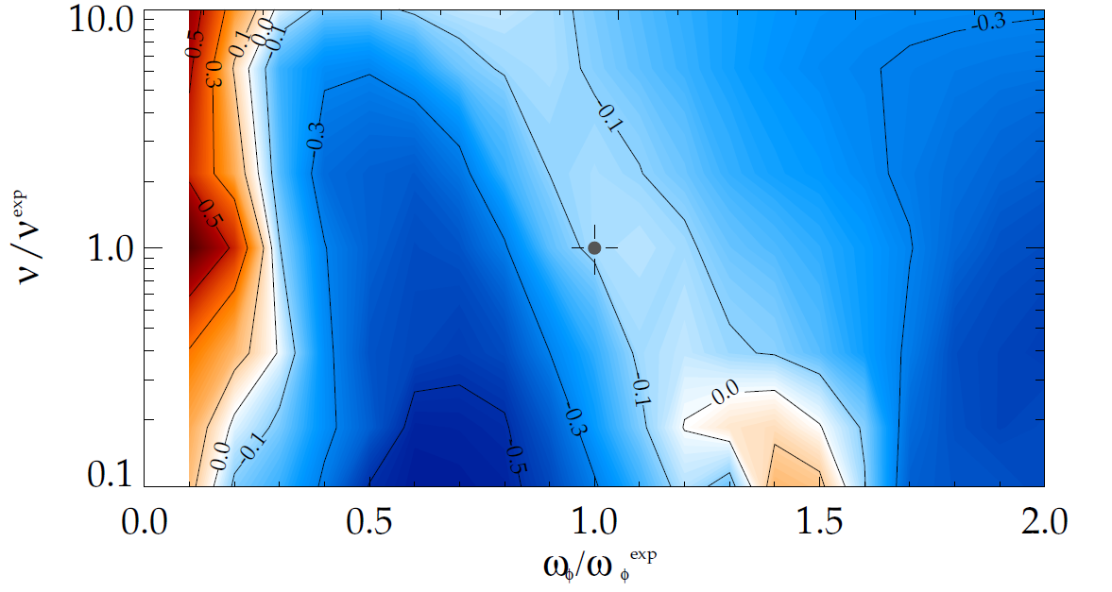
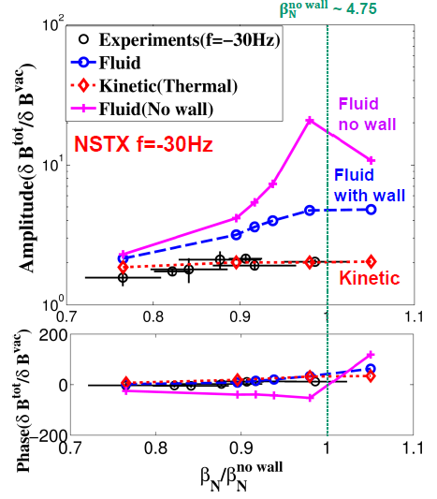
NSTX-Theory collaborations have led the advancement in kinetic global mode stability physics
RWM kinetic stability physics theory
MARS-K: Ideal wall stability (Menard)
(Betti, Berkery,
Sabbagh)
MISK: RWM kinetic stability (Berkery, Sabbagh)
Experiment
MARS-K: Resonant field amp. (Wang)
Precession drift
resonance stabilization
Marginal stability
Bounce/transit
resonance stabilization
instability
(experiment)
RWM physics with M3D-C¹ (Ferraro)
Resistive wall implemented

Slide 22
Theory addresses NSTX-U research priorities, using analytical and simulation tools that produce novel insights
  Several aspects of NSTX-U (and more generally, ST) research require rethinking ideas and mechanisms in conventional tokamaks, leading often to new and exciting insights. Examples are:
  Energy confinement scaling at low collisionality, produced by interplay of micro-tearing, trapped electron modes, and strong sheared flows.
  Copious generation of super-Alfvenic ions due to low magnetic fields, exciting Alfven eigenmodes (AEs) which can provide new mechanisms for beam and thermal transport.
  Novel mechanisms for thermal quench during disruptions. Simulations of new planned experiments for complete maps of halo currents and current ramp-down scenarios, validated by experiments.
  Understanding new physics underlying pedestal structure, and SOL heat flux profiles.
Directly ITER relevant

Slide 23
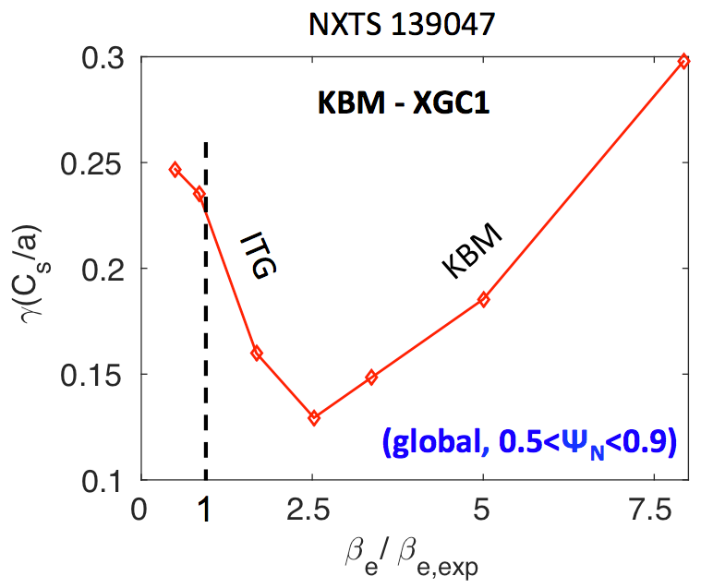
XGC results for NSTX edge plasmas
Understanding turbulence in NSTX edge plasma
  Most likely, the turbulence seen at pedestal top are ITG modes (Diallo, Nucl. Fusion 2013), not KBMs (recent study)
    Cross verification between E&M XGC1 (global, S. Ku)
    and GYRO (flux-tube, W. Guttenfelder) confirmed that
    β is well below β_{KBM}
  Peeling type kinetic e.m. modes can exist in steep NSTX pedestal, but KBMs are not found (PPPL-Theory Notable Outcome report to DOE, 2015)
  Verified existence of blobby turbulence in extended SOL
Divertor heat-flux width: The 1/I_{P} type scaling in NSTX is from neoclassical orbit spread. Only ~30% effect from blobby spread (DOE-FES National Theory Performance Target, led by Chang; Chang, IAEA16)
Bootstrap current in NSTX pedestal is significantly different from Sauter (Hager, submitted to Phys. Plasmas), and can alter the NSTX edge stability diagram (Sabbagh, Nucl. Fus. 2013)
Verified importance of the neoclassical ExB shearing in L-H transition in NSTX (Battaglia, Nucl. Fusion 2013)

Slide 24
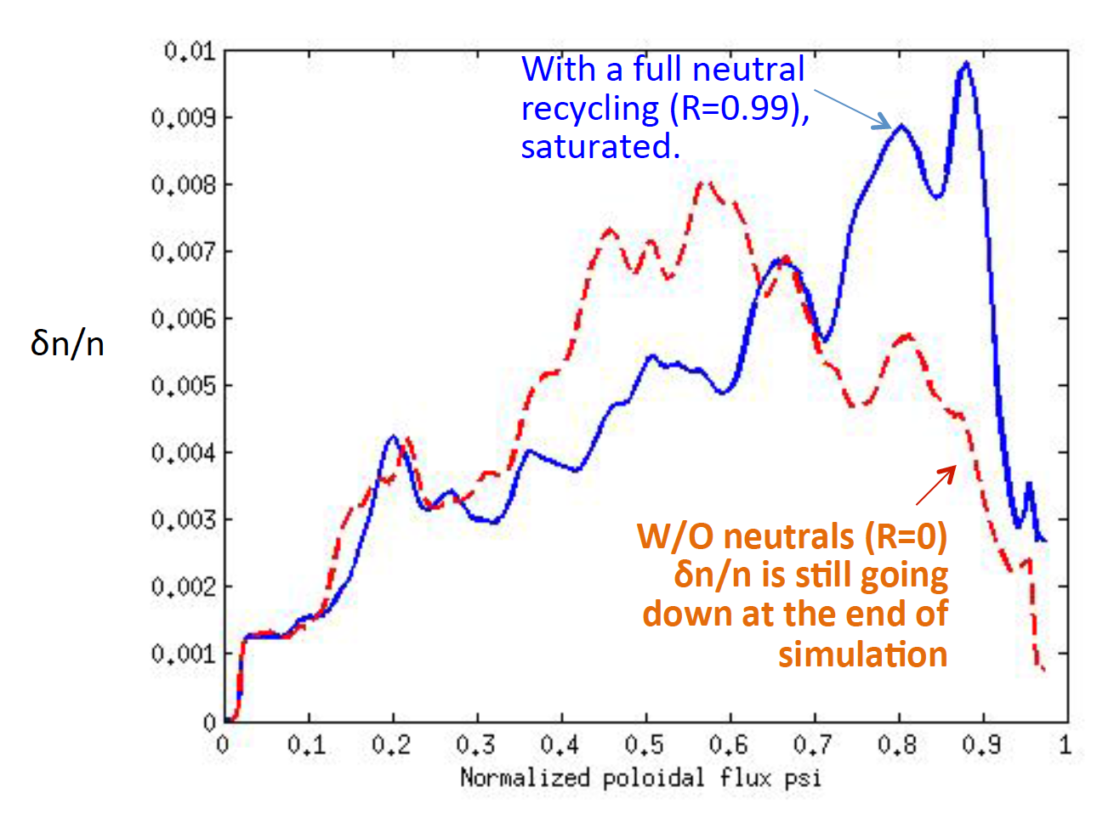
XGC plans for NSTX-U
Large difference in edge turbulence seen by XGC1 between zero and full neutral recycling.
Additional plans for NSTX-U by XGC are
Impurity studies (turbulence, including neoclassical effects )
  How will the high and low Z impurity particles from SOL penetrate through the pedestal?
  What will be their saturated radial profiles in the core?
  What will be the impact of high and low Z impurities on pedestal confinement? On ExB shearing rate?
Kinetic study of 3D field penetration into plasma, and effect on pedestal transport and shape.
Enhancement of the XGC e. m. to include micro-tearing modes
L-H transition physics
Pedestal shape up against turbulence criticality and ELMs
Incorporate DEGAS in XGC, including high-Z atomic physics

Slide 25
XGC1 simulations aid in understanding basis for SOL heat flux trends in NSTX
Experiment shows contraction of SOL heat flux width at midplane with I_{p} as well as influence of Li conditioning
XGC1 calculations with collisions show similar trend with I_{p}
XP 1514:
(Gray) – Heat flux width scaling in NSTX-U; extend range of I_{p}, shape, Li dependence
(Gray) – Is interchange drive responsible for SOL contraction with Li (in collaboration with LODESTAR)?
I_{p} (MA)
Heat flux width determined primarily by neoclassical processes
R16-1, 17-1, ITER

Slide 26
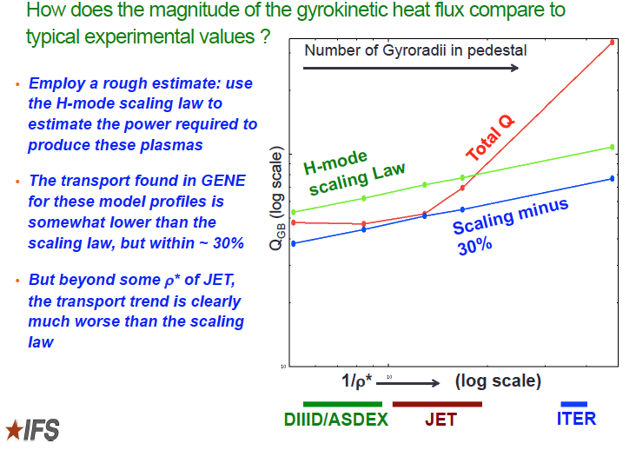
IFS Collaboration with NSTX-U-Theory Group
Kotschenreuther (2015)
Preliminary results indicate a surprisingly optimistic prediction for ST plasmas due in part to
the localization of unstable eigenfunctions in the region of strong velocity shear: to be studied
by XGC in a complementary study, including X-point geometry.

Slide 27
Flux closure and reconnection studies during CHI in NSTX/NSTX-U
Comprehensive resistive MHD simulations have been conducted for the NSTX and NSTX -U:
The goals:
To achieve maximum flux closure and CHI-generated current
How transient CHI scales as it is extrapolated to future (larger) devices such as the ST-FNSF
Understanding the physics of magnetic reconnection during CHI is of great importance for the viability of this concept.
Ebrahimi et al PoP 2013, 2014. PRL 2015,
submitted to NF.
Fig2: Left: Plasmoid formation in simulation of NSTX plasma during CHI / Right: Fast-camera image of NSTX plasma shows two discrete plasmoid-like bubble structures.
CHI experiments provide a very rich platform for studying magnetic reconnection
Fundamental reconnection physics in NSTX-U, in particular reconnecting plasmoids physics will be explored in both the simulations and the experiment.

Slide 28
NSTX-U/Theory Partnership is focusing on issues central to achieving NSTX-U goals
Both over-arching goals and specific yearly Research Milestones (RMs)
  Matched personnel to topical choices
  Attempted to provide mapping to Goals, Milestones
Partnership funding now integrated into the NSTX-U budget
  No longer incremental
Theory work not limited to PPPL Theory/NSTX-U partnership
  Augmented by project theorists, collaborations, SCIDAC, direct Theory coverage of personnel
Significant synergy with work on DIII-D by same personnel – aspect ratio, β, ν*, ρ* leverage on theory validation
  Confinement/effects of AE modes on fast-ion distribution, RMP/NTV/RWM physics, RF heating and current drive, pedestal/SOL characteristics, core transport

Slide 29
Additional Slides

Slide 30
Other related Theory-Experimental work
Theory
Experiment
Develop and implement self-consistent fast ion distribution for calculating HHFW heating and CD using TORIC/NUBEAM/TRANSP (Valeo)
  R16-3, 17-4, IR17-1, R18-2, ITER
RMP/NTV physics for rotation control (Ferraro, Z. Wang, + CU, PU)
  R16-3, 17-4, 18-2, 2016 JRT, ITER
RWM physics with M3D-C¹ (Ferraro)
  Resistive wall implemented
  R16-3, 18-2, ITER
Edge neutral density calculations using ENDD diagnostic + DEGAS2 (Stotler)
  R16-1, 17-3, 18-1, ITER
XP1507 (Gerhardt): High non-inductive fraction, high performance discharges
Multiple XPs study effect of rotation, NTV (T&T, CAE/GAE, TAE gap structure, RWM control and disruption mitigation)
Multiple RWM XPs
Critical info for TRANSP (beam deposition, particle transport), XGC1 (collisional effects in edge)

