Slide 1

Overview of NSTX-U plans for high-Z and liquid lithium plasma-facing components
MA Jaworski¹, M.L. Reinke², V. Soukhanovskii³, A. Brooks¹, R. Kaita¹, R. Maingi¹,
J. Menard¹, M. Ono¹, C. Skinner¹, K. Tresemer¹, and the NSTX-U Team
¹Princeton Plasma Physics Laboratory
²Oak Ridge National Laboratory
³Lawrence Livermore National Laboratory
37th NSTX-U Program Advisory Committee Meeting
Princeton Plasma Physics Laboratory
26-28th, January 2016

Slide 2
Outline
Why must NSTX-U change its PFCs?
How will the PFC modification be conducted while maintaining scientific productivity?
Are we technically ready to move toward liquid lithium PFCs?
Are we prepared to address the scientific challenges associated with the PFC changes?
What strategies are being developed to mitigate risk?

Slide 3
Viability of lithium as a plasma-facing material cannot be assessed with graphite PFCs
Serious attention to potential weaknesses of Li approach demands serious answers on whether liquid Li will deliver on promises
Studies in NSTX and LTX have revealed complex chemistry in general as well as substrate dependence (i.e. C vs. metal)
Evaporated films on graphite are not reactor relevant
Importance of integrated scenarios including the wall materials recently demonstrated (i.e. JET-ILW)

Slide 4
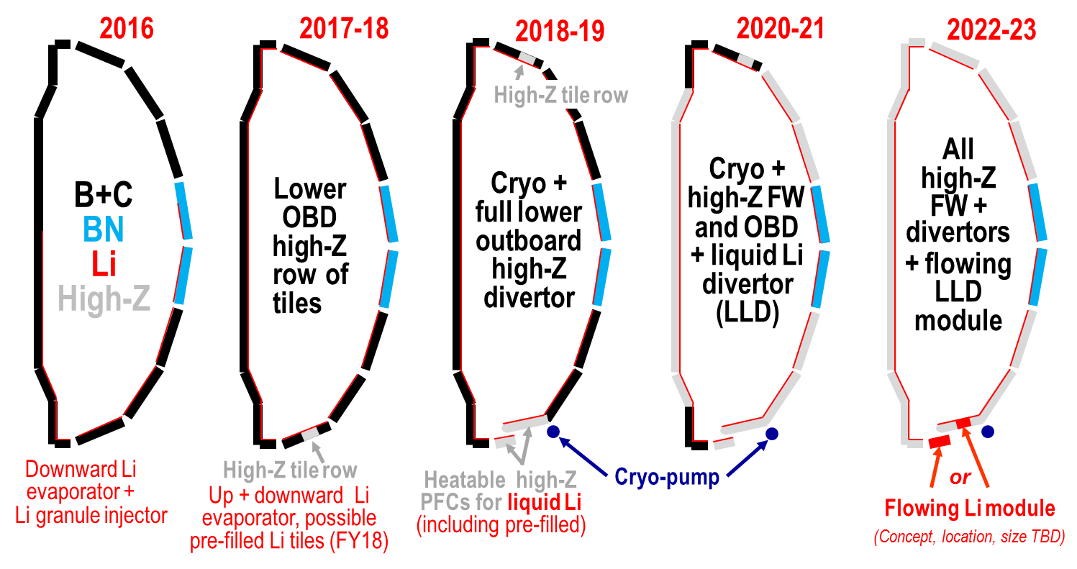
Staged conversion mitigates risk and enables comparative assessment of both high-Z and liquid Li
Open divertor and flexible magnetic configuration enables multiple studies and material selection
Single-variable experiment in single campaign enabled by conversion (i.e. high-Z vs. lithium PFCs)

Slide 5
High-Z tile row will provide design and engineering assessments
Replace continuous row of graphite tiles with high-Z
  Avoid Li substrate diffusion for longer-pulse experiments
  Examine protection of high-Z substrate w/ low-Z coatings
Provide operational experience and validate engineering design and analysis with an eye to future deployments of metallic PFCs
Continue experiments on evaporated Li films on
high-Z substrate in diverted configuration

Slide 6
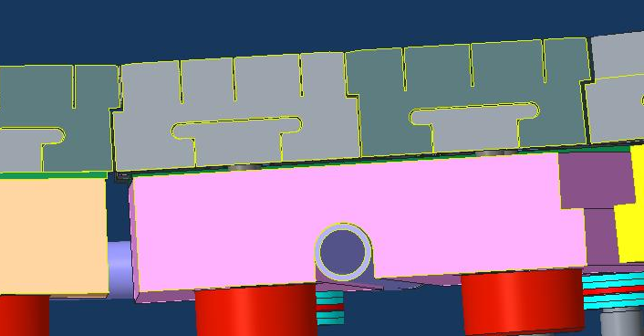
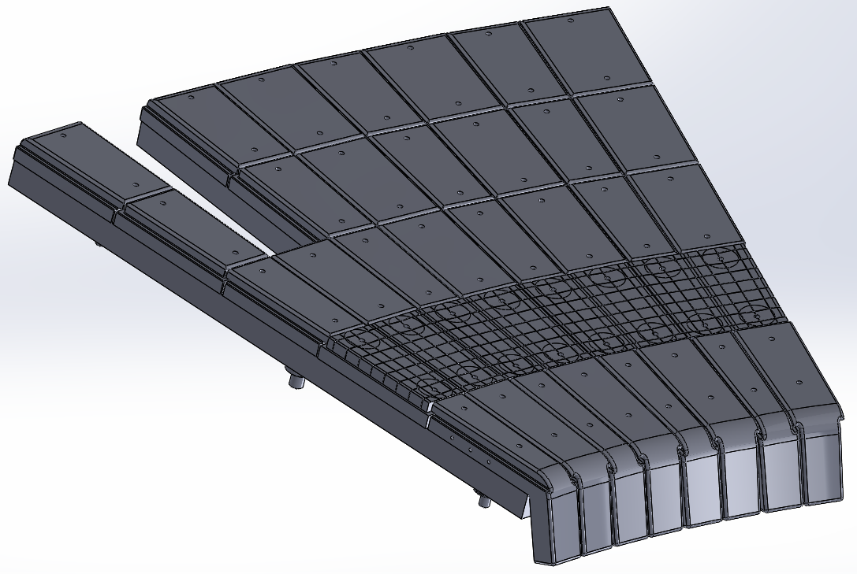
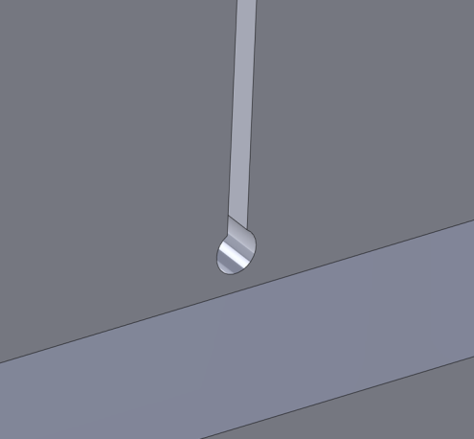
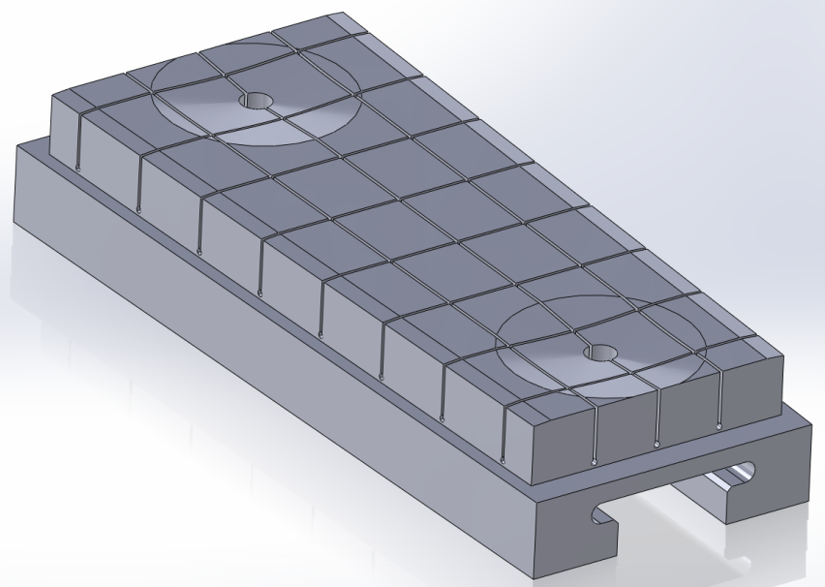
Rapid experiments facilitated by direct replacement of graphite tiles
Machine installation time minimized with 1-for-1 replacement
TZM-alloy provides high-Z, Li-compatible substrate and machinability
Surface castellations relieve thermo-mechanical stresses
  Separate peak stress from peak temperature
  Several design iterations to optimize for NSTX-U tile shape

Slide 7
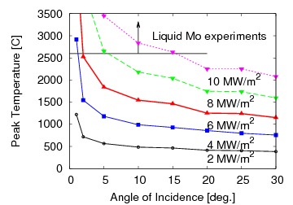
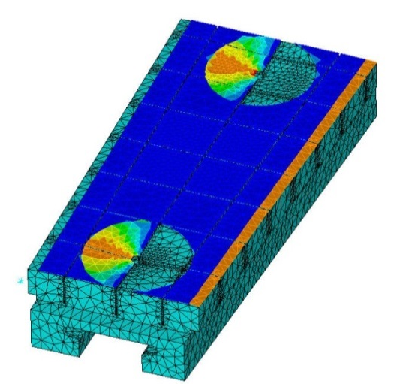
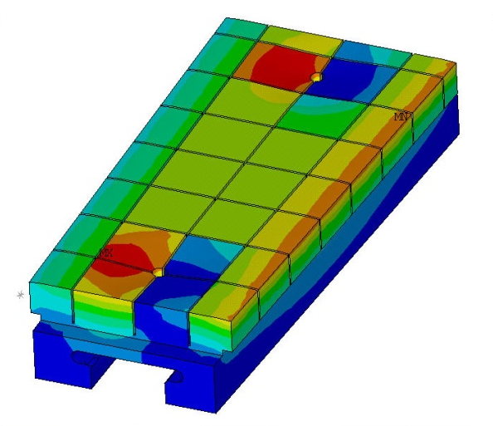
High-Z design will enable broad temperature range and power handling capabilities for experiments
Engineering design improves over graphite
Geometric envelope lead to optimized, but stress-limited design -> good engineering tests
Nominal heat-flux impact factor of 10 MJ/(m² s^{1/2}) capabilities
  Leading edges mitigated with chamfering
  Requires careful alignment
Graphite Geometry
Surface heat flux
Temperature
A. Brooks

Slide 8
Two options leading for low-heat flux PFCs
Previous machines utilized coated graphite (e.g. AUG)
LTX studies show improvement with very-low water partial pressures (~10⁻¹⁰ Torr)
Coated graphite may retain H₂O reservoir while a high-Z coated metal will not
  LLD-like construction feasible with copper base tile with bonded steel and high-Z coating
  Alternative base metals (e.g. stainless steel) with coating or bulk high-Z also options

Slide 9
Near-term program milestones are emphasizing high-Z tile capability
R(17-2): Assess high-Z divertor PFC performance and impact on operating scenarios
  Operations, heat-flux mitigation, erosion, migration and impact on core performance to be assessed
  XP time dedicated in FY16 (XP1526) to establish baseline performance with boronized and lithiated graphite
IR(18-1) (incremental): Investigation of power and momentum balance for high-density and impurity fraction divertor operation
  Establishes baseline assessment of dissipative divertor operation in the NSTX-U
  Critical for establishing vapor-shielding identification and physics studies

Slide 10
Multi-institution effort underway to deploy diagnostics and modeling
Plasma-material interaction science, material migration and surface science studies
Divertor and edge transport studies
Core transport studies

Slide 11
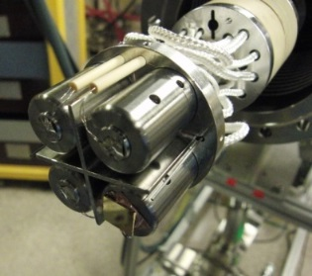
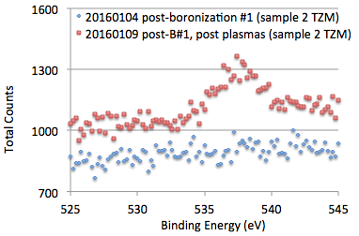
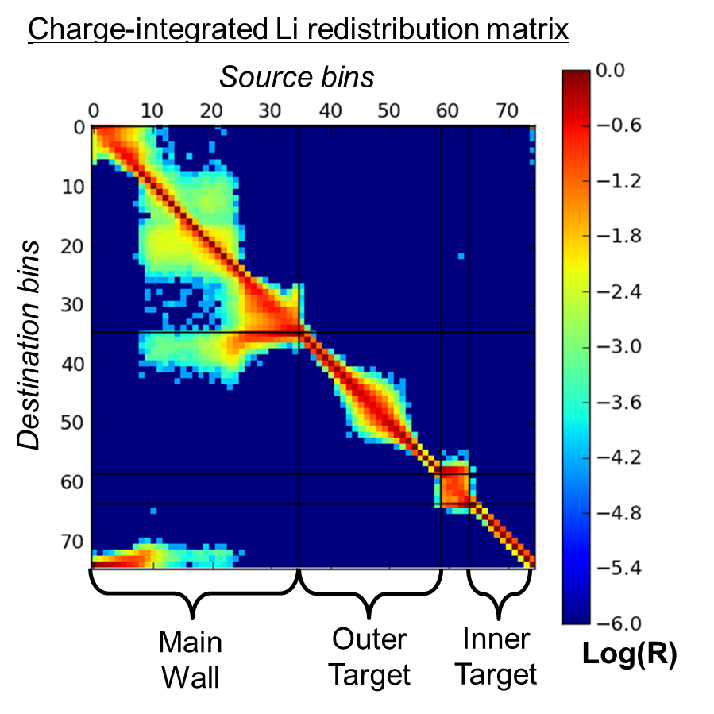
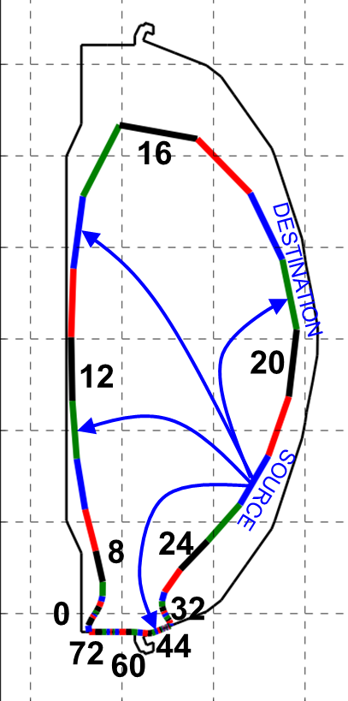
High-Z progression highlights mixed-material PMI and coordinated lab studies
Material Analysis and Particle Probe enables compositional analysis
  Measurements of C, Li, Mo, B, O via XPS
  D retention via TPD
Material migration modeling with WallDYN
  PPPL PhD thesis, collaboration with IPP-MPG & PU
  QCM and witness plate measurements in vacuum vess.
  Mixed-material erosion model development with surf. sci. lab
Post-boronization
Post-plasma operations
C. Skinner
Oxygen peak appears
J. Nichols

Slide 12
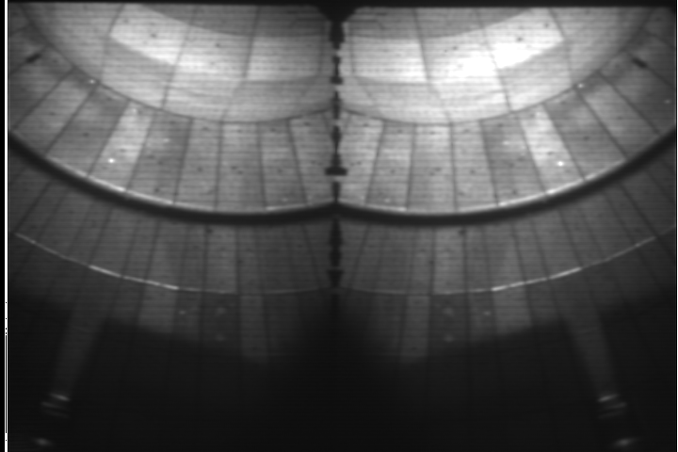
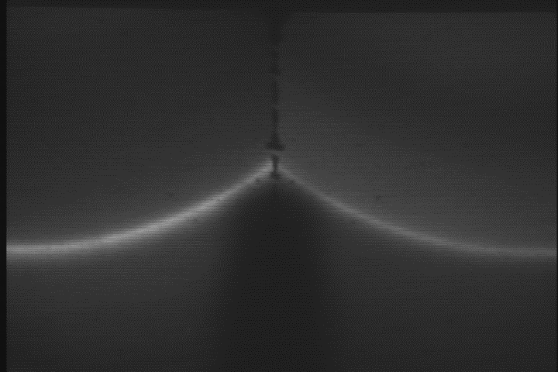
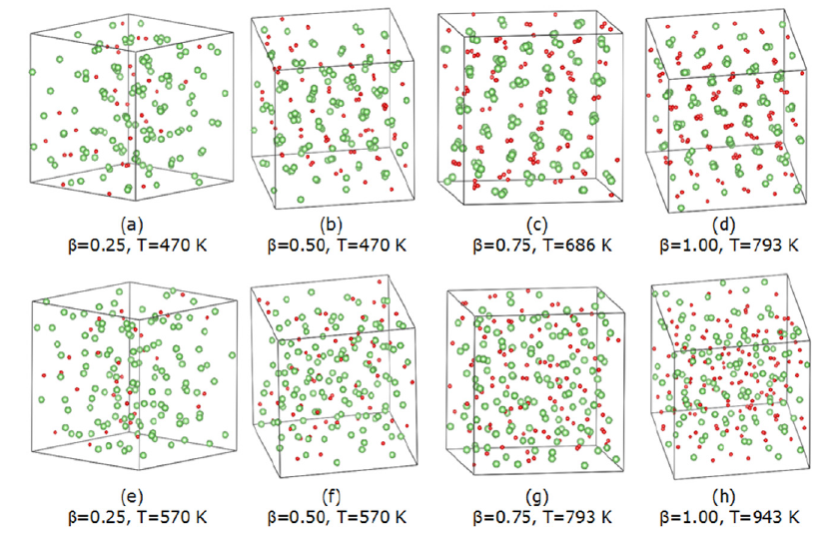
High-Z, mixed-material erosion examined in experiment and with quantum modeling
Extensive diagnosis of PFCs via plasma
  Multiple imaging systems, spectrometers
  Langmuir probes
  Infrared thermography
Atomic scale quantum modeling of lithium mixed-material (Li+D on TZM)
  Examined LiD “rock-salt” formation in liquid lithium
  Results coupled into analysis of Magnum-PSI experiment on TZM(Abrams, NF 2016)
2-color simultaneous imaging
CD Band
D-gamma
F. Scotti, RSI 2015
Increased D concentration
β = N_{D}/N_{Li}
Chen, NF 2016

Slide 13
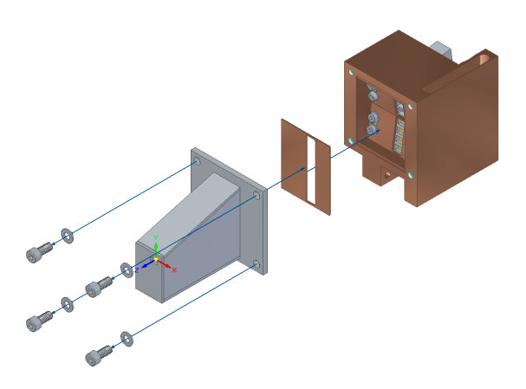
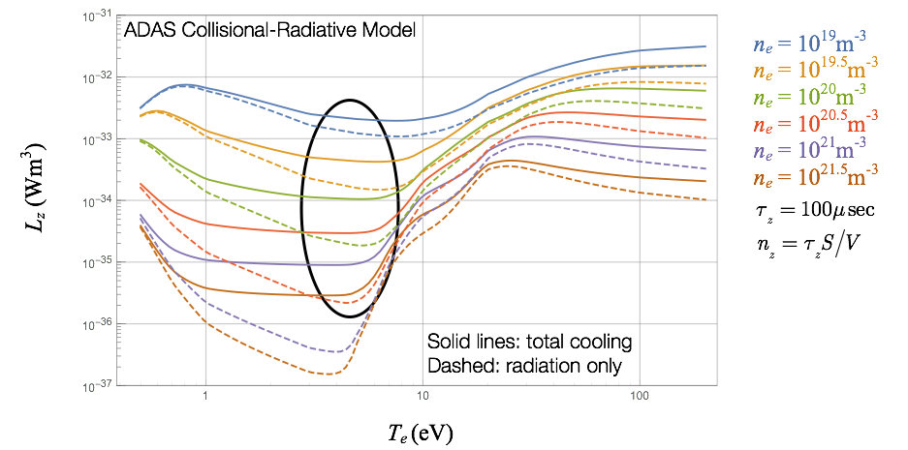
Impact of low-Z and high-Z operations on divertor assessed via spectroscopy and bolometry
Near-surface prompt
redeposition modifies effective material yield into plasma
  Auburn U. group providing
  ADAS simulation & support
  LLNL measurement via 2-color intensified imaging
Radiative power measurements critical to science goals
  New bolometric measurements
  via video and resistive foil bolometers
  (ORNL+PPPL+DIFFER+NIFS)
  Visible imaging and spectroscopy provide species identification and localization
  Comparison with numerous codes in NSTX-U Team (UEDGE, SOLPS, OEDGE) and ADAS coll-rad models
Resistive bolometer
pinhole camera
M.L. Reinke
Schwartz, Goldston

Slide 14
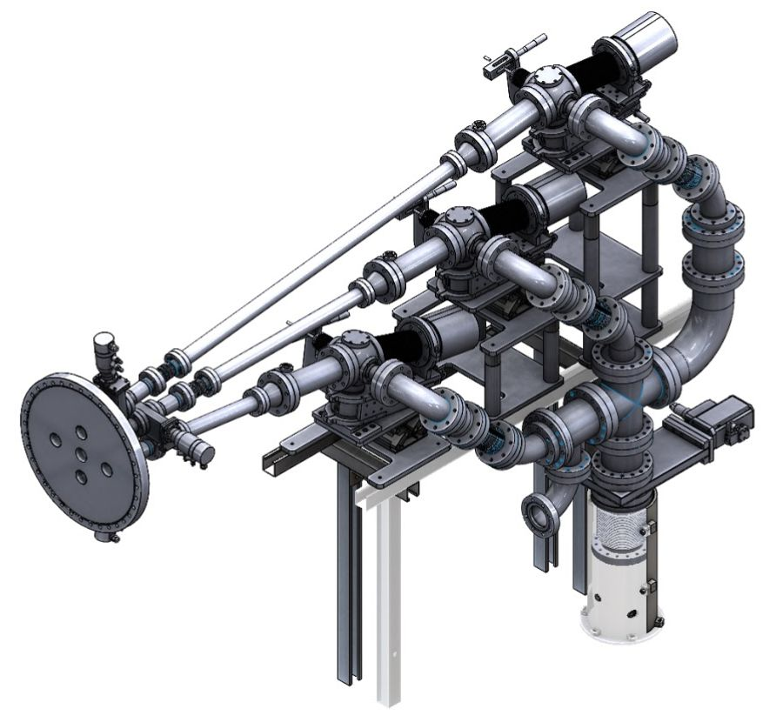
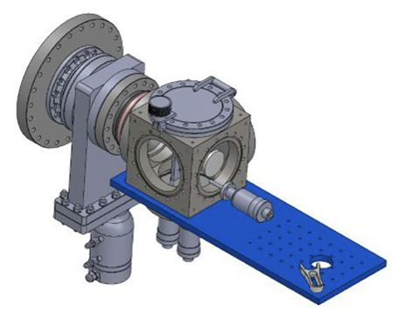
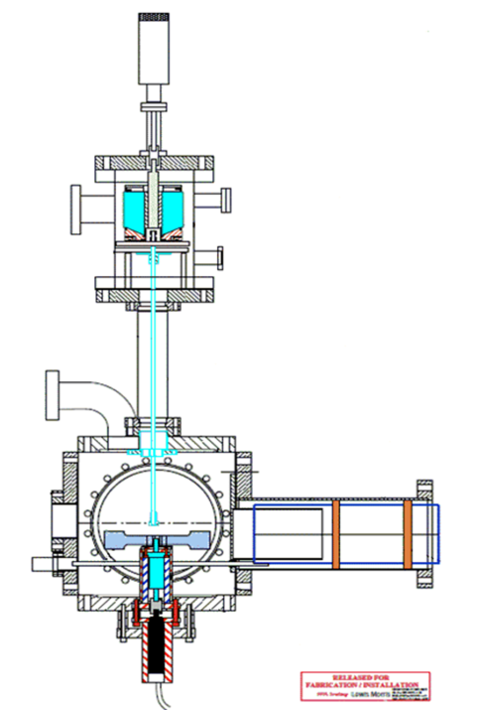
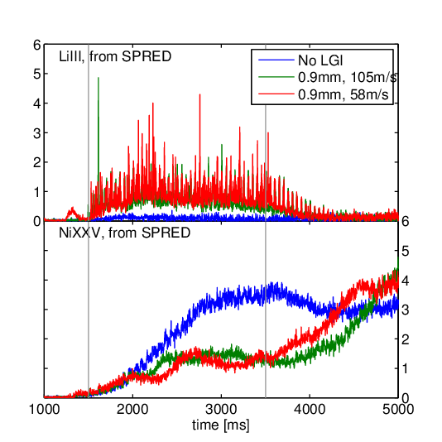
Core transport toolset of diagnostics and actuators in development
VUV/SXR spectroscopy to track core high-Z contamination
  MONA-LISA, XEUS, LoWEUS (demonstrated w/ Mo in C-Mod)
  X-ray crystal spectrometer(future)
New full-midplane core resistive bolometer system
Actuators enable physics and control experiments
  Investigate neoclassical + turbulent + MHD driven transport in low-A device
  LBO and high-Z noble gas injection provide controlled sources
  Core/edge control from ELMs (LGI, 3D fields) and on-axis RF
Laser Blow-Off
target chamber
M. Weller
LLNL Core
Spectroscopy
DIII-D LGI experiments
Injection
Bortolon & Lunsford

Slide 15
Preparation for all high-Z PFC operation will enable future liquid Li comparison experiments
Numerous examples from world program demonstrate importance of scenario impact with high-Z PFCs
  Constrained operating windows
  Modified performance (e.g. confinement)
Power exhaust solutions in development
  Advanced divertor configurations (e.g. snowflake, X-div)
  Extrinsic impurity seeding for radiative divertor
Wall conditioning techniques (i.e. B & Li coatings) mitigate risk to broader science program
Experience of operating with high-Z will feed back into world machine knowledge base

Slide 16
Research and development for flowing liquid lithium modules
?

Slide 17
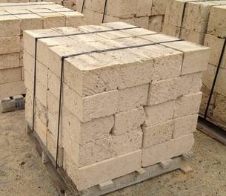

Multiple required elements complex projects

Slide 18
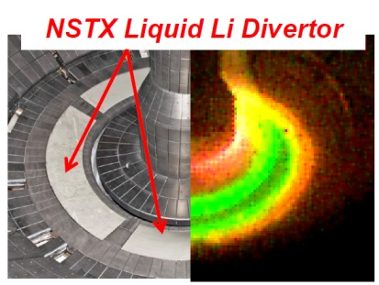
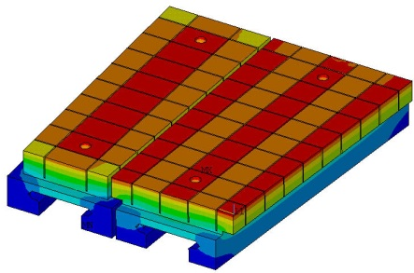
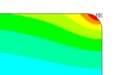
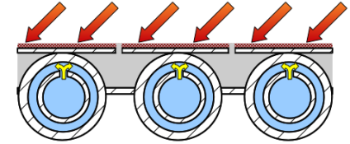
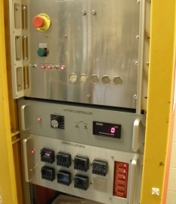
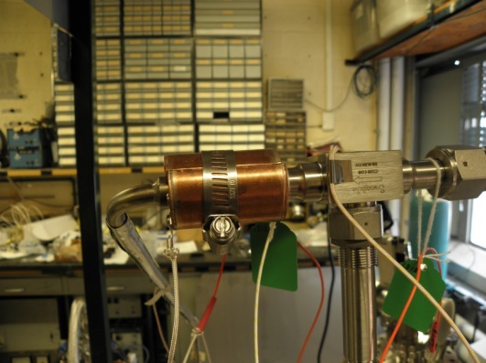
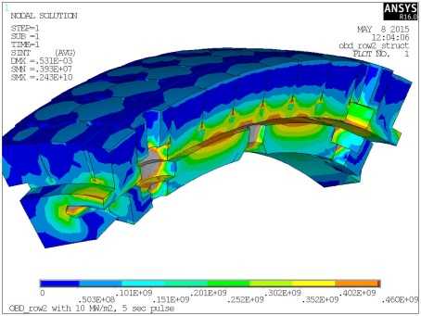
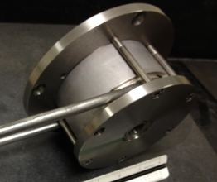
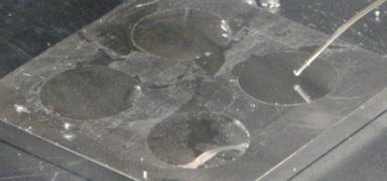
Required elements for flowing, liquid metal PFCs
Heat flux handling
Integrated, flowing LM PFC
Plasma scenarios and operation
Substrate and structural
Safety testing & engineering
Liquid metal wetting and coverage
Pump and loop technologies

Slide 19
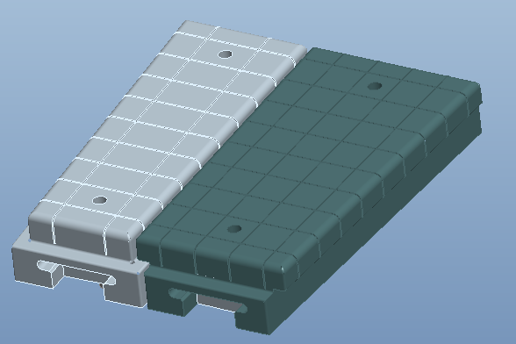
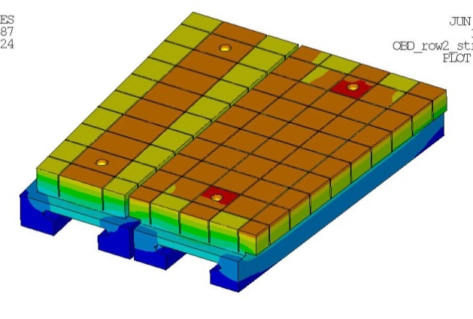
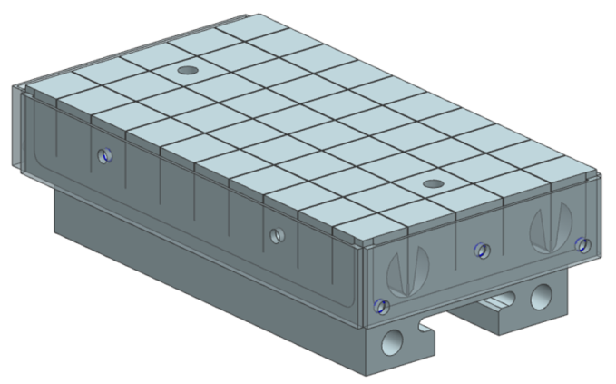
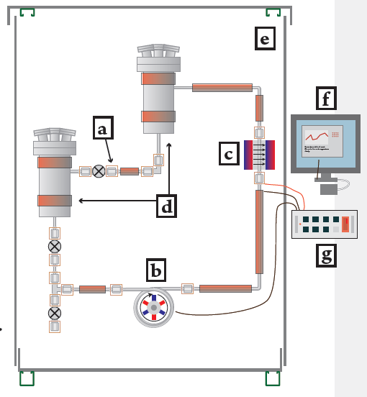
A three-step progression can accelerate tests of flowing, liquid metal PFCs
High-Z divertor tiles + LITER
Pre-filled liquid-metal target
Flowing LM PFC
NSTX-U High-Z Divertor Upgrade 1
Conceptual design for pre-filled LM target
Flowing PFC loop integration

Slide 20
High-Z divertor tiles + Li evaporated coatings provide divertor analogue of Magnum-PSI experiments
High-Z divertor tiles + LITER
  Technical goals:
    Establish non-intercalating substrate for evaporated Li
    Provide high-heat flux substrate for Li experiments
  Scientific goals:
    Quantify maintenance of Li on high-temperature substrate and protection of substrate
    Re-examine suppression of erosion in high-flux divertor
    Understand impact and core-edge compatibility of high-temp. target with limited inventory of Li
NSTX-U High-Z Divertor Upgrade 1
Conceptual design for pre-filled LM target
Flowing PFC loop integration

Slide 21
Pre-filled targets test LM coverage, resupply and impact of significant Li source
Pre-filled liquid-metal target
  Technical goals:
    Achieve introduction of Li in NSTX-U without evaporation
    Realize complex target production as high-heat flux target
  Scientific goals:
    Test models of maintenance of LM wetting and coverage
    Understand limits of LM passive resupply
    Understand impact and core-edge compatibility of high-temp. target with larger inventory of Li
NSTX-U High-Z Divertor Upgrade 1
Conceptual design for pre-filled LM target
Flowing PFC loop integration

Slide 22
Final integration demonstrates LM introduction/extraction and inventory control
Flowing LM PFC
  Technical goals:
    Integrate parallel effort on loop technology with confinement experiment
    Achieve active introduction and extraction from exp.
  Scientific goals:
    Assess material inventory control from LM target
    Understand performance of passive + active replenishment techniques
    Understand impact and core-edge compatibility of high-temp. target
NSTX-U High-Z Divertor Upgrade 1
Conceptual design for pre-filled LM target
Flowing PFC loop integration

Slide 23
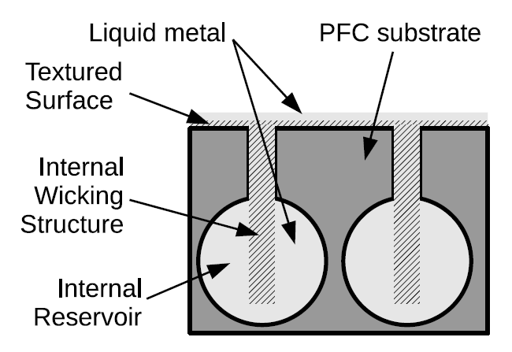
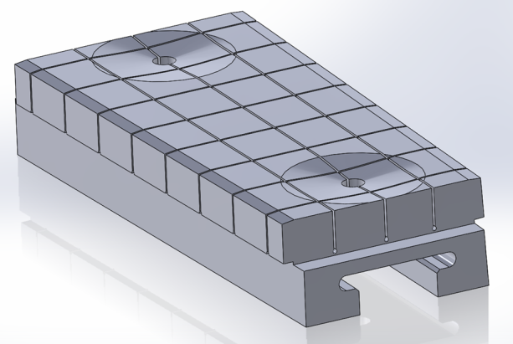

Most mature technologies emphasized for current development path
Capillary-restrained PFCs demonstrated in numerous machines – nearest technology
Pre-filled targets build on high-Z substrate design (see backup)
External Li feed into reservoir region with inertial cooling provides nearest target technology for NSTX-U
High-Z PFC design
Pre-filled target concept
DEMO-relevant PFC concept

Slide 24
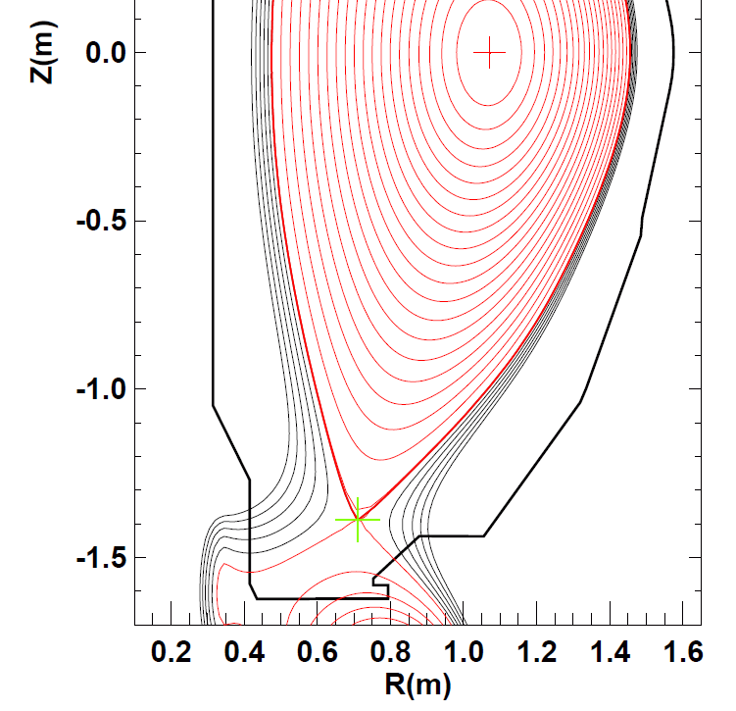
Cryo-pump design requirements being refined to accommodate liquid-metal PFCs
Design requirements for cryo-pump PFCs and divertor currently being developed
Current plan is for significant usage of high-Z material for PFCs
  Upper bullnose and plenum currently specified as high-Z
  Lower bullnose material TBD
Heating of PFCs to 350C during operations will enable liquid metal flow between discharges
Heatable cryo-pump PFCs to 350C
during operations

Slide 25
Summary
Completion of NSTX-U mission element for comparative assessment of high-Z and low-Z liquid PFCs requires high-Z and liquid metal PFC development
Scientific productivity will be maintained by gradual and targeted change-over of PFCs
Staged approach addresses technical readiness by providing incremental R&D path and decision points for push to near-term liquid metal target PFCs
Scientific questions will be addressed with mix of diagnostic, modeling and control tools ranging from PFC to core
Strategy in place to mitigate operations risks associated with PFC upgrades
  High-Z risks mitigated by cognizance of worldwide experience with high-Z and continued wall conditioning program
  Liquid Li PFC risks assessed by broad off-line research and development program including off-line experiments, surface science experiments and linear plasma device testing

Slide 26
Thank you for your attention!
Questions?

Slide 27
Backup slides content overview
Slide 28: Technical aspects of pre-filled liquid metal target R&D
Slide 39: Liquid metal PFC potential benefits
Slide 47: Recent research results and surface science aspects of liquid metal PMI
Slide 58: Further technical aspects of high-Z divertor target upgrade development
Slide 73: Additional LLNL & ORNL diagnostic details

Slide 28
Technical aspects of pre-filled liquid metal targets R&D
Concept overview
Prototype testing and initial surface testing and evaluation
Porous-MHD equations
R&D plan including summer collaboration experiments

Slide 29
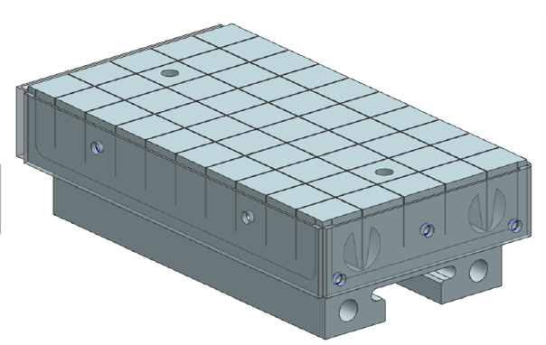
Pre-filled target concept integrates Li reservoir with high-Z tile scheme
Similar to CPS device but applicable as divertor PFC
Utilizes wire-EDM fabrication to obtain complex geometry
Emphasizes passive replenishment via capillary action
P. Rindt, TU/Eindhoven Thesis, Jaworski FED submitted

Slide 30
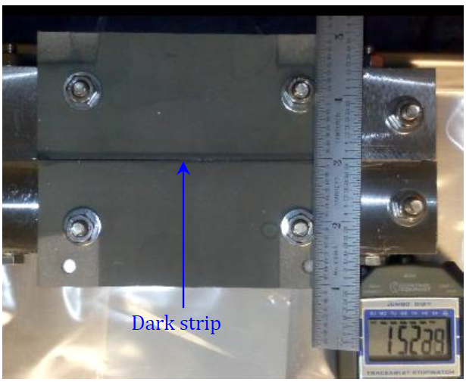
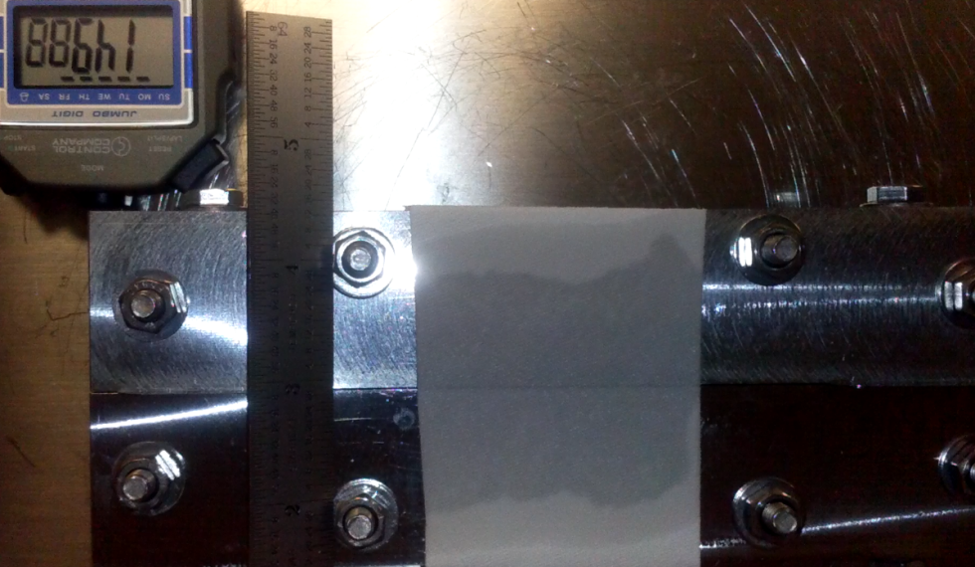
Preliminary tests indicate basic concept is feasible
Prototype testing used isopropyl alcohol as surrogate
Initial tests demonstrated wicking to surface and feasibility to empty reservoir via surface wick
Effectiveness highly dependent on surface capillary structure and texturing
Poor wicking with this material
Improved wicking with better material

Slide 31
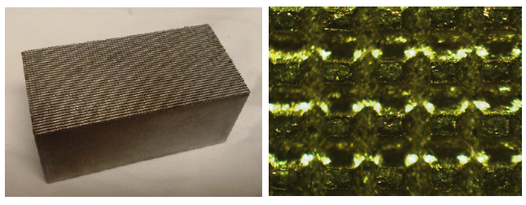
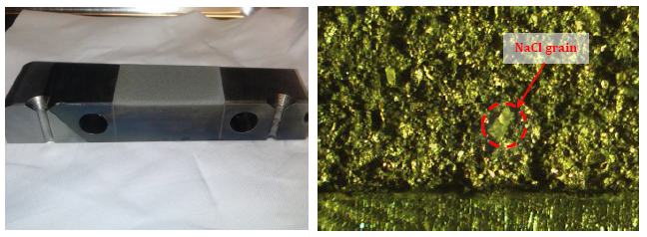
Multiple surface treatments tested for enhancement of wicking and flow (1)
Comparison to LLD flame-sprayed material
Wire-EDM micro-texturing
Enhanced-porosity flame-spray

Slide 32
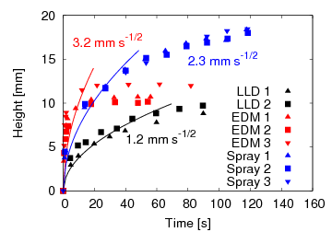
Multiple surface treatments tested for enhancement of wicking and flow (2)
Simple wicking height apparatus used
All samples show improved sorptivity (wicking) over NSTX LLD flame-spray surface
Initial wire-EDM micro-texturing similar to laser-texturing method developed by Lin et al. (J. Nucl. Mater. 2013)

Slide 33
An approach to a liquid-metal PFC: Actively-supplied, capillary-restrained systems
Closely connected primary coolant and liquid lithium reservoir/supply structure
Continuous flow to the surface to flush gettered material and maintain wetted surfaces (substrate protection)
Inertially cooled PFC would be modest step from pre-filled targets
e.g. inter-pore spacing calculation: 1cm spacing provides replenishment of 16-40Hz emptying events at optimum pore size
Jaworski, PPCF 2013

Slide 34
Pre-filled target research and development plan snap-shot
Multi-institution collaboration to address practical and scientific questions
  US partners: JP Allain, DN Ruzic (UIUC)
  International: P Rindt, N Lopes-Cardozo (TU/Eindhoven), TW Morgan (FOM-DIFFER)
Wetting and handling tests to be conducted on candidate surface materials in the Netherlands, Illinois and PPPL
Heat flux testing of pre-filled targets proposed as part of thesis work at Magnum-PSI (P. Rindt, Fall 2016 restart of device)

Slide 35
Bake-out survival and recovery is a key question for pre-filled and flowing PFCs
Two strategies in development
  removable macro films (demonstrated on Magnum-PSI, CPS-method)
  Eroding nano-scale protective films
  Summer experiments conducted by Jaworski at UIUC with collaborators will establish viability of methods
Surface cleaning (oxide removal) demonstrated previously
  Elevated temperature + plasma bombardment (He, Ar)
  PISCES-B, Magnum-PSI demonstrations

Slide 36
Overview of proposed experimental studies at UIUC
Development and testing viability of nanoscale, removable films (leverage low-temperature, controlled plasma processing equipment)
ELM-like heat pulse survival and recovery (leverage DEVEX device)
Characterization of Kelvin effect in porous liquid metal system, multiple substrates
Evaluation of liquid layer thickness and coverage from passively replenished systems
Calibration of UIUC calorimeter probes

Slide 37
Liquid metal PFC potential benefits

Slide 38
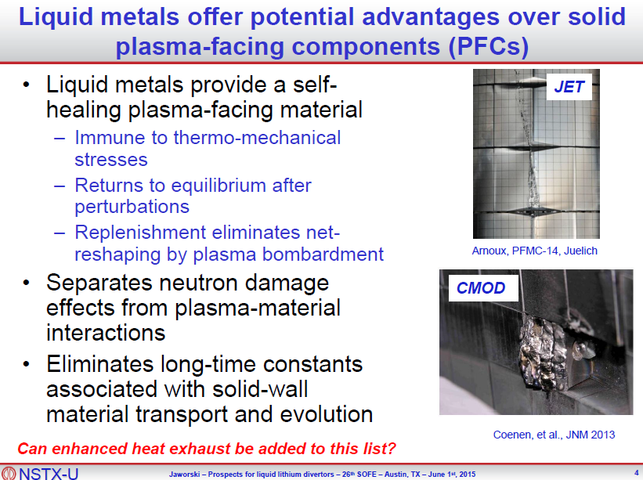
How do we assess the potential of liquid metal plasma facing components?
What is an upgrade path to experimentally test these potential advantages?
High-Z PFCs as test of separation of PMI from substrate
Pre-filled targets to begin testing heat-flux reduction in divertor

Slide 39
Liquid metal PFCs provide additional pathways for energy transport
Energy Transport Mode
Conventional, solid PFCs utilize extrinsic impurities to enhance radiation
Heat Conduction
to Substrate
Solid PFCs

Slide 40
Liquid metal PFCs provide additional pathways for energy transport
Energy Transport Mode
Conventional, solid PFCs utilize extrinsic impurities to enhance radiation
High-power density on slow-flow lithium leads to vapor-shielded targets for extreme heat flux mitigation
Fast-flow concepts can exhaust extreme amounts of power via convection but are less mature
Li CPS (first wall, divertor)
Evaporative and Radiative Cooling
Li Vapor Box,
ARLLD (divertor)
Heat Conduction
to Substrate
FLiLi (first wall)
Sn CPS
(first wall,divertor)
Heat Convection
by Liquid Metal
LiMiTs
(first wall, divertor)
Fast Flow, ACLMD
(first wall, divertor)

Slide 41
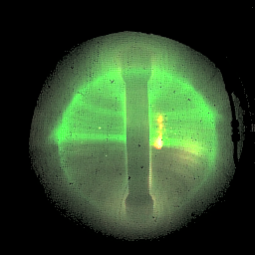
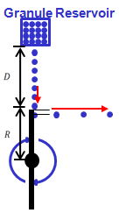
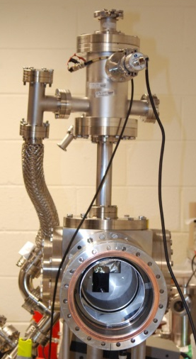
Active Injection of LL as First Line of Defense
Li injection as needed via feed-back control
Li Aerosol in NSTX
Lithium aerosol is introduced by a “droper” at the plasma edge and the ionized lithium tends to flow toward the divertor plate along the field line.
Power and particle flux
Divertor
Entrance
Li Injection
Divertor side wall
Cs/2
Li ionized with Z = 2 and flows toward divertor at Cs/2*.
D. Mansfield FE&D 2010
Li Radiative Mantle
Li granular injector for NSTX-U
RLLD Tray
*R. Goldston NF 2012
Li granular injector on NSTX-U will provide important data on ARLLD.
M. Ono ISLA-4 2015

Slide 42
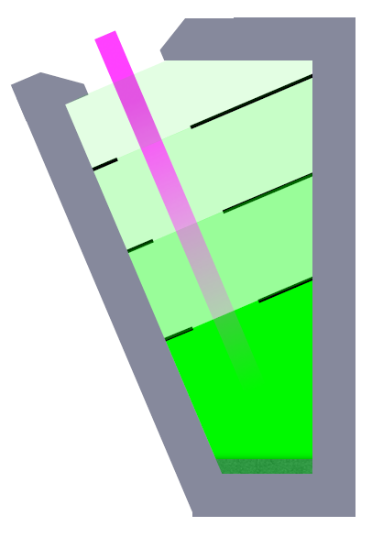
Li Vapor Box (LVB) Divertor
Li vapor divertor target is constrained
in space by differential pumping
  Bottom chamber reaches equilibrium
  density of ~ 10²²/m³ @ 750 C
  Upper chambers pump by condensation,
  at much lower temperature
Plasma energy is dissipated in bottom box
Goldston, ISLA 2015

Slide 43

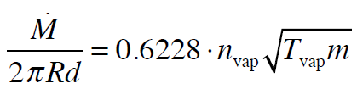

Simple Model Provides Estimate of
Bottom Box Operating Point
Dissipated power estimated from
  Langmuir flux of vapor atoms into plasma
  Conservative E_{dis} = 10 eV energy loss per atom
Mass efflux calculated assuming choked flow
Reactor design point indicates only 230g/s exiting bottom box
  Expect < 1 g/sec to
  reach main chamber
P_{dis} = 200 MW, R = 6 m
l_{box} = 0.5 m, d = 10 cm
R. Goldston

Slide 44


Initial 2-D Navier-Stokes calculations are similar to initial 0-D calculations
2-D
(NSTX “thrives”
on 220 mg/s
from dropper)
0-D
Initial 0-D calculations assumed choked flow and equilibration in each chamber. Also showed pressure balance with lithium unnecessary.
2-D fluid calculations by Hakim and Hammett result in similar behavior (factor of ~2 difference), require reflecting boundaries (white)
Similarity experiment being designed at PPPL to validate simulations

Slide 45
Recent research results and surface science aspects of liquid metal PMI

Slide 46



Suppressed erosion and trapping at target observed in linear plasma device
Mixed-material effect reduces erosion due to LiD formation
Plasma pre-sheath potential well large enough to retain eroded Li
Significant implications for evaporative cooling concepts
T. Abrams 2014 PhD Princeton U.,
T. Abrams 2016 Nucl. Fusion,
M. Chen 2016 Nucl. Fusion.
Li-I emission, t=2.5s
Neutral Li emission
Li Trapping
Plasma
Target
T>700C
Neutral D emission
10 mm
Jaworski, 3rd ISLA, 2013

Slide 47


Suppressed Li erosion observed under high flux deuterium bombardment
Experiments conducted on Magnum-PSI
  Evaporated coatings (loaned LITER unit)
  Pre-filled liquid targets
  Temperature ramp from incident plasma bombardment
Found clear mixed-material effect due to deuterium bombardment
Abrams, 2016 Nucl. Fusion

Slide 48

Quantum modeling of Li-D system indicates formation of LiD likely and impacts transport
First-principles density-function-theory applied to Li-D mixed problem
  DFT simulations calculate interatomic potentials as opposed to classical MD
  Limited to 100s of atoms and 10-20ps simulation times
Bond angle distribution provides “finger-print” compounds in simulation
  Shows rapid formation of LiD compounds
Chen, 2016 Nucl. Fusion

Slide 49


Three effects of LiD formation impacting Li erosion from sample and included in Abrams model
Reduced D diffusivity in LiD predicted from DFT modeling
  D “piling up” at surface at high flux
Preferential D-D sputtering
Reduced Li vapor pressure over LiD vs. pure Li
Chen, 2016 NF; Abrams, 2016 NF

Slide 50


Lithium reactivity leads to mixed-material surfaces
Oxygen uptake by lithium films quantified in laboratory experiments
(Skinner, 2013 JNM)
  Oxide layer formation in ~200s in NSTX (~600s inter-shot time)
  NSTX-U inter-shot time even longer during full-power discharges
NSTX whole-divertor impurity emission indicates little
change (Jaworski, 2013 NF)
  Graphite and liquid-lithium divertor (LLD) surfaces have similar emission properties
  Little impact over entire run from 60g to nearly 1kg injected Li
Oxygen uptake by Li on Mo
NSTX whole-divertor impurity emission

Slide 51

Lithium compounds exhibit complex, substrate-dependent chemistry
Quantum modeling by Krstic indicates preferential bonding of deuterium to oxygen in carbon matrix
Laboratory studies by Capece show increased absorption by oxidized Li, but lower thermal decomposition temperature
Krstic, 2013 PRL
Capece, 2015 JNM

Slide 52



Material Analysis and Particle Probe (MAPP) measurements suggest deuterium retention by oxides
Multiple surface analysis tools available (XPS, TPD, LEISS)
Show rapid oxide formation in LTX despite very low H₂O partial press
Good performance in LTX persists on order of 1000 hr (~40d), consistent with deuterium uptake by oxides
Lucia, PhD thesis, Princeton Univ. (2015), Kaita, ISLA 2015

Slide 53

Understanding material mixing and migration major thrust in NSTX-U
Material migration modeling with WallDYN code implemented on NSTX plasma data
  WallDYN developed to describe material evolution (Schmid, 2011 JNM)
  Utilizes large set of DIVIMP runs to generate transport matrix
  Mixed-material model determines impurity production from each surface
Initial parametric modeling undertaken to identify key variables and sensitivites
  e.g. relative impacts of divertor conditions (Nichols, 2015 JNM)
  Impact of mixed-material erosion model
Actual NSTX geometry
Model close-fitting wall bins
16
DESTINATION
12
20
SOURCE
8
24
0
32
72
44
60
Nichols, 2015 APS

Slide 54
Many remaining issues facing liquid metal PFCs
If temperature limit determined to be a low temperature despite divertor trapping (e.g. LVB) then this would shift technological development for Li to fast flow (see Majeski talk next)
Slow-flow/oozing systems can also utilize tin as alternative metal (strong push in EU)
Significant engineering still required to qualify components and optimize designs
Lithium-based fuel control still would benefit from overall fuel-cycle demonstration (also see Majeski talk)

Slide 55
Steady progress being made to demonstrate and understand liquid metal PFCs and PMI
Compatible temperature limit of liquid lithium PFCs should be experimentally demonstrated and greatly affects heat exhaust potential and concept viability e.g. vapor box or active lithium injection (Ono NF 2013)
  Strong mixed-material effects lead to reduced lithium production
  High redeposition fraction also observed in these experiments
NSTX-U upgrade program aims to experimentally compare high-Z and low-Z approaches in single device with three-step upgrade scheme
Understanding lithium PMI requires attention to mixed material effects
  Impure lithium films observed in most (all?) major devices
  Extrapolation to “pure” lithium flows represents major question in evaluating reactor performance
Near-term science and technologies for realizing pre-filled targets nearly in hand and being considered for FY2018 run campaign
Flowing PFCs can build upon operational experience gained with pre-filled targets and parallel efforts in safety and LM handling systems

Slide 56
Further high-Z divertor target engineering details

Slide 57


Replacement of outboard row of tiles provides significant heat-flux and maintains operational flexibility
Shape developed to perform dedicated tests on outboard PFCs
  ISOLVER free-boundary solver utilized with specified β_{N}
  0D-analysis obtains heating power for some assumed confinement (ITERH98)
Zero-radiation power exhaust provides heat flux figure-of-merit (FOM)
  FOM calculates incident power accounting for magnetic shaping only
  High-Z shape FOM is 66% of full-power, high-triangularity scenario
High-performance discharge
FOM ~ 60 MW/m²
High-Z reference discharge
FOM ~ 40 MW/m²

Slide 58




Castellations separate peak stress from peak temperature
TZM weakens at high temperatures
Castellations reduce surface stress (2-4x)
Avoiding surface cracking and potential high-Z dust production in PFC desirable
Compressive Stress on Surface
at 1.5 sec (ie 1400 C)
-260 MPa
Arc-cast TZM strength
Tensile Stress at 1.5 sec
1,260 MPa at castellation base
Briggs, J., High Temp.-High Press. 3 (1971) p. 363-409.
A. Brooks

Slide 59
Tile Design Basics
  7 “Special” Tiles, 5 Diagnostic and 2 XP
  Most tiles (not Mirnov) are modifications of the base tile type.
    The tile which contains a Mirnov sensor has shallower castellations so as not to clash with diagnostic pocket.
  These modified base tiles are not under review at this time
    Analysis is planned to qualify mods
    If we find they are unable to meet the SRD requirements…
      If they fail XP loads, modify the XP conditions
      If they fail Normal loads, propose to eliminate the tile causing the problems.
Tile sub-type | Number required | Material
Diagnostic: OLPA | 2 (over and under styles) | TZM
Diagnostic: RF Langmuir probe | 1 | TZM
Diagnostic: magnetic sensor | 1 | TZM
Diagnostic: embedded TC | 1 | TZM
Experimental: leading edge | 1 | TZM
Experimental: W+T_{recryst} effect | 1 | W (or W-alloy)
Total | 9

Slide 60
Results for
“Normal”, 2 MW/m2 Nominal for 5 sec
 | Configuration |  | Time, s | Temp, C | Tension, Mpa |  | Compression, Mpa |  | Limits
Location | Castellation Radius | Bolt Head Recess |  |  | Free | Clamped | Free | Clamped | Static Thermal | Fatigue 6000 cycles
Tile Surface |  |  | 5 | 482 | 0.5 | 0.5 | -43 | -44 | 520 | <500(?)
Base of Castellation | Nominal .010" | Yes | 5 | 160 | 595 | 487 | -609 | -824 | 1300 | 500
Base of Castellation | Nominal .010" | No | 5 | 160 | 497 | 398 | -443 | -619 | 1300 | 500
Base of Castellation | Enlarged .020" | No | 5 | 160 | 388 | 304 | -342 | -478 | 1300 | 500
Clear winner: no counterbore, larger castellation base
  Just from this analysis, we could conclude that increasing the clamping strength would be a good idea, however when we take a look at the results from the same analysis, but for the “XP” operating parameters of 10MW/m2 for 1.5 sec…

Slide 61

Static Analysis Summary
Results show that, for both operating conditions
  Castellated tiles, with no bolt counterbores, and with increased radii at the castellation bases are adequate designs to avoid yielding.
However, what about Cyclic Fatigue?

Slide 62



Surface Temperature Reaches 1400 C after 1.5s
Large Temperature Differences on shaded segments between shaded and unshaded (ie enhanced heating)
Surface
Tmax = 2555 C at 5 sec
Base of Castellation
Heat Flux Distribution
Tmax = 1408 C at 1.5 sec

Slide 63
Results summary table
“Normal” 2 MW/m2 and 5 sec pulse
 | Configuration |  | Time, s | Temp, C | Tension, Mpa |  | Compression, Mpa |  | Limits
Location | Castellation Radius | Bolt Head Recess |  |  | Free | Clamped | Free | Clamped | Static Thermal | Fatigue 6000 cycles
Tile Surface | Enlarged .020" | No | 5 | 479 | 17 | 15 | -43 | -44 | 1300 | <500(?)
Base of Castellation |  |  | 5 | 277 | 388 | 304 | -342 | -478 | 1300 | 500
“XP” 10 MW/m2 and 1.0 sec pulse
 | Configuration |  | Time, s | Temp, C | Tension, Mpa |  | Compression, Mpa |  | Limits
Location | Castellation Radius | Bolt Head Recess |  |  | Free | Clamped | Free | Clamped | Static Thermal | Fatigue 6000 cycles
Tile Surface | Enlarged .020" |  | 1.5 | ~1200 | 70 | 72 | -256 | -255 | 520 | <500(?)
Base of Castellation |  | No | 1.5 | ~100 | 495 |  |  |  | 1300 | 500
*at sharp corner where fillet is needed & and stress excluding corner

Slide 64
10MW/m2, 1.0 sec
Reduce duration of XP shots
  By lowering the duration from 1.5 to 1, we effectively lower the peak stresses at the castellation base, gaining thousands of cycles.
  The q√t of this parameter is 10, which is the same as in the “normal” operation conditions
    Appears to be a healthy limit for this system.
Racheting concerns?
  The overall effect of racheting, for a q√t value of 10, is an increase of about 330C.
    Assumes emissivity of 0.3
  For the area of interest, the castellation base, this means at the end of 12 cycles, the castellation temperature reaches ~450C and the yield strength remains essentially unaffected.
  This also means that, with racheting, even at the reduced duration of 1 sec, we have a wider range of surface temps with which to experiment.
    1200 - 1500C

Slide 65



Thermal Ratcheting
2 MW/m2 Nominal for 5 sec
1200 sec Rep Rate
Radiation Cooling Only from Tile Surface and Copper Back Plate
Assumes emissivity of 0.3
Peak Surface
Temp=834 C
Cu Base Plate
Temp = 400 C
End of First Pulse
End of 12th Pulse

Slide 66
Analysis Summary
Recap
  Tiles in free expansion, with no counterbores, and have castellations with enlarged bases are adequate to withstand both “normal” and “XP” operational conditions.
    Neither conditions cause yield
    Both conditions can survive 10^3 cycles
  Racheting will have little to no effect on tile performance
    May actually benefit experiments

Slide 67
Design Summary
The basic tile design is complete.
  Confident in performance for 2 years of operations and experiments
A few remaining tasks…
  Would like to optimize chamfers to help minimize internal stresses
  Need a few more analysis runs to help create more detailed heat flux/duration limits for operational control. (Project deliverable)
  Begin analysis on special tiles, to confirm/deny compliance with requirements.

Slide 68
Schedule
Priority on machining procurement
  Once FDR is complete, chits are put to bed
    Finish analyses, finalize basic tile design
    Begin procurement package on basic tile design, start special tile analyses (simple thermo-mechanical to check thermal stresses)
      Finish package by 1st week in Jan, submit to procurement
      If special tiles need review, hold it 2nd week in Jan
    Special tile procurement to follow close behind normal tiles, asking for partial deliveries & priority on special tiles (to allow for ample time to pot diagnostics)
    Other procurement items (new Bellevilles, grafoil, shim stock, bolts…) follow tile procurement.
      Complete by end of Jan
    Concurrent with these tasks, begin writing installation procedure with whomever will take over this job.

Slide 69


Inhomogeneous surface temperatures result in larger total particle flux
Leading edges result in larger average temperature
  Chamfers localize heating
  Fish-scaling increases average heating
Exponential vapor pressure produces strong increase in particle flux
Lithium likely to erode fastest from areas of enhanced heating

Slide 70


NSTX-U plasma-facing components (PFCs) will be subjected to significant heat and particle fluxes
NSTX-U is the newest US machine
  2x NBI heating power (<13MW)
  2x current (<2MA) and field (<1T)
  5x pulse length (<5s)
Experimental capabilities push toward DEMO-relevance
Open divertor provides unique opportunities for experiments
2nd NBI system
Upgraded OH
and toroidal fields

Slide 71
Further LLNL and ORNL diagnostic details

Slide 72
New LLNL diagnostics for high-Z sources and transport studies
Two new radiation-hardened, intensified CID cameras equipped with custom two-color optics (TWICE-1,-2) (Mo I)
UV-VIS-NIR divertor spectrometer (DIMS) for high resolution multi-chordal spectroscopy (Mo I)
Divertor SPRED VUV spectrometer (Mo III – Mo VIII)
Divertor radiometer based on AXUV diode array (LADA)
Complements diagnostic suite for low Z impurity emission
CD Gerö Band
D-gamma
TWICE-2 views
and NSTX-U
measurements
F. Scotti, RSI 2015

Slide 73
New LLNL diagnostics and tools for high-Z core impurity transport studies
Unique suite of three EUV spectrometers (XEUS, LoWEUS, MonaLisa)
  Continuous spectral coverage 10-450 Å for low and high-Z line emission measurements with ~30 ms time resolution
Laser Blow-Off (LBO) system
  Determination of impurity confinement times, penetration efficiencies
  Determination of impurity radial transport coefficients
  Funded by LLNL internal funding
Mo, W spectroscopy and atomic physics

Slide 74


NSTX-U Developing Tools for Measuring Core and Boundary Radiation
failures during bake prevented utilization of resistive bolometer sensors for P_{RAD} on NSTX
present efforts to redesign and expand bolometer diagnostics to support FY17 operations
  16 ch of lower divertor viewing for boundary radation
  24 ch tangential midplane core radiation (simulated results shown)
resistive bolometers complemented by faster unfiltered AXUV diode arrays presently installed
future expansions anticipated
reconstruction assumed
Midplane Bolometer
CDR Nov. 2015

Slide 75

Exploring New Bolometry Innovations to Support NSTX-U Research Thrusts
spatial resolution and coverage of radiation diagnostics critical for power-balance, radiative exhaust physics, etc.
developing prototype IR video bolometer (IRVB) to improve resolution for expected 2D radiation structure in divertor
  ORNL and PPPL collaborating w/ NIFS and DIFFER
results will inform possible future expansion at NSTX-U and could influence diagnostics at other US/international labs
plasma
thin Pt foil, heated by radiation, imaged by IR camera
testing 32-ch system for viewing lower x-pt late in FY16 campaign

Slide 76
Line of Sight Layout for Bay-J & Bay-I
final adjustments to be made using FY16 ops; want to play w/ range of equilibrium
  manage isolated sensor absence with present stock
vertical position relative to divertor gap (X) needs to be managed, requires access
ANALYSIS GOALS:
divertor radiated power
(R,Z) tracking of peak emission region(s)
rough size and shape of the radiating region

