Slide 1

Overview of the Core Science Group
Status and Plans
S.M. Kaye (SG Leader)
S.A. Sabbagh (SG Deputy Leader)
for the Core Science Group
37th NSTX-U PAC
PPPL, Princeton University
26-27 January 2016

Slide 2
Outline of talk
Core Science Group and its components
Core SG mission elements and TSG research thrusts and their relation to NSTX-U high-level goals
Planned research
  Multi-TSG XPs
  TSG-specific
Benefit of future facility enhancements to TSG goals
Work directed towards FES panels’ recommendations
Summary

Slide 3
Outline of talk
Core Science Group and its components
Core SG mission elements and TSG research thrusts and their relation to NSTX-U high-level goals
Planned research
  Multi-TSG XPs
  TSG-specific
Benefit of future facility enhancements to TSG goals
Work directed towards FES panels’ recommendations
Summary

Slide 4
This talk will address all of the PAC charges
  Assess the research planned to be carried out for the NSTX-U FY2016 experimental campaign - are there any major missing elements, or new opportunities?
  Assess the alignment between the NSTX-U research plans and goals and the FESAC / FES initiatives, research opportunities, and ITER urgent research needs
  Comment on the progress and plans for the NSTX-U / PPPL theory partnership, and how well this partnership and the broader NSTX-U research activities support “integrated predictive capability” (see talk by A. Bhattacharjee)
  Please comment on the present team prioritization of planned facility enhancements including: divertor cryo-pump, non-axisymmetric control coils (NCC), 28GHz ECH/EBW gyrotron, and conversion to all high-Z PFCs and liquid metals research

Slide 5
Core Science Group role is to foster communication/connectivity among TSGs studying confinement and stability (and among other SGs)
Core Science Group consists of three Topical Science Subgroups
Experiment, theory and university reps constitute SG+TSG leadership
SG successful in optimizing run time for XPs that span multiple TSGs

Slide 6
Core SG addresses high-level research goals and priorities of NSTX-U
Explore unique ST parameter regimes to advance prediction capability
  Understand confinement at high normalized pressure and at low collisionality*
  Study energetic particle physics prototypical of burning plasmas*
Develop solutions for PMI under high heat flux conditions
Advance concept for Fusion Nuclear Science Facility (FNSF) by demonstrating 100% non-inductive ops at high performance
  Form and sustain plasma current without transformer for steady-state ST*
* Directly ITER relevant

Slide 7
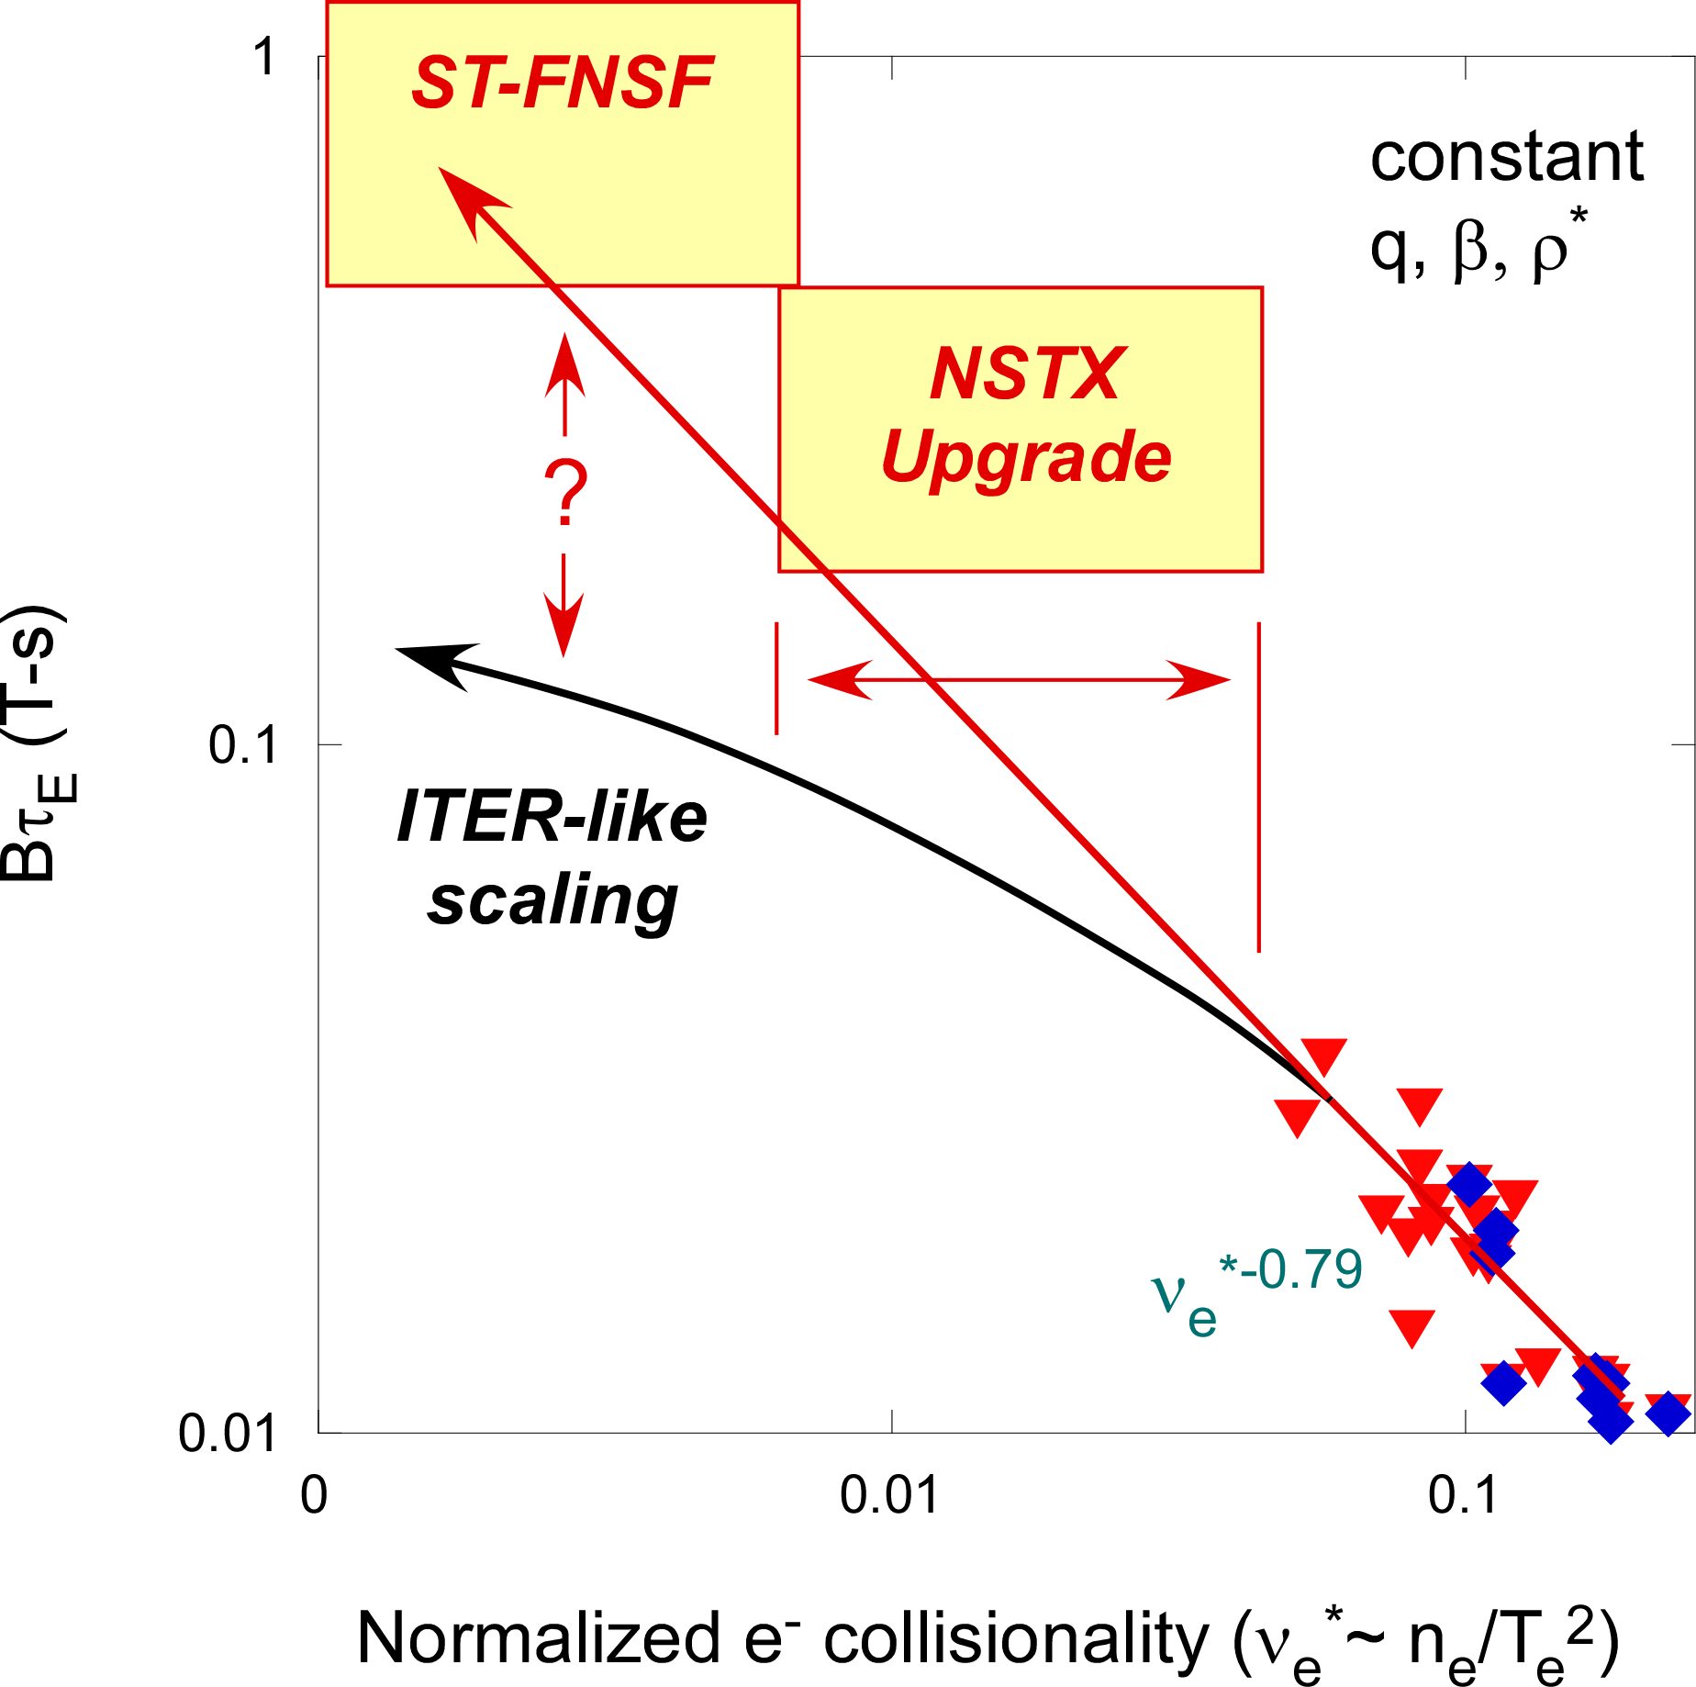
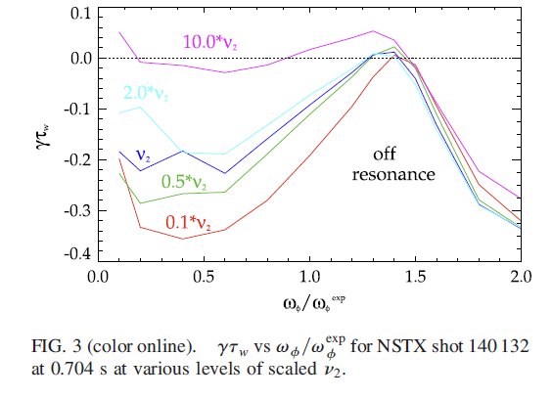
Major upgrades allow the Core SG to accomplish its major research goals
Extended I_{p}, B_{T} range
  Allows for reduction in ν*
    Confinement scaling (T&T)
    Stability optimization (Macro)
  Allows for leverage on varying q, v_{fast}/v_{Alfvén}, β_{fast}/β_{tot} for fast ion instability studies (EP)
2nd NB
  Modifies q, flow profiles
    Transport, NTV, stability, fast ion confinement (T&T, Macro, EP)
  Affects fast ion distribution function directly for AE studies (EP)
ν*^{-0.79}
Kinetic effects important
for RWM stability
NSTX-U
Increasing B_{T}

Slide 8
Core SG contributes to many of the
2016-2018 Yearly Milestones

Slide 9
Early NSTX-U results show promise for physics experiments that address Core SG goals
Long-lived, good performing H-mode achieved after boronization

Slide 10
Outline of talk
Core Science Group and its components
Core SG mission elements and TSG research thrusts and their relation to NSTX-U high-level goals
Planned research
  Multi-TSG XPs
  TSG-specific
Benefit of future facility enhancements to TSG goals
Work directed towards FES panels’ recommendations
Summary

Slide 11
TSG objectives and research thrusts define research for 2016-2018
Transport and Turbulence: Establish predictive capability for the performance of FNSF and future devices
  Characterize H-mode global energy confinement in lower collisionality regimes in NSTX-U
  Identify mechanisms responsible for χ, D: explore parametric dependences with q, v_{φ} using 2nd NB and 3D coils
  Establish and validate reduced transport models for establishing predictive capability
Macrostability: Establish the physics objectives and control capabilities needed for sustained stability of high performance plasmas
  Understand and advance passive and active control to sustain macroscopic stability
  Understand 3D effects for optimizing stability through profile control
  Understand disruption dynamics and techniques for avoidance and mitigation

Slide 12
TSG objectives and research thrusts for 2016-2018 (cont’d)
Energetic particles: Enable predictions of fast ion behavior and associated instabilities in high-β super-Alfvénic regimes (ITER/FNSF)
  Assess effects of NB injection parameters on fast ion distribution function, NB-driven current profile
  Develop predictive tools for *AE-induced fast ion transport
  Develop phase space engineering tools/techniques for fast ion distribution and mode control
Color Coding
Transport and Turbulence
Macrostability
Energetic Particles

Slide 13
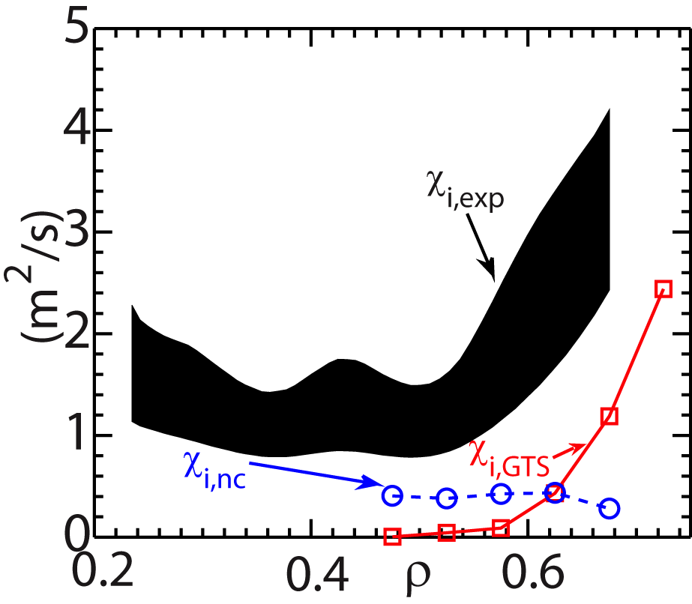
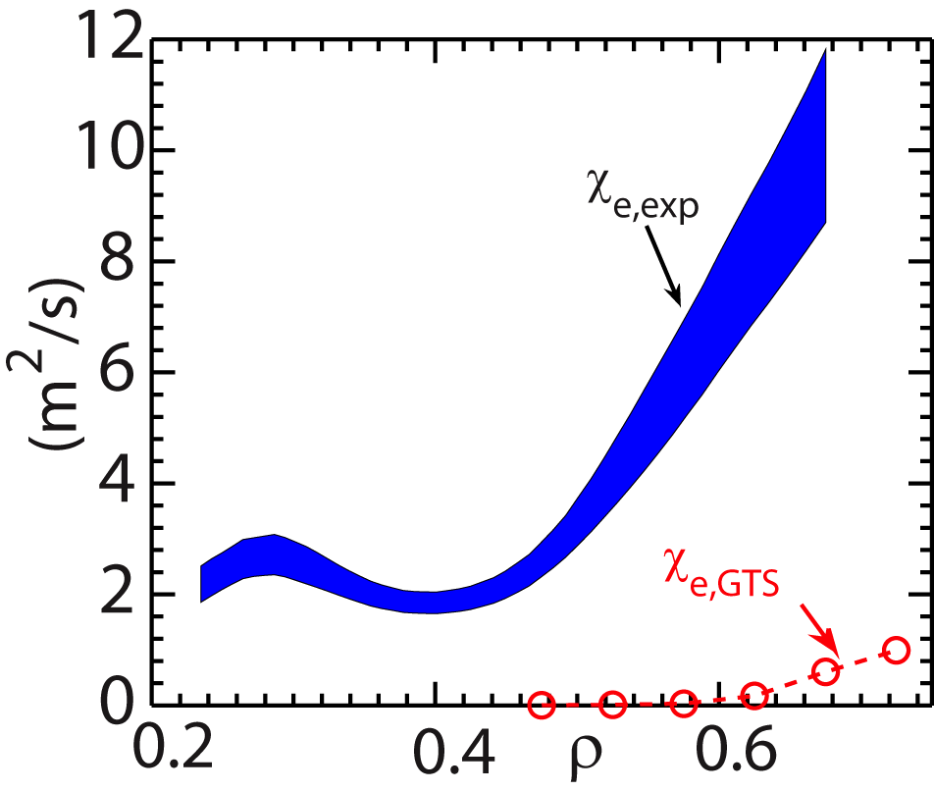
T&T research thrusts map directly to NSTX-U research priorities; recent results support future work
  Understand confinement at high normalized pressure and at low collisionality
    Characterize H-mode global energy confinement in lower ν* regimes
    Identify mechanisms responsible for χ, D: explore parametric dependences with q, v_{φ} using 2nd NB and 3D coils
    Establish and validate reduced transport models for establishing predictive capability
Non-linear GTS indicate low-k ion fluxes
within a factor of two of experimentally
inferred ones
Ions
Electrons
Kelvin-Helmholtz (flow shear driven)+ITG
e⁻ transport cannot be
explained by low-k
Wang PRL & PoP (2015)
Shear-flow modification by 2nd NB, NTV from 3D coils
Low-k turbulence will be diagnosed with expanded, 48-channel, BES array

Slide 14
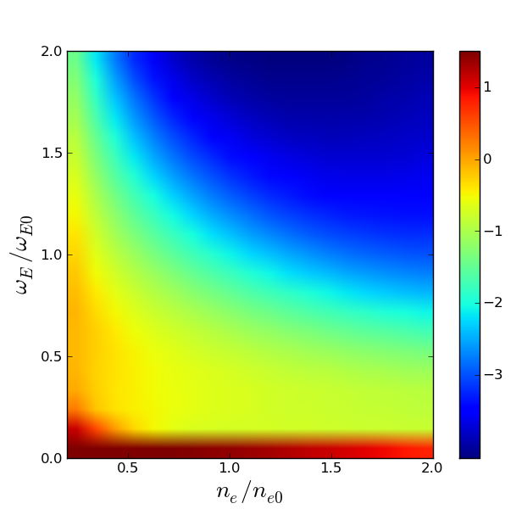
Macro research thrusts map directly to NSTX-U research priorities; recent results support future work
  Understand confinement at high normalized pressure and at low collisionality
NTV depends on both collisionality and rotation (IPEC-PENT)
    Understand and advance passive and active control to sustain macroscopic stability
    Understand 3D effects through profile control
    Understand disruption dynamics and techniques for avoidance and mitigation
      S. Sabbagh talk on disruption PAM
NTV by n=3 core-optimized
NCC in NSTX-U
Log(T_{φ}[Nm])
1/ν
Plateau
1/ω_{E}
TRANSP
Shear-flow modification by 2nd NB, NTV from 3D coils
Rotation, current profile control algorithms
Joint NSTX-U/Theory study of halo currents using tile current measurements
MGI for disruption mitigation
Superbanana Plateau
(ν*/ν₀*)^{2/5}
JK Park

Slide 15
EP research thrusts map directly to NSTX-U research priorities; recent results support future work
  Study energetic particle physics prototypical of burning plasmas
Suppression of TAE/GAE with HHFW
Developing self-consistent NB+RF code to understand
    Develop predictive tools for *AE-induced fast ion transport
    Develop phase-space engineering tools/techniques for f_{fi}, mode control
Fredrickson NF (2015)
Shear-flow modification by 2nd NB, NTV from 3D coils tp study effect on CAE/KAW coupling
HHFW + 3D fields for *AE suppression
Expanded FIDA views, ssNPA for measuring energetic particle distribution
Applied 3D fields modify drive and damping of *AE modes

Slide 16
EP research thrusts map directly to NSTX-U research priorities; recent results support future work
  Form and sustain plasma current without transformer for steady-state ST
    Assess effects of NB injection parameters on fast ion distribution function, NB-current profile
    Develop predictive tools for *AE-induced fast ion transport
Critical Gradient and “Kick” models successful in reproducing effects of TAE on fast ions (Kick model implemented in TRANSP)
2nd NB for adjusting NB-driven j(r)
Expanded FIDA views, ssNPA for measuring energetic particle distribution
Gorelenkov, Podesta

Slide 17
Outline of talk
Core Science Group and its components
Core SG mission elements and TSG research thrusts and their relation to NSTX-U high-level goals
Planned research
  Multi-TSG XPs
  TSG-specific
Benefit of future facility enhancements to TSG goals
Work directed towards FES panels’ recommendations
Summary

Slide 18
SG framework beneficial in synthesizing needs and optimizing run time among TSGs for development of major XPs
  I_{p}/B_{T} scaling (T&T) – Multi-TSG (XP1520-Kaye) [start with B, later w Li] directly addresses two Yearly Milestones
    R16-1: Assess H-mode (and beam) confinement, pedestal and SOL characteristics at higher I_{p}, B_{T}, P_{NBI}
    R17-3: Assess confinement and T&T at low ν* with full confinement and diagnostic capabilities (full I_{p}, B_{T}, high-k scattering in 2017)
    In addition, apply perturbations
    at end of discharge to study
      Impurity transport neon puffs (T&T)
      Particle transport with SGI (T&T)
      NTV studies with 3D fields (Macro)
R16-1, 17-3, 18-1, IR17-1, ITER
Non-linear GTS indicate low-k DTEM leads
to ν* dependence, in addition to μtearing
Wang PRL & PoP (2015)
    Overlap with Boundary SG: Scaling of pedestal structure and transport, SOL widths, transport and turbulence, L-H, H-L threshold studies

Slide 19
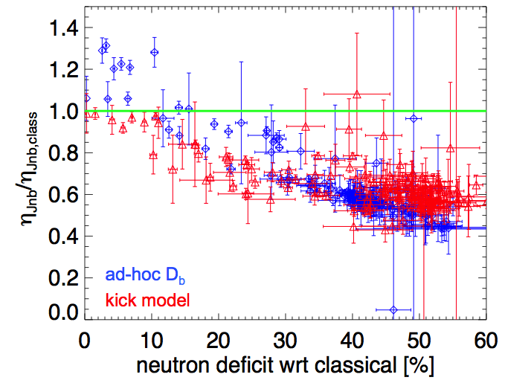
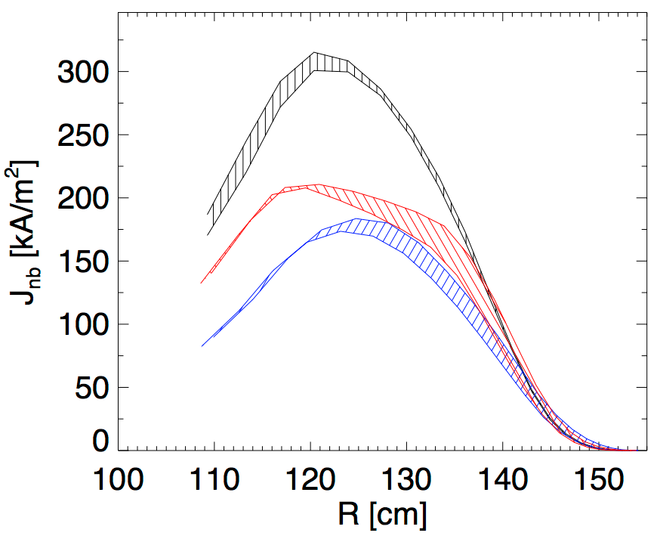
SG framework beneficial in synthesizing needs and optimizing run time among TSGs for development of major XPs
  2nd NB characterization (EP) – Multi-TSG (XP1523-Podesta) [start with B, later w Li] R16-2, 3, 17-1, 4, 18-2, IR18-2, ITER
Podesta JRT15, NF (2015)
    R16-2: Assess effects of NBI injection on fast ion f(v) and NBI-CD profile
    Vary beam source (R_{tan}) injection, power to understand beam ion confinement to modify current, pressure and flow profiles for optimizing plasma confinement, stability and non-inductive current drive
      Energy transport and confinement power scan (T&T)
      NTV studies with varying P_{NBI} and profile (Macro)
    Pedestal structure, L-H threshold dependence on P_{NBI} and heating profile (Boundary SG)
    SOL widths and associated transport and turbulence (Boundary SG)
    β_{N}, l_{i}, rotation control (Integrated Scenarios SG)
Profiles of NB-driven current
NSTX #139048
classical
kick model
Critical to use proper model for calculating
NB-driven j(r) (ad-hoc is radial diffusion only)
ad-hoc D_{b}

Slide 20
T&T research thrusts and plans 2016
Characterize H-mode global energy confinement in lower collisionality regimes in NSTX-U
  I_{p}/B_{T} scaling – Multi-TSG (XP 1520-Kaye) [B now, later Li]
Identify mechanisms responsible for χ, D: explore parametric dependences with q, v_{φ}
  Characterize transport and microturbulence from (1): couple to g-k sims
  Perturbative particle transport using SGI (XMP-Ren)
  Perturbative momentum transport (XP1549-Guttenfelder)
  3D effects on momentum transport (XP1585-JK Park)
  Impurity transport
    Ne puff (XP1551-Munoz-Burgos), vs torque (XP1550-Delgado-Aparicio), intrinsic (Scotti)
  Turbulence studies
    Effect of reverse shear (XP1575-Yuh), q-profile (Ren)
    AE bursting and effects on electron transport (XP1574-Tritz)
    2D GAMs and ZFs with extended BES (XP1584-Smith)
R16-1, 17-3, 18-1, ITER
Priority 1 XPs

Slide 21
T&T research thrusts and plans 2016
Establish and validate reduced transport models for establishing predictive capability
  Validation of gyrokinetic codes in L-mode (XP1521-Ren)
  Develop and test reduced microtearing based electron transport model
  Develop χ_{e,EP} using ORBIT and measured CAE/GAE structures (w/EP); move toward coupling with non-linear HYM simulations
R16-1, 16-2, 17-3, ITER
Non-linear HYM calculations indicate an up to 0.5 MW power channeling from the center of the plasma to the CAE-KAW conversion radius (about 2/3 of the way out
Consistent with lack of central electron heating and broadening of the T_{e} profile with higher CAE activity
Belova PRL (2015)
Priority 1 XPs

Slide 22
Macrostability research thrusts and plans 2016
Understand and advance passive and active control to sustain macroscopic stability
  PID and state-space control (XP1518,1545-Sabbagh)
  RWM stability dependence on NB (XP1546-Berkery)
  Effect of reduced collisionality on NTV (XP1517-Sabbagh)
  TM/NTM physics
    n=1 stability (XP1544-LaHaye), radiation-induced islands (XP1547-Delgado-Aparicio)
Understand 3D effects for optimizing stability through profile control
  EF thresholds and control (XP1506,1515,1516-Myers, XP1543-JK Park, XP1570-Sabbagh)
  3D plasma response (XP1548-Evans, XP1571-Z Wang)
  3D effects on TM/NTMs (XP1572-Okabayashi, XP1573-YS Park)
  Low rotation effects on RWM stability (XP1582-YS Park) and NTV (XP1583-Sabbagh)
R16-2, 16-3, 18-2, ITER
R16-2, 16-3, 18-2, ITER
Priority 1 XPs

Slide 23
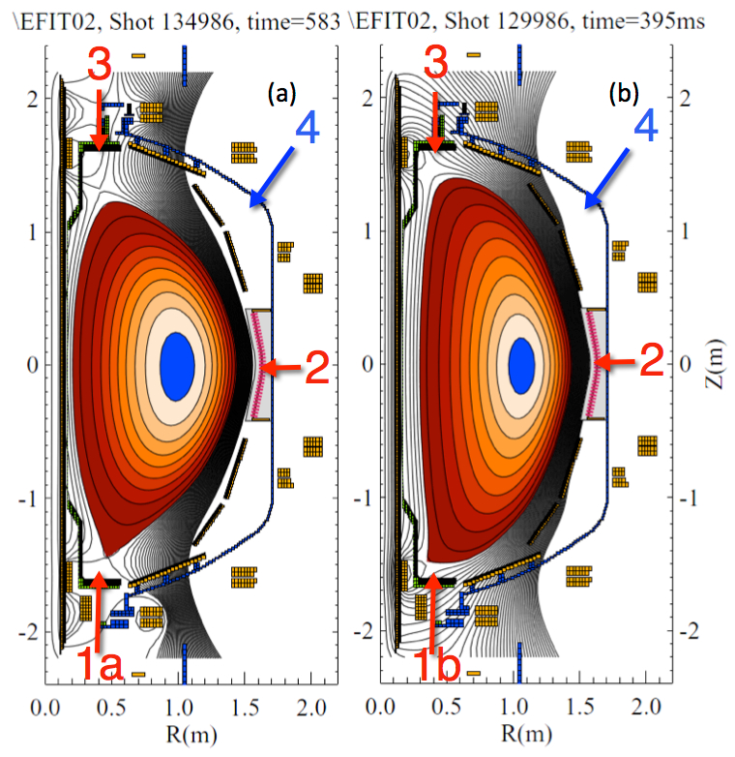
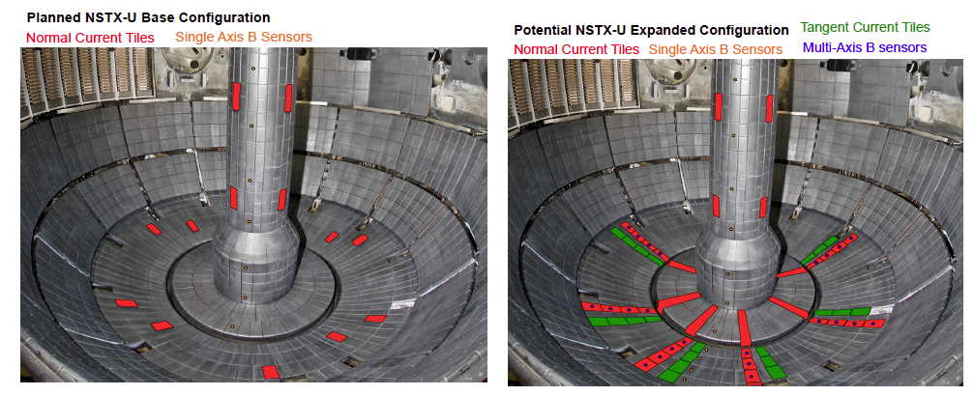
Macrostability research thrusts and plans 2016
Understand disruption dynamics and techniques for avoidance and mitigation
  Explore poloidal angle dependence and private flux region injection of MGI (XP1519-Raman)
  Validation of M3D-C¹ for VDE and disruption modeling (Jardin)
  Halo current asymmetries, rotation (Joint NSTX-U/Theory task)
  Implement real-time physics models for disruption forecasting and avoidance (S. Sabbagh talk)
JRT16, ITER
Priority 1 XPs

Slide 24
EP research thrusts and plans 2016
Assess effects of NB injection parameters on fast ion distribution function, NB-driven current profile
  2nd NB characterization – Multi-TSG (XP1523-Podesta)
  Beam ion confinement (XP1522-Liu)
Develop predictive tools for *AE-induced fast ion transport
  AE critical gradient (XP1524-Heidbrink)
  Use Upgrade capabilities to vary mode properties (frequency, spectrum, structure, regime) for development and validation studies
    NOVA-K, ORBIT, SPIRAL, M3D-K, HYM
Develop phase space engineering tools/techniques for f_{fi}, mode control
  Rotation effects
    Effect on CAE/GAE modes (XP1525-Crocker), TAE modes and gap structure (XP1552-Fredrickson, XP1528-Podesta)
  HHFW (XP1553-Fredrickson)
  3D fields (XP1577-Liu)
R16-2,3, 17-4, IR17-1, R18-2, IR18-2, ITER
R16-2, IR17-1, R18-2, IR18-2, ITER
R16-3, IR17-1, R18-2, IR18-2, ITER
Priority 1 XPs

Slide 25
Outline of talk
Core Science Group and its components
Core SG mission elements and TSG research thrusts and their relation to NSTX-U high-level goals
Planned research
  Multi-TSG XPs
  TSG-specific
Benefit of future facility enhancements to TSG goals
Work directed towards FES panels’ recommendations
Summary

Slide 26
Future facility enhancements will benefit Core SG research
Cryopump will allow for reduced collisionality and n_{e} control
  T&T: Decouple ν* and ρ* dependences with n_{e} control, isolate transport changes due to j-profile evolution at constant n_{e}
  Macro: Modify effect of kinetic resonances for RWM control
  EP: Improved flexibility to manipulate fast ion distribution through density control
NCC: Flow profile modification, modification of f_{fi}
  T&T: Effect of flow shear on turbulence suppression
  Macro: EF/Locked mode thresholds and control, plasma response model validation, effect of flow shear on mode stability, NTV physics, use for active mode control
  EP: Impact on mode drive (f_{fi,} flow shear) and mode damping (3D field modification of continuum/gap structure)
ECH/EBW
  T&T: Effect of RF vs NBI on plasma and impurity transport
High-Z tiles and flowing metal divertors
  T&T: Effect of different PFC (C vs High-Z) on plasma and impurity transport, core-edge coupling

Slide 27
Core SG activities support the priorities identified by the Whole Device Modeling panel
PRD-1: Increase development and support for modular WDM frameworks
  Modularization of TRANSP, including development and implementation of EP transport, NTM island and impurity transport modules
  Fast WDM capability: BEtween and Among Shots Transp (BEAST): NSTX-U ops
PRD-2: Understand and distill physics of gap areas
  Improved kinetic-fluid formulations for both drift-wave turbulence and extended MHD
    T&T: XGC-1, GTS, GYRO with multi-scale physics (exascale computing applications)
    Macro: M3D-C¹, MISK, NTVTOK, GPEC, MARS (M3D-C¹ exascale application)
  Fast particle interactions with thermal (Alfvén) waves and instabilities
    CGM/Kick, HYM, self-consistent treatment of fast ions and RF (TORIC/CQL3D+NUBEAM)
  Couple core & edge: EPED1 lookup table coupling to TRANSP

Slide 28
Core SG activities support the priorities identified by the Whole Device Modeling panel
PRD-3: Code/model validation at all fidelity levels through coupling with experiment
  T&T
    Reduced model testing: RLW, TGLF, MMM T(r,t)
    GYRO, XGC, GTS T(r,t), n_{e,i}(r,t), BES, high-k scattering, polarimetry
  Macro: M3D-C¹, MISK, NTVTOK, GPEC, MARS 3D MP, v_{φ}, magnetics. etc.
  EP: Kick/CGM, HYM, 3D halos (NUBEAM) FIDA, ssNPA, sFLIP, magnetics, reflectometers

Slide 29
Research and development on Disruption studies and modeling addresses key FES panel recommendations
Prediction
  RWM global stability model
    Develop predictive understanding of kinetic effects
    State-space controller implementation
    MHD spectroscopy
Avoidance
  Develop passively stable plasmas
    Close-fitting conducting plates
  Extend operation range through active control
    State-space controller
    EF/NTM/RWM control using NBI, 3D fields for control of p, j, v_{φ}
Mitigation
  Measure effect of MGI poloidal position: testing MGI capabilities
  Current quench forces and halo current asymmetries: toroidally/poloidally resolved current monitors (Joint NSTX-U/Theory task)
Modeling
  M3D-C¹ for integrated simulations throughout duration of disruption
  Automated plasma state reconstruction and stability assessment for PAM
    Gerhardt disruption warning algorithm
    DECAF (See talk by Sabbagh on DECAF)

Slide 30
Core Science research is well-positioned to take advantage of the major device upgrades
  2016 research activities address key programmatic goals and TSG research thrusts
  Code development and validation against experimental data with expanded diagnostic set align with FESAC/FES recommendations from the WDM and Transients panels. Core SG research also addresses needs for ITER research preparation
  Much of the accompanying model development and physics understanding of Core SG research is being carried out within the NSTX-U/Theory partnership (see talk by A. Bhattacharjee)
  The planned facility enhancements, especially the cryopump and NCC, will enable more flexibility in addressing the SG and TSG research objectives

Slide 31
Backup

Slide 32
T&T highlights since PAC-35 (2014)
Progress on validating core drift wave transport mechanisms
  Identification of possible low-k-turbulence-induced transport mechanisms using global gyrokinetic codes
  Density gradient stabilization of ETG modes and understanding through gyrokinetic simulations
  “Stiff” electron transport cannot be explained by gradient-driven effects
  Investigation of roto-diffusion and centrifugal effects on impurity and momentum transport (Bucholtz et al., PoP (2015), Guttenfelder)
Progress on understanding the role of GAE/CAE on core electron transport
  GAE-KAW coupling and power channeling
  Techniques under development to simulate electron thermal transport caused by measured CAEs/GAEs with ORBIT (Crocker)

Slide 33
Linear and non-linear gyrokinetic simulations have shown the role of grad n_{e} in stabilizing ETG modes
Decrease in ETG turbulence amplitude with increasing grad n_{e}
μwave
scattering
ETG
grad T_{e} ~constant
Measured δn/n, linear growth rates, non-linear Q_{e} behave similarly with grad n_{e}
(δn/n)²
γ_{lin}/(c_{s}/a)
GS2
GYRO
Ruiz-Ruiz et al.
(MIT grad student),
PoP (2015)
Low grad n_{e}
High grad n_{e}
~Q_{e}/Q_{GB}
k_{θ}/ρ_{s}
k_{θ}/ρ_{s}
k_{θ}/ρ_{s}

Slide 34
Non-linear gyrokinetic simulations used to study large changes in e⁻ transport in RF discharges
Factor of 4 decrease in high-k turbulence
with no change in local gradients when
RF shuts off
Gradient driven global g-k simulations do not
predict high enough stiffness to explain transport
Q_{e,sim} matches expt after RF-turnoff,
but not before
Factor of 2 decrease in
electron transport with no change in local gradients
Expt (before)
Expt (after)
Sims (GTS)
a/L_{ne}
a/L_{Te}
Non-local flux-driven transport may
be important
a/L_{Ti}
Ren et al., PoP (2015)

Slide 35
Global non-linear GTS gyrokinetic simulations have identified multiple low-k turbulence transport mechanisms
Strong flow shear can destabilize Kelvin-Helmholtz instability
  Non-linear global GTS simulations
  K-H+ITG+Neo ion transport within factor of 2 of expt’l level
  Cannot account for electron transport
Recent GTS simulations have shown possible role of DTEM in contributing to observed favorable collisionality scaling (Bτ_{th}~ν_{*e}^{-0.8})
  In addition to microtearing
  Synergy with DIII-D work
Ions
Electrons
Energy Flux MW/m²
W. Wang et al., NF Letters, PoP (2015)

Slide 36
Non-linear HYM simulations of CAE/KAW coupling address power channeling and effect on T_{e} profile
Full non-linear simulations including multiple (n≥4) unstable modes have been performed
n=4 (largest mode) saturation amplitude (δB/B~6.6e-3) comparable to that inferred from reflectometer displacement measurements (δB/B≤3.4e-3)
Radial component of Poynting vector
HYM calculates channeling of 0.3 to 0.5 MW for n=4
Can result in several hundred eV modification of T_{e} profile (T_{e} broadening observed during periods of high CAE activity, with no δT_{e0})
Belova et al., PRL (2015)

Slide 37
Macrostability highlights since PAC-35 (2014)
Progress in passive and active control to sustain macroscopic stability
  Joint NSTX/DIII-D experiments to unify kinetic RWM theory
  DCON ideal limits and implications for NSTX-U (Berkery)
Understanding 3D field effects and optimizing stability through profile control
  State-space algorithm for rotation control
  GPEC development for more self-consistent NTV optimization
  Use of stellarator optimization tools+VALEN for RWM control with NCC (Lazerson, Bialek)
Understanding disruption dynamics, prediction, avoidance and mitigation
  3D non-linear simulations of VDEs in NSTX with M3D-C¹
  MGI valves for injection in different poloidal locations tested
  DECAF being developed for PAM (see S. Sabbagh talk)
  Multi-machine analysis of non-axisymmetric and rotating halo currents [ITPA] (Myers)

Slide 38
Joint NSTX/DIII-D experiments have led to a unified picture of kinetic RWM physics
Kinetic RWM stabilization occurs from resonances between ω_{plasma} and ω_{precession,} ω_{bounce/circ}, ν*
Plasmas free of other MHD modes can reach/exceed linear kinetic RWM stability
Bursting MHD modes can lead to
non-linear stabilization before linear stability limits are reached
S. Sabbagh, APS Invited 2014
When RWM stable, rotation and
kinetic effects important for
stabilizing plasmas near the
Ideal Wall Limit
J. Menard et al., PRL (2014)

Slide 39
A state-space algorithm for rotation control with NBI and NTV actuators was developed
Algorithm evolves rotation profile
toward global mode stability
γτ_{wall}
I. Goumiri (grad student, PU), S. Sabbagh, D. Gates, et al.

Slide 40
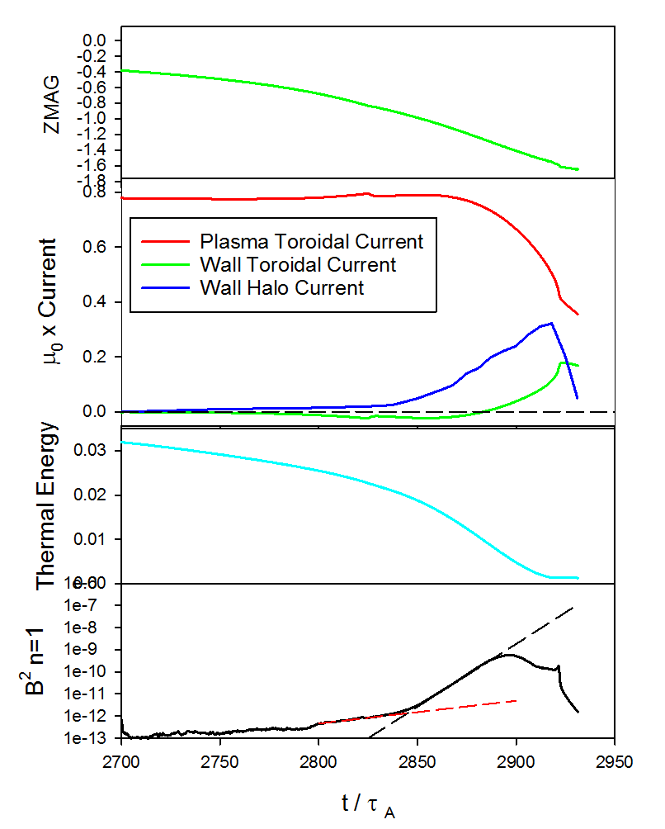
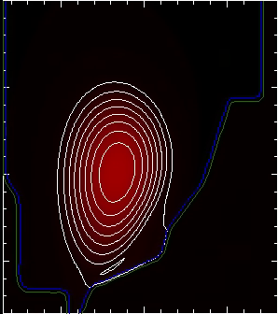
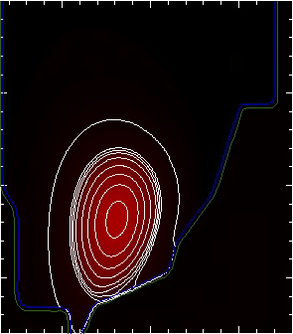
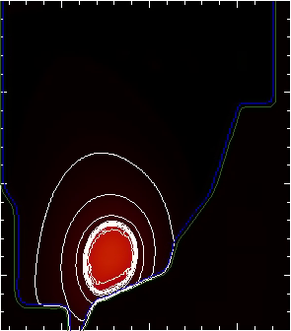
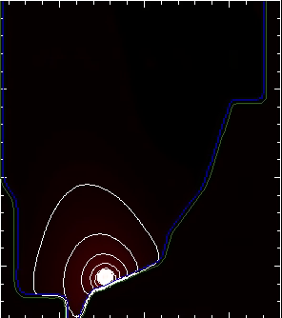
M3D-C¹ modeling of Vertical Displacement Events has been extended to 3D
Implemented arbitrary thickness resistive wall
  3 region computational space (vacuum, RW, plasma)
3D modeling of NSTX VDE with realistic wall resistivity
  Growth of n=1 mode
  Halo currents begin to form when plasma makes contact with vessel
RB_{T} t = 2850
RB_{T} t = 2875
NSTX Discharge 132859
Plasma current
Disruption phase: 2700 < t < 2950
Contours of RB_{T} show halo currents
Wall halo current
RB_{T} t = 2900
RB_{T} t = 2918

Slide 41
Plasma response to 3D fields has significant impact on calculated NTV profiles
The General Perturbed Equilibrium Code incorporates plasma response in calculation of NTV (kinetic effects included)
  3D equilibrium modified by plasma currents induced by 3D fields
Torque creates toroidal phase shift in plasma response
With increasing phase shift, coupling between
external field and plasma becomes inefficient,
resulting in self-shielding process
J.K. Park, APS Invited (2015)

Slide 42
Disruption studies
MGI will assess injection at various poloidal locations, quantify and model gas assimilation
Joint NSTX-U/Theory study on halo current asymmetries, rotation and forces

Slide 43
EP highlights since PAC-35 (2014)
Further developed and validated reduced EP transport models
  CGM/Kick models validated for NSTX & DIII-D
  Kick model implemented in TRANSP
Study of low-frequency EP-driven MHD
  Found to depend on q-profile, rotation
  Experimental results compared to M3D-K, MARS-K predictions
Assessed roles of high-frequency AEs in thermal electron transport
  CAE/KAW coupling (w/T&T)
  Compared HYM code predictions with NSTX data (Crocker/Belova)
Studied mitigation/suppression of AEs, fishbones with HHFW and 3D fields

Slide 44
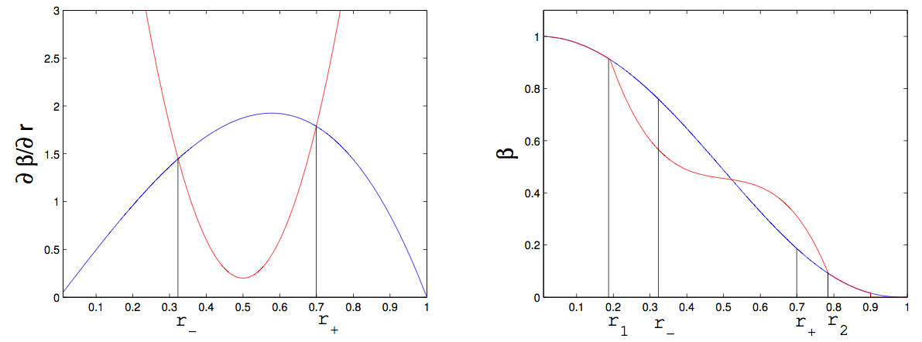
Models for fast ion profile relaxation in presence of AEs are being validated
Critical Gradient Model (Gorelenkov)
  Compute critical due to AE
  Mode growth/damping computed by NOVA-K
“Kick” model (Podesta et al., NF 2015)
  PDF computed by ORBIT & NOVA
  Kicks ~ mode amplitude
Gorelenkov
Critical gradient
Podesta
ΔP
Classical profile
ΔE
r₋
r₊
r₁
r₋
r₊
r₂
CG used to relax EP profile. It is broadened from the initially unstable one between r± → r_{1,2}
Both CGM and Kick models reproduce neutron deficit in an NSTX discharge with multiple unstable TAEs
Neutron Deficit %
Time (ms)

Slide 45
Correct treatment of fast ion phase space evolution is relevant for consistent integrated simulations
Two models tested for fast ion transport in integrated simulations in TRANSP
  Ad-hoc diffusion model (radial diffusion only) & kick model
  Ad-hoc model OK for global quantities (e.g. neutrons, stored energy)
Substantial differences observed for profiles, time evolution of
  Fast ion density, NB-driven current, power to thermal plasma
  Fast ion distribution function
Profiles of NB-driven current from TRANSP
classical
NSTX #139048
kick model
ad-hoc D_{b}
Podesta, JRT 2015, Nuc. Fusion (2015)

Slide 46
Techniques have been employed to mitigate Alfvén Eigenmodes
TAE and GAE modes suppressed by application of HHFW
TAE & GAE have been mitigated by application of 3D fields (Bortolon et al, PRL (2013)
  Fast ion drive for GAE reduced due to fast ion losses (Bortolon)
  Continuum damping of TAE increased due to reduced gap
Self-consistent description of
HHFW/EP under development
using TORIC/CQL3D- NUBEAM
E. Fredrickson et al, NF (2015)
G. Kramer et al, under prep. (2016)

Slide 47
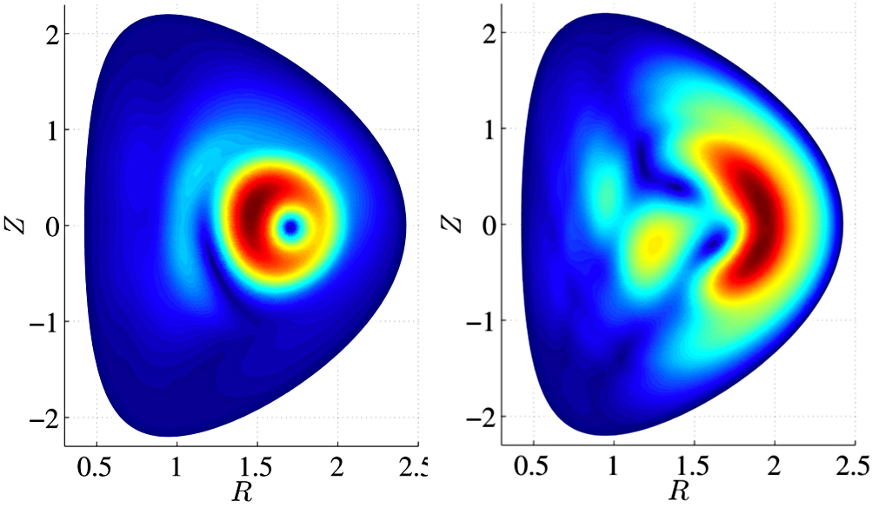
Extensive simulations investigate role of EP in determining stability and character of low-f MHD modes
Linear & non-linear study of fishbones using M3D-K (Fu, Wang):
  Rotation is destabilizing, favors fishbone over kink
  Mode structure evolves with q_{min}, non-linear effects cause broadening
  Both passing & trapped EPs contribute to drive
    Trapped particles’ contribution dominant as mode evolves non-linearly
q_{min}~1.1
q_{min}~1.6
Complements studies of Non-Resonant Kink (NRK) with M3D-K, MARS-F (Hao)
  MARS-F: NRK destabilized at high rotation, mode structure broadened by finite resistivity
Fishbones and NRKs cause significant flattening of EP profile

