Slide 1
Questions and Answers from PAC-37 Day 2
NSTX-U Team
NSTX-U PAC-37
PPPL
January 27, 2016

Slide 2
Questions from NSTX-U PAC-37 (Day 2)
What is the personnel allocation (FTE or headcount) by research group or topic?
What is the QC/QA and pre-testing plan for the solid high-Z tile row to be installed for the FY17 run? What will be done to verify both the materials and design in advance of installation of all the tiles?

Slide 3
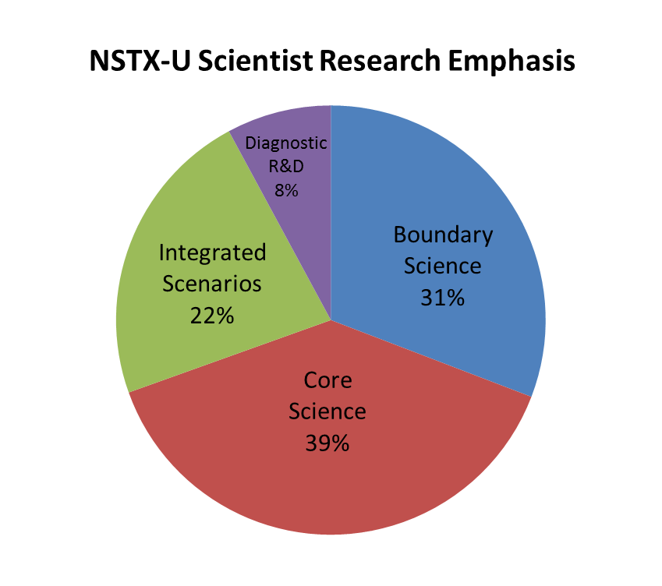
Personnel allocation (head-count) sorted by research area of emphasis / Science Group
~290 NSTX-U scientists in total
Assign single label to each scientist
Boundary
Core
Scenarios
Diagnostic R&D

Slide 4
What is the QC/QA and pre-testing plan for the solid high-Z tile row to be installed? What will be done to verify both material and design? (Jaworski/Tresemer)
The first high-Z tile row is an experimental set
Establish operational experience with high-Z
Verify engineering design methodology
Also a “trial by fire plasma” test of PPPL procurement, QA, and technical staff
Quality control and verifications are being carried out in three main areas
Material specification
Fabrication dimensional controls
Installation procedures

Slide 5
Material specification (trust, but verify)
Numerous discussions with C-Mod engineering staff on TZM specifications in use for past 20+ years
Rather than provide unique minimum requirements of our own creation, we have specified the use of an ASTM standard
ASTM B386 for molybdenum
Alloy type 363 (TZM, vacuum arc-cast, stress-relieved)
Provides specifications on composition, UTS, yield strength, elongation (mech. properties in transverse direction), and softening temperature minimum
Grain orientation specified in procurement specification
Procured material currently under test at PPPL
S. Jurczynski performing tensile tests to verify ASTM spec
Will be testing with XRF analyzer to verify composition

Slide 6
Fabrication will be verified by PPPL QA
Quality Assurance examination of fabricated parts a normal part of PPPL procurement process
QA will be asked to verify critical features of final drawings
T-bar shaft
Chamfer geometry (including dish-pan)
Confirm round at base of castellations

Slide 7
In-vessel Installation Procedure (IP) will specify tile-to-tile positioning
Machine technicians install PFCs to IP specifications
Previously utilized for NSTX-U CS tiles
Extensive shimming expected (designed in) to accommodate uncertainty in outer divertor structure
Installation will be aided by precision installation tool
Inter-tile nominal gap is 0.030” (0.76mm), current plan for tolerancing +0”/-0.025” (0.64mm)
Inter-tile vertical tolerance alignment to within 0.005” (0.127mm)
Vertical misalignment spec. subject to change pending current analysis (PDR CHIT resolution)

Slide 8
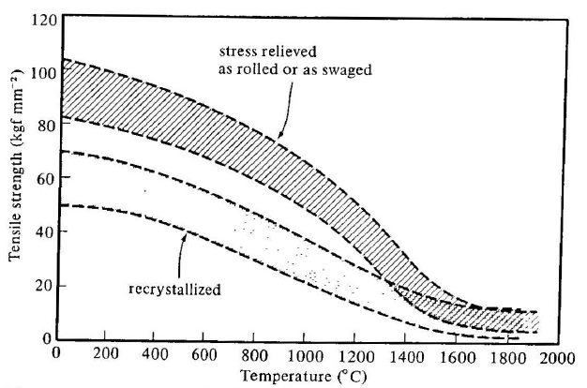
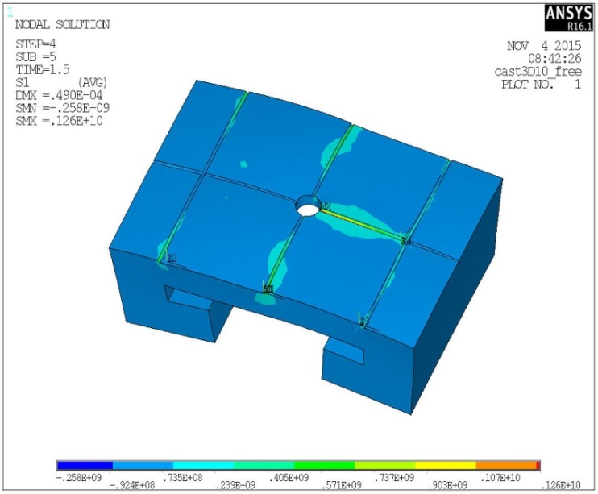
Post-mortem analysis will verify performance after first run-year
Most likely point of failure determined through extensive thermo-mechanical analysis
Castellation base results in stress concentration
Opening force along T-bar spine
Grain orientation specified that this is a longitudinal stress (maximum strength)
Extra tiles procured so that a subset can be destructively examined post-run
These experimental tiles are an engineering (and procurement) test for the cryo-pump divertor PFCs
Arc-cast TZM strength
Tensile Stress at 1.5 sec
1,260 MPa at castellation base
Briggs, J., High Temp.-High Press. 3 (1971) p. 363-409.
A. Brooks

