Slide 1

NSTX-U Researcher Collaboration Activities
S.M. Kaye
NSTX-U PAC-39
PPPL, Princeton Univ.
9-10 January 2018

Slide 2
Researchers remain active during Recovery period
Participation in and development of collaborations for FY17-19
  Experiments on other facilities/theory that address NSTX-U Research Goals for guiding future operations, and which are of benefit to STs and non-STs
  DIII-D major collaboration through integration of PPPL researchers and dedicated run campaign
  MAST-U collaboration has started
  Other collaborations on both domestic and international devices
  Collaboration activities contribute to answering key science questions
Analysis of NSTX-U results ongoing: EP/AE physics, divertor turbulence, transport and confinement, EF/stability to address milestones

Slide 3
NSTX-U Research Goals will be accomplished by several means
Research Milestones (R-): formal list of NSTX-U deliverables
  Primarily carried out by PPPL researchers directly funded by NSTX-U, ITER & Tokamak and/or Theory Divisions
Research Activities (RA-): research that can benefit both ST- and non-ST devices
  Work carried out by both PPPL and non-PPPL researchers
  Non-PPPL researcher work supported by transferred and/or separate funding on other devices
  Means by which collaborators who worked on NSTX-U can keep in touch and communicate ongoing work

Slide 4
NSTX-U Research Milestones and Activities cover the full range of science topics
JRT18: Test predictive models of fast ion transport by multiple AEs
R18-1: Develop/benchmark reduced heat flux and thermo-mechanical models for PFCs/ monitoring
R18-2: Develop simulation framework for ST breakdown and current ramp-up
R18-3: Validate/further develop reduced models for thermal e⁻ transport in STs
R18-4: Optimize energetic particle distribution function for improved plasma performance
RA18-1: Validation of non-axisymmetric plasma response modeling
RA18-2: Develop self consistent calculation of fast wave and energetic ion interactions
RA18-3: Assess transient CHI startup potential for ST current initiation
R19-1: Assess H-mode energy confinement and pedestal with higher B_{T}, I_{p} and NB heating power
R19-2: Demonstrate optimized ramp-up scenarios in STs
R19-3: Validate tearing mode physics for tearing avoidance in high performance scenarios
R19-4: Assess effects of NB injection parameters on fast ion distribution and NB-driven current profile
RA19-1: Expand disruption prediction and avoidance capability for tokamaks
RA19-2: Assess importance of H-species in HHFW-heated NSTX-U full-field plasmas

Slide 5
DIII-D collaboration: two types of opportunities
>Σ3 PPPL FTE researchers funded directly through ITER and Tokamak (I&T) Division to work with PPPL Team on DIII-D
  NSTX-U researchers contributed to 2017 I&T Notable Outcome on modeling EP losses due to AEs
Two week (8 days) dedicated campaign in 2017
  Proposals submitted and prioritized based on near-term NSTX-U goals (including JRT), well-defined ideas that require minimal development time, early career considerations
  Selections finalized after discussions with GA, FFCC in December 2016
  Approximately 50% of run time allocated to non-PPPL researchers

Slide 6
MAST-U collaboration has started
Plasma startup scenario development in anticipation of MAST-U ops in Spring ‘18 (plasma/config commissioning), Fall ‘18 (physics experiments)
  D. Battaglia spent 2 ½ months at MAST-U Summer 2017; plans additional visits
ST devices have common goals
  Robust, flexible startup with active feedback assist
  Broad j(r)/low l_{i} to increase κ, avoid low-q₀ MHD activity
  Minimize flux consumption
Ported LRDFIT for startup modeling (R18-2, 19-2)
  Validated on MAST data
  Developed high order null scenario
Additional collaborations being developed in areas of transport, EP and core MHD
  R18-3,4, R19-1,3,4

Slide 7
Researchers are actively engaging in other domestic and international collaborations during Recovery
  EAST (China): edge physics, plasma materials interactions, effect of lithium
  ASDEX-U, W7-X (Germany): wall conditioning using boron powder
  QUEST (Japan): Full non-inductive operation (CHI, ECCD)
  HL-2A (China): LH stabilization of ELMs, effects of NTMs on fast ions
  KSTAR (S. Korea): Core MHD, rotation physics, plasma control
  LAPD: RF coupling and heating physics

Slide 8
How do collaborations address key questions?
Science Group and presenter
Key research questions: First 1-3 years, 3-5 years, 5-10 years
Can a high-performance ST have 100% non-inductive current, equilibrated?
Does “ST” confinement scaling persist to (3× to 6×) lower collisionality ν*?
Can Alfvénic instabilities be modelled/understood, manipulated to control core?
Can passive & active RWM stabilization be achieved at low ν* and sustained?
How will pedestal transport & turbulence vary vs lower ν*, higher I_{P}, Li coatings
How does heat-flux width scale? Can n_{e} control be sustained? (see backup)
Can heat fluxes be mitigated consistent with high core performance?
Can liquid metals provide a solution for higher confinement, power exhaust?
Can high-harmonic fast-waves provide reliable heating and CD in H-mode?
Can NSTX-U demonstrate solenoidal-free initiation, ramp-up, and flat-top?
Scenarios
D. Battaglia
Core
W. Guttenfelder
M. Podesta
S. Sabbagh
Boundary
A. Diallo
M. Reinke
M. Jaworski
Scenarios
R. Perkins
R. Raman

Slide 9
How do collaborations address key questions?
Science Group and presenter
Key research questions: First 1-3 years, 3-5 years, 5-10 years
Can a high-performance ST have 100% non-inductive current, equilibrated?
Does “ST” confinement scaling persist to (3× to 6×) lower collisionality ν*?
Can Alfvénic instabilities be modelled/understood, manipulated to control core?
Can passive & active RWM stabilization be achieved at low ν* and sustained?
How will pedestal transport & turbulence vary vs lower ν*, higher I_{P}, Li coatings
How does heat-flux width scale? Can n_{e} control be sustained?
Can heat fluxes be mitigated consistent with high core performance?
Can liquid metals provide a solution for higher confinement, power exhaust?
Can high-harmonic fast-waves provide reliable heating and CD in H-mode?
Can NSTX-U demonstrate solenoidal-free initiation, ramp-up, and flat-top?
Scenarios
D. Battaglia
Core
W. Guttenfelder
M. Podesta
S. Sabbagh
Boundary
A. Diallo
M. Reinke
M. Jaworski
Scenarios
R. Perkins
R. Raman

Slide 10
Rotation and stored energy control necessary to achieve target high performance plasmas
Control algorithms developed for NSTX-U, adapted and implemented on DIII-D
Constrained optimization finds beam voltage & perveance variation to produce required torque & power to achieve target rotation & energy
Planning to expand to shear/profile control
Perveance changes faster to compensate slower voltages, but saturates trying to compensate sudden confinement changes
D. Boyer, PPPL

Slide 11
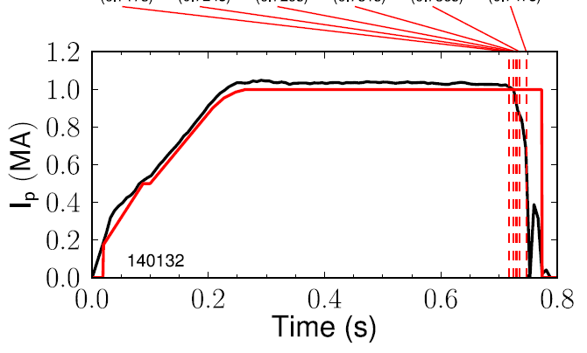
Disruption Event Characterization and Forecasting (DECAF) development for maintenance of high-performance plasmas
Automated disruption event chain analysis to cue avoidance systems (RA19-1)
RWM
VSC
WPC
LON
IPR
LOQ
DIS
(0.717s)
(0.724s)
(0.729s)
(0.731s)
(0.736s)
(0.747s)
Physics-based disruption forecasting models (e.g., reduced kinetic RWM model: Berkery, 2017)
Prediction quantitatively compared to experiment (7% false positive)
Collaborative (inter)national multi-device studies starting (incl. NSTX/-U, KSTAR, DIII-D, TCV)
NSTX
S. Sabbagh, J. Berkery, Columbia U.

Slide 12
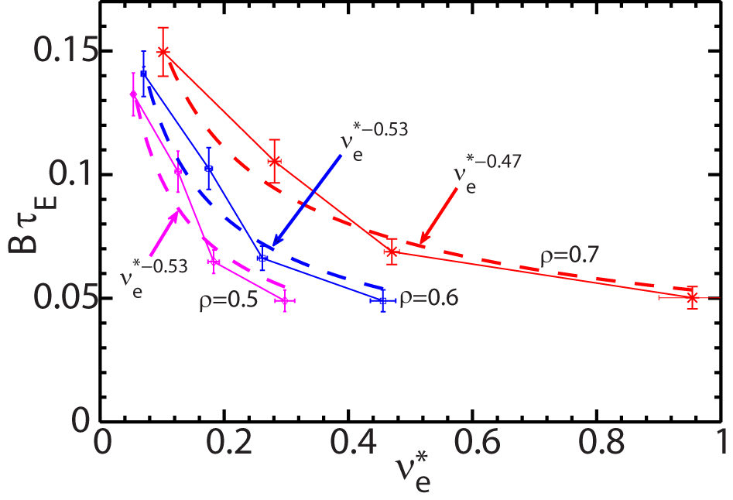
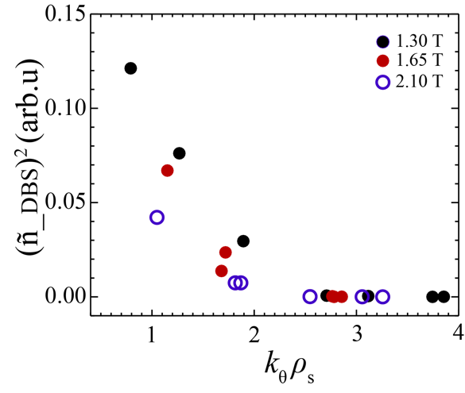
Core low-k turbulence reduced as collisionality decreases in Advanced Inductive Hybrid Scenario at ST-relevant q₉₅
Experiment on DIII-D designed to understand improvement of confinement with decreasing collisionality in STs as well as at higher aspect ratio (R18-3, 19-1)
DBS measurement indicates reduction of turbulence with increasing B_{T} (decreasing collisionality), consistent with energy confinement improvement
E-S/E-M gyrokinetic simulations (flux tube & global) to understand cause of trend
DBS measurement at ρ~ 0.55-0.65, averaged for t=3.75-4 s
Y. Ren, PPPL

Slide 13
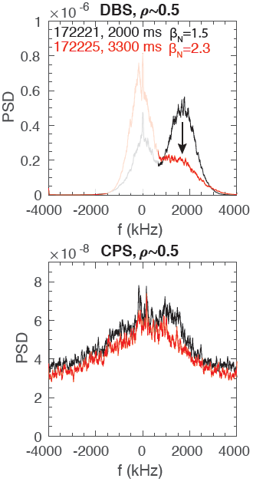
What is the influence of electromagnetic microturbulence at high β?
Enhanced coupling to δB at increasing β is stabilizing to ITG/TEM (R19-3, 19-1)
Measured simultaneous δn (DBS) & δB (CPS) as far in as ρ~0.4 in QH-modes on DIII-D
Use results to validate electromagnetic gyrokinetic simulations
  Ratio of CPS/DBS amplitudes ~δB/δn increases with β, expected from theory
  Requires ray tracing, gyrokinetic simulations + synthetic diagnostics for validation (ongoing for IAEA FEC 2018)
W. Guttenfelder, PPPL

Slide 14
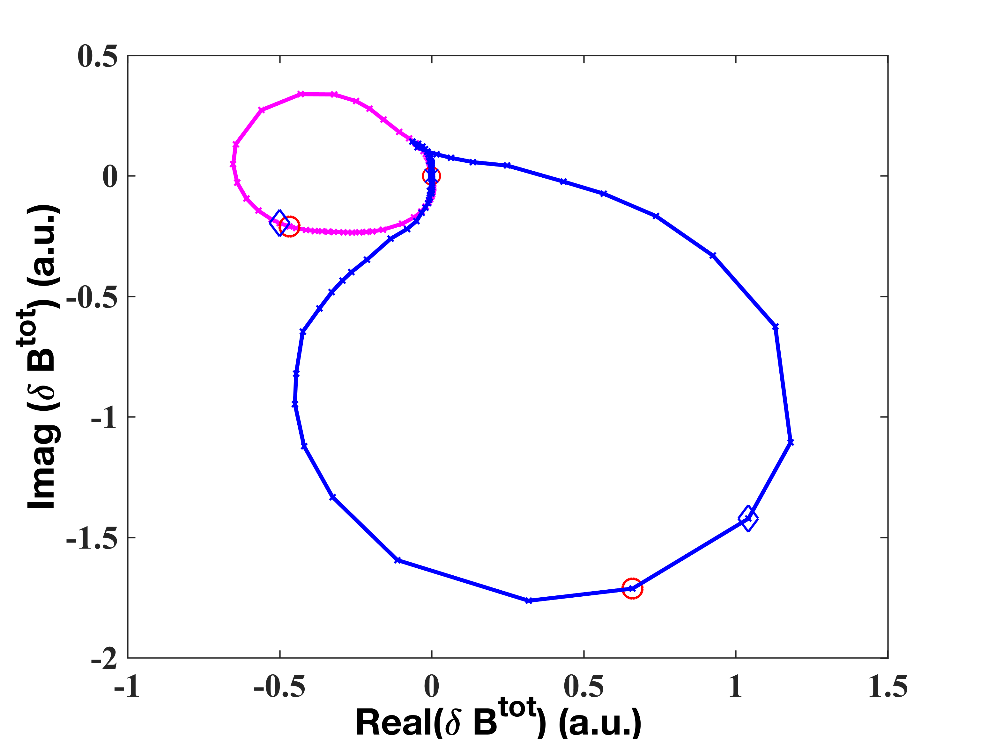
Collaborations on 3D MHD show importance of rotational and kinetic effects in identification and detection of MHD modes
MARS-K shows rotational and drift kinetic effects fundamentally change 3D plasma response and RWM stability in high performance plasmas
  Predicted frequency response to 3D fields can be largely different between fluid and kinetic simulations
  RWM stability inferred from kinetic Nyquist contour explains 3D response in high β and low ν* NSTX plasmas
  Consistent with Berkery/Sabbagh results
  RA18-1
NSTX 124801 β_{N}=4.98>β_{N-nowall}
Kinetic Response
RWM Re(γ)= -13.2s⁻¹ (stable)
Fluid Response
RWM Re(γ)= 13.7s⁻¹ (unstable)
Z. Wang et al, NF 58 016015 (2018)
Advanced 3D MHD spectroscopy, based on Nyquist method, has been used to identify and detect MHD stability and multi-mode response on EAST and DIII-D
  Tested in 2017 and 2018 EAST and DIII-D experimental campaign
  First time successfully extracted experimental transfer function between applied field and plasma response
  This is one method that can be used to develop real-time global MHD stability monitor and improve RWM feedback controller in NSTX-U and other devices

Slide 15
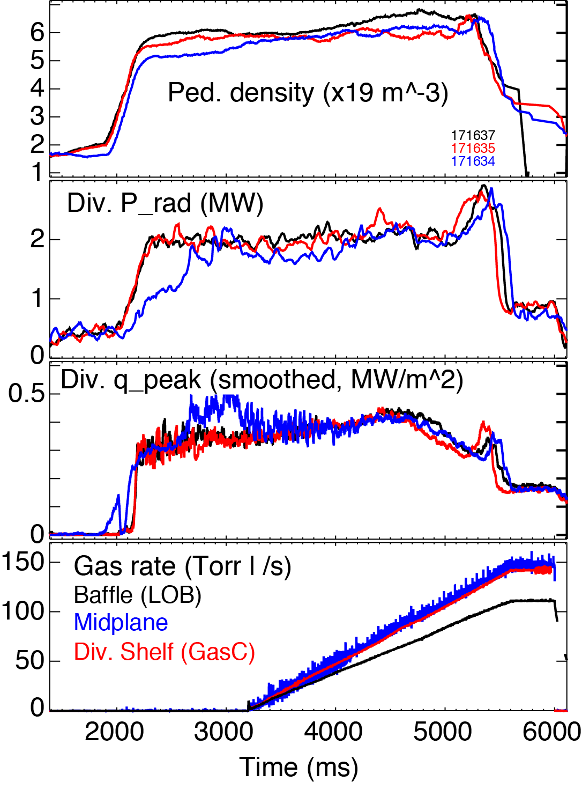
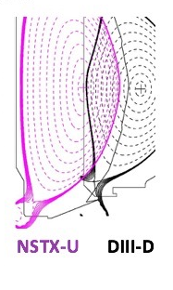
Divertor detachment is one method for heat flux mitigation
Divertor detachment studied in highly-shaped NSTX/NSTX-U similar plasmas on DIII-D (JRT17)
NSTX demonstrated partial detachment sensitivity on
  Gas injection location
  Divertor flux expansion
  Divertor separatrix angle with PFCs
FY2017 result in DIII-D: little change in divertor detachment characteristics with gas injection location (midplane, divertor shelf, divertor baffle)
Analysis to understand differences ongoing
Gas
V. Soukhanovskii, LLNL

Slide 16
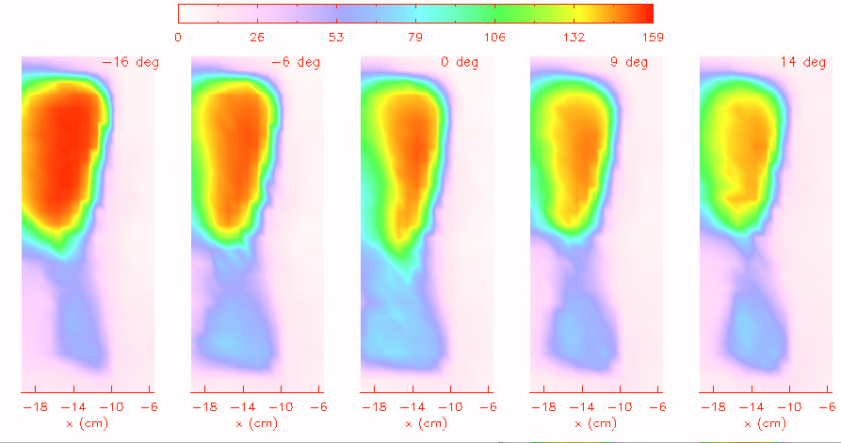
UCLA’s LArge Plasma Device (LAPD) serves as a “test stand” to understand HHFW losses and to improve NSTX-U heating performance
On NSTX, there is a significant loss of HHFW power to the SOL. What is the reason for this?
  Can far-field rectification dissipate substantial HHFW power?
  Is this related to the misalignment of the current straps with B_{TOT} in NSTX(-U)?
LAPD offers opportunity to study these topics in detail
  Flexible setup & diagnostic accessibility
  Detailed 2D and 3D data sets, which are not obtainable on major tokamaks due to time and access constraints
  Plasma parameters are similar to NSTX SOL
Preliminary result:
  The amplitude of potential changes significantly as antenna is tilted relative to field
  LAPD has identified regions of enhanced potential on side of single-strap antenna
  Studying reason for change in potential & impact of tilt effect in the far-field [analog to divertor in NSTX(-U)]
Plasma Potential (V)
0
79
159
Changing tilt angle from -16º to +14º
R. Perkins, PPPL

Slide 17
Summary
Results from collaborations (active and planned) address NSTX-U research elements and will provide guidance for future operational scenarios
  Opportunities for non-PPPL researchers to collaborate exist (or have been proposed) to provide a means to maintain research activities, and to communicate results with the NSTX-U Team
Non-PPPL researchers remain interested in NSTX-U, and we look forward to them bringing their full research expertise back to NSTX-U when operations resume

Slide 18
Back-up

Slide 19
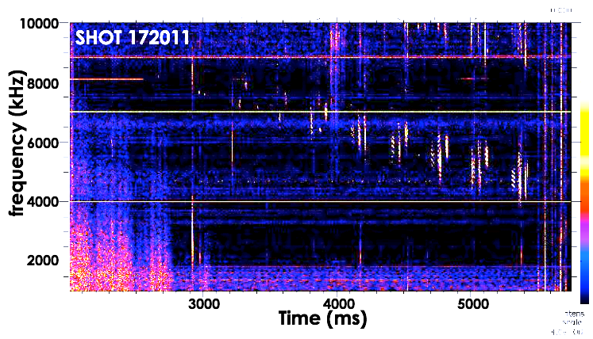
Dedicated campaign experiment on DIII-D investigates stability and f & n scaling of compressional Alfvén eigenmodes on DIII-D
Observed CAEs consistent with many aspects of theory:
  Frequency dependent on beam injection geometry
  Beam density threshold observed
    Beam current ramped at constant voltage (variable perveance beams)
  Observed B_{T} & n_{e} thresholds consistent with resonance condition — f increases with v_{A} as expected
Preliminary 2-point n results
  n < 0 consistent with Doppler shifted cyclotron resonance
  f increases as |n| decreases
Addresses NSTX-U JRT18, R18-4, 19-4
  Results will be used to validate HYM linear and non-linear simulations
I_{beam} ramping down @ constant V_{beam}
Beam density (current) threshold
CAEs
BT ramping down & cycling through beams
S. Tang, UCLA

Slide 20
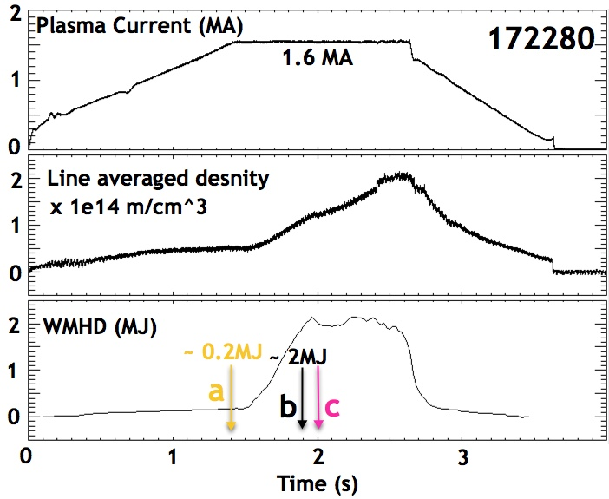

SPI experiments carried out to determine whether pellets can penetrate high temperature edge
Disruption mitigation experiment carried out in DIII-D with low & high-power (L- & H-mode)
Relevance for ITER, Electromagnetic Particle Injector concept for NSTX-U
Results support continued EPI development for higher velocity pellet
Line averaged density
R. Raman, U. Washington

Slide 21
KSTAR 3D physics collaboration demonstrated remarkable predictability of ELM suppression window in n=1 RMP coil space
Used resonant metrics in linear 3D MHD with edge vs. core decoupling
Fully identified 3-rows KSTAR RMP coil operating windows for ELM suppression
Validated its predictability with new RMPs, including dynamically deployed RMP (e)
Predicted stability diagram (I_{M},φ)
with a special choice of I_{T}=I_{B}=5kA
(a-e) Experimental RMP traces
ELM
suppression
Locking
(J.-K. Park et al., under review in Nature Physics (2017, EPS Invited 2018)
+: Experimental locking threshold
+: Experimental ELM suppression threshold

Slide 22
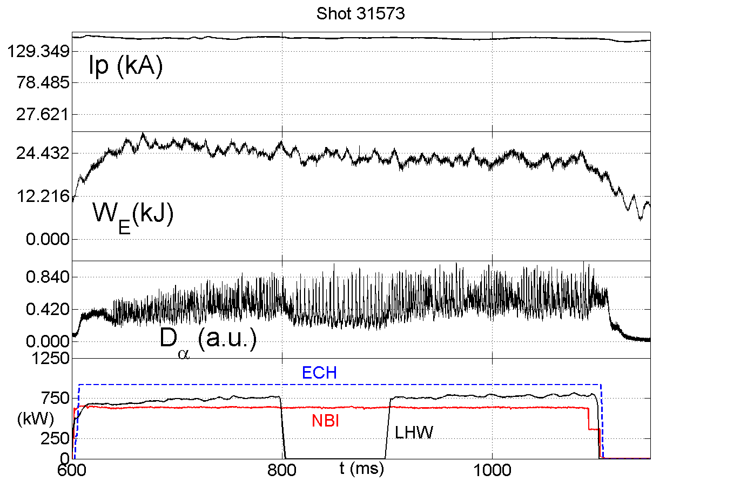
Effect of LHCD on edge plasma stability studied in HL-2A L-mode plasmas
ELM control important for operation of future fusion devices (e.g., ITER)
  Widely believed ELMs due to peeling-ballooning modes
  EAST reported mitigation of ELMs by LH (Chen, NF 2015)
Clear modification of ELM behavior by LH observed in HL-2A
  Analysis ongoing to understand whether modification due to heating or current drive
  Understanding of factors influencing pedestal structure (JRT19, R19-1)
Without LHW
With LHW
P_{LHW}~760kW
Y. Ren, PPPL

Slide 23
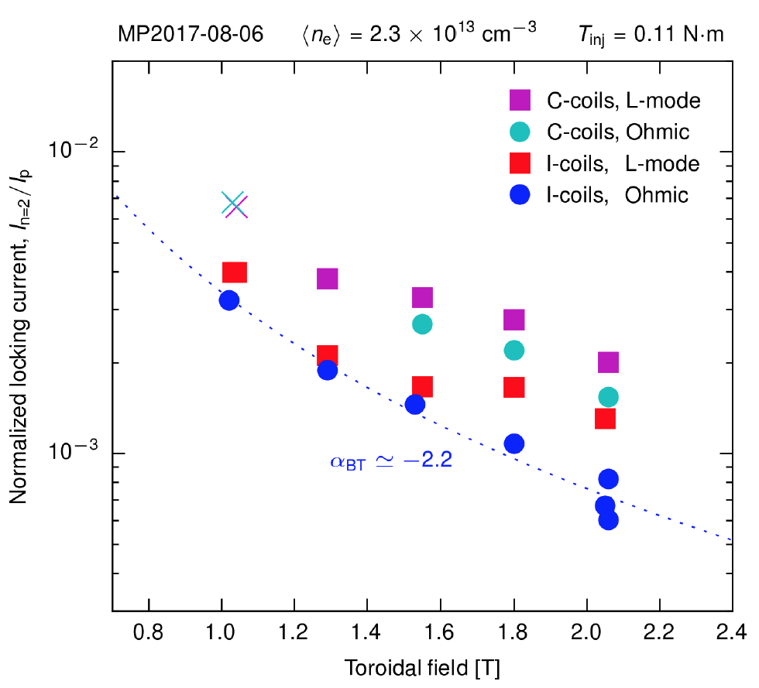
DIII-D collaboration through national campaign shows first systematic negative B_{T} scaling for n=2 error field thresholds
n=2 locking threshold decreases strongly with increasing B_{T} in 22 DIII-D shots
  Similar decrease well-known for n=1 EF
Suggests common mechanisms for resonant locking of n=1 and n=2
Future ST and ITER will be more sensitive to field errors due to higher B_{T} (R19-3)
Experiment also showed a small torque (as in L-mode) can increase EF threshold substantially
C. Myers (PPPL) and DIII-D research team
PRL (2017 submitted)

Slide 24
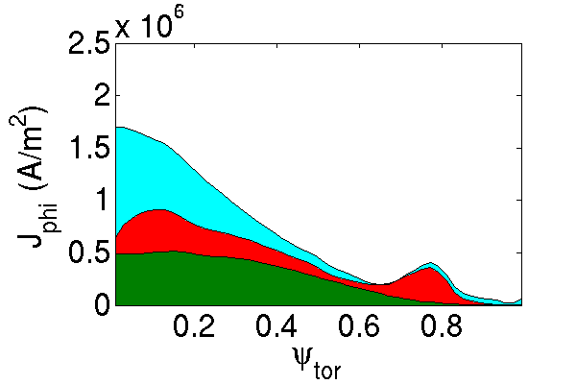
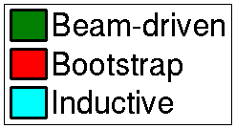
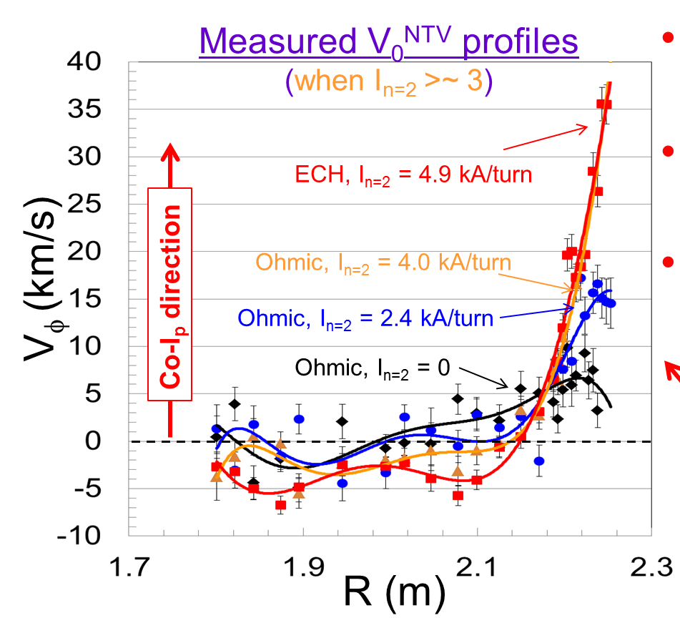
Expanded KSTAR collaborative stability/transport research complements NSTX/-U research and available database
Significant motivation: Understand influence of aspect ratio (A)
  Equilibrium, stability, transport physics all influenced by A
  Leverage large aspect ratio difference: KSTAR = 3.5, NSTX(-U) > 1.3
Sabbagh et al., Columbia U.
Significant progress (all shown at APS DPP ’17)
  Improvements and new capabilities enabling disruption characterization / forecasting research plan in long pulse, high β_{N}
    More detailed equilibrium reconstruction: kinetic reconstructions with MSE
    TRANSP analysis of KSTAR high beta and high non-inductive plasmas
    Stability codes (kinetic MHD, NTM, kink/ballooning/RWM) initially tested on KSTAR kinetic equilibria; compare dominant stabilization physics to NSTX
    Significant co-I_{p} plasma rotation+ shear generated for the first time by NTV
  Improvements/support to key diagnostics
    C-Mod MSE background polychrometer sent to KSTAR (10 channels), building 15 more channels to support 25 total channels (2018)
  Active control of dynamic error fields and global MHD instability
    Created/implemented critical sensor DC and AC compensation for KSTAR RWM PID control (initial control testing 2018 – compare to NSTX results)
71% non-inductive

Slide 25
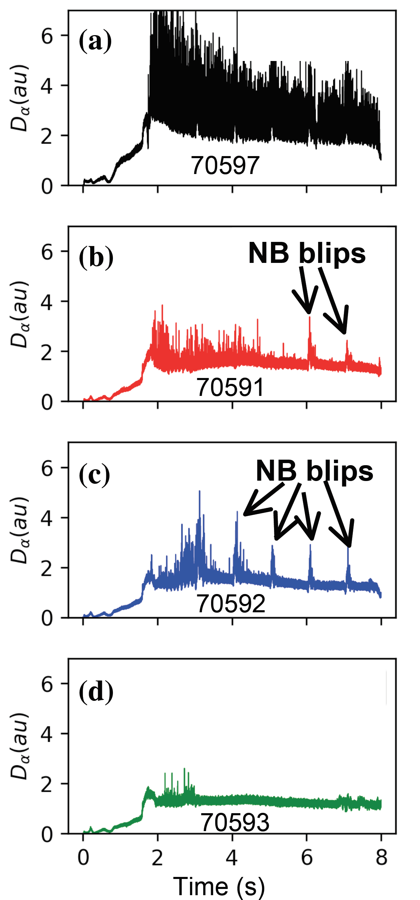
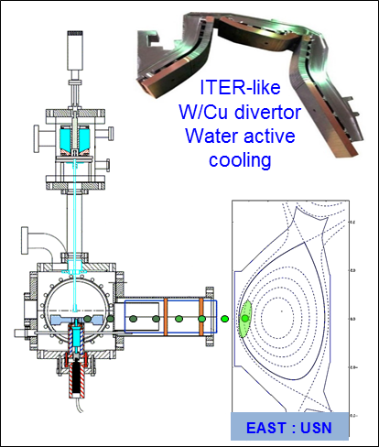
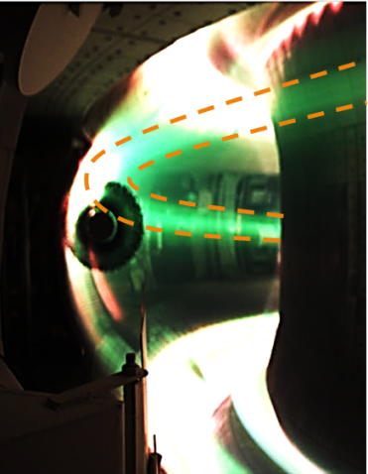
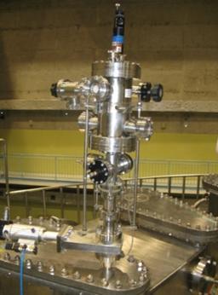
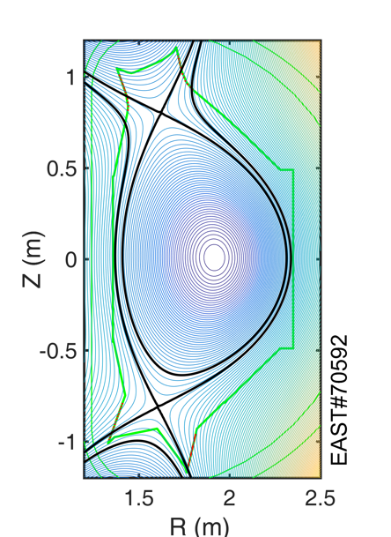
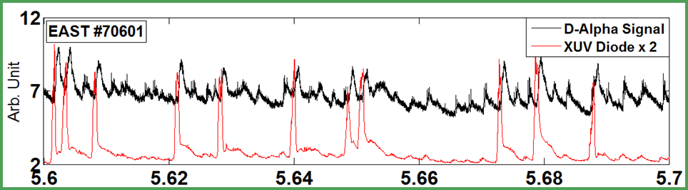
Lithium shown to control ELMs on EAST
Recycling and ELMs progressively reduced with constant Li injection rate
Granule injector triggers and paces ELMs
Two droppers installed
R. Maingi, Nucl. Fusion (2017) submitted
J. Canik, IEEE Trans. Plasma Sci. (2017) submitted
R. Maingi, PPPL

Slide 26
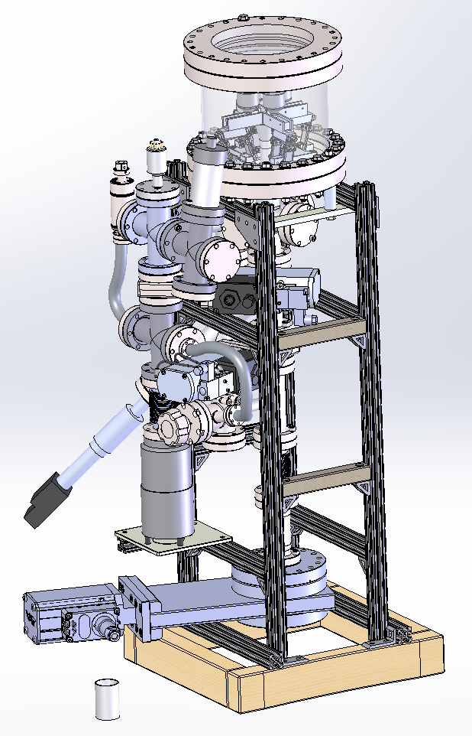
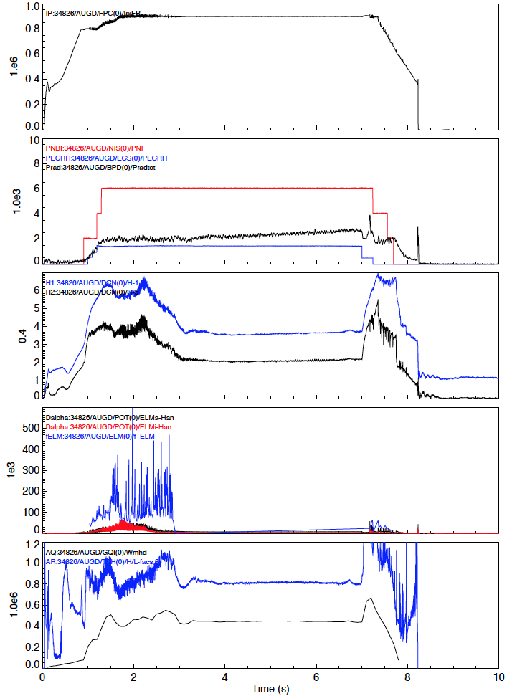
Powder droppers installed on ASDEX-U and W7-X
ASDEX-U
  Impurity Powder dropper installed with BN and B powder. Initial experiments on real time wall conditioning promising
W7X
  Compact Injector being designed to go on Multi-purpose probe for in-vessel B₄C powder injection
#34826
Magnetic Perturbations
P_{aux}
P_{rad}
n_{e}
ELMs suppressed
D_{α}
ELM suppression with MP achieved after B injection in AUG
H₉₈
W_{MHD}
R. Maingi, PPPL

Slide 27
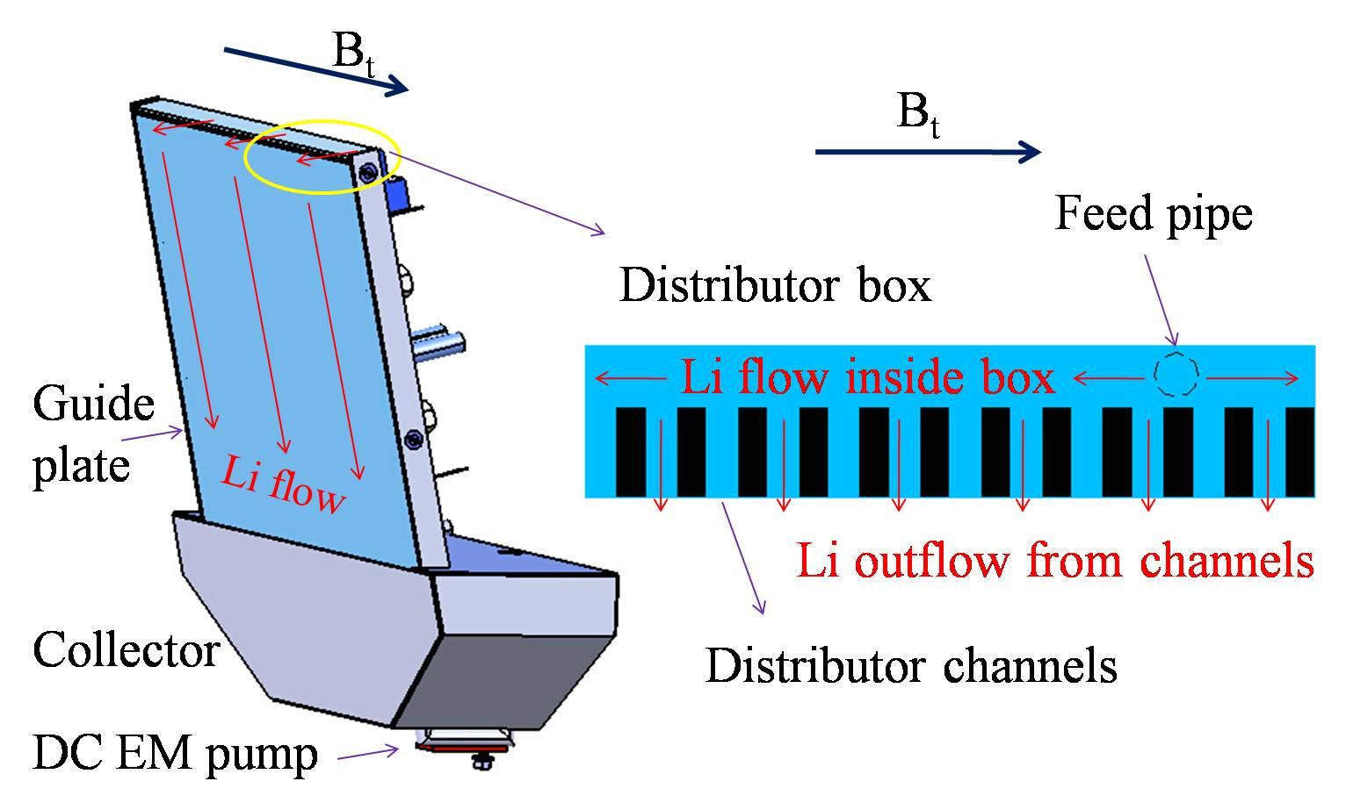
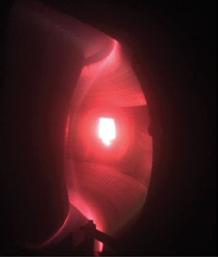
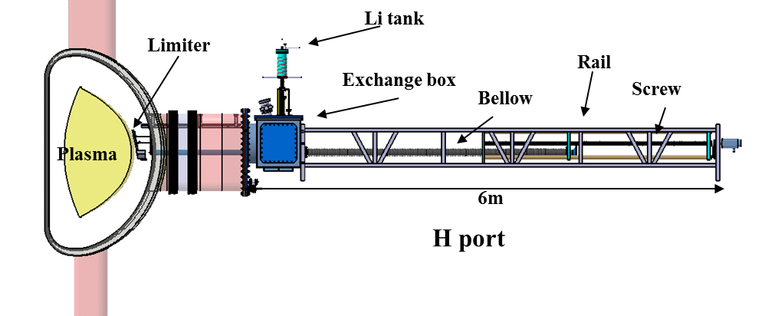
Flowing liquid lithium limiter collaboration: several different limiter designs deployed
Gen. 1: Made at PPPL
  Cu heat sink; SS coating
  Inserted at EAST midplane on MAPES system
  Compatible with H-mode
Gen. 2: Improved distributor, thicker SS coating, and 2 ExB pumps
  Enabled H-mode with transiently high H98 ~ 2
Gen. 3: solid Mo plate, no SS coating
  Two version: flat (PPPL) & corrugated for TeMHD flow drive (UIUC)
  Experiments in 2018
J. Ren et al., RSI. 86 (2015) 023504; J.S. Hu et al. NF 56 (2016) 046011
G.Z. Zuo et al. NF 57 (2017) 046017; G.Z. Zuo et al. RSI 88 (2017) 123506

Slide 28
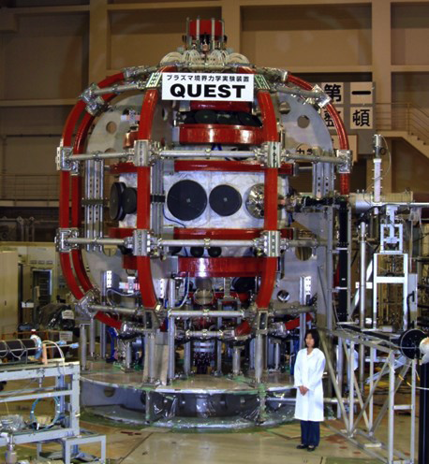
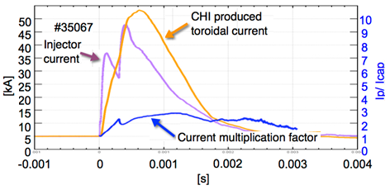
Major goal of the QUEST program is to generate steady-state fully non-inductive plasmas
Coaxial Helicity Injection (CHI) research on QUEST supports NSTX-U longer-term goal of non-inductive startup (R18-2, RA18-3)
The QUEST CHI system has been commissioned by U. Washington
Steady progress increasing current using CHI
  Increased peak toroidal current from 29 kA (Dec. 2016) to 48 kA
  TSC simulations of CHI started
QUEST
Spherical
Tokamak
R. Raman, U. Wash., M. Ono, PPPL

Slide 29
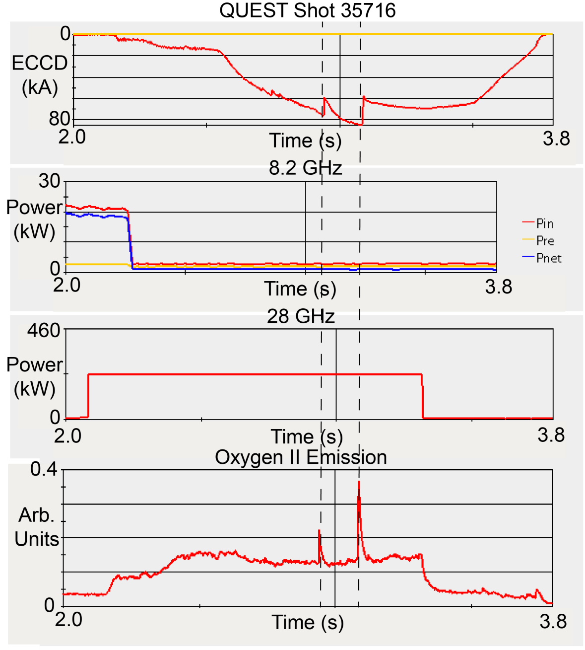
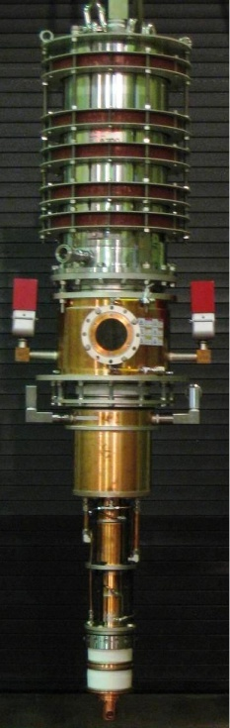
ECCD being used on QUEST to assist current ramp-up
28 GHz gyrotron being used similar to one proposed for NSTX-U
Generated up to 85 kA with 230 kW
Kinetic modeling of energetic electrons and current drive underway
G. Taylor, N. Bertelli, PPPL

