Slide 1



Macroscopic Stability Research - NSTX-U
S.A. Sabbagh, for the NSTX-U Team
NSTX-U PAC-39 Meeting
PPPL
January 9th, 2018
V2.0

Slide 2
NSTX-U restart will provide critical macrostability research of compact, high β plasmas with world-leading capabilities
Overview:
  NSTX-U research is critical to the U.S. DOE FES priorities, needs to continue ASAP
  Significant investment in NSTX/-U data leverages unique, high β compact tokamak physics data and research for key theory validation, confident extrapolation of models
Outline:
  U.S. Program high priority needs defined by DOE and NSTX-U essential role
  Unique aspects/findings of NSTX research stimulating world-leading NSTX-U research
  Capabilities for disruption prediction and avoidance research at high beta
  Recent NSTXU researcher efforts to support ITER through ITPA
  Results from NSTX-U initial operation supporting more rapid progress on restart

Slide 3
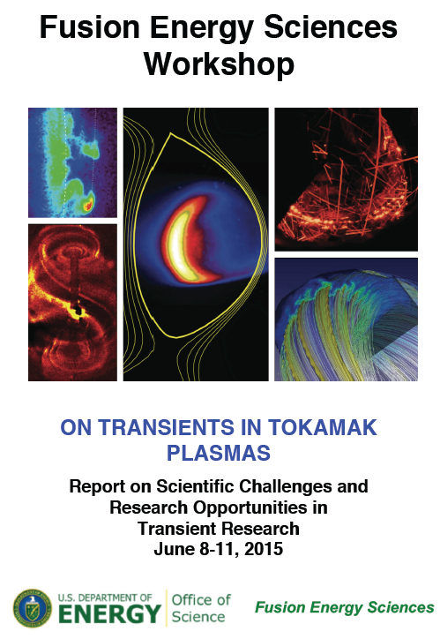
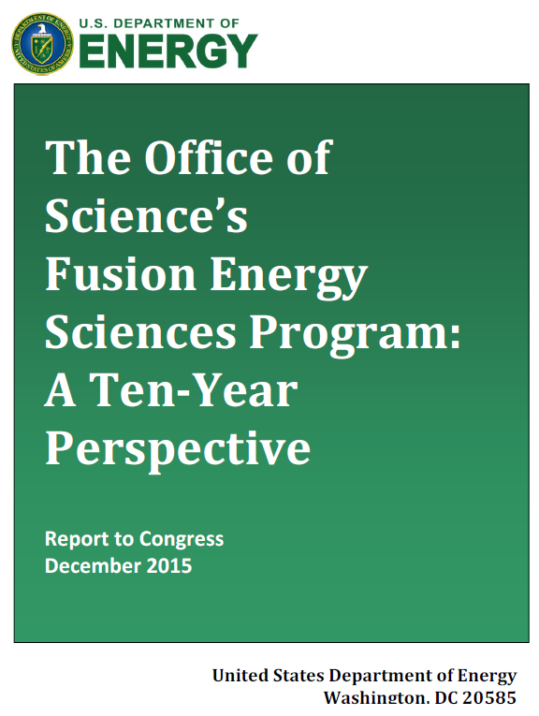
Avoidance/control of transient events are one of two highest DOE FES priorities in macrostability research
Workshop on Transients Report
  Broad community process addressing critical disruption and ELM challenges; identified as critical ITER needs
Charge 2,3
  Disruption prediction / avoidance / mitigation Thrusts/Pursuits include:
    Experimentally validated theoretical understanding of disruption chain events
    Predicted thresholds and control for disruption avoidance and mitigation
    Leverage national/international multi-device data for best extrapolability
FES Program 10 Year Perspective (NSTX-U uniqueness)
  “Exploration of the impact of (device aspect ratio) can inform much of fundamental science pertaining to magnetic confinement.”

Slide 4
NSTX reaches uniquely high β_{N}, low l_{i} range of operation, and the highest β_{N}/l_{i} is not the least stable
Charge 2,3
β_{N}/l_{i}
14
13
12
11
10
Unique high β_{N} > 7, β_{N}/l_{i} > 14 reached!
  In dedicated experiment (shown), disruptivity was higher at “intermediate” values of β_{N}/l_{i}
  In larger database, disruptivity decreases at higher levels of β_{N}/l_{i}
Research leverages NSTX-U capabilities
  Compact ST field geometry (incl. high shaping)
  Stabilizing conducting wall (copper)
  Reduced collisionality (I_{p}, B_{T} increase)
  Plasma rotation and current profile control
  Adv. control of high β_{N} ST eigenmodes
  ➔ Combined to produce highest sustained β_{N} with broad, self-consistent non-inductive current profile (low l_{i})
8
Unstable RWM
Stable/Controlled RWM
6
Active control
Passive control
β_{N}
4
2
β_{N}/l_{i} = 6.7 : computed
NSTX n = 1 no-wall limit
0
(see backup)
0.0
0.2
0.4
l_{i}
0.6
0.8
S. Sabbagh et al., Nucl. Fusion 53, 104007 (2013)
➔ Key MAST-U complementarity: stability physics without stabilizing wall

Slide 5
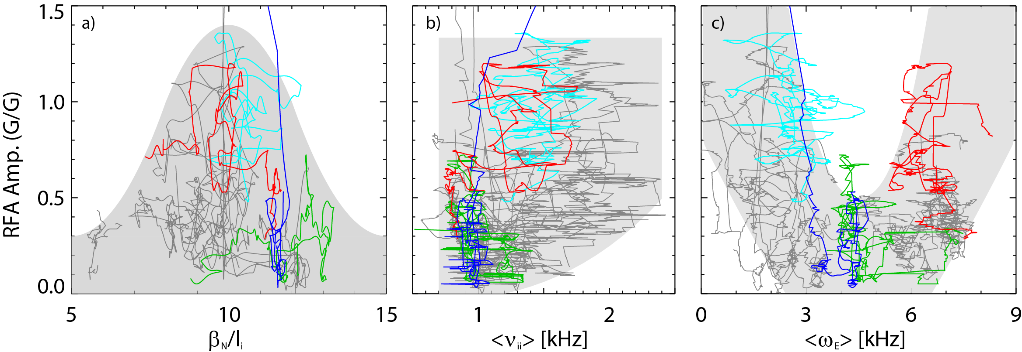
Experiments directly measuring global stability using MHD spectroscopy (RFA) understood by kinetic RWM theory
Resonant Field Amplification (RFA) vs. β_{N}/l_{i}
RFA vs. rotation (ω_{E})
Charge 1
Most
stable
unstable
RWM
Less stable
RFA Amp. (G/G)
RFA Amp. (G/G)
Less stable
Stability vs. β_{N}/l_{i}
  decreases up to β_{N}/l_{i} = 10, increases at higher β_{N}/l_{i}
  Consistent with kinetic stabilization
Rotation
Stability vs. rotation
  Largest stabilizing effect from ion precession drift resonance with ω_{φ}
J. Berkery, et al., PoP 21 (2014) 156112
S. Sabbagh,et al., 2016 EPS Landau-Spitzer Award lecture

Slide 6
Kinetic modifications completely change the understanding and scaling of mode stability at reduced collisionality
Charge 1,3,4
Ion precession drift resonance
stabilization
Past models/ideas
  Collisions provide stabilization
  stability decreased with decreasing ν
  Unfavorable for ITER
Present model
  Collisions spoil broad stabilizing resonances
  Mode stabilization vs. ν depends on rotation profile ω_{φ}
    At strong resonance: mode stability increases with decreasing ν
unstable
stable
stable
unstable
weak resonance
MISK code
Scans from NSTX equilibrium
2.0
➔ Key next step: verify extrapolation to low ν in NSTX-U
J.W. Berkery, et al., Phys. Rev. Lett. 106 (2011) 075004
S. Sabbagh,et al., 2016 EPS Landau-Spitzer Award lecture

Slide 7
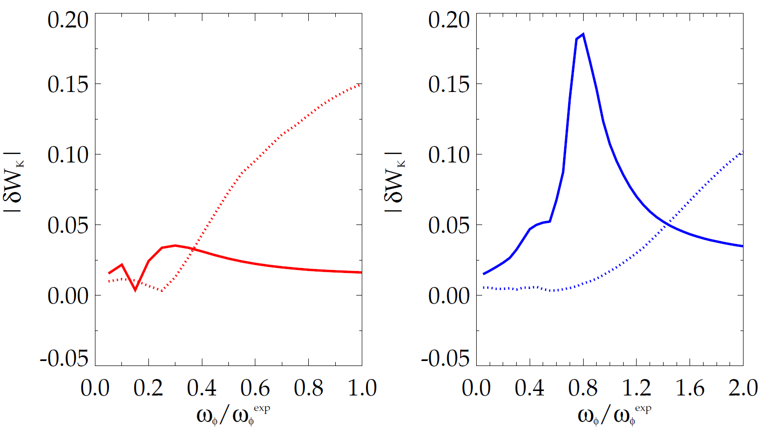
NSTX shows dominant precession drift resonance stabilization vs. bounce resonance for DIII-D in joint XP at similar, high rotation
|δW_{K}| for trapped resonant ions vs. scaled experimental rotation (MISK code)
Charge 1
DIII-D
precession
resonance
NSTX
Also, computed kinetic RWM stability matches disruption onset in both machines over wide rotation range (using same analysis tools)
bounce / circulating
resonance
bounce / circulating
resonance
precession
resonance
  (see backup slide)
Some NSTX / MISK analysis references
- J. Berkery et al., PRL 104, 035003 (2010)
- S. Sabbagh, et al., NF 50, 025020 (2010)
- J. Berkery et al., PRL 106, 075004 (2011)
- S. Sabbagh et al., NF 53, 104007 (2013)
- J. Berkery et al., PoP 21, 056112 (2014)
- J. Berkery et al., PoP 21, 052505 (2014)
- J. Berkery et al., NF 55, 123007 (2015)
133103 @ 3.330 s
stable plasma
133776 @ 0.861 s
stable plasma
DIII-D experimental rotation profile
NSTX experimental rotation profile

Slide 8
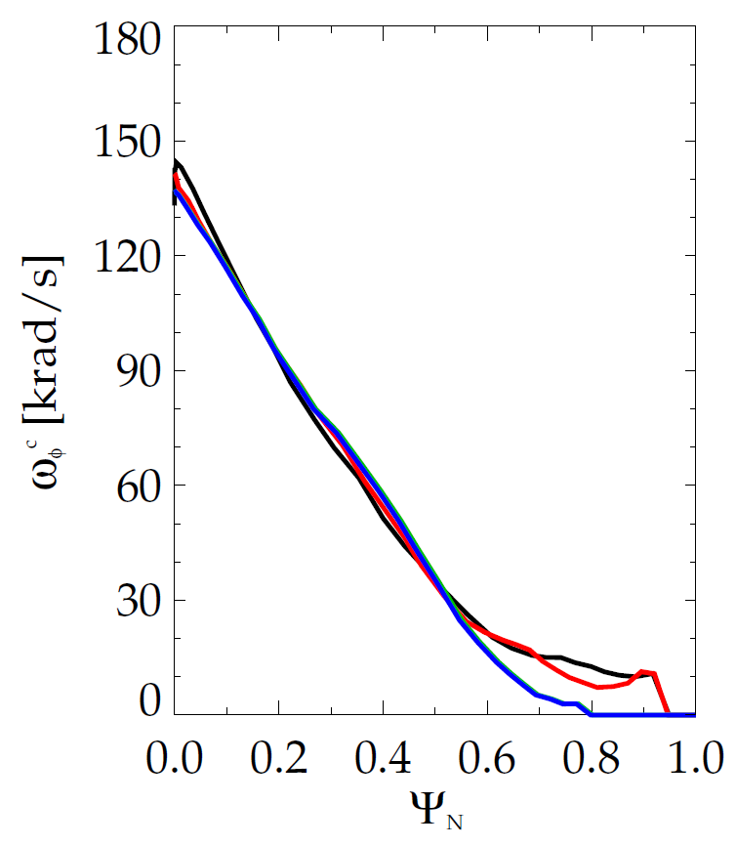
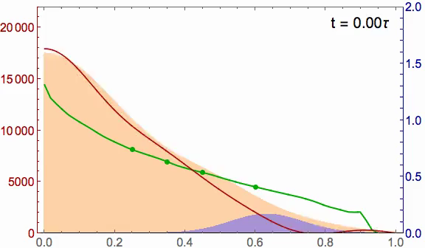
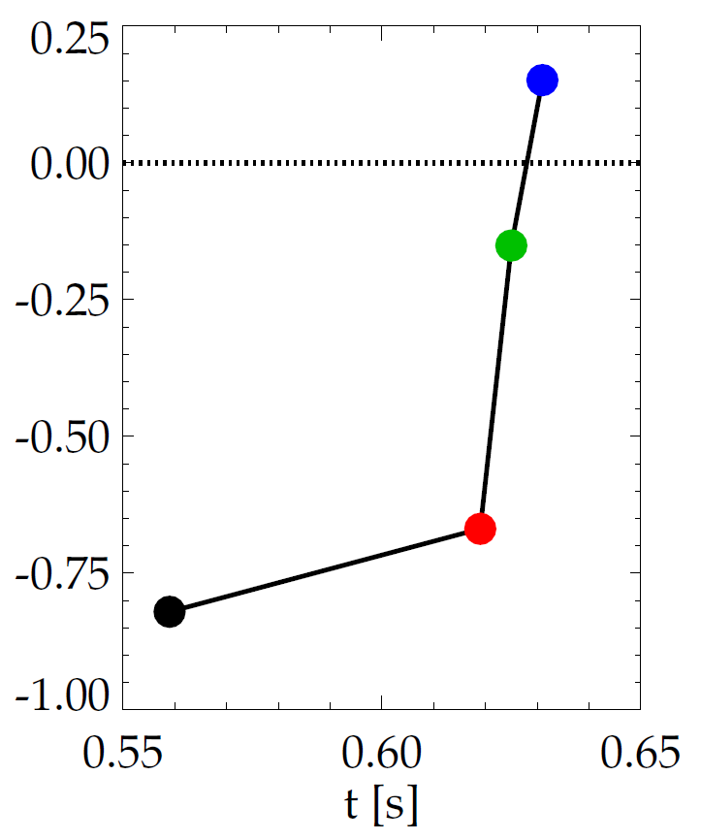
State space rotation controller designed for NSTX-U using non-resonant NTV (3D field) and NBI to maintain stable profiles
NSTX-U (6 NBI sources and n = 3 NTV)
ω_{φ} evolution in NSTX (disruption)
2.0
Marginally stable profile
unstable
20
stable
Steady-state reached in ~ 3τ_{m}
1.5
γτ_{wall}
15
NBI, -NTV torque density (N/m²)
Plasma rotation (kHz)
Broader stable
profile
1.0
MISK
10
5
NTV
0.5
increasing time
NBI
0
0.0
0.0
0.2
0.4
ψ_{N}
0.6
0.8
1.0
I. Goumiri, C. Rowley, S.A. Sabbagh, et al, PoP 24 (2017) 056101
Charge 2,3

Slide 9
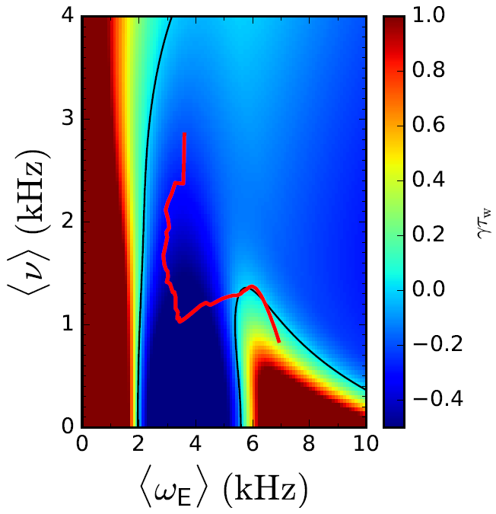
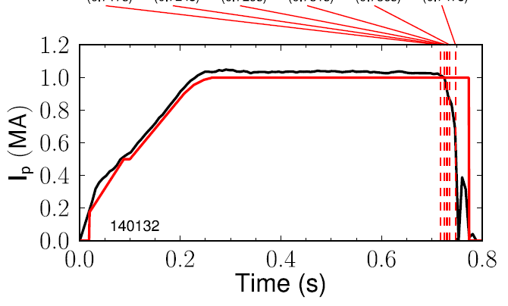
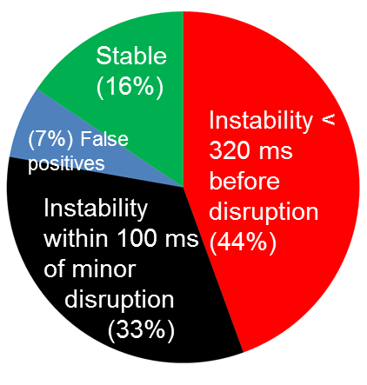
Automated Disruption Event Characterization and Forecasting innovation to enable disruption avoidance
Automated disruption event chain analysis
Disruption forecasting
Charge 1,2,3,4
RWM
VSC
WPC
LON
IPR
LOQ
DIS
NSTX (high β_{N})
γτ_{w}
Predicted instability statistics
(0.717s)
(0.724s)
(0.729s)
(0.731s)
(0.736s)
(0.747s)
Increasing time
Collisionality (kHz)
Global kinetic MHD mode growth
NSTX
Rotation
Cue disruption avoidance systems
Physics-based disruption forecasting, compared to experiment
Recent automated rotating MHD module for TM analysis (see backup)
Portable code for collaborative (inter)national multi-device studies (including NSTX/-U, KSTAR, DIII-D, TCV); supports NSTX-U r/t event handler
NSTX
DECAF code
J.W. Berkery, S.A. Sabbagh, et al., Phys. Plasmas 24 (2017) 056103

Slide 10
In aggregate, NSTX-U provides key capability for disruption avoidance research of unique high beta, compact ST plasmas
Predictor/Sensor (CY available) | Control/Actuator (CY available) | Physics Research
- Rotating and low freq. MHD (n=1,2,3) 2003 | - Dual field -component RWM sensor control (closed loop 2008) | NTM, RWM
- Low freq. MHD spectroscopy (open loop 2005); - Kinetic RWM modeling (2008) | - Control of high β_{N} ST plasmas (closed loop 2007) | Kink/ballooning, RWM
- Real-time physics-based RWM state-space controller observer (2010) | - Physics model-based RWM state-space control of ST modes (2010) | NTM, RWM (ballooning), VDE
- Real-time V_{φ} measurement (2016 NSTX-U) | - Plasma V_{φ} control (by NTV 2004) - NTV + NBI rotation control (closed loop) | NTM, Kink/ballooning, RWM
- Reduced Kinetic RWM stabilization model (2016) - Automated MHD identification (2017) - Real-time MHD spectroscopy (5 Year Plan) - Real-time kinetic stabilization model (new) - Real-time rotating MHD identification (new) | - Safety factor, l_{i} control (closed loop) - NTV + NBI rotation control (closed loop) - Upgraded 3D coils (NCC): improved V_{φ} and mode control (in 5 Year Plan) | NTM, RWM Kink/ballooning, VDE
Capability
Existing
Recent
Upcoming
Routine use of existing systems (reliability shown)
Charge 2,3,4

Slide 11
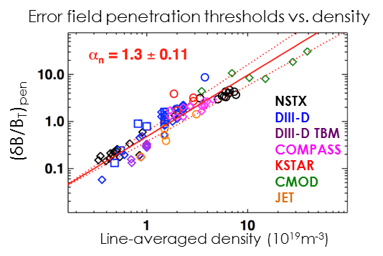
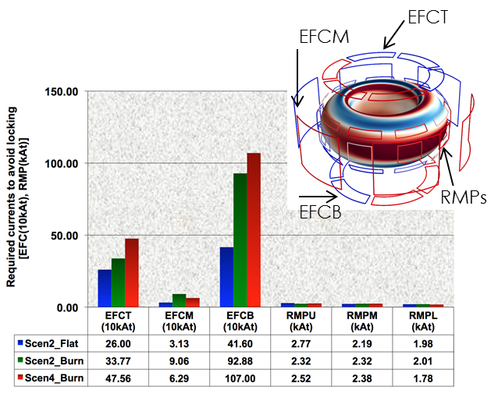
NSTX-U researchers are leading international efforts to support ITER in macrostability analysis
Charge 1,2,3
Error fields (ITPA MDC-19)
  On-going effort to predict ITER error field (EF) tolerance using 3D MHD response metrics
  Resonant n = 1 EF criterion (2017)
  (dB/B_{T})_{pen}=0.0006(n_{e})1.3B_{T}^{-1.7}R^{0.7}β_{N}^{-0.78}
3D field coil effectiveness (ITPA MDC-19)
  Top / bottom ex-vessel coils are found to be 10 times less efficient to control n=1, 2 resonant fields than other coils
Halo currents (ITPA MHD WG-6)
  Multi-machine database (NSTX, DIII-D, C-Mod, JET, AUG) examining halo current magnitudes, asymmetries, rotation
Global mode stability/control (MDC-21)
  Extensive kinetic RWM analysis code benchmarking effort
  Alpha particles, and/or active control required for RWM stabilization at all ω_{φ} in advanced scenario β_{N} = 2.9
J.-K. Park et al.
J.-K. Park et al.
C. Myers, et al.
S. Sabbagh, J. Berkery, et al.

Slide 12
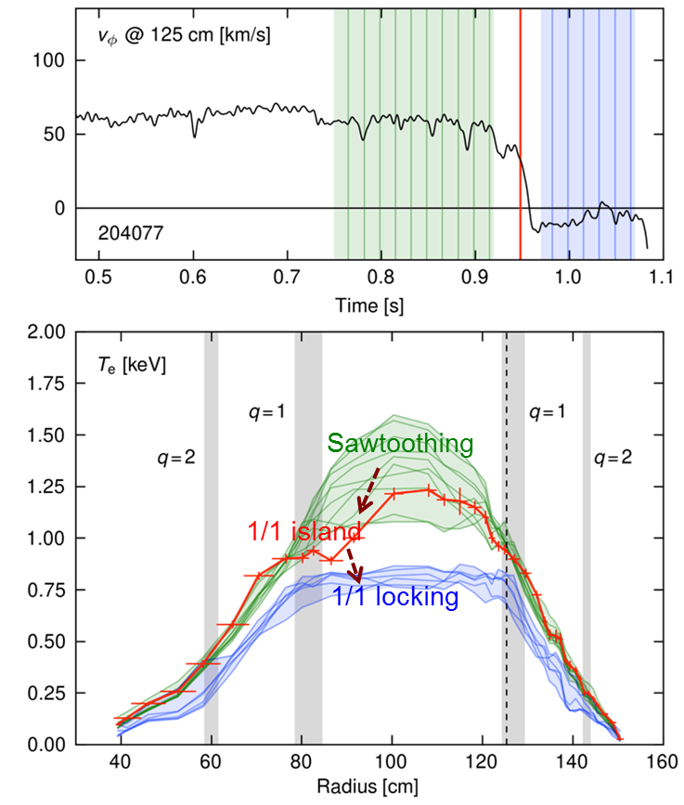
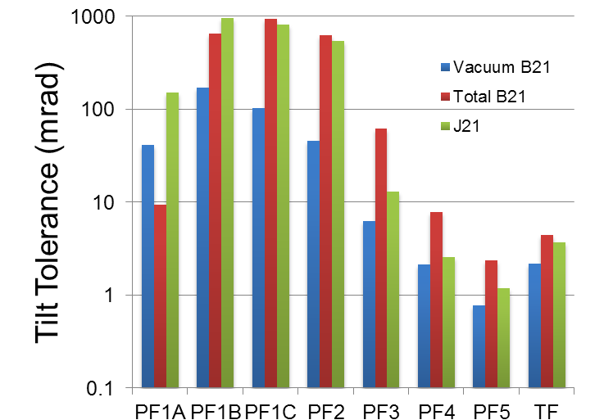
Macrostability research from initial NSTX-U operation provides key insight for rapid progress upon restart
Observation of direct 1/1 mode locking
Error field rapidly characterized
  EF partly corrected using 3D field coils
  IPEC, M3D-C¹ plasma response modeling implicated TF misalignment as likely primary source of locking
    TF misalignment identified, will be corrected
  Codes now being used to set alignment tolerances for all coils
Charge 1,2,3
(J.-K. Park, N. Ferraro)
Larger bars are better
(C. Myers et al., submitted to PRL (2017))
Condition: resonant 2/1 Field < RMP coil at 1 kA-t

Slide 13
Summary (I): NSTX-U recovery paves the way back to world-leading research on unique, compact high β plasmas
Charge 1: Quality/importance of recent NSTX/NSTX-U research results
  Kinetic RWM stabilization research fundamentally changed physics understanding of experimental stability, importance of rotation profile, extrapolation to reduced collisionality (2016 Landau-Spitzer Award)
  Direct measurement of plasma stability through RFA verified key understanding of greater stability at uniquely high β_{N}/l_{i}
  Physics-based disruption prediction/avoidance research (DOE high priority) established
Charge 2: Uniqueness / timeliness for the world program
  Unique (in the world) high β_{N}, β_{N}/l_{i} operational regime provides critical theory validation
  Global MHD stability, error field/plasma response, applied 3D field research directly serve ITER, KSTAR, et al. now; will continue
  Disruption prediction/avoidance research expanded to collaborations on world tokamaks

Slide 14
Summary (II): NSTX-U recovery paves the way back to world-leading research on unique, compact high β plasmas
Charge 3: How/whether NSTX-U will be world-leading after restart
  Disruption prediction and avoidance research is world-leading, highest priority, remains active – plan to be significantly advanced by restart
  Advanced control technique plan for disruption avoidance will remain world-leading on restart, collaborations to keep effort active
  Unique low A, high β_{N} joint experiments w/ tokamaks can resume in timely fashion on restart
Charge 4: How recent findings influence the future NSTX-U program
  NSTX-U 5 Year Plan remains largely intact (e.g. study of kinetic RWM stabilization paradigm at low ν, w/ greatly varied / controlled rotation profile remains strongly relevant)
  Advanced control techniques are planned; if recommended, recovery period provides opportunity for early development / implementation - restart research ASAP
  Disruption prediction research plan can be even more aggressive (e.g. real-time MHD ID)
  3D field coil upgrade remains important for NTV rotation, adv. mode control, ELM studies

Slide 15
Backup Slides Follow

Slide 16
High priority research elements of recent Strategic Planning Meetings align strongly with NSTX-U Macro research
Madison meeting:
  Uniquely high level of consensus in critical Macrostability research areas including
    Compact tokamak design (high field utilization)
    Disruption-free (very low disruption rate)
    Fully/highly non-inductive stable operation
Austin meeting:
  Innovations stated (Working Group-SA3) align with NSTX-U research, including
    Physics understanding of low A advantages
    Disruption event characterization and forecasting
    Disruption avoidance through profile, active mode control
    Stability physics of self-consistent, fully/highly non-inductive operation

Slide 17
NSTX reaches uniquely high β_{N}, low l_{i} range of operation, and the highest β_{N}/l_{i} is not the least stable
Charge 2,3
β_{N}/l_{i}
14
13
12
11
10
Disruptivity
β_{N}/l_{i}
14
13
12
11
10
8
8
Unstable RWM
Stable/Controlled RWM
6
6
β_{N}
Active control
Passive control
β_{N}
4
4
2
2
β_{N}/l_{i} = 6.7 : computed
NSTX n = 1 no-wall limit
0
0
0.0
0.2
0.4
l_{i}
0.6
0.8
0.0
0.2
0.4
l_{i}
0.6
0.8
S. Sabbagh et al., Nucl. Fusion 53, 104007 (2013)
S. Gerhardt et al., Nucl. Fusion 53, 043020 (2013)
Unique high β_{N} > 7, β_{N}/l_{i} > 14 reached!
  In dedicated experiment (shown), disruptivity was higher at “intermediate” values of β_{N}/l_{i}
In the larger database, disruptivity decreases at higher levels of β_{N}/l_{i}
➔ Key MAST-U complementarity: physics of stability without stabilizing wall

Slide 18
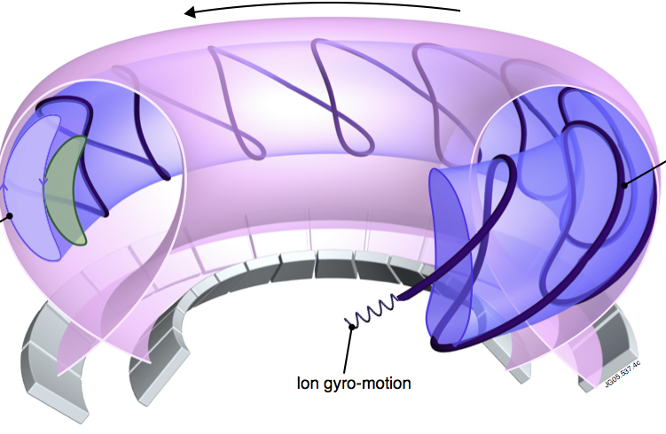
Global mode stability forecasting: build from success of drift kinetic theory modification to MHD as a model
Kinetic modification to ideal MHD
Stability depends on
  Trapped / circulating ions, electrons
  Collisionality; Energetic particles
  Integrated ω_{φ} profile matters!!! : broad rotation resonances in δW_{K}
Trapped orbit 2D
projections
Trapped particle orbit precession drift
Trapped particle
orbit
ion gyro-orbit
and trajectory
plasma integral over particle energy
(Fig. adapted from R. Pitts et al., Physics World (Mar 2006))
Just some references:
B. Hu, R. Betti, et al., PoP 12 (2005) 057301
J. Berkery et al., PRL 104 (2010) 035003
S. Sabbagh, et al., NF 50 (2010) 025020
J. Berkery et al., PRL 106 (2011) 075004
J. Berkery et al., NF 55 (2015) 123007
precession drift
bounce
collisionality
ω_{φ} profile (enters in ω_{Ε})

Slide 19
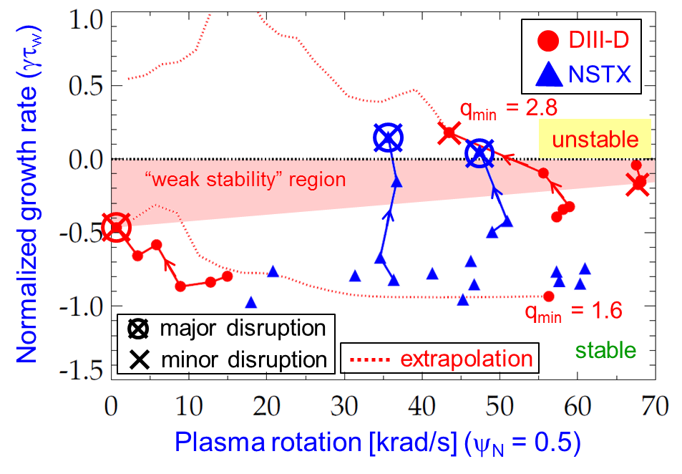
Kinetic RWM stability evaluated for DIII-D and NSTX plasmas, reproduces dedicated experiments over wide rotation range
Summary of results
  Plasmas free of other MHD modes can reach or exceed linear kinetic RWM marginal stability
  Bursting MHD modes can lead to non-linear destabilization before linear stability limits are reached
  Extrapolations of DIII-D plasmas to different V_{φ} show marginal stability is bounded by 1.6 < q_{min} < 2.8
Kinetic RWM stability analysis for experiments (MISK)
S. Sabbagh et al., APS Invited talk 2014
Charge 1

Slide 20
Joint NSTX / DIII-D experiments and analysis gives unified kinetic RWM physics understanding for disruption avoidance
DIII-D (β_{N} = 3.5)
NSTX (β_{N} = 4.4)
RWM Dynamics
  RWM rotation and mode growth observed
  No strong NTM activity
  Some weak bursting MHD in DIII-D plasma
    Alters RWM phase
  No bursting MHD in NSTX plasma
rotation
growth
rotation
growth
ΔB_{p}^{n=1}(G)
amplitude
amplitude
phase
phase
φ_{Bp}^{n=1}(deg)
toroidal magnetics
toroidal magnetics
Frequency (kHz)
D_{α}
D_{α}
(arb)
t (s)
t (s)
Charge 1
S. Sabbagh et al., APS Invited talk 2014

Slide 21
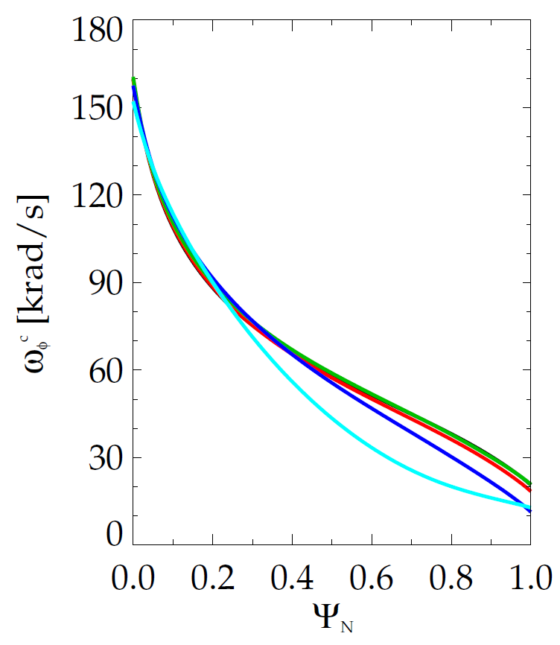
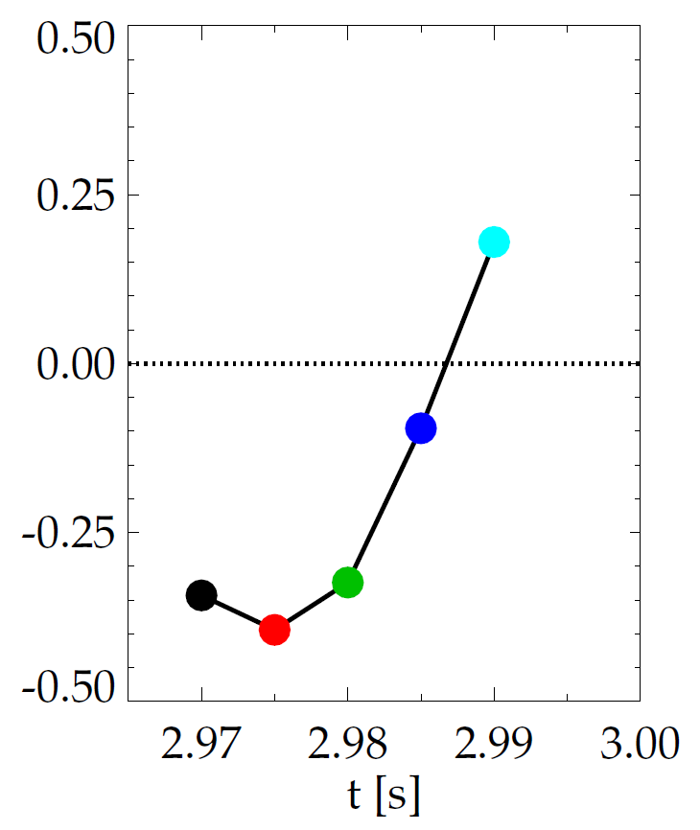
Evolution of plasma rotation profile leads to linear kinetic RWM instability as disruption is approached
Charge 1
DIII-D (minor disruption)
NSTX (major disruption)
Kinetic RWM stabilization occurs from broad resonances between plasma rotation and particle precession drift, bounce/circulating and collision frequencies
unstable
unstable
stable
γτ_{wall}
γτ_{wall}
stable
MISK
MISK
increasing time
increasing time
S. Sabbagh et al., APS Invited talk 2014

Slide 22
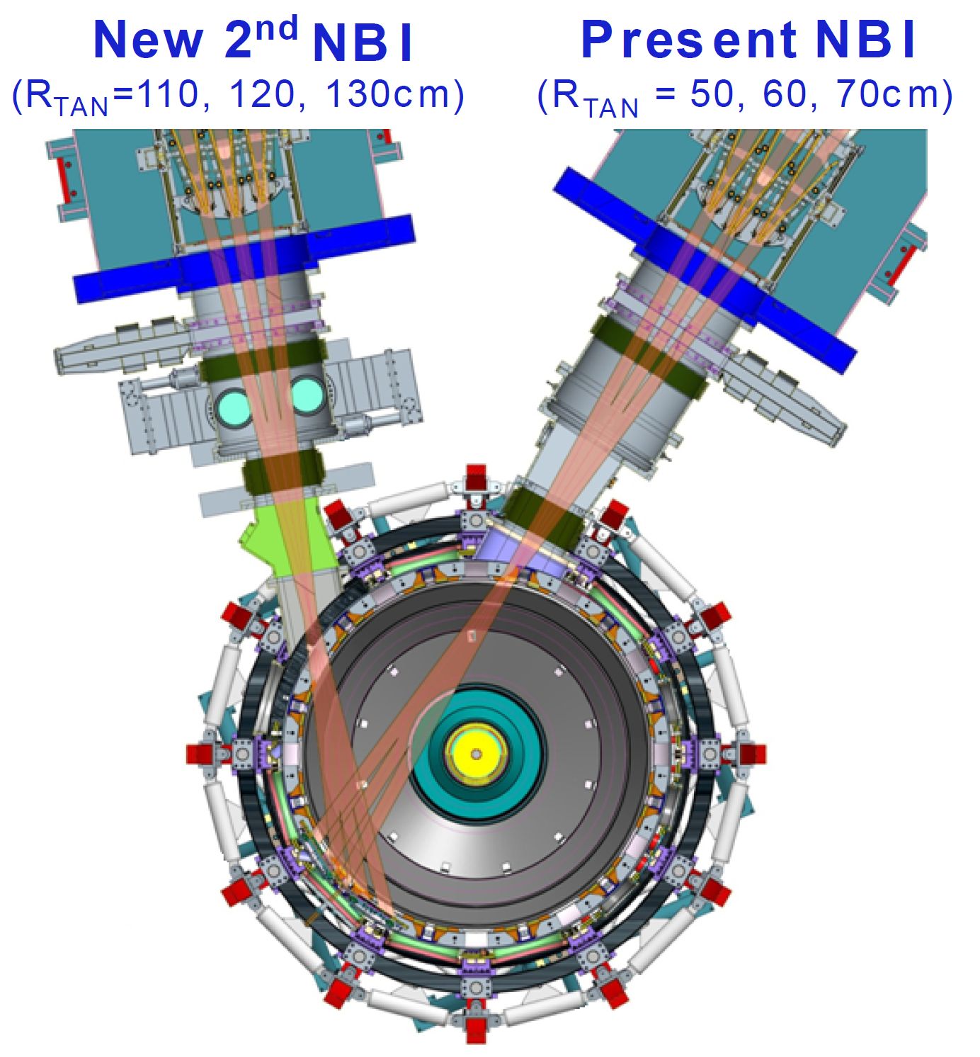
State space rotation controller designed for NSTX-U using non-resonant NTV and NBI to maintain stable profiles
Momentum force balance – ω_{φ} decomposed into Bessel function states
NTV torque:
Charge 2,3
(non-linear)
Momentum Actuators
NBI and NTV torque profiles for NSTX-U
1.5
New NBI
(broaden rotation)
3D Field Coil
(shape ω_{φ} profile)
1.0
-NTV
Torque
NBI, -NTV torque density (N/m²)
0.5
NBI
Torque
(NSTX)
0.0
0.0
0.2
0.4
ψ_{N}
0.6
0.8
1.0

Slide 23
State space rotation controller designed for NSTX-U using non-resonant NTV and NBI to maintain stable profiles
Momentum force balance – ω_{φ} decomposed into Bessel function states
NTV torque:
Charge 2,3
(non-linear)
Momentum Actuators
NBI and NTV torque profiles for NSTX-U
1.5
New NBI
(broaden rotation)
3D Field Coil
(shape ω_{φ} profile)
NBI Torque
(NSTX-U)
1.0
-NTV
Torque
NBI, -NTV torque density (N/m²)
0.5
NBI
Torque
(NSTX)
0.0
0.0
0.2
0.4
ψ_{N}
0.6
0.8
1.0

Slide 24
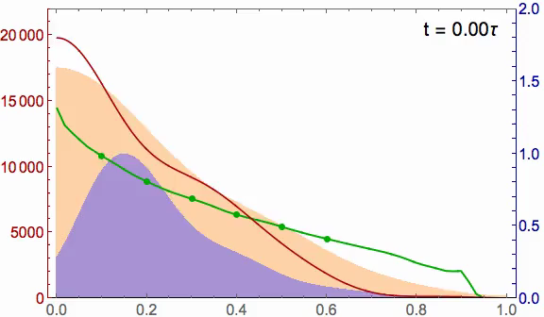
With planned NCC coil upgrade, rotation controller can reach desired rotation profile faster, with greater fidelity
Charge 2,3
NSTX-U ω_{φ} control with
  6 NBI sources
  Greater core NTV from planned NCC upgrade
Better performance
  Faster to target t ~ 0.5τ_{m}
  Matches target ω_{φ} better
2.0
20
Marginally stable profile
1.5
15
NBI
NBI, -NTV torque density (N/m²)
Plasma rotation (kHz)
Broader stable
profile
1.0
10
5
0.5
Planned NCC upgrade
NTV
0
0.0
0.0
0.2
0.4
ψ_{N}
0.6
0.8
1.0
Also, calculations show that NCC can allow RWM control up to ideal MHD wall limit

Slide 25
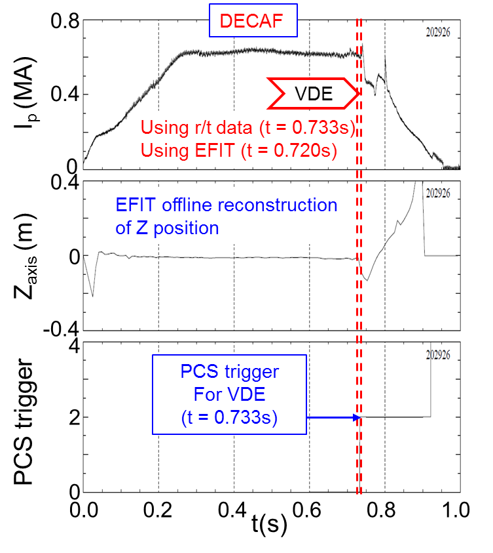
DECAF replicates the triggers found in new real-time plasma shutdown / event handler capability of NSTX-U
Important capability of DECAF: compare analysis using offline vs. real-time data
Plasma Shutdown Handler conditions are analogous to DECAF events
  Control system loss of vertical control ➔ DECAF
DECAF comparison: VDE event
  Matches Plasma Control System when r/t signal is used (1 criterion)
  VDE event 13 ms earlier using offline EFIT signals (3 criteria: Z₀, dZ₀/dt, Z₀ x dZ₀/dt)
I_{p} (MA)
Z₀ (m)
VDE
PCS state

Slide 26
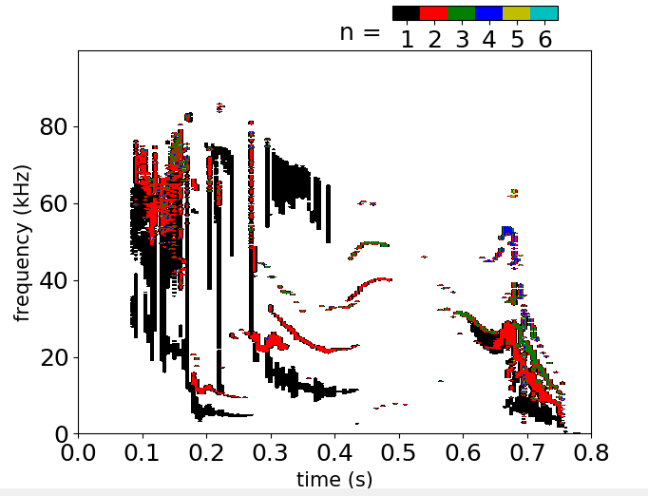
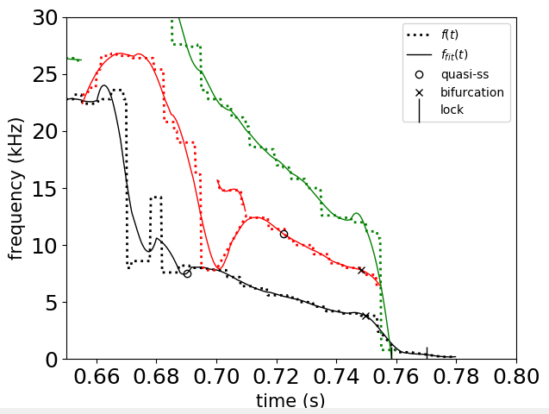
Automated identification of MHD mode bifurcation and locking recently developed for the DECAF code
Zoomed-in View
Charge 3,4
NSTX 138854
bifurcation
lock
Required capability to automatically analyze ubiquitous rotating MHD
Code is completely portable, kept fairly simple, potential future real-time processing

Slide 27
Physics-based RWM state-space controller sustains high β_{N}, low l_{i} plasma; NSTX-U with allow independent coil control
Full 3-D model
~3000+ states
State reduction (< 20 states)
Charge 2,3
RWM
eigenfunction(2 phases, 2 states)
Balancing
transformation
+
+
…
Controller model compensates wall currents
  Includes plasma mode-induced current model (DCON)
  Potential to allow control coils to be moved further from plasma and be shielded (e.g. ITER)
  Straightforward inclusion of multiple modes in controller
➔ USED on NSTX to sustain high β_{N} > 6 operation
S. Sabbagh et al., Nucl. Fusion 53 (2013) 104007

Slide 28
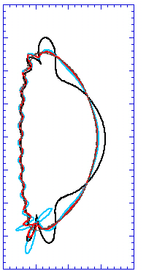
High β_{N} ST global eigenmodes have unique shape, multi-mode character; computed 2nd eigenmode component has dominant amplitude
Computed n = 1 eigenmodes (β_{N} = 6.1)
δB^{n} RWM multi-mode composition
2.0
mode
2
NSTX 133775
DCON δB_{N}
t = 0.655s
1.0
mode
3
Z(m)
mode 1
θ
δB^{n} amplitude (arb)
0.0
Unstable
mode 3
Stabilized by rotation
-1.0
mode
1
mode 2
-2.0
0.0
1.0
2.0
R(m)
ideal eigenmode number
Charge 2,3
mmVALEN code

Slide 29
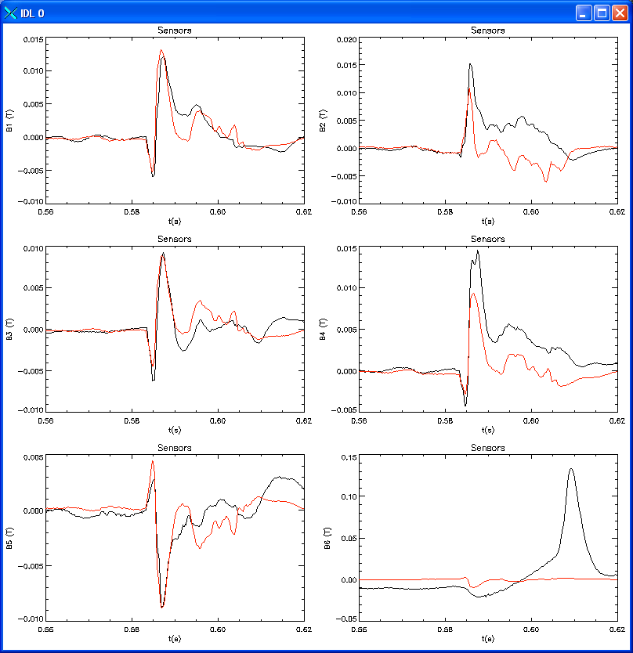
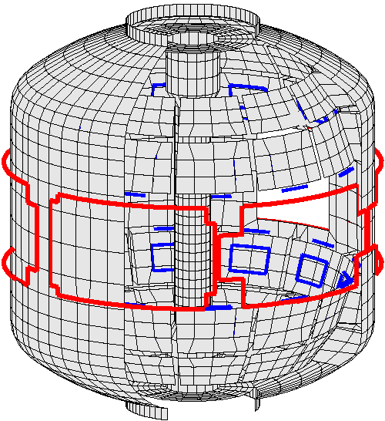
In addition to active mode control, the NSTX-U RWM state space controller will be used for real-time disruption warning
RWM state space controller used for RWM control in NSTX - long pulse plasmas reached high stability parameters β_{N} = 6.4, β_{N} /l_{i} = 13
S. Sabbagh et al., Nucl. Fusion 53 (2013) 104007
Measurement
200
δB_{p}¹⁸⁰
RWM
Controller
(observer)
The controller “observer” produces a physics model-based calculation of the expected sensor measurements – a real-time synthetic diagnostic
If the real-time synthetic diagnostic poorly matches the measured sensor data, a real-time disruption warning signal can be triggered
  Technique will be assessed using the DECAF code
100
RWM Sensor Differences (G)
0
-100
0.56
0.58
0.60
0.62
t (s)
RWM sensors
Charge 2,3

Slide 30
Active RWM control design study for proposed NSTX-U 3D coil upgrade (NCC coils) shows superior capability up to ideal wall limit
NCC 2x6 odd parity, with favorable sensors
NCC 2x12 with favorable sensors, optimal gain
Full NCC coil set allows control close to ideal wall limit
  NCC 2x6 odd parity coils: active control to β_{N}/β_{N}^{no-wall} = 1.58
  NCC 2x12 coils, optimal sensors: active control to β_{N}/β_{N}^{no-wall} = 1.67
NCC (plasma facing side)

Slide 31
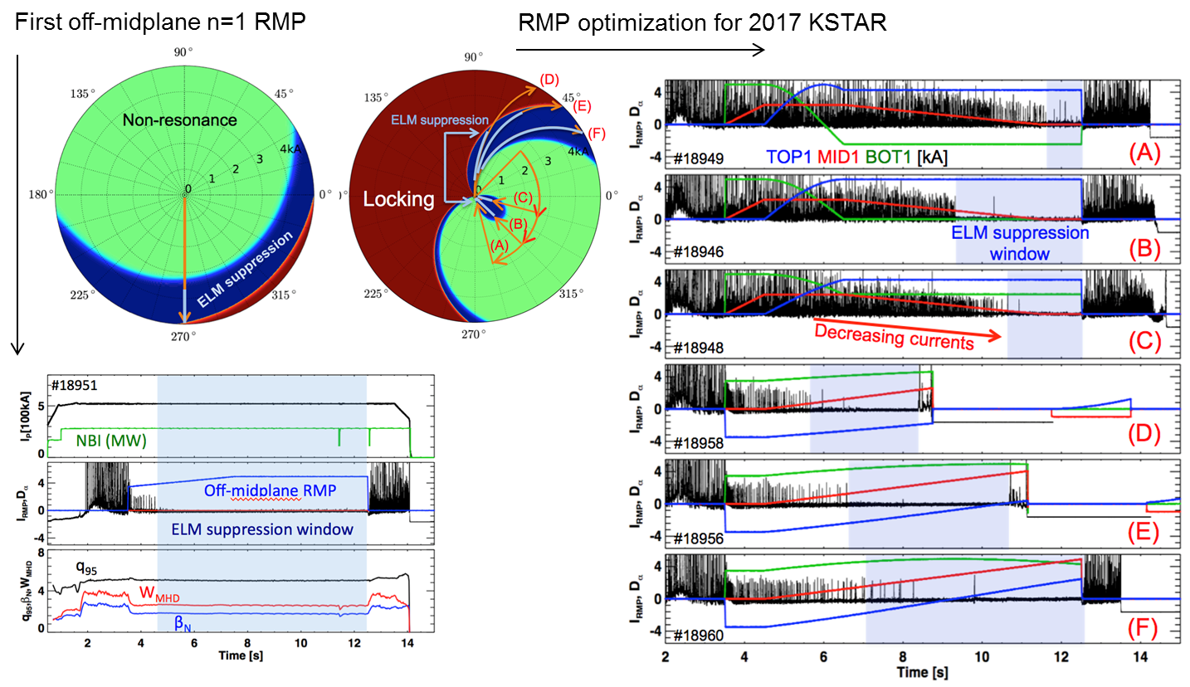
Successful predicition of RMP optimization with partial coil sets and for new targets in 2017 KSTAR campaign
Charge 1, 3
[J.K. Park, KSTAR 2017]

Slide 32
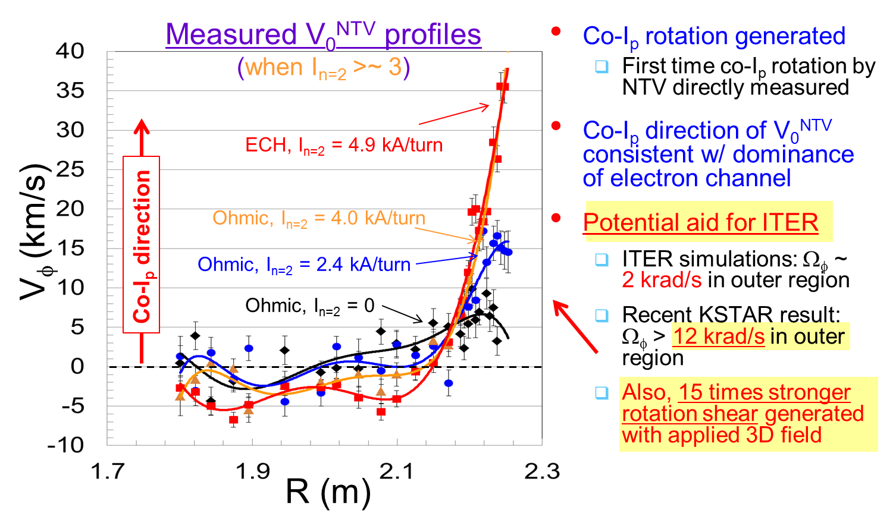
Generalized Neoclassical Toroidal Viscosity (NTV) Offset rotation profile V₀^{NTV} measured in KSTAR
Charge 1, 3
➔ Initially proposed on NSTX-U, potential for joint experiment/analysis with KSTAR
(S.A. Sabbagh, Y.S. Park, J. Kim, W. Ko, et al.)

