Slide 1
Overview of Recent NSTX-U Recovery Activities
NSTX-U PAC 40 – September 11, 2019
Stefan Gerhardt - NSTX-U Recovery Deputy Director
Updated 9/9/2019

Slide 2
Outline
Recent Project History
Scope
Schedule

Slide 3
Recovery Has Had a Sequence of Key Project Reviews in the Last 18 Months
February 2018 Office of Project Assessment (OPA) Phase 1 & 2
Concluded that PPPL should be allowed to continue Recovery (Phase 1)
Revalidated mission need (Phase 2).
September 2018 Director’s Review
Was envisioned as a prelude to baselining, however issues were identified with basis of estimate.
March 2019 Basis of Estimate Review
Validated the cost estimate for the Recovery Project
July 2019 Director’s Review
Validated that the Project was ready to proceed to baselining
August 2019 CDE-2/3A Independent Project Review
Successful CDE-2/3A IPR set the path for ESAAB approval of the baseline and initiation of procurement/fabricated for specified -3A scope
ESAAB meeting is being scheduled

Slide 4
September 2018 Director’s Review Revealed Key Steps Required Before Baselining
Chaired by John Post (LLNL)
The technical scope complete at that time (PF1 coils, PFCs, PF1B power loop) was reviewed favorably and ready for CDE-3A approval
Noted that project risks were properly identified
Recommended revisiting reuse of existing access control system vs new system
Project Action: Added the PSS WBS element.
Key areas requiring additional development before CDE-2:
The basis of estimate was not yet fully documented
Risk mitigation strategies were not well documented
Project Action: Developed new cost books with extensive documentation; held a separate Basis of Estimate review

Slide 5
The Basis of Estimate Review (March 2019) Validated the Revised Cost and Schedule Estimate
Chaired by Diane Hatton (BNL); R. Boivin and J. Milnes from tokamak community
Is there sufficient detailed information available and documented to support the cost estimates? Met
Are the estimates accurate, credible, comprehensive, and do they follow the GAO 12 Steps for Cost Estimating Best Practices? Met
Are project risks identified reasonable and included in the project cost? Substantially Met
Is the schedule resource loaded, identify a critical path, and include sufficient details to successfully achieve CD-4 on time? Met
Can you positively affirm the NSTX-U Recovery Project cost estimate is well documented, comprehensive, accurate and credible as defined by GAO-09-3SP and DOE Order 413.3B?
Basis of Estimate Review Committee response: The BOER Team affirms that the NSTX-U Recovery Project cost is well-documented, comprehensive, accurate, and credible.

Slide 6
July 2019 Director’s Review Provided Confidence that the Project was Ready for Baselining
Chaired by Kem Robinson (LBNL)
Review was comprehensive - technical, cost and schedule, risk, ES&H, management
All charge questions answered in the affirmative except that related to Management
Identified the need to clarify the timing and requirements for the EVMS surveillance
Identified the need to formalize the documentation of project tailoring
Project Response
In consultation with FES and PSO, determined to hold the EVMS surveillance later in CY 2019 (now scheduled for December).
Developed a formal tailoring mapping, including expanded PEP discussion

Slide 7
August 2019 CDE-2/3A was Highly Successful
Chaired by Hanley Lee; subcommittee chairs were Cahill, Kellman, Lavelle, Prestemon, Epps
Answered all questions in the affirmative
Validated the baseline, recommended moving forward on the CDE-3A scope.
Minor corrective actions required; many good suggestions made.
Link to web site for review:
https://sites.google.com/pppl.gov/nstx-urecoverycde-23areview/home
ESAAB date being finalized - procurements can start following ESAAB

Slide 8
Other News
Jon Menard named PPPL Deputy Director for Research in April 2019
Rich Hawryluk was interim Recovery Project Director, March - July 2019
John Galayda named Recovery Project Director since August.
Extensive experience in large DOE projects (NSLS, APS, LCLS, LCLS-II)
Les Hill has been Recovery Project Manager since March 2019
Extensive experience in commercial nuclear operations and project management, DOE EM and SC projects (PPPL SLI, BNL NSLS-II)
A new management tier of Associate Project Managers has been key to recent project success

Slide 9
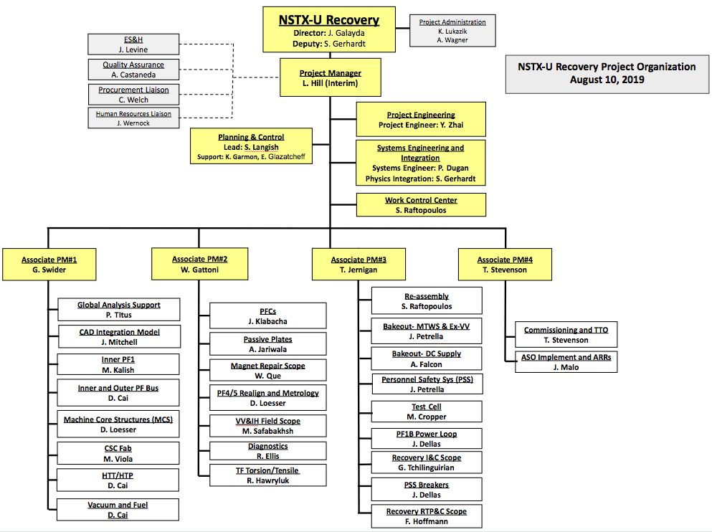
Present Recovery Organization
Facility maintenance and limited targeted modernizations ongoing in parallel with the Recovery Project

Slide 10
Outline
Recent Project History
Scope
Schedule

Slide 11
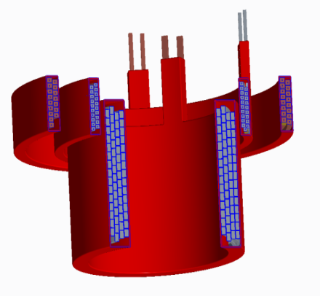
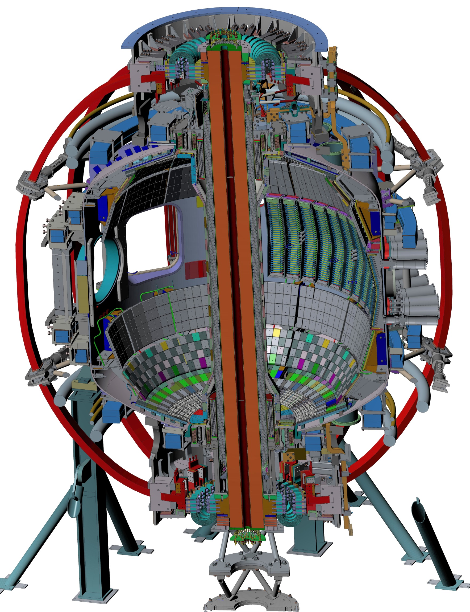
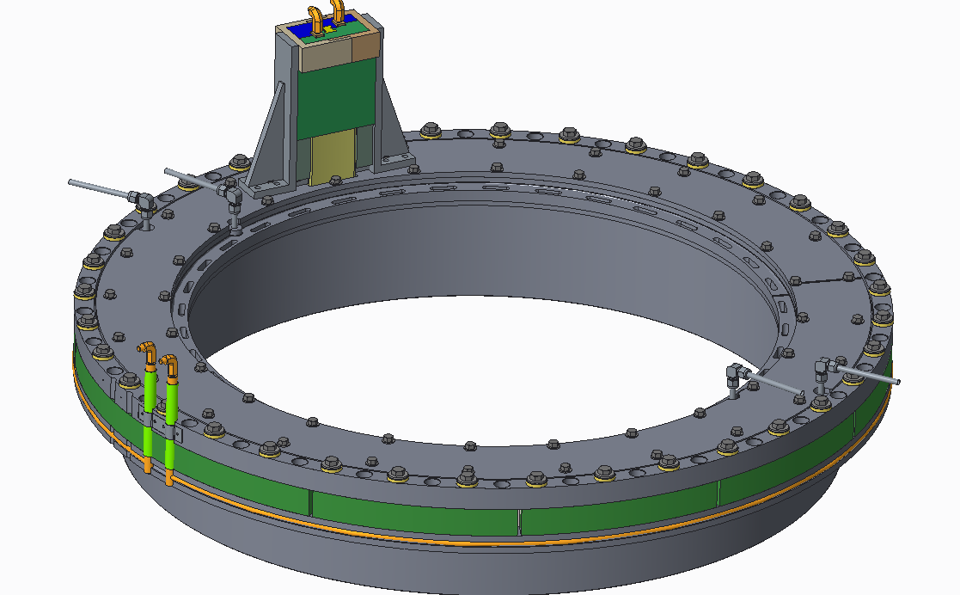
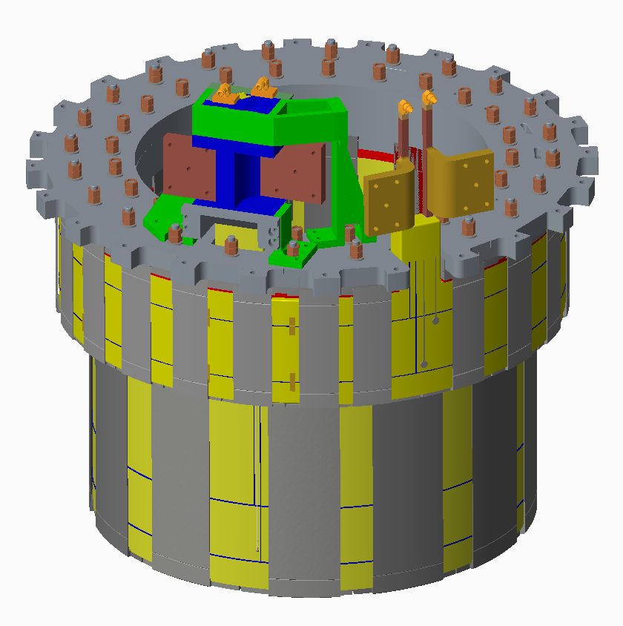
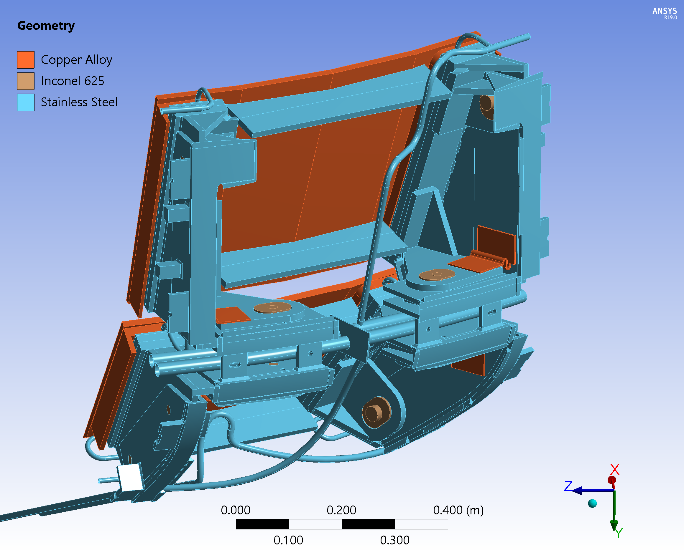
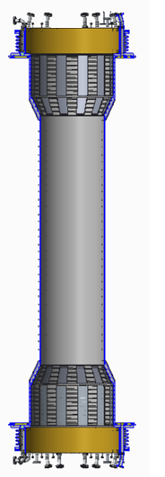
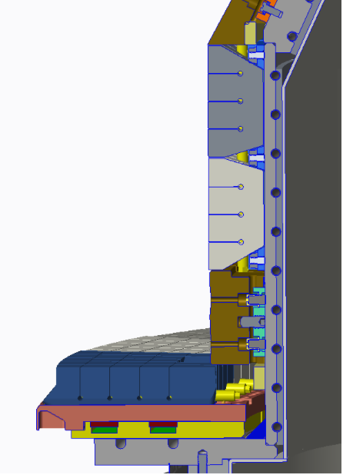
WBS 1.01 in Machine Core Defined to Ensure High-Reliability Operations - all fully designed and part of CDE-3A
Six new inner-PF coils (PF-1a, -1b, -1c, upper and lower)
WBS 1.01.02.01
CAM: Swider
See IPR talk by M. Kalish
PF-1a, -1b, -1c support structures and double O-ring seals
WBS 1.01.02.01
CAM: Swider
See IPR talk by Smith
Repairs to passive plate bracketry to allow operation at full EM load
WBS 1.01.02.02
CAM: Gattoni
See IPR talk by Jariwala
New Center Stack Casing With Improved Heating/Cooling Features
WBS 1.01.02.06 and 1.01.02.04
CAM: Swider
See IPR talks by M. Smith, D. Cai, and M. Viola
New graphite tiles with improved heat flux handling capabilities
WBS 1.01.01
CAM: Gattoni
See IPR talk by J. Klabacha
3A scope in machine core critical for achieving project schedule; tiles define critical path, but other items near

Slide 12
Recovery Project Scope includes Systems to Ensure Safe Operations
Test Cell Shielding
WBS 1.08.01.03
CAM: Jernigan CDE-3A Scope
Shielding scope includes construction of a labyrinth, addition of a shielding materials in various test cell windows and penetrations.
Final Design is complete
See IPR talks by Ascione and Cropper
Personnel Safety System
WBS 1.09.04.01
CAM: Jernigan CDE-3B Scope
Configuration managed safeguards against contact thermal and electrical hazards
A trapped key system to ensure configuration control
A safety instrumented system for test cell access control
Preliminary Design is complete
See IPR talks by Petrella (LOPA, PSS-SIS)
Test Cell Oxygen Deficiency Monitors
WBS 1.08.01.02
CAM: Jernigan CDE-3B Scope
ODH monitoring system will be installed in the test cell
Preliminary Design is complete
Medium Temperature Water System Refurbishment
WBS 1.03.01.02
CAM: Jernigan CDE-3B Scope
Interlocks on 150 ℃ pressurized water systems consistent with ASHRAE will be installed
Preliminary Design is complete
See IPR talk by Gerhardt
Radiation Annunciation
WBS 1.08.01.01
CAM: Jernigan CDE-3A Scope
Install illuminated signs outside test cell indicating when the existing neutron/gamma monitors detect levels exceeding a threshold
Final Design is complete
See IPR talk by Cropper

Slide 13
Project Ends with Reassembly and Commissioning
Reassemble the device - WBS 1.09.02.01
Sequenced installation of tiles, magnets, buswork, etc.
Achieve KPP #1: Alignment of the inner-TF bundle with vertical field coils
Implement Accelerator Safety Order - WBS 1.09.01.01
Write the SAD and ASE, conduct Readiness Assessment and Accelerator Readiness Review
See IPR talks by Stevenson and Malo
Commission the device - WBS 1.09.03.01
Recommission power, control and protection systems, bakeout, coil operations, first plasma
KPP #2: Bakeout all PFCs >260 °C
KPP #3: Vacuum magnet pulse simulating 1.4 MA, 0.85 T, 4 second pulse
KPP #4: >50 kA First Plasma
See IPR talk by Stevenson

Slide 14
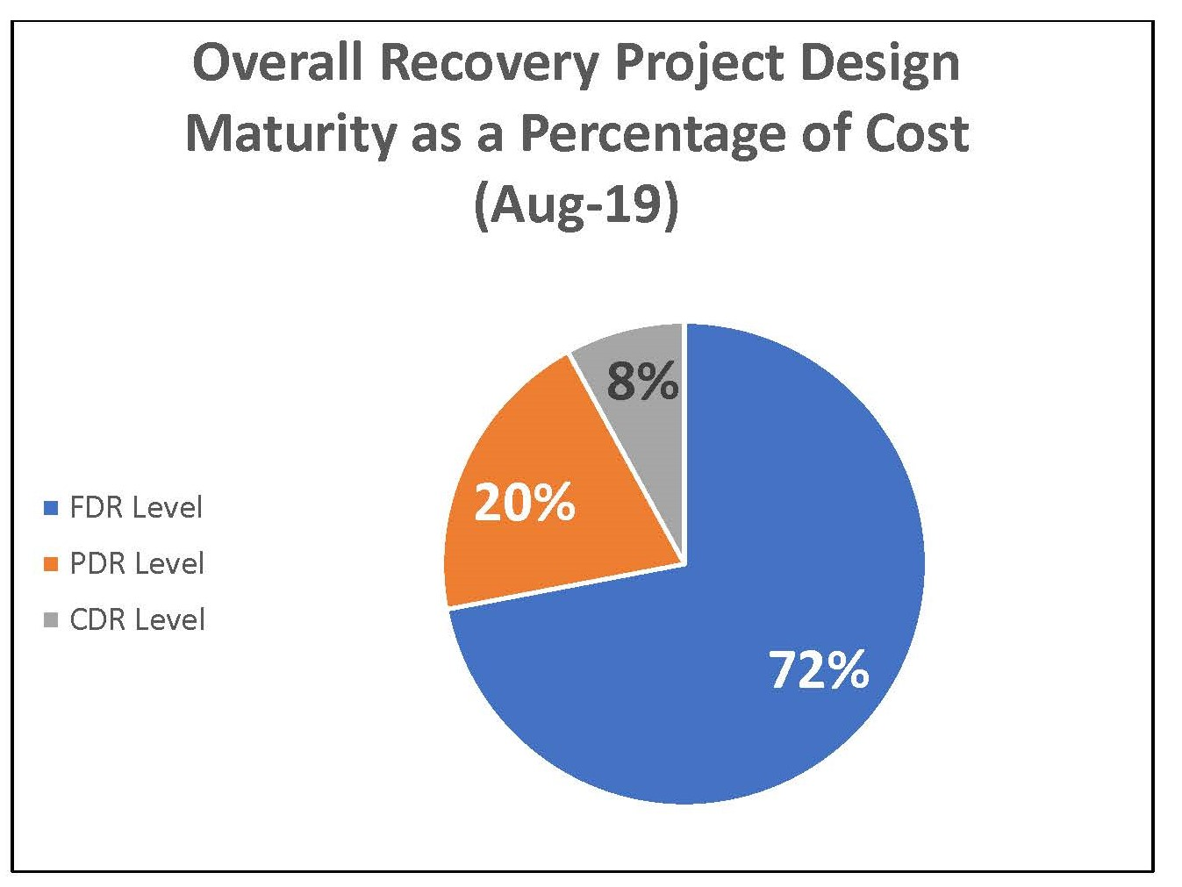
High level of design maturity supports the NSTX-U baseline approval
72% of work packages at final design
Project will be at 100% final design in early Calendar Year 2020, prior to the CDE-3B approval

Slide 15
Large Number of Design Reviews Held Since Previous PAC
WBS 1.1 TORUS SYSTEMS
WBS 1.1.1 - PFCs
PFC FDR (9/28/2018)
CSFW/CSAS Peer Review (5/1/19)
WBS 1.1.2-Vacuum Vessel and Internal Hardware
Polar Region-Inner PF Coil Supports PDR (3/27/18)
Passive Plates & He Line Repair CDR (6/8/18)
Passive Plates & He Line Repair PDR (7/26/18)
Polar Region-Flanges PDR (8/2/18)
VVIH Field Scope PDR (2/23/18)
TF OH / Casing Trial Fit FDR (4/17/18)
CSC Modification PDR (10/16/18)
CSC FDR (12/28/18)
PF-4/5 Realignment CDR (10/25/18)
Metrology Mount FDR (11/26/2018)
HTP HTT FDR (11/1/2018)
PF-4/5 Realignment Peer Review (5/31/19)
PF-4/5 Realignment PDR (7/10/19)
Machine Core Structures FDR (8/5/19 & 8/6/19)
PF-4/5 Realignment FDR (8/9/19)
Passive Plate & He Line Repair FDR (8/21/19)
WBS 1.1.3 - Magnets
Inner PF Coil PDR (12/14/17)
Cooling Water System Interlock PDR (2/22/18)
Inner PF Coils FDR (3/30/18)
Outer PF Coil Inspection / Repair PDR (3/13/18)
TF/OH Bundle Reliability PDR (4/3/18)
Inner PF Prototype Coil Power Test FDR (5/9/18)
Inner PF Water Fitting FDR (1/4/19)
PF Bus Work PDR (2/28/19)
TF Inner Bundle Review #1 (4/9/19)
TF Sample Fabrication Peer Review (4/17/19)
TF Inner Bundle Review #2 (8/7/19 & 8/8/19)
WBS 1.6 CENTRAL I&C
No Recovery Project Design Reviews
WBS 1.8 SITE PREPARATION / ASSEMBLY
NTC Shielding PDR (8/6/18)
Machine Reassembly PDR (8/1/18)
Test Cell Radiation Annunciator & O2 Monitoring PDR (8/14/18)
NTC Shielding FDR (1/14/19)
Test Cell Radiation Annunciator FDR (2/12/19)
WBS 1.9 Site Preparation and Assembly
WBS 1.09.02 NSTX-U Reassembly
Reassembly PDR (8/1/19)
WBS 1.09.04 NSTX-U Personnel Protection System
PSS CDR (12/13/2018)
PSS Requirements Peer Review (5/8/19)
PSS PDR (6/26/19)
WBS 1.10
Shorted Turn Protection CDR (5/9/2019)
Maintenance and Run Preparation Reviews
CAMAC Phase 1 PDR (2/16/18)
GDC Anode PDR (4/19/18)
Bakeout PLC Upgrade PDR (5/10/18)
GDS Expansion Tank Burst Disc FDR (5/29/18)
CAMAC Replacement FDR Phases 1 & 2 (6/26/18)
CAMAC Replacement Pilot FDR Phase 3 (6/6/18)
SAD-2 FDR (12/14/2018)
TVPS Backing Pump FDR (1/12/19)
NTC Network Expansion (CWDM) FDR (6/24/2019
WBS 1.3 AUXILIARY SYSTEMS
WBS 1.3.1 Bakeout
HTHS Feedthrough PDR ()
Gas Piping PDR (1/11/18)
Ex-VV Heating System PDR (2/1/18)
Bakeout DC Connection PDR (4/5/18)
WBS 1.3.3 Vacuum and Fueling
Interspace Pumping FDR (2/20/19)
Private Flux Region Mechanical PDR (04/19/19)
WBS 1.4 PLASMA DIAGNOSTICS
PFC Diagnostics PDR (1/4/18)
Machine Instrumentation PDR (3/22/18)
PFC Diagnostics FDR (3/29/2019)
WBS 1.5 POWER SYSTEMS
PF1B Power Circuits PDR (2/27/18)
PF1B Bipolar Circuit FDR (9/20/18)
Breaker Upgrade/Refurbishment FDR (7/12/2019)

Slide 16
Outline
Recent Project History
Scope
Schedule

Slide 17
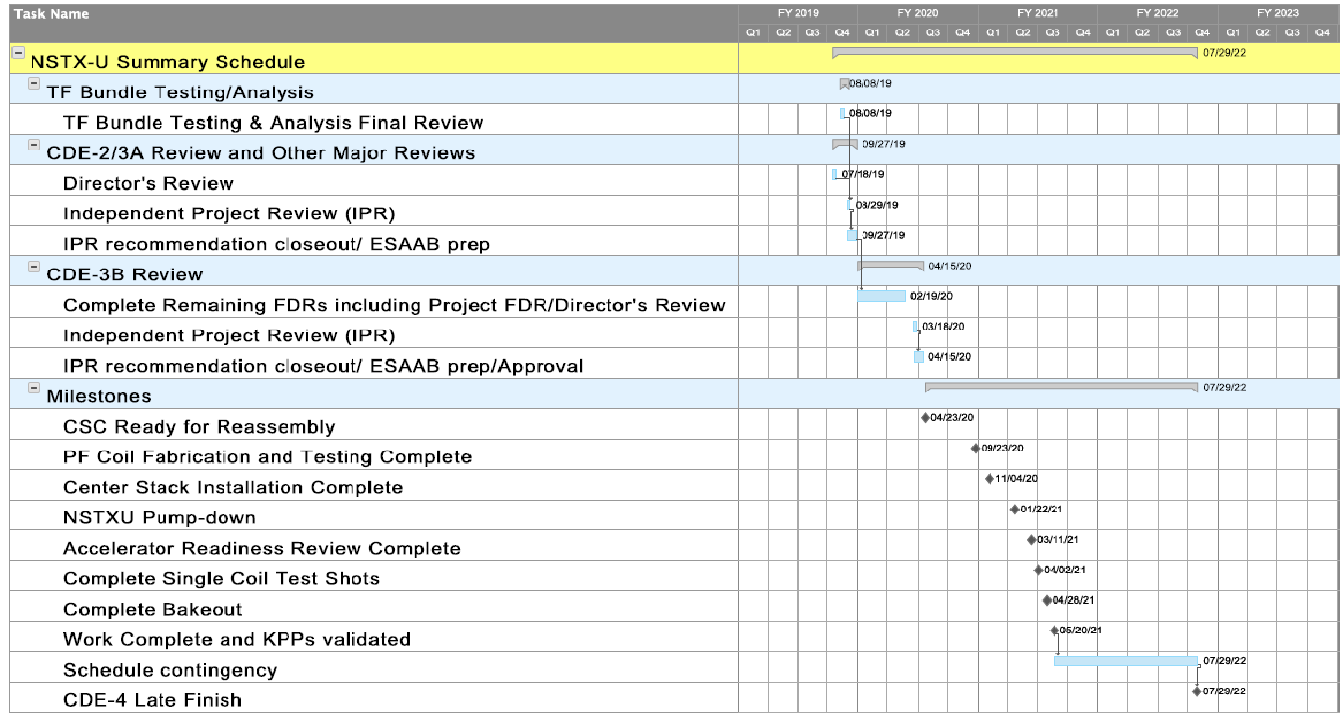
Schedule Includes all Scope and Results in May 2021 Early Finish Data for Completion of the Work
Complete 8/8/19
Complete 7/18/19
3/18/20
First Plasma, Early Finish
5/20/21
7/29/22

Slide 18
Largest, most complex CDE-3A contracts are now in place, balance managed under Critical/Advanced Procurement Plan
PFCs
Plasma Facing Components
Critical/Advanced Procurement Plan
PF Coils
Inner PF Coil Fabrication
Contract awarded
MCS
Machine Core Structures
Critical/Advanced Procurement Plan
CSC
Center Stack Casing Fabrication
Contract awarded
HTT/HTP
Heat Transfer Plate/Heat Transfer Tubes
Contract awarded
PP
Passive Plates
Critical/Advanced Procurement Plan

Slide 19
Summary
Project has have achieved a high level of design maturity
Project management systems have matured and are functioning well
Project is attacking the final design activities and moving into the execution phase
Plan to deliver NSTX-U as a world-class spherical torus user facility in 2021

