Slide 1
EP-TSG: impact of potential “polar region” modifications on research and scenarios
M. Podestà
for the EP-TSG
PPPL
May 24th, 2017

Slide 2
Magnetic equilibrium, pulse duration, injected NB power
Required scenarios include LSN, IWL, USN
Configuration | Flat-top [s] | Max NB power | Notes
LSN | 2 | 8 | Default option for H-mode discharges. Need 2sec for current equilibration, average data over NB modulation pulses or RMPs in stationary conditions.
IWL | 1 | 4 | Excellent scenario for theory/experiment comparison. Good for diagnostics (reduced background from divertor). Well reproducible. Need 1sec for CHERS, MSE data with NB modulation.
USN | 2 | 8 | High-performance alternative to IWL plasmas. Good for diagnostics (reduced background from lower divertor, e.g. vert. FIDA)
EP-related experiments mostly insensitive to details of in/out gap, X-point radius
Reproducibility and reliability (e.g. of NB sources) more important
Possible exception: AE damping rate measurements vs κ, δ
But: will start with ohmic discharges (no AE drive), then add <4MW P_{nb}
Scenarios with rev-B_{t} and rev-I_{p} are highly desirable
Characterize NB ion confinement for counter-NB injection
Validate diagnostics/theory/models, e.g. FIDA, AE destabilization by cntr NB ions

Slide 3
Toroidal field, current and heating systems
Required B_{t} is 0.5-1T
Highly desirable: decrease B_{t} to 0.35T to connect with NSTX
Rev-B_{t} desirable if rev-I_{p} is also possible
Required I_{p}=0.6-1.5MA
Lower limit: high/fully non-inductive scenarios at moderate P_{nb}<6MW
Rev-I_{p} operations desirable
Require reliable NBI, need all 6 source
Include NB modulation capability, min. on/off 10ms
Include adjustable injection voltage 60-90kV
Highly desirable: up to 4MW of HHFW power for 0.5sec
Study interaction of NB ions with RF
Validate codes, e.g. “RF kick operator” in TRANSP
NSTX-U is the only US device with RF

Slide 4
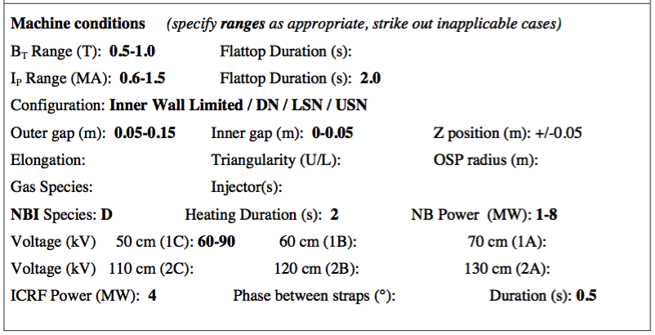
Summary of required parameters

