Slide 1
Materials and Plasma-Facing Components TSG Discussion of Recovery Project impacts
MA Jaworski on behalf of the M&P TSG
NSTX-U Materials and PFCs Topical Science Group
B318 – PPPL – May 24, 2017
*Work supported by DOE contract DE-AC02-09CH11466

Slide 2
Topical overview
Brief summary of TSG shape/scenario requirements based on FY16/17 and 5/7 year plan
Review of 5/7 year research thrusts for M&P
Review of experimental capabilities for FY16/17 plans
TSG summary of impact of polar regions modifications
Impact on PFC-testing shape requests
Impact of Recovery and polar regions on research thrusts

Slide 3
M&P research will develop understanding of material migration and heat-flux handling of high-Z and liquid Li PFCs
5-Year Plan Research Thrusts
MP-1: Understand lithium surface-science for long-pulse
Assess impact of more complete Li coverage
Use the Material Analysis and Particle Probe (MAPP) and laboratory studies to link tokamak performance to PFC surface composition
MP-2: Unravel the physics of tokamak-induced material migration and evolution
Confirm erosion scalings and evaluate extrapolations
Determine migration patterns to optimize technical solutions
MP-3: Establish the science of continuous vapor-shielding
Determine the existence and viability of stable, vapor-shielded divertor configurations
Determine core compatibility and extrapolations for extended durations and next-step device parameters

Slide 4
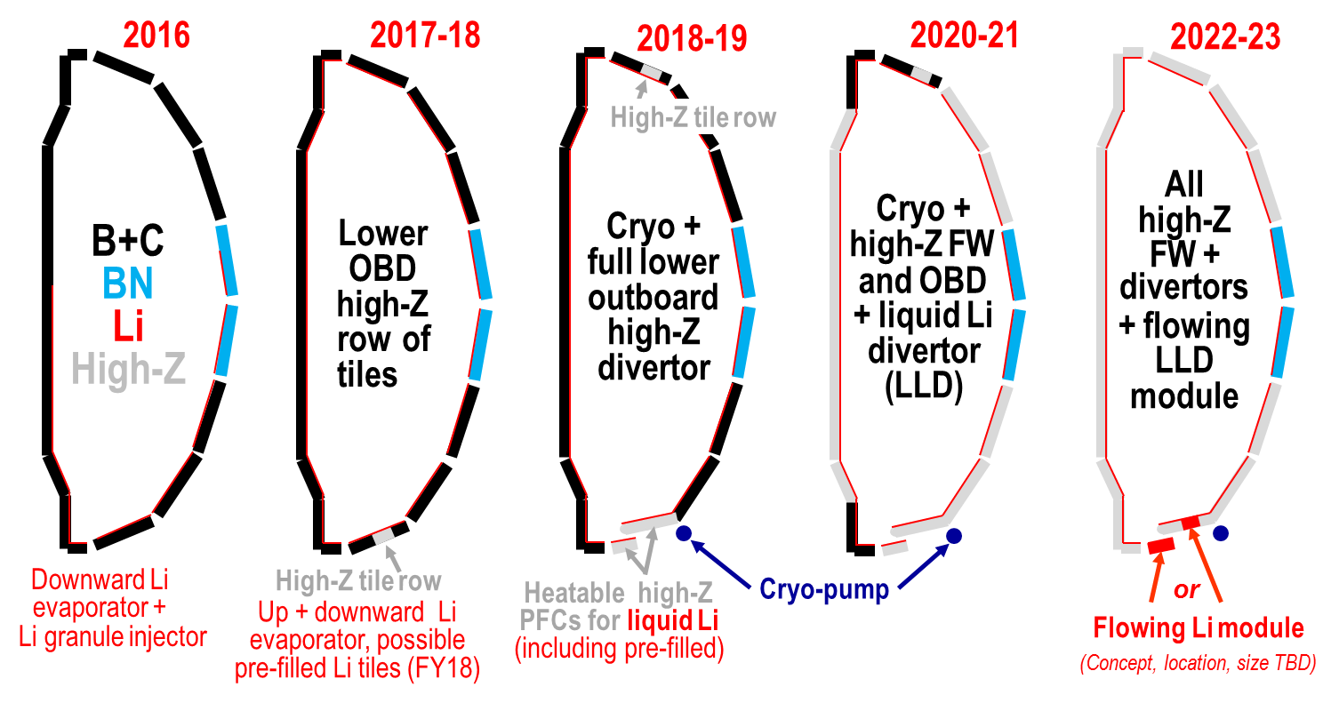
Staged conversion mitigates risk and enables comparative assessment of both high-Z and liquid Li
Open divertor and flexible magnetic configuration enables multiple studies and material selection
Single-variable experiment in single campaign enabled by conversion (i.e. high-Z vs. lithium PFCs)

Slide 5
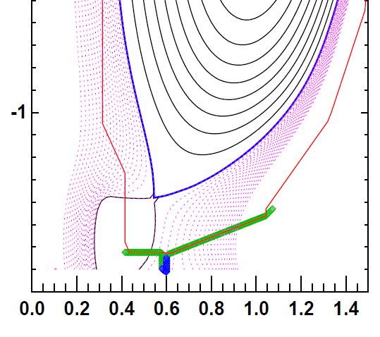
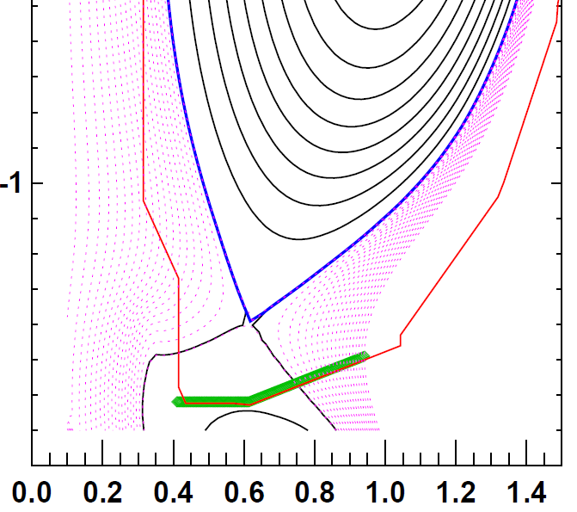
Reference shape requests enable exposure of novel PFC materials and utilizes MAPP diagnostic
Shape developed to perform dedicated tests on outboard PFCs
Heat-flux figure of merit indicates 2/3 of high-performance heat flux on row 2
Does not reverse helicity on IBDH
FY16 plans limited to 1s discharge at 10 MW/m²
Can make MAPP measurements with discharges similar to 2016
Science aided by long pulse capability
Reference shape request:
0.73<R_{SP,out}<0.84 (i.e row 2)
Q_{inc} = 10 MW/m² for 1s, & <max qualified for 5s>
MAPP exposure shape request:
OSP close to/on MAPP R~1.04m
Q_{inc} = <max qualified for 5s>
High-performance discharge
PFC test reference discharge

Slide 6
Reference shape requests enable exposure of novel PFC materials and utilizes MAPP diagnostic
High-performance discharge
Shape developed to perform dedicated tests on outboard PFCs
Heat-flux figure of merit indicates 2/3 of high-performance heat flux on row 2
Does not reverse helicity on IBDH
FY16 plans limited to 1s discharge at 10 MW/m²
Can make MAPP measurements with discharges similar to 2016
Science aided by long pulse capability
Reference shape request:
0.73<R_{SP,out}<0.84 (i.e row 2)
Q_{inc} = 10 MW/m² for 1s, & <max qualified for 5s>
MAPP exposure shape request:
OSP close to/on MAPP R~1.04m
Q_{inc} = <max qualified for 5s>
Shape already achieved in 2016 (203879)
FOM ~ 60 MW/m²
High-Z reference discharge

Slide 7
Topical overview
Brief summary of TSG shape/scenario requirements based on FY16/17 and 5/7 year plan
Review of 5/7 year research thrusts for M&P
Review of experimental capabilities for FY16/17 plans
TSG summary of impact of polar regions modifications
Impact on PFC-testing shape requests
Impact of Recovery and polar regions on research thrusts

Slide 8
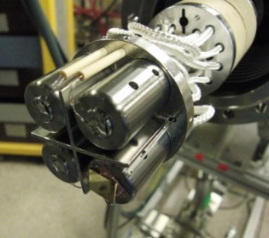
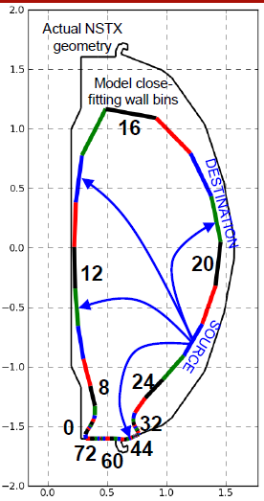
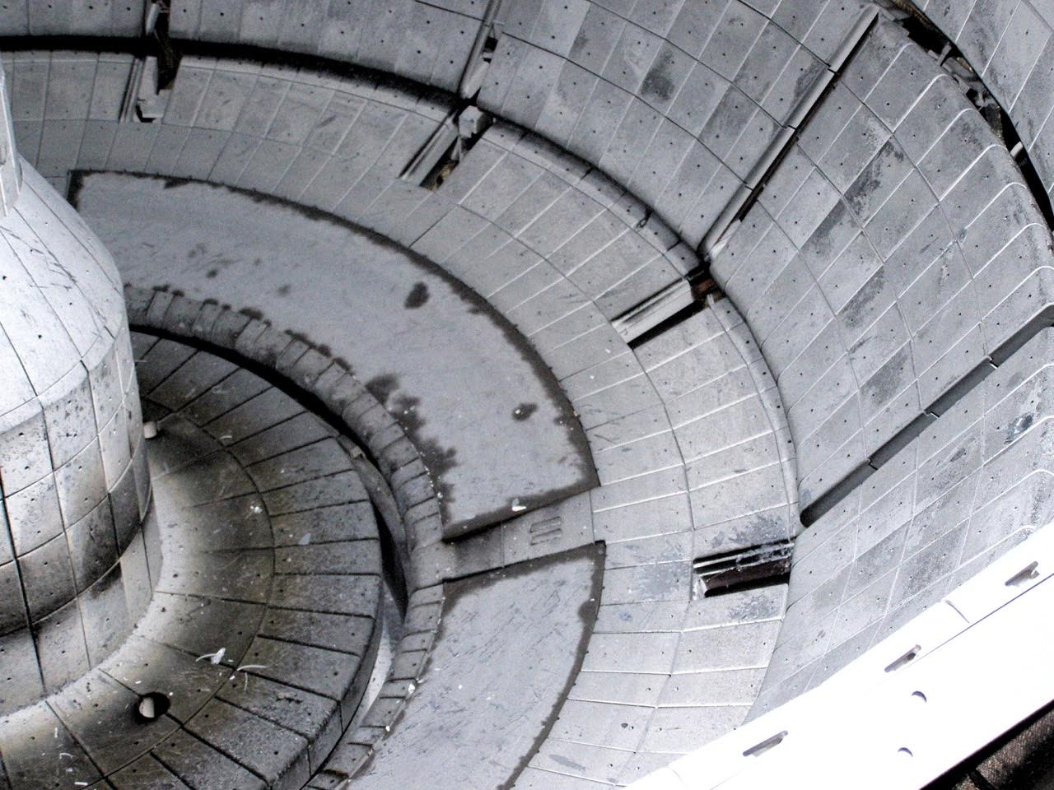
Research thrusts MP-1 and MP-2 not significantly impacted*
M&P TSG meeting held May 11 to gather input
*Assuming diagnostic interpretation and implementation can be addressed
*Assumes B and Li conditioning will continue
Diagnostic impacts
MAPP not affected (Kaita)
IR thermography and spectroscopic: needs analysis of spatial resolution (Vlad, Gray)
Witness plates & QCMs not affected (Skinner)
Langmuir probes; need redesign (Jaworski – included in PFC requirements draft document)
R. Kaita
J. Nichols
C. Skinner

Slide 9
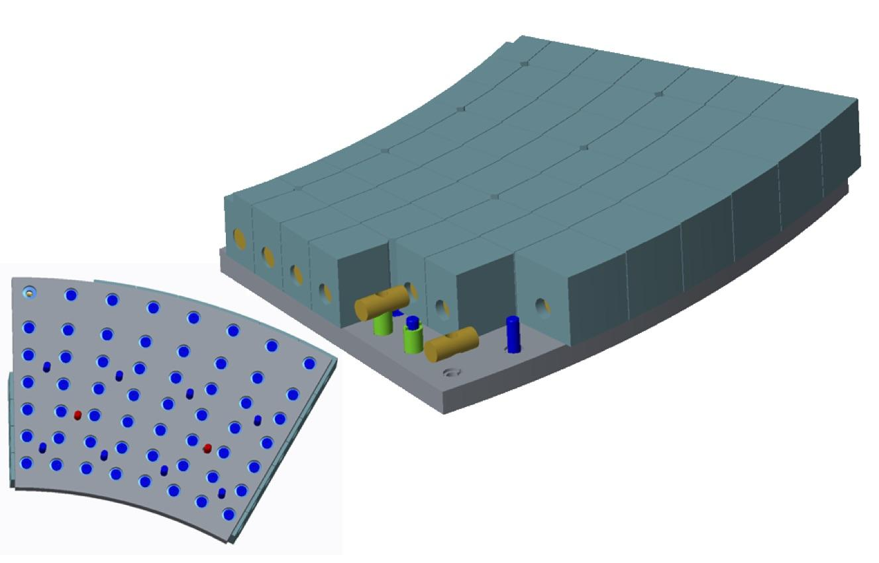
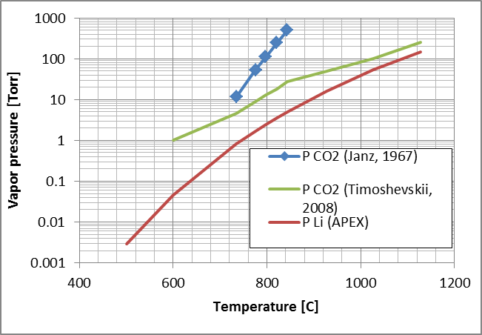
Research thrust MP-3 can continue on general ablative materials
Research plan modified by delay in high-Z and liquid Li
Expect restart with graphite PFCs
Accessible PFC temperatures far exceed NSTX
Redeposited material can create reservoir for decomposition into plasma
Li₂CO₃ decomposition releases CO₂ and should cool plasma
Represents general case of self-limiting material by ablative shielding
Motivates evaluation in revised milestone 18-2 (text tomorrow)
Potential reservoir

Slide 10
Summary
Materials and PFCs TSG group has identified impacts of the recovery activity
Diagnostic impacts brought forth by group
Research plans only require some specific shapes
Shapes for PFC testing already expected to be determined by material performance limits
M&P TSG research thrusts partially impacted by polar-region changes
MP-1 and MP-2 can be conducted with attention to diagnostic impacts
Consideration of general material ablation can make MP-3 more applicable to a wider range of materials

