Slide 1
Impact of Potential Polar Region Modifications for Solenoid Free Plasma Start-up and Ramp-up
R. Raman, D. Mueller*, F. Ebrahimi*
T.R. Jarboe, B.A. Nelson, M. Ono*
University of Washington / NSTX-U, Seattle, WA 98195
*Princeton Plasma Physics Laboratory, Princeton, NJ
PPPL
May 24, 2017
*This work supported by the US DOE contracts FG03-96ER5436, DE-FG02-99ER54519 and DE-AC02-09CH11466

Slide 2
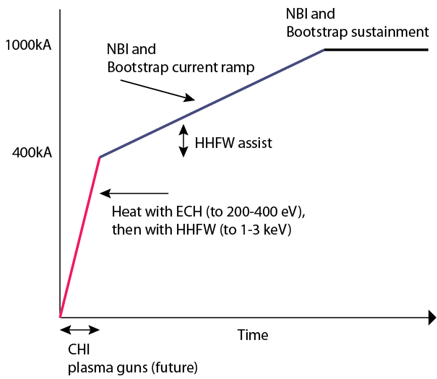
NSTX-U Aims to Develop and Understand Non-inductive Start-up/Ramp-up to Project to ST-FNSF Operation
NSTX-U Start-up &
Ramp-up strategy
Non inductive current ramp-up / sustainment demonstration needs 400-600kA of closed flux current on NSTX-U
Requires high injector flux
Need to heat CHI plasma to over 400eV, preferably to 1keV using ECH
1keV to reduce reliance on HHFW & use NBI directly on CHI target
Eventually CHI will use metal electrodes
CHI T_{e} should increase with reduced low-Z impurities

Slide 3
Uniqueness of NSTX-U Capability
While many fusion experiments are studying non-inductive current drive and current ramp-up, NSTX-U is the only machine in the world that has a program, and hardware capabilities, capable of demonstrating full solenoid-free plasma start-up and current ramp-up to the needed sustainment levels.
This experimental demonstration would fundamentally alter future tokamak/ST designs, and would represent a major and unique NSTX-U contribution to world fusion energy development.
This unique capability on NSTX-U was developed over more than a decade and half of important progress with transient coaxial helicity injection (CHI).
Compared to other methods for solenoid-free-plasma start-up, many of which are presently being studied in existing experiments, transient CHI is the only method for which the scaling is well understood.
The scaling is simple. The current generated is proportional to the injected flux. The conversion factor from open flux to closed flux is quite large in NSTX, about 70%. NIMROD simulations also now support this.

Slide 4
NSTX-U’s Tremendous Capability for SFPS Mission
High Injector Flux Capability (Over 300 mWb)
Start-up currents approaching 1MA can be studied
Near-term benefit is that it would ease the requirements on current ramp-up
For the longer term, it would inform us about new ST designs in which a large fraction of the start-up current (all of it ?) could be generated by transient CHI.
High Toroidal Field (1T)
Needed for injecting more flux
Flexible Current Drive
The second more tangential neutral beam system is projected to be capable of current sustainment, and provide the current overdrive for the ramp-up scenario.
Capability for ECH
NSTX-U at this time does not have an ECH system, but this is an external system that can be easily added since providing this capability does not require internal vessel modifications.
Strong Coupling to MHD Theory
NSTX-U plasmas, through improved diagnosis of the reconnection region, will provide access to new parameter regimes not possible on any basic reconnection studies experiment, because these experiments do not produce plasmas with the confinement and heating parameters possible on NSTX-U.
It is only through experimental measurements that these important simulations, that are also of considerable interest to basic reconnection studies, can be validated.

Slide 5
CHI Research on NSTX-U Would Help Establish Feasibility of New High-Field ST Without Central Solenoid
On NSTX-U, we have a wealth of proven capabilities to conduct game-changing research that would reduce the cost and simplify the tokamak/ST systems and help fusion power be economically competitive.
CHI research would contribute to new ST designs that can benefit from high TF (using new developments in super conducting technology) to generate a very large fraction of current (all of the current?) needed for sustained operation.
Contributes to the basic work on magnetic reconnection. This basic physics research aspect requires an experimental system for model validation, as evidenced by the construction of new experiments solely to study magnetic reconnection physics

