Slide 1
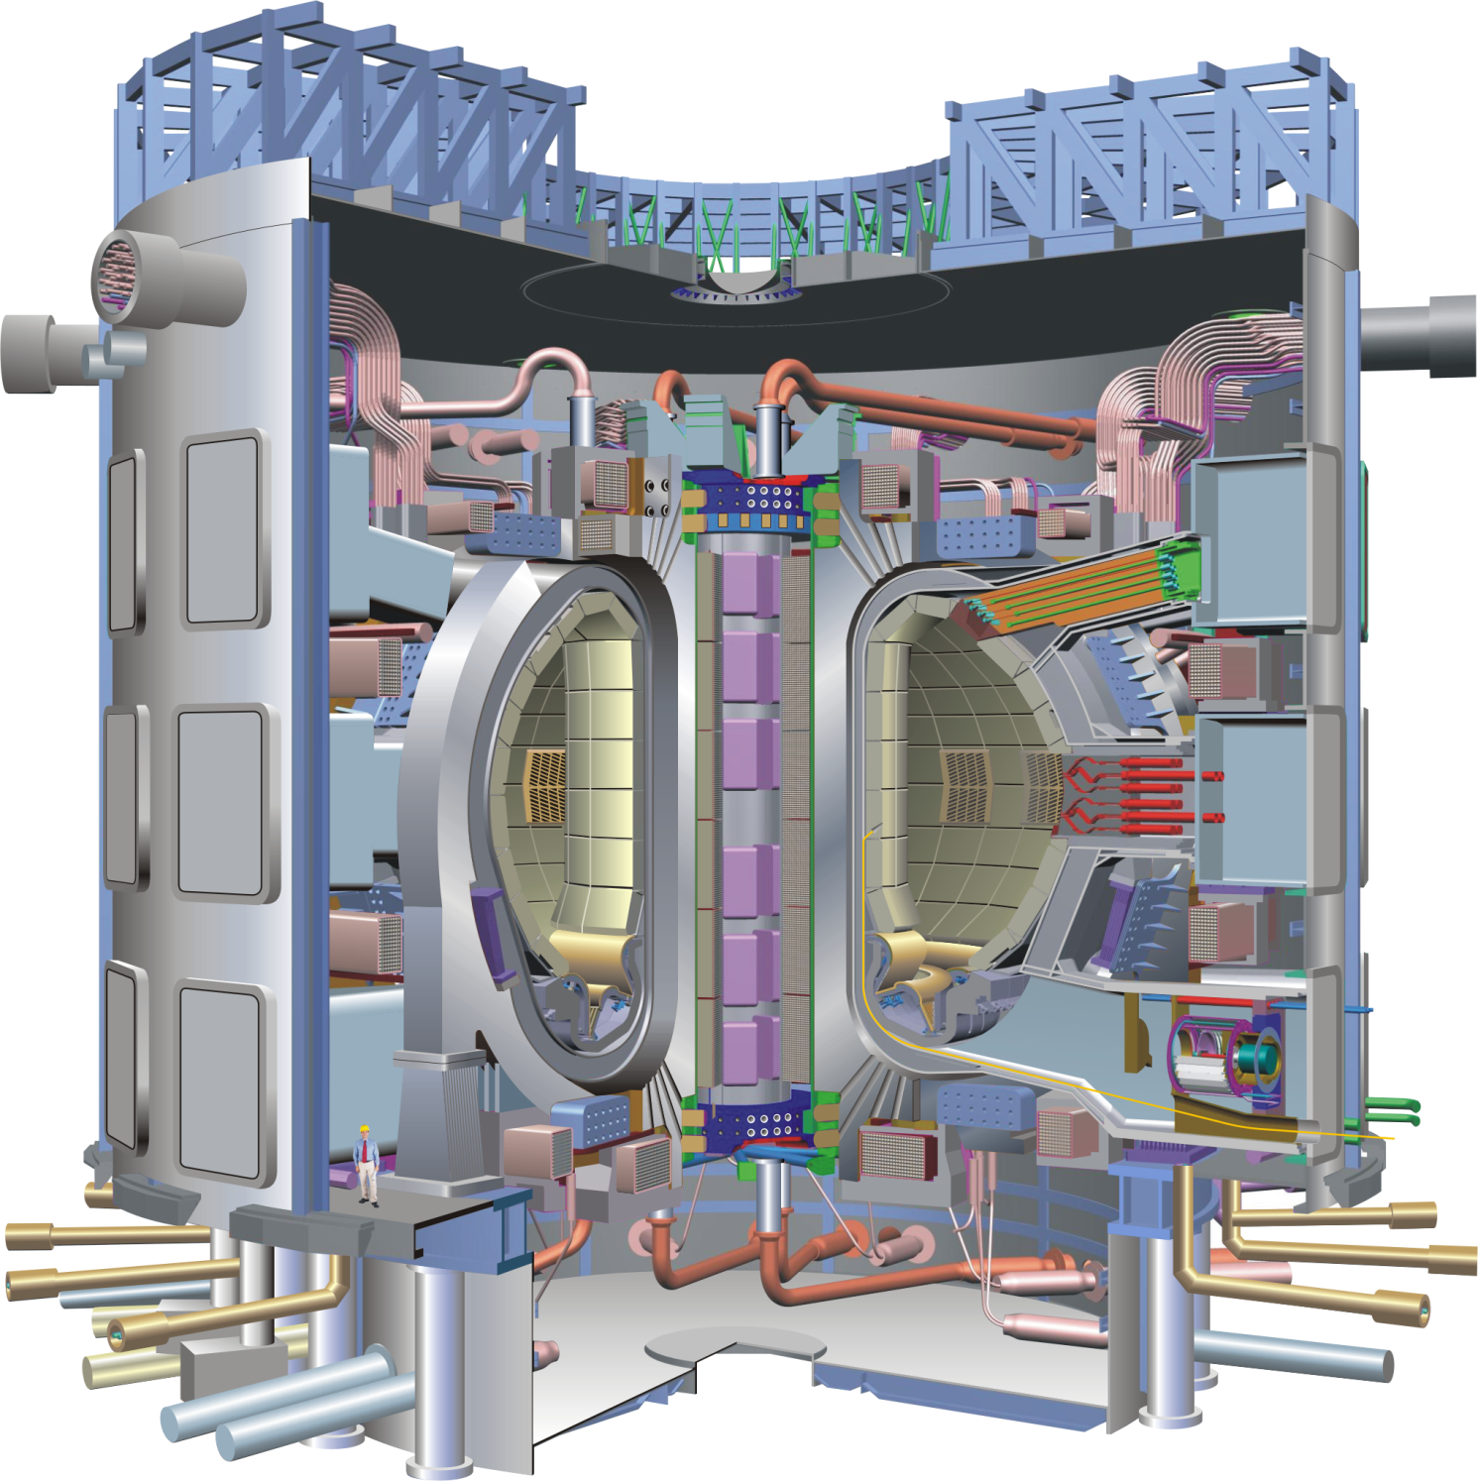
Progress and Outstanding Challenges in Tokamak Research
Michael Bell
former Head of NSTX Experimental Research Operations
Princeton Plasma Physics Laboratory
Princeton University
presented to the
Joint ICTP-IAEA College on Plasma Physics
International Center for Theoretical Physics, Trieste
October 2012

Slide 2
Topics and Preamble
Tokamak fundamentals
Tokamak stability
Confinement and transport
DT experiments in TFTR and JET
The leap to ITER
Disclaimer:
A single lecture cannot encompass all areas of tokamak physics
  Tokamaks have been intensely studied for almost 50 years
Even within the subset of topics, I have had to be very selective
Acknowledgements:
R. Fonck, T. Luce, G. Matthews, J. Menard, H. Qin, J. VanDam

Slide 3
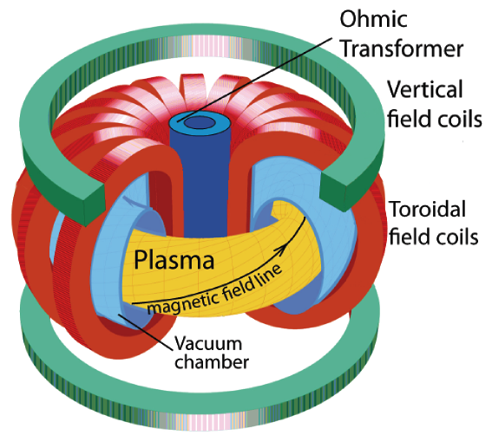
Essential Features of the Tokamak
Toroidal configuration symmetric about its major axis formed by a strong applied toroidal field plus a poloidal field generated by both toroidal plasma current and external coil currents
  The poloidal field is necessary for compensating particle drifts
  The toroidal field is necessary for plasma stability
The configuration need not be symmetric poloidally
  External poloidal field coils can modify
  the shape of the minor cross-section
Z
Poloidal
A tokamak plasma can be described by many different coordinate systems
  relative to the major axis (R, Z, φ)
  relative to the minor axis (r, θ, φ)
  various magnetic coordinates which can simplify calculations
θ
r
φ
R

Slide 4
Tokamak MHD safety factor q
q = number of toroidal transits of a field line around the major axis to complete one poloidal transit around the minor axis
In a stable tokamak plasma, magnetic field lines trace out nested
flux surfaces each characterized by a poloidal flux ψ (∝ I_{p}), an enclosed toroidal flux χ (∝ B_{T}) and value of q
For magnetohydrodynamic (MHD) stability q must be > 1 everywhere
This places an upper bound on the plasma current for a given toroidal field, plasma size and cross-section shape
A tokamak plasma has a “last closed flux surface” beyond which the field lines intersect some material surface
In practice, q must be >~2 near the last closed flux surface

Slide 5
Tokamak MHD Equilibrium
On timescales > Alfvén timescale a/v_{A}, v_{A} = B/(μ₀ρ)^{1/2}, equilibrium is determined by static pressure balance
J × B = ∇p
In a tokamak, axisymmetry reduces this to the 2D “Grad-Shafranov” eqn.
Δ*Ψ = μ₀RJ_{φ} = -[μ₀R²dp/dΨ + FdF/dΨ]
where Δ*Ψ = R² ∇• (∇Ψ / R²)
Ψ is the poloidal flux = RA_{φ}, (A the magnetic vector potential)
p(Ψ) is the plasma pressure
F(Ψ) the poloidal current = RB_{φ}, (B_{φ} the toroidal magnetic field)
In principle, there is an infinite number of solutions
In practice, the solutions are constrained by experimental data
  Total plasma current and coil currents
  External magnetic measurements (fluxes, field components)
  Internal measurements of plasma pressure and magnetic field
  Geometry of surrounding structures
Important MHD parameter: β = plasma pressure/magnetic pressure (B²/2μ₀)

Slide 6
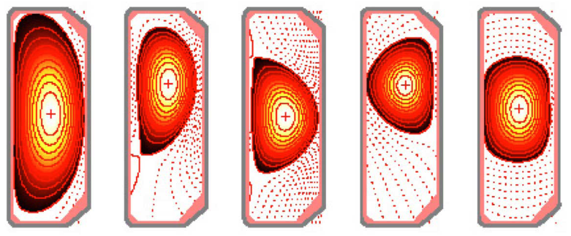
Controlling and Shaping the
Plasma Cross-section in a Tokamak
A tokamak requires a major axial (usually vertical) magnetic field to resist major radial expansion forces on the plasma
  Electromagnetic: a current loop tries to maximize its area
  Hydrodynamic: plasma pressure tries to expand the torus
A uniform axial field produces a nearly circular cross-section
In modern tokamaks, the equilibrium field is generated by many nearby coils to push and pull on the plasma and shape its cross-section
  Aspect ratio: R₀/a (R₀: major radius of toroidal axis, a: minor radius on R)
  Elongation κ: axial height / width = b/a
  Triangularity δ: (inward) displacement of top, bottom points from axis
Feedback control of coil currents is needed to maintain desired equilibrium
δ > 0
δ < 0
Equilibrium control in the TCV tokamak (EPFL, Lausanne)
2b
2a
R₀

Slide 7
Creating a Magnetic Separatrix to Produce a Divertor in a Tokamak
Between two parallel conductors carrying current in the same direction there is a magnetic null point: B⊥ = 0
Through the null there is a surface (separatrix) which separates flux surfaces which encircle only one conductor from those that encircle both
  the null point forms an X-point in a cross-section of the separatrix
In a tokamak divertor, a separatrix is formed between the plasma, carrying toroidal current, and a poloidal field coil with current in the same direction
  on the separatrix q → ∞ because B_{pol} → 0
Particles diffusing from the plasma across this separatrix are then tied to field lines which are diverted away from the main plasma
  these field lines are made to intersect some more distant material surface
Divertors were originally incorporated in tokamaks to reduce the influx of impurities ejected by plasma impinging on surrounding material surfaces
  the divertor plate can also be angled to spread the heat over a wider area
Divertors are now used primarily because they allow easier access to the H-mode of confinement

Slide 8
Topics
Tokamak fundamentals
Tokamak stability
Confinement and transport
DT experiments in TFTR and JET
The leap to ITER

Slide 9
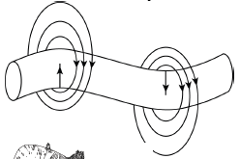
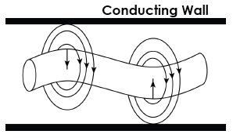
Tokamak Equilibria Can Be Unstable to Many Modes
An (axially) elongated tokamak plasma is unstable to axisymmetric
major-axial displacement
  Divertor coils strongly attract the plasma
  Stability requires fast feedback on radial field
A current-carrying plasma may be subject to a kink instability
  Higher poloidal field on inside of bend reinforces initial displacement
  In a tokamak, the strong toroidal field helps to stabilize the kink
  A surrounding perfectly conducting wall can also stabilize the kink because poloidal field is compressed on the outside of the bend
  A wall with finite conductivity of the wall slows growth of the instability unless the plasma is moving relative to the wall
Figure courtesy T. Luce

Slide 10
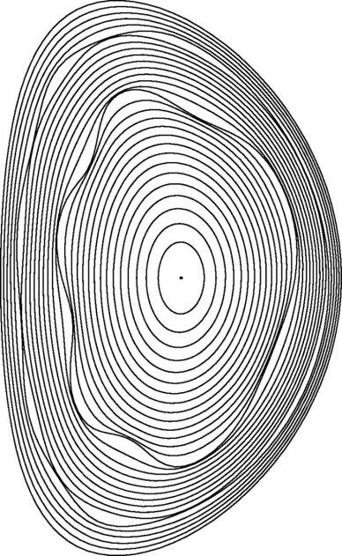
Finite Plasma Pressure and Non-Ideal Plasma Behavior Introduce Other Instability Modes
Can assess MHD stability by perturbing equilibrium fluid elements searching for displacement vectors ξ (perpendicular to the magnetic surfaces) which reduce the potential energy of the system
ξ = ξ₀exp[i(nφ + mθ)]
where n, m are toroidal and poloidal mode numbers
  For kink-like modes (n < ~10) need full 3D displacement
  For high toroidal mode number/short radial wavelength, calculation reduces to ODE ⇒ “ballooning” modes on low field side
  Flux surfaces where q = m/n are susceptible to instability
In “ideal” (infinite conductivity) plasma, flux surface topology is preserved
Finite plasma conductivity allows reconnection of
field inside plasma to form magnetic islands
  Radial excursion of field lines in magnetic islands “short circuits” the isolation of perfect surfaces
  Causes radial transport and flattens profiles

Slide 11
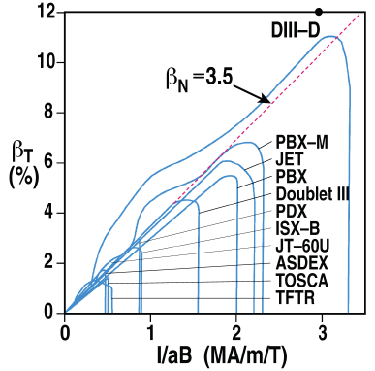
Studies in 1980s Produced a Simple Criterion for Stability to Pressure-Driven Instabilities
Across a range of tokamak shapes, theory showed
⟨β⟩_{max} = C·I_{p}/aB_{T}
where ⟨β⟩ = 2μ₀⟨p⟩/⟨B²⟩ [⟨⟩ indicates volume average] and C is a constant: C ≈ 3.5 mT/MA
This expression was usually approximated by experimentalists as
β_{T,max} (= 2μ₀⟨p⟩/B_{T0}²) = C·I_{p}/aB_{T0}
where B_{T0} is the applied toroidal field at the minor axis
The normalized beta β_{N} = β_{T} / (I_{p}/aB_{T0})
could then be compared to the constant C
Scaling was confirmed across many tokamaks with auxiliary heating
To maximize β_{T} ⇒ operate at lowest q stable to current-driven kink
Pushed tokamak design to achieve high elongation and triangularity
F. Troyon, et al., PPCF 26, 209 (1984); figure T. Luce, APS-DPP 2009

Slide 12
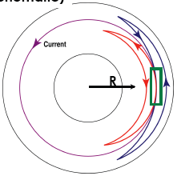
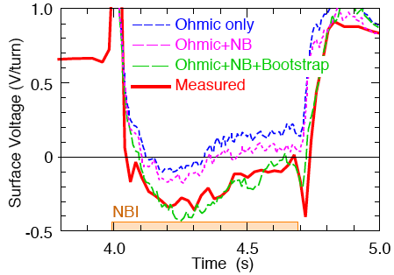
A Consequence of Toroidicity with Important Practical Applications is the “Bootstrap” Current
In a tokamak, only untrapped (passing orbit) electrons carry toroidal current
Bootstrap current arises from differential friction between untrapped electrons and trapped particles on co-parallel (larger r) and counter-parallel (smaller r) legs of their orbits in presence of a radial pressure gradient
I_{B}/I_{tot} ≈ ε^{1/2}β_{P}; ε = a/R₀ - inverse aspect ratio, β_{P} = 2μ₀<p>/B_{P}²(a) - poloidal-β
“Supershots” in TFTR achieved sufficiently high β_{P} to confirm the effect
Important for possibility of a steady-state tokamak reactor
Can only match measured loop voltage by including NBI and bootstrap current
Hotter,
more dense
Cooler,
less dense
TFTR
M. Zarnstorff et al., PRL 60 (1988) 1306

Slide 13
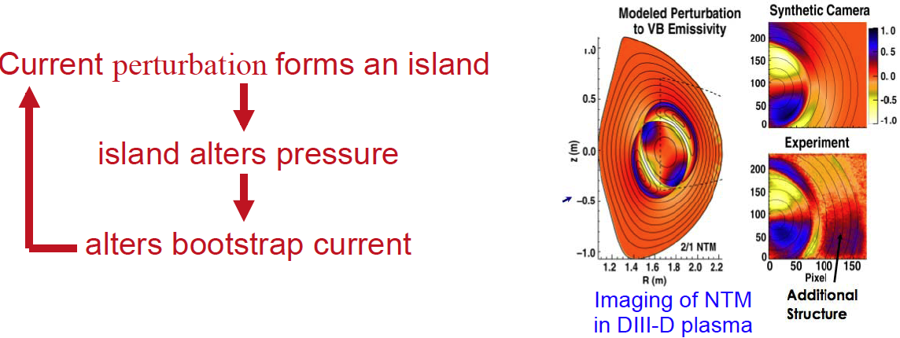
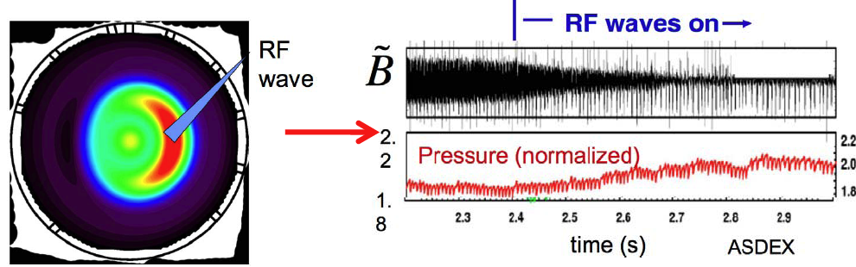
While Potentially Beneficial, Bootstrap Current Can Destabilize High-Pressure Plasmas
Local perturbations to the bootstrap current cause growth of the Neoclassical Tearing Mode (NTM) instability
NTMs of concern to ITER because there is evidence that their threshold for instability decreases with tokamak size
NTMs can be controlled by feedback stabilization using local heating in the island to counteract the perturbation to bootstrap current
Courtesy R. Fonck

Slide 14
Although We Have Learned to Avoid Many MHD Modes, Two Important Instabilities Persist
Disruption: a significant rapid (~ms) loss of plasma confinement followed by termination of the plasma current (0.01 – 0.1s)
  Ubiquitous feature of tokamak operation
    First described over 40 years ago
  May be triggered by many different conditions
    low q_{edge}
    too high or too low density
    high β
    impurity influx
    unfavorable pressure or current profiles
Edge-Localized Mode (ELM): periodic, rapid losses of energy from the edge of plasmas in the “high confinement” mode of operation (H-mode)

Slide 15
Disruptions are Particularly Dangerous for Burning Plasmas: Must be Minimized and Mitigated
In ITER, thermal energy in plasma and poloidal field energy ~ 1GJ
  In current tokamaks ~10MJ
  “Thermal quench” can damage plasma-facing components (PFCs)
    Difficult to make PFCs handle both steady-state and transient heat loads
  “Current quench” can produce damaging electromagnetic forces
    Currents can be induced in conducting elements surrounding plasma
    These currents may be non-axisymmetric: J × B ≠ 0
  Can create large population of energetic (>10MeV) “runaway electrons”
ITER will need to achieve disruption frequency ~1% of discharges
  Identify disruption precursors in real time and take avoidance actions
    e.g. reduce β (heating power) or density (fueling), apply MHD mode control
  Once a disruption starts, use measures to mitigate harmful effects
    Dissipate plasma energy through radiation over entire first wall
    Increase density with massive gas injection, liquid jet or pellet injection

Slide 16
Several Tokamaks Have Demonstrated Mitigation of Disruption Heat Loads, Vessel Currents and Forces
MGI with argon provoked disruptions in Alcator C-Mod, but
Resulting divertor heat loads were significantly reduced
[Whyte, APS 09]
Large density increases with Massive Gas Injection (MGI), shattered pellets and shell pellets in DIII-D, but
Critical density for runaway electron suppression not yet reached
[Hollman, APS 09]
Method adopted for ITER will need achieve minimal number of
false negatives (→ damage) and positives (→ wasted shots)

Slide 17
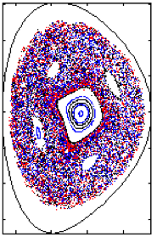
Formation of Stochastic Field Structure Following MGI May Inhibit Runaway Electron Avalanche
Runaway electrons are generated initially by the Dreicer mechanism
  In presence of sufficient electric field, some thermal electrons can be accelerated faster than they lose energy by collisions (∝v⁻³)
Runaways can multiply by direct “knock-on” collisions ⇒ runaway avalanche
Suppressing runaway avalanche by collisions alone would require a critical (Connor-Hastie-Rosenbluth) density equivalent to several hundred grams of gas in ITER
3D resistive MHD modeling shows that formation of stochastic fields triggered by MGI can cause rapid loss of runaways
May not be necessary to attain CHR density limit to avoid runaway damage in ITER
Simulation with NIMROD code of Alcator C-Mod following MGI
V. Izzo, APS-DPP meeting (2009)

Slide 18
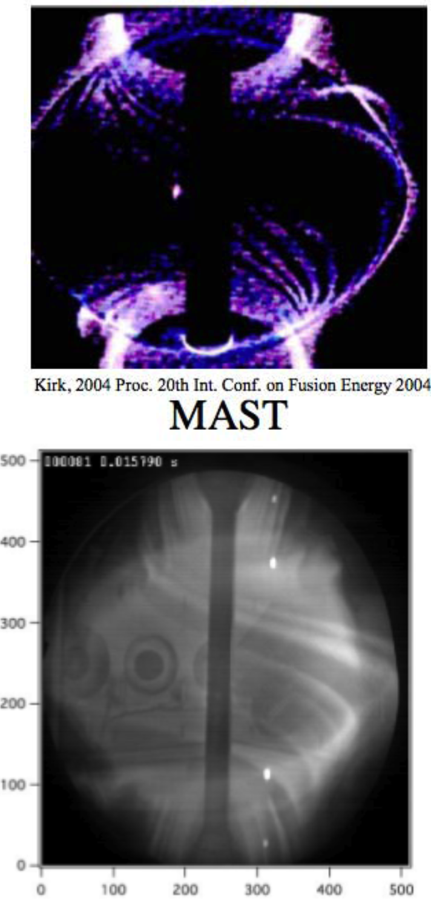
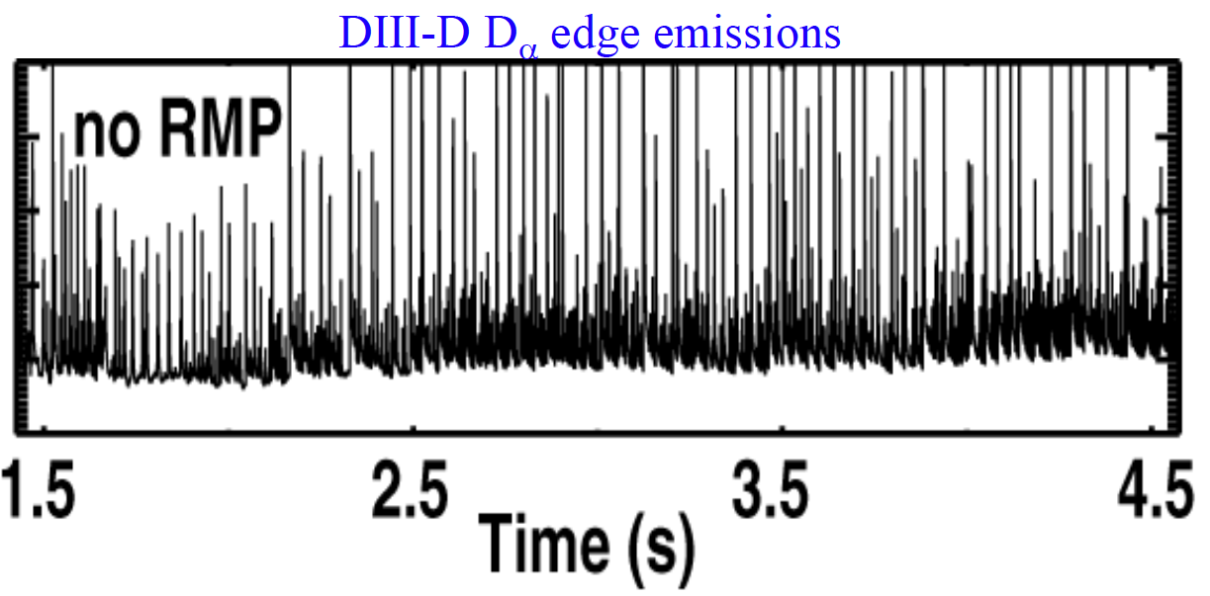
Steep Pressure and Density Gradients in H-mode Plasmas Destabilize Edge Localized Modes (ELMs)
ELMs readily observed as “spikes” in D_{α} line emission from plasma edge
Each spike is correlated with large, coherent filamentary instability at edge
  Periodic ELMs represent a relaxation instability
Many different types of ELM have been found
Can reduce impulsive load by operating in regimes with (or triggering) more frequent ELMs

Slide 19
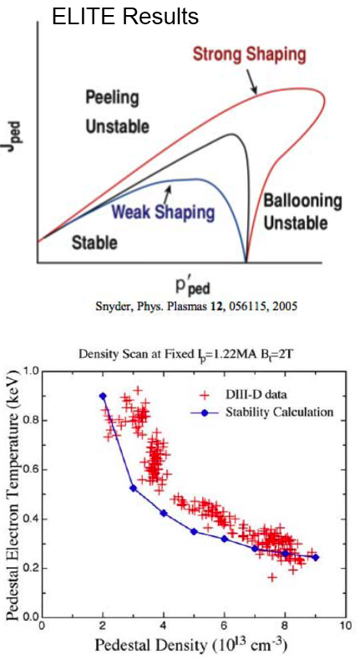
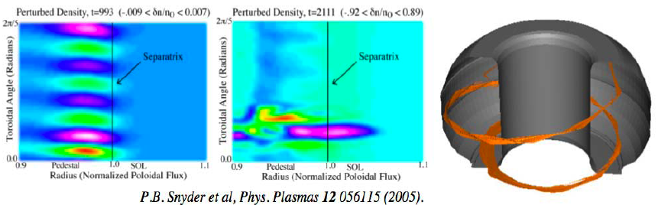
Edge Localized Modes are Well Described by Theory of “Peeling-ballooning” Modes
High edge current density drives “peeling”
High edge pressure drives “ballooning”
Bootstrap current plays crucial role linking pressure and current
ELM then relaxes unstable gradients
Theory describing peeling-ballooning modes reproduces ELM threshold and observed mode structure
Simulation of time evolution

Slide 20
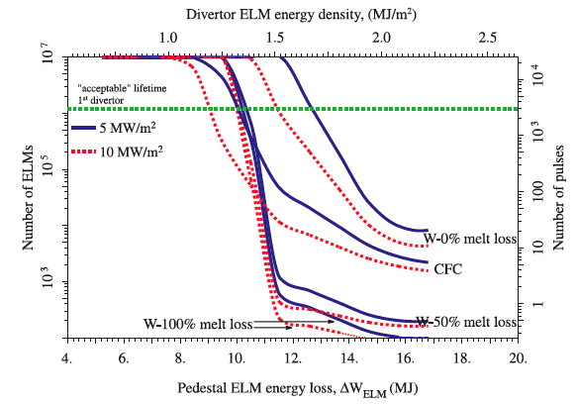
Repeated Large ELMs Will Damage the Divertor Target in ITER and Limit Its Lifetime
Calculated erosion lifetime of a tungsten target (10mm thick) or CFC target (20mm) as a function of ELM energy loss from the pedestal
Heat loads between ELMs are 5 MW/m² (—) and 10 MW/m² (…)
Curves are shown for different fractions of tungsten lost by melting
G. Federici, PPCF (2003)

Slide 21
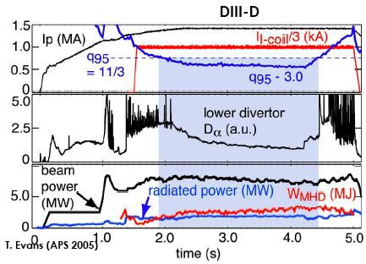
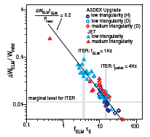
Several Tokamaks are Investigating
ELM Control Methods for ITER
Applying Resonant Magnetic Perturbation (RMP) with non-axisymmetric external coils can suppress ELMs in certain conditions
  RMP creates region with stochastic
  field lines (overlapping islands) at edge
  Additional transport relaxes edge pressure gradient
Repetitively injecting small solid H, D pellets can trigger ELMs
  ELM size reduces with frequency
  Issues: minimum pellet size and penetration; compatibility with fueling requirements
ITER will be equipped with non-axisymmetric coils to control ELMS
T. Evans, APS-DPP meeting (2005)
V. Mukhovatov, PPCF (2003)

Slide 22
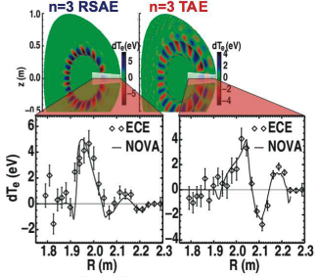
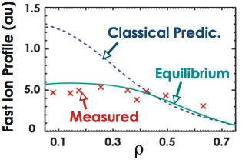
Energetic Ions Including α-Particles Can Destabilize Alfvén Wave Eigenmodes in Toroidal Plasmas
In a torus, the shear Alfvén wave (ω = kv_{A}, v_{A} = B/(μ₀ρ)^{1/2}) develops an eigenmode structure as a result of toroidal and poloidal periodicity
Fusion α-particles with v_{α} > v_{A} can excite Toroidal Alfvén Eigenmodes (TAEs) which then affect the α-particle orbits and cause losses
Theory of Alfvénic modes is now highly developed and successful
  Many modes beyond basic TAEs have been found in shaped, high-β plasmas
Existing tokamaks can use NBI ions to excite modes at low magnetic field
Fast-ion profile becomes flattened by strong Alfvén mode activity
M. Van Zeeland, PRL (2006) 135001

Slide 23
Topics
Tokamak fundamentals
Tokamak stability
Confinement and transport
DT experiments in TFTR and JET
The leap to ITER

Slide 24
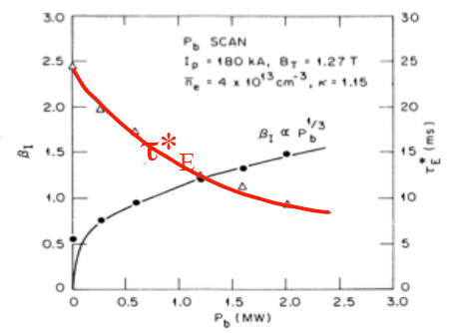
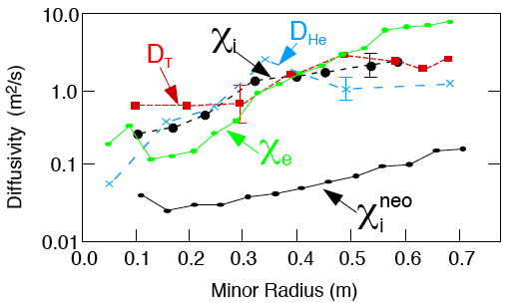
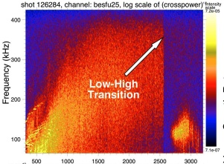
For Plasmas Stable to Large-Scale MHD Modes, Transport From Micro-Turbulence is Dominant
Until 1990s, transport understanding was largely empirical
Despite better confinement in tokamaks, transport was anomalous
  Diffusion exceeded predictions of “neoclassical” (toroidal) theory
Turbulence was blamed but theoretical and simulation tools were not yet sufficiently developed to tackle the problem quantitatively
Measured fluctuations were reduced when plasma underwent transitions from low (L-mode) to high (H-mode) confinement
Confinement degraded
as NBI power increased
Transport coefficients exceeded neoclassical
Broadband turbulent fluctuations
abruptly fall at L-H transition
ISX-B
TFTR
Time (ms)

Slide 25
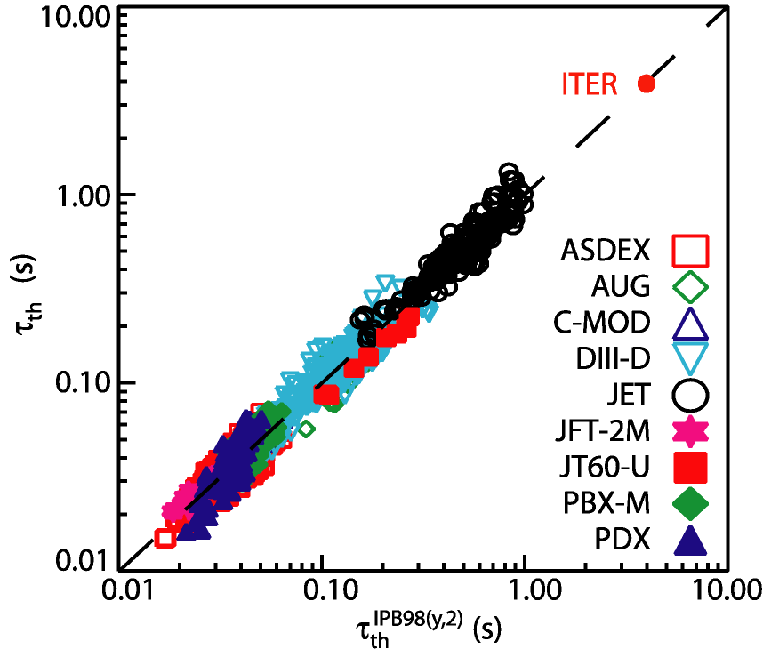
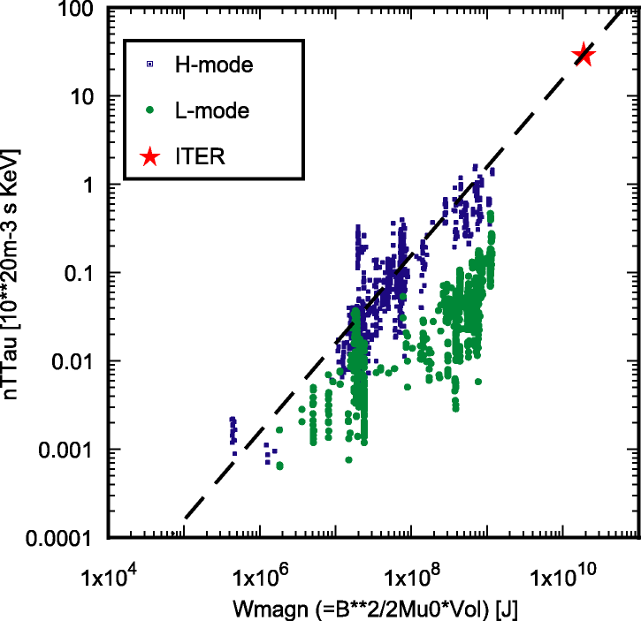
Data from Many Experiments Combined to Produce an Empirical Scaling for Design of ITER
ITER needs a confinement time of ~4s to achieve Q ≈ 10
1998 data from H-mode divertor plasmas with “Type I” ELMs
Can also examine scaling of “fusion triple product” nTτ with tokamak size and magnetic field
Can we put confinement on a firmer footing than a purely empirical scaling?

Slide 26
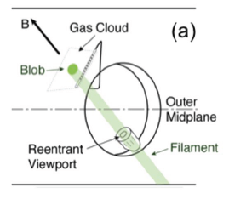
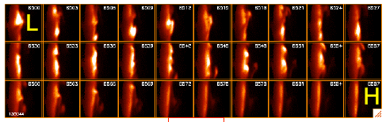
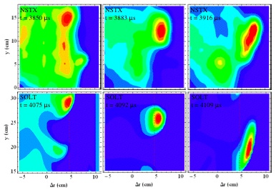
New Instruments and Computational Tools Are Revolutionizing the Study of Turbulence
Fast cameras (up to 10⁶ fps) can visualize turbulent structures
Over 100µs, turbulent edge becomes quiescent at L-H transition
Simulations of “blob” propagation in NSTX
Developments in theory have improved computation schemes
Massively parallel computers allow
realistic simulations of turbulence from
first-principles
Codes incorporate “synthetic diagnostics” to compare simulations with measurements
NSTX data
SOLT code
Courtesy S. Zweben, R. Maqueda, D. D’Ippolito

Slide 27
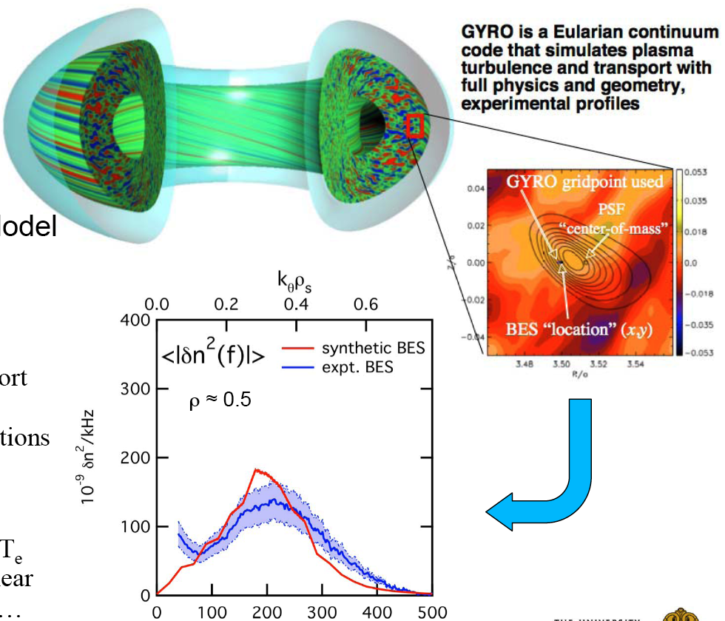
Simulations and Measurements of Ion-Scale Turbulence Have Attained Excellent Agreement
In last 15 years, a “standard model” of ion turbulence and transport has emerged
Example
Simulation with GYRO code of Ion Temperature Gradient (ITG) turbulence in DIII-D
Matches fluctuation spectrum from Beam Emission Spectroscopy (BES)
But, some details remain unresolved and
Electron-scale turbulence not yet accessible
δn (10⁹/kHz)
Cover
Frequency (kHz)
Courtesy R. Fonck

Slide 28
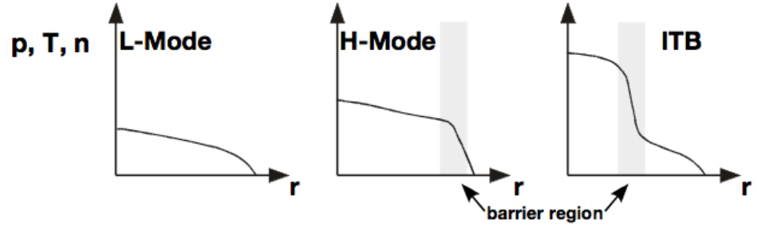
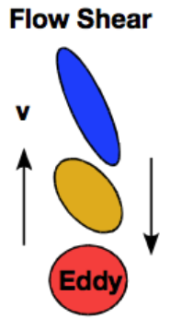
Understanding and Controlling Transport Have Led to Improved Confinement
Transport barrier: region of locally reduced transport in radial profile
  Edge transport barrier → “H mode” (high confinement)
  Internal transport barrier (ITB) in core of plasma
Transport barriers form with suppression of turbulence by
  Flow shear (∂v/∂r): driven by plasma gradients and external momentum sources
  Negative magnetic shear (∂q/∂r<0) : created by current drive including bootstrap current
  Zonal flows: flows created by fluctuations themselves

Slide 29
Dependence of Tokamak Confinement on Plasma-Wall Interactions is Not Well Understood
Many techniques have been applied in tokamaks to modify the interactions between a plasma and its surroundings
  Limiters (object defining the last closed flux surface) vs divertors
  Refractory metallic surfaces (high-Z) vs carbon (graphite, low-Z)
  Baking PFCs and the vacuum chamber (reduces adsorbed H₂O)
  Discharge cleaning (pulsed or glow discharge) by noble gases
  Surface coatings: titanium (gettering), boron, silicon, lithium
All have been claimed to produce benefits!
  Reduced impurities in the plasma – fairly obvious connection
  Better confinement – how?

Slide 30
Dependence of Tokamak Confinement on Plasma-Wall Interactions is Not Well Understood
Many techniques have been applied in tokamaks to modify the interactions between a plasma and its surroundings
  Limiters (object defining the last closed flux surface) vs divertors
  Refractory metallic surfaces (high-Z) vs carbon (graphite, low-Z)
  Baking PFCs and the vacuum chamber (reduces adsorbed H₂O)
  Discharge cleaning (pulsed or glow discharge) by noble gases
  Surface coatings: titanium (gettering), boron, silicon, lithium
All have been claimed to produce benefits!
  Reduced impurities in the plasma – fairly obvious connection
  Better confinement – how?
A common thread in the claims related to “conditioning” is that confinement improves with reduced “recycling” from walls
Recycling describes ions which diffuse from the plasma, impinge on the PFCs, become neutralized and return to the plasma edge
“Conditioning”

Slide 31
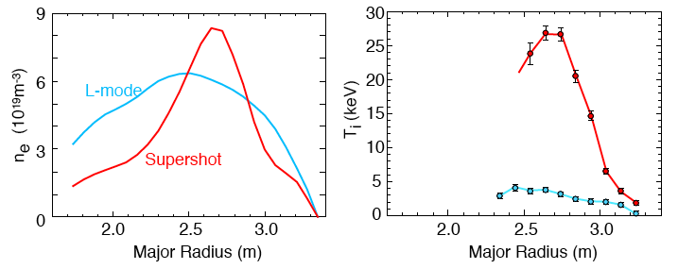
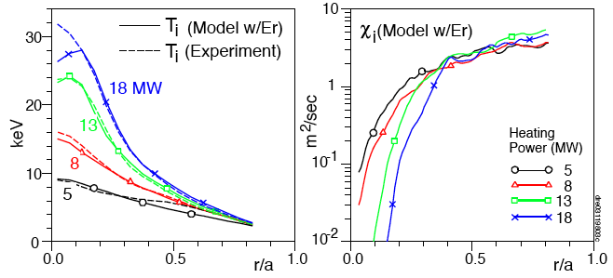
Effects of Wall Conditioning Were
Dramatic in TFTR
Originally used repeated tokamak discharges in helium to deplete the graphite limiter surface of adsorbed hydrogen isotopes ⇒ lower recycling
  With centrally deposited NBI, density profile became peaked
  Ion temperature increased by factor >5 and became very peaked
Injecting lithium into the plasma edge further improved confinement
  Benefits of lithium have since reproduced in tokamaks T-11, NSTX (divertor), EAST and stellarator TJ-II
Theory-based model with ITG turbulence
suppressed by self-consistent flow shear
matches data in supershot power scan
τ_{E}(s): 0.06 → 0.18
n_{e}T_{i}τ_{E}: 0.15 → 4.3
(10²⁰m⁻³keVs )
Model reproduces observed inverse dependence
of ion thermal diffusivity on ion temperature
D. Ernst et al., PRL 81 (1998) 2454

Slide 32
Topics
Tokamak fundamentals
Tokamak stability
Confinement and transport
DT experiments in TFTR and JET
The leap to ITER

Slide 33
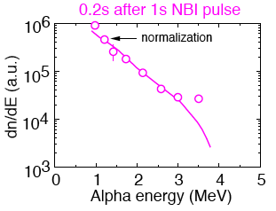
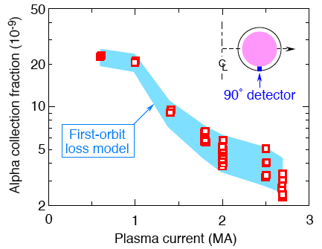
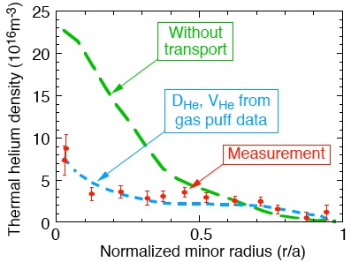
TFTR Measured Confinement and Thermalization of Fusion Alphas in DT Plasmas
Flux of α-particles to detector agrees with calculated loss for unconfined orbits
Confined α-particles show classical slowing- down energy spectrum
Profile of thermalized
α particles matches model for helium puff
Model
Shading shows result from an orbit-following code based on calculated alpha-particle birth and plasma current profiles
At 2.5MA, ~3% of alphas lost on first orbit after birth
Calculated spectrum from Fokker-Planck calculation using measured plasma parameters
Concern was that with central source, α’s might accumulate in core and dilute fuel
In TFTR and JET, the achieved fusion power was modeled quite accurately based on measured plasma parameters and classical ion thermalization
R. Hawryluk et al., PoP 5 (1998) 1577

Slide 34
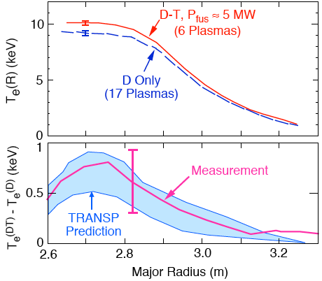
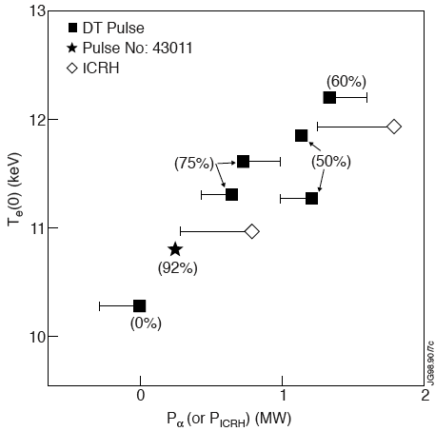
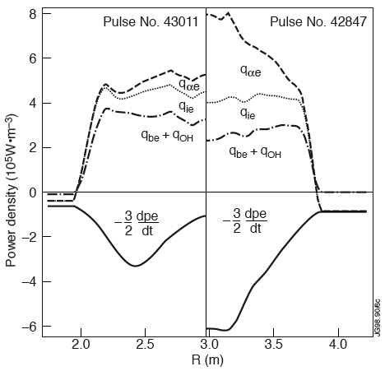
TFTR and Later JET Confirmed
Electron Heating by DT Alpha Particles
DT plasmas in TFTR showed an increase in electron temperature compared to D-only plasmas
With higher Q, JET provided a more definitive demonstration of
α-particle heating
D → DT → T variation
α-heating term
“T-only”
DT
Prediction includes model for isotopic dependence of electron thermal transport
JET experiment also included a comparison discharge in which electrons were heated by energetic ions from ICRH to mimic α-heating
G. Taylor et al., PRL 76 (1996) 2722
P. Thomas et al., PRL 80 (1998) 5548

Slide 35
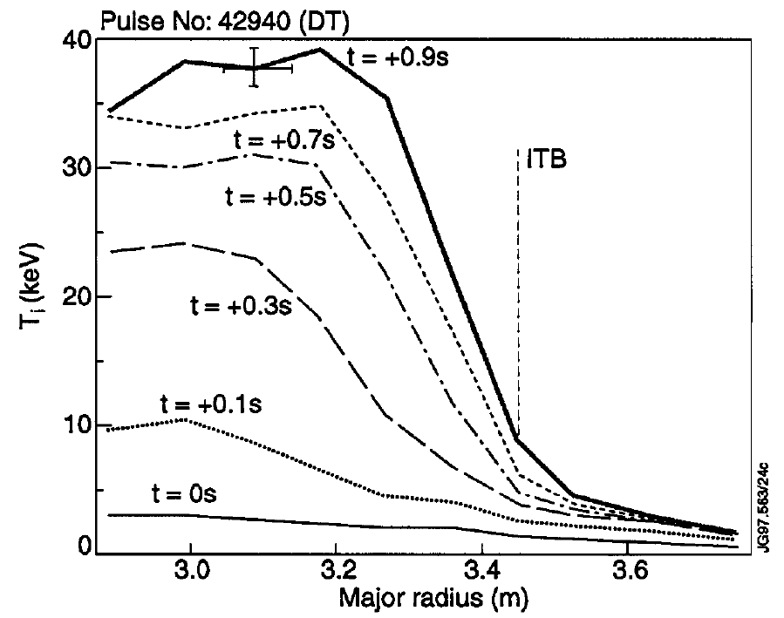
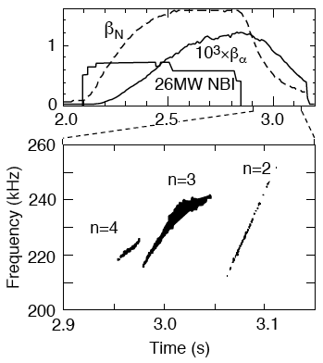
“Advanced Operating Modes”
Also Achieved in DT Plasmas
Both JET and TFTR investigated DT plasmas with q-profile modified to produce q(0) > 1 and low magnetic shear
JET “Hybrid Mode” DT plasma
with Internal Transport Barrier
First observation of α-driven TAE
Mode develops in core when damping by
sub-Alfvén NBI-ions decays
Achieved P_{DT}=8MW, β_{N}=1.9, H=1.5
C. Gormezano et al., PRL (1998)
M. Bell et al., PoP 4 (1997) 1714

Slide 36
Topics
Tokamak fundamentals
Tokamak stability
Confinement and transport
DT experiments in TFTR and JET
The leap to ITER

Slide 37
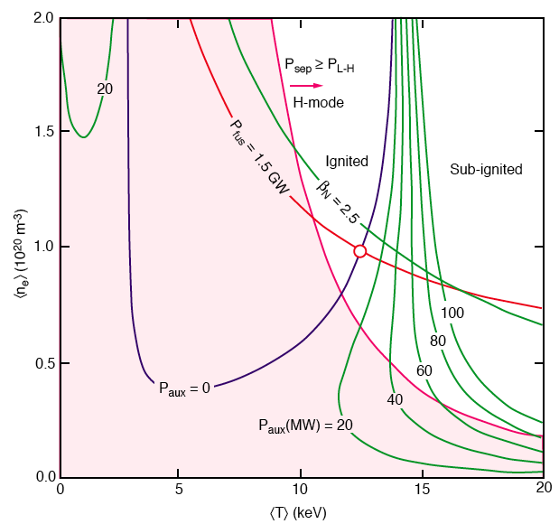
Can Use the Empirical Scaling to Assess Fusion Burn Control and Thermal Stability in ITER
Vary plasma temperature and density to generate Plasma Operation Contours (POpCon)
Sustained fusion ignition (P_{aux}=0) and finite-Q (P_{aux} > 0) are accessible
Need to achieve H-mode
(P_{sep} ≥ P_{L-H}) and stay below the beta limit
Plasma burn will be stable since ITER operates near the stable (right) branch of the ignition curve
  Power loss increases faster than fusion power as temperature rises
Contours depend on I_{p}, B_{T}, scaling of confinement and assumed profile shapes

Slide 38
What New Physics Should We Anticipate in ITER?
ITER requires high energy NBI to penetrate its large plasma
  ~1MeV NBI will dominantly heat electrons (like α-particles)
  JT-60U has demonstrated good performance with 0.4MeV NBI
  Will good confinement in plasmas with T_{i} > T_{e} (hot-ion modes) persist?
  Will TAE activity affect confinement of NB injected ions?
Physics of wave heating (ICRH, ECRH, LHH) is reasonably well understood but there are practical issues
  Coupling power to the plasma is often the limiting factor
  Wave couplers must operate in a more hostile environment
  Large α-particle population may affect wave absorption
Dominant self-heating by fusion α-particles creates challenges, particularly for achieving and maintaining high-confinement modes
  Equilibrated ion & electron temperatures
  Low rotation (reduced momentum input)
  Profiles (n, T, q) become self-organized
All factors involved in
controlling confinement
and MHD stability

Slide 39
Choice of Plasma Facing Materials is Critical
Until recently, most high-power, high-performance tokamaks operated with carbon PFCs in high-heat flux regions
  Carbon is extremely “forgiving” of transient heat loads and low-Z
Carbon retains too much tritium for use in ITER
  Experience in TFTR, JET showed retention of up to 50% of T fuel
ITER planned to use tungsten for its divertor targets during DT
  Other areas would be covered with beryllium tiles (JET experience)
  Concerns about damage to tungsten and tungsten impurities (high-Z)
Several tokamaks are now investigating metal divertor PFCs
  Alcator C-Mod has operated with Mo walls and will soon switch to W
  ASDEX-U has applied W coating on all its graphite PFCs
  JET is now operating with an “ITER-Like Wall”: W divertor, Be elsewhere
Other tokamaks also investigating liquid metals, e.g. lithium in NSTX, for future beyond ITER

Slide 40
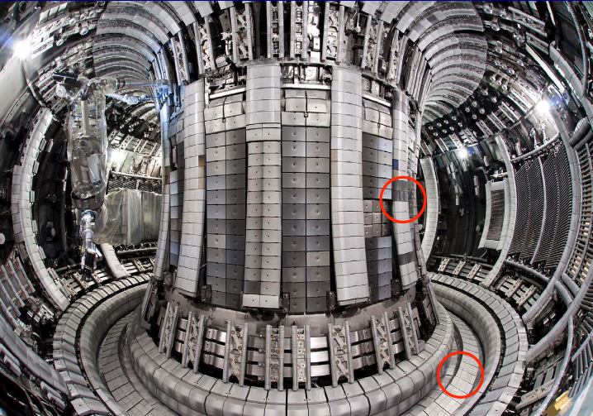
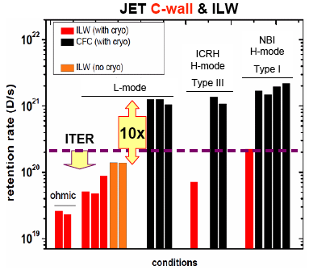
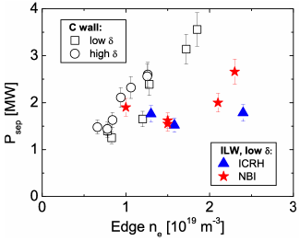
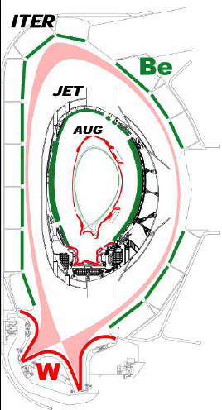
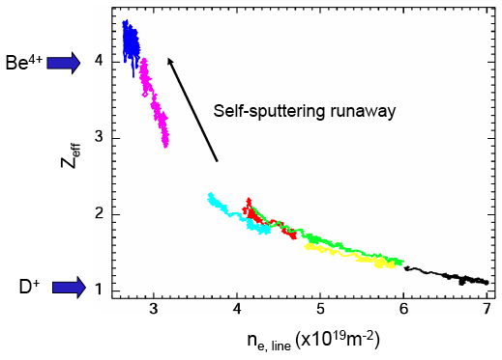
JET has Completed the First Year of Operation With Its ITER-Like Wall (ILW)
Lower D retention
Lower H-mode threshold
Be
W
Low Z_{eff}
Similar results in ASDEX-U
Concerns
higher disruption loads,
narrower window for
good H-mode
G. Matthews, 20 PSI Conf. (May 2012)

Slide 41
After 40 Years,Tokamaks Remain the
Most Successful Confinement Concept
They emerged because they demonstrated better confinement and
They were simpler than stellarators – a few, axisymmetric coils
  Allowed larger devices with auxiliary heating and good diagnostics
We have made great strides in understanding confinement & stability
  Advances in diagnostic techniques allowed much of this progress
We are developing the capability to predict tokamak plasma behavior from first principles: theory → computation → experimental test
Some of the original simplicity of tokamaks has had to be sacrificed to operate them with high power heating and near stability limits
  Many poloidal field coils are needed for plasma shaping and divertors
  They require advanced feedback involving magnets, heating and fueling systems and real-time measurements of many plasma parameter
  Even axisymmetry has been modified for MHD mode (including ELM) control
The first experiments with DT fusion fuel were a resounding success
  We learned how to operate tokamaks in a fusion nuclear environment
  The fusion rates were consistent with our understanding and simulations
  The alpha particles behaved as expected and heated the plasma effectively

Slide 42
Tokamaks are Ready for the “Leap to ITER”
The knowledge we have gained from several generations of tokamaks has given us confidence to proceed to ITER, but ...
There remain unresolved issues in some areas
  Validation of the choice of PFC material
    Alcator C-Mod, ASDEX-U and JET-ILW provide grounds for optimism
  Adequacy of the auxiliary heating systems to achieve the H-mode in order to reach plasma self-heating
  Adequacy of the schemes proposed for ELM control
  Ability to eliminate damaging disruptions reliably
The ultimate success of ITER still depends on research underway now in many tokamaks
  We cannot rely on just one experiment to answer critical questions
Existing tokamaks also need to train the next generation of physicists and engineers who will operate ITER

