Slide 1
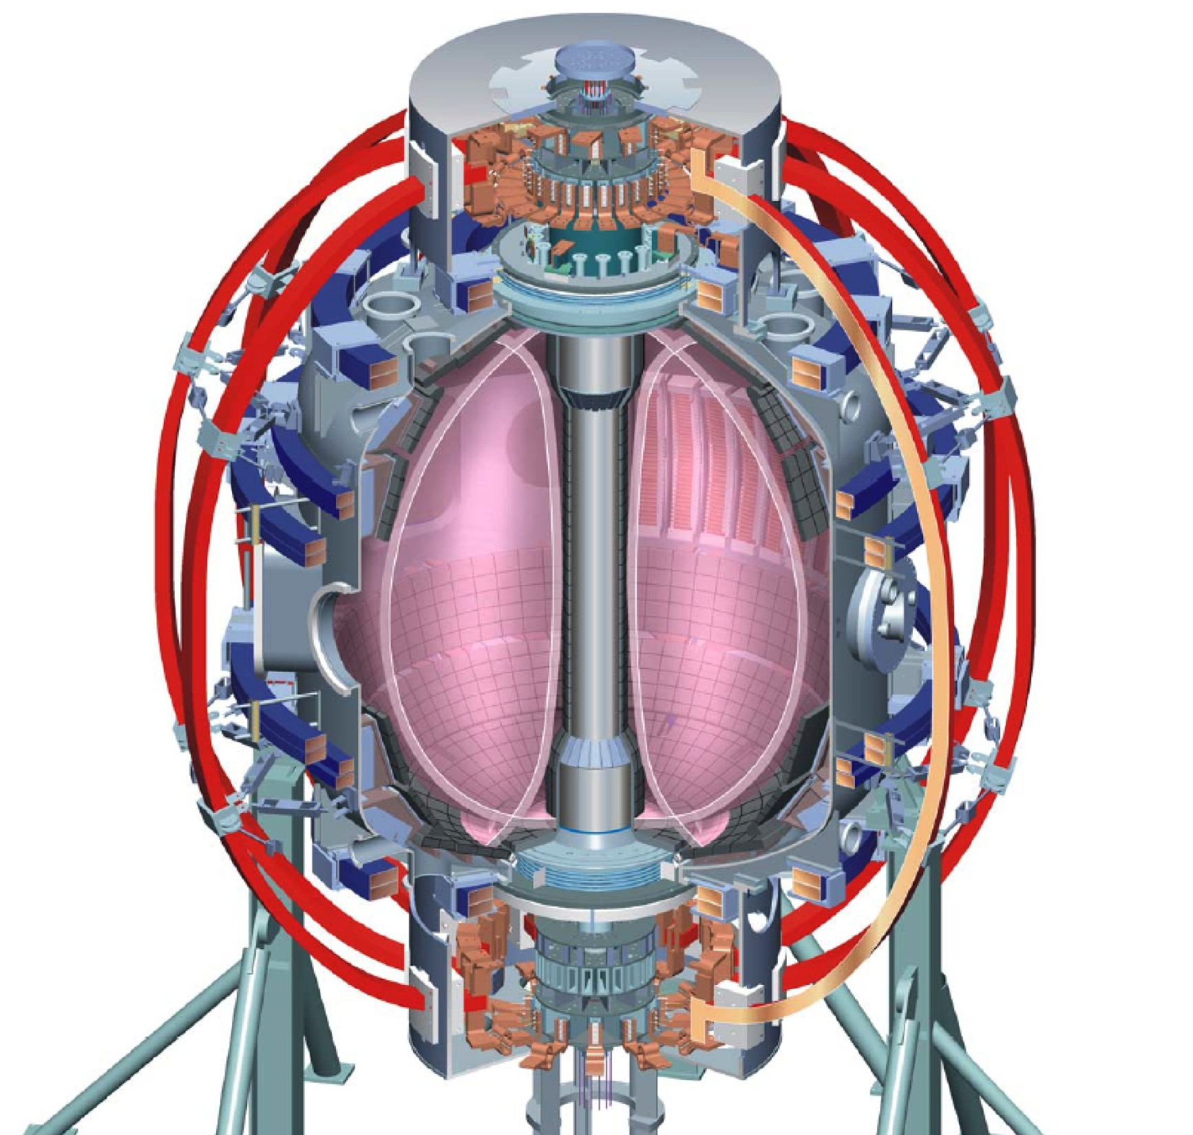
Spherical Tokamaks:
Achievements and Prospects
Michael Bell
former Head of NSTX Experimental Research Operations
Princeton Plasma Physics Laboratory
Princeton University
presented to the
Joint ICTP-IAEA College on Plasma Physics
International Center for Theoretical Physics, Trieste
October 2012

Slide 2
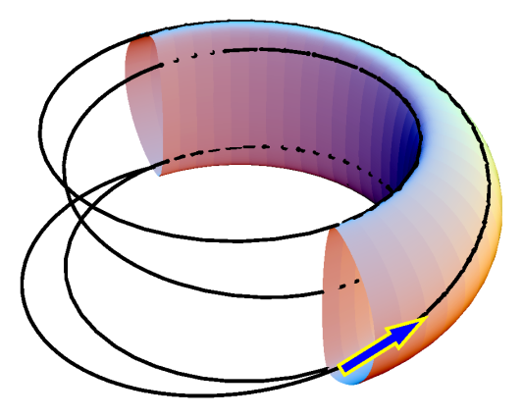
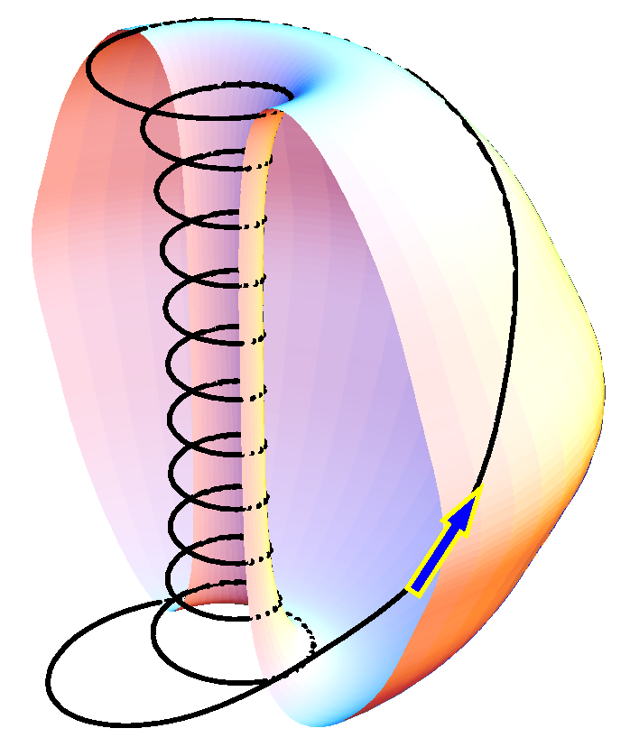
“Spherical Torus” (ST) Pushes the Tokamak to
Extreme Toroidicity
Motivated by potential for increased β [Peng & Strickler, 1980s]
β_{max} (= 2μ₀⟨p⟩/B_{T}²) = C·I_{p}/aB_{T} ∝ C·κ/Aq
B_{T}: toroidal magnetic field on axis;
⟨p⟩: average plasma pressure;
I_{p}: plasma current;
a: minor radius;
κ: elongation of cross-section;
A: aspect ratio (= R/a);
q: MHD “safety factor” (> 2)
C: Constant ~3%·m·T/MA
[Troyon, Sykes - early 1980s]
Confirmed by experiments
  β_{max} ≈ 40%
    [START (UK) 1990s]
Conventional
Tokamak
A ≈ 3, q_{a} = 4
Field
lines
Spherical Torus
A ≈ 1.3, q_{a} = 12
Y-K.M.. Peng et al., NF 26 (1986) 769;
F. Troyon, et al., PPCF 26, 209 (1984); A. Sykes et al. NF 39 (1997) B247

Slide 3
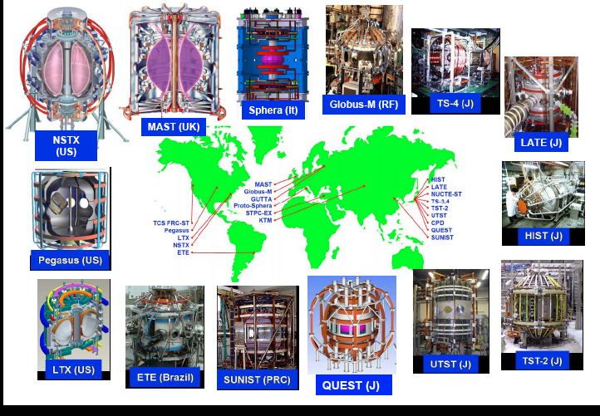
Growing Number of STs Now Operating
Around the World

Slide 4
Spherical Torus Complements and Extends Conventional Aspect-ratio Tokamaks
High β: β_{T} up to 40%; on axis β ~ 1
Extreme cross-section shaping: elongation κ > 2, B_{P}/B_{T} ~ 1
Large fraction of trapped particles: ∼ √ε (ε = r/R)
Large gyro-radius compared to system size: ρ_{i}/a ~ 0.02 – 0.03
Large bootstrap current: I_{Bootstrap} / I_{tot} ~ √εβ_{P} > 50%
  Affects long-term stability of high-beta plasmas
Large plasma flow & flow shear: Mach number M ~ 0.5
  Expect strong effect on ion turbulence
Large population of supra-Alfvénic fast ions: v_{NBI}/v_{A} ~ 4
  Mimics alpha-particle population in a burning plasma
High plasma density at low magnetic field affects electromagnetic waves used for plasma heating

Slide 5
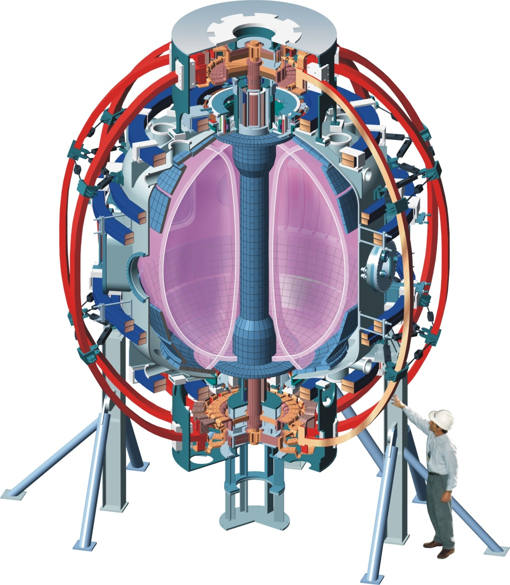
NSTX at PPPL Designed to Study High-Temperature Toroidal Plasmas at Low Aspect-Ratio
Center column with
TF, OH conductors
Conducting plates
for MHD stabilization
Aspect ratio A 1.27
Elongation κ 2.7
Triangularity δ 0.8
Major radius R₀ 0.85m
Plasma Current I_{p} 1.5MA
Toroidal Field B_{T0} 0.6 T
Pulse Length 1.7s
Auxiliary heating:
NBI (100kV) 7 MW
RF (30MHz) 6 MW
Central temperature 1 – 3 keV

Slide 6
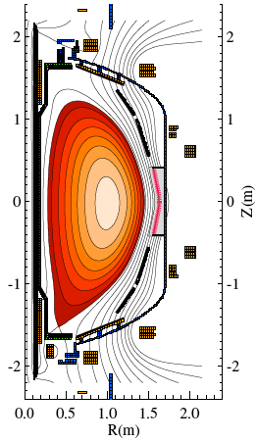
NSTX Confirmed Capability of ST for High-β in Well-Diagnosed Plasmas
2
I
t
,
I
p
[MA]
T
i
,
T
e
[keV]
0.55s
0.55s
1
112600
1
0
5
P
NBI
[MW]
0
H
α
[arb]
0.3
W
EFIT
,
W
TRANSP
[MJ]
0
0
n
e
[10
20
m
-3
]
40
β
T,EFIT
,
β
T,TRANSP
[%]
200
0.5
20
v
i
[km/s]
0
100
n
e
(0)
,
<n
e
>
[10
20
m
-3
]
0.5
0.0
0
0.5
1.0
1.5
0
1
T
i
(0)
,
T
e
(0)
[keV]
R (m)
β_{T} (= 2μ₀⟨p⟩/B_{T0}²) = 38% from
magnetic analysis, 34% kinetic
Achieving high-β facilitated by
broad pressure profile in H-mode
0
0.0
0.1
0.2
0.3
0.4
0.5
0.6
Time (s)
H-mode
J. Menard, et al., Nucl. Fusion 45 (2005) 539

Slide 7
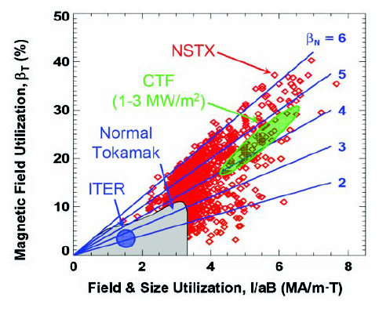
ST Significantly Exceeds
Conventional Tokamak Stability Boundaries
Demonstrates benefits of
  Low aspect ratio and
  cross-section shaping
  Stabilization of MHD modes by nearby conducting plates
  Active feedback suppression of MHD instabilities
* CTF: Operating regime of a possible ST-based fusion “Component Test Facility”
*
β_{T} = 2µ₀<p>/B_{T0}² (%)
Normalized current I_{p}/a·B_{T} (MA/m·T)
Data courtesy S. Sabbagh et al.

Slide 8
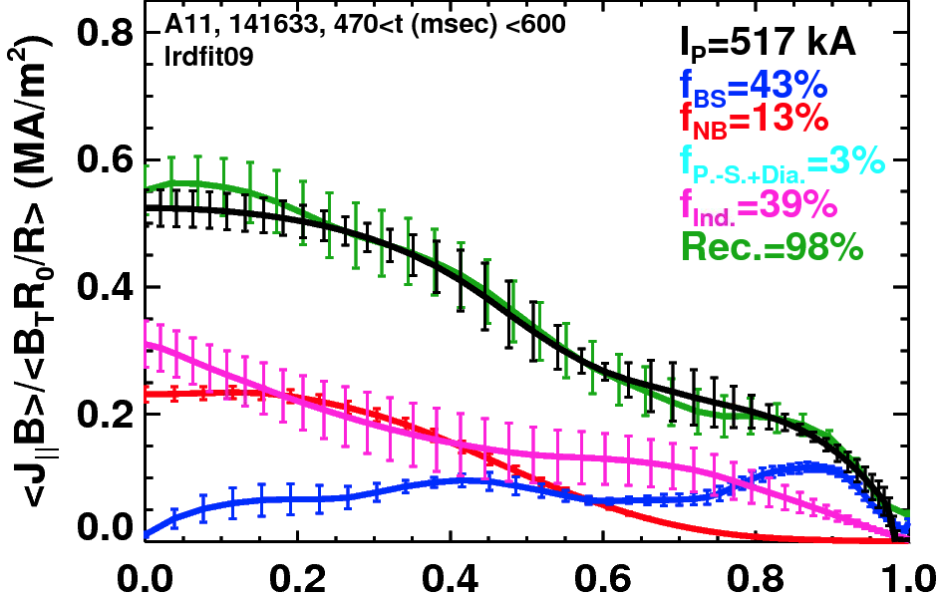
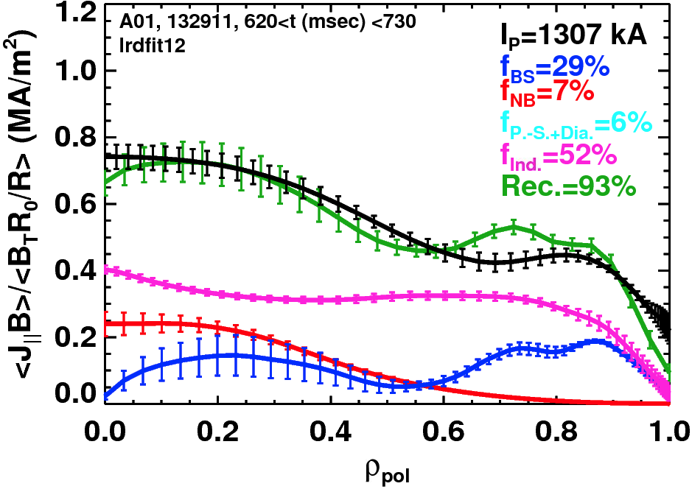
NSTX Achieved Non-Inductively Sustained Current Fraction up to 70% in Quiescent High-β Discharges
Sustained β_{P}=2
500 kA
Compare
  Solutions of G-S equation for J(r) with MSE constraint
with
  Modeled evolution of total current with neoclassical resistivity, including
  Inductive Currents
  Beam-Driven current
  Pressure Driven: Bootstrap + Diamagnetic and Pfirsch-Schlüter
Observe good agreement when
low-frequency MHD activity is absent
  Assume classical beam ion diffusion
  Data consistent with fast-ion radial diffusivity D_{FI} < 1.5 m²/s
High-W_{MHD}
1300 kA
S. Gerhardt et al., NF 51 (2011) 073031
Notes:
8

Slide 9
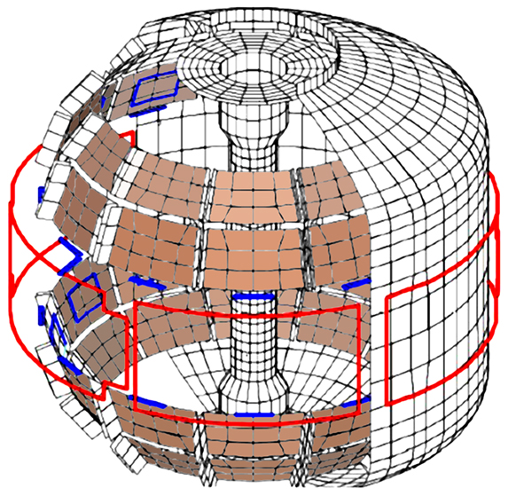
NSTX is Equipped with Non-Axisymmetric Coils to Control MHD Instabilities at High-β
Stabilizing plates (48 graphite-covered copper plates)
48 Internal
Sensors for
B_{R}, B_{P}
6 External 2-Turn Rectangular
Control Coils powered by
Switching Power Amplifiers
(3.5kHz, 1kA)
Conducting plates stabilize ideal modes when β_{N} exceeds “no-wall” limit
Due to finite plate conductivity, plasma can develop “Resistive Wall Mode” (RWM) on timescale for resistive decay of currents in stabilizing plates
Plasma toroidal rotation profiles affect passive stability to RWMs
Can suppress RWM growth by active feedback with non-axisymmetric coils based on real-time mode detection by internal sensors
  NSTX coils generate radial field with toroidal harmonic components n = 1, 2 & 3

Slide 10
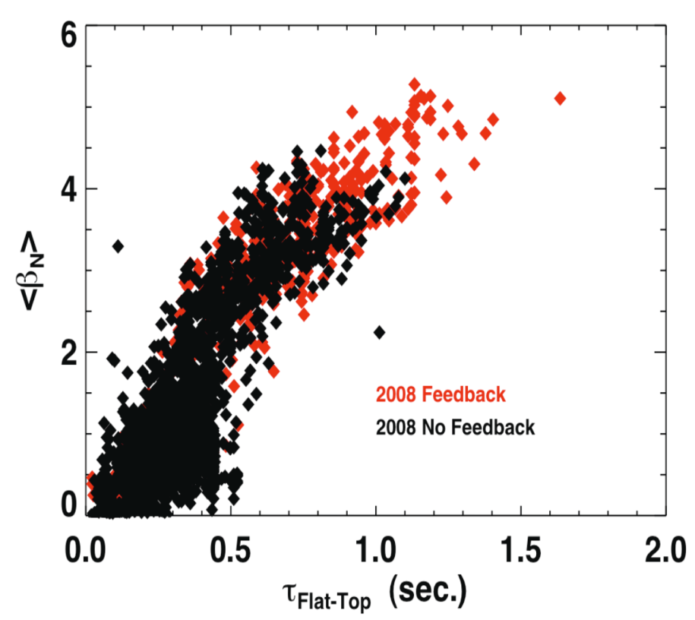
Correction of n = 3 Error Field Plus Feedback Control of n = 1 Mode Extends High-β_{N} Plasmas
Without feedback
With feedback
5
β_{N} (%.m.T/MA)
β_{N} exceeds
no-wall limit
129283
129067
0
0.5
I_{EFC1} (kA)
n=3
0
n=3 + n=1
2008 data set
Without feedback
With n=1 feedback
15
Toroidal rotation frequency (kHz)
R = 1.323m
10
5
0
0
0.5
1.0
Time (s)
Correction of n = 3 intrinsic error field maintains toroidal rotation
Resistive Wall Mode (RWM) grows and eventually terminates discharge when normalized-β exceeds limit for plasma without conducting wall
Application of n = 1 feedback extends high-β_{N} duration
S. Sabbagh et al., NF 50 (2010) 025020; D. Gates et al., NF 49 (2008) 104016

Slide 11

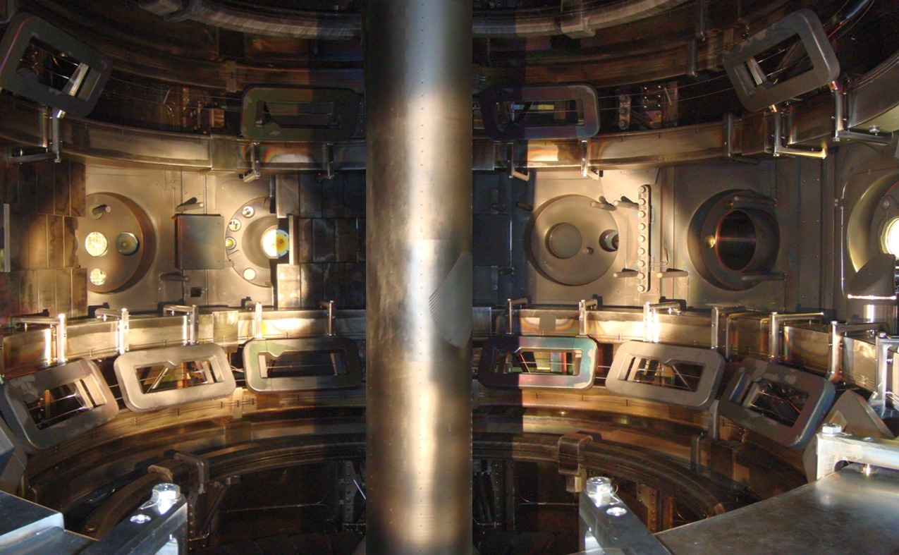
MAST Is Equipped with Very Flexible Set of
18 Resonant Magnetic Perturbation (RMP) Coils
MAST
6 in upper row
12 in lower row
Apply perturbations with toroidal harmonic up to n = 6
  Spatial decomposition contains multiple poloidal (m) components
Coils can be used both for control of “global” instabilities (e.g. kink-like modes) and modes localized to the plasma edge
MAST data courtesy of B. Lloyd and the MAST group, CCFE, UK

Slide 12
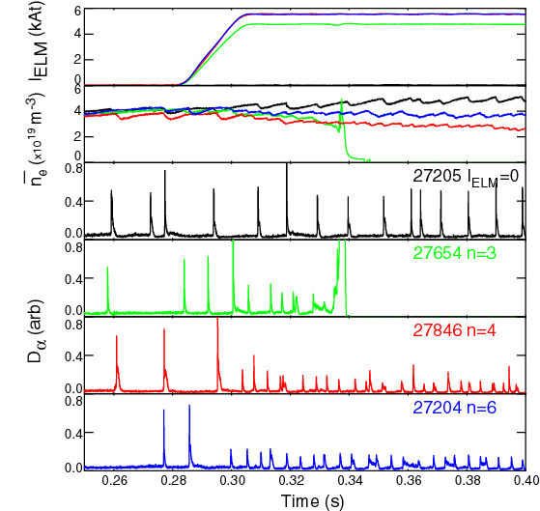
MAST Is Investigating Effect of RMPs on
Edge Localized Modes in H-mode
MAST
n = 3 produces disruption
n = 4 and n = 6 produce
ELM mitigation
  up to a factor of 5 increase in ELM frequency
  similar reduction in ΔW_{ELM}
  Edge pressure gradient is reduced by RMP
Observe stronger braking of rotation as n = 6 → 4 → 3
RMPs have not completely suppressed ELMs in MAST
  Suppression achieved in conventional tokamaks
  under some conditions
Courtesy of I. Chapman and MAST group, CCFE, UK

Slide 13
Reducing Heat Flux on the Divertor
Critical for the Success of the ST
Power flux scaling parameter: P_{SOL}/(R_{SP}δ_{SOL})
    P_{SOL}: scrape-off layer power
    R_{SP}: major radius of divertor “strike-point” (separatrix intersects divertor)
    δ_{SOL}: cross-field width of the scrape-off layer in divertor
  Intrinsically high in the ST due to high power and small size
  δ_{SOL} scales roughly as ~ I_{p}⁻¹ in both STs and conventional tokamaks
Can address problem through all three factors
  Reduce P_{SOL} by radiation both from core plasma and locally in divertor
  Maximize δ_{SOL} by changing magnetic geometry of the divertor
  Increase R_{SP} by leading outer leg of the separatrix to larger major radius
Ultimately a combination of techniques plus the development of resilient divertor materials will probably be needed
  Divertor surface may need to be “self healing” (e.g. liquid metals) to survive off-normal transient events

Slide 14
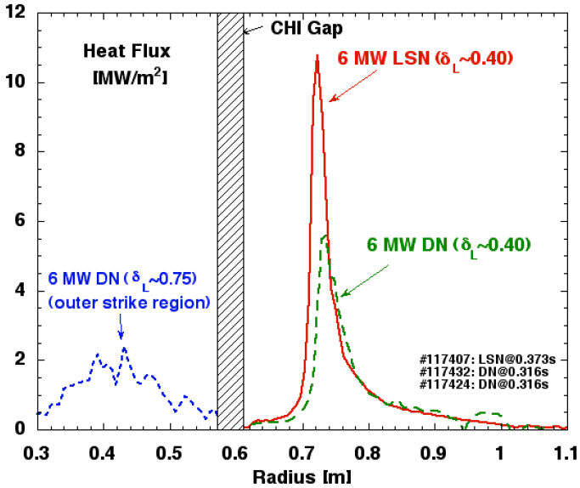
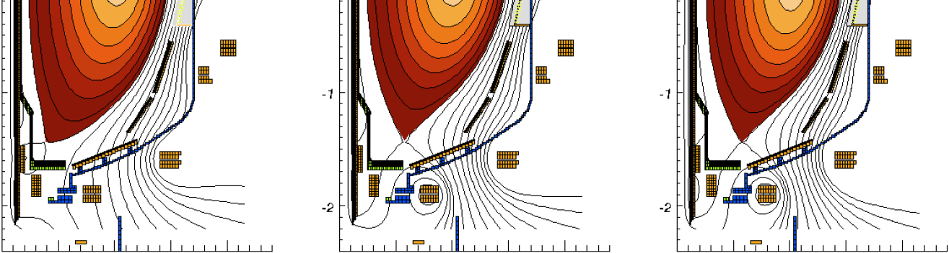
Plasma Shaping Reduces Peak Divertor
Heat Flux in NSTX
Compare configurations with
different triangularity at X-point δ_{X}
  lower single-null (LSN), δ_{X} ≈ 0.4
  double-null (DN), δ_{X} ≈ 0.4
  high triangularity DN δ_{X} ≈ 0.75
Flux expansion reduces heat flux
1 : 0.5 : 0.2
ELMs: Type I → Mixed → Type V
(large) (small)
Measure heat flux to divertor with IR thermography of carbon tiles
R. Maingi, J. Nucl. Mat. 313-316 (2003) 1005

Slide 15
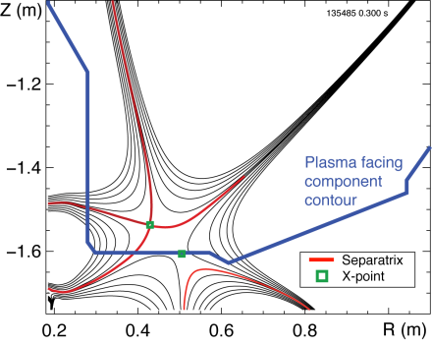
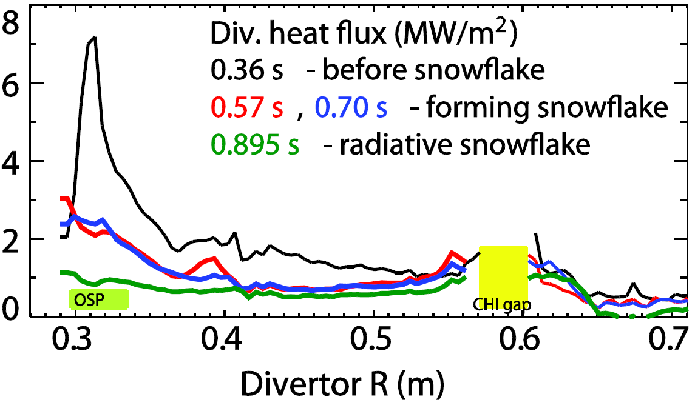
“Snowflake” Divertor Produced Significant
Heat Flux Mitigation in NSTX
Energize additional PF coils in the divertor to create a hexapole field null
  Single divertor coil produces a quadrupole field null
Snowflake divertor experiments with P_{NBI}=4 MW, P_{SOL}=3 MW
  Kept good H-mode confinement
  Peak divertor heat flux reduced from 3 – 7 to 0.5 – 1 MW/m²
  Due to combination of snowflake divertor configuration and outer
  strike-point “detachment” as divertor radiation rises
OSP
Divertor heat flux (MW/m²)
V. Soukhanovskii et al., PoP 19 (2012) 082504

Slide 16
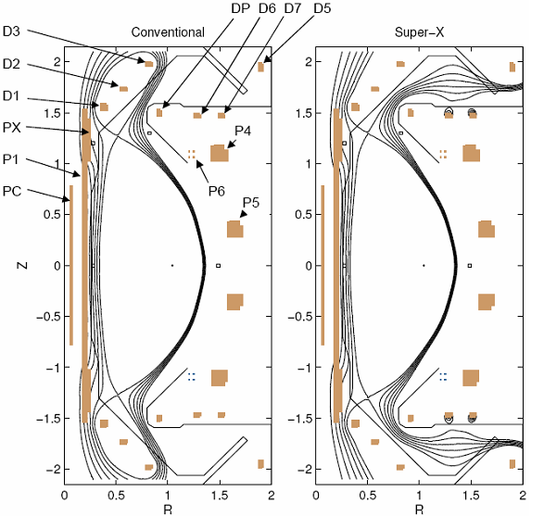
MAST Will Install Additional Internal PF Coils to Produce an Extended or “Super-X” Divertor
MAST
Conventional
Super-X
Simulation of plasma in Super-X divertor
Super-X divertor
Conventional
Increase in strike-point radius
R (m)
Physics to be studied:
  reducing divertor heat loads by radiation and spreading strike zone
  impact on H-mode access, structure of pedestal and ELMs
  turbulence and transport in SOL
  impurity migration and effects on radiation in core and divertor
  propagation and effects of non-axisymmetric phenomena from core
Courtesy of J. Milnes, W. Morris and MAST group, CCFE, UK
P. Valanju, PoP 16 (2009) 056110

Slide 17
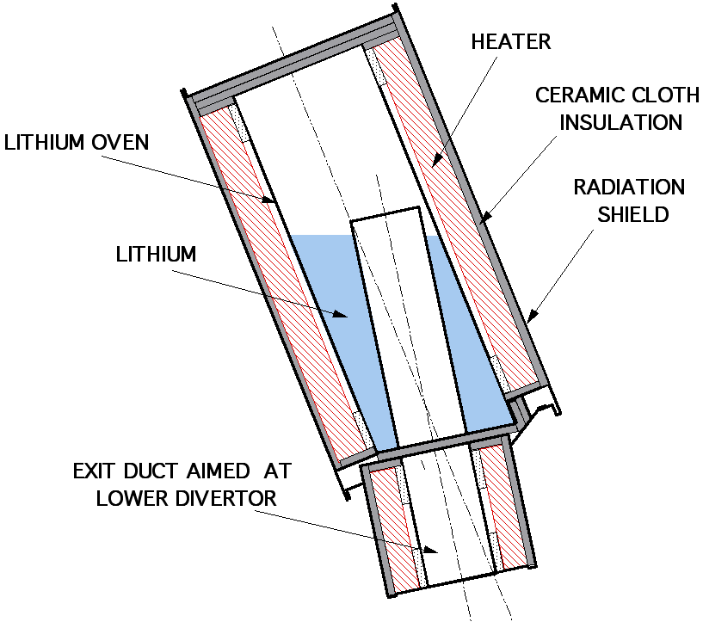
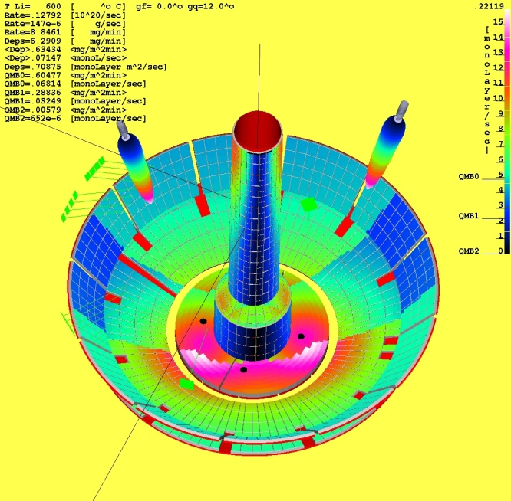
NSTX Has Explored Use of Lithium Coating on Plasma Facing Components (PFCs)
Started with lithium pellet injection: applied 5 - 25mg
Developed dual lithium evaporators (LITERs) to coat lower divertor
Evaporate 1 – 80 mg/min with lithium reservoirs at 520 – 630°C for
7 – 15 min between discharges
Shutters interrupt lithium deposition during discharges
Withdrawn behind airlocks for reloading with lithium
Modeled deposition pattern
LITERs
LITER Canisters
ROTATABLE
SHUTTER
H. Kugel et al., Fus Eng. Des. 85 (2010) 865

Slide 18
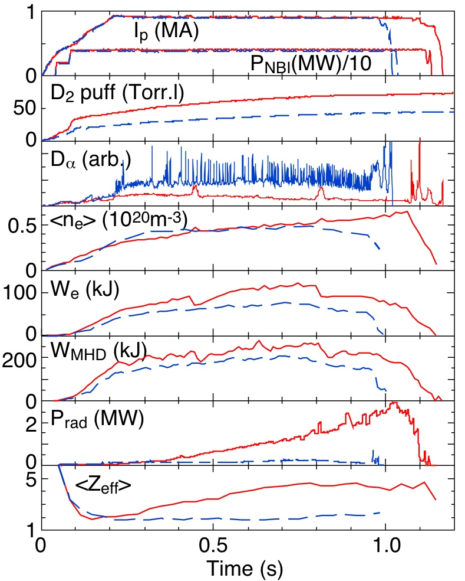
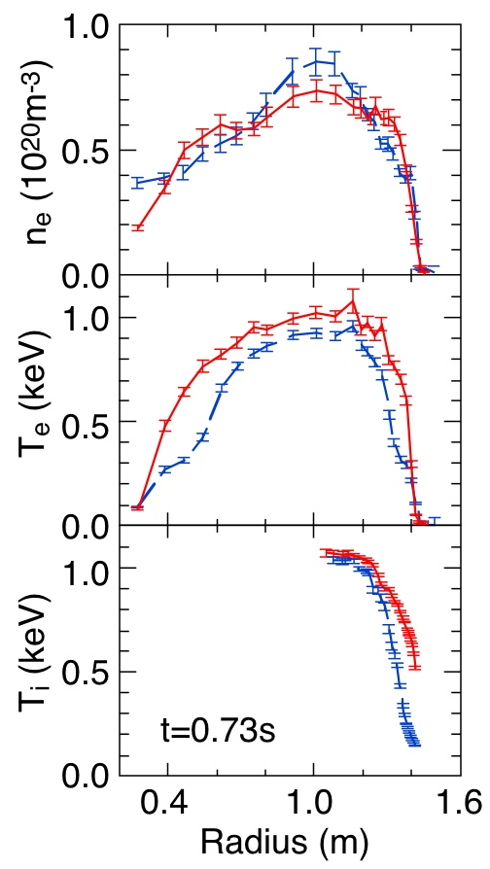
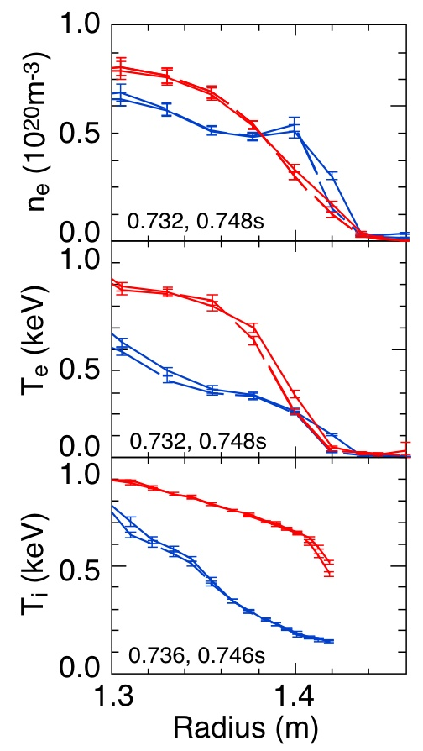
Lithium Coating Reduces Deuterium Recycling, Suppresses ELMs, Improves Confinement
No lithium (129239); 260mg lithium (129245)
Without ELMs, impurity accumulation
increases radiated power and Z_{eff}
Without ELMs, impurity accumulation
increases radiated power and Z_{eff}
M.G. Bell et al., PPCF 51 (2009) 124054

Slide 19
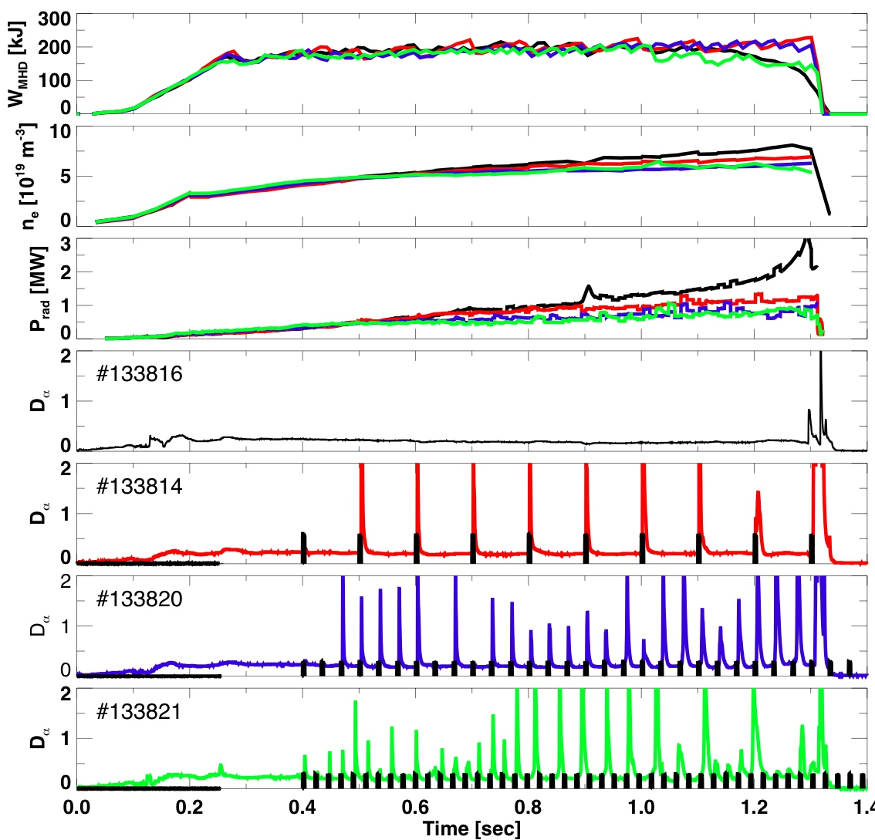
External Non-Axisymmetric Coils Can Induce
Repetitive ELMs in Discharges with Lithium Coating
κ=2.4, δ=0.8, 0.8MA, 0.45T, NBI 4 MW
Applied n = 3 resonant radial field perturbations with NSTX RMP coils
Induced ELMs reduce n_{e}, P_{rad}, Z_{eff} with small effect on plasma energy
No perturbation
I_{coil1}
10 Hz
30 Hz
50 Hz
J. Canik et al., NF 50 (2010) 064016

Slide 20
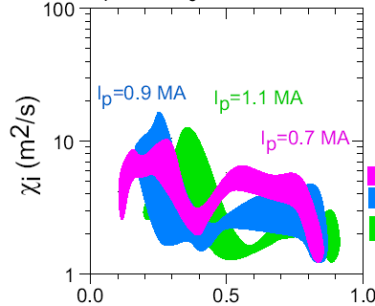
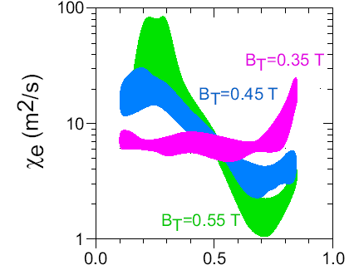
STs Provide New Opportunities to Study Physics of Toroidal Transport Processes
Operate in unique regions of dimensionless parameters
  Normalized gyro-radius ρ∗, normalized collisionality ν∗
  Range of β spans electrostatic to electromagnetic turbulence
Analysis of NSTX data demonstrated that ion transport was close to neoclassical and that electron transport determined core confinement
  Suppression of ion turbulent transport at low B had been postulated
Ion thermal diffusivity
Electron thermal diffusivity
Neoclassical calculation (GTC-NEO code)
including finite banana width
χ_{i} (r/a=0.5-0.8) ∝ I_{p}⁻¹
r/a
r/a
Dependence of electron transport on B-field was a surprise
Low B ⇒ electron gyro-scale turbulence should be measurable (ρ_{e} ~ 0.1 mm)
S. Kaye et al., NF 46 (2006) 848

Slide 21
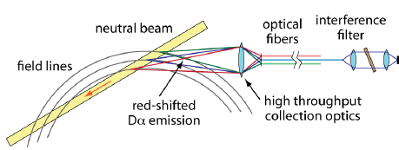
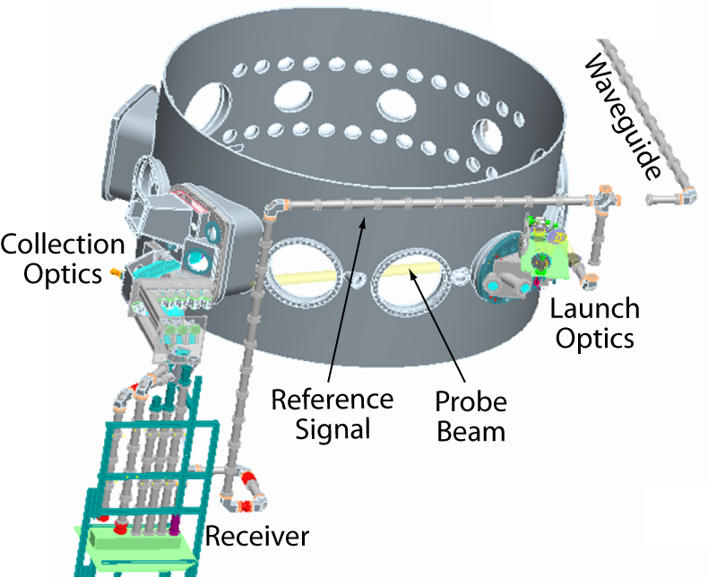
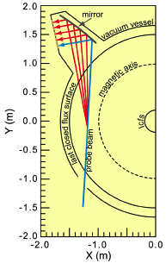
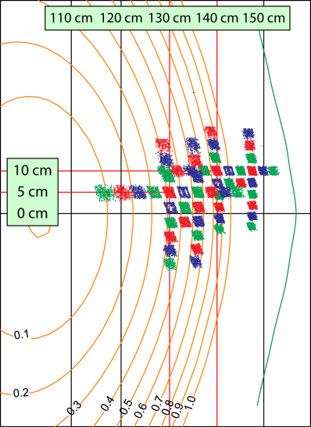
NSTX Equipped with Diagnostics to
Measure Turbulent Density Fluctuations
~
~
Density fluctuations ⇒ potential fluctuations ⇒ v = E × B/B² ⇒ transport
Probe density fluctuation structures perpendicular to B-field; k⊥ ≠ 0
  Structures are extended along B-field: k|| ≈ 0
Beam Emission Spectroscopy
Detect fluctuations in Doppler-shifted D_{α} line from excited beam neutrals
High-k Microwave Scattering
Detect radiation scattered from collimated
280GHz (~1mm) microwave beam
For fluctuations with wavevector k_{P}, frequency ω_{P}
k_{S} = k₀ + k_{P} and ω_{S} = ω₀ ± ω_{P}
D. Smith et al., RSI 81 (2010) 10D717

Slide 22
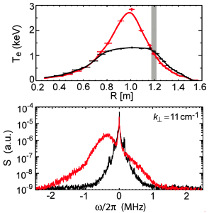
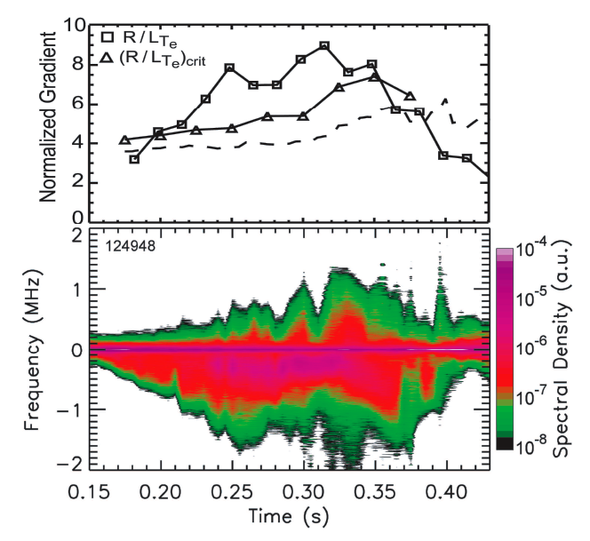
Heating Electrons with ICRF Power Drives
Short-Wavelength Turbulence in Plasma Core
During RF
After RF
Measured R/L_{Te}
GS2 critical R/L_{Te}
Jenko, Dorland critical R/L_{Te}
Scattered power
Detected fluctuations in range k⊥ρ_{e} = 0.1 – 0.4 (k⊥ρ_{s} = 8 – 16) propagate in electron diamagnetic drift direction
  Rules out Ion Temperature Gradient mode (k⊥ρ_{s} ~ 1) as source of turbulence
  Reasonable agreement with linear gyrokinetic code (GS2) in threshold for destabilization of Electron Temperature Gradient (ETG) modes
Measured R/L_{Te} does exceed threshold ⇒ ETG-induced transport is not “stiff”
E. Mazzucato et al., NF 49 (2009) 055001

Slide 23
Reduction in High-k Turbulence Consistent With Reduced Electron Heat Transport in Outer Plasma
Compare discharges with and without lithium applied
  Discharges with lithium have higher global confinement
Fluctuation spectra measured with microwave scattering
Measured density fluctuation vs. k⊥ρ_{s}
χ_{e} profile (TRANSP)
10⁻⁷
Without Li
R = 1.40 – 1.46 m
(r/a = 0.74 – 0.95)
Fluctuation
measurements
10⁻⁸
Without Li
Fluctuation level (δn/n)² (rel)
Electron thermal diffusivity (m²/s)
10⁻⁹
With Li
141314
141328
141314
141328
With Li
10⁻¹⁰
5
10
k⊥ρ_{s}
20
Normalized minor radius
ρ_{s} = ion sound-speed gyro-radius = √[γm_{i}(kT_{e})/Z_{i}]/eB
Y. Ren et al., PoP 19 (2012) 056125

Slide 24
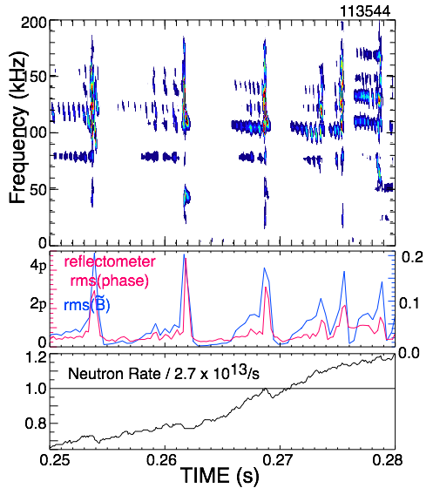
NSTX Accesses Fast-Ion Phase-Space Regime
Overlapping With and Extending Beyond ITER
Energetic ions from NBI heating in NSTX mimic alpha-particles in ITER
Energetic ions interact with Alfvén waves and excite toroidal eigenmodes
When many modes grow they can form an “avalanche instability” which modifies the particle orbits and can eject some ions
Frequency spectra of magnetic fluctuations
Density of fast ions 30–65 keV measured spectroscopically
Avalanche
M. Podestå et al., PoP 16 (2009) 056104

Slide 25
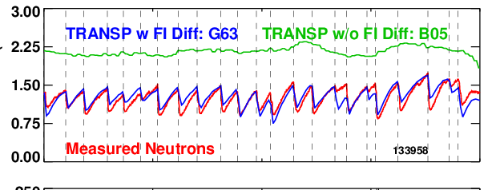
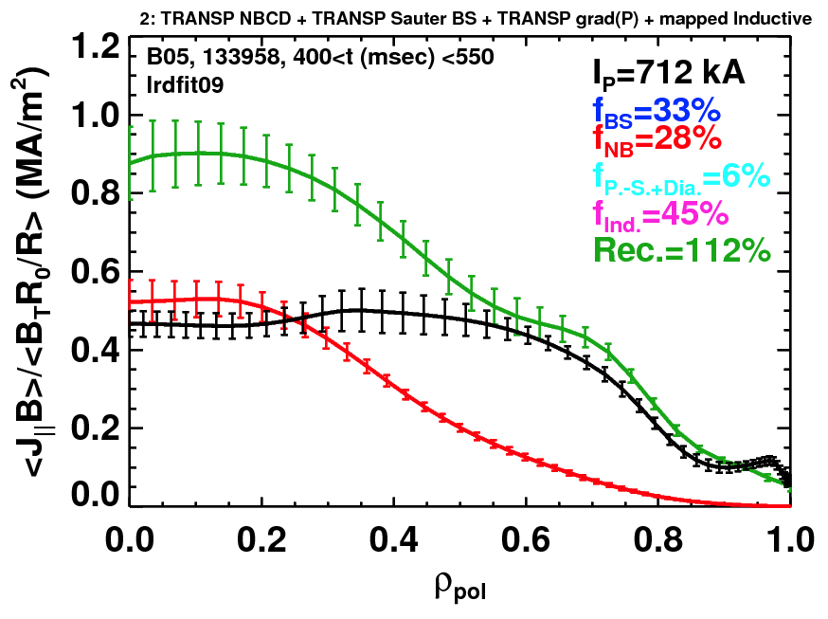
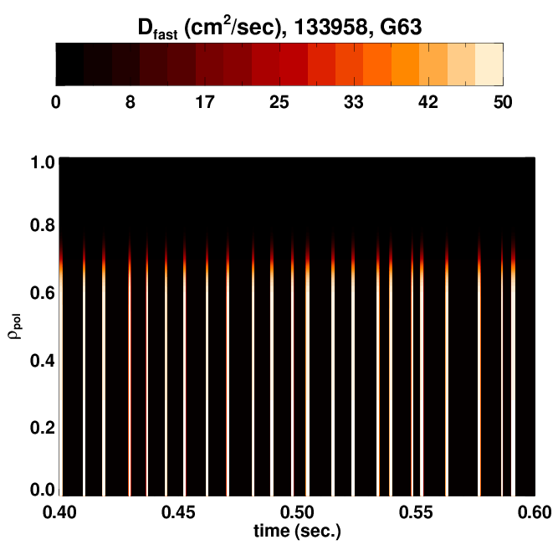
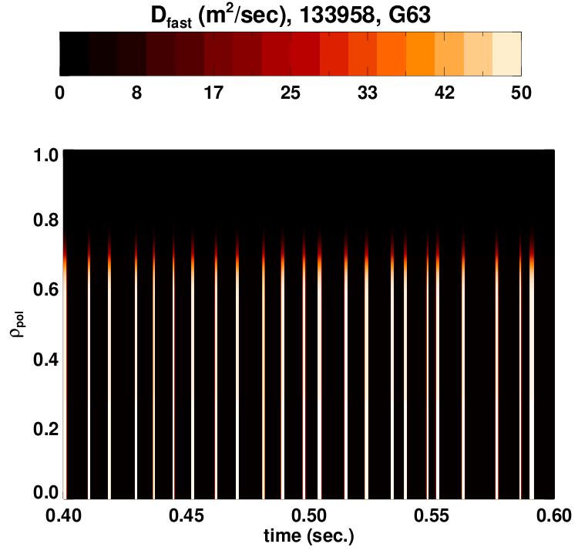
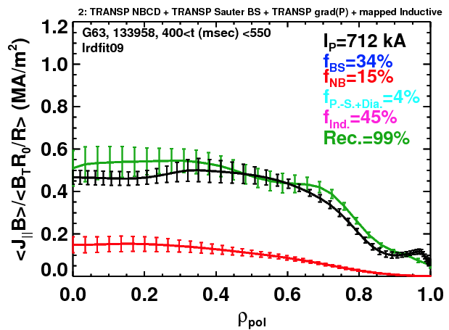
TAE Avalanches Lead to Broadening of the
Beam Driven Current Profile
All (Neo)classical physics.
Neutrons
Discrepancy between reconstruction and total due to large classical J_{NBCD}.
With Impulsive D_{FI}.
Reduced J_{NBCD} eliminates discrepancy between reconstruction and total.
Repetitive bursts in 20 – 100 kHz range
Model using spatially and temporally localized fast-ion diffusivity D_{FI}(ψ,t)
  Use DD neutron dynamics to determine D_{FI}
  Modeled current profile then matches that inferred from magnetic data
S. Gerhardt et al., NF 51 (2011) 033004

Slide 26
Generating and Sustaining the Toroidal Plasma Current in the ST
There is very little room for a central solenoid winding in the ST
  Flux swing scales with the square of solenoid radius
  Protecting the insulation from neutron damage would be very challenging
  Schemes have been proposed to use iron cores or removable solenoids
The bootstrap current can provide a large fraction of the toroidal plasma current in the ST
  Scales as √εβ_{P}
High-energy NBI can also drive significant current
  Requires an initial toroidal current ~1MA to confine the ions
However, techniques are needed to initiate current and to control its profile to maintain optimum MHD stability
We will now discuss methods being investigated in NSTX and MAST
  Many other STs are also actively exploring current drive schemes

Slide 27
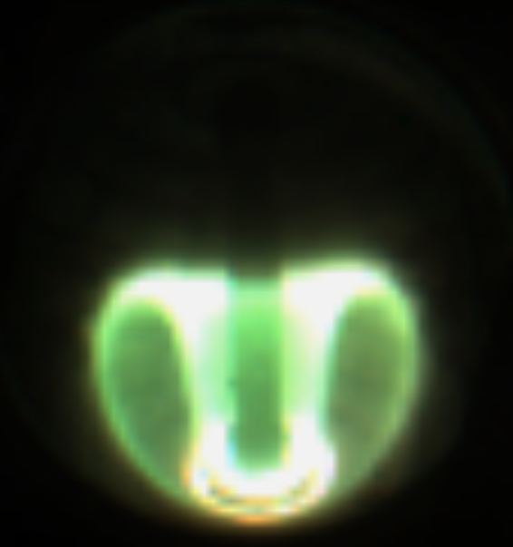
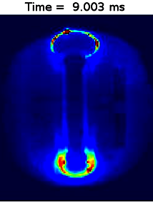
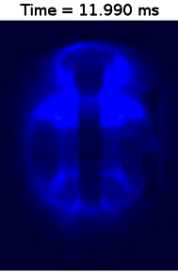
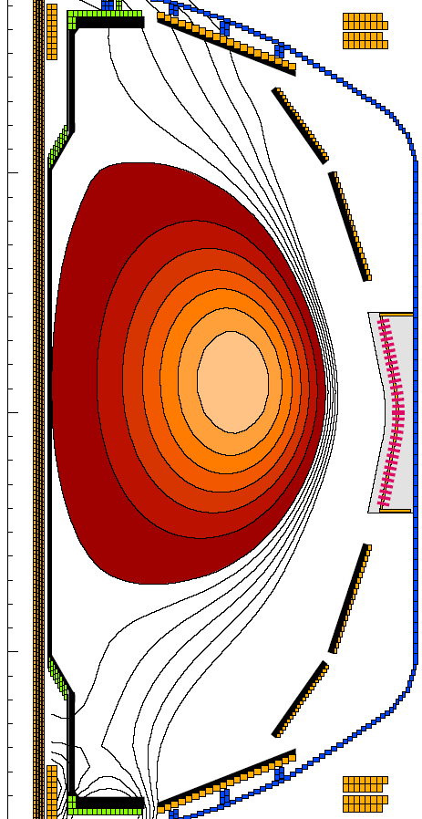
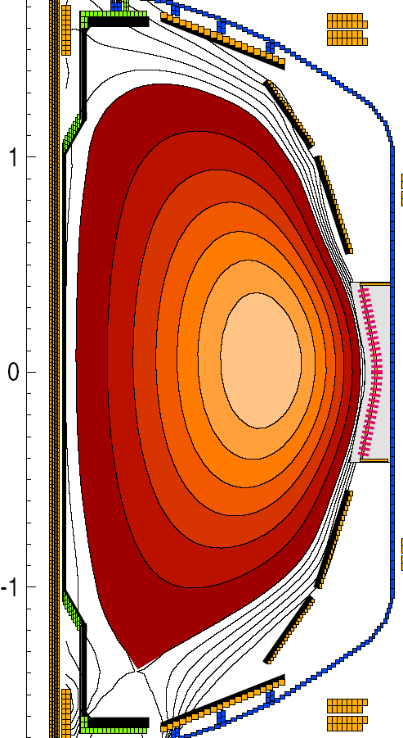
NSTX Developing Coaxial Helicity Injection (CHI) for Non-Inductive Initiation of Toroidal Plasma Current
Initial growth
250
200
I_{tor}
150
kA
100
20:1
50
I_{inj}
0
5
10
15
Detachment
Time (ms)
Decay
After I_{CHI}→0, toroidal plasma current flows on closed flux surfaces
Without additional heating and current drive, current decays resistively
R. Raman et al., NF 49 (2009) 055014

Slide 28
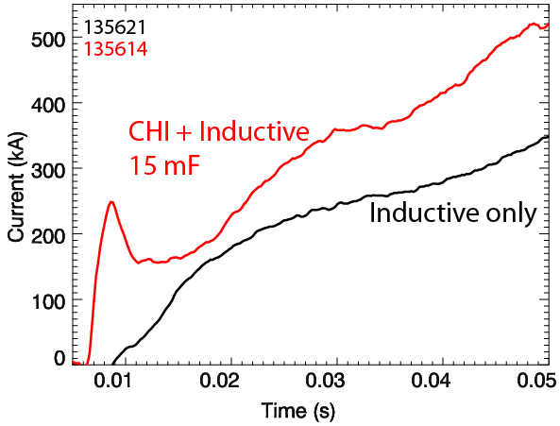
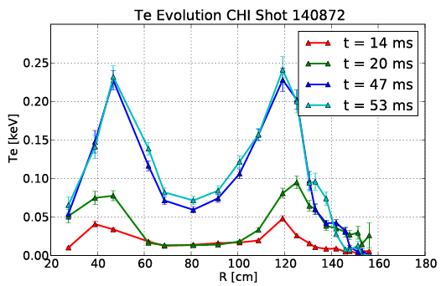
CHI Produced Substantial Increases in Plasma Current for Same Applied Inductive Flux
200 kA more current with CHI start-up
Lithium coating of lower divertor (electrodes) improved CHI initiation
  Reduced radiation by carbon and oxygen impurities
Discharges compared had same waveform of solenoid current
Reached 1MA using 40% less flux than induction-only case
  Hollow T_{e} maintained during current ramp following CHI
  Higher average T_{e} reduced resistive flux consumption
  Low normalized internal inductance l_{i} ≈ 0.35
  Aids achieving high elongation
Electron temperature profile after CHI
B. Nelson et al., NF 51 (2011) 063008

Slide 29
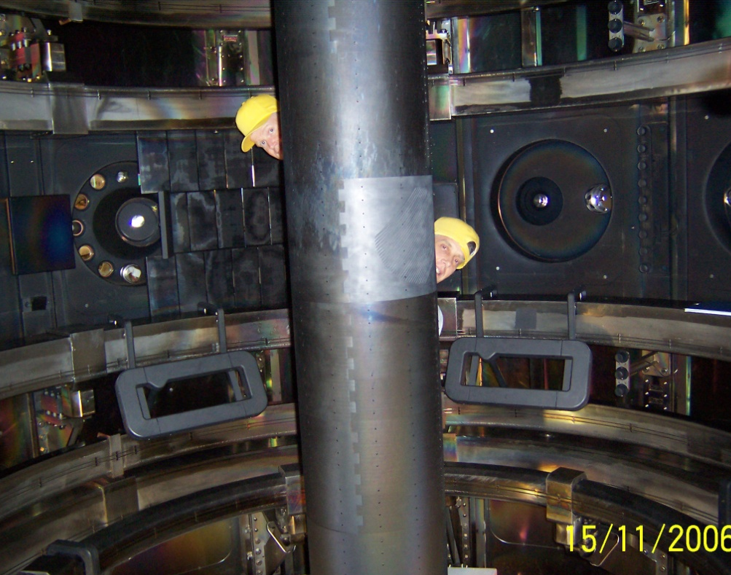
MAST Used Waves in Electron Cyclotron Frequency Range to Drive Current
MAST
Electron cyclotron frequency: f_{ce} = eB/2πm_{e} = 28GHz @ 1T
O-mode waves only propagate above the electron plasma frequency:
f_{pe} = √(n_{e}e²/ε₀m_{e})/2π = 28GHz @ 1 × 10¹⁹m⁻³
ST plasma is typically “overdense” ⇒ must rely on other wave modes
The electrostatic Electron Bernstein Wave (EBW) can be generated by Mode Conversion in a plasma from externally launched e.m. waves
MAST used a mirror with slanted grooves on its center column to change the polarization of waves launched from the outboard side
The reflected waves (X-mode) convert to EBW in the plasma
When EBW are absorbed on resonant electrons they can generate current
Courtesy of B. Lloyd and MAST group, CCFE, UK

Slide 30
100 kW of 28GHz RF Power Generated 17kA Plasma Current by EBW CD in MAST
MAST
0
.
0
1
I_{P1} (kA)
#18253, t=90ms
-
0
.
5
Solenoid Current
T_{e} (keV)
0
2
0
I_{P4} (kA.turn)
4
0
Vertical Field
0
2
6
0
4
0
Plasma Current
I_{p} (kA)
2
0
n_{e} (10¹⁸m⁻³)
0
1
10
0
#
1
8
1
5
8
P_{RF} (kW)
#
1
8
2
6
1
5
0
#
1
8
1
8
9
RF Power
0
0
.
2
0
.
4
0
.
6
0
.
8
1
.
0
1
.
2
0
0
.
0
0
.
1
0
.
2
0
.
3
Major radius (m)
Time (s)
EBW-driven current augmented by flux from Vertical Field and Solenoid
Temperature and density peak at electron cyclotron resonance layer
V. Shevchenko et al., NF 50 (2010) 022004

Slide 31
ST Is Making Good Progress Toward a “Next Step” While Contributing to the Physics Basis of ITER
Ability of the ST to achieve high β now well established
Advanced plasma stabilization methods and diagnostics being applied to improve performance
Provides a unique opportunity to study transport and turbulence
Investigating fast-ion instabilities relevant to ITER
Developing innovative solutions to heat-flux management
Developing non-inductive startup and sustainment schemes
NSTX is currently undertaking a major refit to install additional NBI heating and upgrade its coils
  Double its NBI power and magnetic field and extend its pulse-length
MAST will soon install its Super-X divertor and upgrade its heating

Slide 32
Supplementary Slides
The following slides contain additional material which expand on several of the topics covered in the main talk

Slide 33
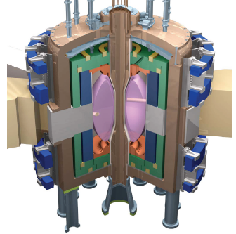
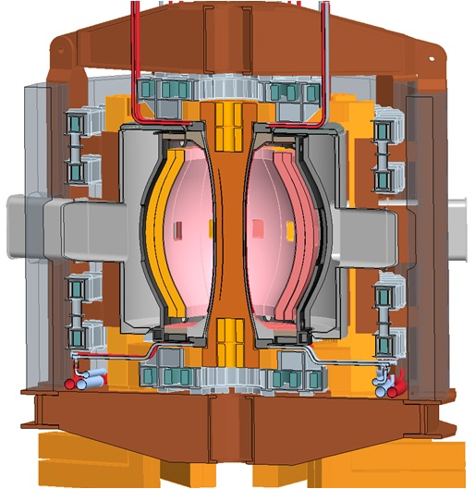
ST Experiments are being Proposed for
Fusion Energy Development
ST combines several potential advantages
  Compact size
  High neutron wall loading for nuclear component testing
  Simplified maintenance scheme
Considerations for achieving required performance:
  Adequate confinement
  High bootstrap current fraction
  Adequate margin on safety factor
ST Design Studies
Fusion Nuclear
Science Facility
Pilot Power Plant
 | β_{N} | κ | H_{98y,2}
FNSF | 3-5 | 2.5-3.2 | 1.2-1.6
Power Plant | 6-8 | 3-3.5 | 1.3-1.6

Slide 34
NSTX High-Harmonic Fast Wave System Provides Auxiliary Power for Heating and Current Drive
12-element antenna for 6MW coupled power at 30MHz
  ω_{RF} = 10 – 15 × ω_{c,D} (majority-ion cyclotron frequency)
  Phase control of currents in antenna elements changes phase velocity of waves launched into plasma
  k_{tor} = ±(4 –14) m⁻¹
RF Sources
P₁
P₂
P₃
P₄
P₅
P₆
Decoupler
Elements
p
5 Port
Cubes
p
p
p
p
p
I₁
I₇
Δφ_{V21}
Poloidal Antenna Elements
HHFWs heat electrons by
  Landau damping: phase velocity v_{ph} = ω/k ~ v_{th,e}
  Transit-time magnetic pumping: bounce frequency ε^{1/2}v_{th,e}/qR ~ ω_{RF}
J. Wilson et al., PoP 10 (2003) 1733

Slide 35
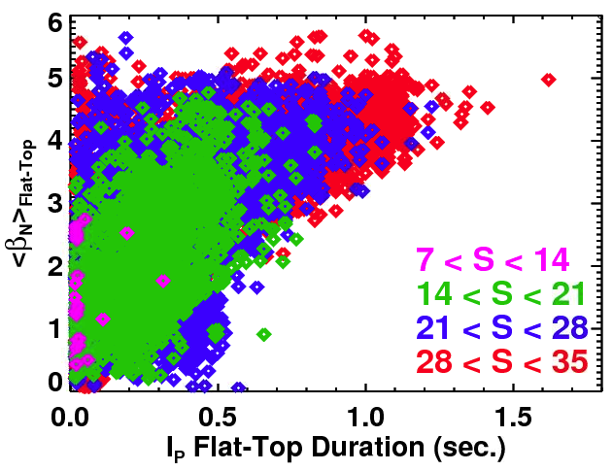
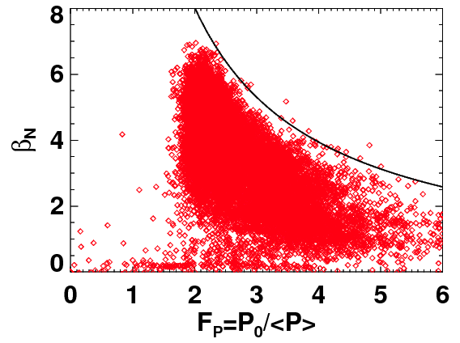
Both Boundary Shaping and Profile Variations Impact Reliability of High-β_{N} Operation
Boundary Shaping Effects
Pressure Profile Shape Effects
Define a shape parameter* S
  “How much safety factor (q₉₅) does the shape have for given I_{P} and B_{T}”
Pulse-average β_{N} maximized for large values of S
β_{N} limit calculated to scale inversely with the pressure peaking
Observations support this dependence
H-mode produces a broad pressure profile by creating an “edge transport barrier”
* Lazarus, et al, Phys. Fluids B 1991
S. Gerhardt et al., NF 51 (2011) 073031

Slide 36

Variation of Control System Parameters Confirms Action of Feedback Loop
Detect n=1 magnetic perturbation
  48 B_{P}, B_{R} magnetic sensors in vessel
  Analyze signals in real time to obtain amplitude, toroidal phase
Apply n=1 radial field with:
  Amplitude proportional to detected perturbation
  Phase shifted relative to detected perturbation
Feedback can be changed from stabilizing to destabilizing as phase varied
Growth of mode slows toroidal rotation by J × B force between perturbed plasma current and external fields
0° FB Phase
225° FB Phase
90° FB Phase
180° FB Phase

Slide 37




Fast Visible Images Show Plasma Asymmetry as Resistive Wall Mode Develops
Before RWM activity
Visible light emission comes from plasma edge
  Core radiates in soft x-ray region
DCON code models mode structure at boundary
  uses experimental equilibrium
  includes n = 1 – 3 mode components
  uses relative amplitude / phase of n spectrum measured by RWM sensors
114147
t = 0.250s
Modeled structure
RWM with ΔB_{p} = 9mT
114147
t = 0.268s
114147
114147
(exterior view)
(interior view)
S. Sabbagh et al., NF 46 (2006) 635

Slide 38




With RMP, Obtain Good Agreement in Edge Structures Between Images and Field Line Mapping
MAST
n=6
n=4
n=3
Camera images
tangential view
Field line mapping
ERGOS code
Laminar plot at φ=315°, which is the average tangency radius for the image
Courtesy of I. Chapman and MAST group, CCFE, UK

Slide 39

Application of RMP Splits the Outer Strike Point on the Outer Divertor Plate
MAST
High spatial resolution (1mm) IR measurements of divertor plate temperature reveal the splitting as RMP is applied
Zoomed
Observed only for RMP magnitude above a threshold
  Currents induced in plasma can shield small applied fields
Strike point splitting coincides with onset of density reduction
Courtesy of A. Thornton and MAST group, CCFE, UK

Slide 40




Partial Divertor Detachment by Divertor Gas Puffing Reduces Peak Heat Flux Without Degrading Core
Gas puff 1×10²²D/s
Intense gas puff creates region of dense radiating plasma near divertor
Core radiation and carbon density are reduced during partial detachment
V. Soukhanovskii et al., NF 49 (2009) 095025
Notes:
40

Slide 41

Lithium Coating Improves Both
Total and Electron Confinement
7
Normalized radius ρ = 0.65
6
5
Electron thermal diffusivity χ_{e} (m²s⁻¹)
4
3
2
0
100
200
300
400
500
Lithium deposited before shot (mg)
H-mode threshold reduced by lithium by up factor 4
Electron temperature profile becomes broader with lithium
Electron thermal transport in outer region progressively reduced by lithium
Ion confinement remains close to neoclassical both with and without lithium
S. Ding et al., PPCF 52 (2010) 015001

Slide 42


Lithium Affects ELMs Through Changes in
Temperature and Pressure Profile at Edge
Without lithium, ELMing
With lithium, ELM free
129015, 0.4 s
Last 20% ELM cycle
129038, 0.525 s
n_{e} (10²⁰m⁻³)
T_{e} (keV)
p_{e} (kPa)
Normalized poloidal flux Ψ_{N}
Normalized poloidal flux Ψ_{N}
Shift of maximum in pressure gradient to region with lower magnetic shear (∂q/∂r) stabilizes kink/ballooning instability at edge
R. Maingi et al. PRL 103 (2009) 075001

Slide 43


With Lithium Coated PFCs, Global Confinement Trends are Similar to Conventional Aspect Ratio
τ~B_{T}⁰
Compare experimental confinement time with prediction from ITER 1998 scaling
Prior to use of lithium, NSTX confinement showed weaker I_{P}, stronger B_{T} dependence
S. Gerhardt et al., NF 51 (2011) 073031

Slide 44



Electron Gyro-Scale Fluctuations Suppressed by Negative Magnetic Shear in Plasma Core
Negative central shear (dq/dr < 0)
Normal shear
5
Scattering
region
4
3
q (EFIT with MSE constraint)
2
1
∂q/∂r < 0
0
Suppression of Electron Temperature Gradient (ETG) driven turbulence by shear-reversal had been predicted (F. Jenko & W. Dorland, PRL 2002)
Shear-reversed q-profile is compatible with bootstrap driven current
H. Yuh et al., PoP 16 (2009) 056120

Slide 45


Strong Confinement Dependence on Collisionality
Reproduced in Micro-Tearing Turbulence Simulations
Experiment
Simulations of Micro-Tearing
δB_{r} (Gauss)
Experiment
B_{t}τ_{E} (T-s)
χ_{e}^{sim} ~ ν_{e}^{1.1}
120968
ν∗_{e} (at r/a = 0.5)
Follow mode evolution to “steady” state
Collisionality varied from experiment
Predicted χ_{e} and scaling consistent with experiment (Ωτ_{E} ~ B_{t}τ_{E} ~ ν*_{e}^{-0.8})
Transport dominated by magnetic “flutter”
Lithium has enabled NSTX to achieve lower collisionality
Strong increase in τ_{E} as ν∗_{e} decreases (τ_{E} ∝ χ_{e}⁻¹)
S. Kaye et al., IAEA FEC 2012, to be published
W. Guttenfelder, et al., PRL 106, 155004 (2011)

Slide 46



Low Frequency MHD Instabilities Can Also Redistribute Fast Ions
Initial modes are kink-like, global instabilities with frequencies typically a few kHz
  Primarily n = 1, weaker n = 2 present
Add 3-D perturbed field to 2-D equilibrium field and follow orbits of an ensemble of test particles by integration of Lorentz force (SPIRAL code)
Energetic ions are redistributed
  Outward radially
  Towards V||/V = 1
This redistribution can then affect stability of other modes: *AE, RWMs
  CAE activity observed after onset of low frequency MHD
CAEs are possible cause of enhanced core electron transport
  Resonant with electron orbit frequencies
Fast-ion
density
reduction
0.9
1.0
1.1
1.2
1.3
1.4
1.5
R(m)
Calculated change in fast-ion distribution due to kink mode
SPIRAL code
Z [m]
V||\V
CAE resonances
R [m]
Energy [keV]
A. Bortolon to be submitted to PoP 2012
Notes:
46

Slide 47

Evidence for Current Drive by HHFW by Comparing Co- and Counter- CD Phasing
Toroidal loop voltage (V/turn)
Time (s)
Wavenumber k_{T} ≈ ±7m⁻¹ – phase velocity matches ~2keV electrons
Inductive loop voltage controled by feedback to maintain plasma current
Difference in voltage required implies 150kA driven by HHFW
Codes modeling wave interaction calculate 90 – 230 kA driven by waves
J. Wilson et al., PoP 10 (2003) 1733

