Slide 1

The Mission of NSTX-U Toward the Development of Fusion Energy
Dr. Devon Battaglia
On behalf of the NSTX-U Team
Princeton Plasma Physics Laboratory (PPPL)
Science and Technology Seminar
Laboratory for Laser Energetics
September 4, 2015

Slide 2
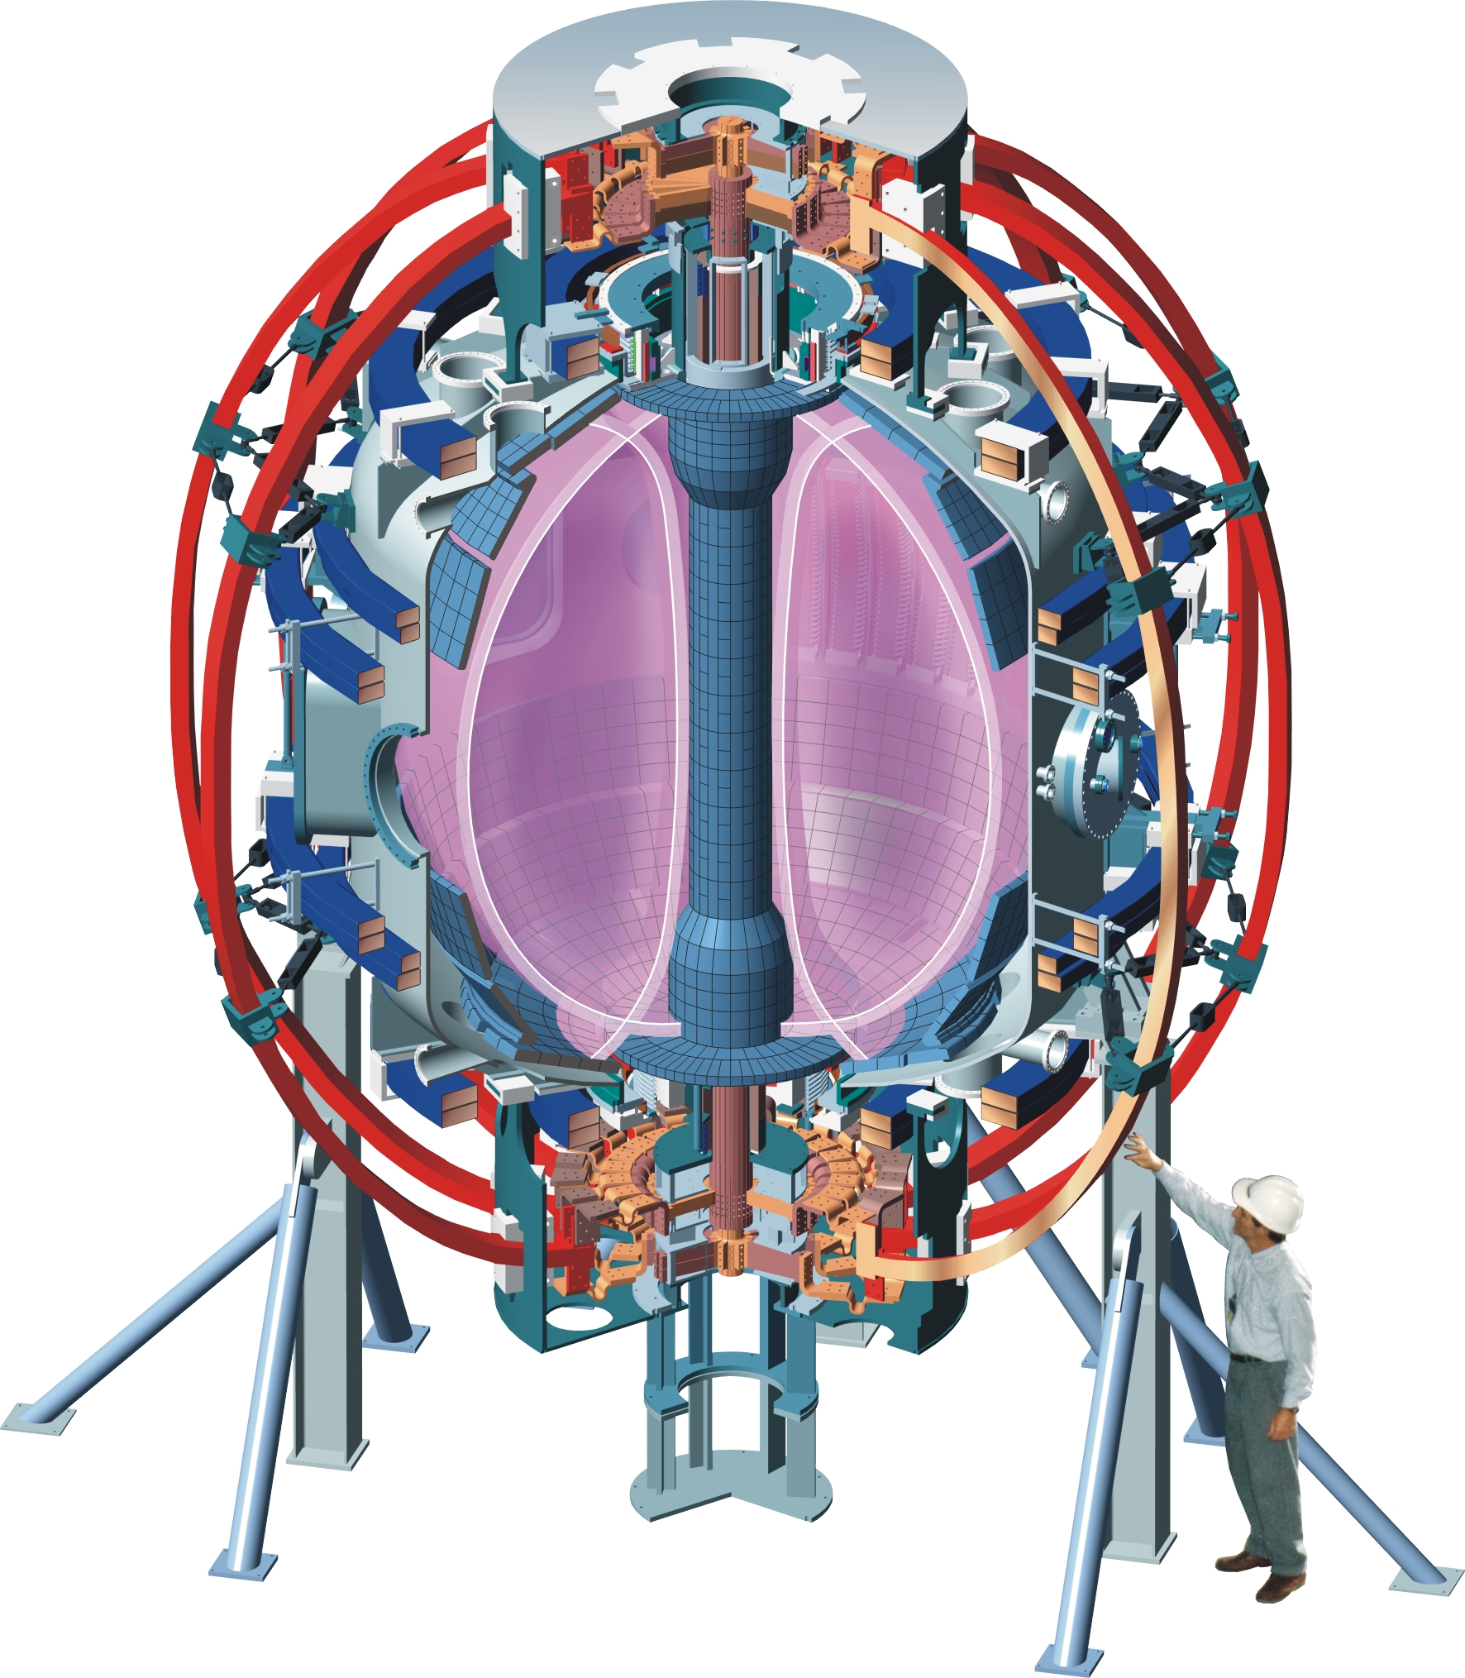
The National Spherical Torus Experiment Upgrade (NSTX-U) in Princeton, NJ
National Spherical Torus Experiment (NSTX)
  Operated 1999 – 2011
NSTX-Upgrade (NSTX-U)
  Starts up October, 2015
Study the confinement of hot plasma by magnetic fields for fusion energy research

Slide 3
Outline
Fusion and magnetic confinement of plasmas
Tokamaks and fusion energy research
Motivation for studying spherical tokamaks
NSTX-U scientific mission toward fusion energy

Slide 4
Outline
Fusion and magnetic confinement of plasmas
Tokamaks and fusion energy research
Motivation for studying spherical tokamaks
NSTX-U scientific mission toward fusion energy

Slide 5
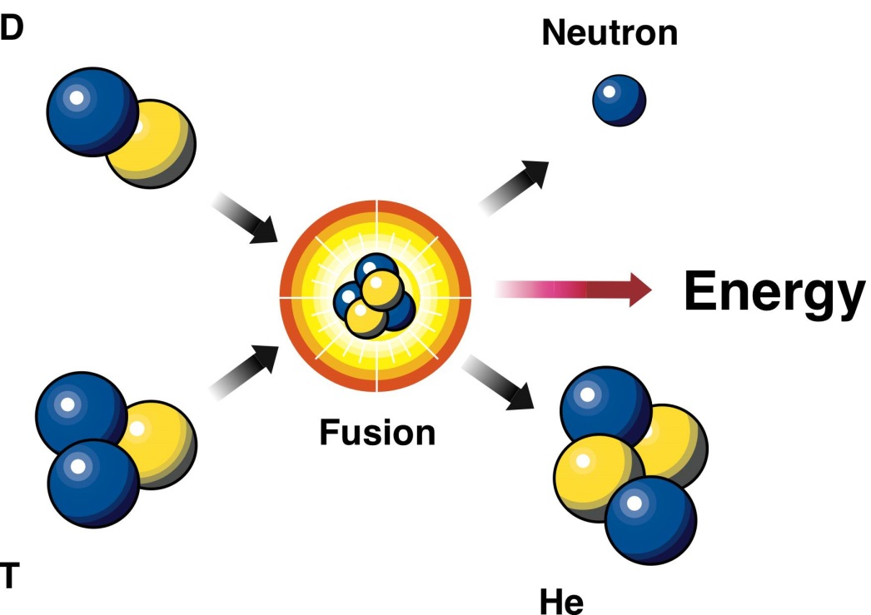
Can we harness the energy source of the stars?
No CO₂ production
Abundant fuel supply that is easy to transport
Radioactive waste is short-lived, low-level
Cannot have a runaway reaction
D: deuterium
n: neutron
T: tritium
α: helium
High energy gain
≈ 1000 ×

Slide 6
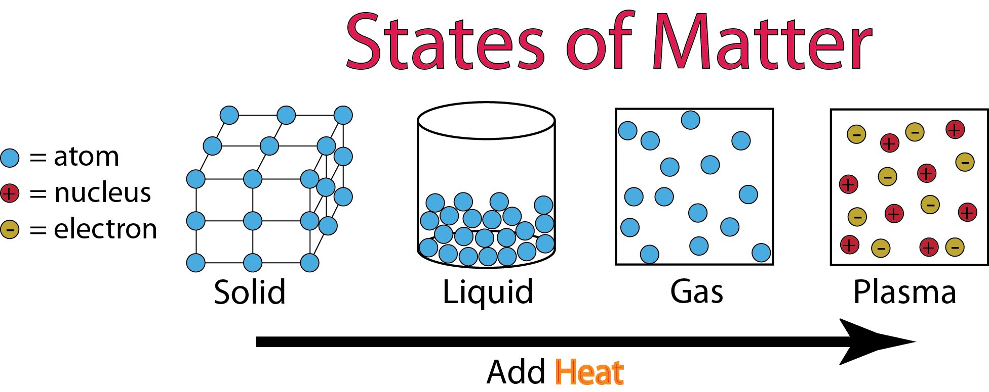
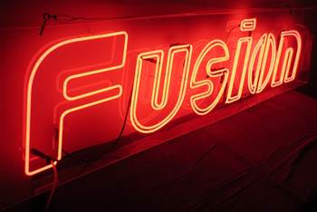
Fusion is hot!
Fusion is “easiest” with a fuel mixture of deuterium and tritium at 200 million ^{ᵒ}C
  All matter is in the plasma state at these temperatures
Plasmas: a soup of ions and electrons
  Plasmas are commonplace in our lives

Slide 7
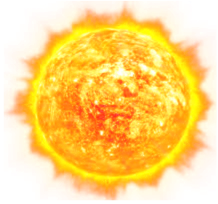

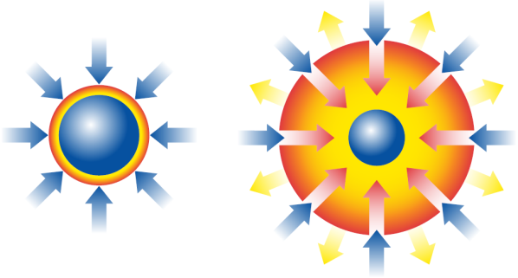
Confinement of plasma for controlled fusion on earth differs from stars
Gravitational Confinement
Gravity
Sun
Fusion
Inertial Confinement
Magnetic Confinement
Intense Energy
Beams
Fuel Pellet

Slide 8
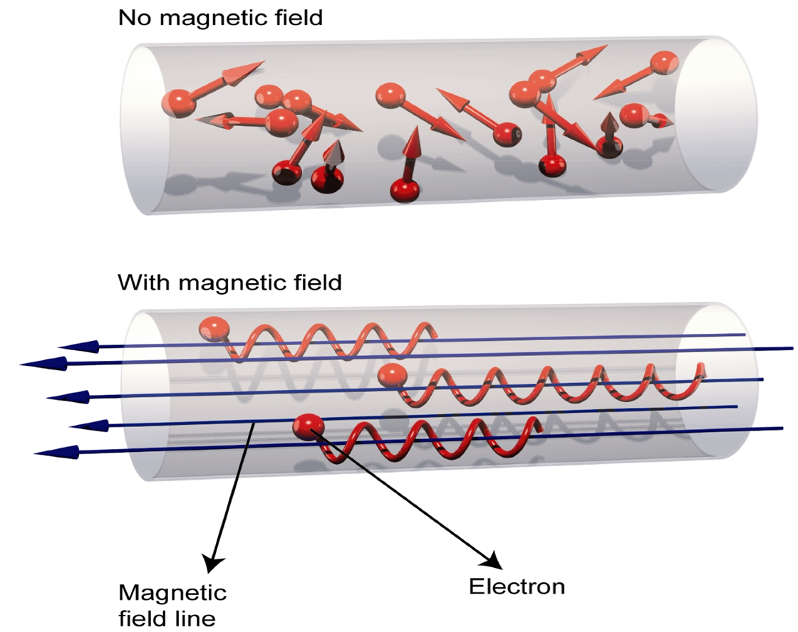
Magnetic fields can keep hot plasma away from a cold wall
No magnetic field: hot plasma touches cold wall
Charged particles are “tied” to a magnetic field
  Follow helical trajectories along magnetic field lines

Slide 9
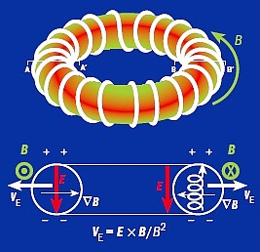
What if we made a magnetic donut?
Torus (donut) has a stronger magnetic field at the inside edge
  Particles feel different field strengths as they “orbit” a field line
  Ions drift up, electrons drift down
Electric field from charge separation causes all particles to drift out
  Plasma still touches the wall

Slide 10

What if we made a magnetic donut?
Torus (donut) has a stronger magnetic field at the inside edge
  Particles feel different field strengths as they “orbit” a field line
  Ions drift up, electrons drift down
Electric field from charge separation causes all particles to drift out
  Plasma still touches the wall

Slide 11
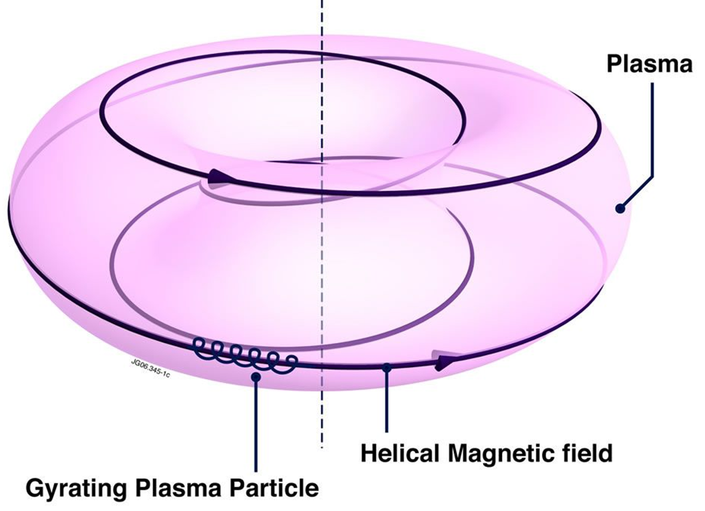
Here’s the twist: “twisting” the magnetic field around the torus improves confinement
Helical magnetic field short-circuits electric field that would otherwise expel plasma
Now, charged particles are tied to a magnetic surface

Slide 12
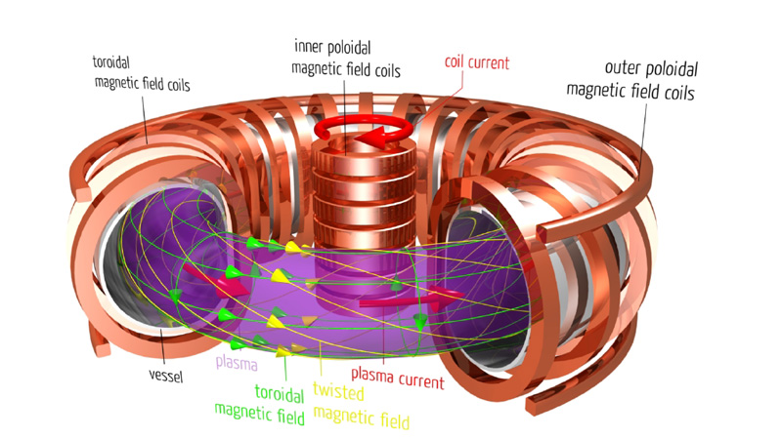
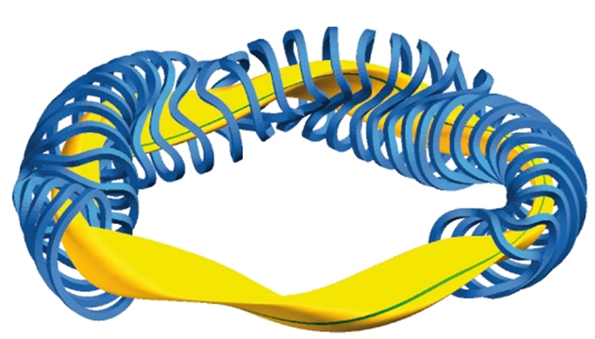
Two leading schemes for making helical fields: tokamaks and stellarators
Tokamak: drive a toroidal current in the plasma
  Produces poloidal mag field
  Poloidal + toroidal = helical
Stellarators: helical field using complex magnets
  No plasma current needed

Slide 13
Outline
Fusion and magnetic confinement of plasmas
Tokamaks and fusion energy research
Motivation for studying spherical tokamaks
NSTX-U scientific mission toward fusion energy

Slide 14
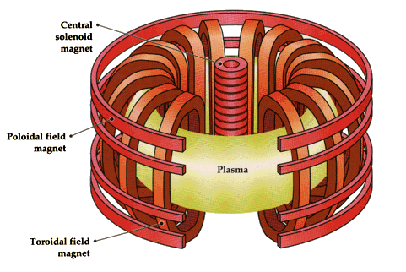
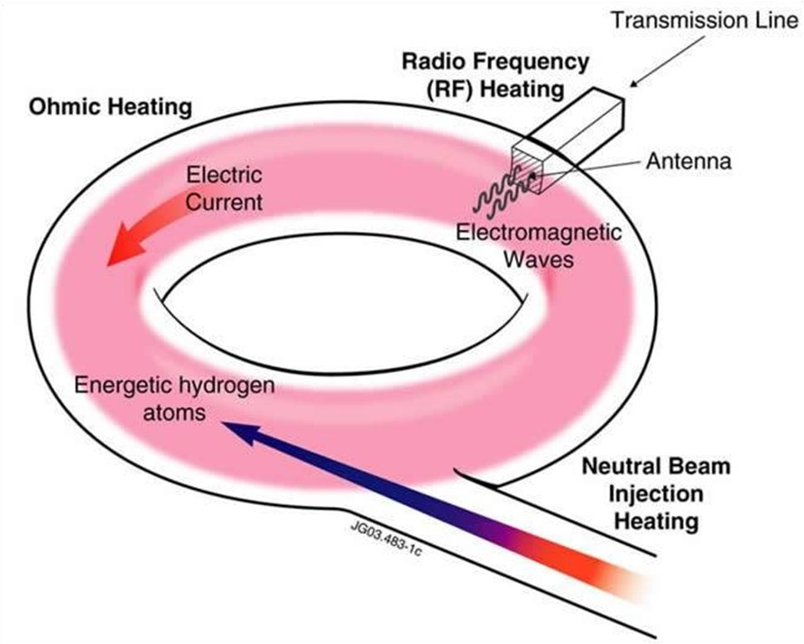
Maintaining the plasma current is a requirement for a tokamak reactor
Tokamak experiments drive plasma current using:
  Induction from a central solenoid
  Neutral beam and RF injection
  Self-generated “bootstrap” current
Reactor will require fully non-inductive current drive
  Solenoid could be used to start discharge (a minute or so)
    Solenoid current decreases to zero
  After that, all current must be “non-inductive”

Slide 15
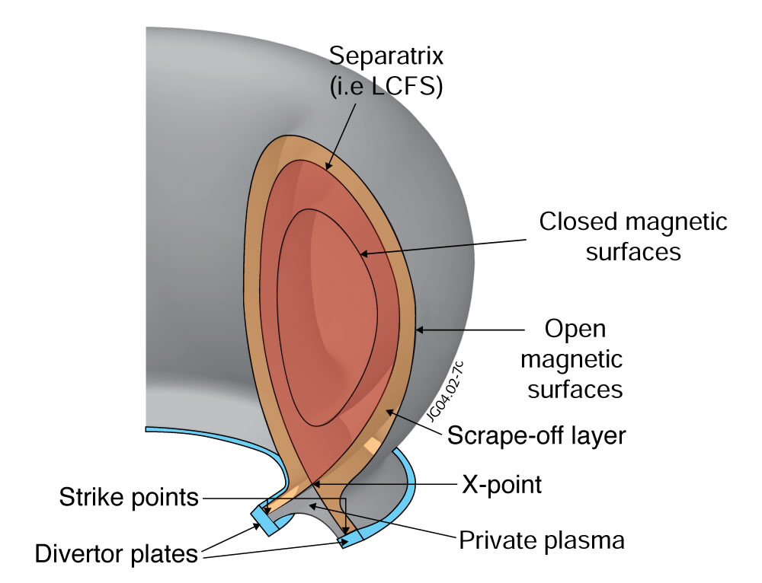
The rate energy is lost from hot core to cold wall sets the size of the tokamak reactor
Core (170,000,000°C)
Scrape-off layer (1,000,000°C)
Divertor plates (< 500°C)

Slide 16
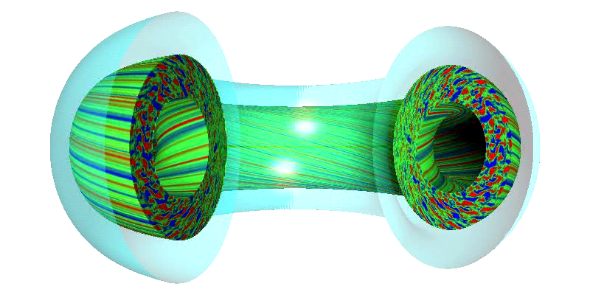

Plasma turbulence is typically what leaks the most energy from the core
Calculations enabled by recent advances in supercomputing

Slide 17
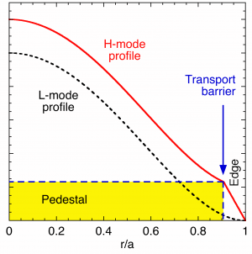
H-mode: a “barrier” leads to a “pedestal” in the plasma pressure
Hotter
Hot
Spontaneous reduction in turbulence at the tokamak edge
  High confinement or H-mode state
Pedestal develops
  Large gradients in temperature, density and flows at edge
  Enables smaller, cheaper fusion reactors
Core

Slide 18
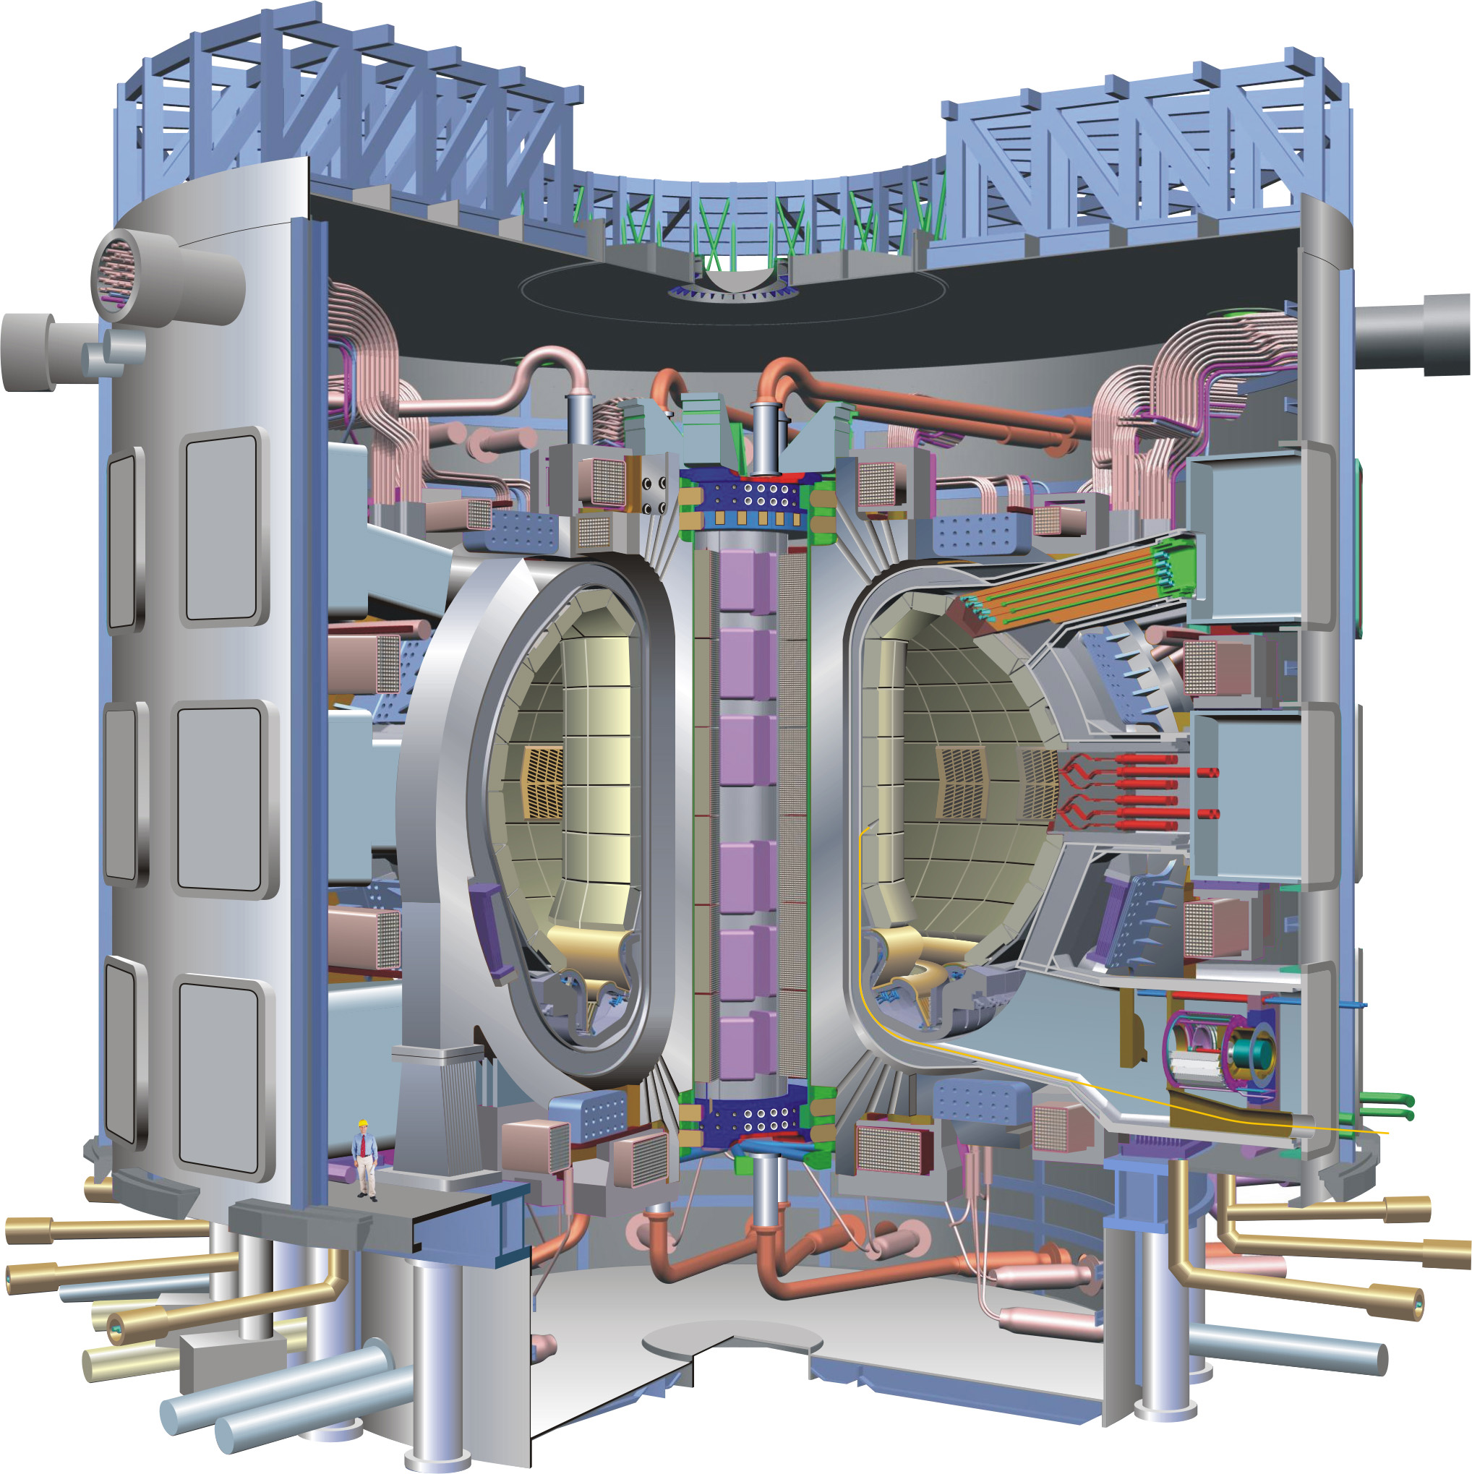
ITER (a tokamak) will be the first experiment with a goal of demonstrating Q = 10
“Burning” or self-heated plasma with 10 times more energy out than went in
  Majority of plasma heating comes from fusion reactions
Size (and cost) of ITER driven by expected energy confinement
  EU, Japan, US, China, Russia, South Korea and India all sharing cost
Can we make smaller tokamak reactors?

Slide 19
Outline
Fusion and magnetic confinement of plasmas
Tokamaks and fusion energy research
Motivation for studying spherical tokamaks
NSTX-U scientific mission toward fusion energy

Slide 20
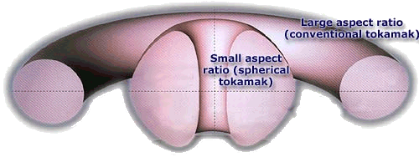
Aspect ratio and elongation are important free parameters in tokamak design
Aspect ratio A = R / a, Elongation κ = b / a
R = major radius, a = minor radius, b = vertical ½ height
b
a
R
a
A ~ 3
κ = 1.5 - 2
A ~ 1.5
κ = 2 - 3

Slide 21
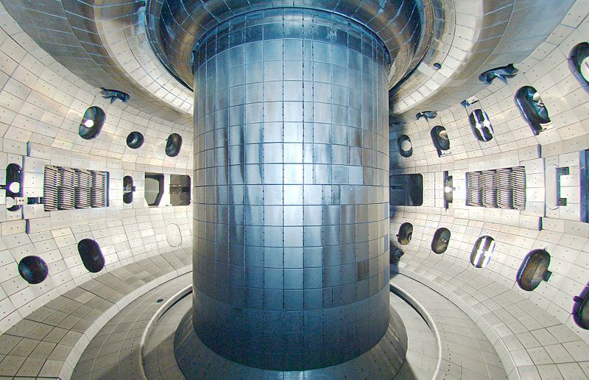
Inside the DIII-D tokamak: it looks like a donut

Slide 22
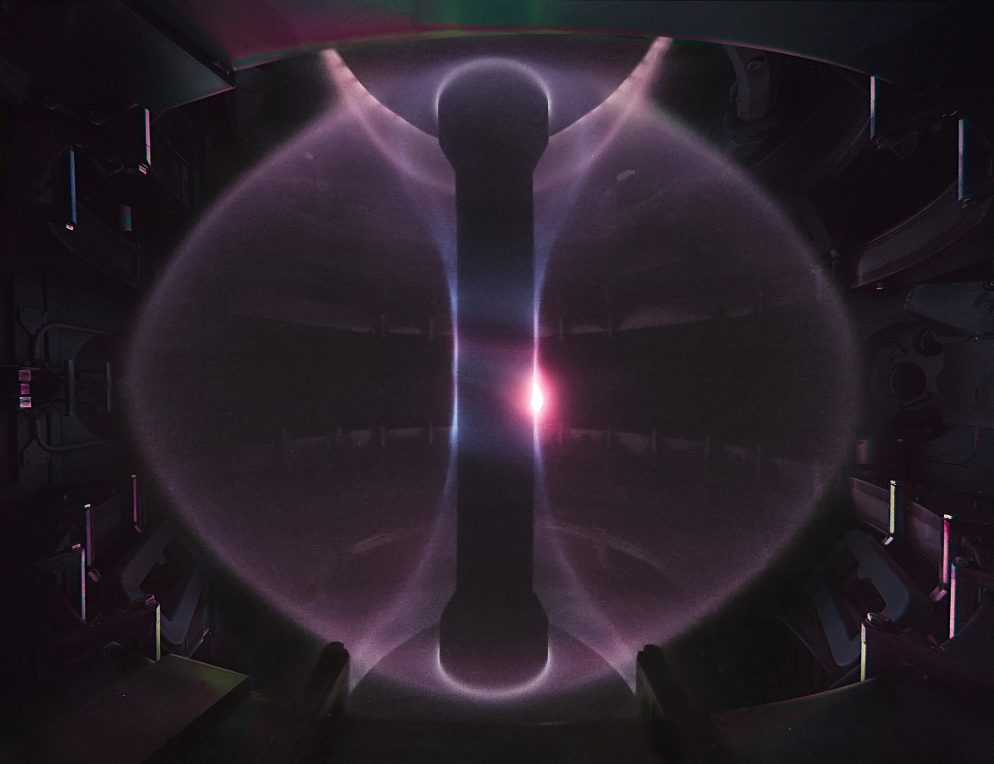
Spherical tokamak plasma looks more like a cored apple than a donut

Slide 23
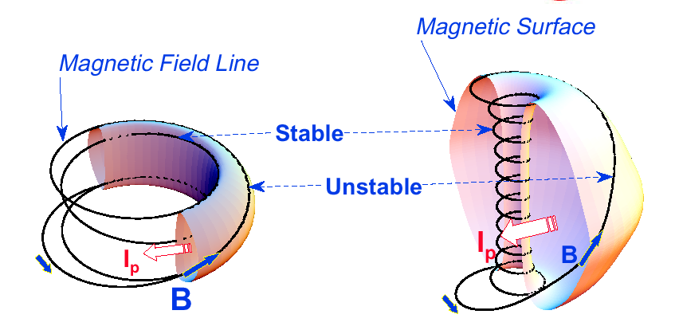
Magnetic field lines twist tightly around the “center column” in an ST
Tokamak
Spherical Tokamak
Notes:
A spherical tokamak is a low aspect ratio tokamak. Tokamak is a donut like aspect ratio of about 3 where as ST is aspect ratio of about 1.5. As the aspect ratio is reduced, the hole of the donut is reduced and it disappears entirely at A = 1. As the aspect ratio is reduced, the plasma elongate naturally takes on the spherical shape due to self fields. Another important property is the magnetic field line. The tokamak magnetic field line goes around torus at relatively constant pitch where as the ST geometry, the field line transit the outboard unstable region quickly but spend many toroidal transits in the inboard stable region. This makes ST plasma stable for high beta and also makes the edge safety factor high ~ 10 compared to ~ 3 for tokamak.
As a result, there are a number of new unique physics regimes which can be accessed at low aspect ratio, which can be utilized to enhance the understanding of toroidal confinement physics and improve predictive capabilities for ITER and future fusion facilities.

Slide 24
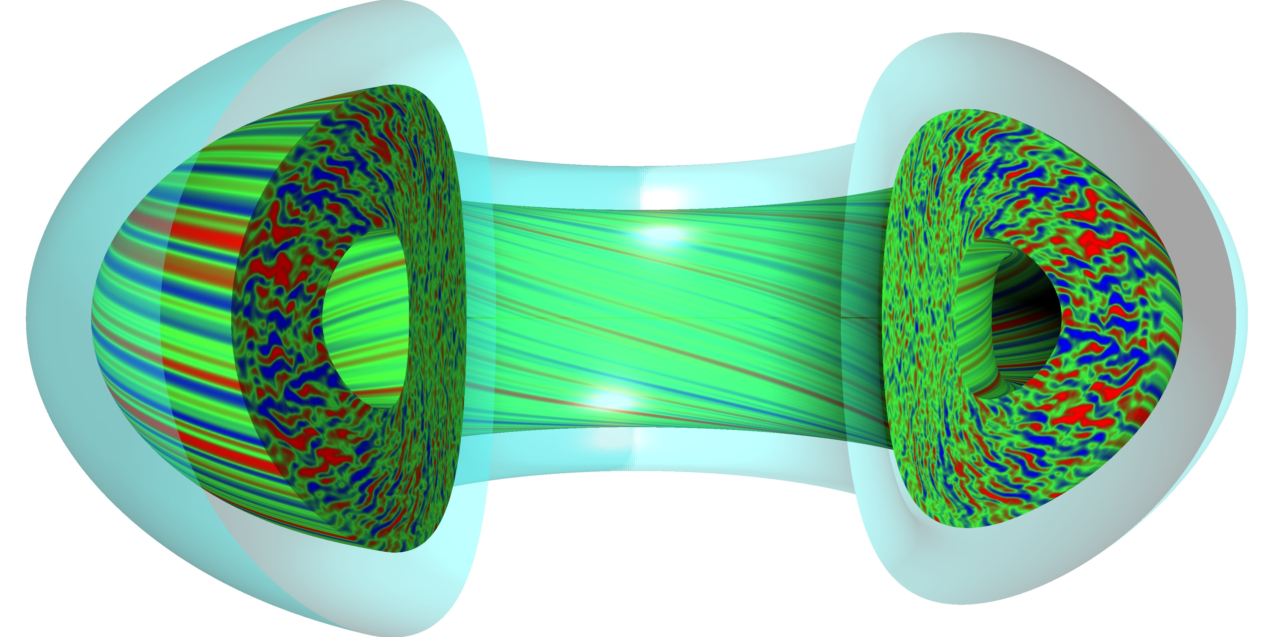
Pressure limit in tokamaks set by “bad curvature”
H
L
L
“Gravity”
Pressure = density x temperature

Slide 25
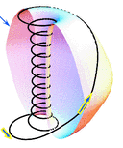
Spherical tokamaks have larger plasma pressure limits
Field lines spend more time on stable side near center column
  STs operate at larger beta
  β_{T} = ⟨p⟩ / (B_{T0}²/2μ₀)
    Pressure / magnetic field = Efficiency
    ST: 10 – 40%
    Tokamak: 3 – 10%
STs reach target performance at reduced cost
  P_{fusion} ∝ β_{T}² B_{T0}⁴ x Vol
$
Physics Knob
Investment

Slide 26
ST is a leading design for a fusion nuclear science facility (FNSF)
Large surface-to-volume ratio and cost efficiency make the ST an attractive FNSF design
  FNSF will test materials and designs for power plant components under realistic heat and neutron loads
    Vacuum vessel, fuel cycle, first wall materials…
  ST meets the required design criteria in a smaller and cheaper device compared to a standard aspect ratio tokamak
    ST maximizes fusion neutron flux at the plasma boundary
ST is also a unique test bed for plasma physics important for future devices, such as ITER
  Team up with conventional aspect ratio experiments to provide wide range of parameters to test theories and models

Slide 27
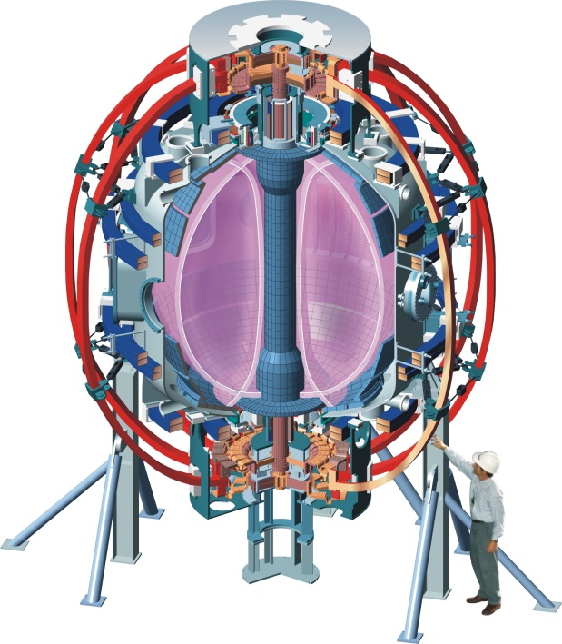
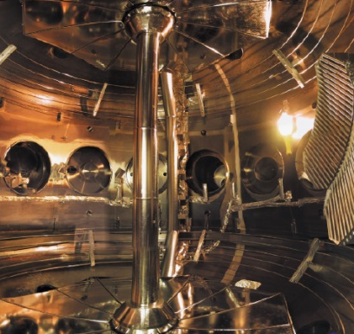
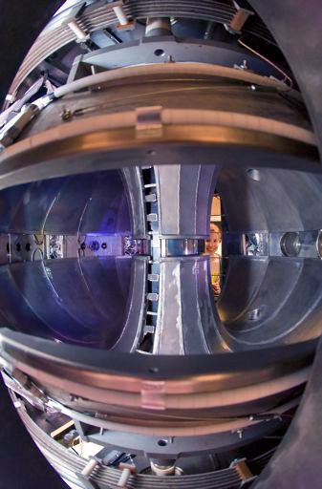
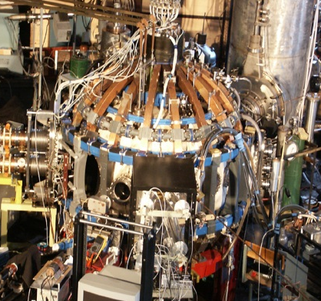
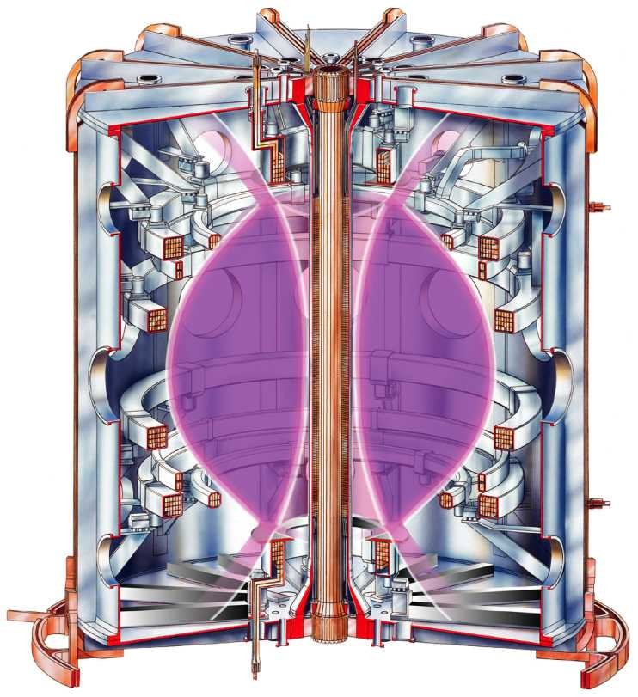
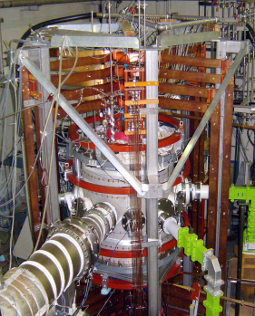
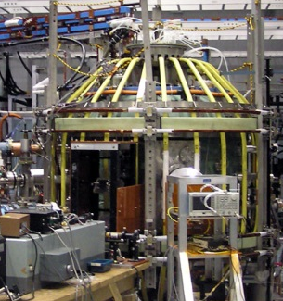
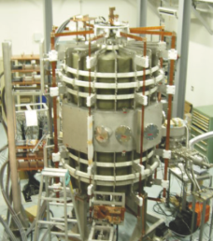
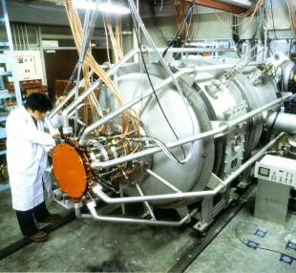
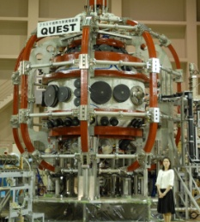
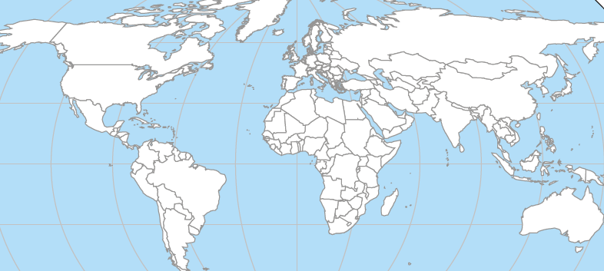
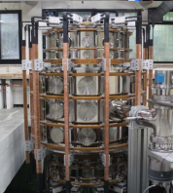
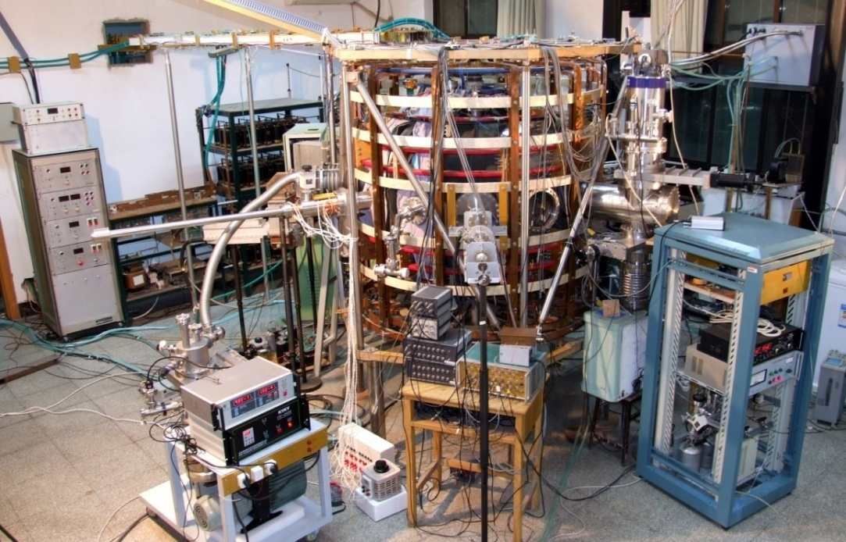

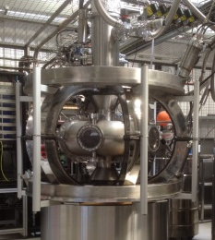

Many smaller experiments support the two main ST research programs
NSTX, USA
PEGASUS, USA
LTX/CDX-U, USA
GLOBUS-M, Russia
MAST, UK
HIST, Japan
LATE, Japan
TST-2, Japan
UTST, Japan
R₀ ~ 0.75 m
QUEST/CPD, Japan
R₀ ~ 0.85 m
VEST, Korea
HIT-II, USA
HIT-II
PEGASUS
GLOBUS-M
QUEST
HIST
LATE
TST-2
TS3/4
UTST
MAST
KTM
VEST
NSTX/LTX
ST25(HTS)
SUNIST
SUNIST, China
ETE, Brazil
ST25, UK
TS3/4, Japan
ETE
STs operated since 2000
Notes:
NSTX and MAST are MA class STs so they are the flag ships of ST research. They are at present undergoing upgrades for 1 T operation. Globus-M is a medium size ST and it is undergoing upgrade to 1 T operation. There a large number of STs in Japan. And the QUEST device is the largest and their flagship device. It aim is to operate steady-state. There are also STs in China, Korean, Kazakhstan, and Brazil. One recent addition is ST25 which is the first all high temperature SC magnet tokamak by Tokamak Energy which is private funded enterprise. You can see quite a range of aspect ratio. The lowest one is PEGASUS with A = 1.15 with extremely slender center post. LTX is a lithium dedicated machine with A = 1.5. I do not have the time to cover the lithium research but there are companion papers at this conference for those interested. NSTX and MAST are 1.32. The ST devices spans quite broad range to make sure we capture necessary low A physics.

Slide 28
Outline
Fusion and magnetic confinement of plasmas
Tokamaks and fusion energy research
Motivation for studying spherical tokamaks
NSTX-U scientific mission toward fusion energy

Slide 29
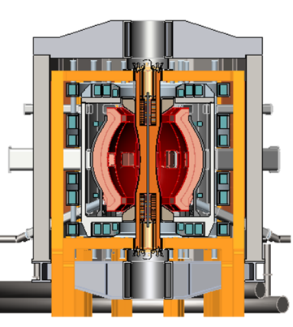
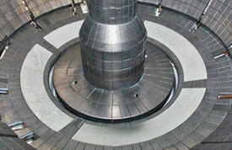
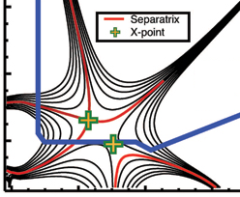

NSTX Upgrade mission elements
Advance ST as candidate for Fusion Nuclear Science Facility (FNSF)
Develop solutions for the plasma-material interface challenge
Explore unique ST parameter regimes to advance predictive capability - for ITER and beyond
Develop ST as fusion energy system
ST-FNSF
Liquid metals/Li
“Snowflake”
ITER

Slide 30


NSTX-U will provide new data to support
FNSF design and ITER operations
Previous
center-stack
New
center-stack
New center column doubles toroidal magnetic field, plasma current
  Access conditions closer to FNSF
  Pulse lengths increase from 1 to 5 seconds
Second neutral beam injection system
  Doubles heating power, increases flexibility available for experiments
  More tangential injection improves current drive, especially at small plasma current
Increased flexibility in divertor configuration
TF OD = 20cm
TF OD = 40cm
Present NBI
New 2nd NBI

Slide 31
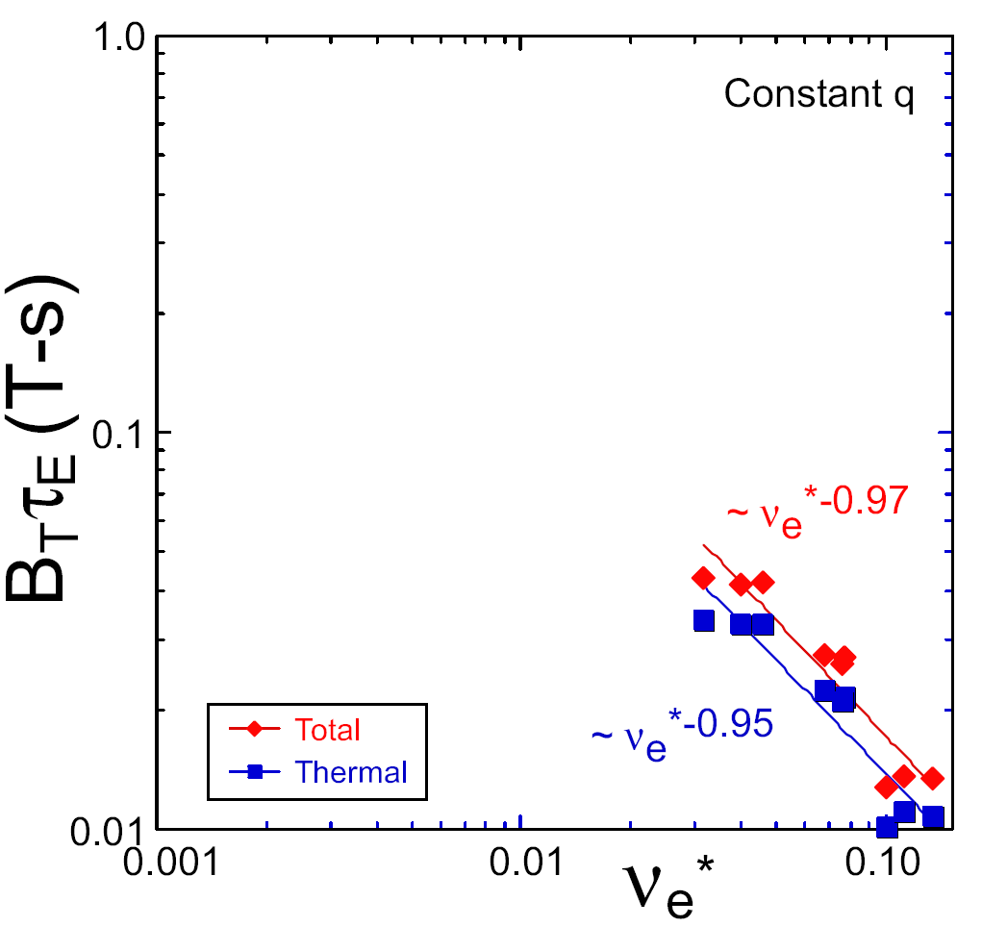
NSTX / MAST observed confinement increase at higher T_{e}
Will confinement trend continue, or look like conventional A?
ST-FNSF
constant q, β, ρ∗
NSTX Upgrade
?
NSTX
ITER-like scaling
Normalized electron collisionality ν_{e}* ∝ n_{e} / T_{e}²
Favorable confinement results could lead to more compact ST reactors

Slide 32
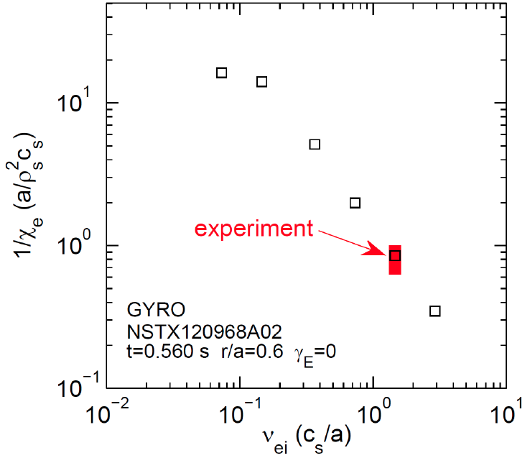


Large-scale simulation of turbulence in agreement with ST confinement scaling
Predicts further confinement improvement with reduced collisionality.
Confinement
NSTX-U /MAST-U

Slide 33
Low collisionality operation achieved on NSTX using lithium wall coatings
Lithium coatings on carbon tiles reduced gas source from wall
  Lead to a larger H-mode pedestal, larger core temperature
  Confinement continued to improve with reduced collisionality
Longer discharges will address first wall solutions
  New diagnostics and campaigns with different wall materials will advance studies of plasma-wall interaction

Slide 34
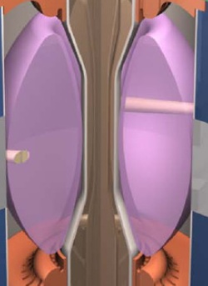
NSTX-U will exploit new tools for developing fully non-inductive scenarios for a FNSF
Compact ST-FNSF has no/small central solenoid
ST-FNSF Scenarios
I_{P} [MA]
Non-inductive sustainment
Current ramp-up and profile control
NBI
HHFW
EC/EBW, HI, PF
Time
Solenoid-free
Start-up
~ 1-2 MA of solenoid-free start-up current needed for FNSF
Notes:
ST has been addressing critical issues for FNSF: A compact FNSF facility does not have solenoid. So, the solenoid-free start-up is a critical issue for ST-FNSF. But solenoid-free start-up is attractive for tokamak reactor design as well. Other issues are ramp-up….

Slide 35
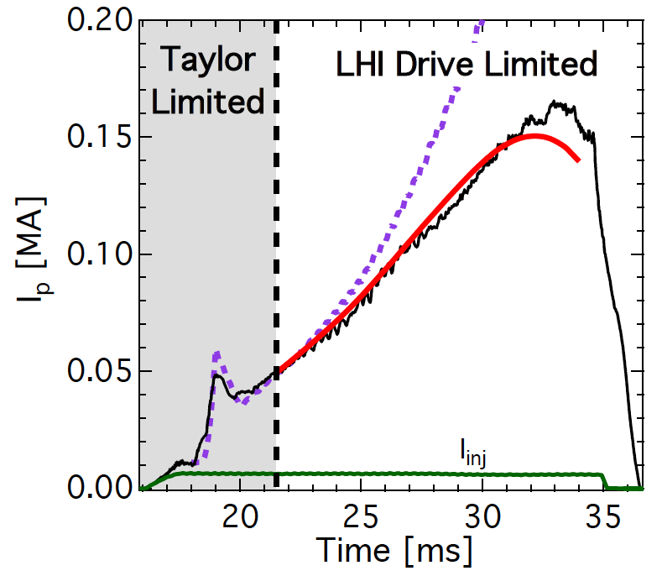
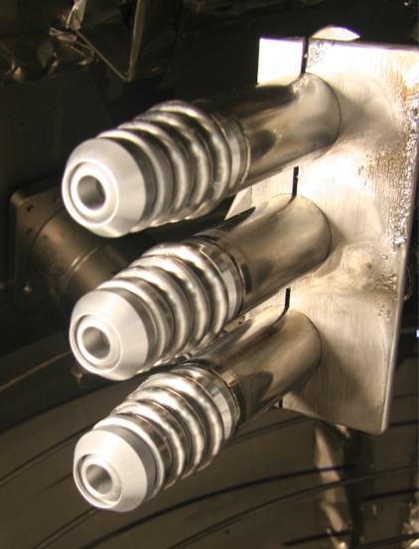


Plasma gun startup demonstrated on the Pegasus ST at UW-Madison

Slide 36
NSTX achieved 70% non-inductive current drive
Will NSTX-U achieve 100% as predicted by simulations?
TRANSP Contours of Non-Inductive Fraction
H_{98y2}
ITER H-mode confinement scaling multiplier
I_{P}=1 MA, B_{T}=1.0 T, P_{NBI}=12.6 MW
Steady-state operation required for FNSF

Slide 37
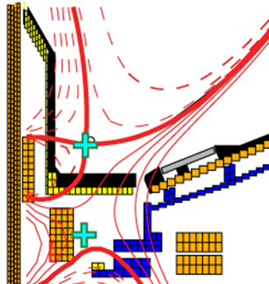
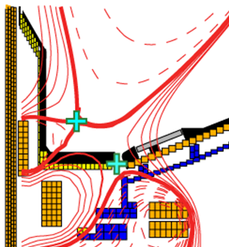
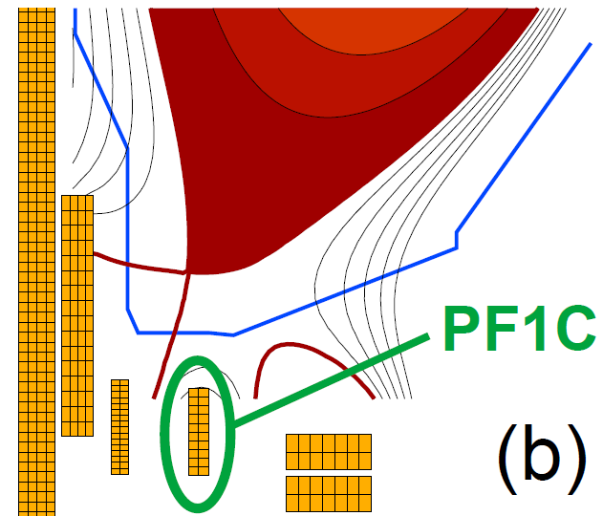
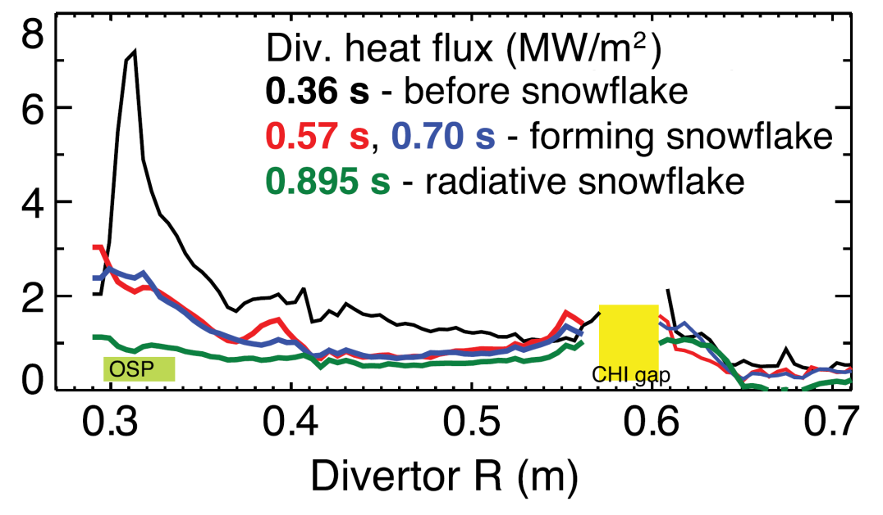
NSTX-U will test ability advanced divertors to mitigate large heat flux
Standard Divertor
Snowflake/X Divertor
NSTX-U peak heat fluxes will be up to 4-8× higher than in NSTX
NSTX-U has additional coils for improved control of magnetic fields in divertor

Slide 38
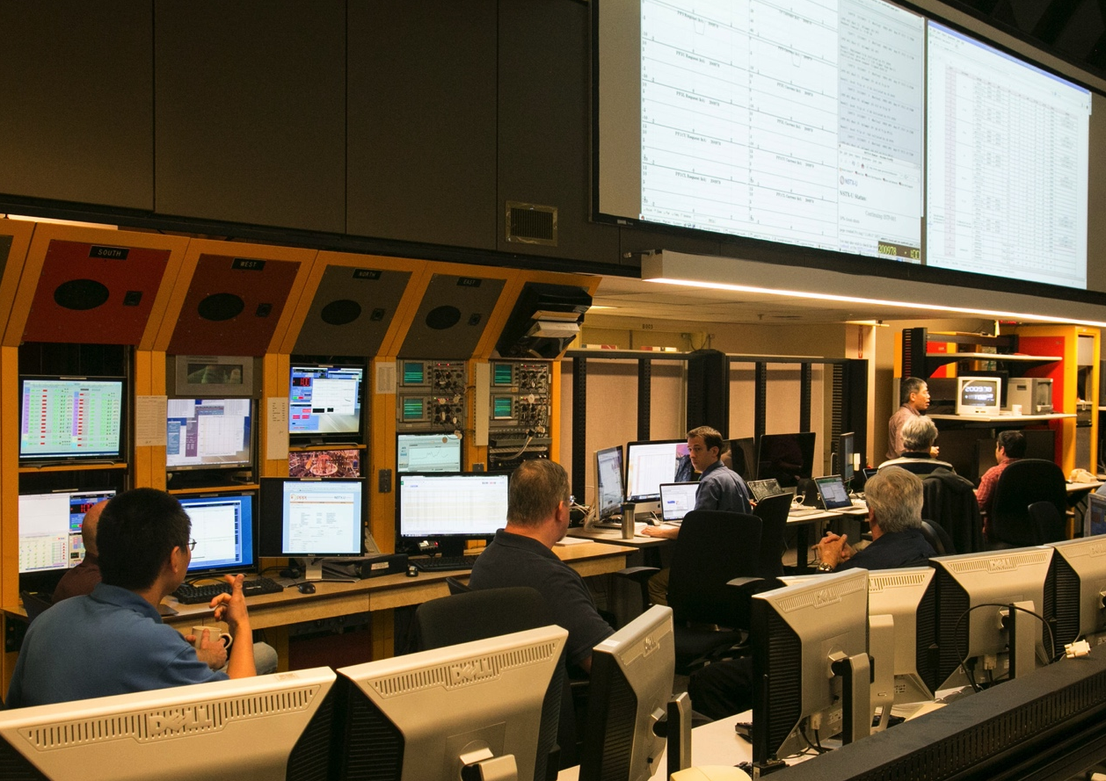

We are on our way!
Construction completed with plasma demonstration
  Scientific operations begin October, 2015

Slide 39
Summary
Spherical torus (ST) concept for magnetic confinement fusion exploits the benefits of low aspect ratio
  Fusion is an exciting and promising energy source
  Tokamaks use a strong toroidal magnetic field plus a poloidal field generated by a toroidal plasma current to “hold a star in a jar”
  STs are compact tokamaks that efficiently use the available toroidal magnetic field
NSTX-U is advancing the ST as a candidate for a Fusion Nuclear Science Facility and a future reactor concept
  FNSF is a critical step on the road to fusion energy
  NSTX-U will address critical issues for FNSF and beyond:
    Energy confinement at lower collisionality in an ST
    Divertor and first wall solutions
    Non-inductive start-up, ramp-up and sustainment of the plasma current
    Stability and control at high β.

