Slide 1




NSTX-U
Supported by
Scientific Opportunities and Challenges on the
National Spherical Torus eXperiment Upgrade (NSTX-U)
Coll of Wm & Mary
Columbia U
CompX
General Atomics
FIU
INL
Johns Hopkins U
LANL
LLNL
Lodestar
MIT
Lehigh U
Nova Photonics
Old Dominion
ORNL
PPPL
Princeton U
Purdue U
SNL
Think Tank, Inc.
UC Davis
UC Irvine
UCLA
UCSD
U Colorado
U Illinois
U Maryland
U Rochester
U Tennessee
U Tulsa
U Washington
U Wisconsin
X Science LLC
Jon Menard
NSTX-U Program Director
Culham Sci Ctr
York U
Chubu U
Fukui U
Hiroshima U
Hyogo U
Kyoto U
Kyushu U
Kyushu Tokai U
NIFS
Niigata U
U Tokyo
JAEA
Inst for Nucl Res, Kiev
Ioffe Inst
TRINITI
Chonbuk Natl U
NFRI
KAIST
POSTECH
Seoul Natl U
ASIPP
CIEMAT
FOM Inst DIFFER
ENEA, Frascati
CEA, Cadarache
IPP, Jülich
IPP, Garching
ASCR, Czech Rep
Graduate Student Seminar
PPPL theory conference room
February 2, 2015

Slide 2
Talk Outline
Introduction to Spherical Tokamaks/Tori (STs)
Description of NSTX Upgrade
Unique physics characteristics of ST and research opportunities
  Macroscopic Stability
  Transport and Turbulence
  Boundary Physics
  Energetic Particles
  Non-inductive start-up, ramp-up, sustainment
Summary

Slide 3
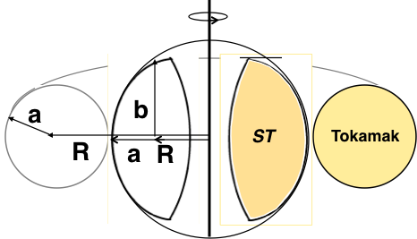
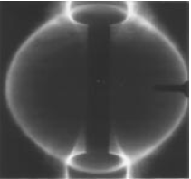
ST is a low aspect ratio tokamak with A < 2
Natural elongation makes its spherical appearance
Aspect Ratio A = R /a
Elongation κ = b/a
“natural” = “without active shaping”
Camera image from START
B_{TF} ∝ I_{TF}/R
I_{p}
I_{TF}
I_{TF}
I_{p}
I_{p}
x
I_{p}
I_{p}
I_{p}
x
x
A. Sykes, et al., Nucl. Fusion (1999).
Note: ST differs from FRC, spheromak due to B_{TF}
Y-K.M. Peng, D.J. Strickler, NF (1986)

Slide 4
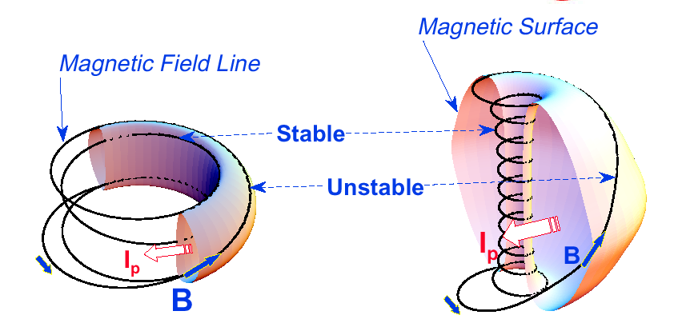
A spherical tokamak (ST) is a high beta tokamak
Favorable average curvature improves stability at high beta
Aspect Ratio A = R /a
Elongation κ = b/a
Toroidal Beta β_{T} = ⟨p⟩ / (B_{T0}²/ 2μ₀)
Tokamak
ST
A ~ 3,
κ = 1.5-2,
q₉₅ = 3-4,
β_{T} = 3-10%
A ~ 1.5,
κ = 2-3,
q₉₅ = 8-12,
β_{T} = 10-40%
Notes:
A spherical tokamak is a low aspect ratio tokamak. Tokamak is a donut like aspect ratio of about 3 where as ST is aspect ratio of about 1.5. As the aspect ratio is reduced, the hole of the donut is reduced and it disappears entirely at A = 1. As the aspect ratio is reduced, the plasma elongate naturally takes on the spherical shape due to self fields. Another important property is the magnetic field line. The tokamak magnetic field line goes around torus at relatively constant pitch where as the ST geometry, the field line transit the outboard unstable region quickly but spend many toroidal transits in the inboard stable region. This makes ST plasma stable for high beta and also makes the edge safety factor high ~ 10 compared to ~ 3 for tokamak.
As a result, there are a number of new unique physics regimes which can be accessed at low aspect ratio, which can be utilized to enhance the understanding of toroidal confinement physics and improve predictive capabilities for ITER and future fusion facilities.

Slide 5
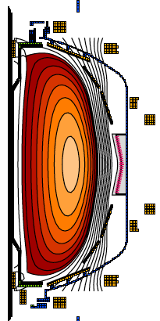
ST can be compact, high beta, and high confinement
Higher elongation κ and low A lead to higher I_{p}, β_{T} and τ_{E}
Aspect Ratio A = R /a
Elongation κ = b/a
Toroidal Beta β_{T} = ⟨p⟩ / (B_{T0}²/ 2μ₀)
• ST has high Ip due to high κ and low A
High κ ∼ 3.0 equilibrium in NSTX.
I_{p} ~ I_{TF} (1 + κ²) / (2 A² q*)
S. Jardin et al., FS&T (2003)
• Ip increases tokamak performance
τ_{E} ∝ I_{p}
β_{T} [%] ≡ β_{N} I_{p} / (aB_{T0})
• ST can achieve high performance cost effectively
I_{p} ~ I_{TF} for ST due to low A and high κ
$
D.A. Gates et al., NF (2007).
Notes:
A spherical tokamak is a low aspect ratio tokamak. Tokamak is a donut like aspect ratio of about 3 where as ST is aspect ratio of about 1.5. As the aspect ratio is reduced, the hole of the donut is reduced and it disappears entirely at A = 1. As the aspect ratio is reduced, the plasma elongate naturally takes on the spherical shape due to self fields. Another important property is the magnetic field line. The tokamak magnetic field line goes around torus at relatively constant pitch where as the ST geometry, the field line transit the outboard unstable region quickly but spend many toroidal transits in the inboard stable region. This makes ST plasma stable for high beta and also makes the edge safety factor high ~ 10 compared to ~ 3 for tokamak.
As a result, there are a number of new unique physics regimes which can be accessed at low aspect ratio, which can be utilized to enhance the understanding of toroidal confinement physics and improve predictive capabilities for ITER and future fusion facilities.

Slide 6
New physics regimes are accessed at low aspect ratio, enhancing the understanding of toroidal confinement physics
  Lower A → increased toroidicity → higher β, strong shaping
  Higher β → electromagnetic effects in turbulence, energetic-particle modes, RF heating and CD (over-dense plasmas)
  Higher fraction of trapped particles (low A), increased normalized orbit size (high β), and flow shear (due to low B, low A)→ broad range of effects on transport and stability
  Increased normalized fast-ion speed (high β) → simulate fast-ion transport/losses of ITER
  Compact geometry (small R) → high power/particle/neutron flux relevant to ITER, reactors
Notes:
A spherical tokamak is a low aspect ratio tokamak. Tokamak is a donut like aspect ratio of about 3 where as ST is aspect ratio of about 1.5. As the aspect ratio is reduced, the hole of the donut is reduced and it disappears entirely at A = 1. As the aspect ratio is reduced, the plasma elongate naturally takes on the spherical shape due to self fields. Another important property is the magnetic field line. The tokamak magnetic field line goes around torus at relatively constant pitch where as the ST geometry, the field line transit the outboard unstable region quickly but spend many toroidal transits in the inboard stable region. This makes ST plasma stable for high beta and also makes the edge safety factor high ~ 10 compared to ~ 3 for tokamak.
As a result, there are a number of new unique physics regimes which can be accessed at low aspect ratio, which can be utilized to enhance the understanding of toroidal confinement physics and improve predictive capabilities for ITER and future fusion facilities.

Slide 7
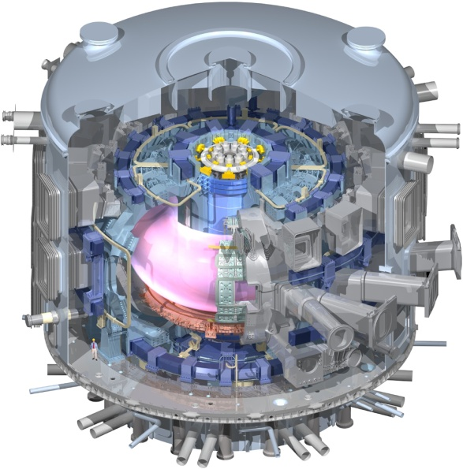
Unique ST properties support and accelerate
a range of development paths toward fusion energy
Burning Plasma Physics - ITER
Extend Predictive Capability for ITER and Toroidal Science
  High β physics, rotation, shaping for MHD, transport
  Non-linear Alfvén modes, fast-ion dynamics, Electron gyro-scale turbulence at low ν*

Slide 8
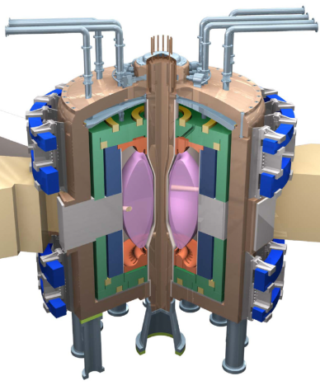
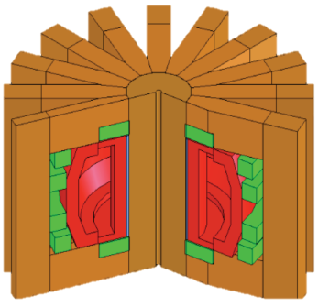
Fusion needs FNSF(s) (modest cost, low T, and reliable) to Test and Qualify Fusion Components
Fusion needs to develop reliable/qualified components which are unique to fusion:
Divertor / PFC
Blanket and Integral First Wall
Vacuum Vessel and Shield
Tritium Fuel Cycle
Remote Maintenance Components
FNSFs
FNSF-ST
FNSF-AT
Without R&D, fusion components could fail prematurely which often requires long repair/down time. This would cripple the DEMO operation.
FNSF can help develop reliable fusion components.
Such FNSF facilities must be modest cost, low T, and reliable.
If the cost of volume neutron source (FNSF) facility is “modest” << ITER, DEMO, it becomes highly attractive development step in fusion energy research. M.A. Abdou, et al., FTS (1996)

Slide 9
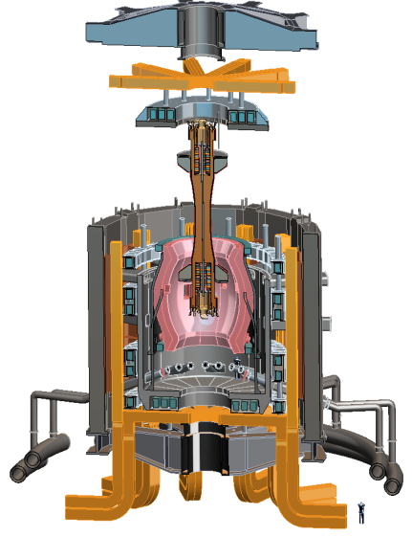
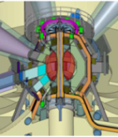
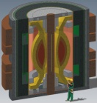
There have been several studies of ST-FNSF showing the potential attractiveness of this approach
Projected to access high neutron wall loading at moderate R₀, P_{fusion}
  W_{n} ~ 1-2 MW/m² , P_{fus} ~ 50-200MW, R₀ ~ 0.8-1.8m
Modular, simplified maintenance
Tritium breeding ratio (TBR) near 1
  Requires sufficiently large R₀, careful design
R&D Needs for an ST-FNSF
  Non-inductive start-up, ramp-up, sustainment
    Low-A → minimal inboard shield → no/small transformer
  Confinement scaling (especially electrons)
  Stability and steady-state control
  Divertor solutions for high heat flux
  Radiation-tolerant magnets, design
Example ST-FNSF concepts
PPPL
ORNL
Culham (UK)
UT Austin

Slide 10


NSTX-U to provide data base to support ST-FNSF design, ITER operations, boundary solutions
Previous
center-stack
New
center-stack
New CS provides higher 2x TF (improves stability), 3-5s needed for J(r) equilibration
More tangential injection provides 3-4x higher CD at low I_{P}:
  2x higher absorption (40→80%) at low I_{P}
  1.5-2x higher current drive efficiency
~ 5-10x increase in nTτ from NSTX
NSTX-U average plasma pressure ~ Tokamaks
TF OD = 20cm
TF OD = 40cm
Key NSTX-U research topics for FNSF and ITER
Stability and steady-state control at high β
Confinement scaling (esp. electron transport)
Non-inductive start-up, ramp-up, sustainment
Divertor solutions for mitigating high heat flux
Present NBI
New 2nd NBI
J. Menard, et al., NF (2012)

Slide 11
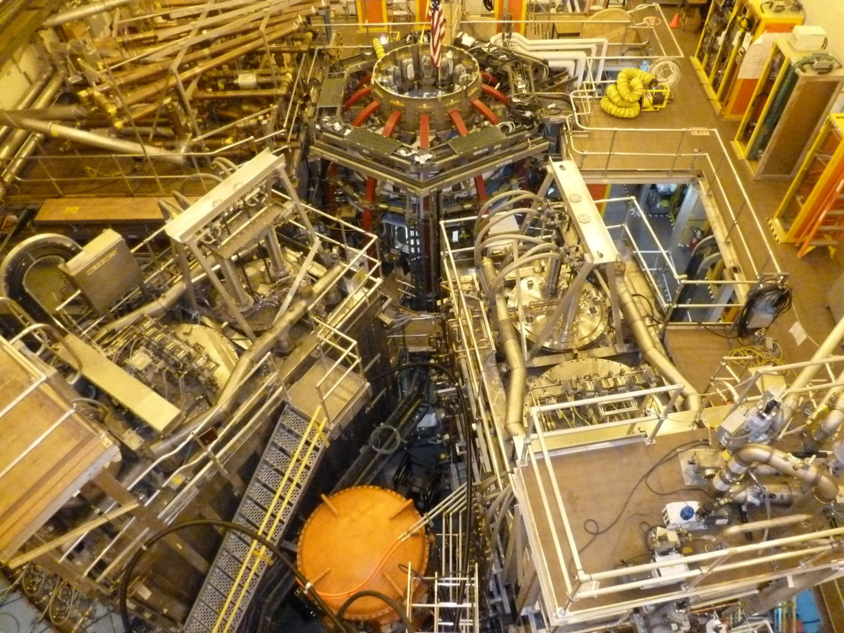
NSTX Upgrade Project nearing completion
First plasma expected Mar/Apr 2015, research in May/June
1st NBI
New 2nd NBI
11

Slide 12
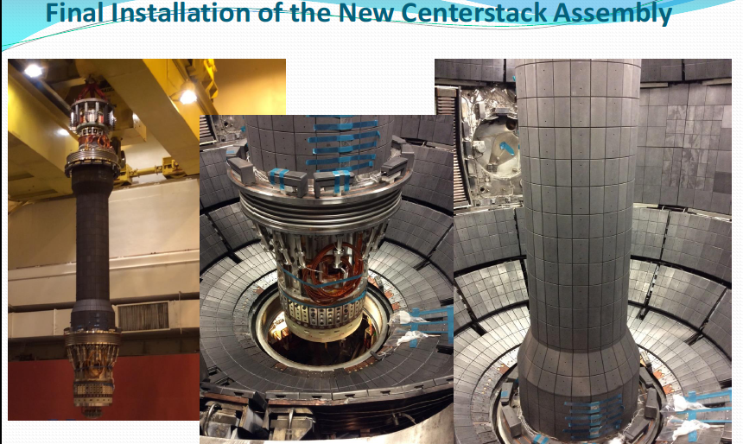
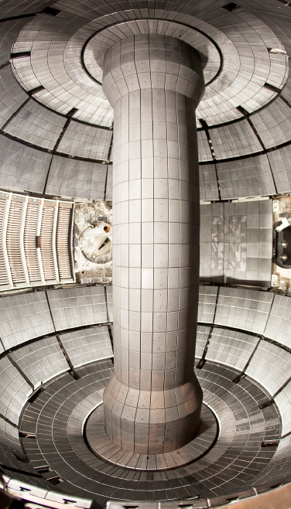
New Center-Stack Installed In NSTX-U
Vacuum pump-down achieved last month (January)

Slide 13
Talk Outline
Introduction to Spherical Tokamaks/Tori (STs)
Description of NSTX Upgrade
Unique physics characteristics of ST and research opportunities
  Macroscopic Stability
  Transport and Turbulence
  Boundary Physics
  Energetic Particles
  Non-inductive start-up, ramp-up, sustainment
Summary

Slide 14
Higher β_{T} enables higher fusion power and compact FNSF for required neutron wall loading
P_{fusion} ∝ ⟨p⟩ ² x Vol
Data base from START, MAST, PEGASUS and NSTX
β_{N} = 6
40
5
P_{fusion} ∝ β_{T}² B_{T0}⁴ x Vol
4
$
Toroidal β (%)
ST-FNSF
Product
Physics Knob
3
Investment
20
Tokamak
2
High neutron wall loading W_{n} possible in a compact ST
ITER
0
8
0
4
W_{n} ∝ P_{fusion} / Area
I_{p}/aB_{T0} (MA/mT)
W_{n} ∝ β_{T}² B_{T0}⁴ a (not strongly size dependent)
W_{n} ~ 1 MW/m² with R ~ 1 m FNSF feasible!

Slide 15
Record β_{N} and β_{N} / l_{i} accessed in NSTX
using resistive wall mode stabilization
High β_{N} regime is important for bootstrap current generation.
High β_{N}/l_{i} regime important since high f_{BS} regime has low l_{i}.
ST-FNSF
Unstable RWM
Stable / controlled RWM
S.A. Sabbagh PRL(2006)
J. W. Berkery, PRL (2011)
W. Zhu, PRL (2006)
S.A. Sabbagh at this APS
Major mission of NSTX-U is to achieve fully non-inductive operations at high β

Slide 16
Research opportunities
How do RWM stability and rotation damping from neoclassical toroidal viscosity (NTV) change at the lower (ultimately up to 10x lower) collisionality values of NSTX-U?
  Enhanced kinetic damping for RWM?
  Enhanced rotation damping in 1/ν regimes?
What are leading causes of disruptions in ST? and what are implications for next steps?
  NSTX-U will implement advanced profile and instability controls – how much does this reduce disruptivity?
  NSTX-U will perform in-depth study/diagnosis of “halo/hiro” currents, i.e. edge plasma and wall currents and forces induced by disruptions

Slide 17
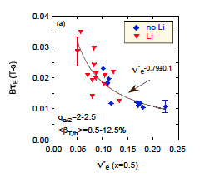
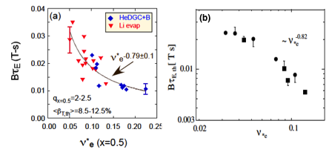
Favorable Confinement Trend with Collisionality and β found
Important implications for future STs and Demo with much lower ν*
τ_{E, th} ∝ ν_{*e}^{-0.1} β^{-0.9} tokamak empirical scaling (ITER98_{y,2})
τ_{E, th} ∝ ν_{*e}^{-0.8} β^{-0.0} ST scaling
NSTX
Fig. 70. (a) Normalized confinement time as a function of collisionality at mid-radius in NSTX. Blue points are from discharges that used HeGDC+B wall conditioning, while red points are from discharges that used Li. Reprinted with permission from S.M. Kaye et al., Nucl. Fusion 53 063005 (2013). Copyright (2013). Institute of Physics.
(b) Collisionality scan of thermal energy confinement time in MAST. Reprinted with permission from M. Valovic et al., Nucl. Fusion 51 073045 (2011). Copyright (2011) Institute of Physics.
NSTX
MAST
~ ν_{*e} ^{-0.82}
B τ_{E,th} [ T s]
ν_{*e}
S.M. Kaye et al., NF (2007) (2013)
M. Valovic et al., NF (2011)
Very promising ST scaling to reactor condition, if continues on NSTX-U/MAST-U

Slide 18
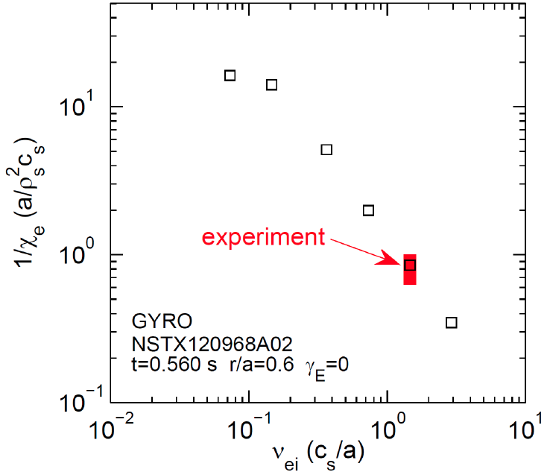


Microtearing-driven (MT) transport may explain ST collisionality scaling
Microtearing-driven χ_{e} vs. ν_{ei} using the GYRO code.
MT growth rate decreases with reduced collisionality in qualitative agreement with the NSTX experiment.
Further electron confinement improvement expected due to reduced collisionality.
NSTX-U
W. Guttenfelder, et al., PoP(2012)

Slide 19
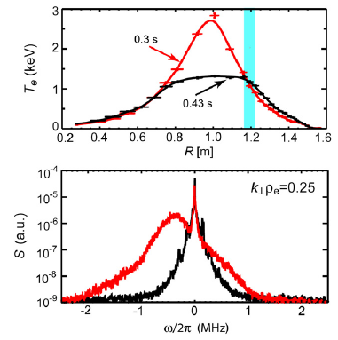
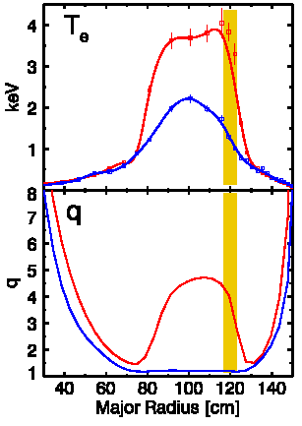
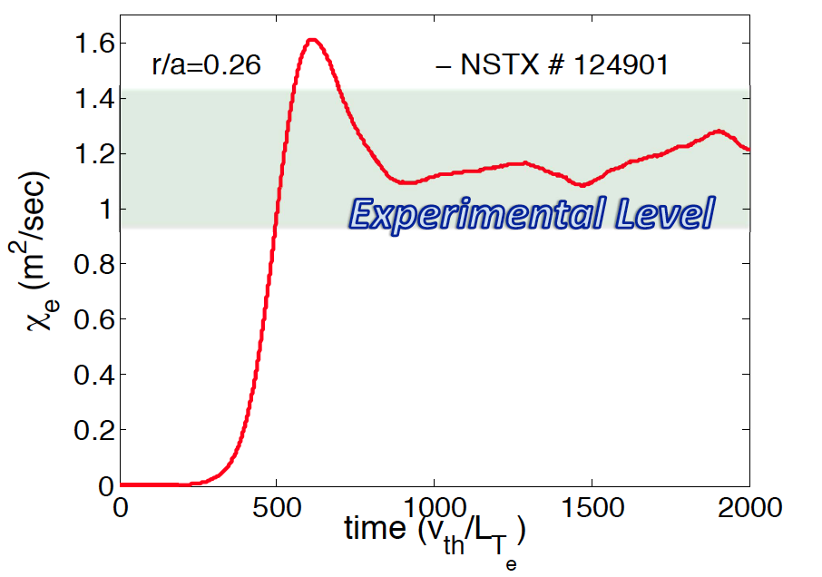
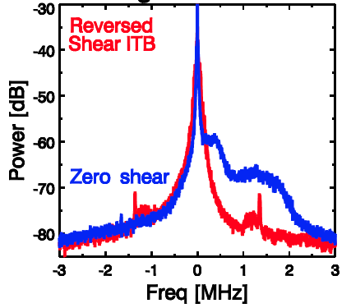
ETGs measured for the first time with high-k scattering
High β_{e} or larger ρ_{e} ∝ β_{e}^{0.5} of ST plasma enabled measurement of ETGs.
Electron Temperature Gradient Mode (ETG) Excitation with Core Electron Heating
ETG Suppression in Reversed Shear
Calculated ETG χ_{e} by GTS code agrees with experiment
χ_{e} (m²/sec)
χ_{e} (m²/sec)
χ_{e} (GTS)
time (V_{th}/L_{Te})
S. Ethier et al., IAEA (2010)
E. Mazzucato et al., NF (2009)
Shear stabilization of ETGs D. R. Smith, et al., PRL (2009)
Density gradient stabilization of ETGs Y. Ren, et al., PRL (2011)
Note: Here we call electron gyro-scale turbulence as ETGs
H.Y. Yuh et al., PoP (2009)
J.L. Peterson, et al., PoP(2011).

Slide 20
Research opportunities
What are the leading causes of anomalous electron transport in the ST, and tokamaks generally?
  Will electrostatic turbulence (ETG, TEM) dominate over micro-tearing (χ_{e} ~ ν) at lower collisionality values of NSTX-U?
Will ion thermal and impurity transport remain predominantly neoclassical?
  Neoclassical diffusivities also scale ~ ν
Notes:
Here is the outline of this review to give you an overview of the world ST research.

Slide 21
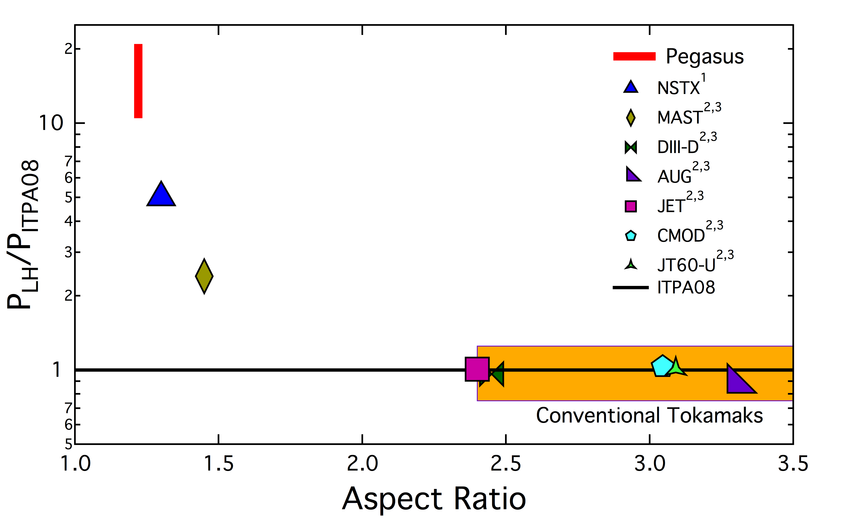
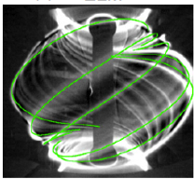
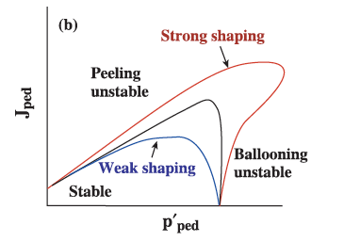
H-mode / ELM physics: High Priority Research Goal
Unmitigated ELMs could cause PFC damage in reactors
Video images of MAST plasmas showing a filamentary ELM structure.
ST is in strongly shaped ELM regimes
L-H power threshold scaling extended for low A
P.B. Snyder et al., PoP (2002).
MAST
(Type I)
NSTX, PEGASUS
(Type I)
FNSF
  N. Ben Ayed et al., PPCF (2009).
K.E. Thome et al., EPR (2014)
• NSTX/MAST/PEGASUS accessed H-mode at very low heating power < 1 MW and also in ohmic plasmas
• NSTX-U and MAST-U will provide H-mode access scaling for FNSF

Slide 22
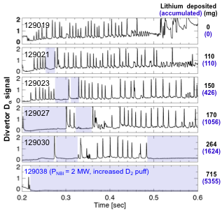
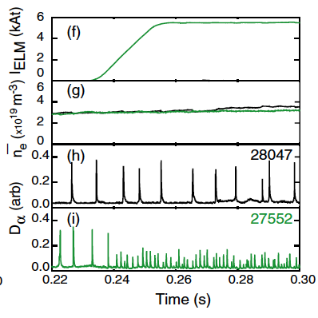
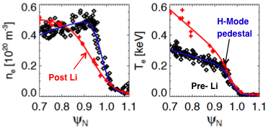
ELM Stabilization and Mitigation
Through application of lithium and 3-D fields
ELMs stabilized with edge pressure modification with Li in NSTX
ELM mitigation with n=3
3-D fields (ELM Coils) in MAST
D.K. Mansfield, et al., JNM (2009)
Increasing Type I ELM freq. by x 8 (900 Hz) has reduced heat flux
R. Maingi, et al., PRL (2009).
A. Kirk et al., NF (2013)

Slide 23
Research opportunities
At higher aspect ratio and lower collisionality of NSTX-U, will ELMs remain predominantly J||-driven?
H-mode pedestal profiles determine overall fusion performance…. But what are dominant transport mechanism(s) in the H-mode pedestal region?
  Neoclassical, kinetic ballooning, electron ∇T (ETG), other?
  Ahmed Diallo’s Early Career Award with “burst” Thomson Scattering will help determine fast time evolution, transport
Lithium coatings substantially increased NSTX global confinement (1.4x ITER H) – important for next-steps
  How high can we make energy confinement in NSTX-U?
  2x ITER H-mode scaling? What sets the limit?

Slide 24
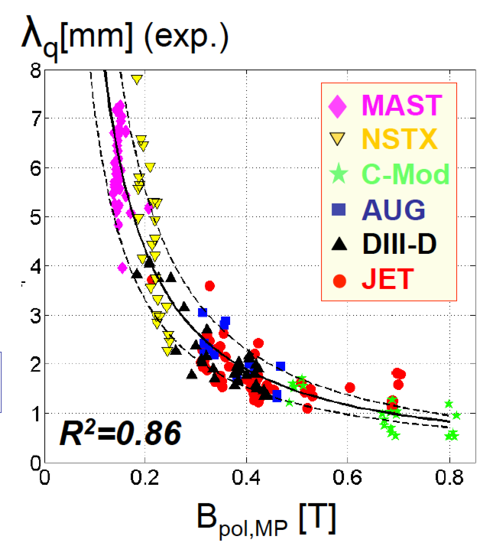
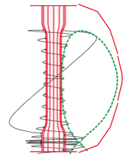
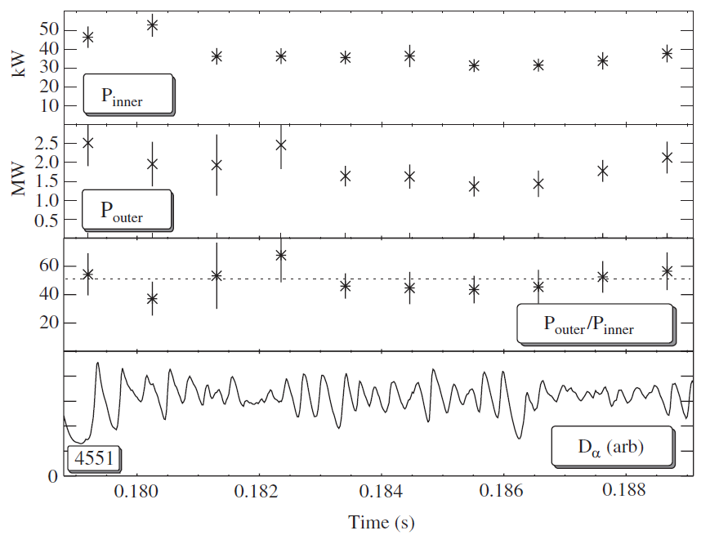
Divertor heat flux in Low-A regime
ST power flux width clearly shows 1/B_{poloidal} variation
STs data breaks A degeneracy of power flux width study.
Most divertor power arrives at outboard side in MAST and NSTX!
T. Eich et al., NF (2013).
P_{OB} >> P_{IB}
Inboad heat flux
Outboad heat flux
Ratio of outboard power flux vs. inboard in MAST
~ 40 kW
P_{IB} (kW)
~ 2 MW
Heuristic model by R.J. Goldston, NF (2012).
P_{OB} (kW)
* Unfavorable for large size, Ip devices such as ITER and Demo
"P B / R" as the new heat flux metric which is favorable for STs
~ 50
P_{OB}/P_{IB}
Time (s)
G.F. Counsell et al., PPCF (2002)

Slide 25
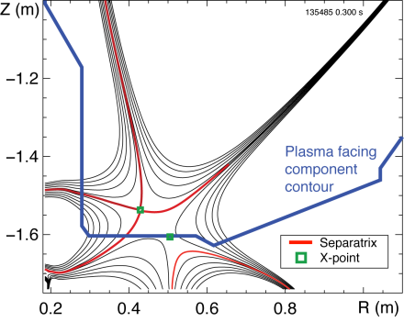
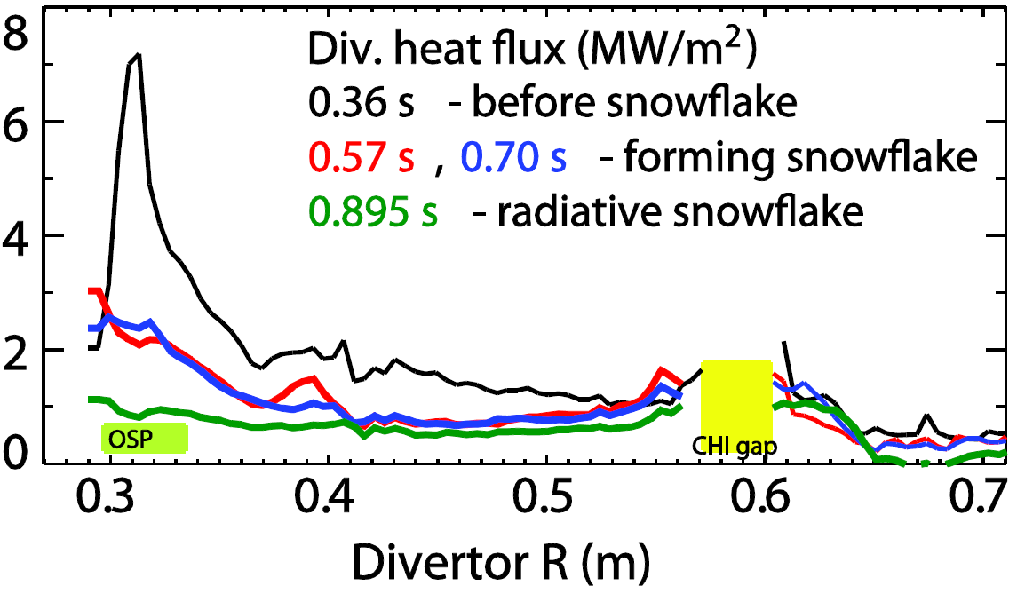
Divertor flux expansion of ~ 50 achieved with
Snow Flake Divertor with large heat flux reduction in NSTX
Snowflake divertor in NSTX
NSTX-U will investigate novel divertor heat flux mitigation concepts needed for FNSF and Demo.
• Up-and-down symmetric Snow Flake / X-divertors
• Lithium + high-Z metal PFCs
OSP
Divertor heat flux (MW/m²)
V. A. Soukhanovskii et al., PoP (2012)

Slide 26
Research opportunities
What sets the heat flux width in the open field line region?
  Mostly drifts + collisions (i.e. neoclassical) or does turbulence play a role?
How does divertor geometry (such as snowflake) influence the plasma edge properties?
How do Li and high-Z PFCs modify the edge region, and also the core performance?
  NSTX-U will study “vapor shielding” regime to improve understanding of Li evaporation + radiation and impact on power exhaust / heat-flux mitigation / core performance

Slide 27
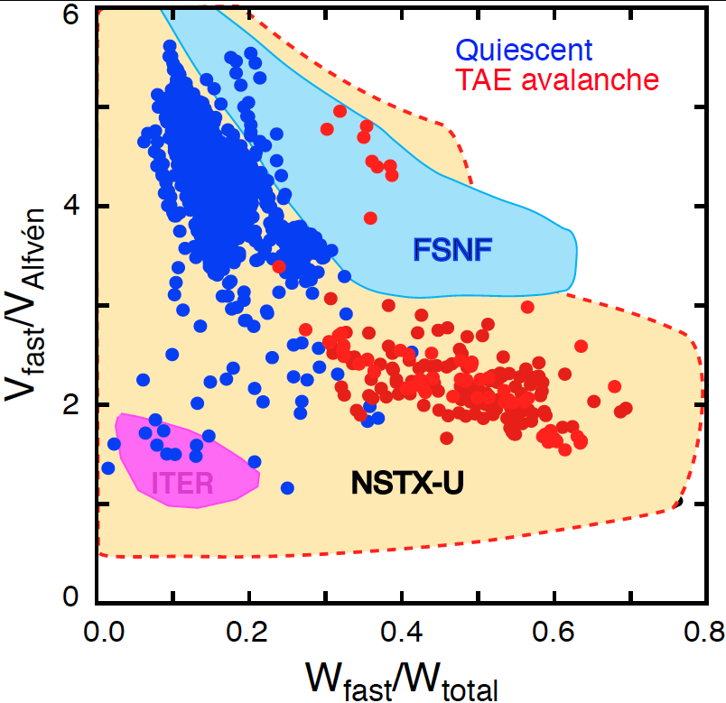
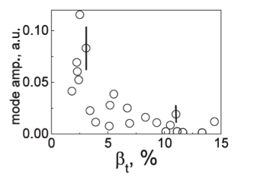
NBI heated ST plasmas provide an excellent testbed for α-particle physics
Alfvenic modes readily accessed due to high V_{α} > V_{Alf}
α-particles couples to Alfven-type mode strongly when V_{α} > V_{Alf} ~ β^{−0.5} Cs
V_{α} > V_{Alf} in ITER and reactors
In STs, the condition is easily satisfied due to high beta
A prominent instabilities driven by fast particles are global and called toroidal Alfven eigenmodes (TAE).
NSTX-U will also explore V_{α} < V_{Alf} regime giving more flexibility
EP parameter space
TAEs significantly modified at high β as V_{Alf} C_{s}
Stabilization of TAEs at high β in MAST
  M.P. Gryaznevich et al. PPCF (2004)
  E. D. Fredrickson et al., NF (2013)

Slide 28
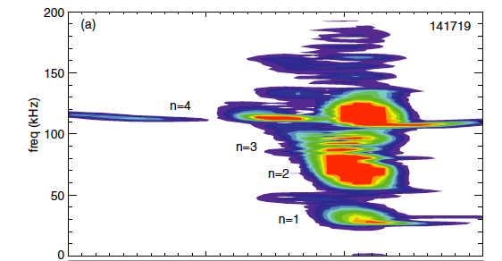
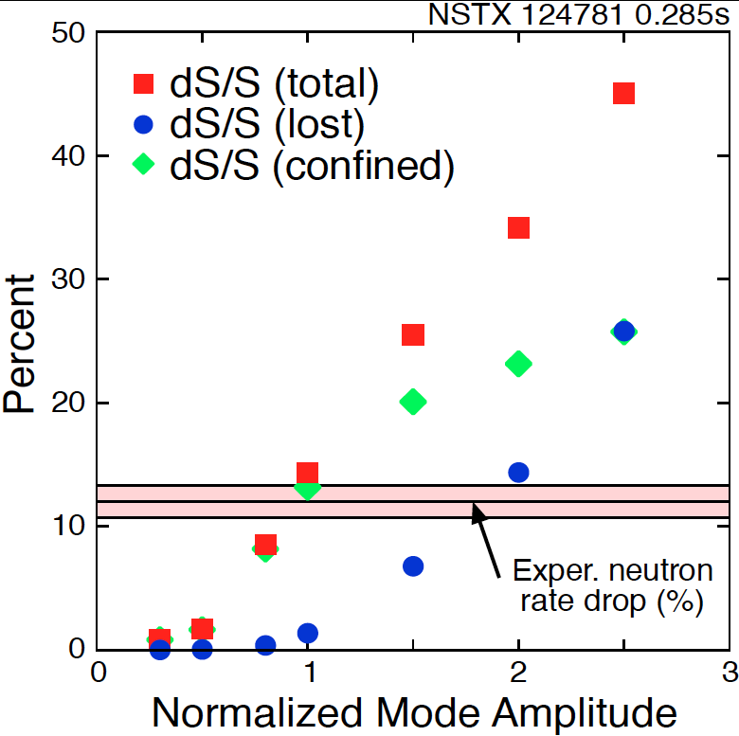
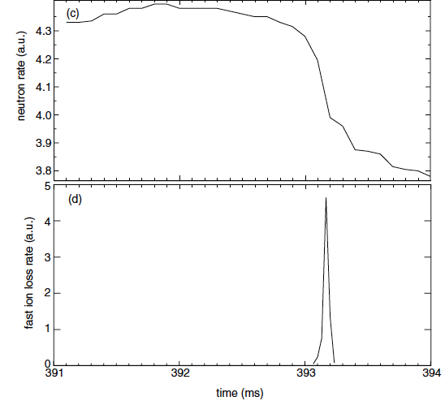
“TAE avalanche” shown to cause energetic particle loss
Uncontrolled α-particle loss could cause reactor first wall damage
Multi-mode TAE avalanche can cause significant EP losses as in “sea”of TAEs expected in ITER
Progress in simulation of neutron rate drop
due to TAE avalanche
(a)
Frequency (kHz)
Neutron rate (a.u.)
Fast ion loss rate (a.u.)
Time (ms)
Time (ms)
D.S. Darrow et al., NF (2013).
  E. D. Fredrickson et al., NF (2013)

Slide 29
Research opportunities
Will reduced drive for fast-ion instabilities in NSTX-U reduce anomalous fast-ion transport?
How will NSTX-U plasmas respond to more tangential neutral-beam / fast-ion injection?
  Are current and momentum drive consistent with theory?
What is role of high-f fast-ion instabilities (GAE/CAE) in core electron transport?
  Is this physics unique to high-beta/ST?

Slide 30
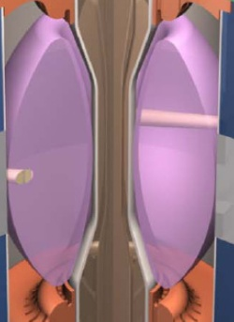
I_{P} Start-up/Ramp-up Critical Issue for ST-FNSF/Demo
Compact ST-FNSF has no/small central solenoid
ST-FNSF Scenarios
high β_{T}, β_{N}, κ, disruption avoidance, high H, heat flux mitigation
I_{P} [MA]
Current ramp-up and profile control
NBI
Solenoid-free
Start-up
HHFW
EC/EBW, HI, PF
Time
• Two novel techniques for solenoid-free start-up and ramp-up will be investigated
  RF: ECH/EBW and HHFW
  Helicity Injection
~ 1-2 MA of solenoid-free start-up current needed for FNSF
Notes:
ST has been addressing critical issues for FNSF: A compact FNSF facility does not have solenoid. So, the solenoid-free start-up is a critical issue for ST-FNSF. But solenoid-free start-up is attractive for tokamak reactor design as well. Other issues are ramp-up….

Slide 31
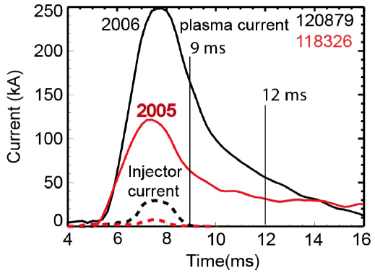
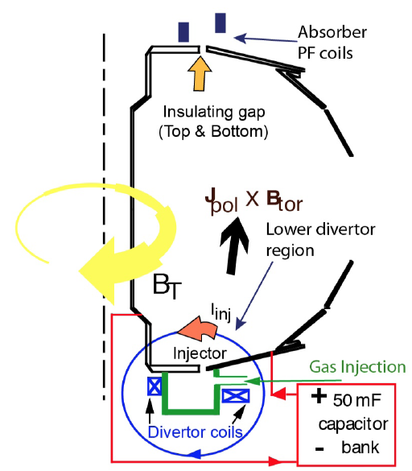
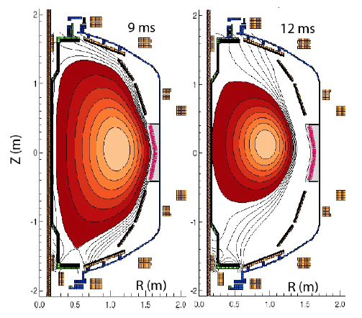
Helicity Injection Is an Efficient Method for Current Initiation
Coaxial Helicity Injection (CHI) Concepts Being Developed
CHI developed on HIT and HIT-II and transferred to NSTX
Discharge evolution of 160 kA closed flux current produced by CHI alone in NSTX
R. Raman et al., PRL (2006)

Slide 32
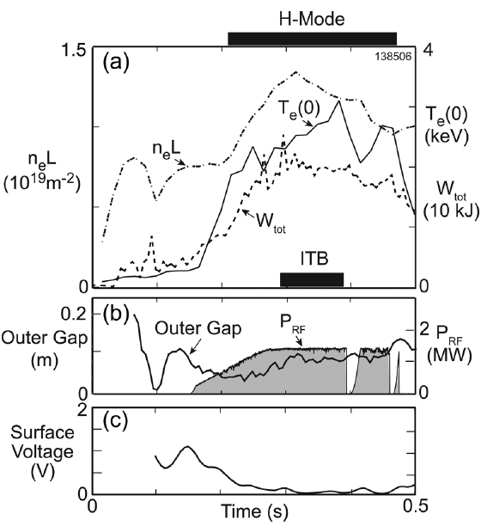
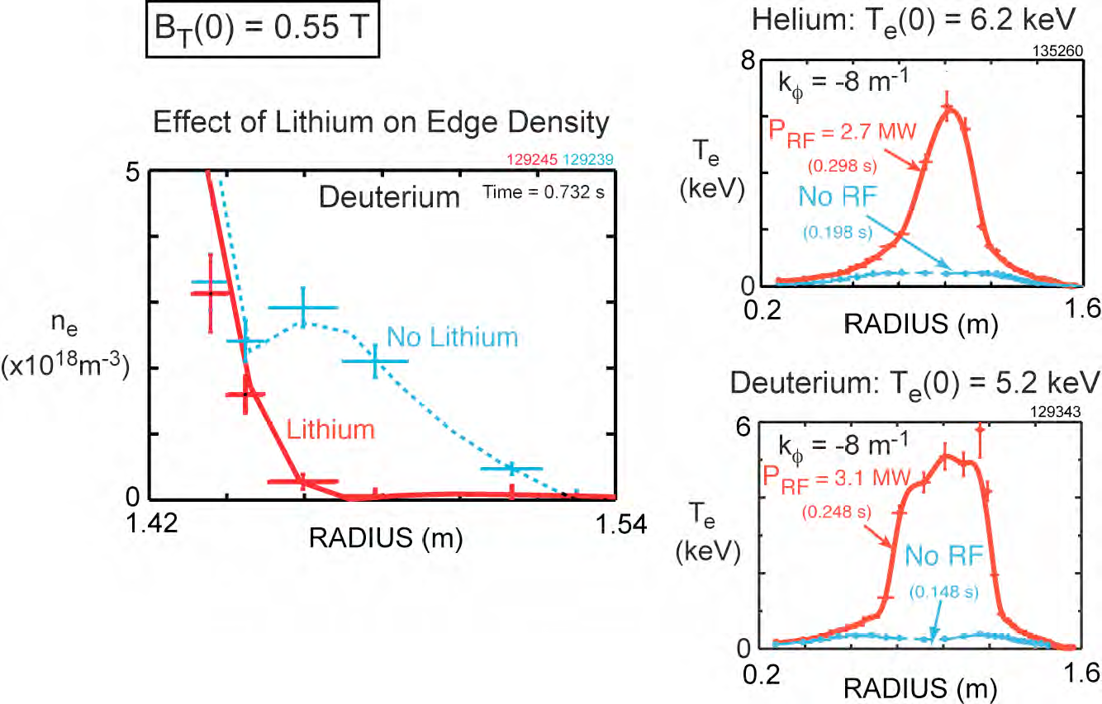
Current Ramp-Up and Profile Control Crucial for FNSF
Major Research Topics for NSTX-U
Efficient HHFW electron heating due to high β_{e} achieved in NSTX.
Near sustained discharges obtained with modest HHFW power
NSTX
G. Taylor et al., PoP (2010), (2012)
HHFW current ramp-up will be tested in NSTX-U at higher power ~ 4 MW.

Slide 33
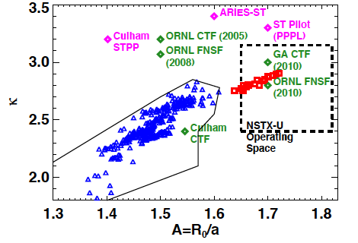
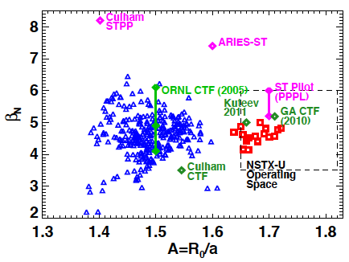
NSTX has accessed A, β_{N}, κ needed for ST-based FNSF
Requires f_{BS} ≥ 50% for plasma sustainment
f_{BS} ≡ I_{BS} / I_{p} = C_{BS} β_{p} / A^{0.5} = (C_{BS}/20) A^{0.5} q* β_{N} ∝ A^{-0.5} (1+κ²) β_{N}² / β_{T}
SC-ST
S.P. Gerhardt et al., NF (2011)
NSTX achieved f_{BS} ~ 50% and f_{NI} ~ 65-70% with beams
NSTX-U expects to achieve f_{NI} ~100% with the more tangential NBI (~ 1.5- 2x higher current drive efficiency)

Slide 34
Research opportunities
Can NSTX-U really sustain all of its current without a transformer? If so, at what performance level?
If NSTX-U succeeds at non-inductive sustainment, what level of non-inductive start-up and ramp-up is achievable?
  Is it really possible to have a tokamak with NO solenoid?
Can we develop simple yet powerful enough models to simulate all this accurately?
  Complex combination of current drive, transport, stability (TRANSP, TSC, + other models)

Slide 35
Summary
NSTX-U will provide many opportunities to study toroidal confinement physics in new regimes:
  Low aspect ratio, strong shaping, high β, low collisionality
  Access to strong fast-ion instability drive, high rotation
  Advanced divertors, lithium walls, high-Z PFCs
The opportunities described here are just a small fraction of the research possibilities available!
Please see next slide for people to contact for more
Notes:
Here is the outline of this review to give you an overview of the world ST research.

Slide 36
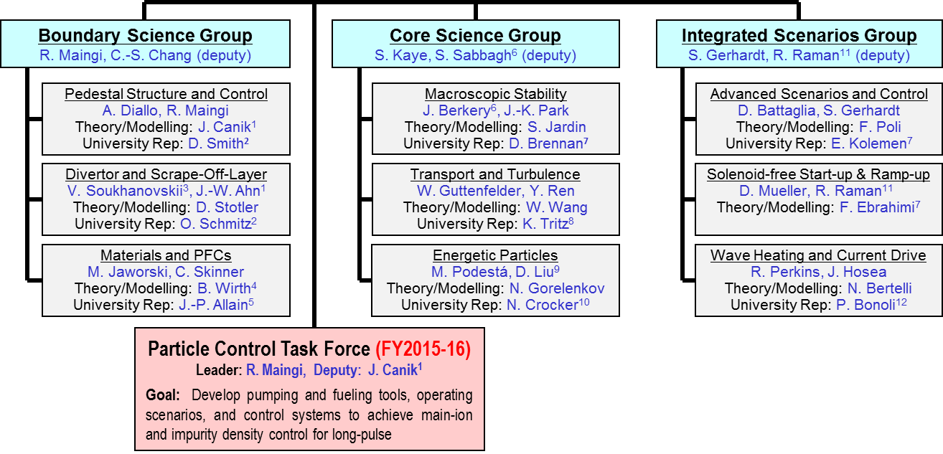
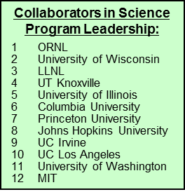
Contacts for 1st/2nd year projects, thesis ideas
Notes:
Here is the outline of this review to give you an overview of the world ST research.

