Slide 1




NSTX-U
Supported by
Program update - with emphasis on collaboration plan during Upgrade outage
J. Menard
Columbia U
CompX
General Atomics
FIU
INL
Johns Hopkins U
LANL
LLNL
Lodestar
MIT
Nova Photonics
New York U
ORNL
PPPL
Princeton U
Purdue U
SNL
Think Tank, Inc.
UC Davis
UC Irvine
UCLA
UCSD
U Colorado
U Illinois
U Maryland
U Rochester
U Washington
U Wisconsin
Culham Sci Ctr
U St. Andrews
York U
Chubu U
Fukui U
Hiroshima U
Hyogo U
Kyoto U
Kyushu U
Kyushu Tokai U
NIFS
Niigata U
U Tokyo
JAEA
Hebrew U
Ioffe Inst
RRC Kurchatov Inst
TRINITI
NFRI
KAIST
POSTECH
ASIPP
ENEA, Frascati
CEA, Cadarache
IPP, Jülich
IPP, Garching
ASCR, Czech Rep
NSTX-U FY2012 1st Quarter Review
B205 - PPPL
January 27, 2012

Slide 2
Outline
Overview of researcher activities for 2012-13
FY2012-14 milestones
PAC-31 charge issues/questions
Schedule for 5 year plan preparation
Collaboration overview
Summary

Slide 3
Staff plans for FY2012-13 analysis and research
Complete analysis and publication of FY2011-12 data
Develop, write NSTX Upgrade 5 year plan for 2014-18
Planning and design studies supporting post-Upgrade ops:
  Start-up: CHI upgrades, point helicity injection (plasma guns)
  Boundary: Divertor cryo-pumps, divertor diagnostics
  Lithium: Additional Mo tiles, upward Li evaporators, next-gen LLD
  Transport, EP: New high-k scattering, polarimetry, assess solid-state NPA
  MHD: 3D-coil physics design for RWM/RMP/TM/EFC/NTV/TAE + disruption force diagnostics, disruption precursor ID
  Control: Rt-MSE for NBI J-profile control, rt-control of heat flux
Update/extend physics design of ST-FNSF
  LDRD to further develop configuration/concepts, utilize NSTX team expertise
  Predictive modeling of start-up, sustainment, transport, stability, divertor
  Will be topic of future Monday AM videoconference
Collaborate on domestic and international facilities
  Initial collaboration plans described with research plans

Slide 4
FY2012-14 research milestones emphasize analysis, simulation, and projection to and preparation for NSTX-U
FY2012
FY2013
FY2014
Expt. Run Weeks:
12
Transport and Turbulence
Perform integrated physics+optical design of new high-k_{θ} FIR system
Macroscopic Stability
Investigate magnetic braking physics and toroidal rotation control at low ν* (with ASC TSG)
Assess access to reduced density
and ν* in high-performance scenarios (with ASC, BP TSGs)
Boundary
and Lithium
Project deuterium pumping using lithium coatings and cryo-pumping
Assess relationship between lithium-conditioned surface composition and plasma behavior
Waves+Energetic Particles
Perform physics design of ECH & EBW system for plasma start-up & current drive in advanced scenarios
Assess reduced models for *AE mode-induced fast-ion transport
Solenoid-free Start-up/ramp-up
Simulate confinement, heating, and ramp-up of CHI start-up plasmas
(with HHFW TSG)
Adv. Scenarios and Control
Assess advanced control techniques for sustained high performance (with MS, BP TSGs)
ITER Needs + Cross-cutting
Identify disruption precursors and disruption mitigation & avoidance techniques for NSTX-U and ITER
Joint Research Target (3 facility)
Understand core transport and enhance predictive capability
Stationary regimes w/o large ELMs, improve understanding of increased edge particle transport
TBD

Slide 5
NSTX-U PAC meeting – April 17-19, 2012
Preliminary ideas for PAC charge topics/questions:
NSTX-U team scientific productivity during Upgrade outage
  Analysis, publications, present and upcoming milestones
NSTX-U team participation and utilization of collaboration with other facilities to prepare for NSTX-U operation and contribute to fusion science generally
Preliminary ideas and preparation for 5 year plan:
  Initial operation of NSTX-U = 2014-15
  Longer term: later stages of 5 year plan = 2016-18

Slide 6
Draft schedule for 5 year planning preparation
Jan-Mar 2012 – define physics program, needed diagnostic and facility upgrades for initial ops (2014-15) and 2016-18
April 2012 – get initial feedback from PAC on long-term plans
May 2012 – formulate/finalize plan elements and outline, identify/finalize authors, begin writing chapters
October 2012 – First drafts of plan chapters due
Nov-Dec 2012 – internal review/revision/editing of plan
Jan/Feb 2013 – 5 yr plan presentation ‘dry-run’ to PAC-33
Plan presented to Review committee and FES Mar/Apr 2013

Slide 7
Collaborations: Held team-wide discussion on FY12-13 opportunities and expectations in Sep-Dec 2011
Collaboration should aim to support NSTX-Upgrade mission
  Also support toroidal physics generally, ICCs, and non-fusion applications
For all researchers, use Upgrade outage as opportunity to:
  Extend and improve your ongoing and future research on NSTX
  Learn about other facilities – bring back knowledge, best practices
  Try or learn something new – new physics, diagnostics, analysis, …
Aim to form small teams from NSTX (PPPL + non-PPPL)
  Coordinate research plans, analysis, travel, and participation
Expectations for researchers:
  Select 1 primary and 1 secondary/backup collaboration project
  Aim for 1st author papers, invited talks – PRL/NF/PoP, APS/IAEA
  Present your results periodically to NSTX, PPPL research seminars
Facilities: MAST, DIII-D, C-Mod, LHD, EAST, KSTAR, JET, more to come
Funding: PPPL covers salaries of PPPL NSTX researchers by default
Challenge: no additional NSTX funding dedicated to collaboration
Working closely with PPPL off-site research department

Slide 8
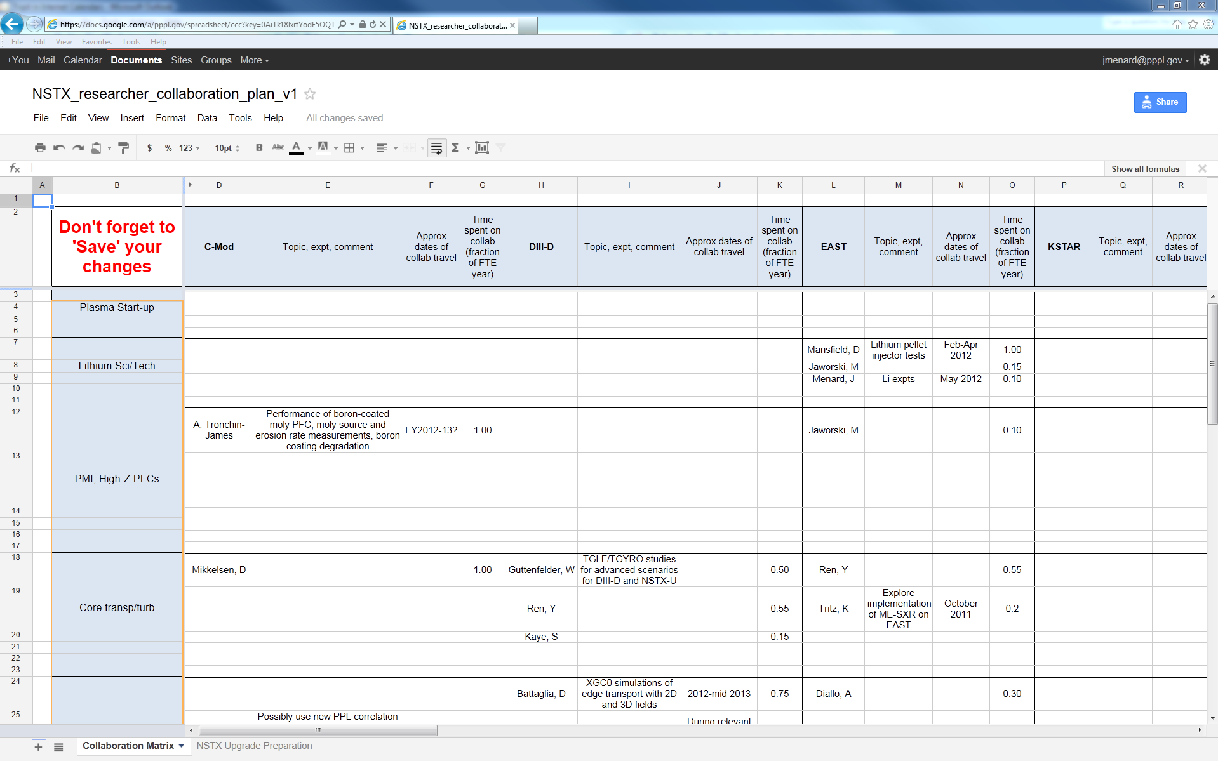
Google docs used to share collaboration plan – organized by topic, facility, person, date, FTE-yrs
https://docs.google.com/a/pppl.gov/spreadsheet/ccc?key=0AiTk18lxrtYodE5OQTJkeVFsdU42eWN0alVnaHFyWUE#gid=0
Click the link above (should be available to all), or e-mail me at jmenard@pppl.gov if you have trouble
Entries with topics and travel dates are the most well defined, others may be place-holders

Slide 9
Collaborations in materials/PMI, boundary physics
EAST is only other divertor H-mode facility using lithium
  Li/transport expts on EAST – D. Mansfield, J. Menard, M. Jaworski, K. Tritz
Li surface chemistry issues on LTX, working with PU, Purdue
  Use Purdue MAPP on LTX + surface/PMI studies – C. Skinner, M. Jaworski
  Improve equilibrium reconstruction/control on LTX – Gerhardt, Menard
Assess high-Z PFCs for NSTX-U through collaboration on C-Mod
  LLNL group to assess: Mo with low-Z coatings, study cryo-pump for density control with moly PFC (particle balance, supersonic gas jet fueling), possibly radiative divertor control development
Develop NSTX-U snowflake control on DIII-D
  V. Soukhanovskii + E. Kolemen
Test LLNL SPRED, NIR for NSTX-U divertor diagnosis
  LLNL to work with Y. Raitses’ LTP source
Pedestal/SOL transport, turbulence, stability research for ITER and NSTX-U
  Pedestal turbulence using correlation reflectometer on C-Mod - A. Diallo
    A. Diallo also planning XPs on DIII-D (R. Groebner), possibly MAST
  XGC0 simulations of DIII-D edge transport w/ 2D & 3D fields - D. Battaglia
  SOL turbulence measurements with GPI on EAST, C-Mod - S. Zweben

Slide 10
Collaborations on core transport and turbulence
Pursue TGLF/TGRYO studies for scenario prediction for NSTX-U and DIII-D, also DIII-D transport studies
  W. Guttenfelder, Y. Ren, and S. Kaye
Comparison of NSTX and MAST transport physics, BES data
  S. Kaye, W. Guttenfelder, D. Smith/Univ. Wisconsin
Exploration of new/needed turbulence diagnostics for NSTX-U
  PCI for intermediate k_{θ} ρ_{s} (C-Mod) – Y. Ren
  Polarimetry for δB from μ-tearing (DIII-D & C-Mod) – Ren, Guttenfelder
Impurity transport studies, perturbative transport
  Exploring use of ME-SXR on EAST for profile meas. – K. Tritz (JHU)
3D field effects on transport and turbulence
  Transport simulations on LHD - D. Mikkelsen & (maybe) W. Guttenfelder

Slide 11
Collaborations in start-up, scenarios/control, MHD
Plasma start-up
  Work with Pegasus on plasma guns, possibly DIII-D to improve PF-only + EC start-up and inform proposed NSTX-U ECH/EBW – D. Mueller
  Investigate application of CHI on QUEST – R. Raman (U. Wash)
  EBW startup experiments on MAST - G. Taylor
Advanced Scenarios and Control - E. Kolemen (relocated to GA)
  Prepare for current and rotation profile control in NSTX-U through collaboration on DIII-D using off-axis NBI (and counter-NBI), NTV
  Contribute to development of ITER plasma control specification
  MAST vertical control analysis/experiments – prep for NSTX-U/MAST-U
  Long-pulse tokamak ops/control experience (EAST/KSTAR) – D. Mueller
MHD Physics
  Assist DIII-D in new 3D δB sensors - N. Logan, J-K Park, J. Menard
  3D field physics in long-pulse H-mode in KSTAR – J.-K. Park, S. Sabbagh
  RWM physics at reduced ν* on DIII-D, NTV on MAST – S. Sabbagh/CU

Slide 12
Collaborations in waves and energetic particles, and diagnostic development
RF coupling and edge-loss studies in DIII-D for NSTX-U, ITER
  J. Hosea, R. Perkins, G. Taylor
RF-only H-mode in EAST – R. Wilson, G. Taylor
  Supports RF-only plasma heating/start-up studies for NSTX-U
Energetic particles and Alfvén eigenmode physics
  Study fast-ion physics on JET (2 year relocation), prep for possible DT campaign, beam ion loss measurements on LHD - D. Darrow
  Several fast-ion/AE physics opportunities on MAST
    Assess operation of MAST *AE antenna, participate in expts – E. Fredrickson
    Assess performance of neutron collimator, NBI fast-ion redistribution models – M. Podesta
    Fusion product loss detector – D. Darrow, W. Boeglin
Diagnostic development
  Assist with ITER diagnostics – B. Stratton
  Assist with MPTS on JET, LTX, maybe KSTAR & Pegasus – B. LeBlanc
  Develop/prepare new Accurate Wavelength Lens Spectrometer (AWLS) on LTX for installation/usage on NSTX-U – R. Bell

Slide 13
Some statistics, and issues going forward
Tracking 30-35 researchers, including on-site collaborators
  ~90% of researchers have definitive plans well-aligned with NSTX-U and/or PPPL research goals
Approximate order of collaboration emphasis by facility:
  DIII-D, C-Mod, EAST, MAST, KSTAR, LHD, LTX, …
  U.S. facilities most mature in diagnostics, tools, analysis, and are therefore often most attractive to researchers
EAST and KSTAR have expressed strong interest in collaboration from PPPL/NSTX researchers
  EAST, KSTAR still developing diagnostics, heating systems, organization for integrating collaborators – improving
Prep for NSTX-U operation highest priority by late 2013
  Also tracking who/what is needed for operations and diagnostics

Slide 14
Summary
Physics analysis and publication progressing well
  Papers published Oct-Nov 2011: 21+
  Papers submitted (in review): 13
  APS-DPP
    Invited talks: 7
    Contributed Orals: 13
    Contributed Posters: 48
  APS April Meeting (upcoming): 1 invited talk (momentum transport)
Brainstorming/planning for 5 year plan underway
Collaboration planning & preparation progressing well
  Many opportunities and interested researchers identified
  Strong support of NSTX-U/PPPL/FES strategic goals

Slide 15
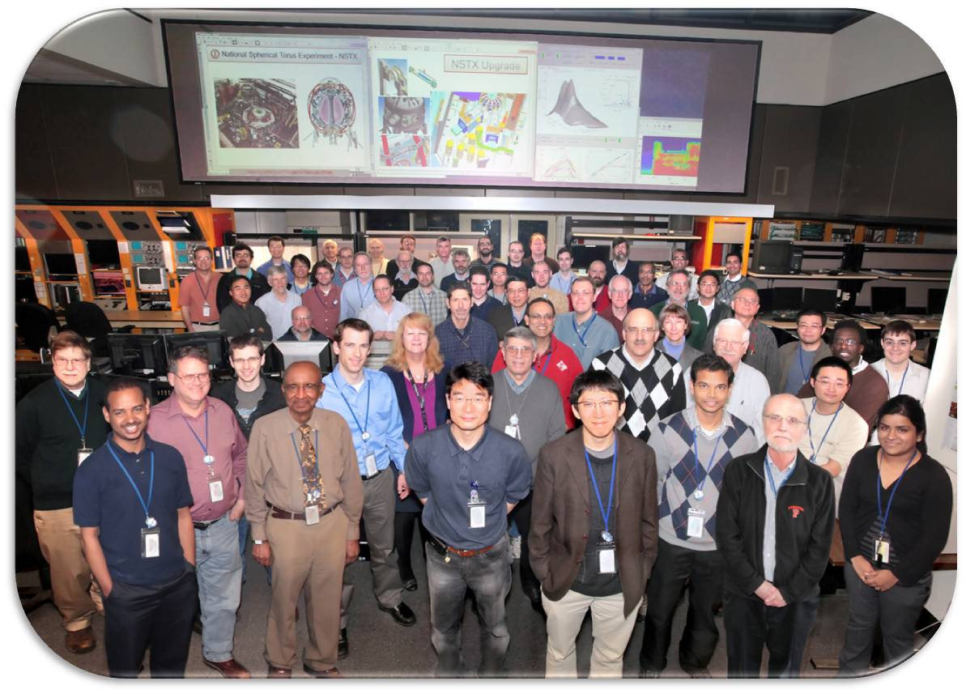
NSTX
Supported by
NSTX Facility Update
College W&M
Colorado Sch Mines
Columbia U
CompX
General Atomics
INEL
Johns Hopkins U
LANL
LLNL
Lodestar
MIT
Nova Photonics
New York U
Old Dominion U
ORNL
PPPL
PSI
Princeton U
Purdue U
SNL
Think Tank, Inc.
UC Davis
UC Irvine
UCLA
UCSD
U Colorado
U Illinois
U Maryland
U Rochester
U Washington
U Wisconsin
Culham Sci Ctr
U St. Andrews
York U
Chubu U
Fukui U
Hiroshima U
Hyogo U
Kyoto U
Kyushu U
Kyushu Tokai U
NIFS
Niigata U
U Tokyo
JAEA
Hebrew U
Ioffe Inst
RRC Kurchatov Inst
TRINITI
KBSI
KAIST
POSTECH
ASIPP
ENEA, Frascati
CEA, Cadarache
IPP, Jülich
IPP, Garching
ASCR, Czech Rep
U Quebec
NSTX-FES FY 2012 Q-1 Review
January 27, 2012

Slide 16
Outline
FY 2012 Facility Summary and Status
ARRA Upgrade Project Final Report
FY2012-14 Facility and Diagnostic Planning

Slide 17
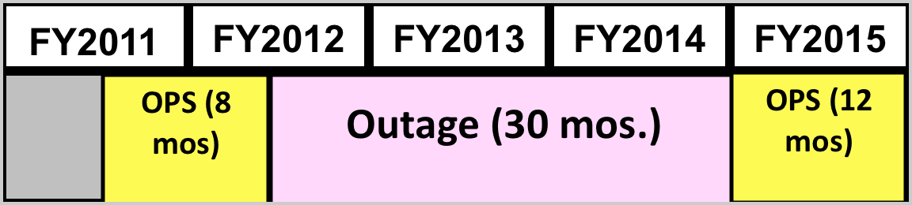
Upgrade acceleration maximizes NSTX run time and scientific productivity over next 5 yr period (2011-15)
Base Plan
OPS
Outage (30 mos.)
OPS
Revised
Plan
Outage (30 mos.)
OPS
APS
APS / IAEA
APS
APS / IAEA
CD-3
Approval
CD-4
Completion
Next Five Year Plan Review
NSTX-U Ops Prep
Collaborations, data analysis / publications, next-step ST study
Next Five Year Period
FY 2014-2018
After the TF fault, the NSTX Upgrade outage started six month earlier.
Revised schedule aligns well with the next 5 year plan period.
A good progress was made in removing and storing diagnostics and related racks with adequate documentation for re-installation planned in FY 2013.
NSTX-U activities are generally going very well.

Slide 18
Good Progress on the Diagnostic Removal
62 Diagnostics - 45 removed, 5 partially removed, 6 remain
Beam Emission Spectroscopy (BES)
Bolometer - divertor array
Bolometer - midplane array
CHERS - poloidal
CHERS - toroidal
Edge bias & Langmuir probes - inter-LLD
Edge deposition monitors
Edge pressure gauges
Edge Rotation Diagnostic (ERD)
Fast cameras - divertor & LLD
Fast Ion D-Alpha (FIDA) Radial view
Fast Ion D-Alpha (FIDA) Tangential view
Fast lost ion probes
Filterscopes, 1-D D-alpha cameras (EIES)
FIReTIP - multi-chord interferometry
Gas puff imaging - divertor
Gas puff imaging - midplane
High-k scattering
Infrared cameras
Interferometry/forward scattering - 1 mm
Langmuir probes - PFC tiles
Langmuir probes - fast eroding
Langmuir probes (baffled) - outboard
Langmuir probes (high density) - inter-LLD
Magnetics - diamagnetism
Magnetics - flux loops
Magnetics - locked modes
Magnetics - outboard divertor halo current
Magnetics - Rogowski coils
Magnetics - RWM sensors
MAPP
Mirnov coils - high frequency
Mirnov coils - poloidal array
Mirnov coils - three-axis
Mirnov coils - toroidal array
MSE-CIF
MSE-LIF
Neutron detectors
NPA - E || B scanning
NPA - solid state
Plasma TV
Reflectometer - 65 GHz backscattering
Reflectometer - correlation
Reflectometer - fixed freq.
Reflectometer - FM/CW
RF Probe - lower dome
Spectroscopy - Divertor UV/visible
Spectroscopy - LOWEUS EUV
Spectroscopy - Lyman-alpha array
Spectroscopy - SPRED VUV
Spectroscopy - SWIFT 2D flow
Spectroscopy - VIPS visible
Spectroscopy - XEUS EUV
Spectroscopy - X-ray crystal - horizontal
Spectroscopy - X-ray crystal - vertical
Thomson scattering - MPTS
Visible bremsstrahlung
X-rays - "Optical" array
X-rays - Tangential TG spectrometer
X-rays - ultrafast pinhole camera
X-rays - Ultrasoft arrays
X-rays - bremsstrahlung spectrum
Removed
Partially removed
Remain
TBD

Slide 19
ARRA Funding Greatly Enhanced Research Capability
Planned ARRA Upgrades Completed on Schedule
  Extra 12 channels for the multi-pulse Thomson scattering system for improved H-mode pedestal and plasma edge spatial resolution to support the FY 11 joint research milestone.
  Enhancement to the liquid lithium divertor target capability for modifying edge collisionality, including two lithium evaporators, and LLD diagnostics.
  Post Doctoral Fellows to support the enhanced research capabilities.
  2nd switching power amplifier system for improved error field/resistive wall mode/resonant magnetic perturbation spectra to control the edge error field.
  Motional Stark Effect Laser Fluorescence advanced diagnostic system for internal magnetic and electric field measurements was installed and commissioned.
  Inboard Divertor Molybderum Tiles for assessing the viability of molybdenum tiles as a divertor PFC for NSTX-U (upper divertor being considered).
  Li Granule Injector for triggering ELMS in a controlled manner. Commissioned and planned to be tested in RFX (Italy), EAST and possibly on DIII-D

Slide 20
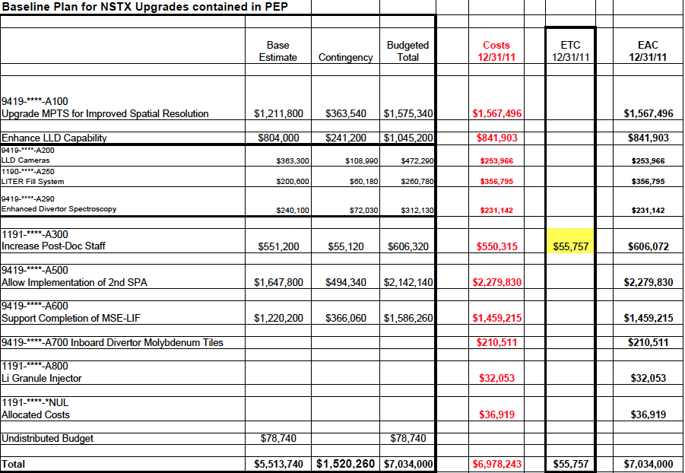
NSTX ARRA Upgrade Budget Summary ($M)
All of the Planned Upgrades Completed on Schedule

Slide 21
Facility and Diagnostic Upgrade Plans for FY 2012 – 2014
In Support of the NSTX-U Operation and Research Plan
Facility and Diagnostic Milestones:
FY 12: Identify possible high priority facility and diagnostic enhancements for the post upgrade operations
FY 13: Complete the conceptual design of high priority facility and diagnostic enhancements for post-upgrade operations
FY 14: Implement high priority facility and diagnostic enhancements for post-upgrade operations as the resource permits (if for example, the upgrade project under runs)
Other Related Activities:
NSTX Team Facility – Diagnostic Upgrade Brainstorming Meetings in July 2011 and Feb. 2012.
NSTX collaboration diagnostic grants decision in Jan-Feb, 2012
DOE advanced diagnostic grant solicitation and NSTX laboratory collaboration proposal solicitation in 2013
NSTX physics collaboration grant solicitation in 2014

Slide 22
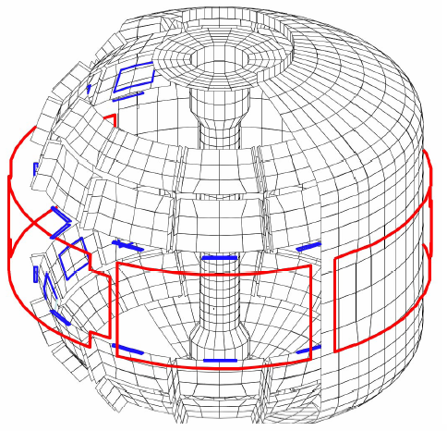
New MHD and Plasma Control Tools Available for NSTX-U
Sustain β_{N} and Understand MHD Behavior Near Ideal Limit
Copper passive
conductor plates
SS Vacuum
Vessel
2nd 3-channel Switching Power Amplifier (SPA) commissioned in July 2011 powers independent currents in six EFC/RWM coils for simultaneous control of n = 1, 2, 3 field harmonics
• RWM spectrum dependence
• Rotation and beta effects on NTMs
• Response to 3D fields for EFC, ELM and Neoclassical Toroidal Viscosity physics
• Disruption physics
B_{R}
B_{P} sensor
6 ex-vessel midplane control coils
• A Real-Time Velocity (RTV) diagnostic (commissioned in 2011) will be incorporated into the plasma control system for feedback control of the plasma rotation profile using the NBI and non-resonant magnetic braking as the actuators.
• A new Plasma Control System (PCS) platform with increased capabilities (e.g., 64-bit operating system and ability to support additional I/O points and real-time algorithms) will be implemented for NSTX-U. A similar system will be used for the Digital Coil Protection System (DCPS) for the Upgrade Project.

Slide 23
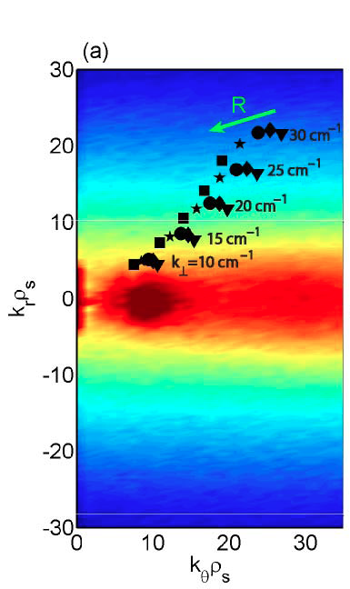
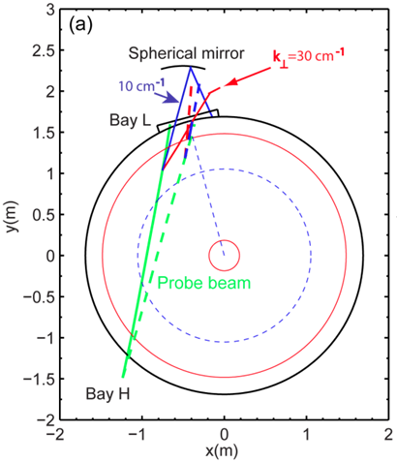
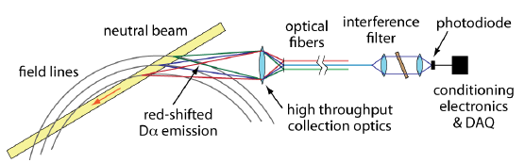
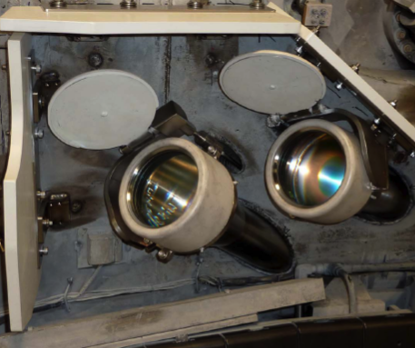
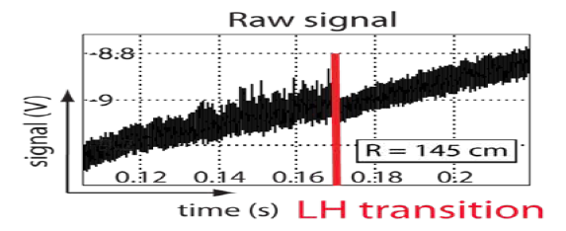
Transport and Turbulence
Increase and Understand H-mode Confinement at Lower n_{e}, ν*
Modes
0.1
1
k⊥(cm⁻¹)
10
100
BES - 16 ch BES worked well in FY 2010 and at least 32 ch BES available for NSTX-U
High k Upgrade - Upgraded system with 2-D k spectrum for NSTX-U
μTEARING
ITG/TEM
ETG
BES
High-k
• BES together with high-k to provide a comprehensive turbulence diagnostic set.
• High-k with a new solid-state source is running reliably.
A candidate new high-k scattering system for allowing 2 D k spectrum.
Neutral Beam
Optical fibers
field lines
red-shited
Dα emission
High throughput collection optics
U. Wisconsin
Receivers to relocate from Bay K to Bay L
UCD
Notes:
Here is an overview of the NSTX facility operation and upgrade plan for FY 10-12. We plan to run 14 run weeks in each of fiscal year. We will conduct one extra ARRA week this year using the carry over from last fiscal year. For incremental, we propose to run up to 6 run weeks each in FY 11 and 12. We have a very strong set of upgrade becoming available this year . In FY 11, our base upgrade activities are either supported by ARRA funding or by the collaborators. Our base upgrade resources will be mostly devoted to the preparation for the major upgrade outage planned in FY 13-14 to install a new center-stack and the 2nd NBI which will be described by Ron Strykowsky our upgrade project manager.

Slide 24
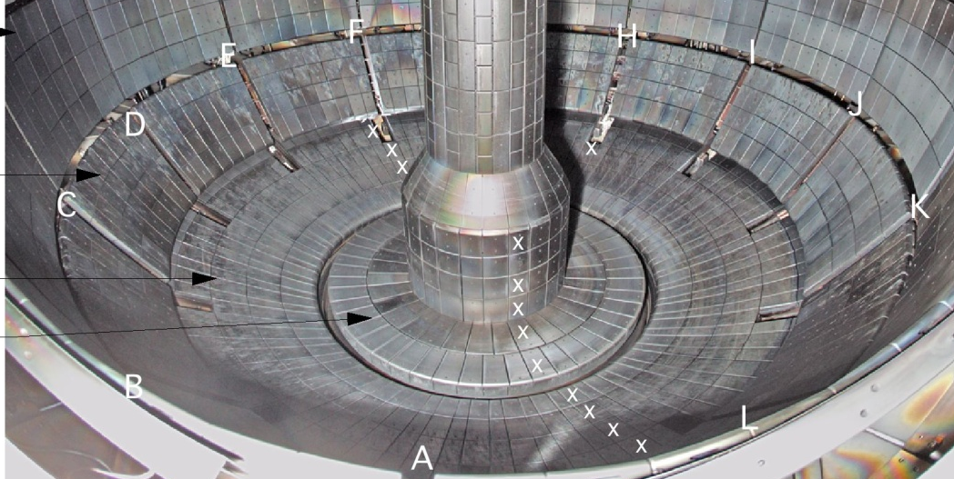
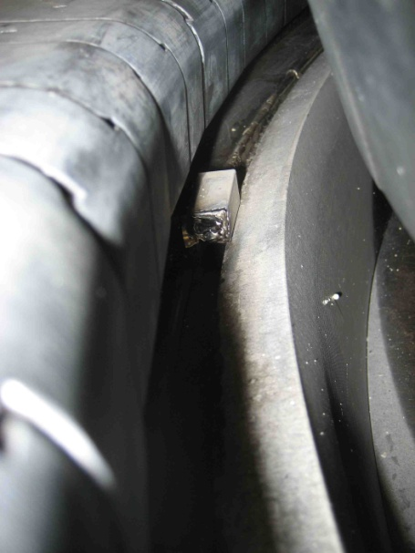
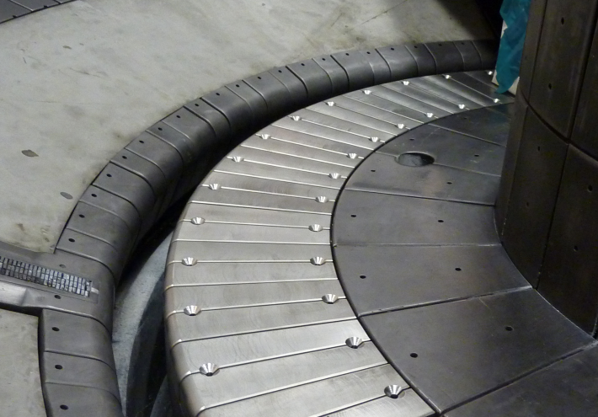
Boundary Physics
Need to Assess Heat and Disruption Loads for Advanced Divertor
LLD removed due to the heat and disruption loads concerns
Lower divertor to start with all graphite tiles for NSTX-U
LITER system will be available for lower divertor as before
Assessing installation of inboard divertor moly-tiles for upper divertor and associated upper divertor LITER system
Moly armor for exposed SS flange surfaces in CHI gap being considered during the outage
• For FY 12-14, advanced divertor upgrade conceptual design work will commence for the five year plan – e.g., moly-based PFCs, liquid lithium divertor, and closed divertor with cryo-pump.

Slide 25
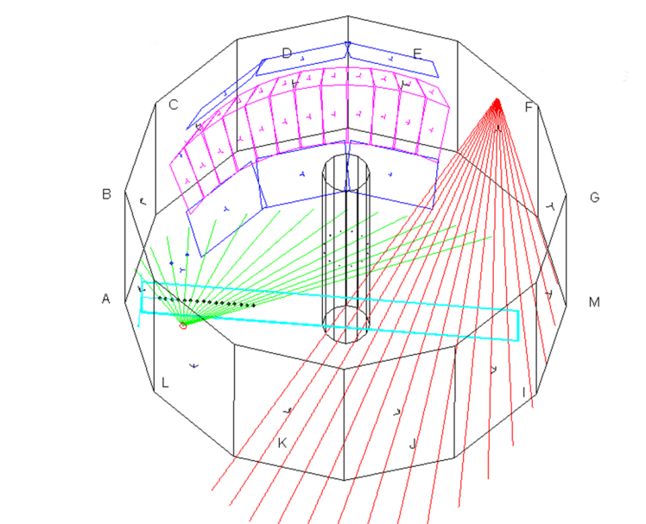
Tangential-FIDA for Energetic Particle Research
For NBI fast ion transport and current drive physics
Tangential FIDA Views
UC Irvine
• T-FIDA upgrade will provide two new views of plasma.
• Two new ports in vacuum vessel are being installed.
• Expect to have installation complete and ready for commissioning at start of next run.
Vertical
Tangential
• Better localization in velocity space weighted toward parallel velocity
• Well suited to investigate NBI fast ion transport and current drive physics
FY 2013 - 14 Energetic Particle Conceptual Design and Diagnostic Upgrade
  Active TAE antenna
  Possible SS-NPA enhancement due to removal of scanning NPA (UCI)

Slide 26
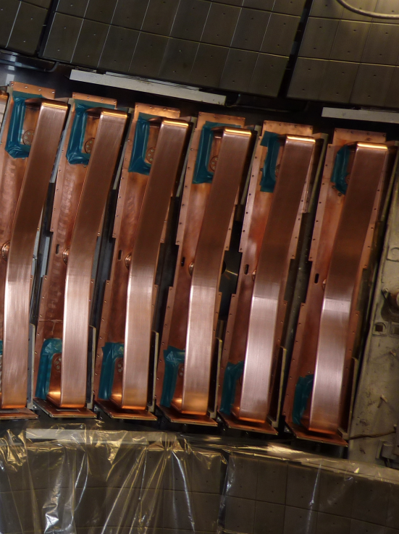
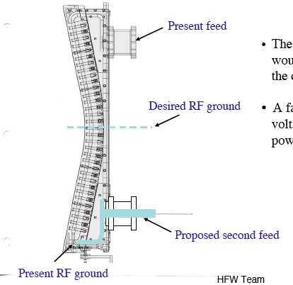
Possible HHFW Antenna Refurbishment
Double Feed Antenna
• HHFW power system to undergo modest refurbishment
• Reliable high power operation in H-mode is high priority goal
• HHFW antenna may need structural enhancement against disruption loads in the feedthru area
• FY 2012 - HHFW Antenna disruption load being analyzed
• FY 2013 – Perform necessary modification
• FY 2013/14 – Start MW-class ECH/EBW system design for non-inductive operations

Slide 27
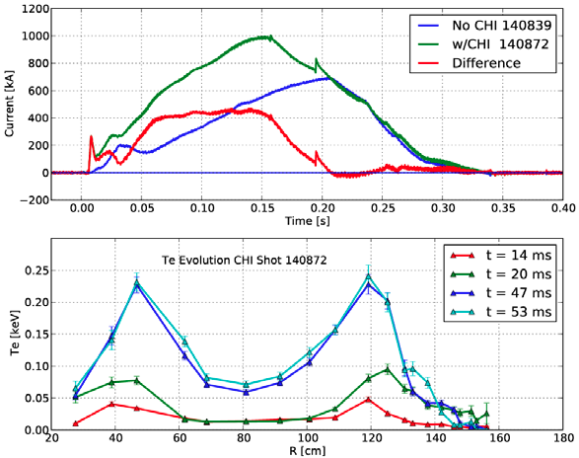
Solenoid-free Start-up
High Priority Longer Term Goal for NSTX-U
FY 2013-14 Non-Inductive Start-up Systems Design for Post-Upgrade Operations
• NSTX-U scenario development
• Low-inductance Advanced Plasma Operations
• For longer term, MW-class ECH/EBW start-up and ramp up system envisioned
Success of CHI aided by Low-Z Impurity Control
U Washington
• PEGASUS gun start-up producing exciting results Ip ~ 160 kA. The PEGASUS gun concept is technically flexible to implement on NSTX once fully developed.
• High current gun for the NSTX-U will be developed utilizing the PEGASUS facility in collaboration with University of Wisconsin
• Conceptual design of the MA-class ECH/EBW system to be performed in FY 13-14

Slide 28
Backup Slides

Slide 29
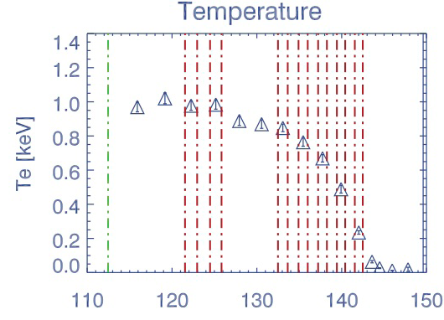
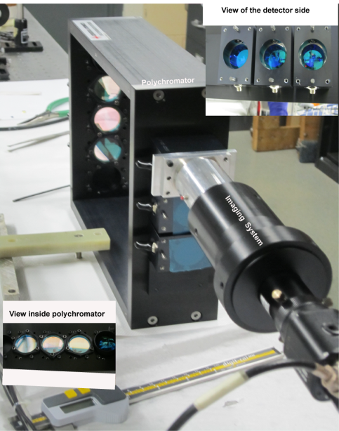
Enhanced Pedestal / Profile Diagnostics
for Pedestal and Core Transport Joint Research Targets
R(cm)
Additional 12 channels enhance resolution in pedestal to ~1 cm and improve diagnosis of ITB in plasma core
Polychromator assembly
• Twelve additional channels for the multi-pulse Thomson scattering (MPTS) system were installed and commissioned in July, 2011.
• Calibration was performed in situ by employing Rayleigh and Raman scattering of the light from the MPTS laser system by nitrogen and argon introduced into the vacuum vessel

Slide 30
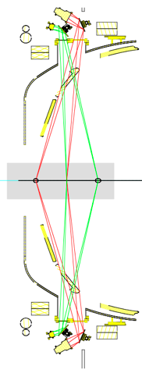
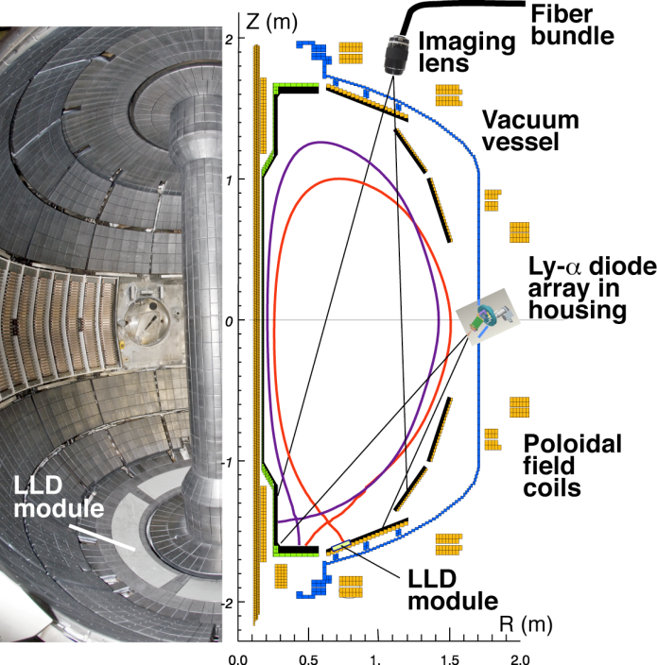
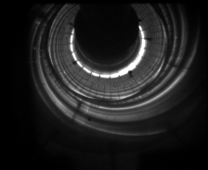
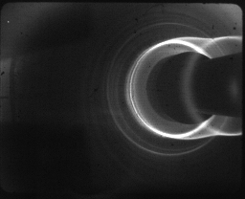
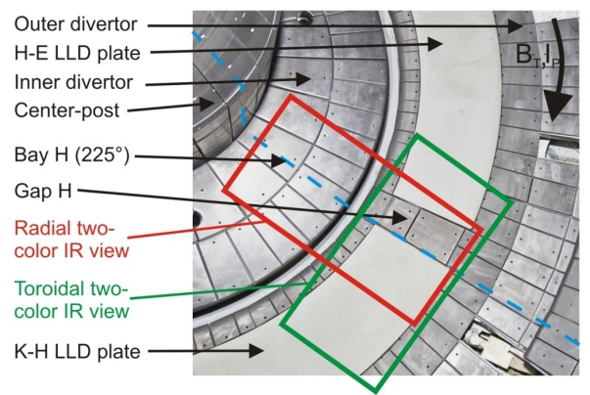
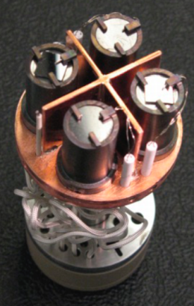
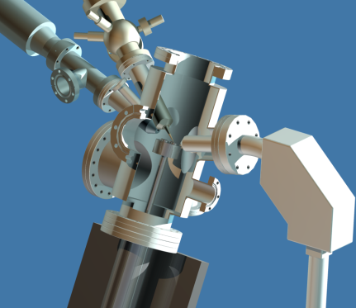
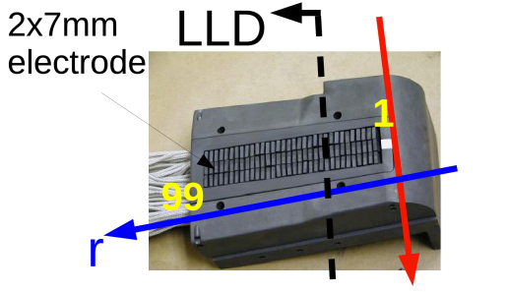
Enhanced Capability for LLD and Boundary Physics
Multi-Institutional Contributions
Two fast 2D visible and IR cameras with full divertor coverage
Divertor Imaging
Spectrometer
  Lithium CHERS
ORNL
LLNL, ORNL
Li I
LLNL
C II
MAPP diagnostic systems
Dense Langmuir Probe Array
Will be replaced by simpler probe array
Dual-band fast IR Camera
PMI Probe / to be replaced by MAPP Probe
U. Illinois
ORNL
Purdue U.
Notes:
With the NSTX PAC recommendation, we have been increasing the LLD diagnsotic capabilities including lithium CHEERS, PMI probe, Lyman Alpha LLD recycling diode array, three view divertor bolometer, and two color fast IR divertor camera.

Slide 31
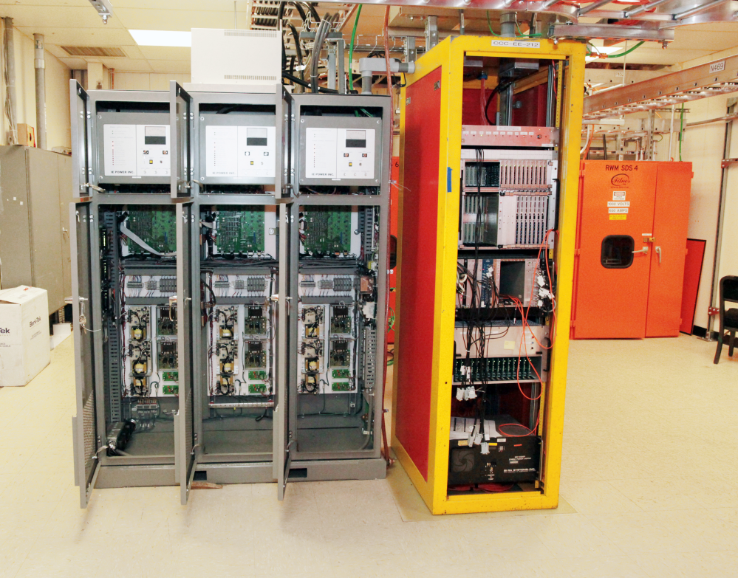
2nd SPA Successfully Installed and Commissioned
Sustain β_{N} and Understand MHD Behavior Near Ideal Limit
Copper passive
conductor plates
SS Vacuum
Vessel
B_{R}
B_{P} sensor
6 ex-vessel midplane control coils
2nd 3-channel Switching Power Amplifier (SPA) comissioned in July 2011 powers independent currents in six EFC/RWM coils for simultaneous control of n = 1, 2, 3 field harmonics
    RWM spectrum dependence
    Rotation and beta effects on NTMs
    Response to 3D fields for EFC, ELM and Neoclassical Toroidal Viscosity physics
    Disruption physics
31

Slide 32
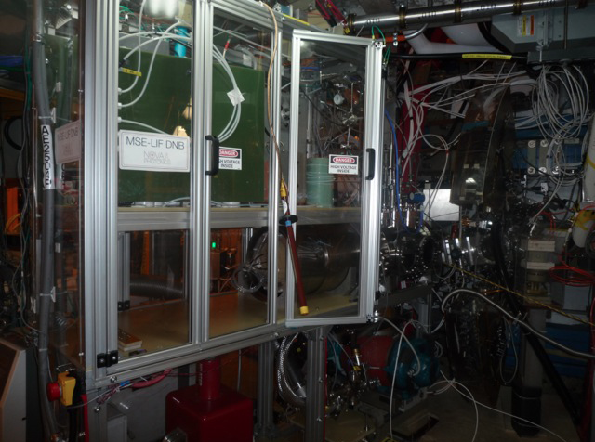
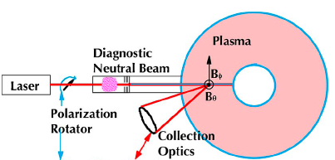
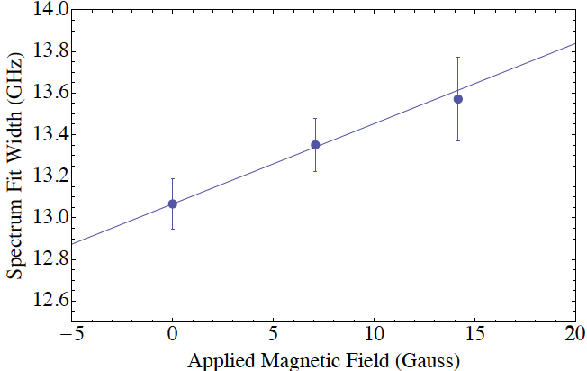
MSE-LIF Installed for Enhanced Pedestal / Profile Diagnostics
Installed and Commissioned on NSTX
The Motional Stark Effect measurement based on Laser Induced Fluorescence (MSE-LIF) diagnostic will provide measurements of the field line pitch angle profile without requiring injection of the heating neutral beam.
Schematic of the MSE-LIF system
MSE-LIF Magnetic Field Calibration Scan with ~ 10 Gauss resolution on NSTX
MSE-LIF DNB system on NSTX
Nova Photonics
MSE-LIF provides unique capabilities
• Measure RF-driven current without the heating neutral beam.
• Measure total magnetic field in plasma to reconstruct total plasma pressure.
• Together with MSE-CIF, yield radial electric field profile

Slide 33
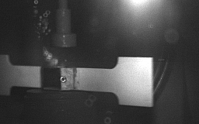
Lithium Granules Injector for ELM Control Completed
Tests on fusion devices should proceed during 2012-13.
Spherical Lithium granules (0.6 mm) have been horizontally redirected at speeds approaching 100 m/s.
Dropping rates (pacing frequencies) of 500 Hz have been readily achieved.
A dropper apparatus which allows the granule size to be changed between discharges has been built and is being tested.
Granule Reservoir
Struck Granule Horizontally
Redirected at 70 m/s
t = 800 μs

